Slide 10
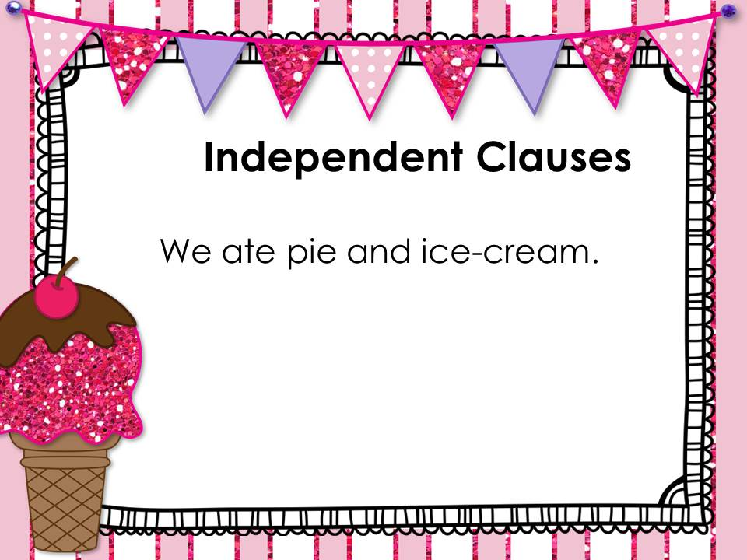

Slide 40
Click here
Click here
Click here

Slide 41
Click here
Click here

