Slide 1
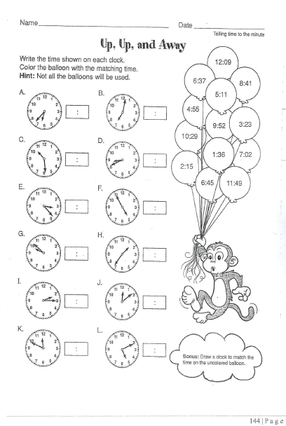
Thursday, October 17, 2019
Tuesday: Classworks
M - Amiyah - 1
M – Erin - 2
M – Jaiden – 3
M – Caydance - 4
M – Jaylie – 5
M – Macon – 6
M – Paisleigh - 7
M – Jearon - 8
M – Landon – 9
M – Kaylee - TC
We have pledge this week: At 8:20, the following will go to the office to represent our class and state the pledge:
Macon
Khamani
Lexi
Jaiden
Brena
Carleen
7:55 – 8:30

Slide 3
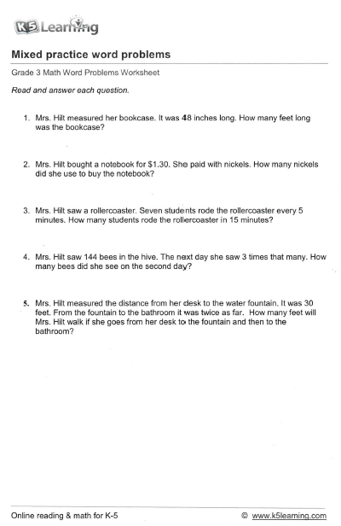
48 ÷ 12 = 4
1.30 total, so count by 5’s to 130 = 26 OR count by 5’s to 100 and then by 5’s to 30 and add together
7 x 5 = 35; then 35 x 3 = 105
144 + 144 + 144 = 432 OR 144 x 3
30 = desk to fountain; 30 x 2 = fountain to bathroom; so 30 x 2 = 60 + 30 = 90
Review Homework

Slide 4
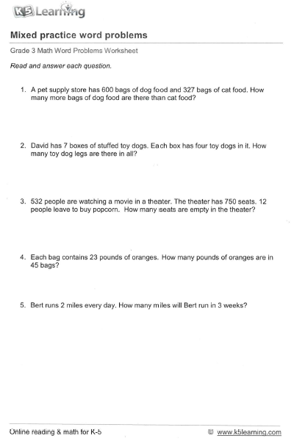
Homework

Slide 5

CHOMP TIME
F.A.S.T. Groups
Focused Academic Support Time

Slide 6
F.A.S.T. Designations
Computers – Classworks: M - Jaiden- 1 M - Erin - 2 M - Jearon - 3 R - Khamani - 4 M – Carleen– 5 M – Katelynn - 6 M - McKenzie- 7 M - Elin - 8 M - Noah – 9 M – Kaylah - TC | Mrs. Roby: LLI Jaiden | Mrs. Thompson: SIPPS Cohen Amiyah Caydance Jaylie Kaylee
Spotlight: Aiden, Emma, Paisleigh, Cayli, Adalyn, Alexis
Landon – Phonics 1st with Mrs. Page
Macon – SIPPS with Mrs. Bess
8:40 – 9:10

Slide 7

Reading Time
Objective: RL.3.3 Describe characters in a story and explain how their actions contribute to the sequence of events.
Objective: RL.3.5 Refer to parts of stories and poems when writing or speaking about a text, using terms such as chapter, scene, and stanza; describe how each successive part builds on earlier sections.
Objective: RL.3.7 Use information gained from illustrations, other visual elements, and the words in a text to demonstrate understanding of the text.
9:10 – 9:45

Slide 8

Gather at the Carpet with your Yellow Folder.
Are we still the best?

Slide 9
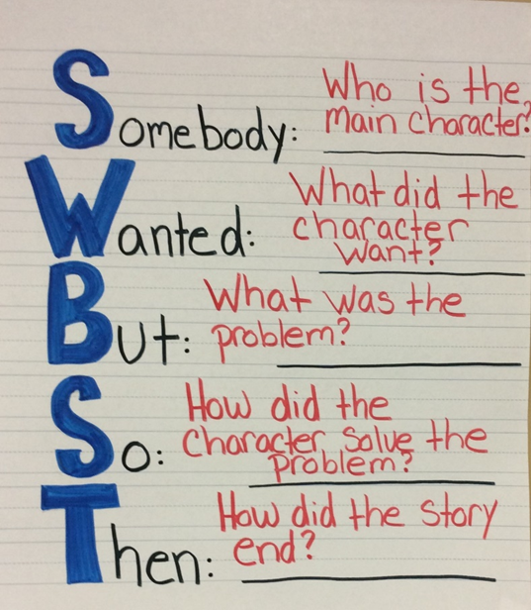

Let’s review this story.
Who can give a summary of this book?

Slide 10
MM Response Journal p8
Double Entry Journal
Now let’s think character change…
I will read from the beginning of the story and from the end.
I want you to discuss with your partner what Nicky is like in each part of the story I read.
Record your ideas in your double-entry journal.

Slide 11
Page 6 and 7
How does Nicky feel in this part of the story? Turn to your Partner
Record in your Double-entry journal on the “Nicky at the beginning” column.

Slide 12
Page 35 and 36
How does Nicky feel at the end of the story? Turn to your Partner
Record in your Double-entry journal on the “Nicky at the end” column.

Slide 13
Classroom Discussion
How does Nicky feel at the beginning of the story? How do you know?
How does Nicky feel at the end of the story? How do you know?
How does Nicky change between the beginning of the story and the end? Turn to your partner

Slide 14

Restroom Break
9:45 – 9:55

Slide 15

Computers – Classworks:
  M - Katelynn - 1
  M – Kaylah -2
  M – Landon - 3
  M – McKenzie - 4
  M - Khamani - 5
  M - Elin - 6
  M – Jaiden – 7
  M - Erin - 8
  M – Brena – 9
  M – Cayli - TC
  Mrs. Roby
  LLI:
  Carleen
  Jearon
  Kaylee
  Macon
Independent Daily Reading & Teacher Conferences
  Mrs. Thompson:
  LLI
  Jaylie
  Caydance
  Amiyah
  Cohen
Everyone else – Independent Novel
9:55 – 10:25

Slide 16



Vocabulary & Grammar Time
10:25 – 10:40

Slide 17
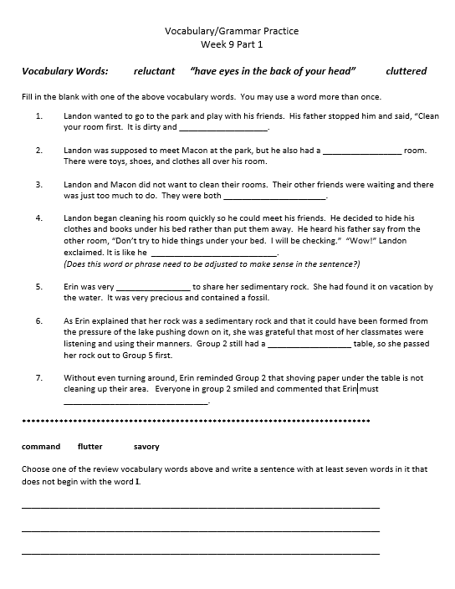

Slide 18
Out of Classroom!
Recess 10:40 – 11:05

Slide 19

Writing Time
Objective: W3.2
.
11:05 – 11:35

Slide 20


Nonfiction Introduction
Do you remember these books from earlier this year?
What do you think you know about nonfiction?
Nonfiction writers write about real things that they are curious about.
They write about these topics in a way that helps readers become interested in and curious about them as well.

Slide 21

Read aloud
I want you to think about what kinds of information the author gives about dragonflies in this book.

Slide 22
Classroom Discussion
What is something you found out about dragonflies?
In this book, the author asks a question and then answers it by telling the reader what his life would be like if he were a dragonfly.

Slide 23
Think, Pair, Share
If you were going to write an animal book like this one, called Are you a __________?, what animal might you write about, and why? Turn to your partner
Let’s make an anchor chart of some of your ideas

Slide 24
Math Fluency & Focus Lesson!
11:35 – 11:55

Slide 25
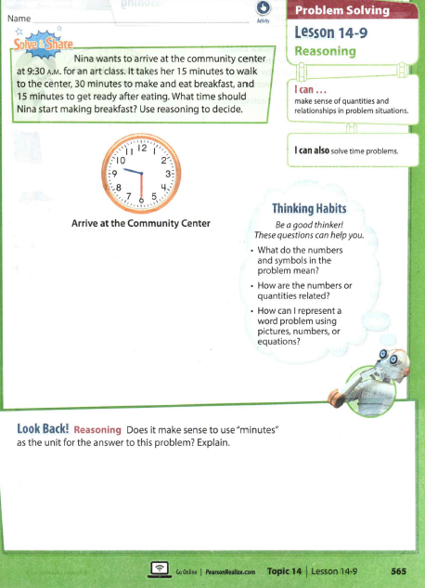

Slide 26
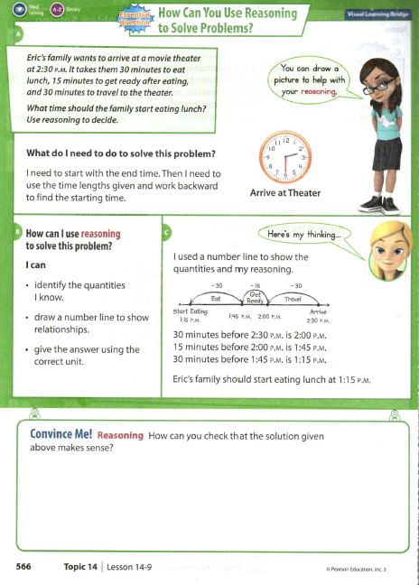
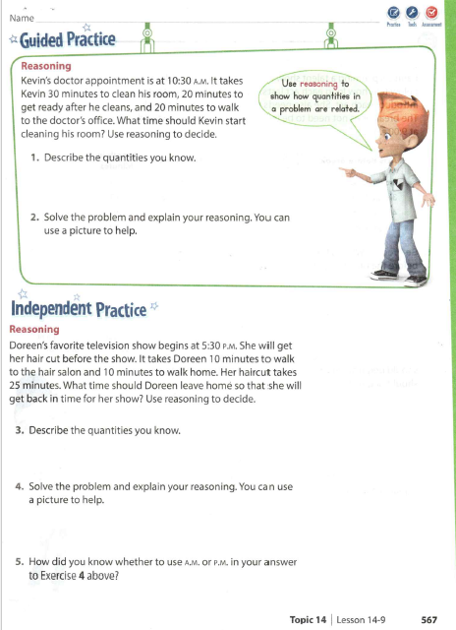

Slide 27
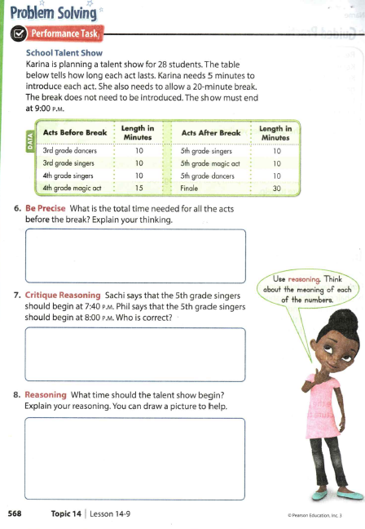

Slide 28

Out of Classroom!
Lunch 12:35 – 1:05

Slide 29
Restroom Break
1:05 – 1:10

Slide 30

Out of Classroom!
Activity 1:10 – 1:55

Slide 31
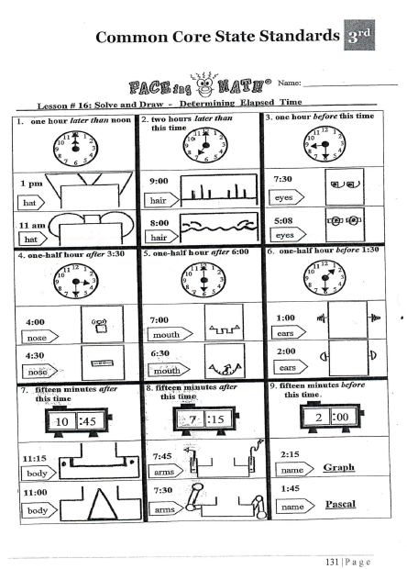
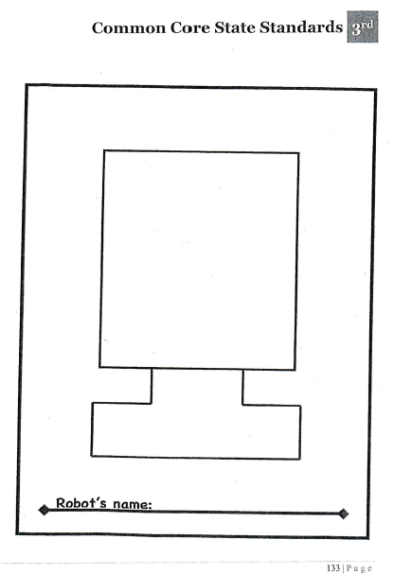

Slide 32
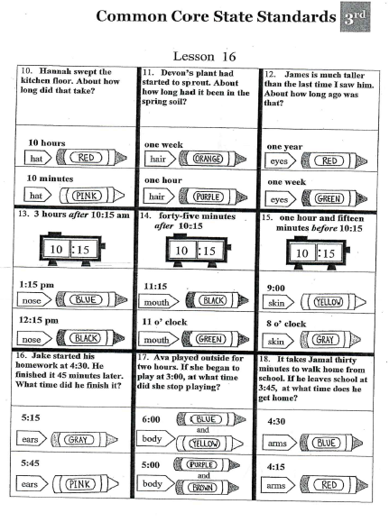

Slide 33
3 Branches of Government
https://www.brainpop.com/socialstudies/usgovernment/branchesofgovernment/
https://www.brainpop.com/socialstudies/usgovernment/politicalparties/
https://www.brainpop.com/socialstudies/usgovernment/voting/

Slide 34
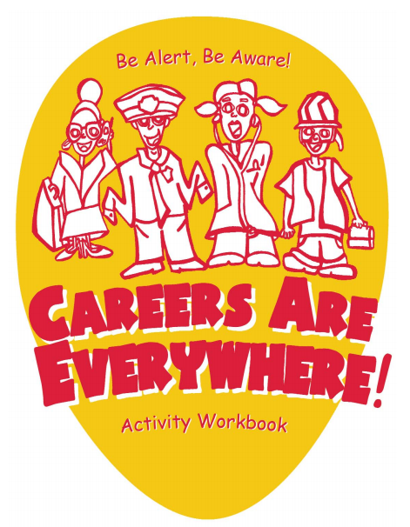

Slide 35
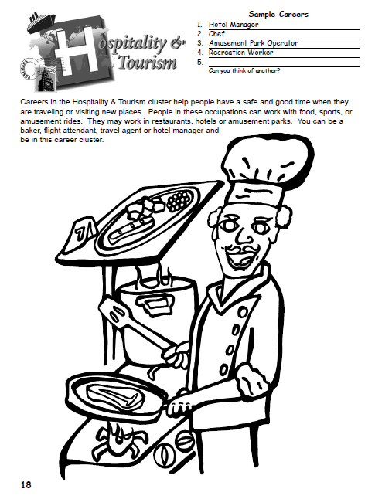

Slide 36
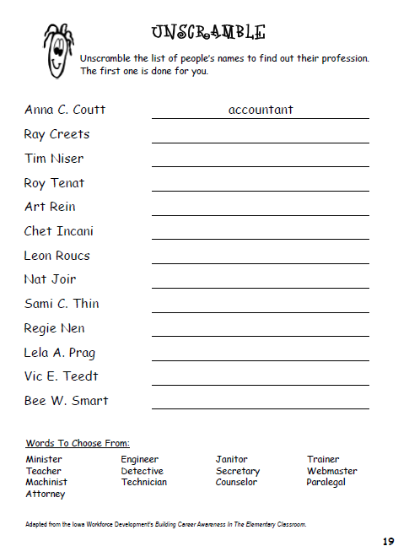

Slide 37
Restroom Break
3:10 – 3:15

Slide 38




3:10 – 3:15 Wrap Up!
Pair-Up back to back and share one thing you learned in class today with your partner
Pack-Up
Office will announce:
Car Riders – Leave around 3:20
Bus Riders – (listen to intercom for dismissal)
2:30 – 3:20
How much time has elapsed?

