Slide 1
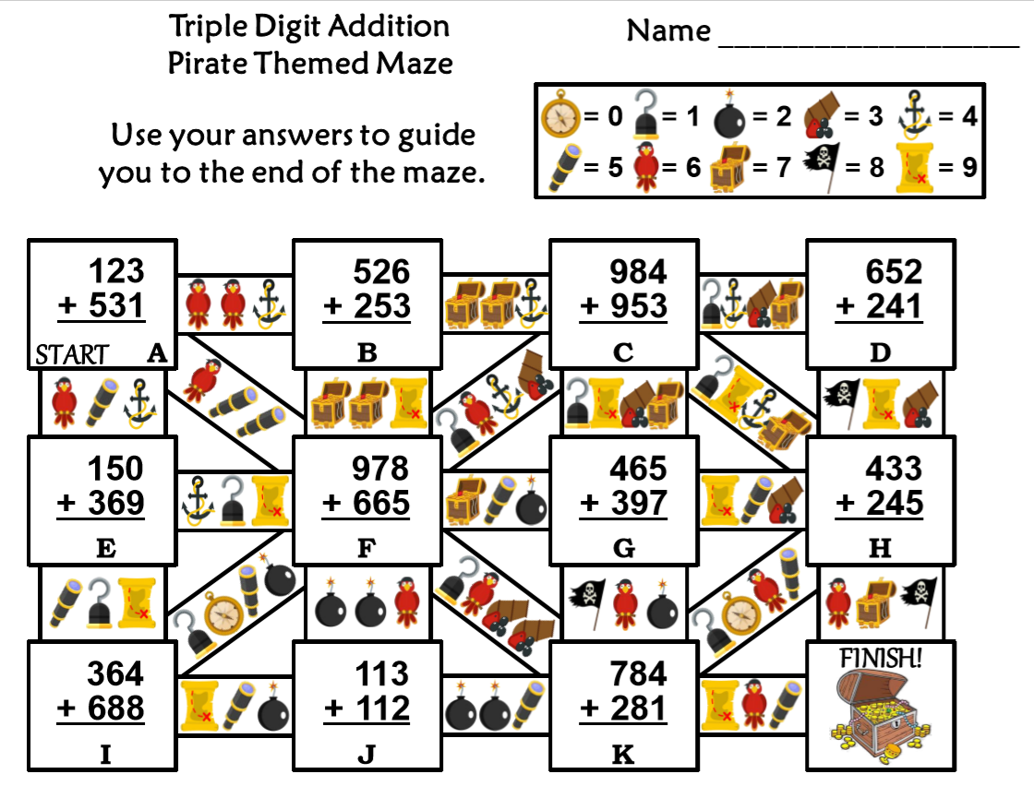
Friday, March 6, 2020
Superkids | Classworks
1 - Kaylee 2 – Amiyah 3 – Cohen | 4 – Brena - M 5 – Erin - M 6 – Carleen - M 7 – Emma - M 8 – Addisen - M 9 – Jaiden - M
GREEN BUTTONS FIRST - Emma rdg
- Brena both
7:55 – 8:30

Slide 2
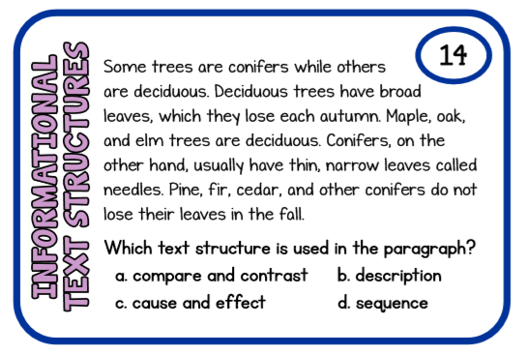

Slide 3

CHOMP TIME
F.A.S.T. Groups
Focused Academic Support Time

Slide 4
F.A.S.T. Designations
Computers – Classworks MATH: 1 – Erin 2 – Katelynn 3 – Brena 4 – Elin 5 – Addisen 6 – Kaylah 7 – Carleen 8 - Jaiden 9 – Emma | Mrs. T: SIPPS Amiyah Jaylie Caydance Lazerrick Kaylee Cohen Paisleigh
  All others – Book of your choice
Landon – Phonics 1st with Mrs. Page
Macon – SIPPS with Mrs. Bess
8:40 – 9:10

Slide 5

Reading Time
9:10 – 9:30

Slide 6
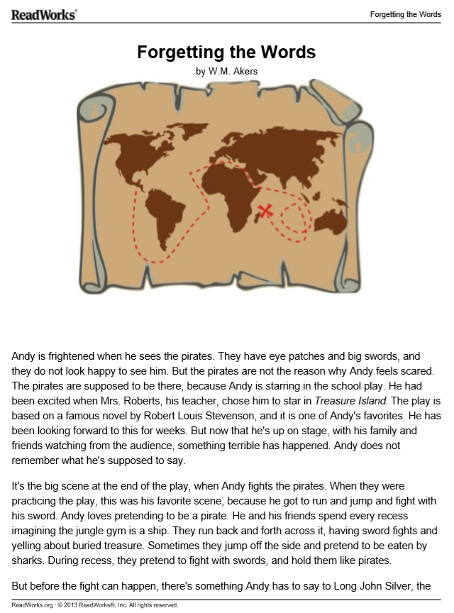
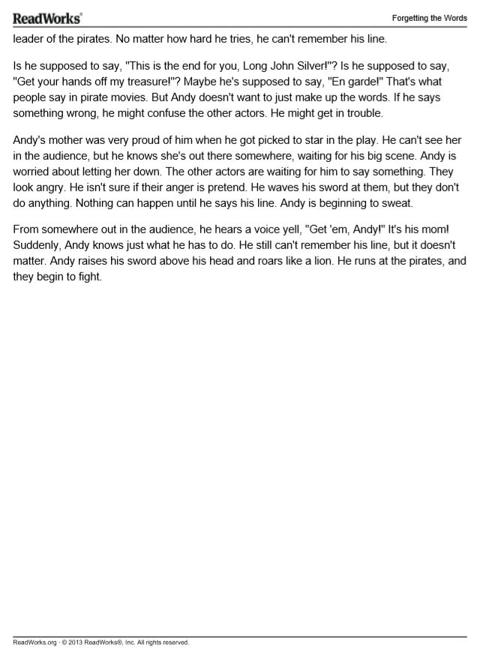

Slide 7
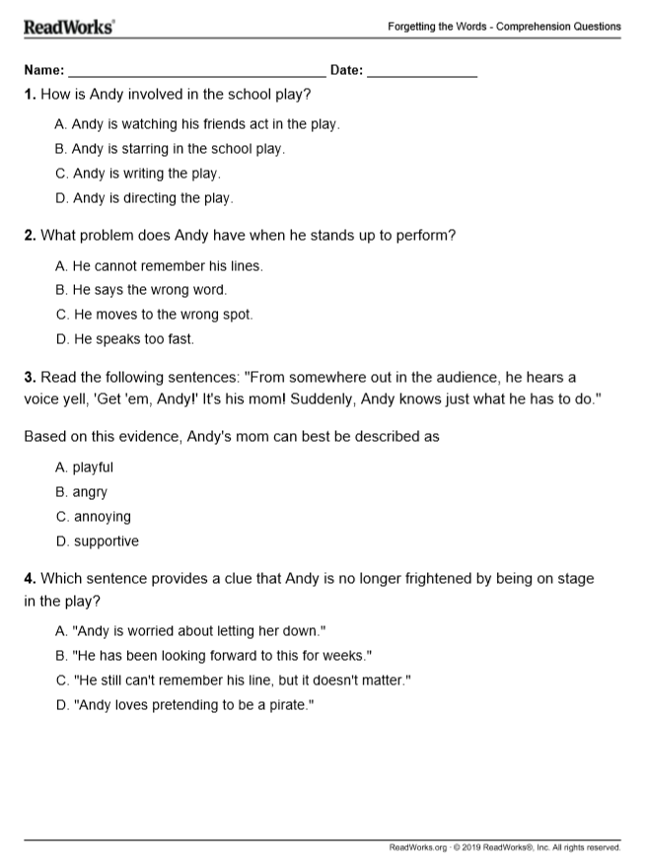
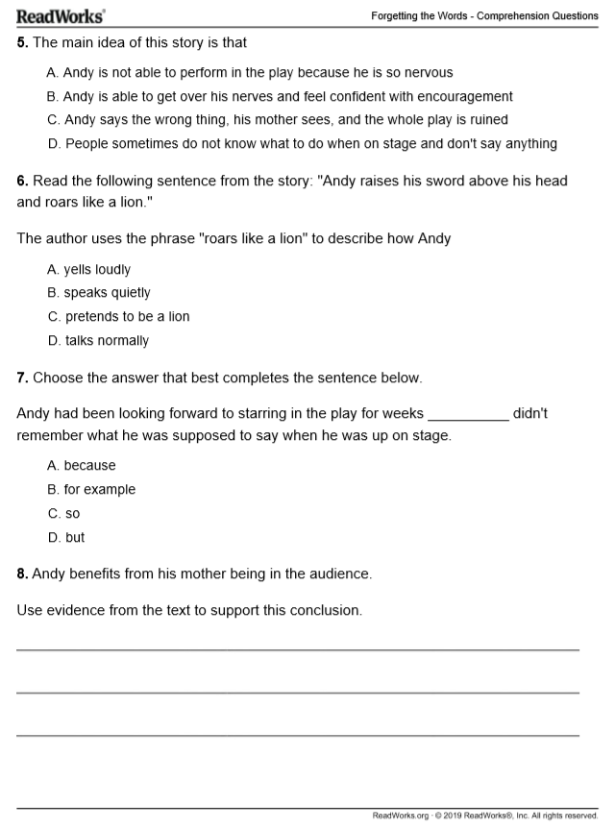

Slide 8
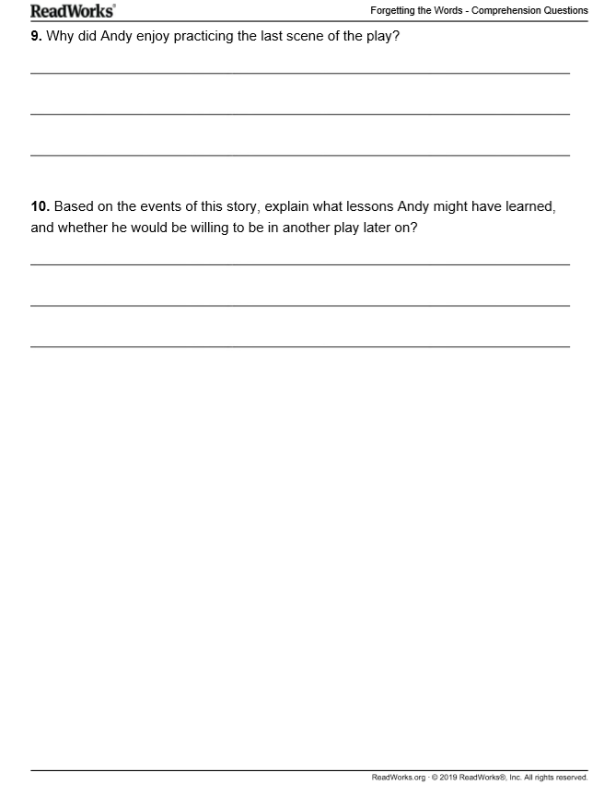

Slide 9

Restroom Break
9:45 – 9:55

Slide 10

Independent Daily Reading & Teacher Conferences
Superkids: 1 – Amiyah 2 – Kaylee 3 – Macon 4 – Paisleigh 5 - Cohen | Epic: 6– Khamani 7– McKenzie 8 – Adalyn 9 - Cayli TC - Elin | Mrs. T: LLI: Jearon Jaiden Brena Carleen Addisen Erin
  All others – Book of your choice
9:55 – 10:25

Slide 11



Morning Work Review & Snack Time
10:25 – 10:40

Slide 12

A Reward for Good/Improved Behavior!

Slide 14
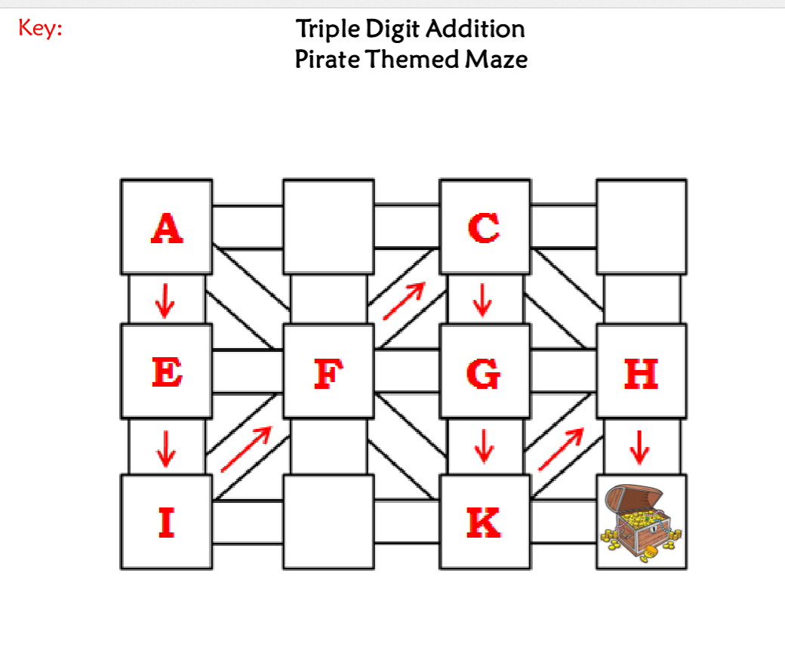

Slide 15
Out of Classroom!
Recess 10:40 – 11:05

Slide 16
Station Time!
11:05 – 12:35
Math 3.NF.1 I can understand that a fraction 1/b as the quantity formed by one part when a whole is partitioned into b equal parts. I can understand that a fraction a/b as the quantity formed by a parts of size 1/b.
Math 3.NF.2 I can represent a fraction 1/b on a number line diagram by defining the interval from 0 to 1 as the whole and partitioning it into b equal parts.
.

Slide 17
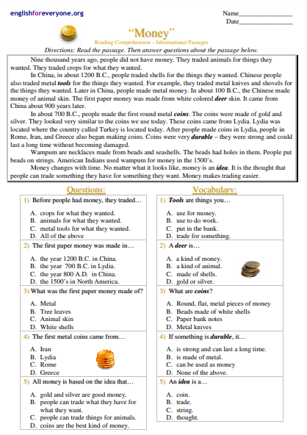
Handout – Independent Work

Slide 18
Rotation 1
11:05 – 11:25
Group 1 – Computers 1-5: Free Choice
Group 2 – Blue Table – Finish “SHAPE GARDEN”
Group 3 – Computers 6-TC: worksheet for https://www.uscurrency.gov/educational-materials/classrooms/currency-academy
Group 4 – Mrs. Thompson – Reading
Group 5 – Handout

Slide 19
Rotation 2
11:25 – 11:45
Group 5 – Computers 1-5: Classworks Reading
Group 1 – Blue Table – Finish “SHAPE GARDEN”
Group 2 – Computers 6-TC: worksheet for https://www.uscurrency.gov/educational-materials/classrooms/currency-academy
Group 3 – Mrs. Thompson – Reading
Group 4 – Handout

Slide 20
Rotation 3
11:45 – 12:05
Group 4 – Computers 1-5: Classworks Reading
Group 5 – Blue Table – Finish “SHAPE GARDEN”
Group 1 – Computers 6-TC: worksheet for https://www.uscurrency.gov/educational-materials/classrooms/currency-academy
Group 2 – Mrs. Thompson – Reading
Group 3 – Handout

Slide 21
Rotation 4
12:05 – 12:20
Group 3 – Computers 1-5: Classworks Reading
Group 4 – Blue Table – Finish “SHAPE GARDEN”
Group 5 – Computers 6-TC: worksheet for https://www.uscurrency.gov/educational-materials/classrooms/currency-academy
Group 1 – Mrs. Thompson – Reading
Group 2 – Handout

Slide 22
Rotation 5
12:20 – 12:35
Group 2 – Computers 1-5: Classworks Reading
Group 3 – Blue Table – Finish “SHAPE GARDEN”
Group 4 – Computers 6-TC: worksheet for https://www.uscurrency.gov/educational-materials/classrooms/currency-academy
Group 5 – Mrs. Thompson – Reading
Group 1 – Handout

Slide 23

Out of Classroom!
Lunch 12:35 – 1:05

Slide 24
Restroom Break
1:05 – 1:10

Slide 25

No Activity

Slide 26

1:10 – 1:30

Slide 27

1:30 – ??

Slide 28
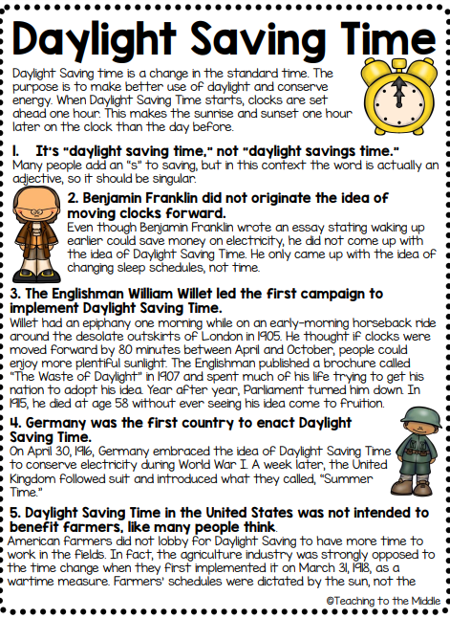
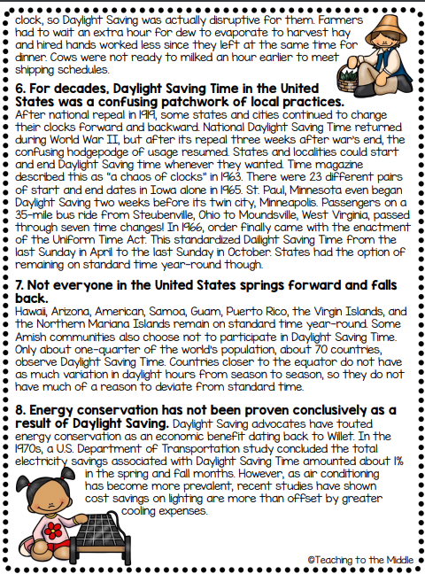

Slide 29
Restroom Break
3:10 – 3:15

Slide 30




3:20 – 3:25 Wrap Up!
Pair-Up back to back and share one thing you learned in class today with your partner
Pack-Up
Office will announce:
Car Riders – Leave around 3:25
Bus Riders – (listen to intercom for dismissal)
2:30 – 3:20
How much time has elapsed?

