Slide 1

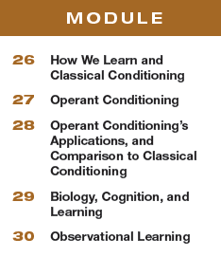
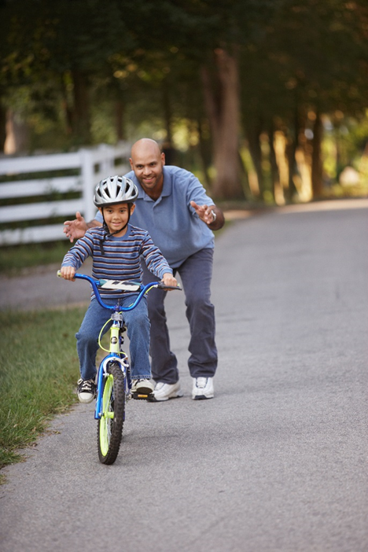
Unit 6
Learning

Slide 2

Learning Targets
Module 30
30-1 Differentiate observational learning from associative learning, and explain how observational learning may be enabled by neural mirroring.
30-2 Discuss the impact of prosocial modeling and of antisocial modeling.
Observational Learning
30-3 Discuss the violence-viewing effect.

Slide 3
Talk with your partner.
Who has been a significant role model for you?
In what ways? What have you learned from them?
For whom are you a model?
In what ways? What do you model for others?

Slide 4

What is observational learning?
Higher animals, especially humans, learn without direct experience, by watching and imitating others.
We learn our native languages and various other specific behaviors by observing and imitating others,
a process called modeling.
For instance, a child who sees his sister burn her fingers on a hot stove learns not to touch it.

Slide 5
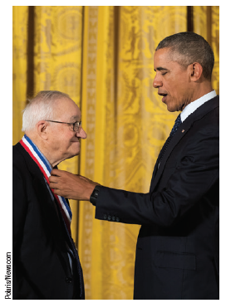
Who is Albert Bandura?
Albert Bandura, shown here receiving a 2016 U.S. National
Medal of Science from President
Obama, is the pioneering researcher of observational learning.

Slide 6
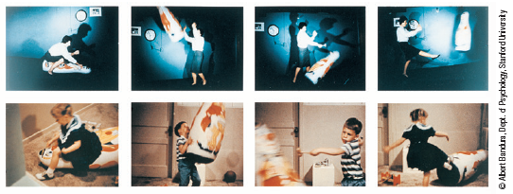
What research did Bandura conduct?
The Bobo Doll Study

Slide 7

What was the research design?
A preschool child works on a drawing.
An adult in another part of the room builds with Tinkertoys.
As the child watches, the adult gets up and for nearly 10 minutes pounds, kicks, and throws around the room a large inflated Bobo doll, yelling, “Sock him in the nose. . . . Hit him down. . . . Kick him.”

Slide 8
What happened next?
The child is then taken to another room
filled with appealing toys.
Soon the experimenter
returns and tells the child she has decided to save these good toys “for the other children.”
She takes the now-frustrated child to a third room containing a few toys, including a Bobo doll.
Left alone, what does the child do?

Slide 9
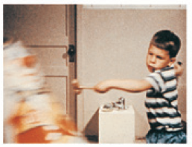
What was the result?
Compared with children not exposed to the adult model, those who viewed the model’s
aggressive actions were more likely to lash out at the doll.
Observing the aggressive outburst apparently lowered their inhibitions.
But something more was also at work, for the children imitated
the very acts they had observed and used the very words
they had heard.

Slide 10
What is the take away?
By watching models, we experience
vicarious reinforcement or vicarious punishment,
and we learn to anticipate a behavior’s consequences
in situations like those we are observing.
We are especially likely to learn from people
we perceive as similar to ourselves, as successful,
or as admirable.

Slide 11
1. What Would You Answer?
Bandura’s famous Bobo doll experiment is most closely associated with which of the following?
latent learning
B. classical conditioning
C. operant conditioning.
D. cognitive maps
observational learning

Slide 12
Think about your earlier responses.
Who has been a significant role model for you?
In what ways? What have you learned from them?
For whom are you a model?
In what ways? What do you model for others?
In what ways have you experienced vicarious reinforcement or punishment by watching your role model?

Slide 13
So we learn by observation, but how?
Mirror neurons are frontal lobe
neurons that some scientists
believe fire when we perform
certain actions or observe
another’s actions.
The brain’s mirroring
of another’s action may enable
imitation and empathy.

Slide 14
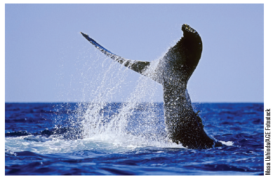
How is imitation adaptive?
In one 27-year analysis of 73,790 humpback whale observations, a single whale in 1980
whacked the water to drive prey fish into a clump. In the years since, this “lobtail” technique
spread among other whales (Allen et al., 2013).

Slide 15
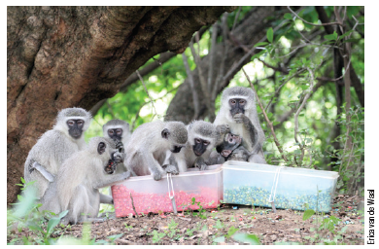
Researchers trained groups of vervet monkeys to prefer either blue or pink corn by soaking one color in a disgusting-tasting solution.
Four to six months later, after a new generation of monkeys was born, the adults stuck with whatever color they had learned to prefer—and, on observing them, so did all but one of 27 infant monkeys.
(van de Waal, et. al., 2013)

Slide 16
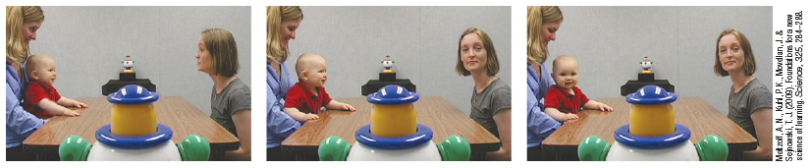
Humans are natural imitators
By 8 to 16 months, infants imitate various.
novel gestures (Jones, 2007)
By 12 months they look where an adult is looking.
(Meltzoff et al., 2009)
And by 14 months, children imitate acts modeled on TV. (Meltzoff, 1988; Meltzoff & Moore, 1989, 1997)

Slide 17
Do we imitate emotions as well?
YES! We find ourselves yawning when others yawn, smiling when others smile,
laughing when others laugh.
Observing others’ postures, faces, voices, and writing styles, we unconsciously synchronize our own to
theirs—which helps us feel what they are feeling. (Bernieri et al., 1994; Ireland & Pennebaker, 2010)
Imitation helps us gain friends, leading us to mimic those we like. (Chartrand & Lakin, 2013)

Slide 18
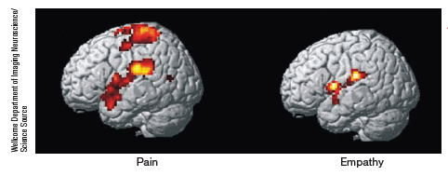
So can we feel others’ pain?
Brain activity related to actual pain (left) is mirrored in the brain of an observing loved one (right).
Empathy in the brain shows up in emotional brain areas, but not in the somatosensory cortex, which receives the physical pain input.

Slide 19
What is prosocial modeling and what is its impact?
Prosocial modeling is positive, constructive, helpful behavior.
People who exemplify nonviolent, helpful behavior can also prompt similar behavior in others.
Watching others help pick up spilled books or coins, or viewing positively-themed television programming can produce positive helping behaviors in others.

Slide 20
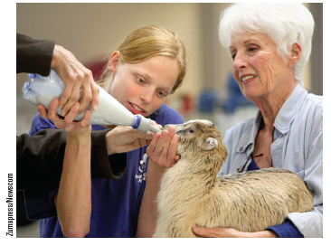
Prosocial modeling
This girl is
learning orphan-nursing skills, as
well as compassion, by observing
her mentor in this Humane Society
program.

Slide 21
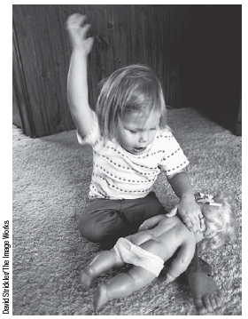
Antisocial modeling
Observational learning may also have antisocial effects.
This helps us understand why abusive parents might have aggressive children.

Slide 22
TV shows, movies, and online videos are sources of observational learning.
During their first 18 years, most children in developed countries spend more time watching TV than they spend in school.
The average teen watches more than 4 hours a day; the average adult, 3 hours.
(Robinson & Martin, 2009; Strasburger et al., 2010)

Slide 23
How violent is television programming?
Between 1998 and 2006, prime-time violence on TV reportedly increased 75 percent (PTC, 2007).
An analysis of more than 3000 network and cable programs aired during one closely studied year revealed:
nearly 6 in 10 featured violence
74 percent of the violence went unpunished.

Slide 24
What is depicted in violent programming?
In addition, research showed:
58 percent of violent shows did not depict the victims’ pain,
nearly half the incidents involved “justified” violence,
nearly half involved an attractive perpetrator.

Slide 25
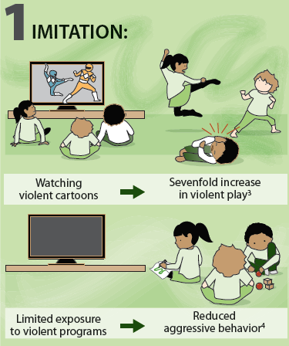
What prompts the violence- viewing effect?
Experimental studies have found that media violence viewing can cause aggression.

Slide 26
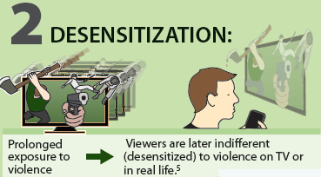
How does desensitization impact violent behavior?
Viewers become progressively less
bothered by the violence.
Compared to a control group, subjects expressed less sympathy for
domestic violence victims and rated victims’ injuries as less severe.
Mullin & Linz, 1995

Slide 27
What does the research show?
The American Psychological Association (APA) Task Force on Violent Media (2015) found that the “research demonstrates a consistent relation between violent video game use and increases in aggressive behavior, aggressive cognitions, and aggressive affect, and decreases in prosocial behavior, empathy, and sensitivity to aggression.”

Slide 28
How does exposure to media violence impact children?
The American Academy of Pediatrics (2009) has advised pediatricians that “media violence can contribute to
aggressive behavior, desensitization to violence, nightmares, and fear of being harmed.”

Slide 29
Let’s pause for a quote…
“ Thirty seconds worth of glorification of a soap bar sells soap.
Twenty-five minutes worth of glorification of violence sells violence.”
~U.S. Senator Paul Simon, Remarks to
the Communitarian Network, 1993

Slide 30
2. What Would You Answer?
Briefly explain how the concepts below could be
used to help a child stop throwing temper tantrums.
• Extinction (operant conditioning)
• Positive reinforcement
• Modeling
• Negative reinforcement
• Shaping
• Extinction (classical conditioning)

Slide 31
Learning Target 30-1 Review
Differentiate observational learning from
associative learning.
Observational learning involves learning by watching and imitating, rather than learning associations between different events.
We learn to anticipate a behavior’s consequences, because we experience vicarious reinforcement or vicarious punishment.

Slide 32
Learning Target 30-1 Review cont.
Explain how observational learning may
be enabled by neural mirroring.
Our brain’s frontal lobes have a shown ability to mirror the activity of another’s brain.
The same areas fire when we perform certain actions, as when we observe someone else performing those actions. Some psychologists believe mirror neurons enable this process.

Slide 33
Learning Target 30-2 Review
Discuss the impact of prosocial
modeling and of antisocial modeling.
Children tend to imitate what a model does and says, whether the behavior being modeled is prosocial behavior (positive, constructive, and helpful) or antisocial behavior.
If a model’s actions and words are inconsistent, children may imitate the hypocrisy they observe.

Slide 34
Learning Target 30-3 Review
Discuss the violence-viewing effect.
Media violence can contribute to aggression. This violence-viewing effect may be prompted by imitation and desensitization.
Correlation does not equal causation, but study participants have reacted more cruelly when they have viewed violence (instead of entertaining nonviolence).

