Slide 1
TOBACCO FREE ZONE
COFFEE COUNTY
CENTRAL HIGH SCHOOL
HEALTHY SCHOOL TEAM
2012-2013

Slide 2
CCCHS HEALTHY SCHOOL TEAM
STATEMENT
Increase the school population’s awareness of the dangers of tobacco use
GOALS
Provide information and resources for tobacco cessation
Provide information and resources regarding the negative, health effects of tobacco use

Slide 3
KEY COMPONENTS
PUBLIC SERVICE ANNOUNCEMENTS
POSTERS
INFORMATIONAL RESOURCES & HOT ZONES
QUIT HELPLINES
HEALTHY SCHOOL TEAM WEBPAGE
STUDENT INVOLVEMENT

Slide 4
PUBLIC SERVICE ANNOUNCEMENTS
What kind of information will the PSAs contain and how will students benefit?
The State of Tennessee’s Quitline phone number, website, and free services will be advertised along with a visual aid to increase students’ awareness of the negative health effects of smoking.
One of the PSAs featured is coming up next!

Slide 5
Burning money as fast as you can make it?
Tennessee Tobacco Quitline: 1-800-QUIT-NOW
This program is FREE to all Tennessee residents. You may also join the program online at www.tnquitline.com. IT’S FREE!! Receive a FREE Tobacco Quit Kit. Work with a FREE Quit Coach. Learn to deal with tobacco cravings and other challenges.

Slide 6
PUBLIC SERVICE ANNOUNCEMENTS
Where will teachers get PSAs to use in their classrooms?
Each week a new set of administration approved PSAs will be emailed to teachers.

Slide 7
PUBLIC SERVICE ANNOUNCEMENTS
How can we use them?
Print and Post PSAs
Display PSAs on overheads before
or between classes
Use PSAs as part of the lesson
Encourage students to use them in assignments

Slide 8
POSTERS
How will themed posters be used?
Posters, useful in targeting themed, tobacco related issues, will be posted throughout the school.
Tobacco related themes will change monthly. So, posters throughout the school will be changed to reflect the monthly theme.
SOME Featured Monthly Topics:
Secondhand Smoke
Tobacco Industry Strategies
Tobacco Use and Pregnancy
Environmental Pollution/Toxins
See our calendar on the webpage for other details.

Slide 9
POSTERS
How will our school obtain posters?
Free posters have been provided by:
The U.S. Centers for Disease Control and Prevention
The American Lung Association
The National Clearinghouse for Alcohol and Drug Information, and others.
A poster, entitled “Within 20 Minutes of Quitting,” will be provided to staffulty for use in classrooms. Other posters will be used throughout the school in the 2012-2013 school year, and will be changed to address the monthly theme.

Slide 10
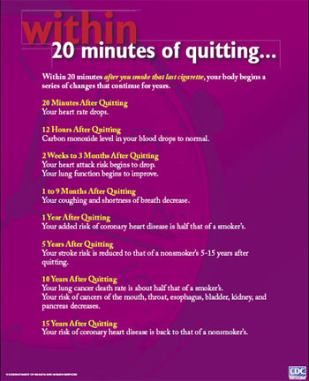

Slide 11
Informational Cards, Brochures, and Pamphlets
Where will these resources be available?
The following CCCHS “Hot Zones” will have FREE resources:
Office Counters Administrative Offices
SCC Offices Nurse’s Station Library
What purpose will they serve?
These resources will provide informational websites, quitting strategies, coupons, and more. Clearing houses such as the CDC and NIH have also provided CCCHS with these resources FREE of charge.

Slide 12
QUIT HELPLINES
Do they really offer what they advertise?
Yes, and more
The State of Tennessee’s Stop Smoking Quitline, that is advertised on the PSAs, will also inform the caller that they may be eligible for nicotine patches, gum, and other stop smoking products if they are eligible for TennCare.
Other free services include a personal coach who is just a phone call away.

Slide 13
QUIT HELPLINES
Is Tennessee’s Quitline the only contact that we will offer students?
Various tobacco free services will feature cell phone apps, daily emails, and text messages along with their Quitlines. Just as students will have different needs, different resources will be provided, including support group connections on Facebook to other teens who are also trying to quit.

Slide 14
HEALTHY SCHOOL TEAM WEBPAGE
RESEARCH LINKS, CALENDAR, FILES, & PHOTO ALBUMS
CCCHS staffulty, students, parents, and the community are encouraged to use our webpage to:
Make a Pledge to Quit Tobacco Use
Follow our links and files for research
Check our calendar for upcoming events
Encourage students to participate in the activities
Make a difference in the lives of others by supporting someone who is quitting or who has quit, and
Encourage students, parents, and the community to take the pledge with us.

Slide 15
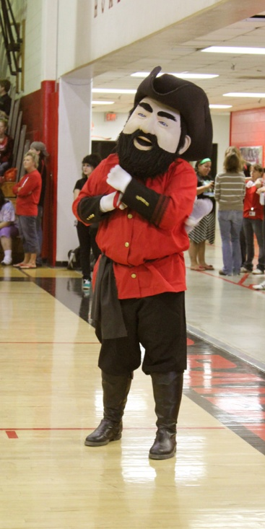
STUDENT INVOLVEMENT
How can CCCHS students become involved?
CCCHS Healthy School Team encourages students to become participants and to be involved in the Tobacco Free Zone goals.
Students will be instrumental in keeping the campaign fresh from a student’s perspective, as well as in assisting with the ongoing activities and efforts to educate students about the dangers of tobacco use.

Slide 16
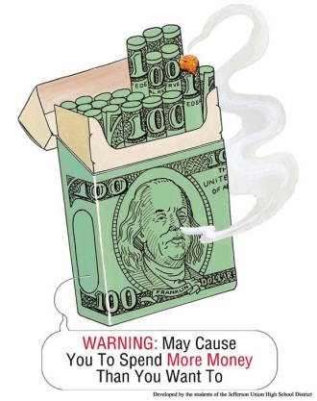
SCHOLARSHIPS
The Student Counseling Center has received an announcement from the Healthy School Team that the Legacy Foundation will award two, $5,000 scholarships to two students, who have been instrumental in their school’s tobacco free programs.
Students’ participation in the CCCHS Healthy School Team’s goals, of providing education and resources through our tobacco free programs, will help CCCHS students qualify.

Slide 17
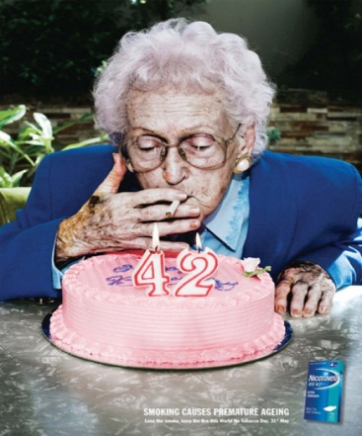
Contacts
Healthy School Team: Angelia Hannah, Betsy Phillips, Brenda Sissom, Caroline Crabtree, Donna Jones, Judy Hodge, Kandy Shemwell, Katrina Wright, Mary Jane Barton, Sarah Walker, Suzanne Reed
For PSAs, Posters, Hot Zone materials, and webpage information see Angelia Hannah.

