Slide 1
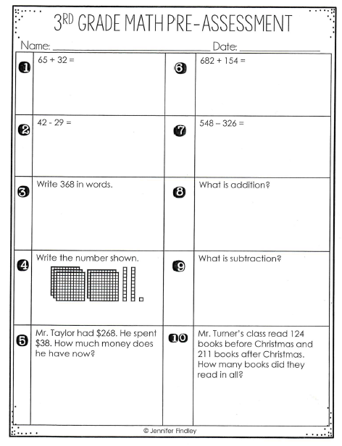
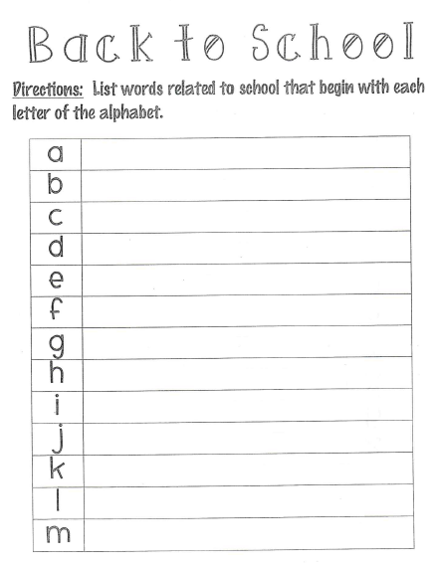

Thursday, August 8, 2019
1. Math Pre-Assessment – part 1
Let’s see what we remember! ☺
2. Complete Back to School handout.
3. Read the chapter book you chose from our Classroom Library to read as your independent novel.☺
7:55 – 8:30

Slide 2
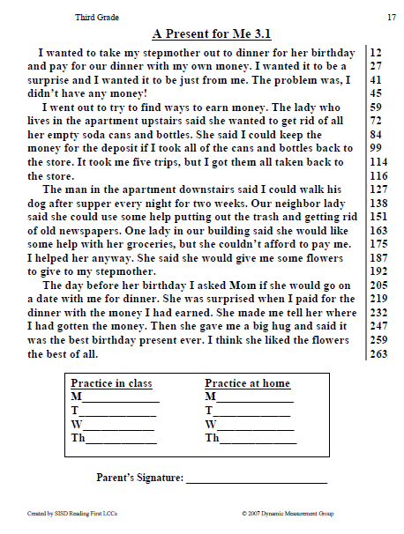
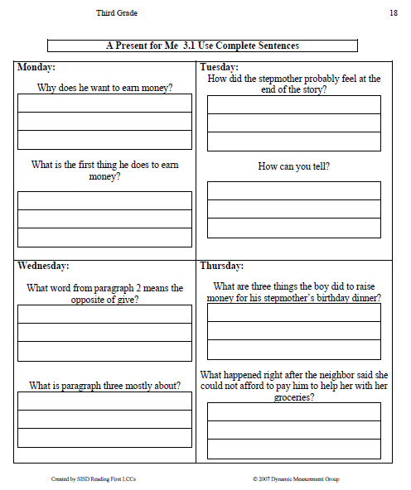
Homework Review - Wednesday
8:30 – 8:40

Slide 3
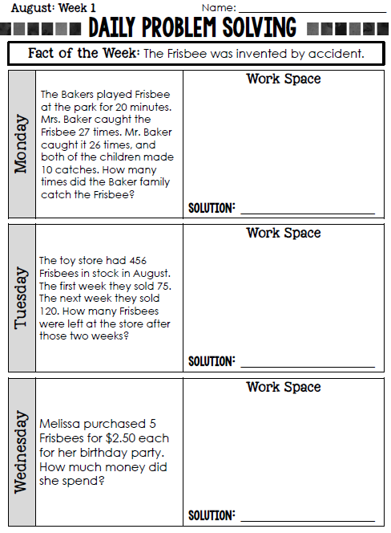
Homework Review - Wednesday

Slide 4
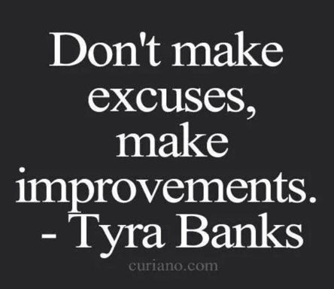

CHOMP TIME
F.A.S.T. Groups
Focused Academic Support Time
8:40 – 9:10

Slide 5
7 Habits of Highly Effective People
Habit #1: Be Proactive
Habit #2: Begin with the End in Mind
  I plan ahead and set goals.
  I do things that have meaning and make a difference.
  I am an important part of my classroom and contribute to my school’s mission and vision, and look for ways to be a good citizen.

Slide 6
7 Habits of Highly Effective People
Habit #1: Be Proactive
Habit #2: Begin with the End in Mind
Habit #3: Put First Things First
  I spend my time on things that are most important. This means I say no to things I know I should not do.
  I set priorities, make a schedule, and follow my plan.
  I am disciplined and organized.

Slide 7
7 Habits of Highly Effective People
Habit #1: Be Proactive
Habit #2: Begin with the End in Mind
Habit #3: Put First Things First
Habit #4: Think Win-Win
  I balance courage for getting what I want with consideration for what others want.
  I make deposits in others’ Emotional Bank Accounts.
  When conflicts arise, I look for options that work for both sides.

Slide 8


Independent Daily Reading & Teacher Conferences!
Challenge Yourself, can you focus only on reading your book?
9:00 – 9:10

Slide 9

Restroom Break
9:10 – 9:20

Slide 10
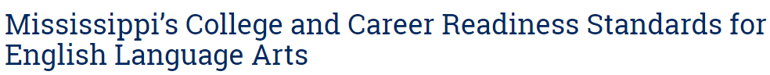

Reading Time
9:20 – 9:55
Objective: RL.3.2
I can recount stories; determine the central message, lesson, or moral and explain how it is conveyed through key details in the text.
Objective: RL.3.7
I can explain how specific images and illustrations contribute to or clarify a story.

Slide 11

Gather at the Carpet…
Are you proud of how you moved to the carpet?
Do we need to try again?

Slide 12
Review Turn to your Partner…
Demonstrate respectful communication: take turns and listen intently to what your partner is saying so you will be able to share with the class what they have shared with you.
What is something you did in school last year that was especially fun or interesting? Turn to your Partner
What is something you enjoyed over the summer? Turn to your Partner
Objective: SL.3.1b Follow agreed-upon rules for discussions (e.g., gaining the floor in respectful ways, listening to others with care, speaking one at a time about the topics and texts under discussion).

Slide 13

What do you remember about this story? Turn to your Partner

Slide 14

Comprehension Strategy: REREADING
The purpose of rereading is to understand what you are reading at a deeper level

Slide 15
Listen carefully for any details you might have missed when I read this yesterday. I will pause and ask you some questions after some sections.
REREAD

Slide 16
After p10:
How do you think the children feel at this point in the story? Why? Turn to your Partner

Slide 17
After p22:
How do you think the children feel now? Why? Turn to your Partner

Slide 18
After p28:
How do you think the children feel now? Why? Turn to your Partner

Slide 19


Classroom Discussion
What do you think happens to Miss Viola Swamp? What in the story makes you think so?

Slide 20
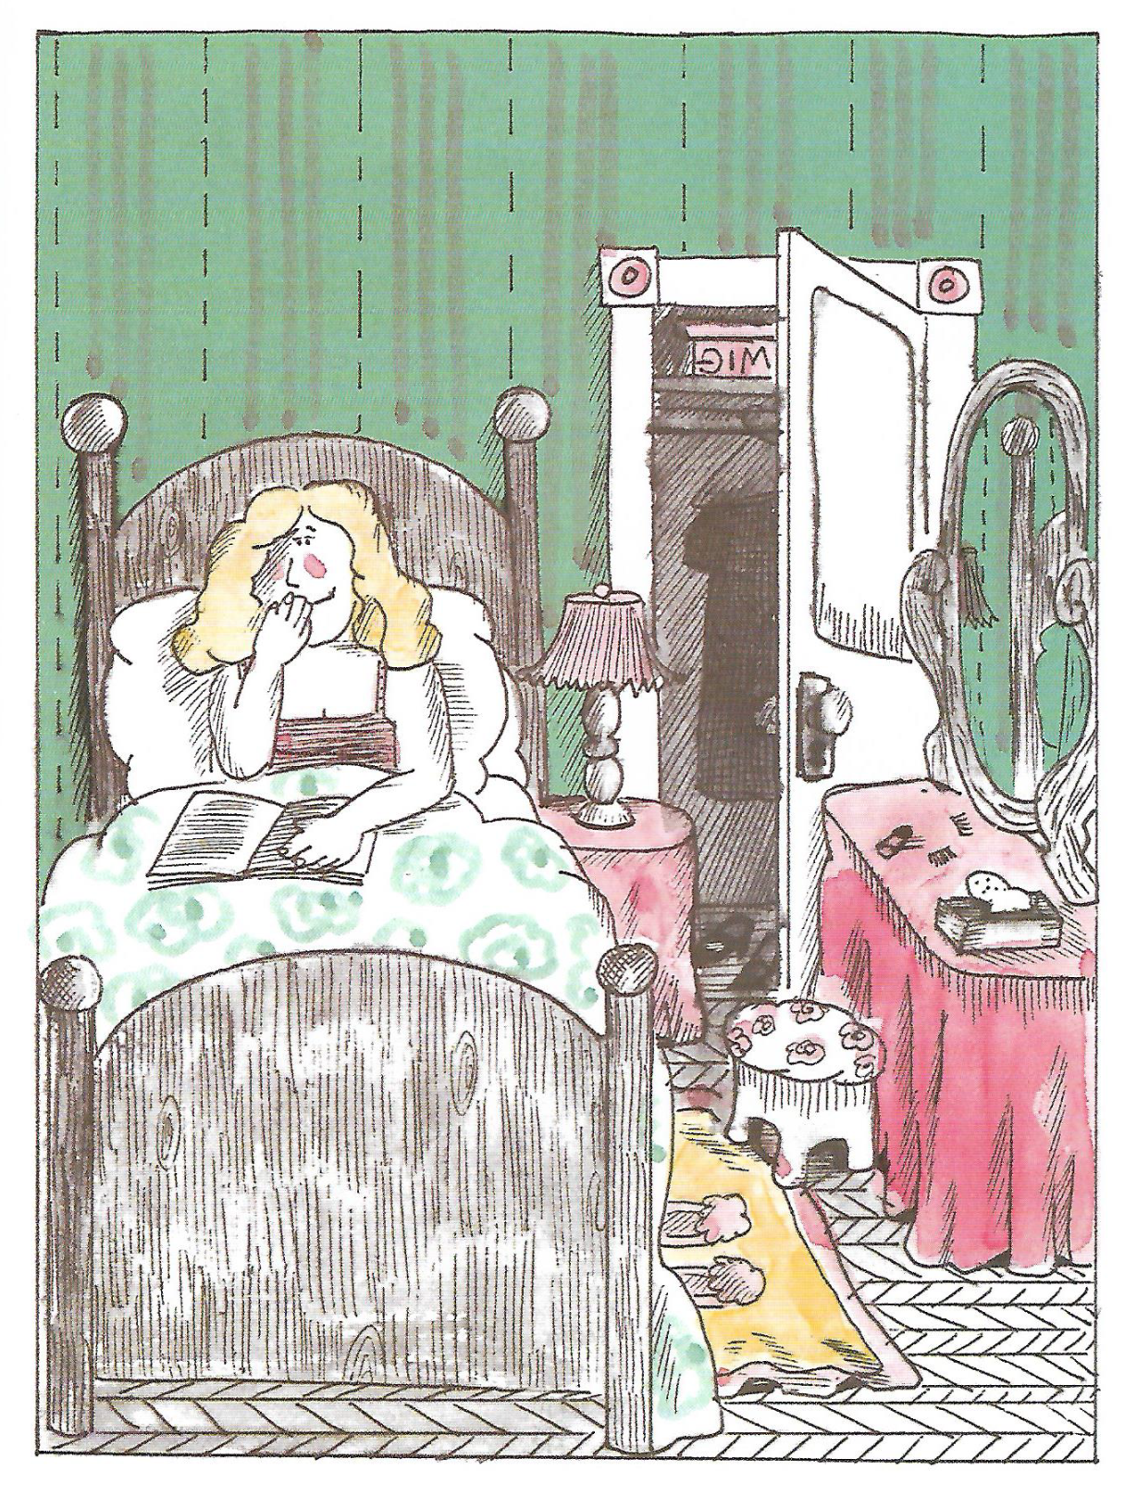

Classroom Discussion
What clues do you see in this illustration that help you understand what happens in the story?

Slide 21
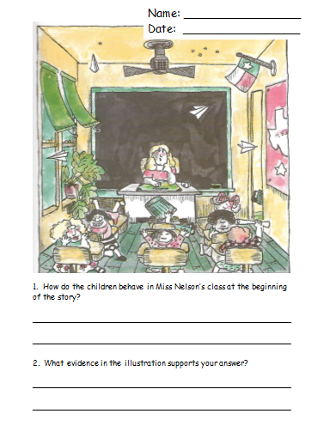
Comprehension Check
9:55 – 10:25

Slide 22
Independent Daily Reading & Teacher Conferences!
Challenge Yourself, can you focus only on reading your book?
10:25 – 10:40

Slide 23

Out of Classroom!
Recess 10:40 – 11:05

Slide 24

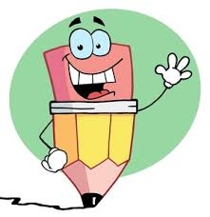

Writing Time
Objective: W3.1
I can write an opinion piece on familiar topics or texts, supporting a point of view with reasons.
11:05 – 11:20

Slide 25

Writing About Reading
Today, I want you to write your opinion of whether you think Miss Viola Swamp is a good teacher.
Readers can have different opinions about the characters and different events in a story, and that is fine!
What is important is that you give reasons to support your opinion.
I will model how to write an opinion piece about Miss Viola Swamp, and then you will write one. ☺

Slide 26
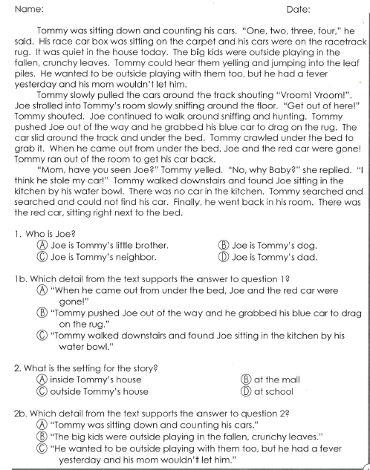
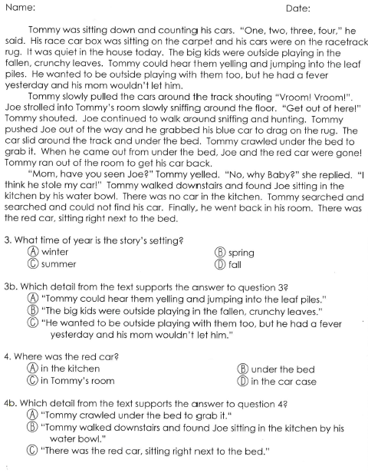
Support your Answer

Slide 27
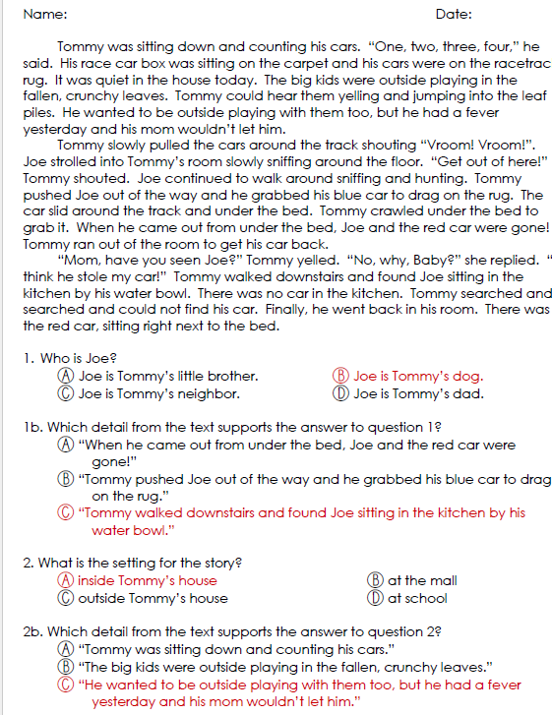
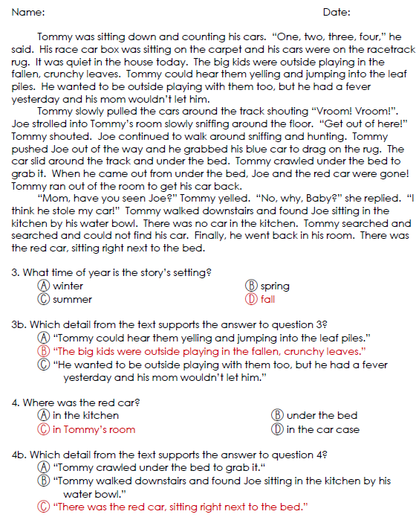

Slide 28

Speaking & Listening Time
11:45 – 12:10

Slide 29

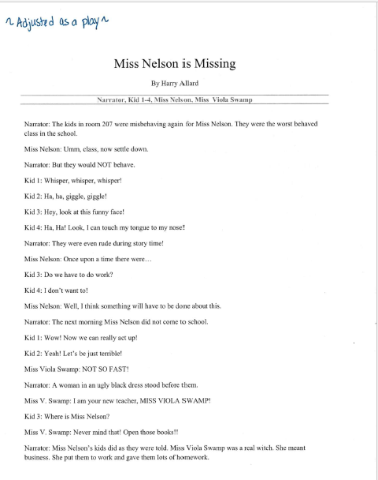
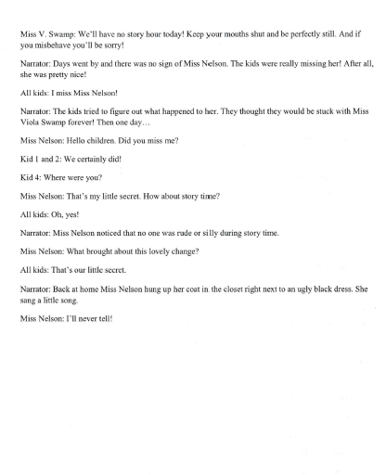
Theater Time

Slide 30
Math Time!
12:10 – 12:35

Slide 31
Begin Math
Pre-Assessment
Let’s see what we remember from second grade so I’ll know where we need to help you the most! ☺

Slide 32

Out of Classroom!
Lunch 12:35 – 1:05

Slide 33

Restroom Break
1:05 – 1:10

Slide 34

Out of Classroom!
Activity 1:10 – 1:55
  School Staff Intro – Bus Conduct

Slide 35
Continue Math
Pre-Assessment
Let’s see what we remember from second grade so I’ll know where we need to help you the most! ☺

Slide 36
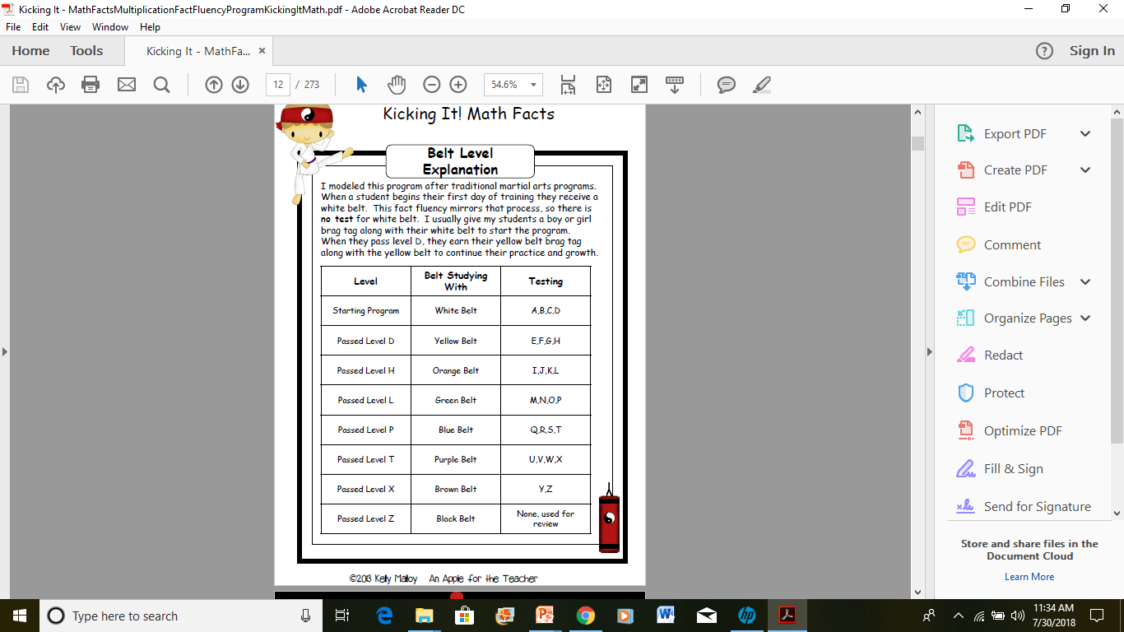
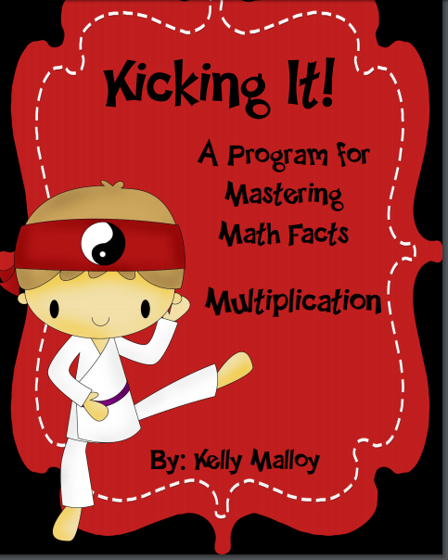
Practice!! – Quiz on Tuesdays and Fridays
2:15 – 2:17

Slide 37
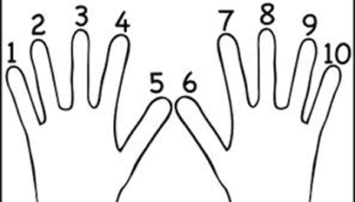

Fluency Practice, Part 2
Count to 20 forward and backward (watch my fingers so you know if I’m going up or down; closed fist means stop)
  Whisper every other number (whisper-1, speak-2, whisper-3, speak-4, whisper-5, speak-6)
  Hum every other number (hum, speak-2, hum, speak-4, hum, speak-6)
  Think every other number (think, speak-2, think, speak-4, think, speak-6)
  What did we just count by? Turn to your Partner
  Now lets count by twos
Closed fist means stop

Slide 38
Kagan Classbuilding ☺
Quiz-Quiz-Trade:
“All About School”
2:20 – 2:30

Slide 39

SCIENCE TIME
Objective: P.3.5.1 I can plan and conduct scientific investigations to determine how changes in heat (i.e., an increase or decrease) change matter from one state to another (e.g., melting, freezing, condensing, boiling, or evaporating).
2:30 – 3:20

Slide 40

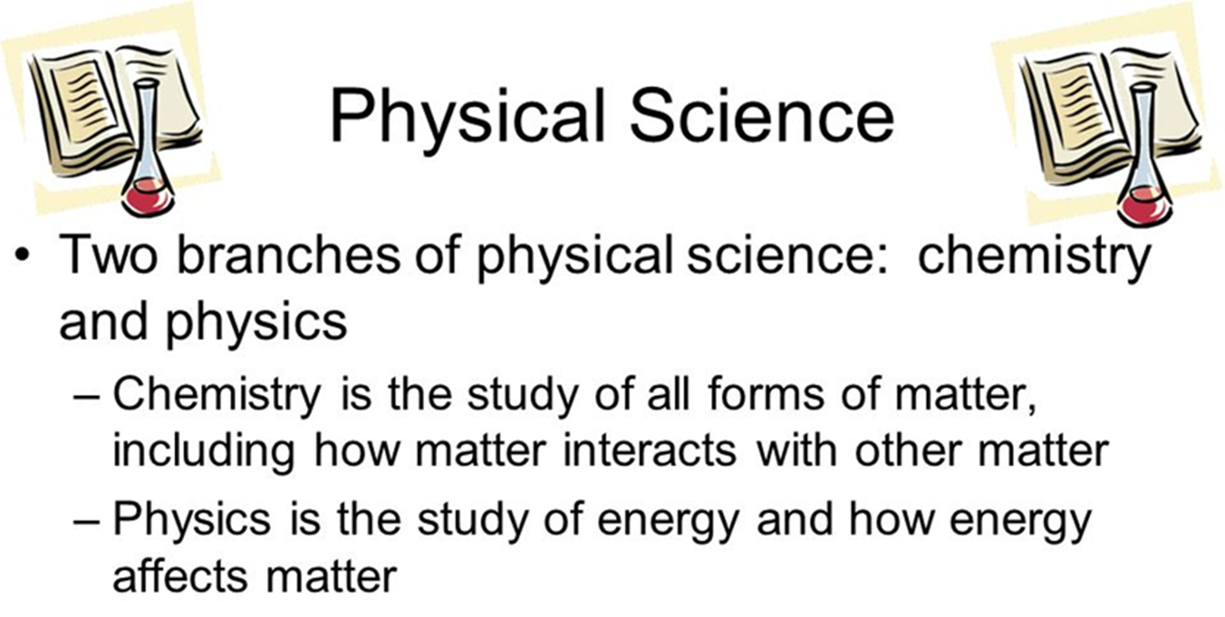

Slide 41
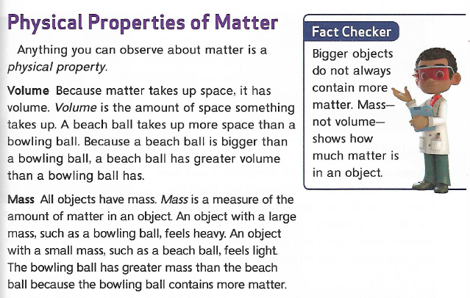

Slide 42
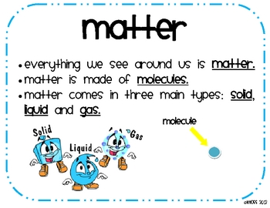
Review S.T.A.R.
http://studyjams.scholastic.com/studyjams/jams/science/matter/properties-of-matter.htm

Slide 43
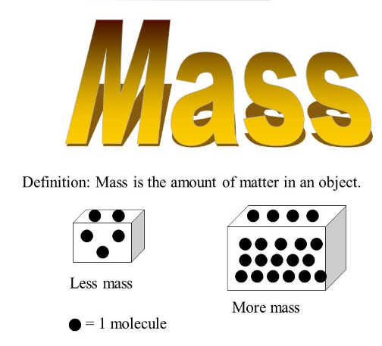
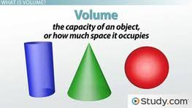
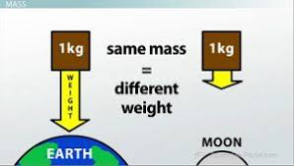

Slide 44
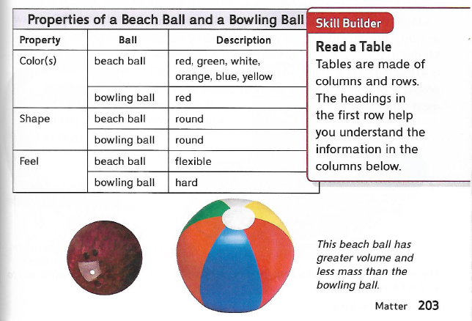

Slide 45
Gather at the Carpet…
Was it a perfect transition?

Slide 46
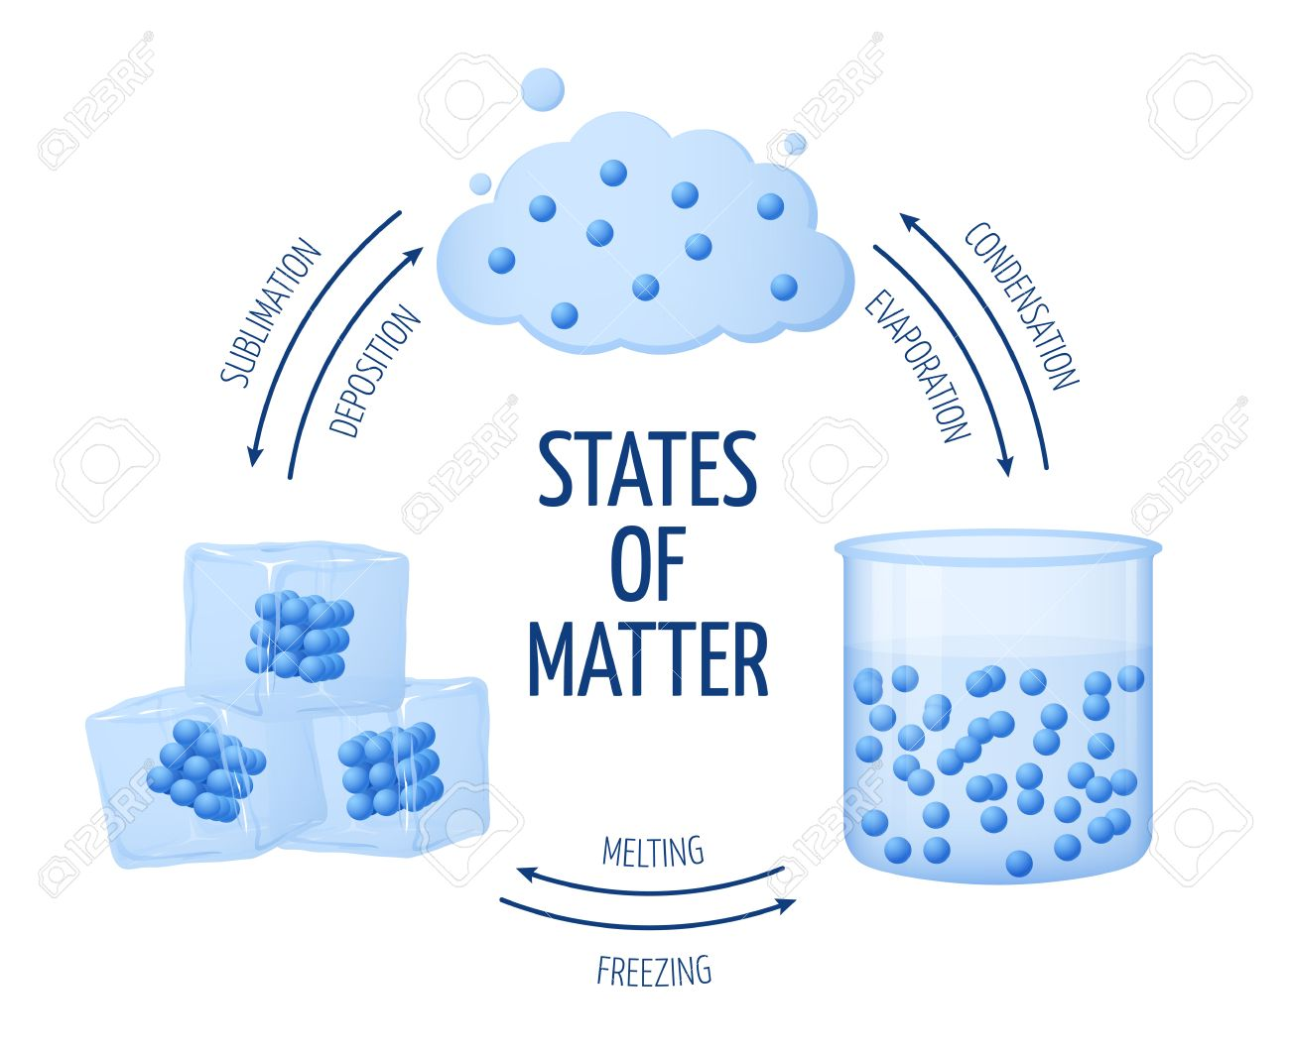
http://studyjams.scholastic.com/studyjams/jams/science/matter/solids-liquids-gases.htm

Slide 48
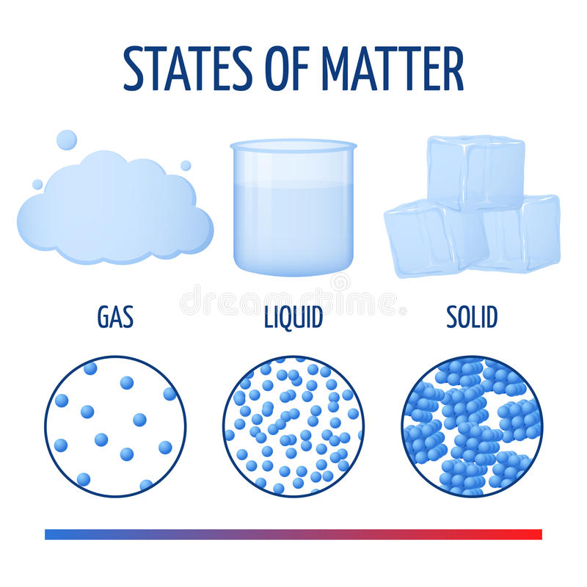
S.T.A.R.

Slide 49




3:20 – 3:25 Wrap Up!
Pair-Up back to back and share one thing you learned in class today with your partner
Pack-Up
Office will announce:
Car Riders – Leave around 3:25
Bus Riders – (listen to intercom for dismissal)
2:30 – 3:20
How much time has elapsed?

