Slide 1
Georgia Milestones
Welcome to 3rd Grade
Mrs. Edmunds, Mrs. Hoffman, Ms. Neal, & Mrs. Stanley

Slide 2
Thank you for joining us! Please make sure you are ready by:
Thank you for coming! Please make sure you...
Turn on your cameras
Mute your microphone (background noise can cause interference)
Take notes and jot questions to ask at the end, or type in the chat box

Slide 3
Agenda
Welcome
What Is Milestones?
What Does Milestones Look Like?
How Can I Help?
Survey

Slide 4
Sign in
Please type your name, your child’s name and his/her teacher’s name in the chat box.

Slide 5
What is the Georgia Milestones?
It is an online assessment that measures how much students have learned based off our Georgia Performance Standards.
The assessment will include selected response, constructed response, extended response, and technology enhanced questions about the content they have learned this school year.
3rd grade is a Gateway Grade...your child will need to show proficiency in ELA to move on to 4th grade

Slide 6
3rd Grade Testing Schedule
Wednesday, April 28: ELA Section 1
Thursday, April 29: ELA Section 2
Friday, April 30: Math Sections 1 & 2

Slide 7
What is selected response?
Multiple Choice

Slide 8
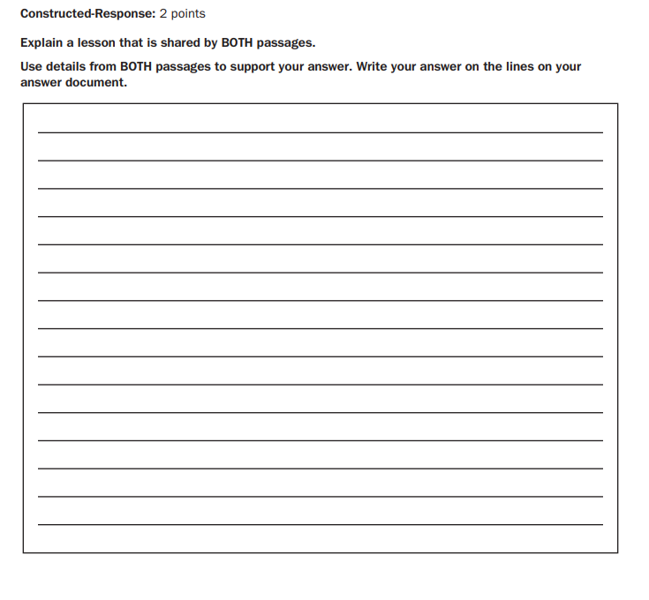
What is constructed response?
The response should give sufficient evidence to support the answer using both texts.

Slide 9
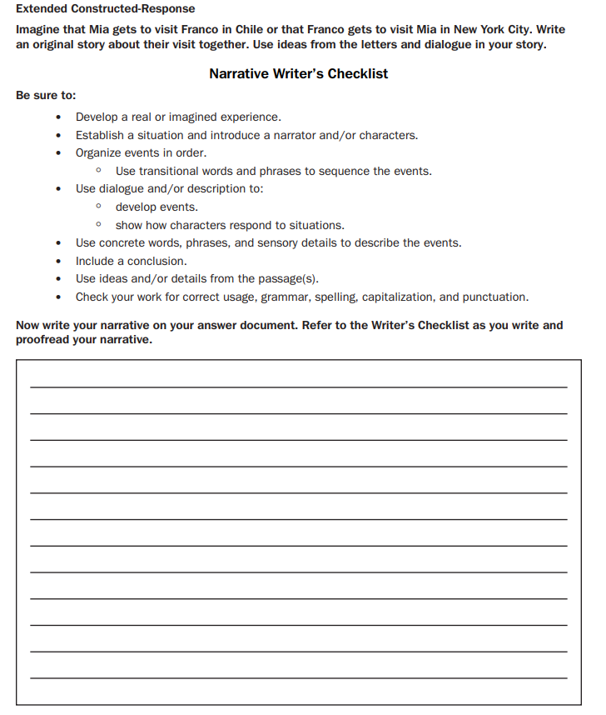
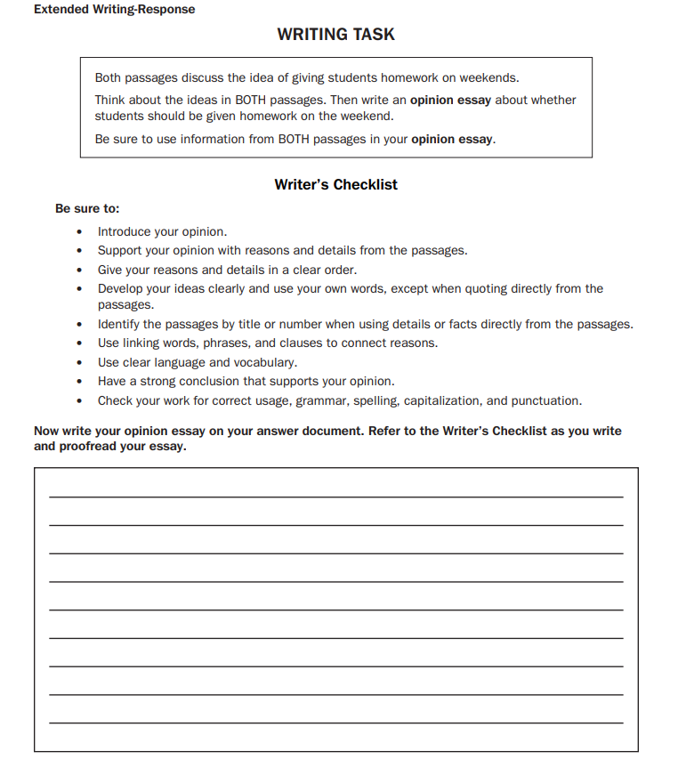
What is extended response?
Essay

Slide 10
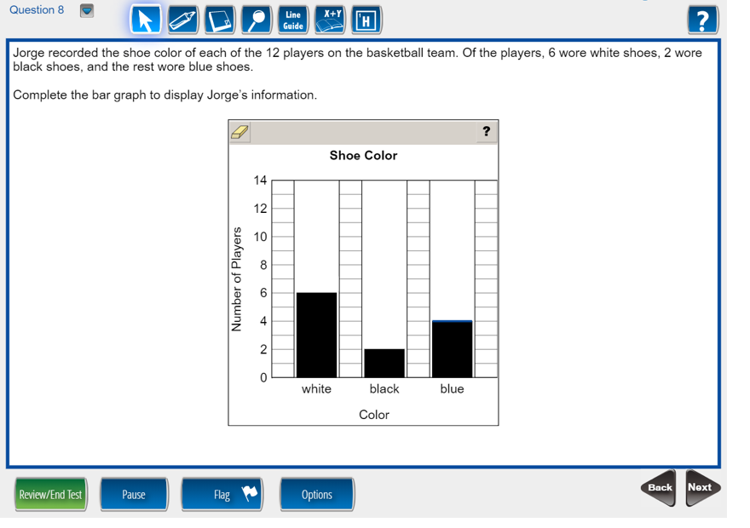
What is technology enhanced?

Slide 11
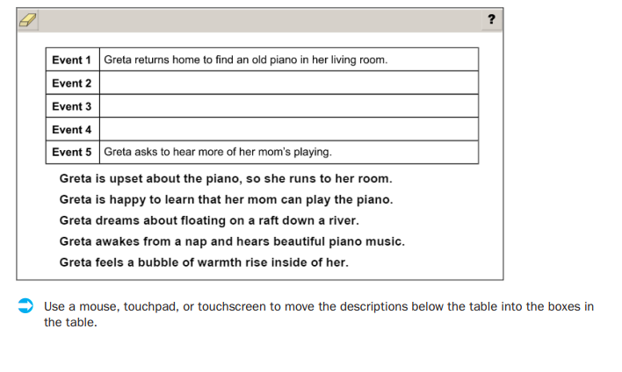
What is technology enhanced?

Slide 12
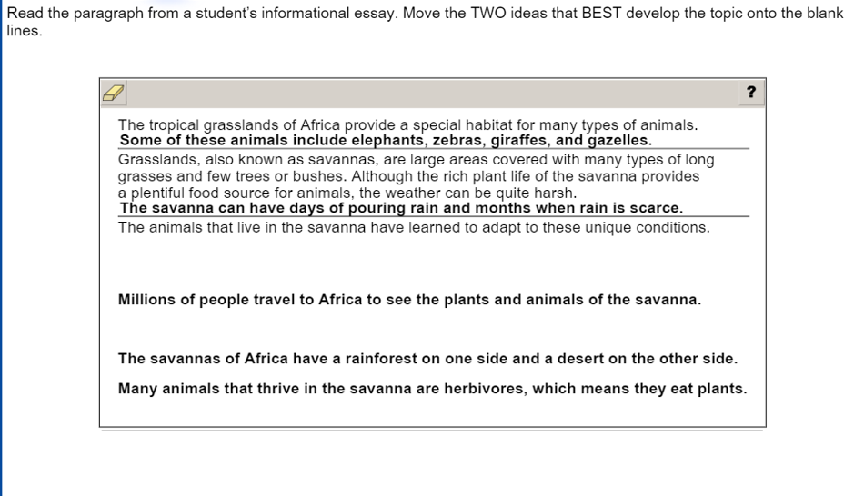
What is technology enhanced?

Slide 13
What can I do?
LOTS of encouragement! They are ready!
Remind your child read all directions, take their time, and review their work.
Explain that this is their chance to SHOW WHAT THEY KNOW!
Point out that some questions will be challenging, but don’t give up!
Get a good night’s sleep each night (10-11 hours).
Eat a good breakfast each morning.
Make sure that your child is ON TIME. They should be at school BEFORE 8:30.

Slide 14
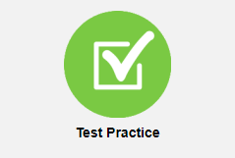
Where can I find more information and/or practice for my child?

Slide 15
When will I know my child’s results?
We will let you know as soon as we are notified!
Please complete our survey...click for the link
Questions?
Thank you for coming!!

Slide 16
ALTERNATIVE RESOURCES

