Slide 1
GES Kindergarten
Week 4- April 13-17

Slide 2
Standards
Reading:
R.I.K.1: Ask and answer questions when reading.
R.L.K.3: Name characters, setting, and events in the story.
Writing:
W.K.1: Use a combination of drawing, dictating, and writing when composing opinion, narratives, and informative texts.
L.K.2: Use g appropriate capitalization, punctuation, and spelling when writing.
Phonics:
R.F.K.2: Demonstrate understanding of sounds (middle sounds, short vowels).
Sight Words:
R.F.K.3: Read common high frequency sight words.
Math:
KNBT 1 Compose & decompose #’s 11-19 into tens & ones

Slide 3
Reading
Essential Questions:
How do the author and illustrator help us understand the frog life cycle?
How do frogs grow and change compared to you?
I Can:
I can restate the frog life cycle in sequential order.
I can state how I grow and change compared to frogs.

Slide 4
Reading
Activity: Read the books to a sibling, parent, pet, or toys.
Nonfiction:
Frogs
Fiction:
I Don’t Want to Be a Frog

Slide 5
Day 1
Read for fun!
Make a list of things you know about frogs.
Add new information after you read/listen to the book.
Capture This and That Activity:
Illustrate a poisonous frog and frog’s sticky tongue.

Slide 6
Day 2
Reread the text.
Ask and answer simple recall questions.
Introduce Vocabulary.
Write a sentence about a fact you learned today about frogs.
Listen and Draw Activity:
Illustrate a frog’s habitat and a tadpole’s gills.

Slide 7
Vocabulary
Croak- the deep, hoarse noise that a frog makes
Gills- body parts that a fish or tadpole uses to breathe
Habitat- the natural place where a plant or animal lives
Poison- something that can kill or hurt living things

Slide 8
Day 3
Discussion:
*Look at pages 20-21, how do these pages help you understand the meaning of the word “poison”?
* Reread page 7. How can we the use the text and illustration to help us understand the unknown word “habitat”?
* Compare and contrast frogs and toads.
* Using the illustration on page 14 and the text, what can you infer about frogs’ tongues?
Label It Activity:
Construct a frog LIfe Cycle display

Slide 9
Day 4
Review vocabulary words.
Demonstrate a frog’s croak.
How do a tadpole’s gills compare to our lungs?
Describe a frog’s habitat. Are there certain things that a frog needs in its habitat?
Why do some frogs have poison in their skin? Are these kinds of frogs “bad”?
Part 2: Read I Don’t Want to Be a Frog.
Connect It!
Label the parts of a frog.

Slide 10
Day 5
Wrap up:
Restate the frog life cycle.
Journal Prompt: Would a frog make a good pet? Why or Why not?

Slide 11
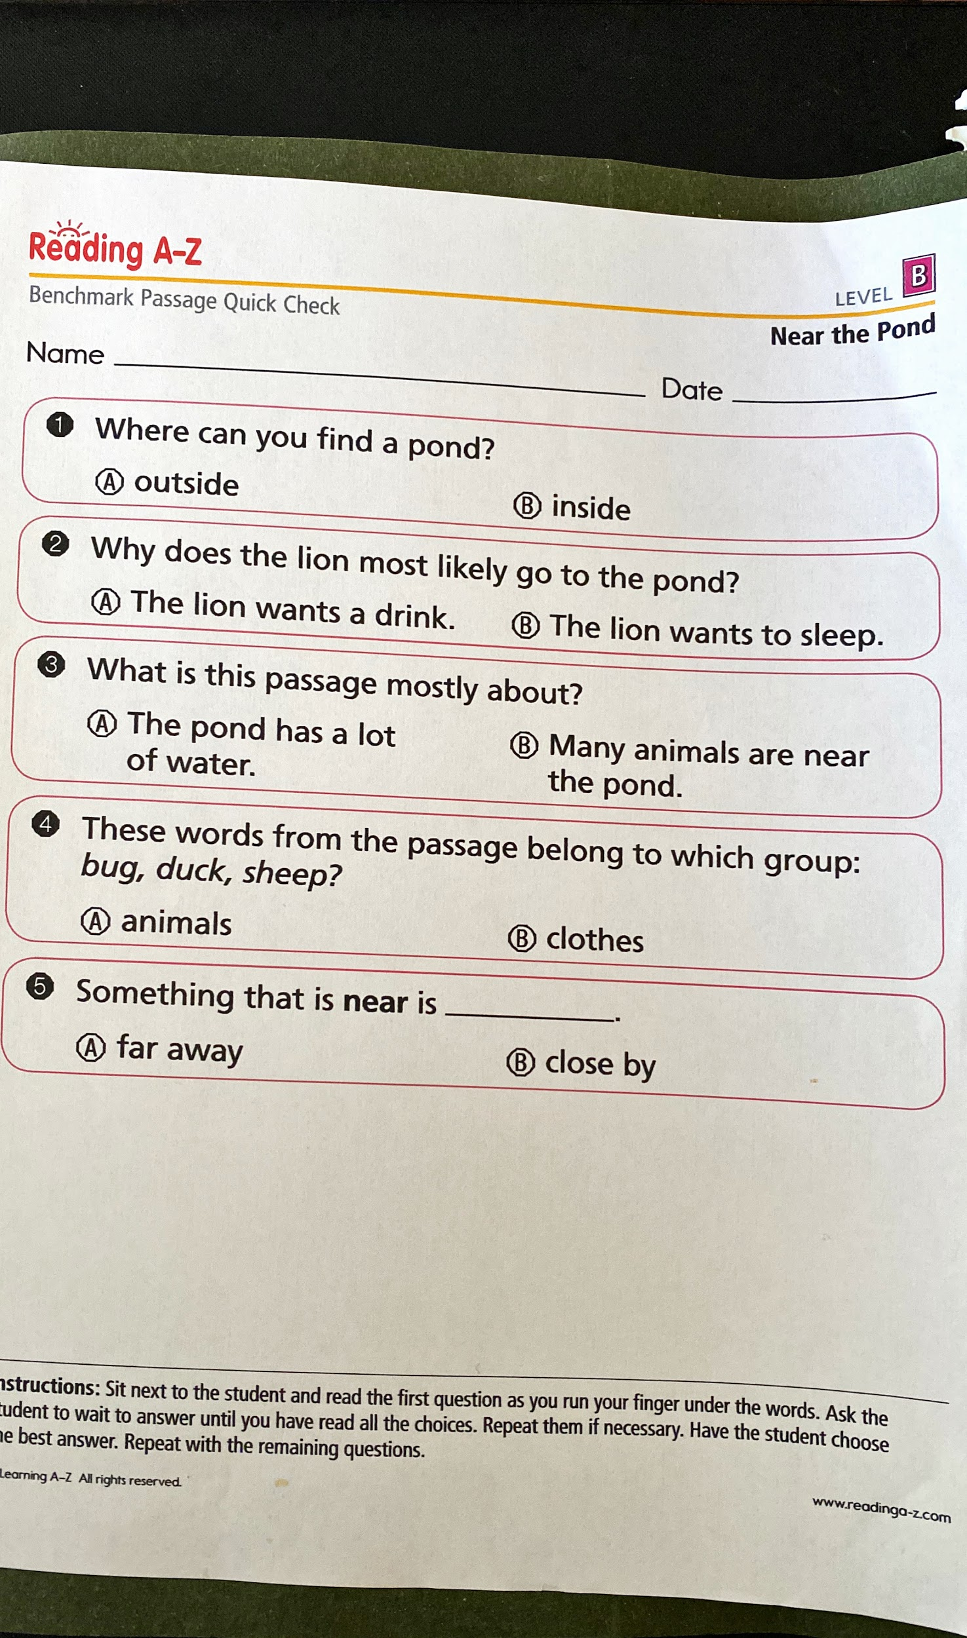

Slide 12
MATH:
You be the teacher! Get a piece of paper and pen,dry erase marker and board, or sidewalk chalk (use this one ONLY outside). Draw a ten bar and some ones. Your student (parent,sibling,stuffed animal, pet) has to tell you what number you drew. Do this as many times as you’d like:)

Slide 13
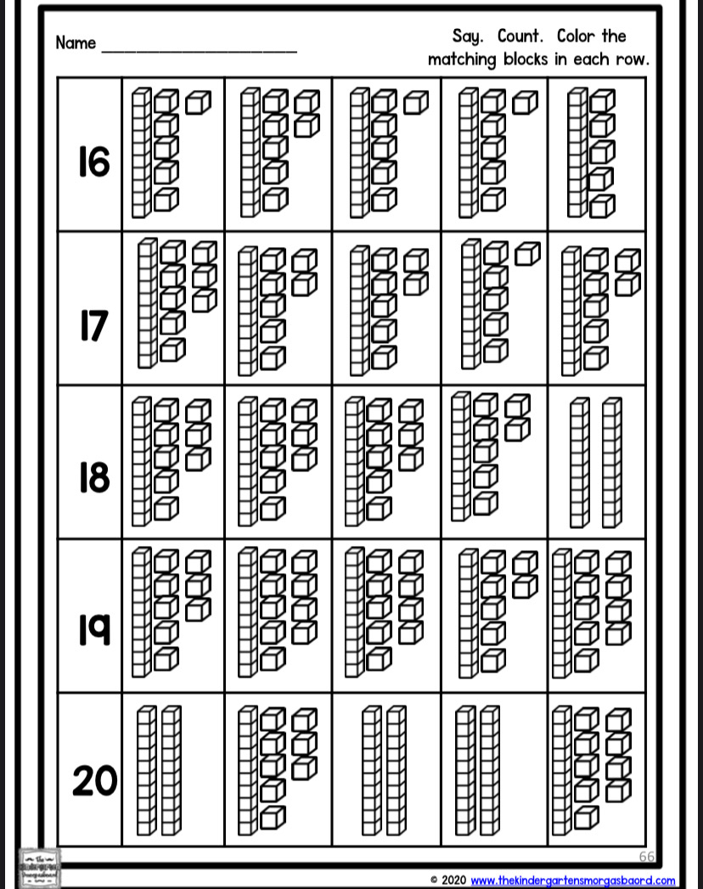
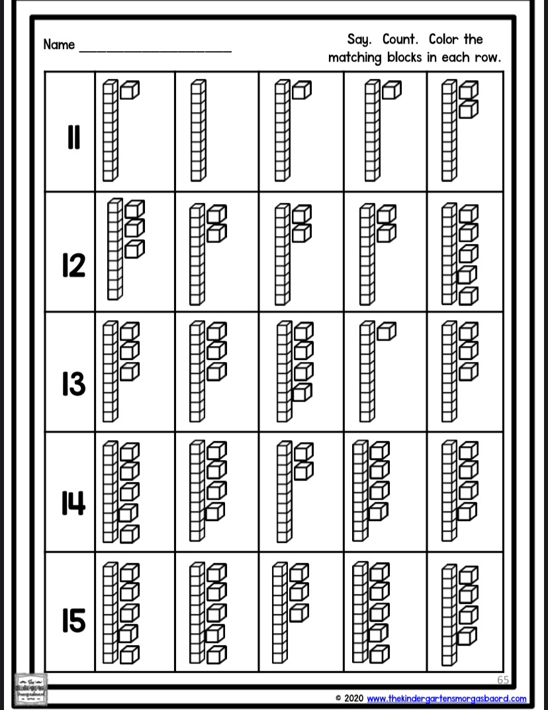

Slide 14
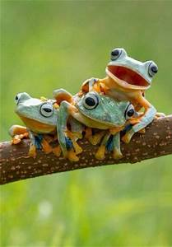
Science
L.K.3A Students will demonstrate an understanding of what animals and plants need to live and grow.
L.K.3A.2 Construct explanations using observations to describe and report what animals need to live and grow (food, water, shelter, and space).
I
Continued on next slide...

Slide 15
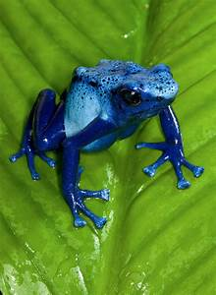
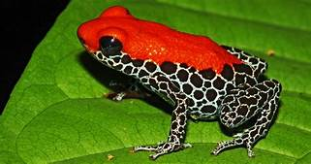
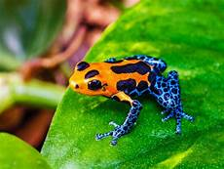
Science
A habitat is where you live. Frogs have lots of different habitats. Some live in trees. Some live near lakes or rivers. Some frogs even live in the mud.
*Can you draw a picture of a frog living one (or 2) of
these habitats?
2. Not all frogs are green or brown. Some are yellow or
blue. Some frogs are even red.
* Can you draw a picture of a frog that is not green or
brown?

Slide 16
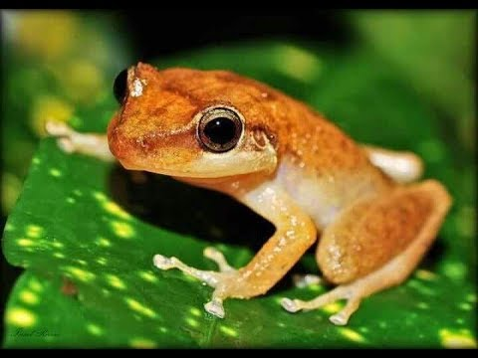
Science
1. Listen to this video of a Coqui frog and see if you can croak like it does. You will have to copy and paste it into a web browser.
https://youtu.be/LZUOiZG84c0
(Coqui frogs UP CLOSE and LOUD!)

Slide 17
Writing
Activity:
Choose 1:
Write three sentences about your favorite season.(opinion)
see science slide (informative)
Write three sentences about one day at the pond. You can pretend you are a frog. See next slide. (narrative)

Slide 18
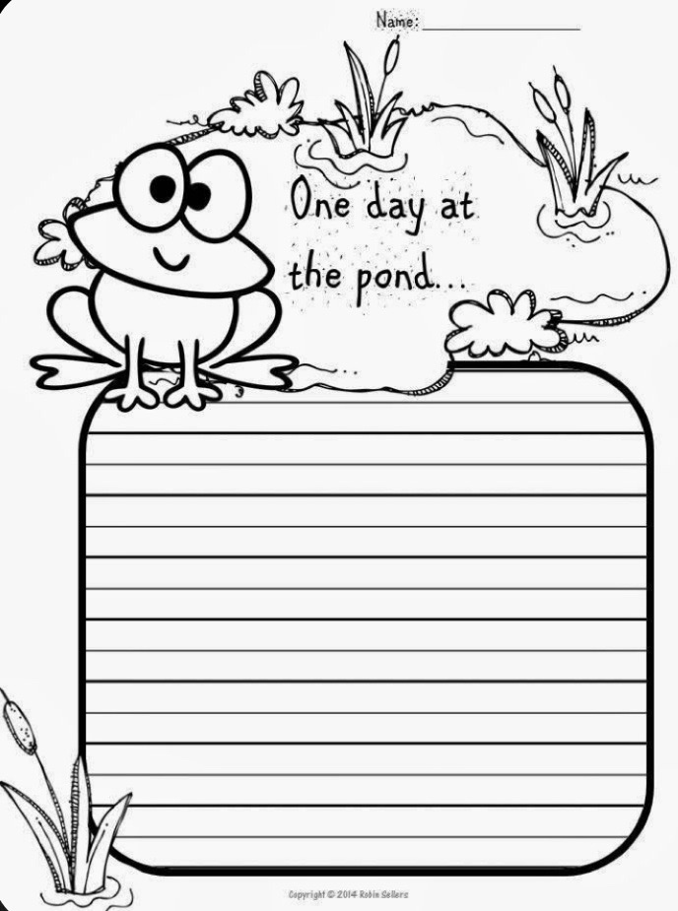

Slide 19
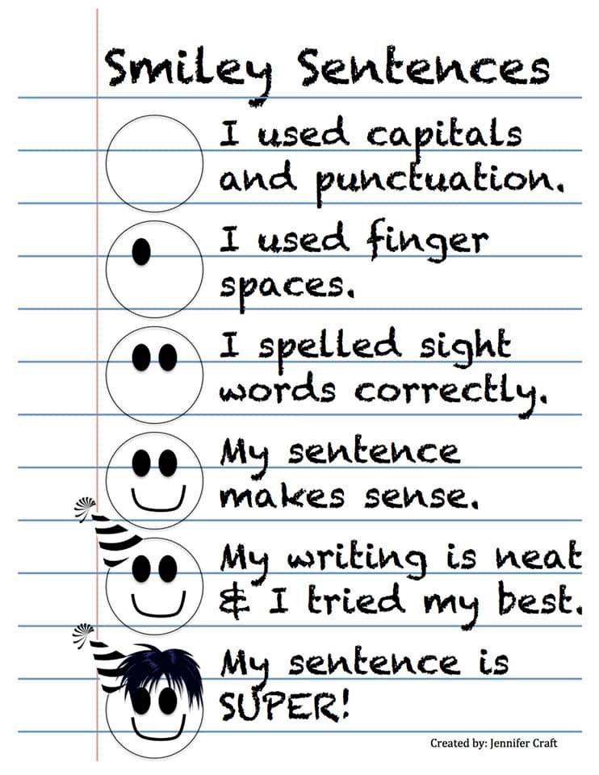

Slide 20
Phonics
The following word list includes words that use our short vowel addressed on the phonics worksheet given. You may practice these words all week by sounding them out and reading them, writing them with different fun materials, coming up with words that rhyme with these words, and even using them in sentences. At the end of the week a spelling test can be given to see if the words have been mastered.
Dog Log
Hot Cop
Rock Got
Fox Box
Mop Lock
Bonus word: frogs

Slide 21
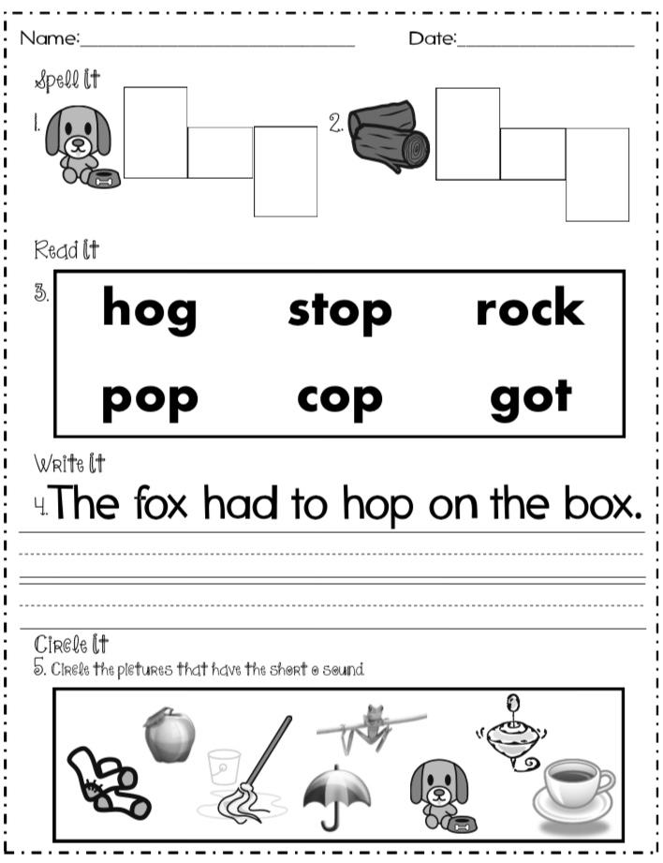

Slide 23
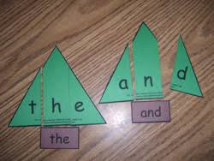
Sight Words
Sight Words: way, find, may, water
Activity: Get a piece of paper and write your sight words on the paper, leaving a space between each letter. Draw a shape around them.
Cut the paper between each letter
to make a puzzle. Get someone to
solve the puzzle.

Slide 24
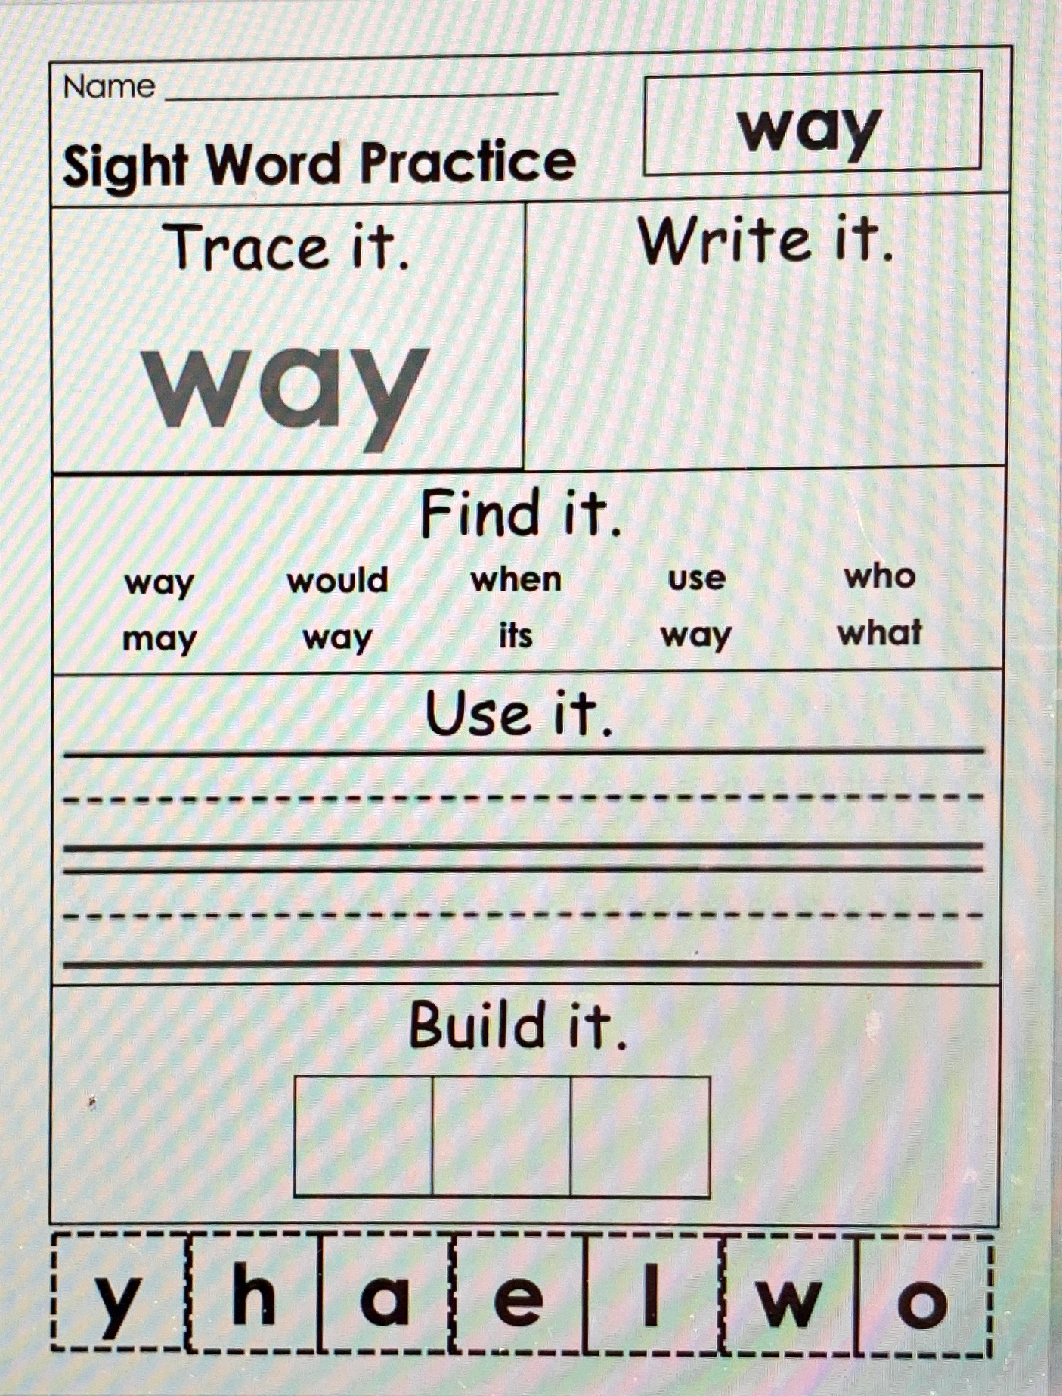

Slide 25
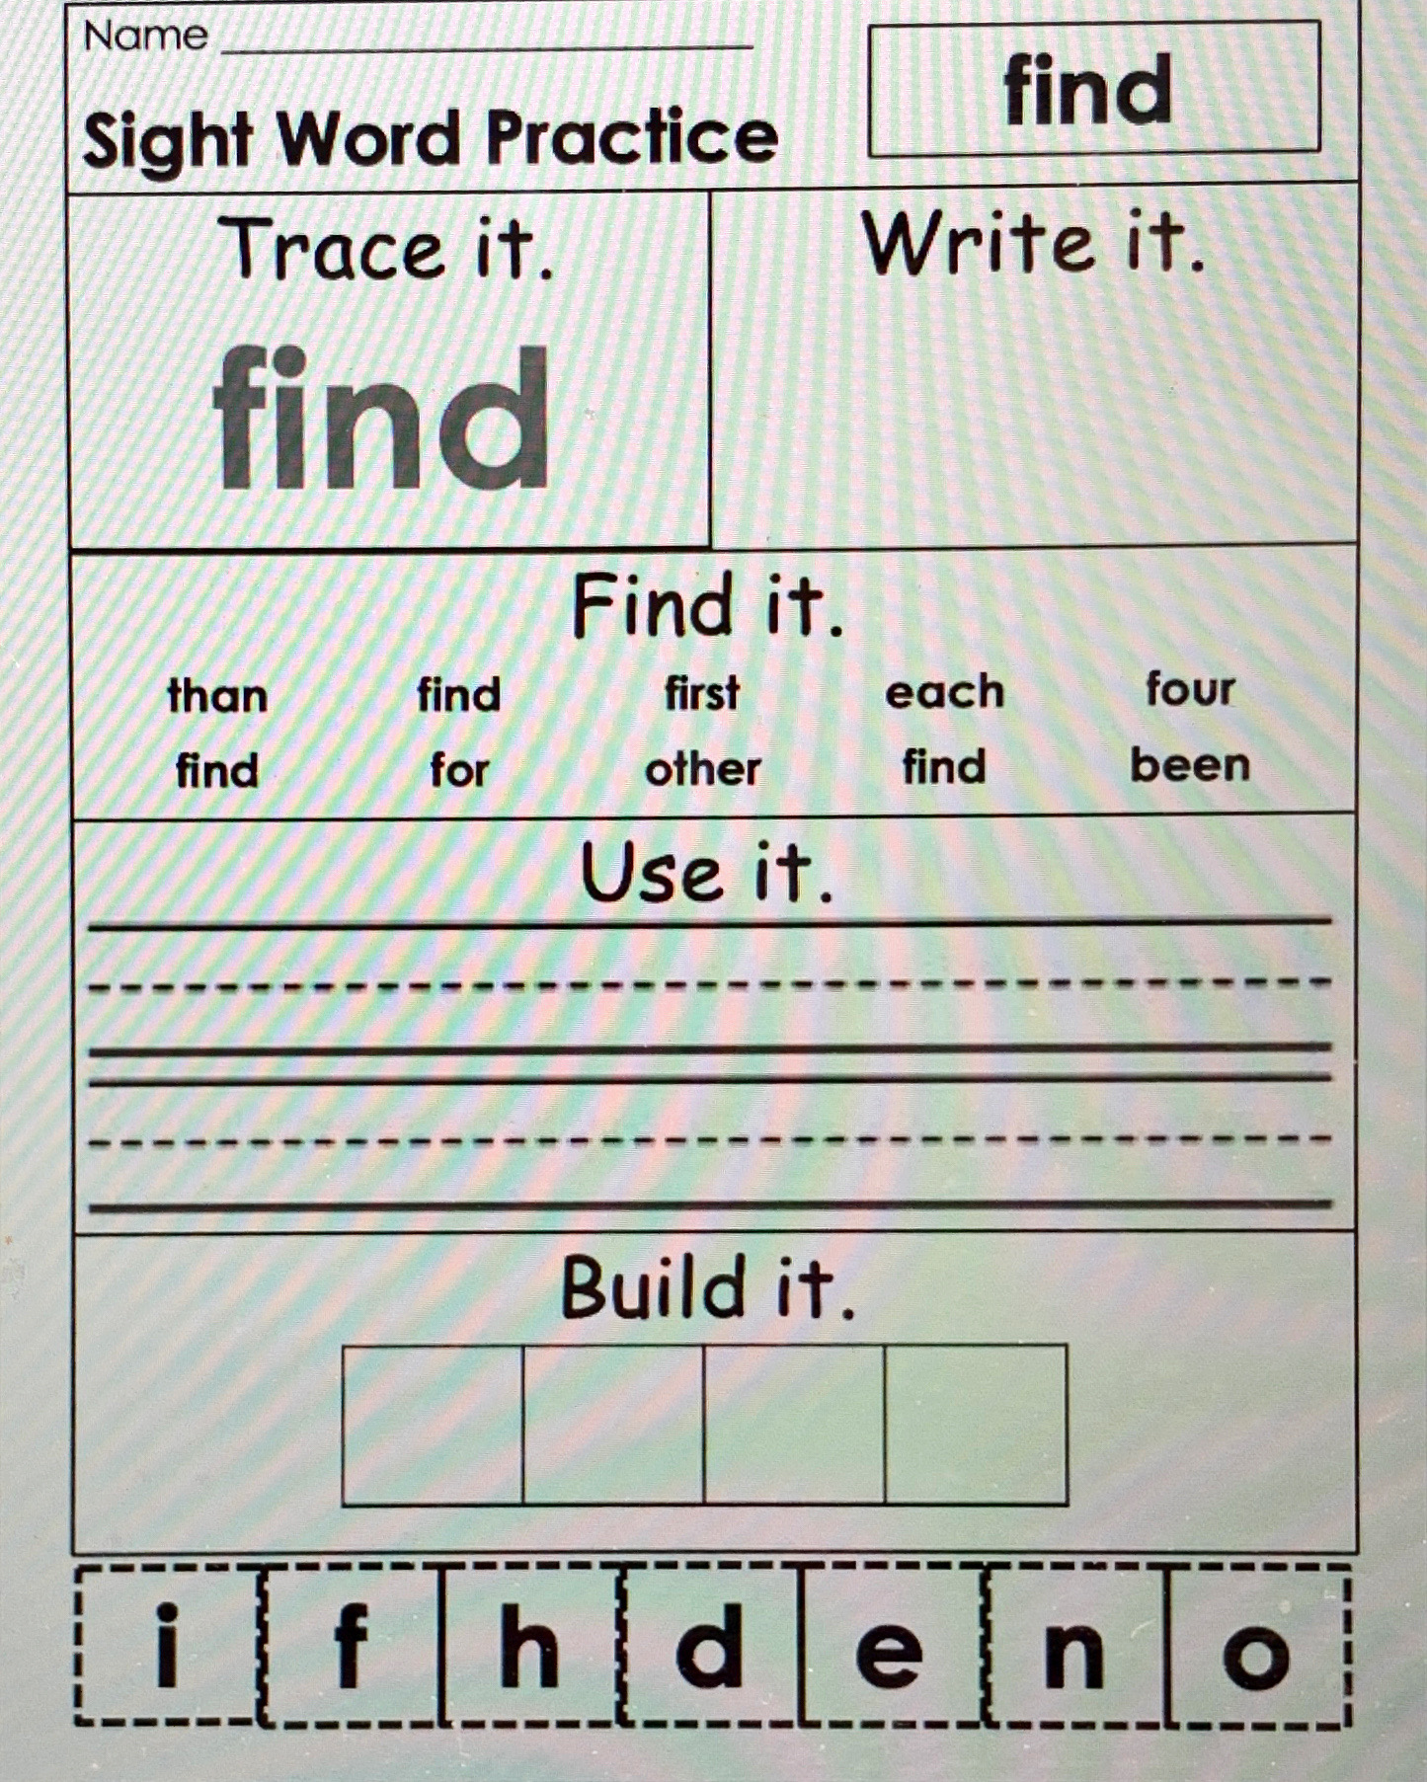

Slide 26
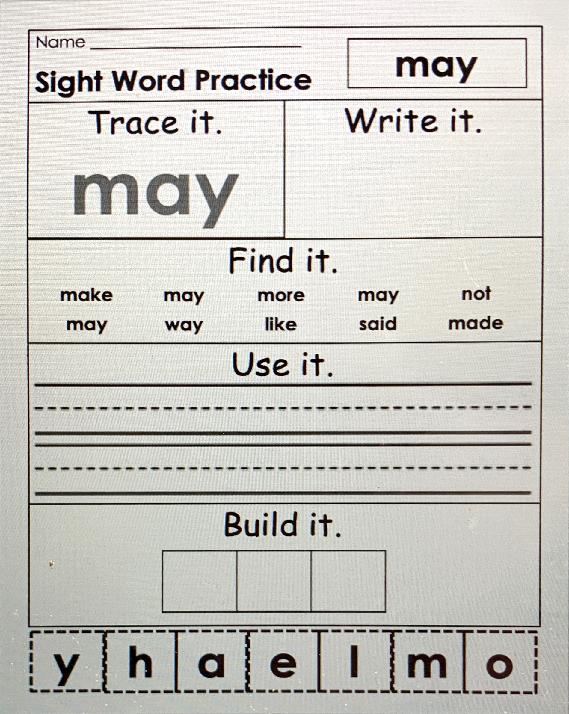

Slide 27
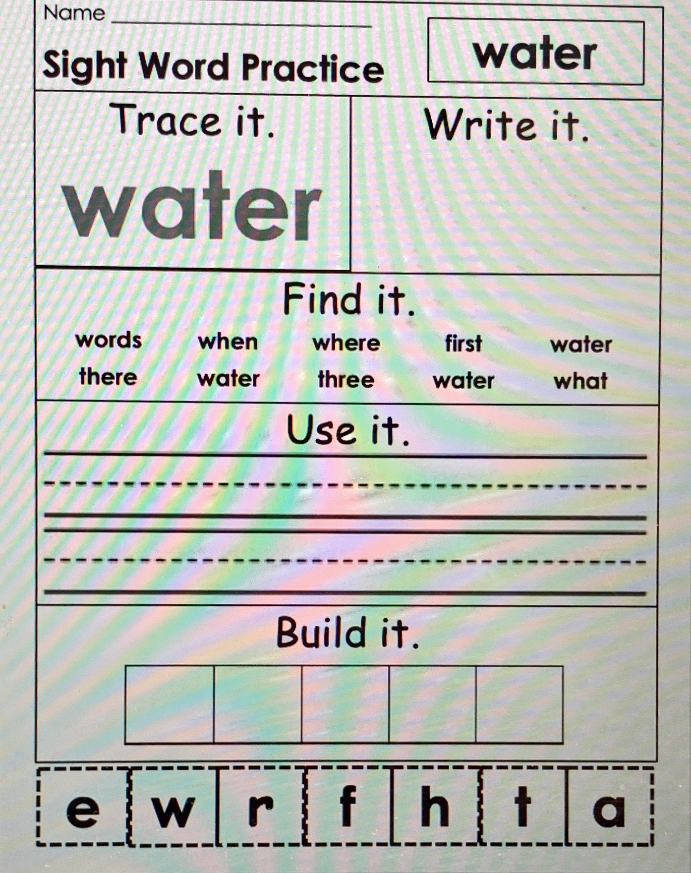

Slide 28
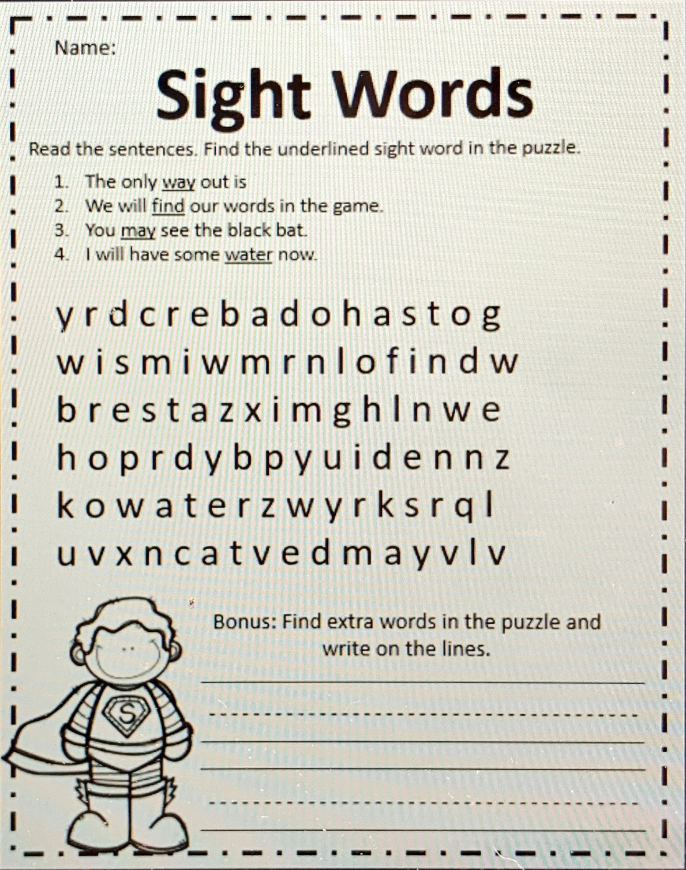

Slide 29
Baseball Words.mp4
Basketball words.mp4
Soccer ball words.mp4
These are review videos of our sight words with flash cards. Remember, though some words can be sounded out, you should remember these words and read them automatically. 😊

Slide 30
Optional Activity:
Lt. Gov. Hosemann would like to hear from students. He will be sharing some of these writings/drawings on social media and with senators. To submit to his office, email child's writing along with permission slip to Ltgov@senate.ms.gov. Students k-3 May submit this writing.

Slide 31
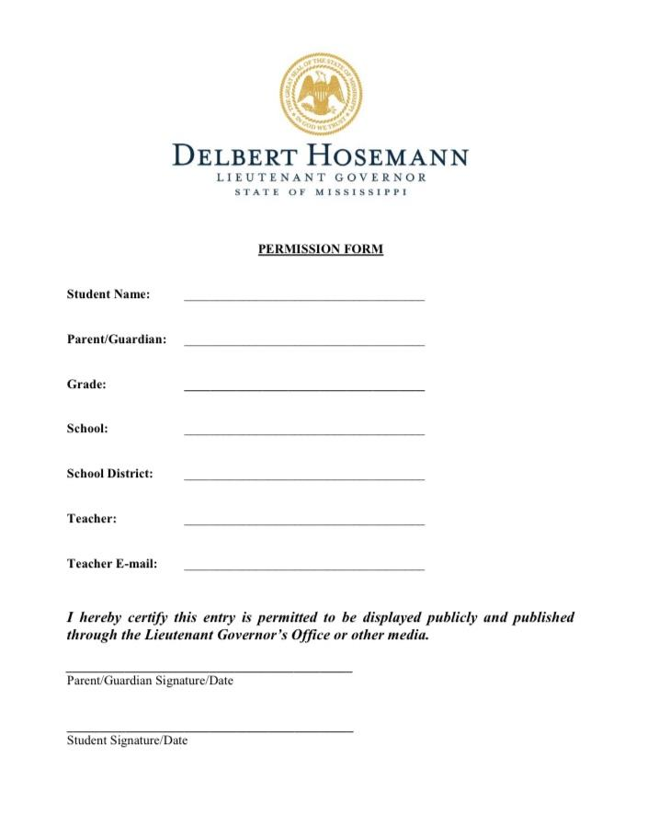

Slide 32
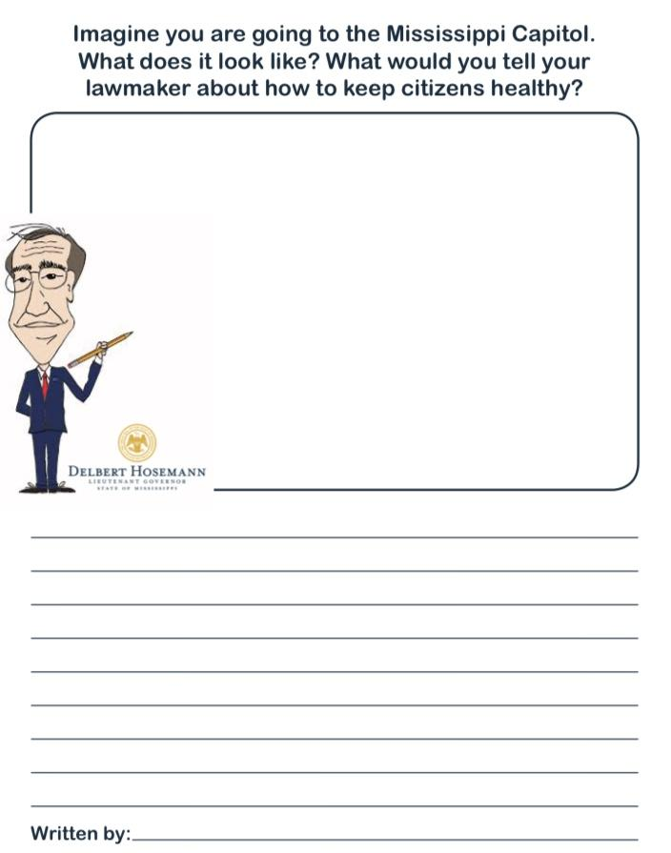

Slide 33
Online Resources Section
These are not links. On this page you will have to type the website name in the web browser, but these are great YouTube alternatives during this time of distance learning and all throughout the year!

Slide 34
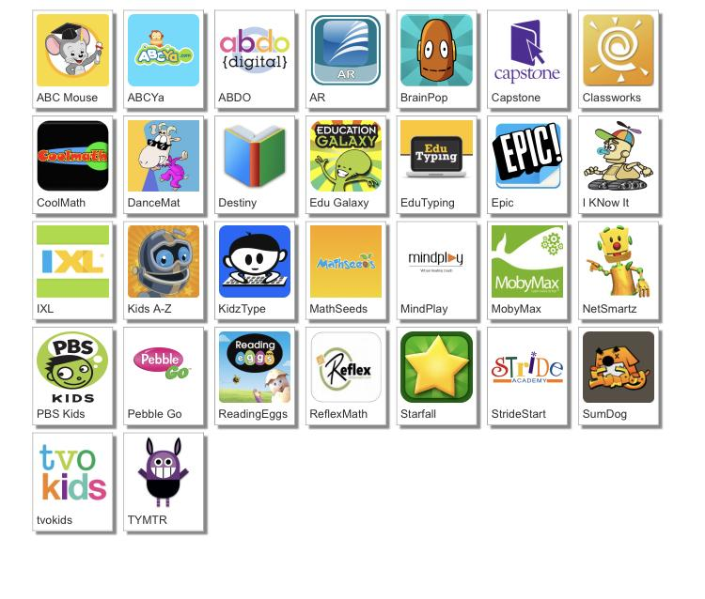
http://www.dcsdms.org/ll/

Slide 35
Message from the Teachers
We miss you guys. We are so proud of all of the hard work you guys have done. Listen to your parents. They are your teachers right now. We may do things differently, but we are all working together to do all that we can for you guys. We would love to see a picture of you working hard. You can send these to us via Remind. Keep working hard, and we hope to see you soon! :)

Slide 36
Note to the parents, thank you for investing in your child’s education!

