Slide 1
Finding the Percent of a Number
6.RP.3c

Slide 2
All numbers can be written in three forms!
Fraction
Decimal
Percent
What form of the number you use depends on the math problem you are trying to solve.

Slide 3
Today, we will be working with Percents.
Fraction
Decimal
Percent
However, we will need to change the percent into one of it’s other forms in order to solve problems.

Slide 4
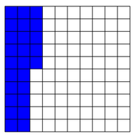

First,
What is a Percent?
We use the symbol % to represent a percent.
The word “percent” really just means “per hundred”.
25% means “25 per hundred” which is $\frac{25}{100}$
Fraction Decimal Percent (%)
$$\frac{25}{100}$$
25%

Slide 5
Percent of a Number
In real life, not all situations are described as 100%
Think about the following situations.

Slide 6
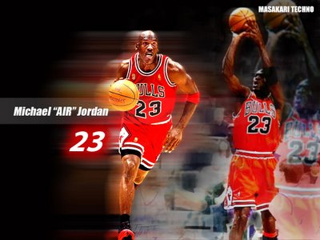
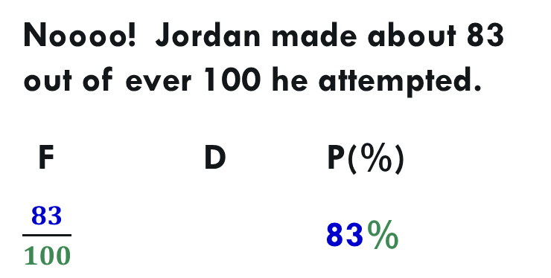
Sports
Michael Jordan was a great free-throw shooter. But, did he make 100% of every free-throw he attempted?
Noooo! Jordan made about 83 out of ever 100 he attempted.
F D P(%)
$\frac{83}{100}$ 83%

Slide 7
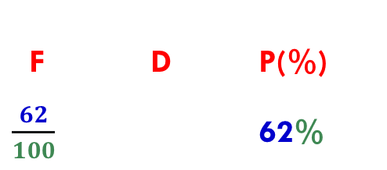
Trivia.
ONLY answer the question asked!
1) What's this guy’s name?
Bret Favre
What sport did he play
and what position?
Football, QB
Did Favre complete
100% of the passes
he threw?
3) What college did he play for?
No!
University of Southern Mississippi
7) Any guess as to about how many out of ever 100 did he complete?
4) What NFL team is he most known for?
Green Bay Packers (16 years)
F D P(%)
$\frac{62}{100}$ 62%
How many super bowl rings does
he have?
1 ring from Super Bowl XXXI

Slide 8
Percent of a Number
As we have seen from the examples, some percents are described as a portion of 100%
Jordan completed 83% of his free-throws.
Favre completed 62% of his passes.

Slide 9
Percent of a Number
Look at this math problem.
A spaceship carrying 40 aliens land on Earth. Of the 40 aliens, 25% have the highly desirable feature of having a third eye.
Before we solve this problem, let me ask you a question.
Do ALL (100%) of the aliens have a third eye?
No, only a portion (25%) of the 40 aliens
have a third eye.

Slide 10
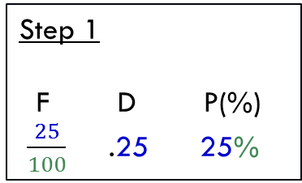
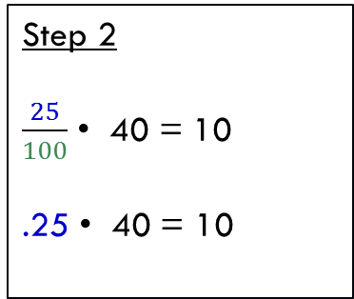
Percent of a Number
A spaceship carrying 40 aliens land on Earth. Of the 40 aliens, 25% have the highly desirable feature of having a third eye.
When asked to find a certain percent of a number
Step 1: You must first change the percent to a decimal or fraction!
Step 2: Then, MULTIPLY that by the number.
Find 25% of 40.
Step 1
F D P(%)
$\frac{25}{100}$ .25 25%
Step 2
$\frac{25}{100}$ • 40 = 10
.25 • 40 = 10

Slide 11
Guided Practice
Step 1: You must first change the percent to a decimal or fraction.
Step 2: Then, MULTIPLY that by the number.
Step 1
F D (%)
Step 2
Answer
1) Find 4% of 200.
2) Roy took a math quiz. There were 92 problems on the quiz and he answered 25% of them correctly. How many problems did he get correct?
3) Find 30% of 50.
Notes:
1) 8 2) 23 3) 15

Slide 12
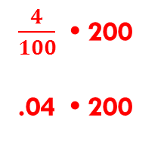
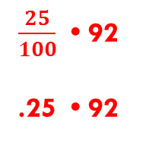
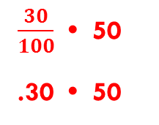
Guided Practice
ANSWER KEY!
Step 1: You must first change the percent to a decimal or fraction.
Step 2: Then, MULTIPLY that by the number.
Step 1
F D (%)
Step 2
Answer
1) Find 4% of 200.
$\frac{4}{100}$ .04 4%
$\frac{4}{100}$ • 200
.04 • 200
8
2) Roy took a math quiz. There were 92 problems on the quiz and he answered 25% of them correctly. How many problems did he get correct?
$\frac{25}{100}$ .25 25%
$\frac{25}{100}$ • 92
.25 • 92
23
$\frac{30}{100}$ .30 30%
$\frac{30}{100}$ • 50
.30 • 50
15
3) Find 30% of 50.
Notes:
1) 8 2) 23 3) 15

Slide 13
You Try
Step 1: You must first change the percent to a decimal or fraction.
Step 2: Then, MULTIPLY that by the number.
Step 1
F D (%)
Step 2
Answer
1) Find 60% of 15.
2) Tori took a math quiz. There were 56 problems on the quiz and she answered 25% of them correctly. How many problems did she get correct?
3) Find 6% of 550.

Slide 14
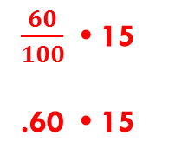
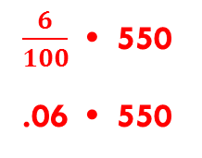
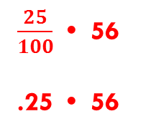
ANSWER KEY!
You Try
Step 1: You must first change the percent to a decimal or fraction.
Step 2: Then, MULTIPLY that by the number.
Step 1
F D (%)
Step 2
Answer
1) Find 60% of 15.
$\frac{60}{100}$ .60 60%
$\frac{60}{100}$ • 15
.60 • 15
9
2) Tori took a math quiz. There were 56 problems on the quiz and she answered 25% of them correctly. How many problems did she get correct?
$\frac{25}{100}$ .25 25%
$\frac{25}{100}$ • 56
.25 • 56
14
$\frac{6}{100}$ .06 6%
$\frac{6}{100}$ • 550
.06 • 550
33
3) Find 6% of 550.

Slide 15
End of PowerPoint

