Slide 1
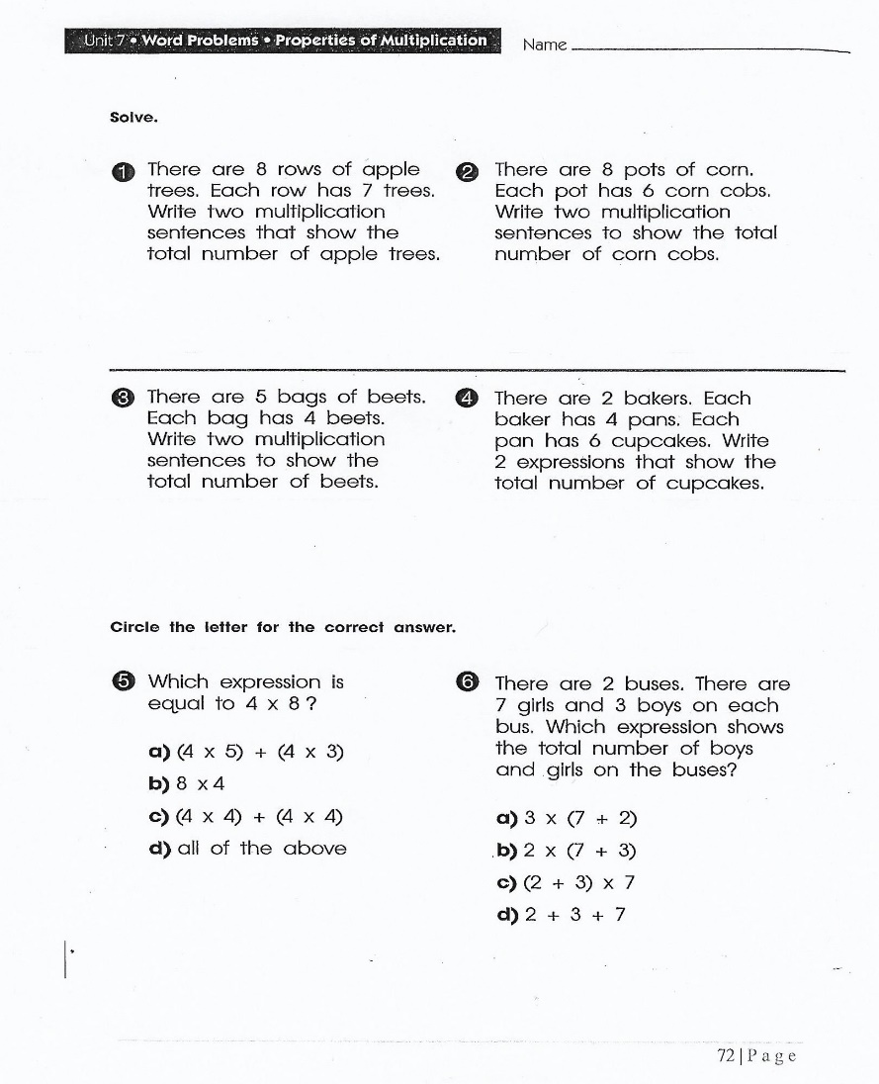
Wednesday, September 18, 2019
Wednesday: Imagine Math – classworks unavailable
Amiyah
Jaiden
Jaylie
Macon
Landon – LLI w/Mrs. Thompson
7:55 – 8:30

Slide 2
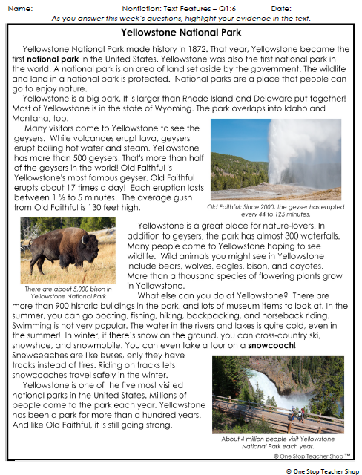
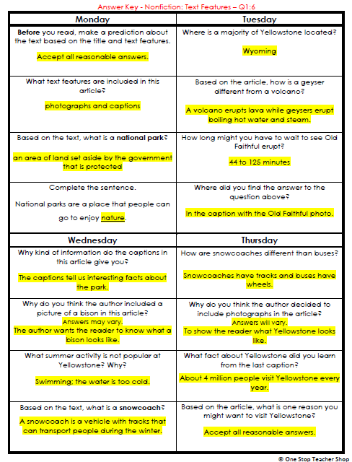
Reading Homework
Snack Time – 10:30

Slide 3
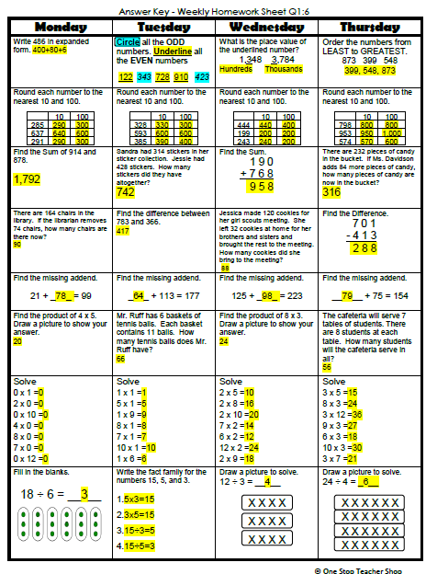
Math Homework

Slide 4

CHOMP TIME
F.A.S.T. Groups
Focused Academic Support Time

Slide 5
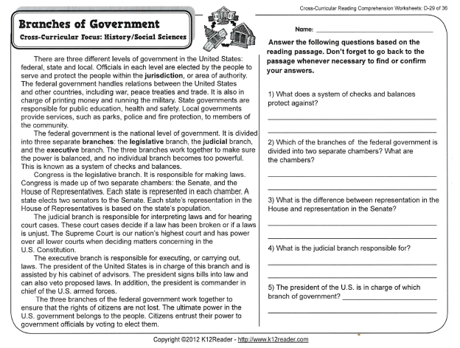
F.A.S.T. Designations
Computers – EPIC – Classworks unavailable: McKenzie - 1 Amiyah - 2 Caydance - 3 Emma - 4 Aiden - 5 Lexi - 6 Katelynn - 7 Kaylee – 8 Jaylie – 9 - | Mrs. Roby: LLI Kaylah Brena Carleen Adalyn | Mrs. Thompson: LLI and/or Dibels-Progress Monitoring Paisleigh Jaiden Macon | Paired Partners Complete passage: Cayli - Jordyn Khamani - Elin Noah – Erin Cohen - Jearon
Landon to Ms. Page for Phonics First
8:40 – 9:10

Slide 6

Restroom Break
9:10 – 9:20

Slide 7

Reading Time
Objective: RL.3.5
I can refer to parts of stories, dramas, and poems when writing or speaking about a text, using terms such as chapter, scene, and stanza; I can also describe how each successive part builds on earlier sections..
9:20 – 9:55
Objective: RL.3.7
I can explain how specific images and illustrations contribute to or clarify a story.
Objective: SL.3.1c
I can ask questions to check understanding of information presented, stay on topic, and link my comments to the remarks of others.

Slide 8
Classroom Leaders Present… ☺

Slide 9
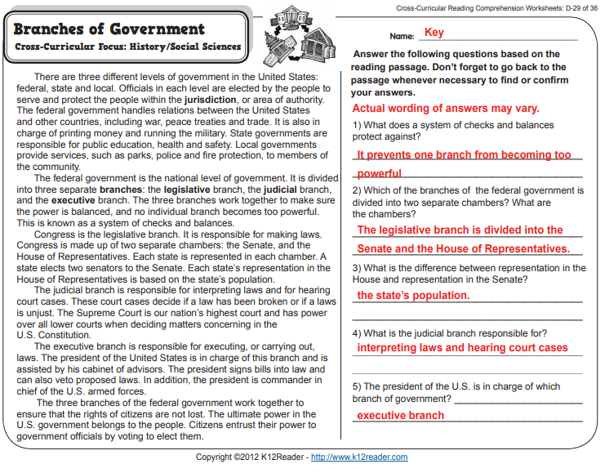

Slide 10

Gather at the Carpet
Are we still the best?

Slide 11

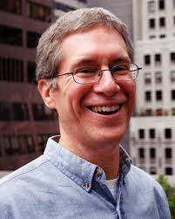
Author & Illustrator: Kevin Henkes
In this story you will meet a young mouse named Lilly who has a new baby brother named Julius.
I will stop during the reading so you and your partner can discuss what you have learned about Lilly.

Slide 12
After page 11
What have you found out about Lilly so far? Turn to your partner

Slide 13
After page 25
What more have you found out about Lilly? Turn to your partner

Slide 14

Classroom Discussion
What is this story about?
Remember that main characters usually have problems to solve.
What is Lilly’s problem in this story? How is her problem solved?

Slide 15

Independent Daily Reading & Teacher Conferences
  Mrs. Roby:
  LLI
  Emma
  Caydance
  Kaylee
  Jordyn
Computers – Epic:
  Jaiden - 1
  Elin -2
  Jearon - 3
  Lexi - 4
  Aiden - 5
  Kaylah - 6
  Katelynn - 7
  McKenzie - 8
  Erin - 9
  Mrs. Thompson:
  SIPPS
  Amiyah
  Landon
  Jaylie
  Macon
  Cohen
  Paisleigh
9:55 – 10:25

Slide 16



Vocabulary & Grammar Time
Snack Time
10:25 – 10:40

Slide 17

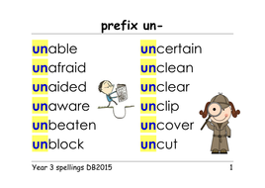
unfortunate – ?
Let’s listen to pages 6 & 7 again.
Unfortunate has the prefix un-
  Un- means not

Slide 18

unfortunate - ?
Let’s listen to page 6 again.
Based on what you heard and what you know about the prefix un-, what do you think unfortunate means?
Did you use your knowledge of the prefix un- to determine that unfortunate means unlucky

Slide 19
What’s the new word we are learning that means “unlucky”?
unfortunate

Slide 20

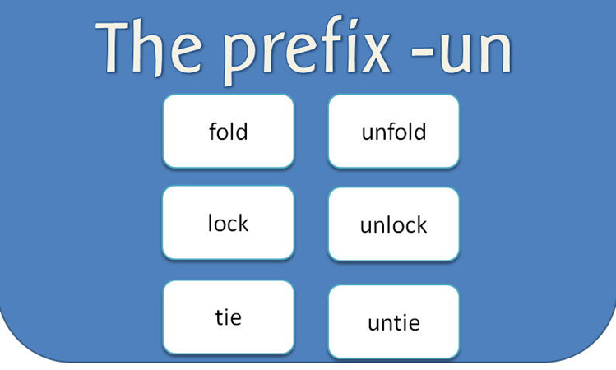
fortunate – ?
Fortunate and unfortunate are antonyms.
If unfortunate means “unlucky,” what do you think fortunate means?
Fortunate means “lucky.”

Slide 21
Unfortunate or Fortunate?
Olive is at the bookstore. When she asks the salesperson for a comic book she wants, he says, “It’s your lucky day. This is our last copy.”
Is Olive unfortunate or fortunate? Why?
– Turn to your Partner
  Olive is unfortunate/fortunate because…

Slide 22
Unfortunate or Fortunate?
Olive is walking on the sidewalk after a rainstorm. A car drives through a puddle and splashes her with rainwater.
Is Olive unfortunate or fortunate? Why?
– Turn to your Partner
  Olive is unfortunate/fortunate because…

Slide 23
Unfortunate or Fortunate?
Olive is eating lunch with her friend Orlando. As she lifts a spoonful of soup to her mouth, Orlando shouts, “Stop! There’s a fly in your soup!”.
Is Olive unfortunate or fortunate? Why?
– Turn to your Partner
  Olive is unfortunate/fortunate because…

Slide 24
What’s the new word we are learning that means “unlucky”?
unfortunate

Slide 25
What’s the new word we are learning that means “lucky”?
fortunate

Slide 26
immense – very large
Immense means the same thing as large, but with this important difference: when something is immense, it is huge or very large.

Slide 27
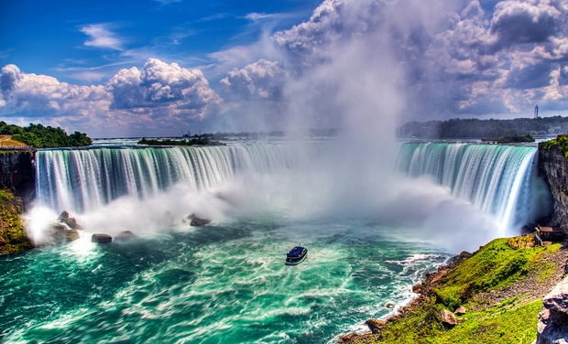
immense
Let me name a few things I have seen that are immense.
Niagara Falls in New York

Slide 28

immense
Atlantic Ocean – East of The United States of America

Slide 29
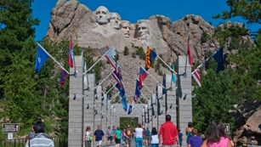
immense
Mount Rushmore in South Dakota

Slide 30
immense
When have you seen something that is immense? Where did you see it? Turn to your Partner
  I saw an immense…

Slide 31
What’s the new word we are learning that means “very large”?
immense

Slide 32
Out of Classroom!
Recess 10:40 – 11:05

Slide 33



Writing Time
Objective: W3.3
I can write narratives to develop real or imagined experiences or events using effective technique, descriptive details, and clear event sequences.
11:05 – 11:35

Slide 34
Gather at the Carpet…
Was it a perfect transition?

Slide 35

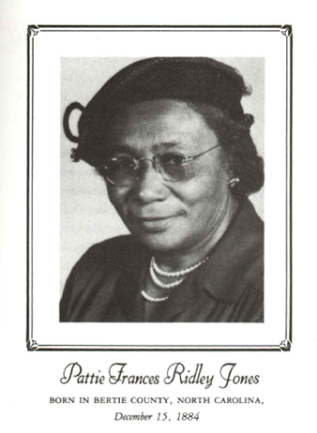
Remember our two previous stories from Childtimes – “Our House” and “Chores”?
Today I will read “John and the Snake” also by Pattie Ridley Jones.
In this personal narrative, she describes one incident from her childhood.
Imagine what is happening while I read.

Slide 36
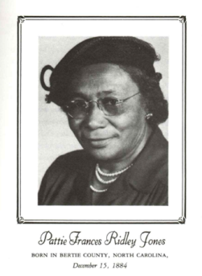
What incident does Pattie Ridley Jones describe in this personal narrative?
What did you see in your mind?
What other senses did you imagine using?
Many personal narratives, like this one, tell us about just one interesting incident from the author’s life.
What is one interesting incident from your life that you could write about? Turn to your Partner

Slide 37
This story – “John and the Snake” is a personal narrative.
A personal narrative can be about just one interesting incident, such as when the author’s brother was bitten by a snake.

Slide 38
Add to Anchor Chart
Notes About Personal Narratives
A personal narrative tells a true story from the author’s own life.
Write about a memory
Sensory details help the reader see, hear, smell, taste, or feel what happens
Write about single, interesting incidents

Slide 39


Writing Time
Writing Journal
Remember:
Write silently
Double-space, or skip every other line
Continue writing until time is up
Write about an interesting incident from your own life.
Work on a personal narrative you started earlier.
Start a new personal narrative about anything from your own life.

Slide 40
Sharing and Reflecting
Who wrote about an interesting incident from their own life? Tell us about it.
What other topics from your own life did you write about? Tell us about them.

Slide 41
Math Fluency & Focus Lesson!
11:35 – 11:55

Slide 42
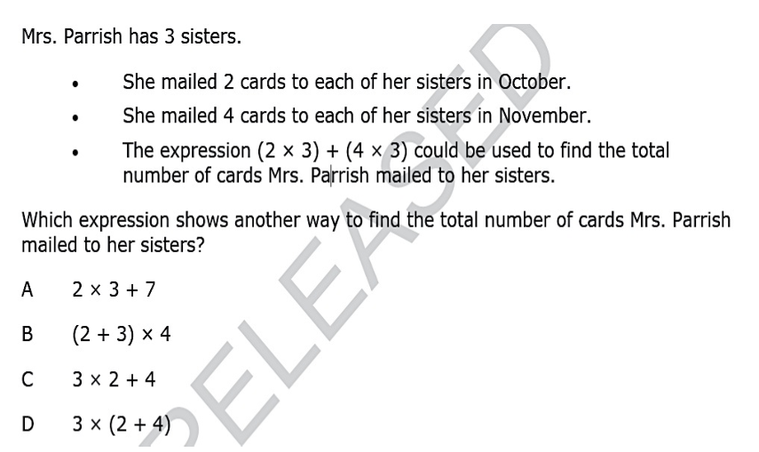

Slide 43
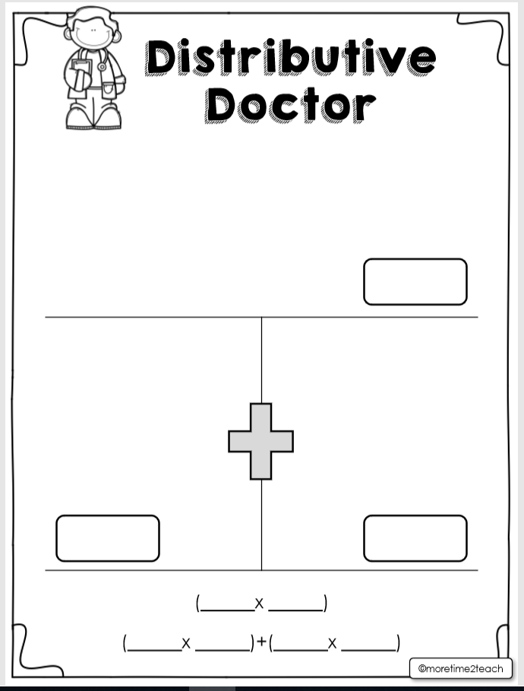

Slide 44
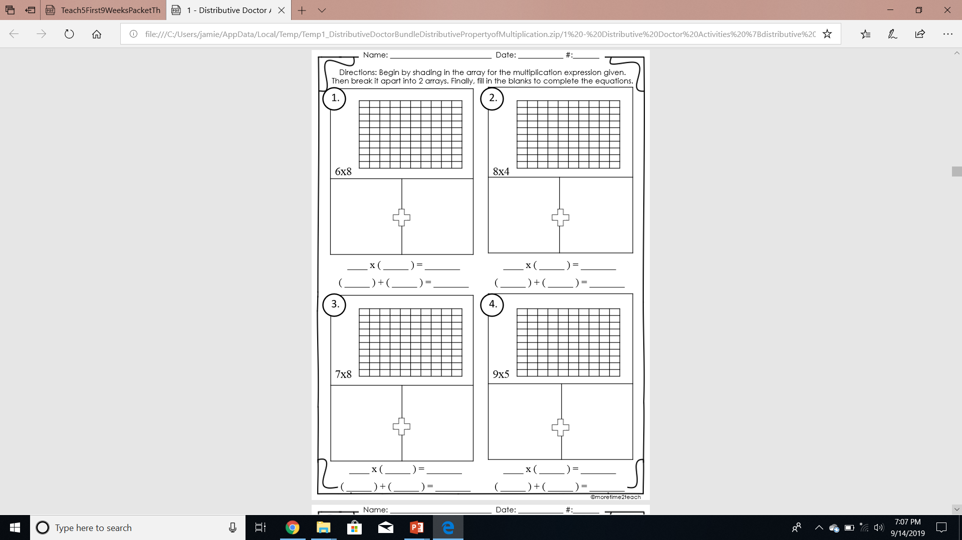
Distributive Doctor Continued!
Guided Practice

Slide 45
Student Leaders! ☺

Slide 46
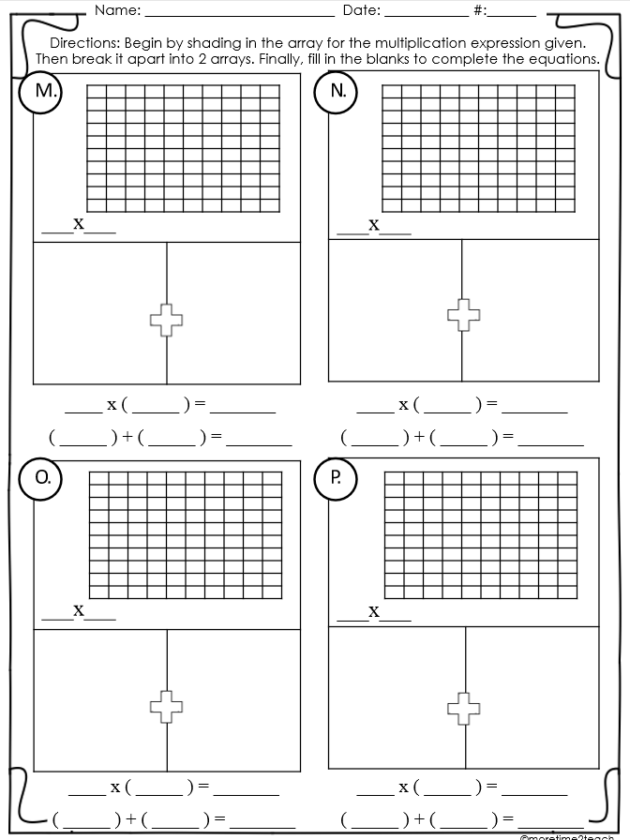
Mrs. Roby’s station

Slide 47
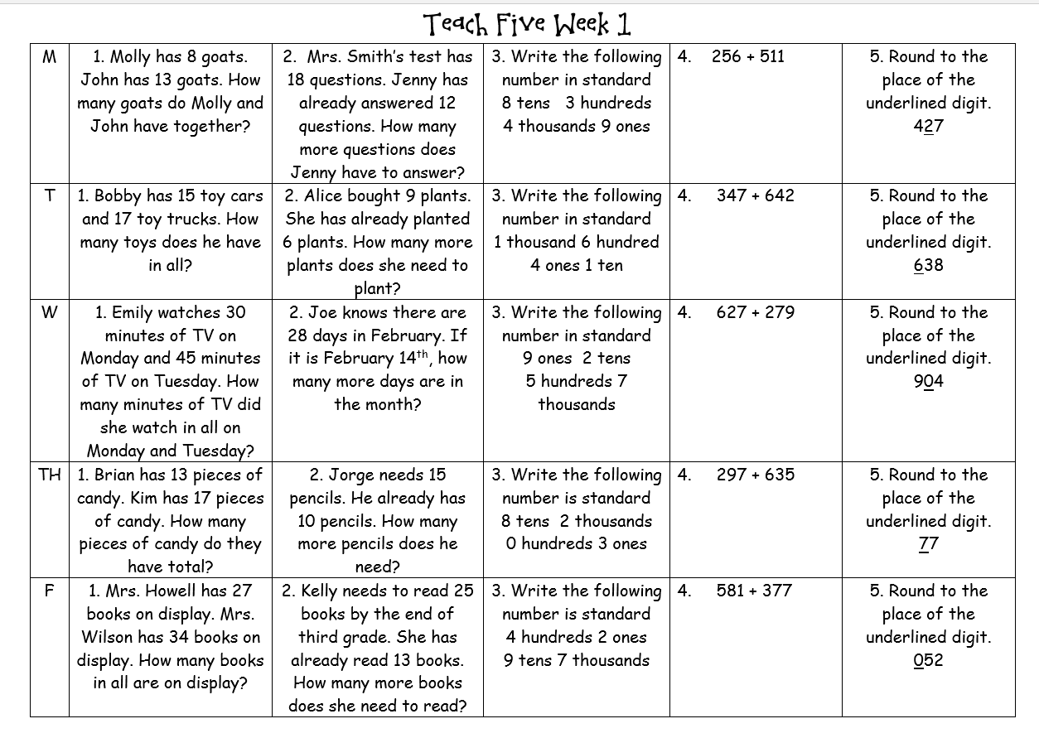
Independent Practice - Wednesday
Complete the problem with your number in your math stash.
Begin working on the other problems until 4 minutes are up.
Take turns becoming the teacher – Number 1 first.
All pencils are down, and eyes are on teacher
Group discusses the problem and the answer is checked
Then number 2 begins, etc.

Slide 48
Small Group Rotations 1 & 2
  Rotation #1 - 11:55 – 12:15
Group 1 – Computers (TC, A, B, C, D): Epic
Group 2 – Mrs. Roby: Math Practice
Group 3 – Computers (E, F, G, H, I): Imagine Math
Group 4 – Mrs. Thompson: Reading Passage
Group 5 – Independent Practice: Teach 5 - Wednesday
  Rotation #2 - 12:15 – 12:35
Group 5 – Computers (TC, A, B, C, D): Epic
Group 1 – Mrs. Roby: Math Practice
Group 2 – Computers (E, F, G, H, I): Imagine Math
Group 3 – Mrs. Thompson: Reading Passage
Group 4 – Independent Practice: Teach 5 - Wednesday

Slide 49

Out of Classroom!
Lunch 12:35 – 1:05

Slide 50
Restroom Break
1:05 – 1:10

Slide 51

Out of Classroom!
Activity 1:10 – 1:55

Slide 52
Small Group Rotations 3 & 4
  Rotation #3 - 1:55 – 2:15
Group 4 – Computers (TC, A, B, C, D): Epic
Group 5 – Mrs. Roby: Math Practice
Group 1 – Computers (E, F, G, H, I): Imagine Math
Group 2 – Mrs. Thompson: Reading Passage
Group 3 – Independent Practice: Teach 5 - Wednesday
  Rotation #4 - 2:15 – 2:35
Group 3 – Computers (TC, A, B, C, D): Epic
Group 4 – Mrs. Roby: Math Practice
Group 5 – Computers (E, F, G, H, I): Imagine Math
Group 1 – Mrs. Thompson: Reading Passage
Group 2 – Independent Practice: Teach 5 - Wednesday

Slide 53
Small Group Rotation 5
  Rotation #5 - 2:35 – 2:55
Group 2 – Computers (TC, A, B, C, D): Epic
Group 3 – Mrs. Roby: Math Practice
Group 4 – Computers (E, F, G, H, I): Imagine Math
Group 5 – Mrs. Thompson: Reading Passage
Group 1 – Independent Practice: Teach 5 - Wednesday

Slide 54
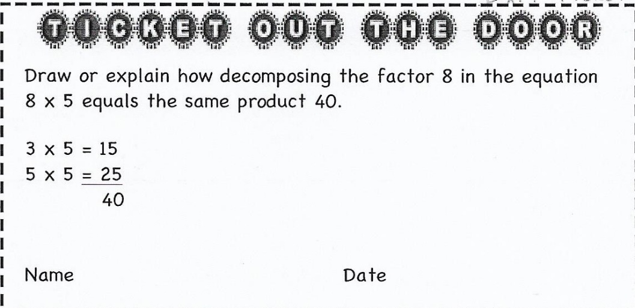

Slide 55
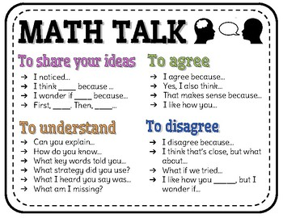
Student Debrief
Compare your answers with your partner’s answers
Who would like to share what they noticed?

Slide 56
Restroom Break
3:10 – 3:15

Slide 57




3:10 – 3:15 Wrap Up!
Pair-Up back to back and share one thing you learned in class today with your partner
Pack-Up
Office will announce:
Car Riders – Leave around 3:20
Bus Riders – (listen to intercom for dismissal)
2:30 – 3:20
How much time has elapsed?

