Slide 1
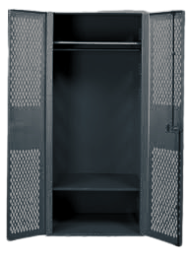
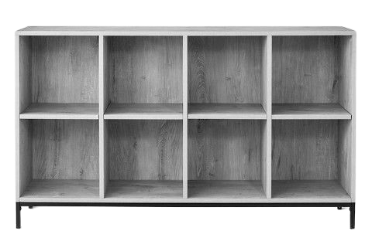
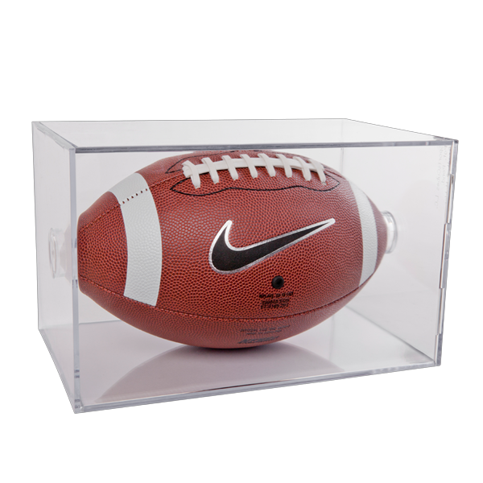
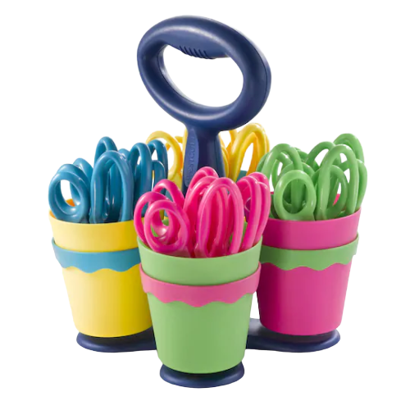
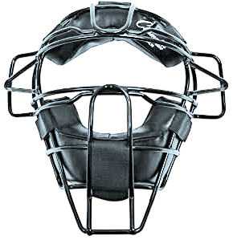
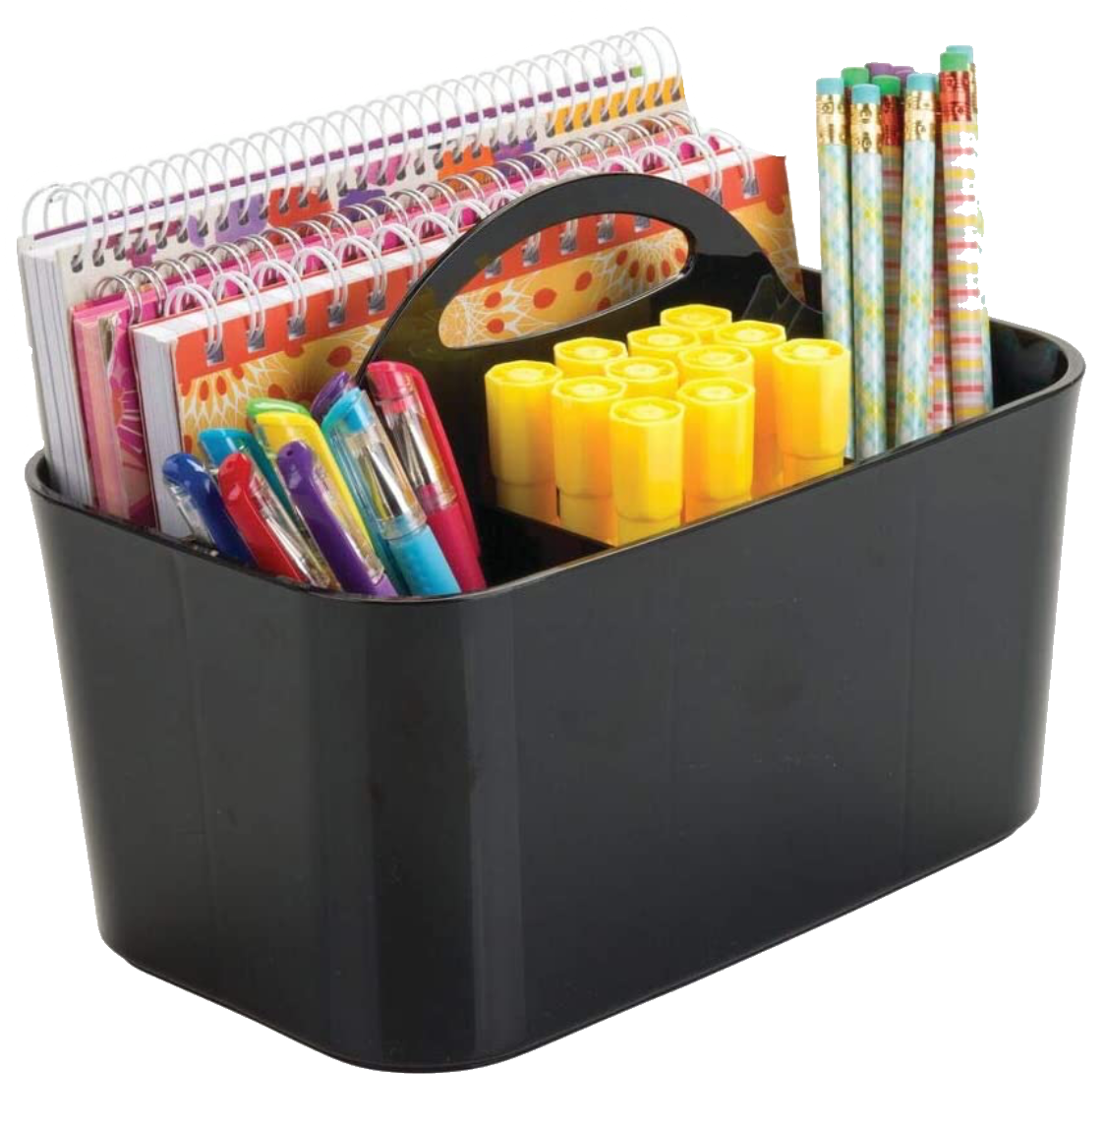
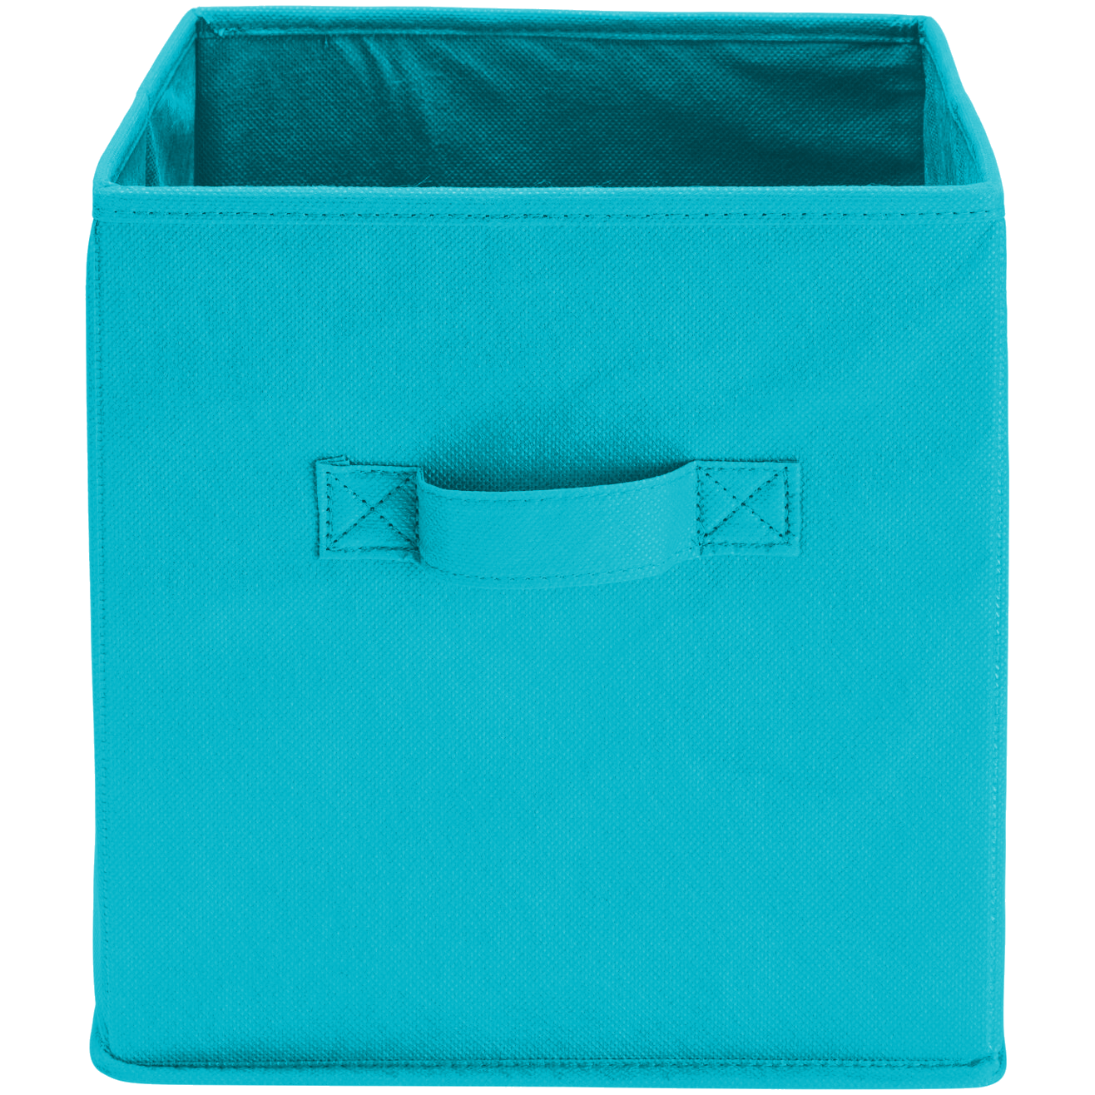
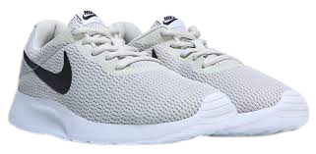
Welcome Back!!
We have missed YOU!!

Slide 2
Grade Level Teachers
Jan Morris (Math/Science)
jan.morris@carrollcountyschools.com
Amanda Skelton (Reading/ELA)
amanda.skelton@carrollcountyschools.com

Slide 3
Schedule
2nd-5th-students will not be rotating, teachers will to minimize contact

Slide 4
Arrival
Students may enter the building at 7am. They will report directly to their homeroom. If they ordered breakfast, it will be given to them in their classroom.
The tardy bell will ring at 7:40.

Slide 5
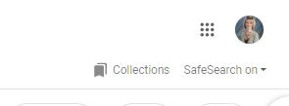
Google Classroom
Accessing Google Classroom is easy!
Go to www.google.com
Choose the waffle in the top, right hand corner and choose Google Classroom
Use the two links below for in-depth instructions and troubleshooting tips.
Video Tutorial
Step by Step Instructions

Slide 6
Class Dojo
Why we use Class Dojo and we need you to join:
It is FREE, and can be used on computers or iOS and Android devices
Receive school and classroom announcements shared in Stories (and see pictures and videos!)
Quickly message your child’s teacher
Track your child’s daily behavior
See work posted in their Portfolio

Slide 7
Safety
It is our goal to provide your child a safe and welcoming learning environment. We are striving to give your child the very best education while making their time at school enjoyable. The changes we have made are for your child’s safety.
Students time in the hallways will be scheduled and limited to reduce contact with large groups.
Hand washing will be intentional and frequent.
Students are spaced out as much as possible.
Grade levels will split up in various locations for Recess to reduce the number of students in a particular area.
Water Fountains will be turned off. Please send a filled water bottle with your child to school daily-label your child’s bottle (water only).
Masks are not mandatory but highly encouraged.

Slide 8
Take Home Folders
Agendas-PK-1st
*daily take-home folders will replace agendas for 2nd grade
*please write or include any correspondence in it-excuses must be written on a piece of paper

Slide 9
Discipline Procedures
For minor incidents, students will receive an MIR (Minor Incident Report).
Parents will be contacted for each MIR.
A parent conference will be held if a child receives a 3rd MIR in a nine weeks period.
If behaviors continue after 3 MIR’s in a nine week period, an office referral will be made.

Slide 10
Breakfast and Lunch
Breakfast and lunch will be eaten in the room to reduce the contact with large groups.
Lunchroom staff/school staff will deliver meals to each classroom.
Breakfast: Lunch
Student $1.35 Student $2.25
Reduced $0.30 Reduced $0.40
Adult $1.75 Adult $3.50
Extra Milk $0.50

Slide 11
Exploratory
PE-non-contact lessons will be taught
No equipment will be used at this time
Music-will be provided in the music room with social distancing in place
Computer Labs-Students will travel as a class to the computer labs with assigned Chromebooks. Class size will be minimized for labs.
STEM-students will travel to the lab and will have assigned seating with social distancing in place.

Slide 12
After-school
After-school is offered five days a week
The cost is $6.00 a day.
Students will have a snack each day.
Students will stay in different locations in the school to social distance as much as possible.

Slide 13
Transportation
Parents will use the QR code in the student packet to find bus numbers
Car rider signs are inside Open House packets
Please let us know your child’s daily mode of transportation before leaving open house. Any changes to their transportation must be made in writing or directly to the front office. We are not allowed to take transportation changes over email or through Class Dojo.

Slide 14
First Day of School
Parents will be allowed to walk their students to their classroom on the first day of school.
Parents need to practice social distancing when entering the building.
Masks are strongly encouraged
There should only be one adult escorting the child/children to eliminate overcrowding.

Slide 15
Needed Supplies
Clorox or Lysol Wipes/spray
Tissue
Paper Towels
Hand Soap
Hand Sanitizer

Slide 16
Nurse Information
Hope Velez,RN is the school nurse
If your child has a medical condition that needs to be discussed, please contact her at (770)832-8588 and press 1 when prompted.
Students are not allowed to have/bring over the counter medications nor prescription medications to school. Medications may be brought in by a parent to the clinic.

Slide 17
You’re off to great places! Today is your day! Your mountain is waiting so get on your way.
-Dr. Seuss

