Slide 1
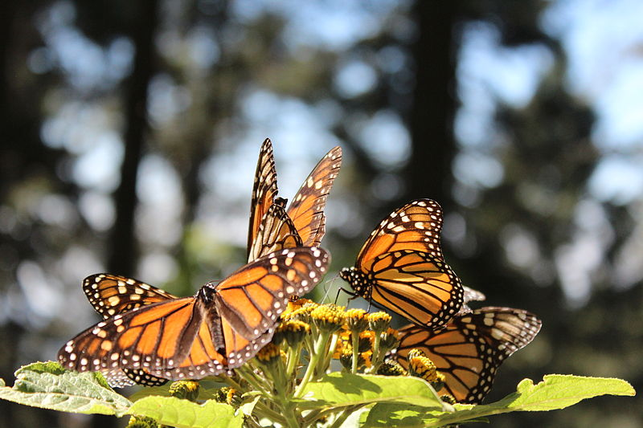
Lesson 6.NS.9 (ALT 3) Adding and Subtracting Integers with Double Signs

Slide 2
We have been learning how to Add and Subtract Integers using:
Number Lines
Rules

Slide 3
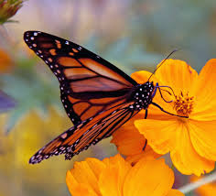
Why Learn?
Well, let’s take a look at how a hike and a little “butterfly watching” ties this skill to the real world!

Slide 4
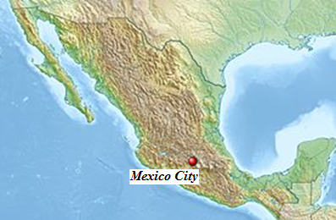
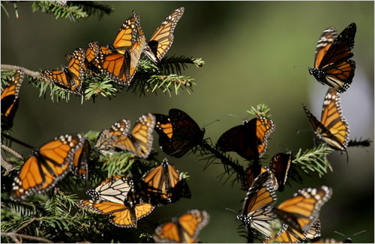
Butterfly watching …
(also called butterflying) is a hobby concerned with the observation and study of butterflies!
If you are in to butterflying, then you must add The Monarch Butterfly Biosphere Reserve to your bucket list of must-do’s.
Every year hundreds of millions of butterflies undertake a great journey of up to 3,000 miles in their annual migration from Canada and the United States to a protected reserve located just outside of Mexico City, Mexico.
The reserve is a 200 square mile protected area which serves as a winter home for up to 60 million to a billion butterflies!

Slide 5
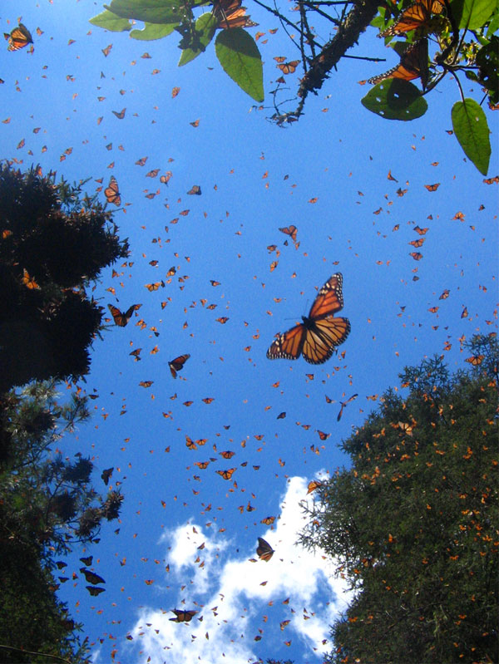
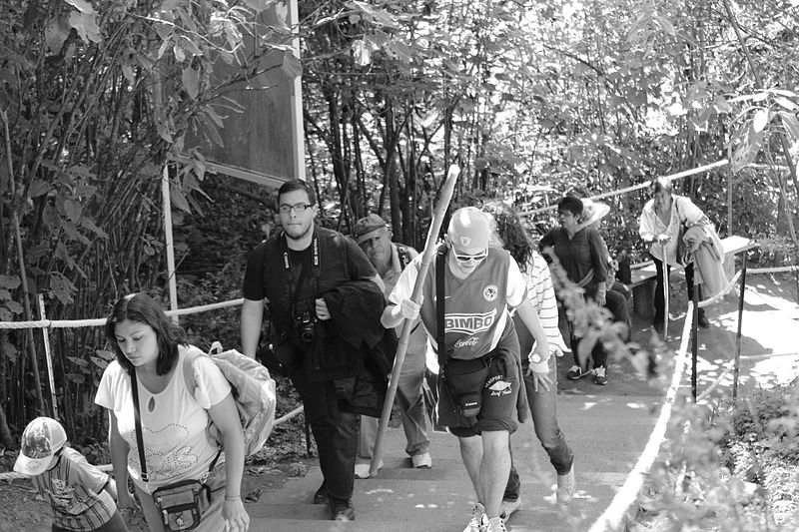
Serious butterfly watchers should be prepared to hike anywhere from 20 minutes to over an hour (or to ride a donkey).
You can only reach the butterflies on paths laid by the reserve, and they congregate at extremely high altitudes — between 9,000 and 11,000 feet — so visitors should be in good enough physical condition to handle steep inclines.

Slide 6
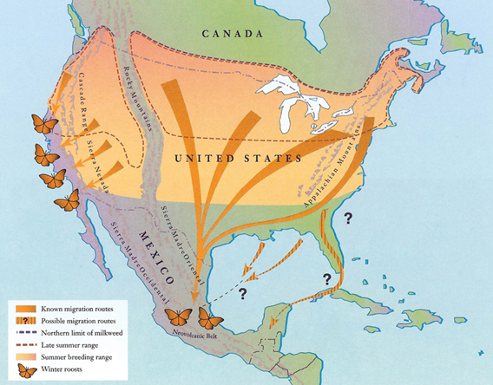
¡hola
Meet Henry the hiker!
Henry loves backpacking and has always wanted
to hike the mountainous terrain of Mexico to see
the annual migration of the monarch butterflies.
Notes:
“hola” translates to “Hi” in Spanish.

Slide 7
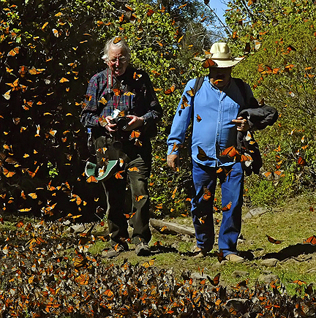
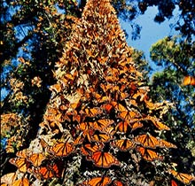
MAP
Real World Application
Henry and his best friend start their
hike at an elevation of 8,500 feet.
They ascend 375 feet, then stop and take pictures of a cluster of butterflies on a tree. They hike another 1,000 feet on the same path where they next stumble upon a field of thousands of butterflies in flight. After enjoying the view for awhile, Henry and his friend decide that they would like to tour the butterfly museum and gift shop. They turn the opposite direction, and descend 1,700 feet to the museum.
Write an expression that would determine the elevation of the butterfly museum.
8,500 + 375 + 1000 – 1700
Field of Butterflies in flight
Start Hike
8,500 ft
Cluster of Butterflies on tree

Slide 8
Let’s Practice our Rules…
Same Signs…
ADD the numbers.
KEEP the sign.
$$−6 −4=$$
$$12 + 3=$$
Stack-up the numbers and Circle the signs.
Different Signs…
SUBTRACT the numbers.
Give sign of the bigger digit.
$$−8+10=$$
$$5 −15 =$$
Notes:
Model for students to see.

Slide 9
Let’s Practice These…
We also justified that our rules work by using number lines.
$$−6 −4=$$
Same Signs = Same Direction
$$−8+10=$$
Different Signs = Different Directions
Notes:
Model for students to see.

Slide 10
Today, we are going to continue adding and subtracting integers, but our problems will be a little more complex.

Slide 11
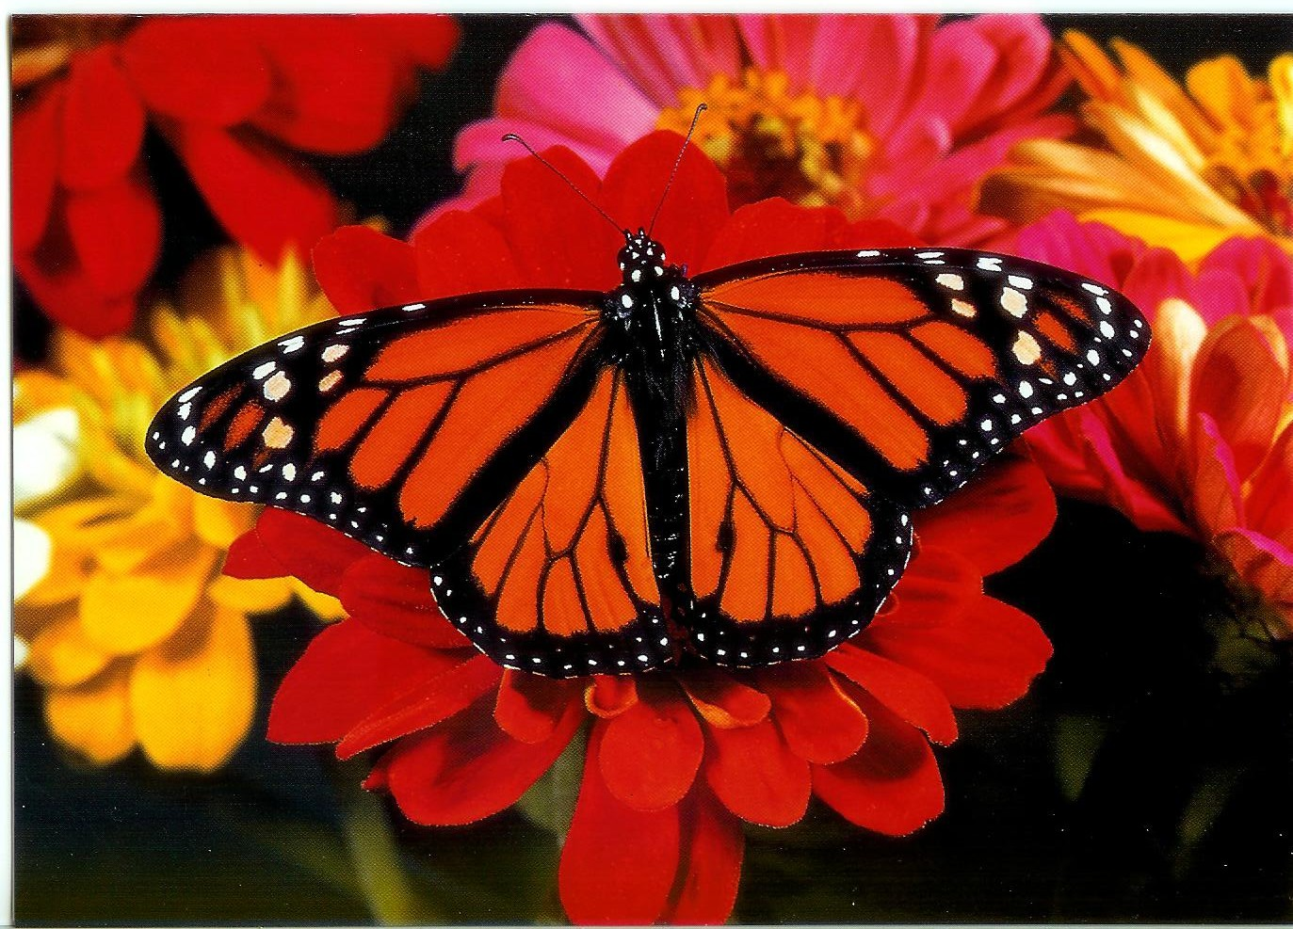
Let’s Get Started with Today’s Skill…
Section 1: What are Double Signs?
Section 2: Modeling on a Number Line when
Double Signs are involved
Section 3: Using Integer Rules when
Double Signs are involved

Slide 12
What are DOUBLE SIGNS?
Which problems below do you think have double signs?
Select all that apply.
A. $8 − 12$
B. $10 + (−13)$
C. $−4 − 3$
D. $−7 – (−5)$
E. $−(−9) + 16$
Notes:
Answer: B, D, E

Slide 13
If you are asked to work a problem that has double signs…
You will need to turn the doubles signs to just one sign.
Let’s see how to turn two signs into just one sign…
Notes:
Answer: B, D, E

Slide 14
DOUBLE Negatives -(-)

Slide 15
Negative and Positive $+(−)$ or $−(+)$
Any combination of a negative and a positive can be turned into a negative.
Examples
Notes:
This skill was learned in 6th grade.

Slide 16
Moving On…
Section 1: What are Double Signs?
Section 2: Modeling on a Number Line when
Double Signs are involved
Section 3: Using Integer Rules when
Double Signs are involved

Slide 17
Steps When using a Number Line
$Model on a Number Line:$ ̶ 9 + ( ̶ 2) =
SAME SIGNS = SAME DIRECTION
Step 1: Get rid of any double signs.
$−(−) = +$
$+(−) = −$
Step 2: Model as normal.
̶ 9
̶ 22
$$−11$$
̶ 9 ̶ 2 =
Notes:
Chick once to start animation.

Slide 18
Guided Practice
$Model on a Number Line:$
̶ ($−$7) ̶ 2 =
Get rid of any double signs.
$−(−) = +$
$+(−) = −$
Model as normal.
Same signs = Same direction
Different signs = Different Directions
Notes:
Teacher should model.
-(-7) – 2 =
7 – 2 = 5

Slide 19
You Try!
–(– 9) + 3
12 + (–17)
Solve using modeling.
Remember, you need to get rid of the double signs first.
Notes:
Guided Practice 12 You Try -5

Slide 20
Moving On…
Section 1: What are Double Signs?
Section 2: Modeling on a Number Line when
Double Signs are involved
Section 3: Using Integer Rules when
Double Signs are involved

Slide 21
Steps for Adding or Subtracting Integers Using Rules
( Example 1 )
$$Solve: −12−(−14) =$$
Same Signs…
ADD the numbers.
KEEP the sign.
Get rid of any double signs.
$−(−) = +$
$+(−) = −$
Stack-up and
Circle the signs.
Different Signs…
SUBTRACT the numbers.
Give sign of the bigger digit.
̶ 12 + 14
̶ 12
+ 14
Different Signs:
$2$
SUBTRACT the numbers.
Give sign of the bigger digit.

Slide 22
Steps for Adding or Subtracting Integers using Rules
( Example 2 )
$$Solve: −\left(−9\right)+9=$$
Same Signs…
ADD the numbers.
KEEP the sign.
Get rid of any double signs.
$−(−) = +$
$+(−) = −$
Stack-up and
Circle the signs.
Different Signs…
SUBTRACT the numbers.
Give sign of the bigger digit.
$$9 + 9$$
9
+ 9
Same Signs:
$18$
ADD the numbers.
KEEP the sign.

Slide 23
Steps for Adding or Subtracting Integers using rules
( Example 3 )
$$Solve: 14+(−20)=$$
Same Signs…
ADD the numbers.
KEEP the sign.
Get rid of any double signs.
$−(−) = +$
$+(−) = −$
Stack-up and
Circle the signs.
Different Signs…
SUBTRACT the numbers.
Give sign of the bigger digit.
$$14−20$$
14
̶ 20
Different Signs:
$−6$
SUBTRACT the numbers.
Give sign of the bigger digit.

Slide 24
Steps for Adding or Subtracting Integers using rules
( Example 4 )
$$Solve: −7+(−5) =$$
Same Signs…
ADD the numbers.
KEEP the sign.
Get rid of any double signs.
$−(−) = +$
$+(−) = −$
Stack-up and
Circle the signs.
Different Signs…
SUBTRACT the numbers.
Give sign of the bigger digit.
$$̶ 7 − 5$$
̶ 7
̶ 5
Same Signs:
$−2$
ADD the numbers.
KEEP the sign.

Slide 25
LET’S PRACTICE
SOME MORE
GET YOUR
PENCILS READY!
Notes:
1) 126 2) -70

Slide 26
Same Signs
Add the digits and
Keep the sign.
Different Signs
Subtract the digits and
give sign of the bigger digit.
Guide Practice #1
You Try #1
– 6 – (– 12)
2 – (– 3)
Notes:
Guided Practice 6 You Try 5

Slide 27
Same Signs
Add the digits and
Keep the sign.
Different Signs
Subtract the digits and
give sign of the bigger digit.
Guide Practice #2
You Try #2
– 12 + (– 10)
15 + (– 21)
Notes:
Guided Practice -22 You Try -6

Slide 28
Same Signs
Add the digits and
Keep the sign.
Different Signs
Subtract the digits and
give sign of the bigger digit.
Guide Practice #3
You Try #3
– (– 14) – 7
– (– 80) – 100
Notes:
Guided Practice 7 You Try -20

Slide 29
Same Signs
Add the digits and
Keep the sign.
Different Signs
Subtract the digits and
give sign of the bigger digit.
Guide Practice #4
You Try #4
25 + (–10)
– 8 + (–16)
Notes:
Guided Practice 15 You Try -24

Slide 30
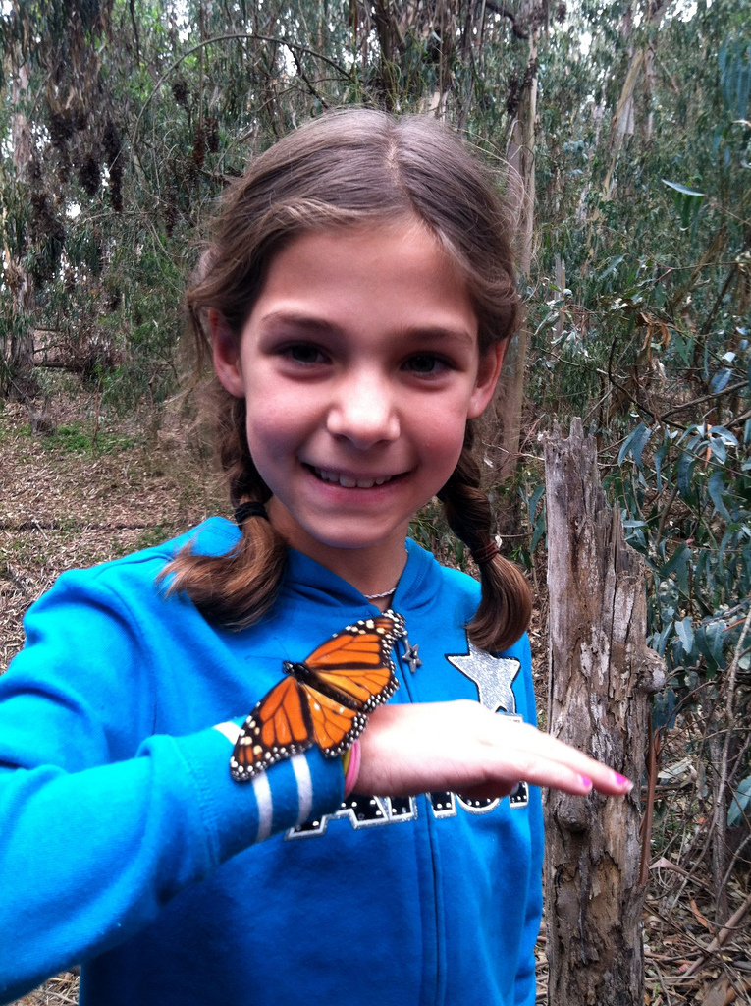
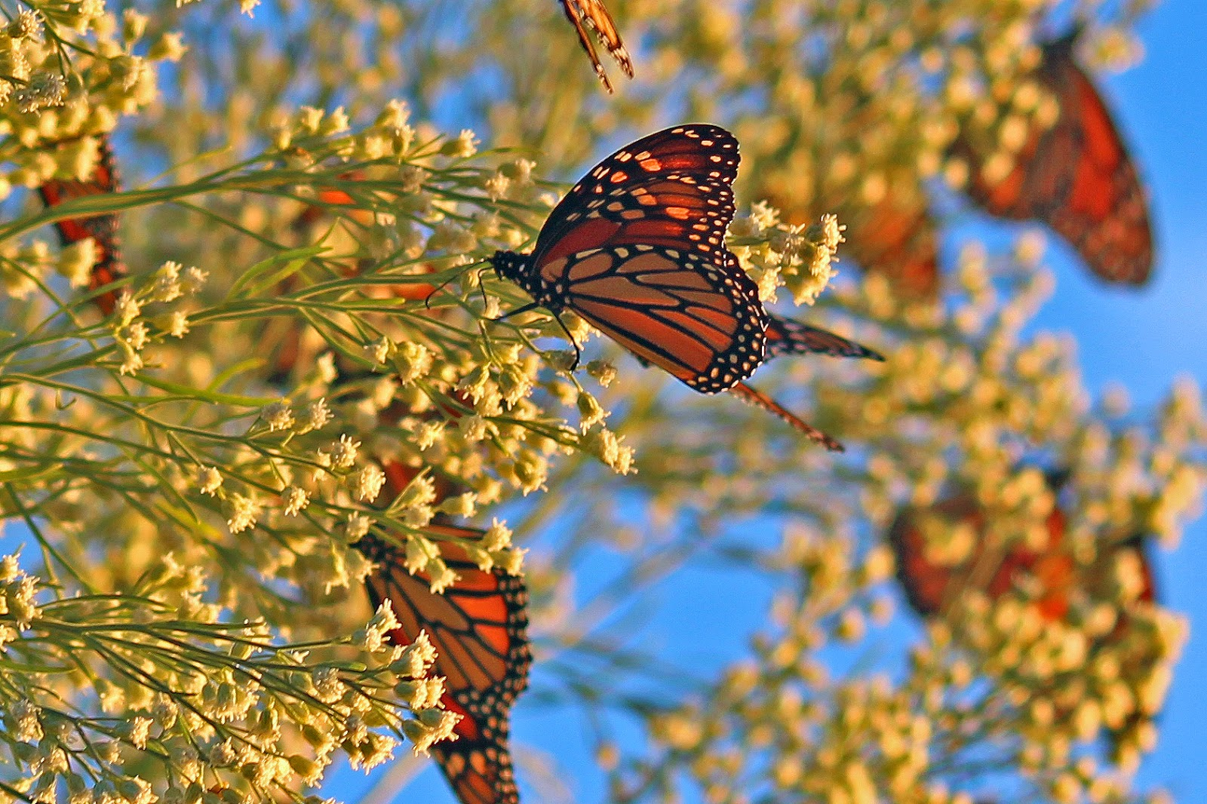
End of PowerPoint

