Slide 1
Fraction Number Lines
Lesson 9-5

Slide 2
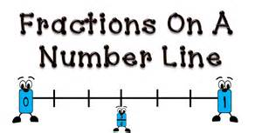
Objective
I can identify fractional parts and mixed numbers on a number line.

Slide 3
Vocabulary

Slide 4
You already know how to write whole numbers on a number line. Today we are going to learn how to write fractions on a number line.
We already know how to write number lines. On your whiteboard - can you show what a number line looks like?

Slide 5
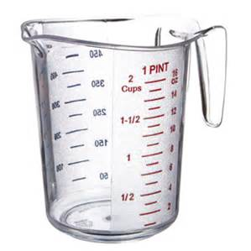
When have you or someone in your family used a cup like this?
Where do you see a number line on this cup?

Slide 6
Pose the Problem
Take one strip of paper. This strip is 1 whole unit. What numbers can you write at the ends of the strip to show this?
0 and 1
Fold one of your strips in half once. Fold the other strip in half twice. Open the strips. Write fractions for the fold lines. Record your work on your recording sheet.

Slide 7
Small Steps
Which number line on your recording sheet can you use to show the work you did with your paper strip?
Line A
Why?
There are 3 evenly spaced numbers on the paper strip, and the first number line has 3 evenly spaced marks.
Label the marks on the number line to match your paper strip.

Slide 8
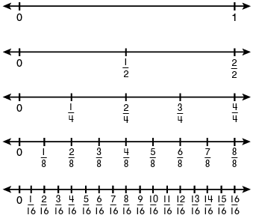
Fraction Number Line

Slide 9
Fill in the missing fractions in the number line.

Slide 10
Fill in the missing fractions in the number line.

Slide 11
Fill in the missing fractions in the number line.

Slide 12
Fill in the missing fractions in the number line.

Slide 13
Fill in the Missing Numbers

Slide 14
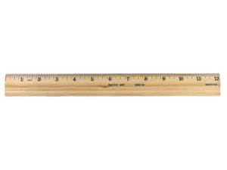
Fractions and Length
Lesson 9-7

Slide 15
Objective
I can use the model, symbol, and words used to describe a fractional part of the length of an object.

Slide 16
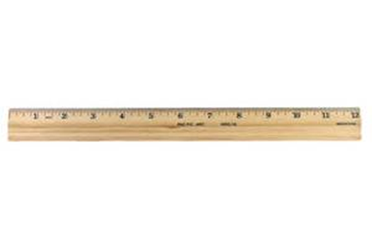
You already know how to write a fraction to describe part of a whole and part of a set. Today you are going to learn how to write a fraction to describe part of a length.

Slide 17
Connect
Suppose that I asked you to find the length of a ribbon. What information would I be asking you to find?
How long the ribbon is.

Slide 18
Teaching Tool 22
Find the fraction strip that has ¼ in one of the parts.
Label the other parts of the strip.
Then color 3 parts of the strip.
Write a fraction next to it to tell what part of the length of the strip you colored.

Slide 19
What fraction of the length of the 1 strip do the other strips show?
1
6
1
6
1
6
1
6

Slide 20
What fraction of the length of the 1 strip do the other strips show?
1
8
1
8
1
8
1
8
1
8

Slide 21
What fraction of each length is black?

Slide 22
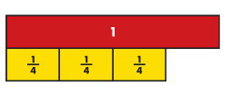
Write the unit fraction that represents each part of the length:
3
4

Slide 23
Write the unit fraction that represents each part of the length:
5
6

