Slide 1
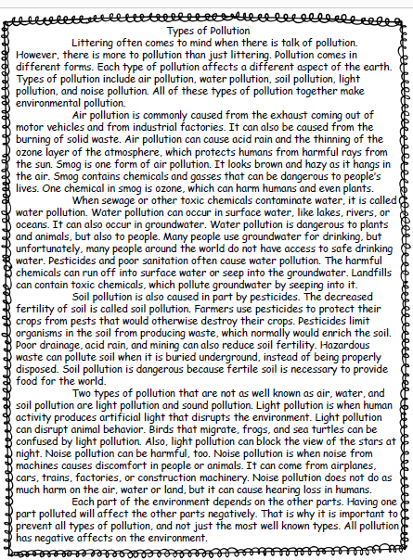
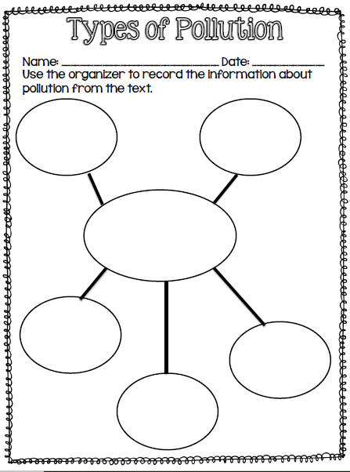
Tuesday, December 10, 2019
7:55 – 8:30

Slide 2
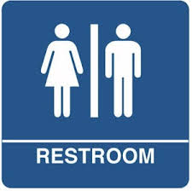
Restroom Break
8:30 – 8:40

Slide 3
NWEA TEST - READING
8:40 – 11:00

Slide 4
Restroom Break
11:00 – 11:10

Slide 5
Indoor Recess!
Recess 11:10 – 11:45

Slide 6
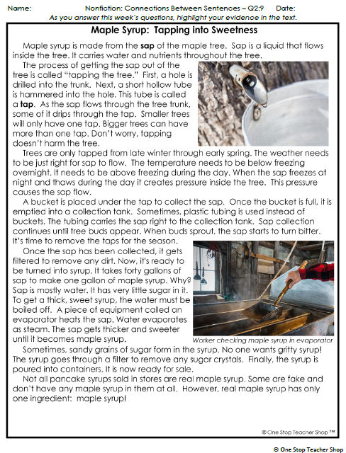
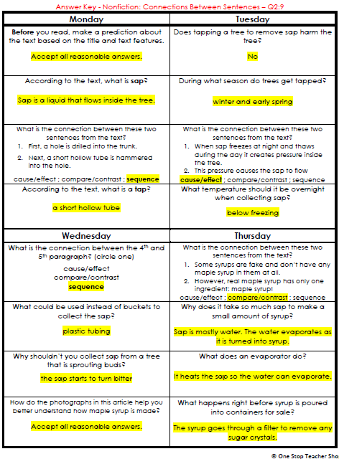
Reading Homework

Slide 7
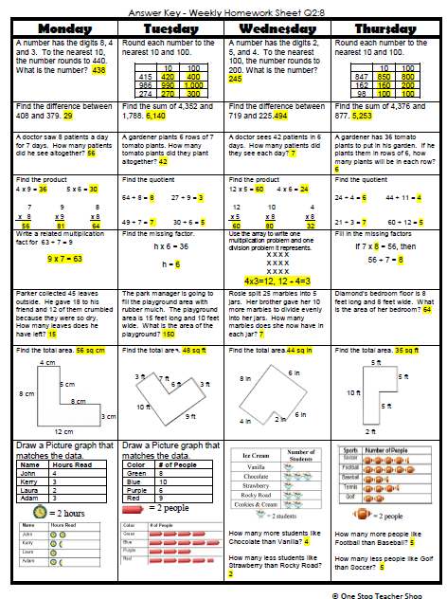
Math Homework

Slide 8

Reading Time
Objective: RL.3.3 Describe characters in a story and explain how their actions contribute to the sequence of events.
Objective: RL.3.5 Refer to parts of stories and poems when writing or speaking about a text, using terms such as chapter, scene, and stanza; describe how each successive part builds on earlier sections.
Objective: RL.3.7 Use information gained from illustrations, other visual elements, and the words in a text to demonstrate understanding of the text.
11:55 – 12:35

Slide 9
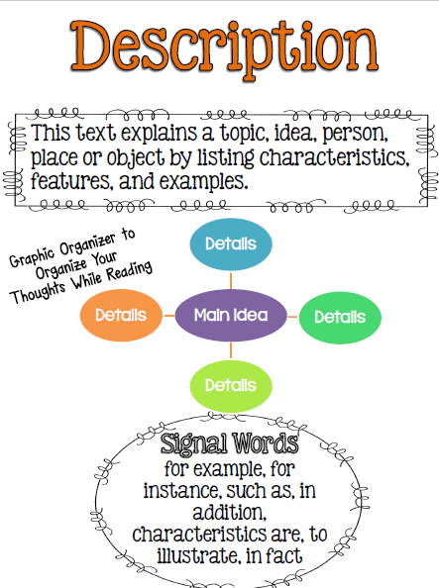
Review
Focal Text Structure

Slide 10
How does the author use description to help the reader understand about types of pollution?

Slide 12
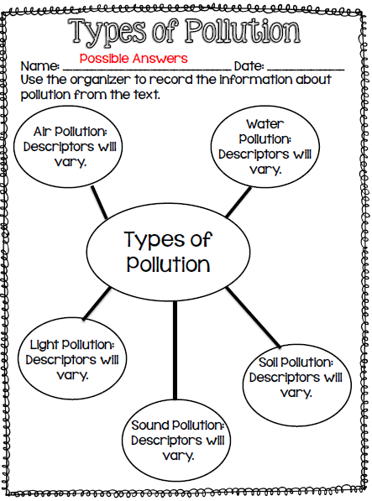

Slide 13
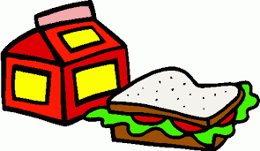
Out of Classroom!
Lunch 12:35 – 1:05

Slide 14
Restroom Break
1:05 – 1:10

Slide 15

Out of Classroom!
Activity 1:10 – 1:55

Slide 16
Reading Time
Objective: RL.3.3 Describe characters in a story and explain how their actions contribute to the sequence of events.
Objective: RL.3.5 Refer to parts of stories and poems when writing or speaking about a text, using terms such as chapter, scene, and stanza; describe how each successive part builds on earlier sections.
Objective: RL.3.7 Use information gained from illustrations, other visual elements, and the words in a text to demonstrate understanding of the text.
1:55 – 2:30

Slide 17

Gather at the Carpet
Are we still the best?

Slide 18
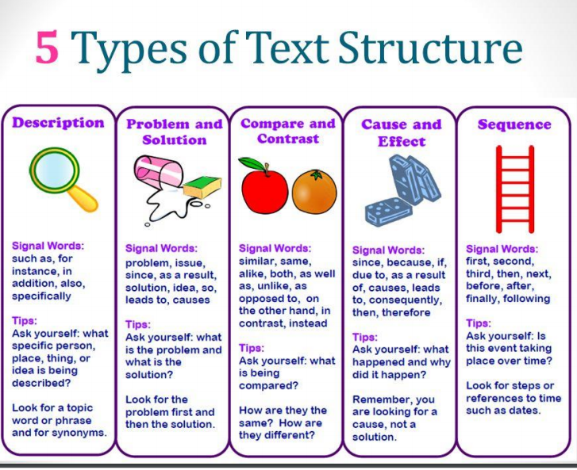

Slide 19
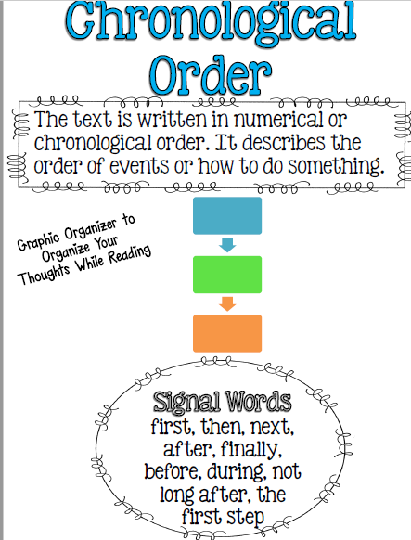
Focal Text Structure

Slide 20
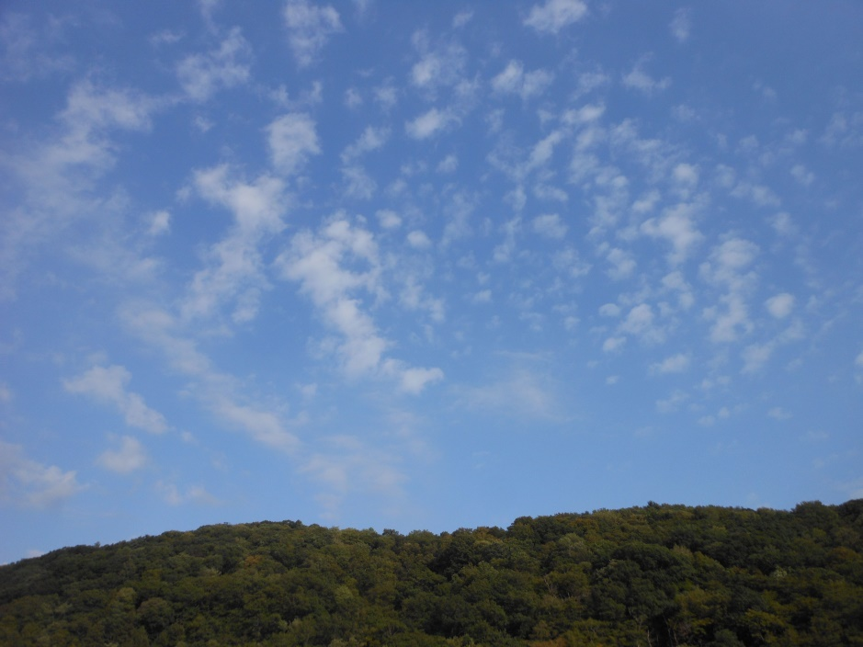
What is chronological order?
Introducing the text structure

Slide 21
Is this paragraph in the right order?
A monarch butterfly sips nectar from a flower. They molt, or shed their skin, four times. Soon it will lay eggs. Then they form a chrysalis to become a pupa. The eggs will hatch. The caterpillars eat milkweed. After a few weeks, the adult butterfly comes out of the chrysalis and flies away.

Slide 22
There are definitely some problems!
A monarch butterfly sips nectar from a flower. They molt, or shed their skin, four times. Soon it will lay eggs. Then they form a chrysalis to become a pupa. The eggs will hatch. The caterpillars eat milkweed. After a few weeks, the adult butterfly comes out of the chrysalis and flies away.

Slide 23
Let’s put it in the proper order
A monarch butterfly sips nectar from a flower. They molt, or shed their skin, four times. Soon it will lay eggs. Then they form a chrysalis to become a pupa. The eggs will hatch. The caterpillars eat milkweed. After a few weeks, the adult butterfly comes out of the chrysalis and flies away.

Slide 24
Let’s put it in the proper order
A monarch butterfly sips nectar from a flower. Soon it will lay eggs. The eggs will hatch. The caterpillars eat milkweed. They molt, or shed their skin, four times. Then they form a chrysalis to become a pupa. After a few weeks, the adult butterfly comes out of the chrysalis and flies away.

Slide 25
This is a chronological order paragraph
A monarch butterfly sips nectar from a flower. Soon it will lay eggs. The eggs will hatch. The caterpillars eat milkweed. They molt, or shed their skin, four times. Then they form a chrysalis to become a pupa. After a few weeks, the adult butterfly comes out of the chrysalis and flies away.

Slide 26
What do you think chronological order means?
A monarch butterfly sips nectar from a flower. Soon it will lay eggs. The eggs will hatch. The caterpillars eat milkweed. They molt, or shed their skin, four times. Then they form a chrysalis to become a pupa. After a few weeks, the adult butterfly comes out of the chrysalis and flies away.

Slide 27
What do you think chronological order means?
A monarch butterfly sips nectar from a flower. Soon it will lay eggs. The eggs will hatch. The caterpillars eat milkweed. They molt, or shed their skin, four times. Then they form a chrysalis to become a pupa. After a few weeks, the adult butterfly comes out of the chrysalis and flies away.

Slide 28
Chronological order = Time order
A monarch butterfly sips nectar from a flower. Soon it will lay eggs. The eggs will hatch. The caterpillars eat milkweed. They molt, or shed their skin, four times. Then they form a chrysalis to become a pupa. After a few weeks, the adult butterfly comes out of the chrysalis and flies away.

Slide 29
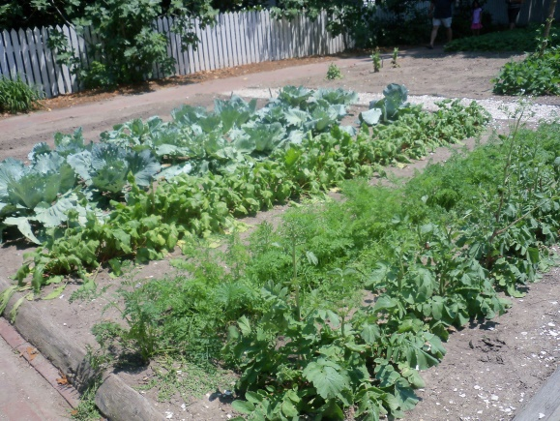
Can you find the chronological order words in this paragraph?
Growing a garden can be fun. First, find a sunny spot and prepare the soil. Then, plant your seeds. Make sure that you read the directions to plant them at the correct time! As the plants grow, water them each day. Soon you will have plenty of vegetables!

Slide 30
Can you find the chronological order words in this paragraph?
Growing a garden can be fun. First, find a sunny spot and prepare the soil. Then, plant your seeds. Make sure that you read the directions to plant them at the correct time! As the plants grow, water them each day. Soon you will have plenty of vegetables!

Slide 31
Why does this paragraph have to be in chronological order?
Growing a garden can be fun. First, find a sunny spot and prepare the soil. Then, plant your seeds. Make sure that you read the directions to plant them at the correct time! As the plants grow, water them each day. Soon you will have plenty of vegetables!

Slide 32
Chronological Order Words
When you see these words, you are probably reading a chronological order text
Next
Later
First
Finally
After
Before
Soon
Dates

Slide 33
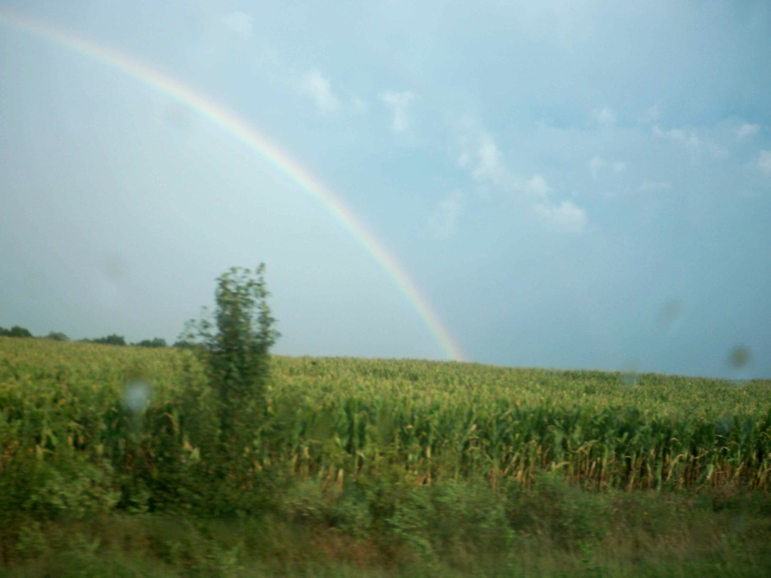
Kinds of chronological order texts
What kinds of topics do you think are good for chronological order? Make a list of at least 3.

Slide 34
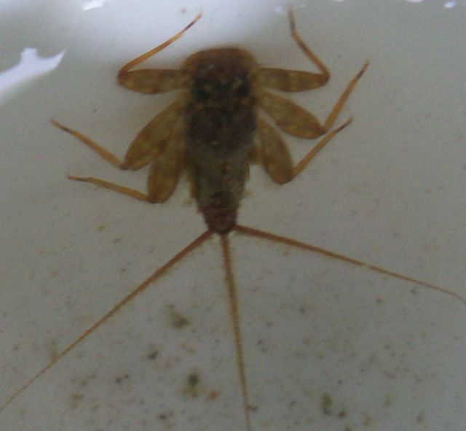
Kinds of chronological order texts
Animal Life Cycles
These texts often tell about the life of an animal
Why do you think these texts are arranged in chronological order?
Notes:
Photo: Mayfly larva

Slide 35

Kinds of chronological order texts
Biographies
These texts tell about a person’s life
Have you ever read a biography?
Notes:
Photo: Dolley Madison

Slide 36
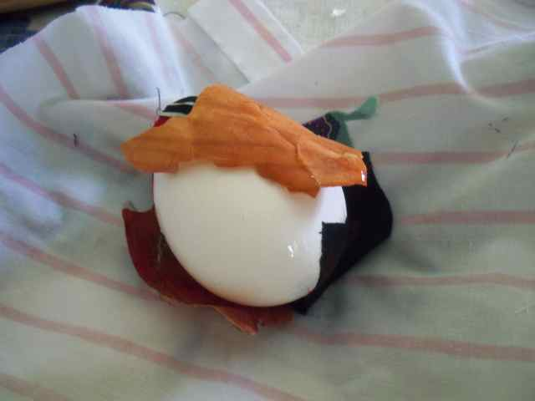
Kinds of chronological order texts
Procedural text
These texts give directions for how to do something
Have you ever read a procedural text? Why do you think they’re written in chronological order?
Notes:
Photo: Dolley Madison

Slide 37
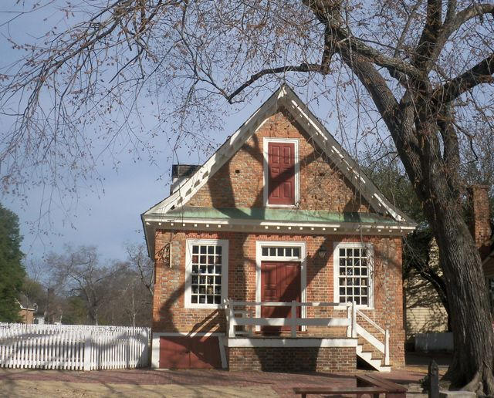
Kinds of chronological order texts
Historical text
These texts explain historical processes or events
Notes:
Photo: Dolley Madison

Slide 38
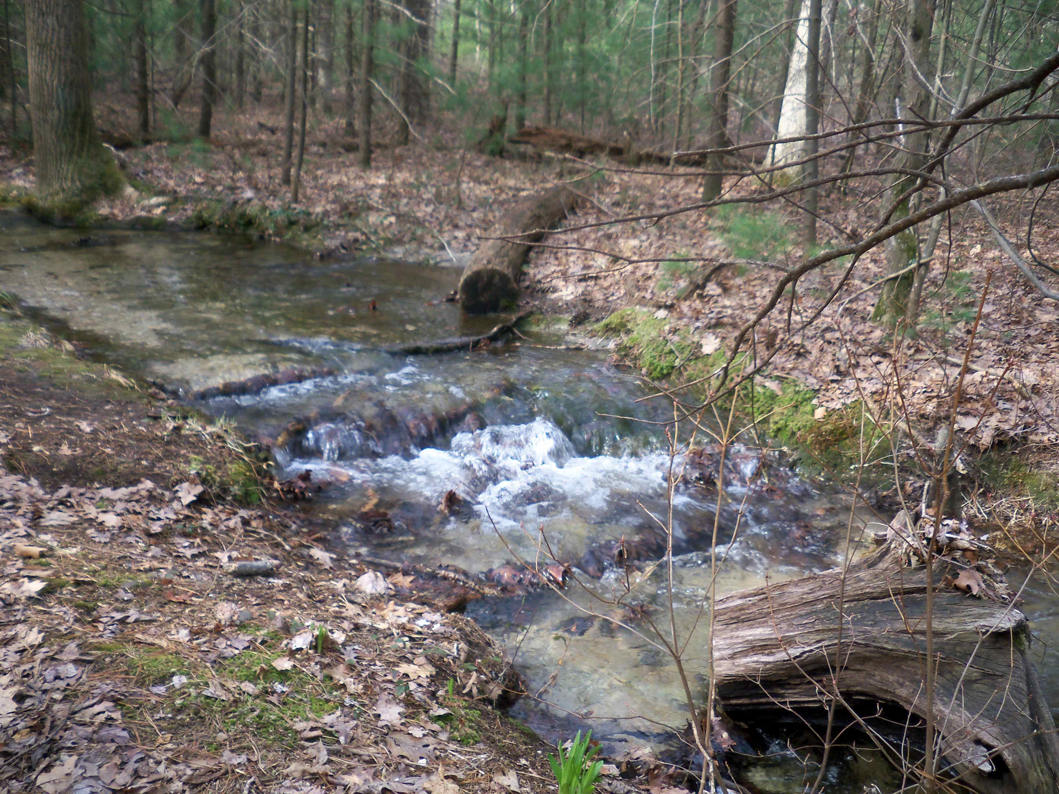
Kinds of chronological order texts
Scientific processes
These texts describe scientific processes
Notes:
Photo: Dolley Madison

Slide 39
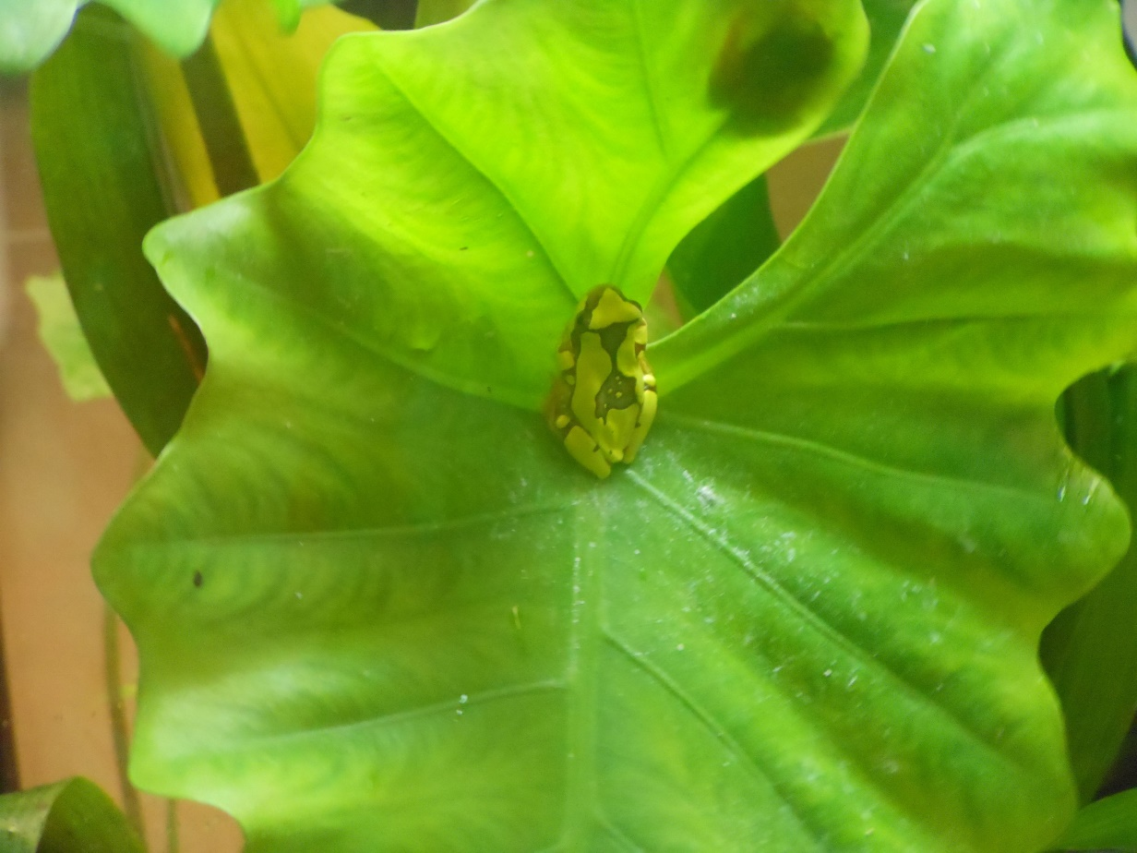
Chronological Order Texts
What chronological order texts have you read?

Slide 40
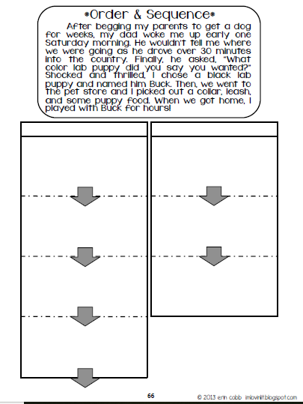

Slide 41
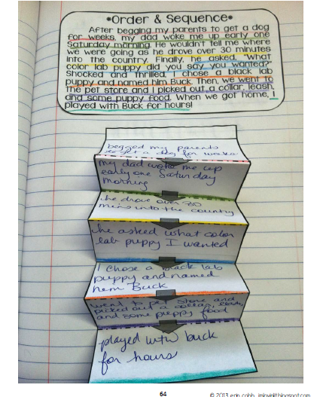

Slide 42

Reader’s Theater – Sequence/Chronological Order

Slide 43
Math Fluency & Focus Lesson!
2:30 – 3:00
3.MD.5 I can recognize area as an attribute of plane figures and understand concepts of area measurement. (a) a square with side length 1 unit, called “a unit square” is said to have “one square unit” of area, and can be used to measure area.
3.MD.6 I can measure areas by counting unit squares.

Slide 44
Fluency Practice
Count by sixes to 60
  6, 12, 18, 24, 30, 36, 42, 48, 54, 60
Count by sevens to 70
  7, 14, 21, 28, 35, 42, 49, 56, 63, 70
Count by eights to 80
  8, 16, 24, 32, 40, 48, 56, 64, 72, 80
Count by nines to 90
  9, 18, 27, 36, 45, 54, 63, 72, 81, 90

Slide 45
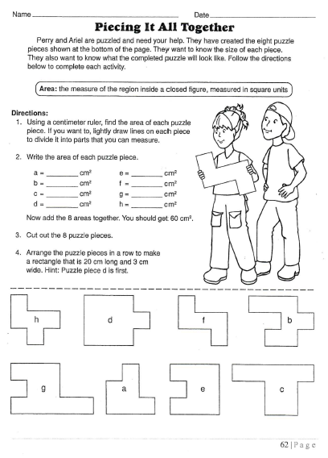

Slide 46
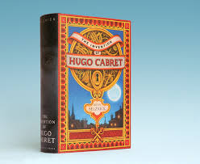
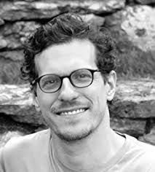
Classroom Novel - Hugo
3:00 - 3:10
Part 2 Chapter 7
Author: Brian Selznick
RL3.3 I can describe characters in a story (e.g. traits, motivations, or feelings) and explain how their actions contribute to the sequence of events.

Slide 47
Restroom Break
3:10 – 3:15

Slide 48




3:10 – 3:15 Wrap Up!
Pair-Up back to back and share one thing you learned in class today with your partner
Pack-Up
Office will announce:
Car Riders – Leave around 3:20
Bus Riders – (listen to intercom for dismissal)
2:30 – 3:20
How much time has elapsed?

