Slide 1

Parents,
I hope you and my friends are doing well during this hard time. Please know that you are not alone and that I am here for you. On my webpage I have uploaded a copy of the ELA and Math packets that are available for pick up in front of the school. The pages that are currently being worked on will be listed weekly. I will give you username and passwords to educational websites as well. If you need help with any of the activities please do not hesitate to contact me. I will be contacting you individual to set up a time to check in with you weekly. I will be able to video chat with you and my kiddos as well. Please check your email, remind and my webpage for changes and updates. I hope this helps ease your concerns with the distance learning and school closure transitions. It takes a village to raise our kids. Thank you for letting me be a part of yours.
Additional website passwords:
Lets Find out: blockhappy4886
News1 : blockhappy4886
Sincerely,
Mrs. Nikki Sutlick

Slide 2
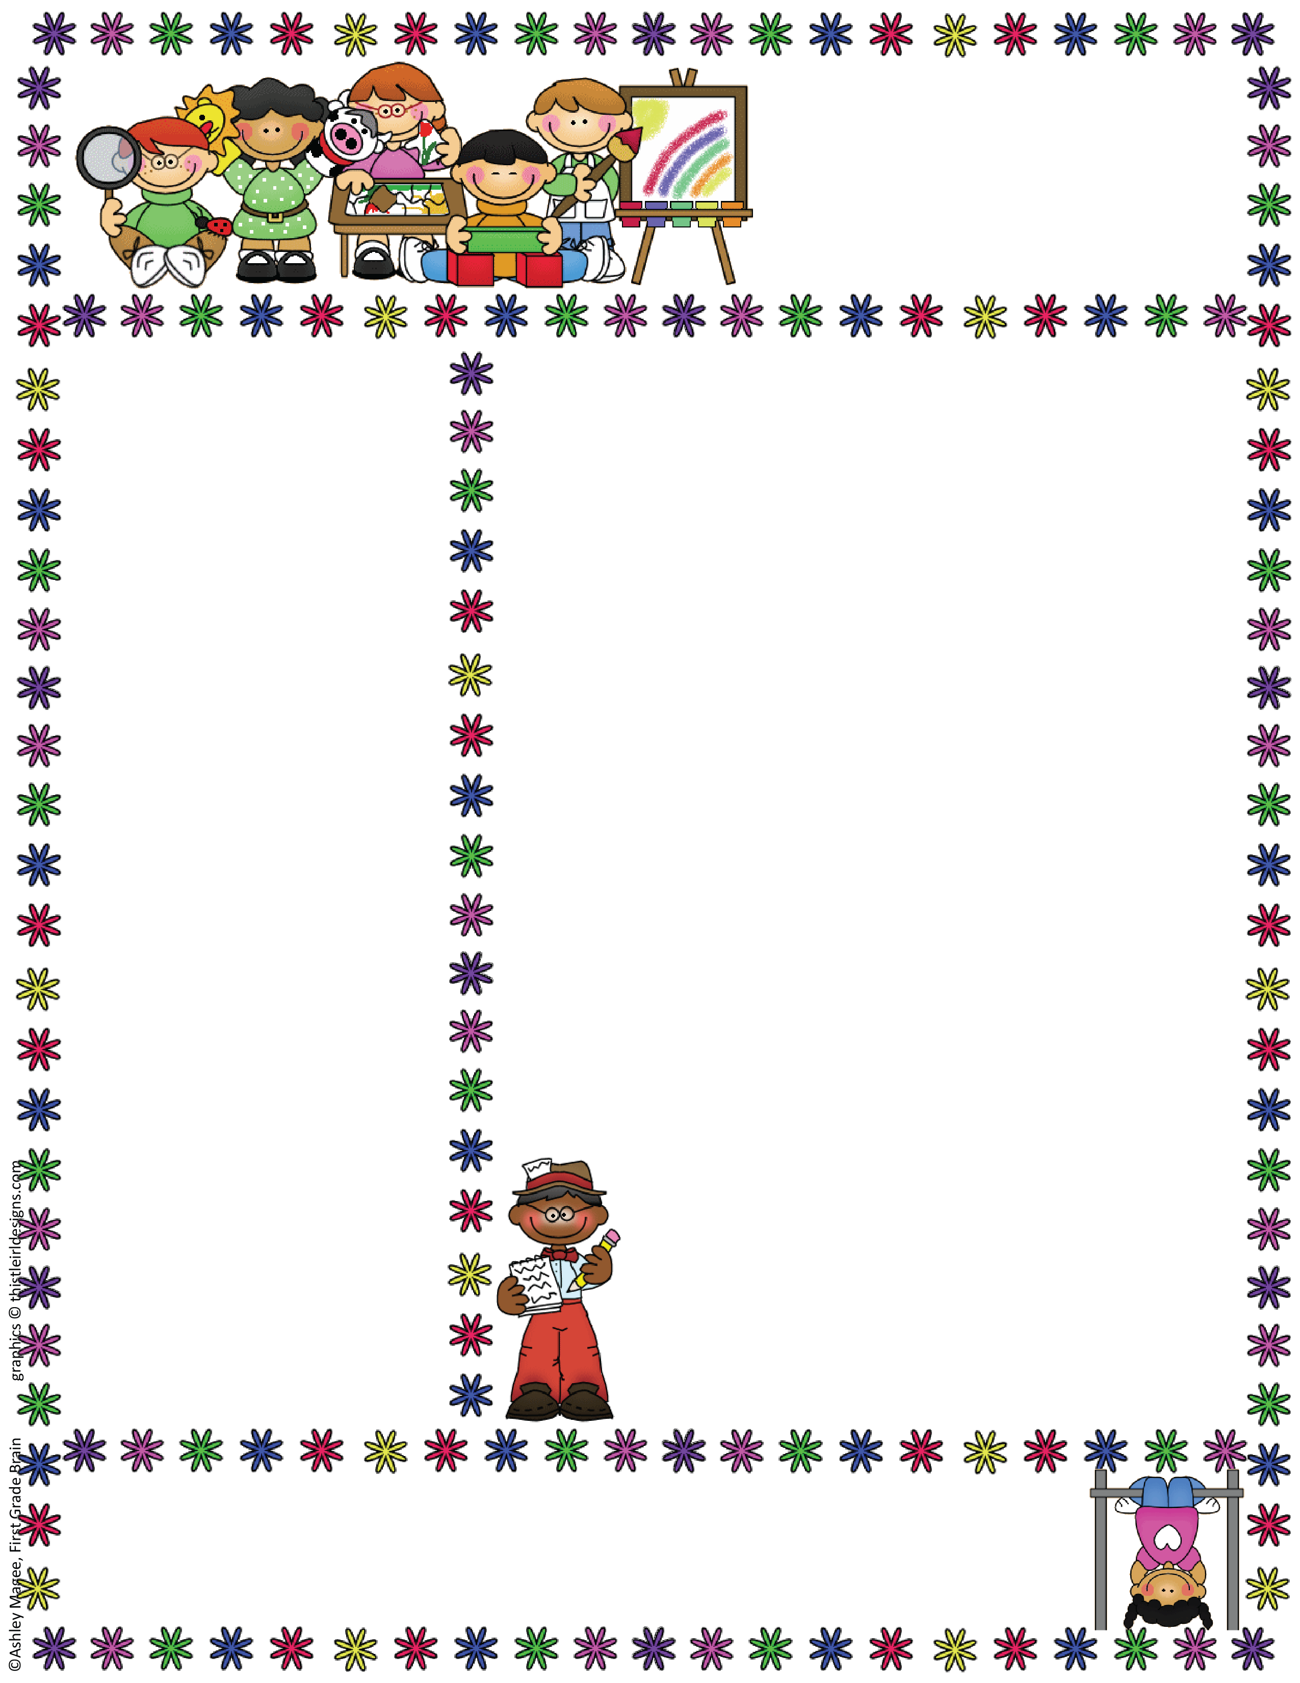
Distance Learning Newsletter
March 23-27, 2020
ELA Standards:
Speaking & Listening SL.9-10.1
Speaking & Listening SL.9-10.6
Vocabulary L.9-10.4
Key details RI.9-10.1
Main Idea RI.9-10.2
Text evidence RI.9-10.5
Writing W.9-10.2
Don’t Mess With This Dad
Before you begin the lesson ask your child, “What do you think baby frogs look like? Do they look like frogs, only smaller? Or do they look different?”
Watch the Video “From Tadpole to Frog”
After video ask, “What do you know about baby frogs that you may not have before? How do they change as they grow?”
Read “Don’t Mess With This Dad”
Complete the Reading Checkpoint questions 1-4.
Read “A Letter From Norbert Know-It-All” then write him back or verbally share facts about frogs you learned from the text.
Complete “The Life Cycle of a Frog” to show comprehension of the sequence of a frog’s life cycle.
Play Frog Dad Comprehension Game by answering questions correctly.
A Frog Grows Up
Read “A Frog Grows Up”.
Complete “Show What You Know” questions 1-4.
Practice reading a chart by completing the activity “A Bullfrog’s Hungry Week”.
*Complete “Follow that Frog!” to practice fine
motor skills and counting.
*Reinforce sequencing skills with the online game
“What’s the Order?”
* Hands on Fun? Improve sequencing and labeling
skills by creating a Life Cycle Lily Pad Necklace!
You will need scissors, glue, yarn/string, drinking
straw.
Additional Skills:
Fine Motor Skills
Following Directions
Tracing/Writing Name, letters, numbers( see link on webpage)
Vocabulary:
Egg
Frog
Gills
Hatch
Lungs
Metamorphosis
Tadpole
Enrichment Activities:
Looking for more great activities for your child to practice skills? Check out the following websites: www._______________
Learning Supports: The following lessons have been recorded on Zoom should your child need support from me to complete these assignments. The Zoom meeting # is ________________________.

Slide 3
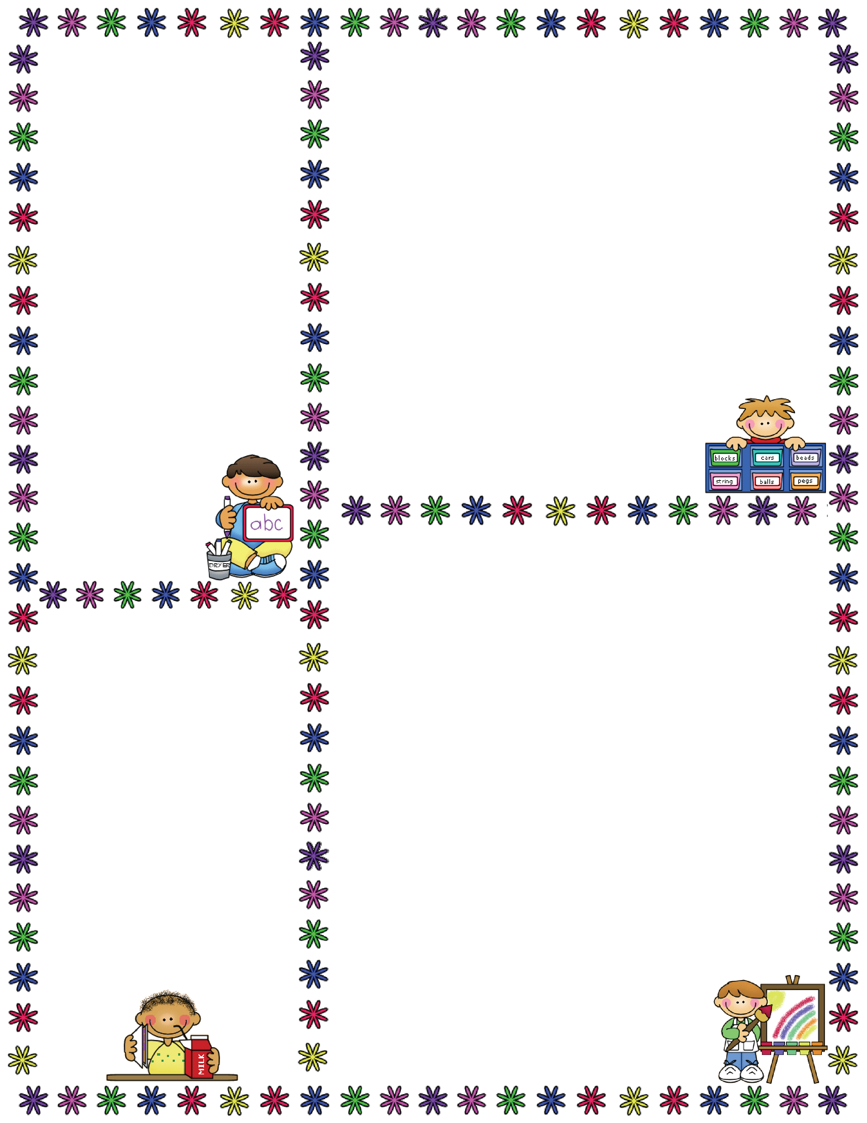
Life Skills Development:
*Complete the Calendar Skills
worksheet to practice
reading a calendar and
identifying days of the
week.
*Help your child transfer
their math lessons to the
real world by having them
set the table for the
appropriate number of
people eating dinner, count
how many items are left of a
specific food to determine if
it should be added to the
grocery list, etc.
*Work on following directions by having
them complete simple cooking or cleaning
tasks involving 3 or
more steps.
Math Standards
Use the operations of addition and subtraction with whole numbers less than 20 CN.2.a.a
Dinosaur Math Puzzle – Cut apart and have student match pieces together. (March 23-27)
Counting Gold Coins (March 23-27)
I Can Add to 5!
I Can Subtract to 5!
Golden Number Bonds ( I will let you know which sheets to work on weekly)
Roll, Add, and Color
Subtraction to 10
Roll and Solve
Before and After
I Can Add to 10!
I Can Subtract to 10!
Tally Marks to 20
Tally Up Your Coins
Lucky Clover
Reading Comprehension With Visual Choices
Each story comes with a variety of pictures to use as distractors so you can increase the field of options for your child as they demonstrate mastery.
Your child should begin with a choice of __2__ pictures for each question.
The pictures have the story title and question number on the back so you can provided the correct visuals for each question.
Read the story, or have your child read the story to you and then have them select the visual that answers each question.
Once your child can master the story __4___ times by correctly answering __4___ out of 5 questions. Once they demonstrate mastery, you can increase the difficulty by adding an additional picture to each question.
Stories included:
Life Cycle of a Frog
Freddy the Frog
Animal Camouflage
Who Lives at the Pond?
The Wetlands
Weekly Conference Call:
I would like to touch base with you weekly to discuss your child’s lessons and provide any additional supports you may need. I will contact you using the PowerSchool contact number listed via remind. I will set up call and video hours to assist you with activities if needed as well.

