Slide 1
College Transition 101
Understanding and Maneuvering through the Transition from High School to College
Leslie Zerbinos, MS, CRC
Rehabilitation Counselor
ADRS

Slide 2
TWO-YEAR COLLEGE
FOUR-YEAR COLLEGE OR UNIVERSITY
TRADE OR VOCATIONAL PROGRAMS
THE MILITARY
WORK

Slide 3
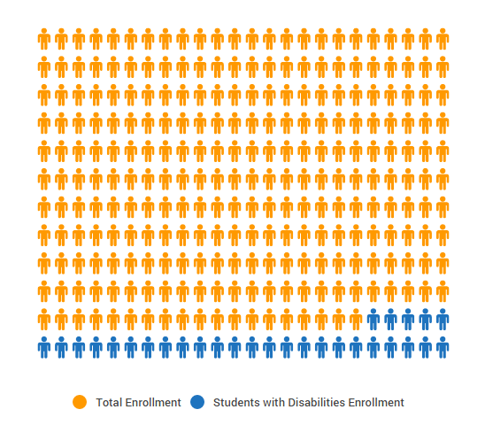
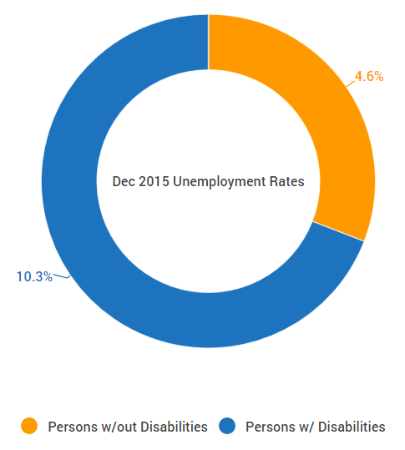
Stats…
In a recent study of students with disabilities, the National Center for Education Statistics revealed that of the 20.2 million students enrolling in colleges in 2015, ~2.42 million (11.1%) of these students have some kind of disability. These numbers indicate a growing trend in enrollment as more and more schools develop the necessary resources to support this group of students.

Slide 4
Choosing the “Right” School
Continuing education choices:
Colleges and universities (4 year): Prepares individual for a wide range of professional careers. They offer Bachelor’s degrees, in-depth studies, and can help students prepare for graduate degree programs.
Community or junior colleges (2 year): Great option for those unsure of career path, or not ready for a 4-year college or university. They offer Associate’s degrees and job training programs; many classes or credits transfer to 4-year colleges.
Vocational or technical colleges: Direct path toward specific jobs. There are programs in a wide range of areas, including web design, medical office administration, and electronics. These programs offer “hands-on” learning.

Slide 5
Choosing the “Right” School
What does the student want to study?
Find out what kind of services they offer, and learn about the reasonable accommodations they can provide to match the student’s disability.
Visit the campus. Don’t rely on a brochure or online images. They’re going to make it look best in those photos – it could be very different in real life.
Ask the school about student retention rates. In addition to the general retention rate of students, what is the retention rate of students with disabilities?
Talk to current students with similar disabilities to find out what their experiences are like. They can offer key insight into the nature of the school’s support, coursework, & accommodation methods.
Visit the “Career Services” center of the school. A good career center is every student’s best friend.

Slide 6
Important Legislation to Know
Rehabilitation Act of 1973 (esp. Section 504)
ADA (Americans with Disabilities Act) of 1990
It is important to know how these two pieces of legislation differ from the Individuals with Disabilities Education Act (IDEA) of 1990. In the K-12 system, schools operate under IDEA – which provides special education and related services to students aged 3-21 – as well as Section 504 and the ADA to make sure students receive the supports they need. In higher education, however, IDEA no longer applies – only Section 504 and the ADA are used.

Slide 7
One more piece of important legislation…
FERPA of 1974 -- The Family Educational Rights and Privacy Act (FERPA) is a Federal law that protects the privacy of student education records. This law applies to all schools that receive funds under an applicable program of the U.S. Department of Education.
FERPA gives parents certain rights with respect to their children's education records. These rights transfer to the student when he or she reaches the age of 18 or attends a school beyond the high school level.

Slide 8
Financial Aid
Federal Student Aid Programs
Every college-bound student should complete the Free Application for Federal Student Aid (FAFSA). The results outline eligibility for federal funding and tell you how much you should expect to contribute independently. Completing this application will determine whether or not the student is eligible to receive the Pell grant, as well as participate in any federal loan programs. It is open to students from all backgrounds, and those with disabilities are equally encourage to apply to the program. Federal Student Aid Information Center: 1-800-433-3243

Slide 9
Financial Aid
Scholarships specifically for students with disabilities
Now you can begin to look at scholarship opportunities that cater to students with disabilities. A simple Web search can yield overwhelming results—and awards vary significantly in dollar amount and eligibility requirements. There are scholarships specifically available for students with:
General disabilities
Learning and cognitive disorders
ADHD
Autism
Physical disabilities
Vision, speech, or hearing impairment

Slide 10
Financial Aid
Just a few examples:
Rise Scholarship Foundation (for students with LD)
Shire ADHD Scholarship
Google Lime Scholarship for Students with Disabilities (for those in STEM fields)
DisABLEDperson Inc. Scholarship
Foundation for Science and Disability Student Award Program
Also, remember to check with: employers, organizations, religious groups, Chambers of Commerce, etc., for more scholarship opportunities

Slide 11
Self-Advocacy and Accommodations
To ensure that their programs and activities are fully accessible to students with disabilities, colleges and universities are required to provide “reasonable accommodations” to their practices, policies, and procedures – and to provide auxiliary aids and services to students with disabilities.
However, under federal disability law, only if the student has disclosed a disability is the institution or program responsible for providing accommodations.

Slide 12
Accommodations
Some examples of modifications/aid/services might include:
Priority registration
Course substitutions
Testing in a room with limited distractions
Exam modifications (i.e., extended time on tests, readers, scribes, proctors)
Permitting the use of calculators
Providing qualified interpreters
Providing note-takers or copies of the notes
Providing textbooks and/or classroom materials in alternative formats (i.e., Braille, audiotape, or digital files)
Note that academic accommodations must be authorized by a specific office on campus — generally known as the “Student Support Services” (or Disability Support Services) office — and are determined on an individual basis.

Slide 13
Steps to Take…
The first thing the student should do is contact the person in charge of accommodations on campus and register as a student with a disability (student’s responsibility). Usually this person is called the Coordinator of Student Support Services (SSS) or Disability Support Services (DSS).
When the student meets with the SSS or DSS Coordinator, the student must provide that individual with current documentation of the disability. IEP forms are usually not considered documentation. Check the college or university’s web site for a handbook for students with disabilities. Often, it will detail what the documentation requirements are. Students can also ask the SSS Coordinator, the Dean of Student Affairs, or their academic advisor.
The student should discuss accommodation needs with the DSS Coordinator. Accommodations used in the past – including what has worked or not – and what he/she thinks will be needed while in college should be discussed.

Slide 14
Next Steps…
The person in charge of accommodations will then review the documentation and determine whether or not the student is eligible for services – and, if so, which accommodations the college or university will provide. The person in charge of accommodations will then give the student a letter of accommodations informing professors of authorized accommodations.
The student should then give the accommodation letter to professors and be prepared to talk with professors about how to receive accommodations.
NOTE: *Accommodations go into effect once the Accommodation Letters have been delivered and are not expected to be retroactive.* Therefore, it is highly recommended that students give the letter to professors in the beginning of the semester, but they may do so at any point during the semester.
Professors should provide the accommodations that are specified in the letter, and they must keep this information confidential. If the professor has questions about the letter that a student doesn’t feel comfortable answering, he/she should discuss with the SSS coordinator.
Students should monitor accommodations. Are the accommodations working? Are additional accommodations needed? If so, student should contact the SSS coordinator.

Slide 15
Independent Living
Where is the student going to live?
How will he/she travel from one place to another?
Will the student require supports to live independently in the community?
Will he/she need help with finances?
How will the student access healthcare?
What recreation and leisure opportunities can the student access at the school/ in the community?

Slide 16
Assistive Technology

Slide 17
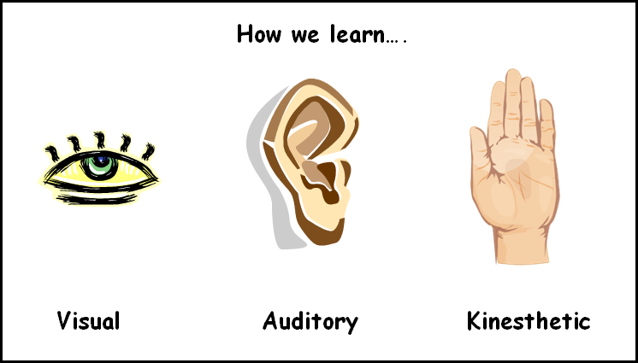
Assistive Technology
Know the learning style
Know needs and discover what AT devices and software best meet needs – If you haven’t found the right tool, keep experimenting with possible AT devices. Share ideas with teachers, therapists, and family members so they can help you find the right solution.
Identify AT resources offered by the student’s preferred colleges – Investigate resources available through the SSS office located at each preferred college.
Find out about maintaining AT devices and knowing where to go for help – Keep manuals, contact info, etc., in a folder, so when trouble arises, everything is in one place. No more “the dog ate my homework” excuses. ☺

Slide 18
How can parents help?
Parents of youth with disabilities are often very good at advocating for their child in a variety of settings They may not be as familiar with the importance of transition planning, or what they can do to help their youth be better prepared for the adult world of employment, postsecondary education, and independent living. Here are some tips to help you maximize your role as a parent and partner during secondary transition planning:
Understand your child’s disability – During transition planning, seek to better understand how the disability may affect your child’s pursuit of post-secondary education, employment, or independent living.
Help your child to build self-confidence and self-determination – Help your child to discover his/her interests & strengths and to build upon them. Research possible careers in these areas.
Help your youth develop independence in learning, studying and living skills – Positive traits such as eagerness to learn new things, effectively managing time, and taking responsibility for doing a good job will serve youth well in the adult world, esp. when it comes to postsecondary education and employment.
Understand the impact of “soft skills” on employment and educational success & use activities in the home to build those skills – Teach your child how to communicate appropriately with others, maintain personal appearance, take work direction, and resolve conflict.

Slide 19
How can VR help?
Counseling & guidance (job exploration, etc.)
Vocational Evaluations (Lakeshore)
Testing for college potential
Planning for college
College Prep
Adaptive Driver Training (Lakeshore)
Job Readiness
Assistance finding competitive employment
Supported employment
Independent living
Assistive technology assessments

Slide 20
Tips for success in college
Seek out help when needed. Don’t forget to register with the school’s Student Support Services office. Some schools may not know how to adequately accommodate a particular disability. Be sure to have some suggestions of services the school can provide. Also see out learning coaches, tutors, etc. to stay on track.
Map out usage of time. – Easy to fall behind in course work with extracurricular activities, etc. Find a good time management tool – i.e., daily planner or PDA.
Plan ahead – esp. for final projects and important tests. Break down assignments into smaller, more manageable pieces.
Make sure to learn how you learn — i.e., visual, auditory, or hand-on learner.
Be an active learner – ask questions about the readings to improve memory & understanding.
Create effective study routines – i.e., distraction-free.
Organize your study space – “de-clutter” your desk; make “to-do” lists.
Start early – try not to procrastinate.
Identify problems that repeatedly get in the way – if you are feeling frustrated, try to figure out what caused it and “problem-solve.”
Get familiar with college campus surroundings.
Serve as your own best advocate.
Use technology to your advantage.

Slide 21
Graduation from high school triggers many changes for students with a disability and for their parents. Once your child graduates, the regulations and protections found in the IDEA no longer apply. Students now enter the world of adult services, which may have unique eligibility requirements, unfamiliar language, multiple entry points, and the possibility of long waiting lists. In preparation for transition, both parents and their youth need to become familiar with disability rights, laws, and responsibilities that might impact postsecondary education, employment, and independent living.

Slide 22
Any Questions?

Slide 23
Resources
www2.ed.gov/about/offices/list/ocr/transition
www.understood.org
www.usnews.com
www.affordablecolleges.online.org
www.top10onlinecolleges.org
www.collegeview.com
www.going-to-college.org
www.npr.org

