Slide 1
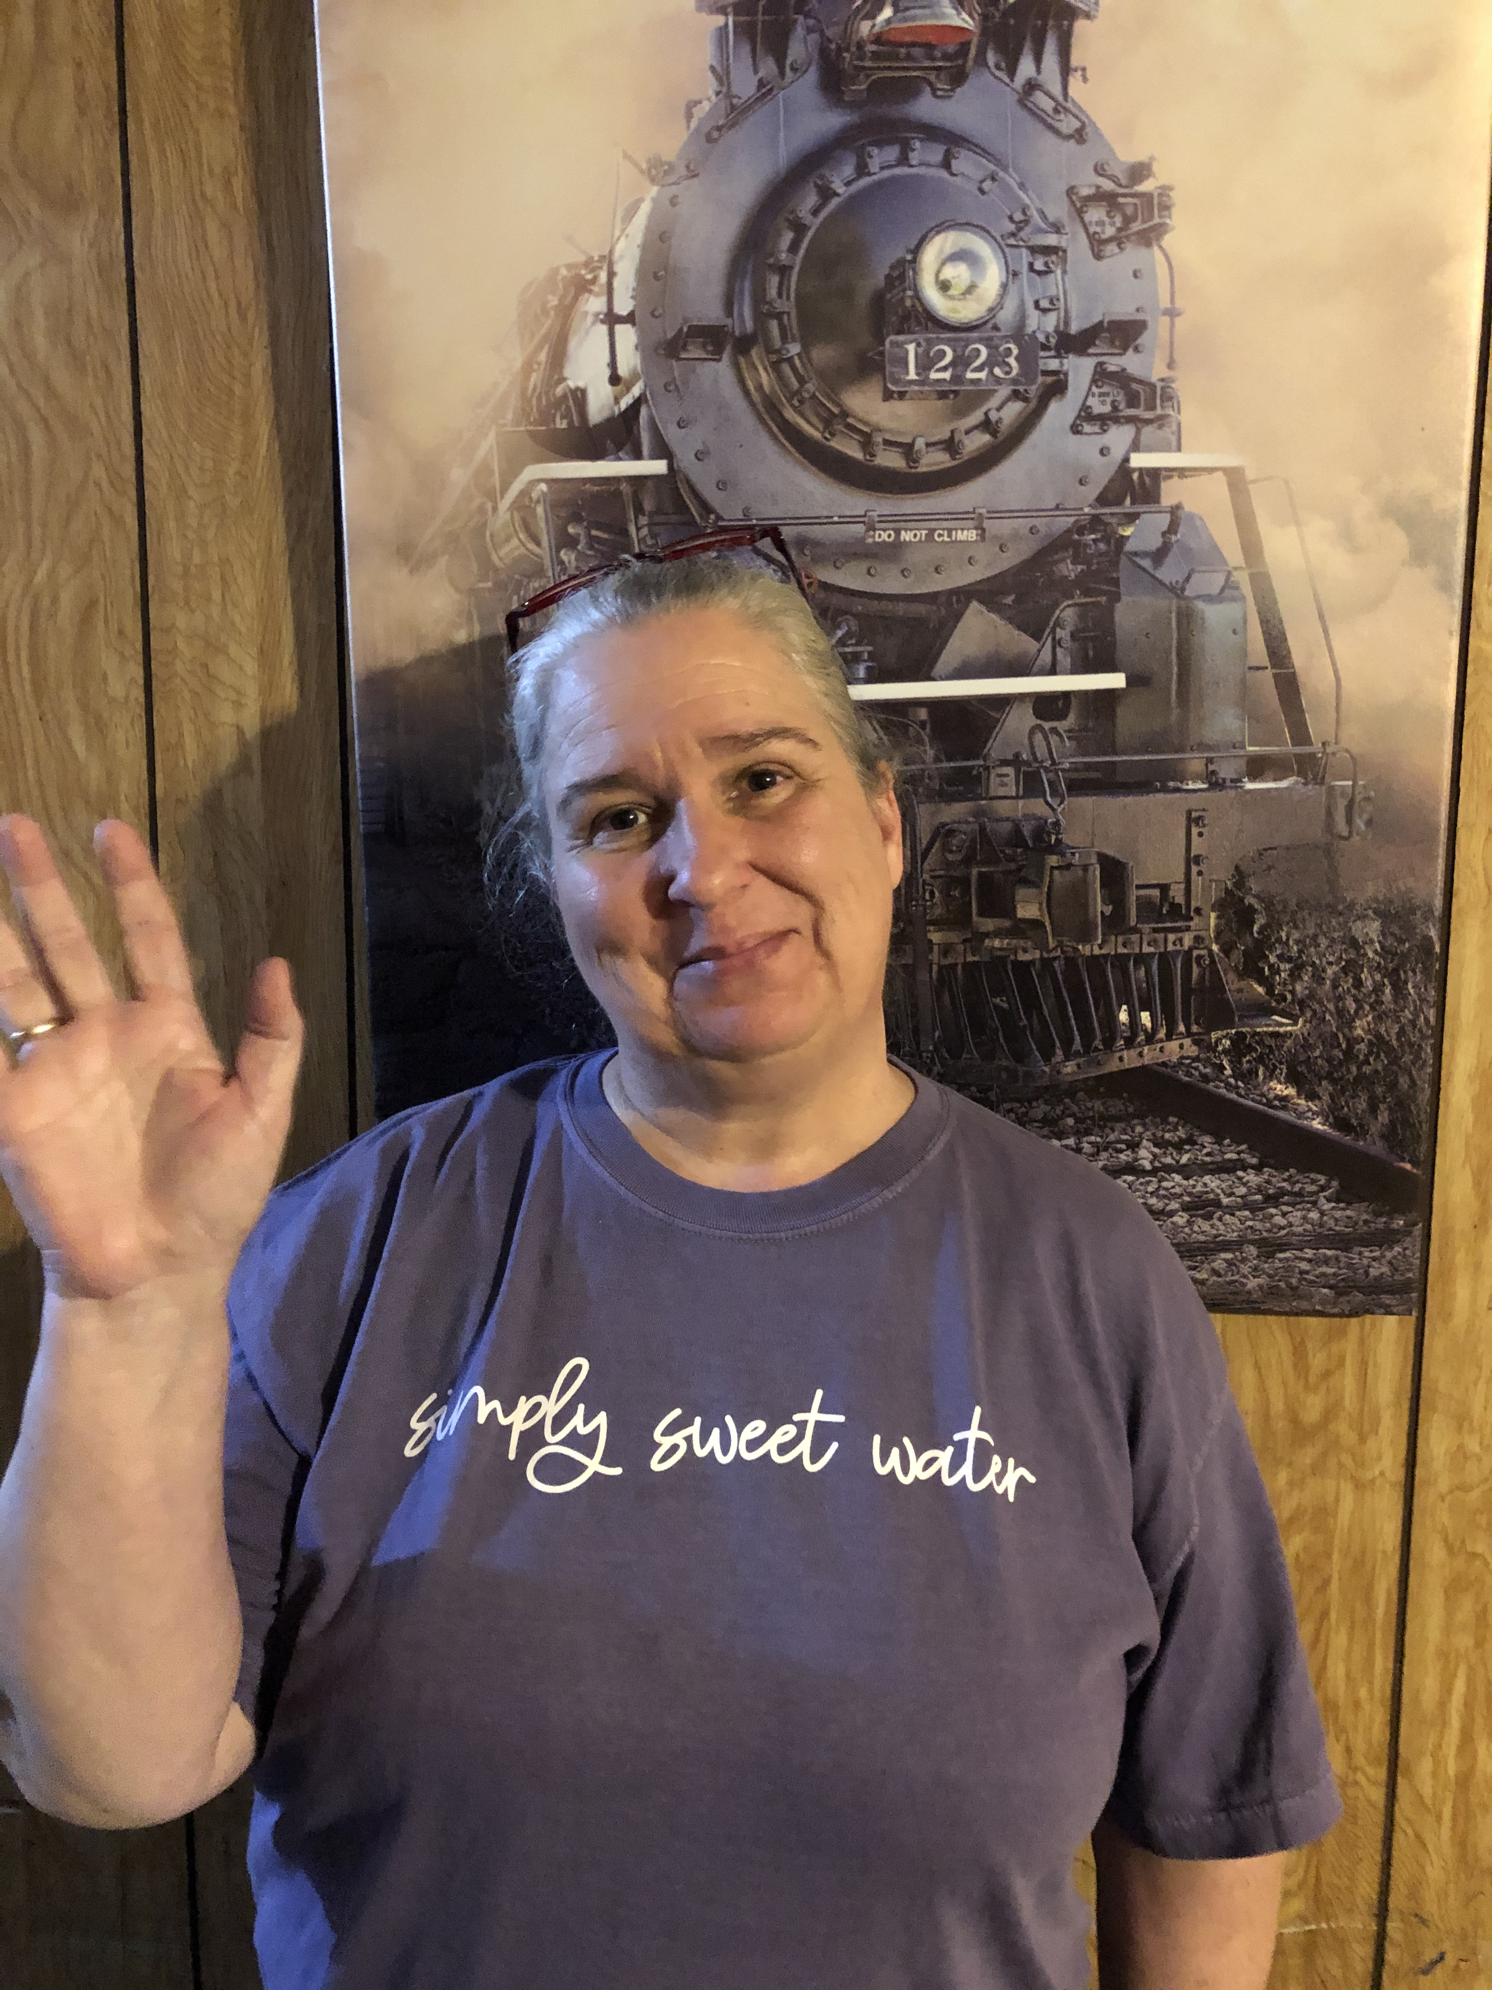
Put a picture or gif of you here!

Slide 3
Hi! My name is Ms. Lynn, and if you are watching this PowerPoint I will be your teacher for the upcoming school year. I am looking forward to having you in my class this year. Things are very different and sometimes a little scary, but it’s ok. We will get through the unknown together. In the meantime, enjoy the rest of your summer break, and I look forward to seeing you Monday, August 17th. Have a happy and safe weekend!
Bye!!!

Slide 4
Put a picture or gif of you here!
My name is Anita Lynn, but everyone calls me Nina. I am a widow with two children and seven grandchildren.
I graduated in May of 1999 from the University of West Alabama with a degree in Elementary Education.
In August of 1999 I was hired at SWHS to teach Kindergarten. Since then, I have been fortunate enough to teach 3rd, 4th, 5th, 6th, and now 2nd. This year starts my 22nd year at SWHS, and my 6th year teaching second grade.
I love what I do, and I am looking forward to a great year!

Slide 5
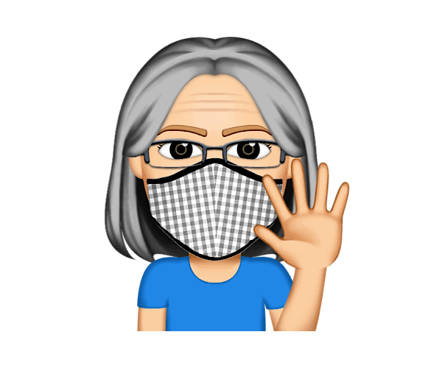
Put a picture or gif of you here!
I am 6 feet tall!
My pet is a 9 year old dog named Jasper.
I like to play hidden object games.

Slide 6
My children and grandchildern
Sitting in my rocking chair on the front porch
Winter
Christmas
Chocolate, chocolate, and chocolate!
MY JOB!!!!!!!!

Slide 7
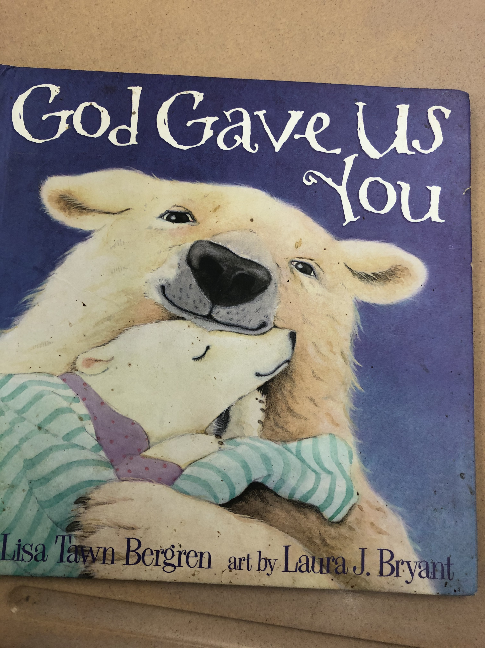

Slide 8
nlynn@marengo.k12.al.us
Don’t use Twitter
334-994-4263

