Slide 1
Standard precautions

Slide 2
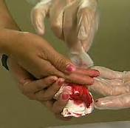
Standard precautions
These are rules developed by the CDC to prevent HCW’s contact with blood/body fluids and help break the chain of infection
The basic ideas of standard precautions are:
Every body fluid must be considered a potentially infectious material
All pts must be considered potential sources of infection, regardless of their disease or diagnosis

Slide 3
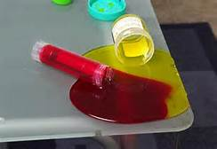
Standard precautions
Standard precautions must be used in any situation where HCW may contact:
Blood or any fluid that may contain blood
Any body fluids, secretions, and excretions:
mucus, sputum, saliva, CSF, urine, feces, vomitus, amniotic fluid, synovial fluid, pleural fluid, pericardial fluid, peritoneal fluid, semen, vaginal secretions

Slide 4
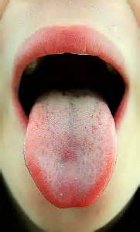
Standard precautions
Standard precautions must be used in any situation where HCW may contact:
Mucous membranes
Nonintact skin
Tissue or cell specimens

Slide 6
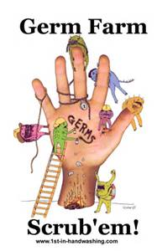
Standard precautions
The basic rules of standard precautions:
Handwashing: must be done before & after contact with pts, if hands are contaminated with blood/body fluids, & immediately before gloving and after removal of gloves

Slide 7
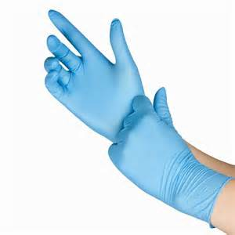
Standard precautions
The basic rules of standard precautions:
Gloves: must be worn whenever contact with blood/body fluids is possible; gloves must be changed after each pt and between tasks on the same pt; gloves must not be reused

Slide 8
Standard precautions
The basic rules of standard precautions:
Gowns: must be worn during any procedure that is likely to cause splashing or spraying of blood/body fluids

Slide 9
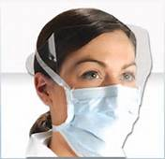
Standard precautions
The basic rules of standard precautions:
Masks and Eye Protection: must be worn during procedures that may produce splashes or sprays of blood/body fluids

Slide 10
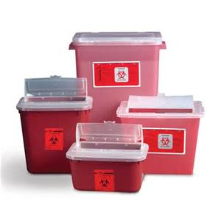
Standard precautions
The basic rules of standard precautions:
Sharps: Extreme care must be taken while handling sharps to avoid accidental cuts or punctures; sharps containers must be labeled with red biohazard symbol and never be emptied or reused

Slide 11
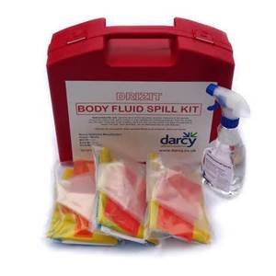
Standard precautions
The basic rules of standard precautions:
Spills or Splashes: must be wiped up immediately and the area disinfected

Slide 12
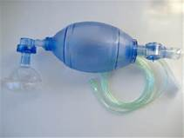
Standard precautions
The basic rules of standard precautions:
Resuscitation Devices: must be used to avoid the need for mouth-to-mouth resuscitation

Slide 13
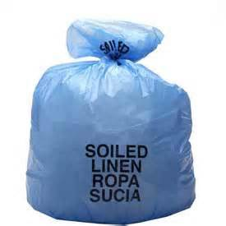
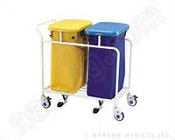
Standard precautions
The basic rules of standard precautions:
Waste and Linen Disposal: follow agency policy developed according to law to dispose of waste and soiled linen

Slide 14
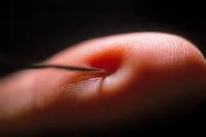
Standard precautions
The basic rules of standard precautions:
Injuries: Any cut, injury, needlestick, or splashing of blood/body fluids must be reported immediately

