Slide 1
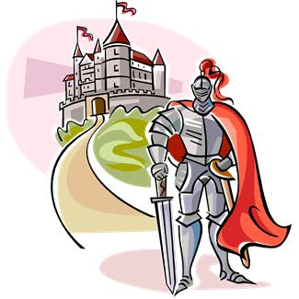
Characteristics of the Medieval Romance
A Tale of High Adventure.
A religious crusade, a conquest for the knight’s lord/King, and/or the rescue of a captive lady (or any combination).

Slide 2
8 Characteristics (In brief):
Idealizes Chivalry (Code of Chivalry – hero-knights abided by this code)
Idealizes the noble hero-knight and his daring deeds
Women are idealized and held in high regard by hero-knight
Imaginative, vast, fairytale like setting
Mystery and supernatural elements abound
Repetition of the magical numbers 3 and 7
Tale involves a quest for love and/or adventure by hero-knight
Simple, predictable, inevitable plot

Slide 3
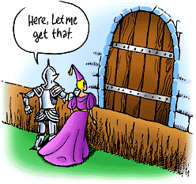
1. Medieval romance usually idealizes chivalry.
Chivalry…
What is this?
Honor, Respect,
Loyalty, Courtesy,
Gentlemanly
Behavior, courage,
Self-less acts.

Slide 4
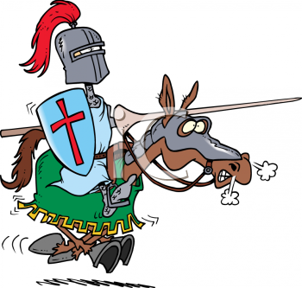
2. Medieval romance idealizes the hero-knight and his noble deeds.
The Hero-knight
Is well respected
And looked up to.
There are usually
High expectations
Of him and he
May have already
Performed some
Chivalrous and
Brave, daring tasks.

Slide 5
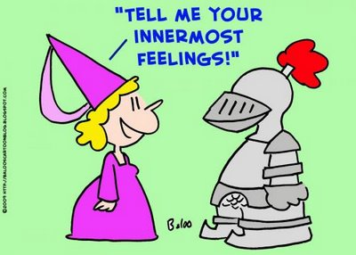
3. An important element of the medieval romance is the knight’s love for his lady, or high regard and respect for women in general.

Slide 6
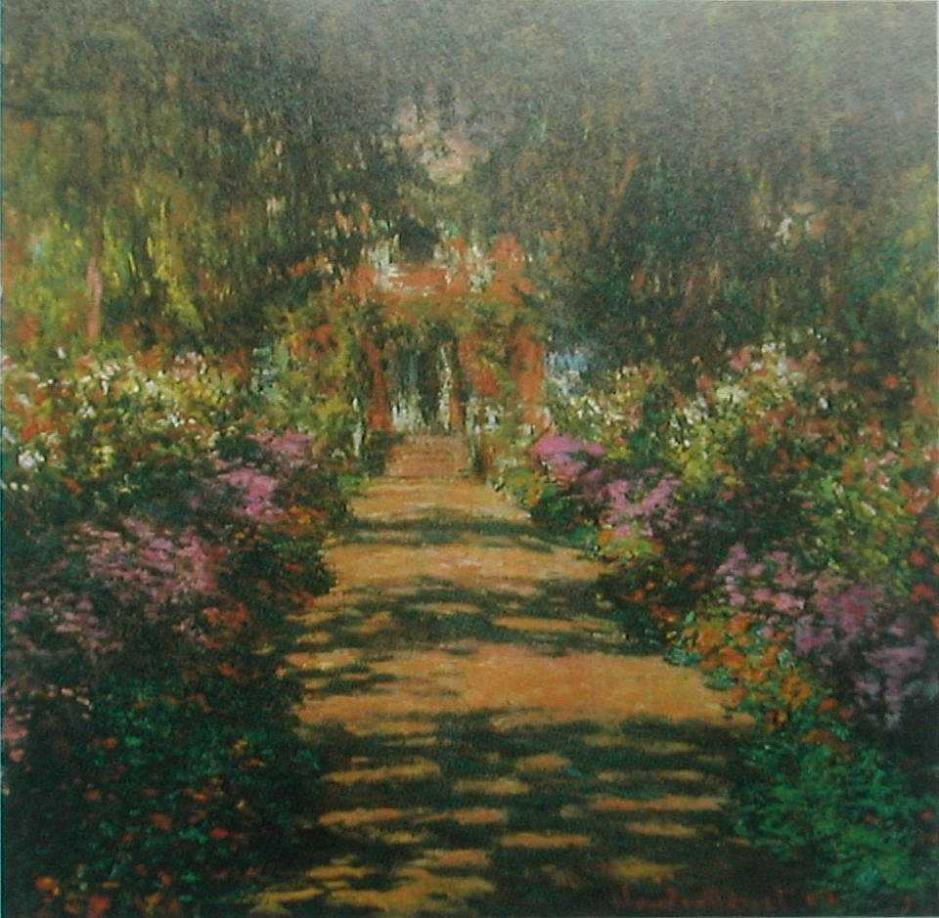
4. The settings of medieval romance tend to be imaginative and often vast and fairytale like.
“Once upon a
Time in a faraway
Land….”

Slide 7
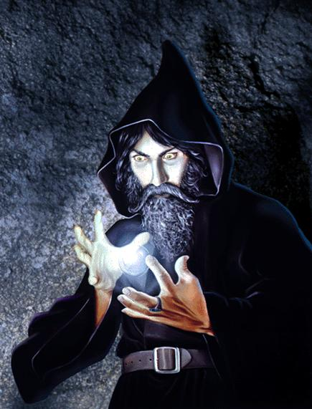
5. Medieval romance derives mystery and suspense from supernatural elements or characters. Witches, wizards and dragons were popular.

Slide 8
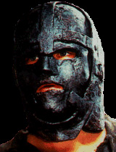
Medieval romance incorporates concealed or disguised identities of some characters. (Adds to the mystery and suspense.)

Slide 9
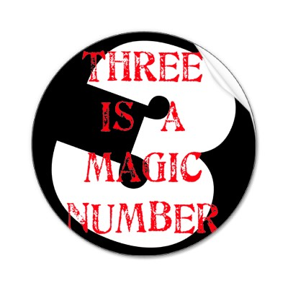
6. Repetition of the mystical number 3, and the number 7.
There is often a motif
Or pattern of the use
Of one or both of these
Numbers. Events or
Characters often
Happen revolving
Around these numbers.

Slide 10
7. Our hero-knight must complete a quest for love or adventure and while doing so will perform daring deeds.

Slide 11
8. Medieval romances have a simple, predictable plot with some inevitable events. “Once upon a time….and they lived happily ever after.”
Inevitable means unavoidable, can’t be stopped.

Slide 12
Characteristics of the Hero-Knight
Birth of this hero is shrouded in mystery (as in where, when…).
He is reared away from his true home in ignorance of his real parents.
For a time, his true identity is unknown.
After meeting an extraordinary challenge, he claims his right. (He must overcome obstacles and complete an adventure or specific tasks to claim his hero status).
His triumph benefits a nation or a group.

Slide 13
Hero-Knight vs. Epic Hero
How is the hero-knight similar to the epic hero we studied in Beowulf?
How is the hero-knight different?
How well does the hero-knight’s journey fit into the model of a hero we studied earlier? (Think of the characteristics of a hero we studied.)
Can you think of any present day examples of a hero-knight from your own reading or viewing?

Slide 14
8 Characteristics of Medieval Romance
Review Time: List, in your own words, the 8 characteristics of a medieval romance:
1.
2.
3.
4.
5.
6.
7.
8.

