Slide 1
Gas Laws

Slide 2
Methanol (CH₃OH) is the simplest alcohol. Methanol can be manufactured by combination of gaseous carbon monoxide and hydrogen. Suppose 68.5 kg CO(g) is reacted with 8.60 kg H₂(g). Calculate the theoretical yield of methanol. If 3.57 × 10⁴ g CH3OH is actually produced, what is the percent yield of methanol?

Slide 3
KMT
1. Particles are far apart relative to size.
2. All collisions are elastic.
3. Particles are in constant motion.
4. No forces of attraction between particles.
5. KE = 1/2mv²

Slide 4
Pressure
Pressure—the force per unit area on a surface
Increased with increased number of collision of molecules
Depends on volume, temperature, and the number of molecules
Units (standard pressure = 1.00 atm = 760. mm Hg = 101.3 kPa = 760. torr)
1 Pa | Pascal = 1 N/m² (SI unit)
1 psi | = 1 lb/in² (English unit) = 6,891 Pa
1 Bar | = 10⁵ N/m² = 101.3 kPa
1 Tor | = 1 mm Hg
1 atm | = 101.3 kPa = 760 mm Hg = 14.70 psi

Slide 5
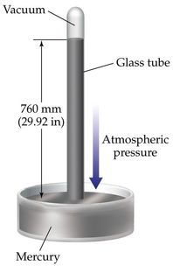
Measuring Pressure
Barometer—device used to measure atmospheric pressure
Exact height of mercury depends on atmospheric pressure, or force per unit area.

Slide 6
Gas Laws
3 laws
-Boyle’s Law
-Charles’ Law
-Gay-Lussac’s Law
*All depend on pressure (atm), temperature (K), volume (L), and quantity (n = moles)
Change one variable, it affects all three.
***Do not worry about memorizing names of laws, only care about relationships!!

Slide 7
Warm up (in your notes)
Convert the following units of pressure:
1.) 7.89 atm = ____________ mm Hg
2.) 204.5 kPa = ___________ atm
3.) 2.00 atm = _____________ mm Hg

Slide 8
Boyle’s Law
Pressure-Volume relationship
Volume of a fixed mass of gas varies inversely with the pressure at constant temperature.
Why? KMT
Decreased volume = more collisions = more pressure
Practice
A sample of oxygen gas has a volume of 150.0 mL when its pressure is 0.947 atm. What will the volume be if its pressure increases to 0.987 atm and the temperature remains constant?

Slide 9
Charles’s Law
Temperature-Volume relationship
Volume of a fixed mass of gas varies directly with the temperature at constant pressure.
Units—Temperature is always in Kelvin.
Why??
*A sample of neon gas occupies a volume of 752 mL at 25ºC. What volume will the gas occupy at 50ºC if the pressure remains constant?

Slide 10
Gay-Lussac’s Law
Pressure-Temperature relationship
Pressure of a fixed mass of gas at constant volume varies directly with the temperature.
Why??
Practice
The gas in a container is at a pressure of 3.00 atm at 25ºC. Directions on the container warn not to keep it in a place where the container exceeds 52ºC. At what pressure would the container be at 52ºC?

Slide 11
Combined Gas Law
Combines Boyle’s, Charles’, and Gay-Lussac’s laws to express relationship between pressure, volume, and temperature.
A helium-filled balloon has a volume of 50.0 L at 25ºC and 1.08 atm. What volume will it have at 0.855 atm and 10ºC?

Slide 12
On a clean sheet of paper…
How hot will a 2.3 L balloon have to get to expand to a volume of 400. L? Assume that the initial temperature of the balloon is 25ºC.
Turn in when finished.

Slide 13
Ideal Gas Law
Relates pressure, temperature, volume, and number of molecules of a gas
For IDEAL gases only—only useful if all five assumptions of KMT are followed.
Deviations from ideal gas behavior happen if there is:
high pressure
low temperature
polarity
larger molecules
All cause attractive forces to take over.

Slide 14
PV = nRT
P = Pressure
V = Volume
n = moles of a substance
R = ideal gas constant
T = temperature

Slide 15
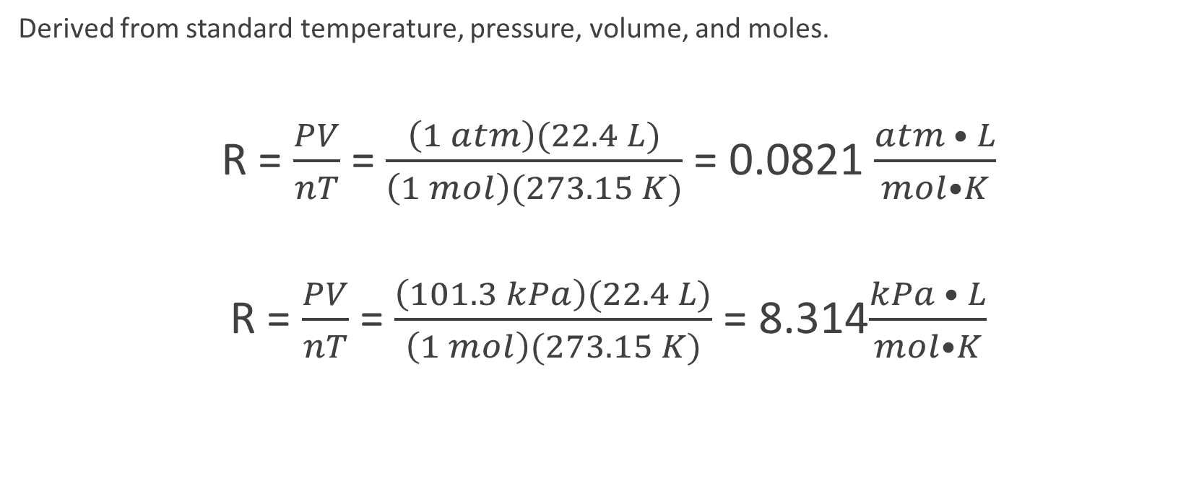
Ideal gas constant
Derived from standard temperature, pressure, volume, and moles.
R = $\frac{PV}{nT}$ = $\frac{\left(1 atm\right)(22.4 L)}{\left(1 mol\right)(273.15 K)}$ = 0.0821 $\frac{atm • L}{mol•K}$
R = $\frac{PV}{nT}$ = $\frac{\left(101.3 kPa\right)(22.4 L)}{\left(1 mol\right)(273.15 K)}$ = 8.314$\frac{kPa • L}{mol•K}$

Slide 16
Practice
1.) Calculate the number of moles of gas contained in a 3.00 L container at 27°C and 1.50 atm.
2.) Calculate the pressure of a 5.0 L container with 5.43 g of H₂ gas at 298 K.

Slide 17
Finding molar mass of a gas
If the moles of a gas (n) is equal to the mass (m) divided by the molar mass (MM) then we can derive the ideal gas law to read:
PV = n R T PV = mR T
MM
Practice
What is the molar mass of a gas sample that has a mass of 1.574 g that occupies a volume of 8.3 L at a temperature of 127℃ and a pressure of 155.30 kPa?

Slide 18
Finding Density
Derived from ideal gas law.
$PV=\frac{mRT}{MM}$ → MM = $\frac{mRT}{VP}$
What is the molar mass of a pure gas that has a density of 1.40 g/L at STP?

Slide 19
Practice
1.) A mixture of nitrogen and neon gases contains equal moles of each gas and has a total mass of 10.0 g. What is the density of this gas mixture at 500 K and 15.0 atm? Assume ideal gas behavior.
2.) The vapor pressure of solid iodine at 30.0 °C is 0.466 mm Hg.
a. How many milligrams of iodine will sublime into a 1.00 L flask?
b. If 2.00 mg of I₂ are used, what will the final pressure be?
c. If 10.00 mg of I₂ are used, what will the final pressure be?

Slide 20
Dalton’s Law of Partial Pressure
Partial pressure—pressure of each gas in a mixture (each gas in a mixture exerts pressure independently of the other gases present).
Dalton’s law of partial pressures—the total pressure of a gas mixture is the sum of the partial pressures of the component gases.
P_{T} = P₁ + P₂ + P₃ + …
The partial pressure of a gas depends on the number of moles of gas, the size of the container, and the temperature of the mixture

Slide 21
Practice
A mixture of 6.00 g of oxygen and 9.00 g of methane is placed in a 15.0 L vessel at 0ºC. What is the partial pressure of each gas? What is the total pressure in the vessel?

Slide 22
Partial Pressures and Mole Fractions
Amounts of given gases can also be related to partial pressure through mole fraction.
A mixture of 2 moles of H₂, 3 moles of NH₃, 4 moles of CO₂, and 5 moles of N₂ exert a total pressure of 800. torr. What is the partial pressure of each gas?

Slide 23
Collecting gas over water
Common way of experimentally measuring the volume of a gas.
Measures displacement of water to get volume.
Assumes atmospheric pressure is equal to pressure inside burrette or test tube if water levels are equal.
Use Dalton’s Law to account for vapor pressure of water (Table helps determine vapor pressure of water at particular temperatures).

Slide 24
Practice
If 60.0 L of nitrogen is collected over water at 40.0 °C when the atmospheric pressure is 760.0 mm Hg, how many moles of nitrogen are collected?
Vapor pressure of water at 40.0ºC is 55.4 mmHg.

Slide 25

Temperature—what does it measure?
What is the exact relationship?
(KE)_{avg} = $\frac{3}{2} RT$

Slide 26
Root Mean Square Speed
KE of particles is dependent on two things….
Speed of particles is determined as an average
u_{rms} = $\sqrt{\frac{3RT}{M}}$

Slide 27
u_{rms} = $\sqrt{\frac{3RT}{M}}$
Desired units for u_{rms} are meters per second.
R = 8.3145 J/mol· K
1 J = 1 kg· m²/s²
M = mass of 1 mol of gas particles in kilograms
Calculate the root mean square velocity for the atoms in a sample of helium gas at 25ºC.

Slide 28
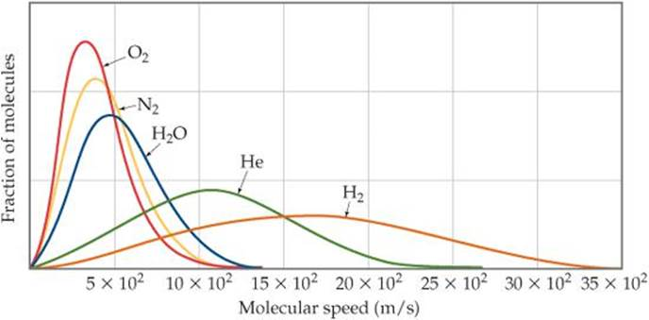
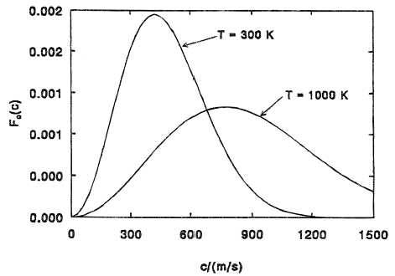
Maxwell-Boltzmann Distribution

Slide 29
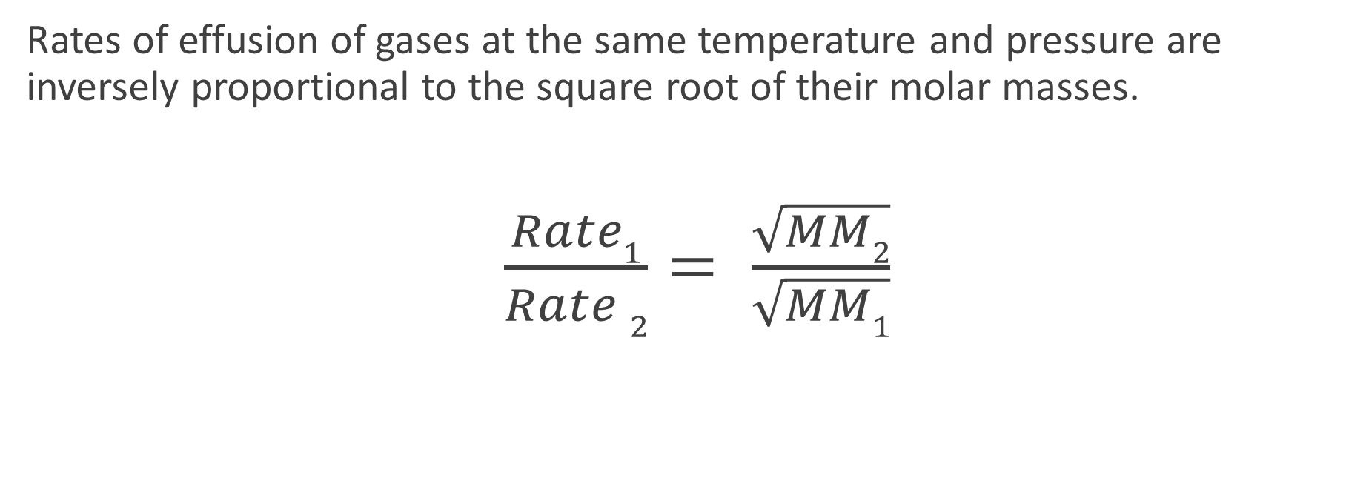
Graham’s Law of Effusion
Rates of effusion of gases at the same temperature and pressure are inversely proportional to the square root of their molar masses.
$\frac{Rate1}{Rate 2}= \frac{\sqrt{MM2}}{\sqrt{MM1}}$

Slide 30
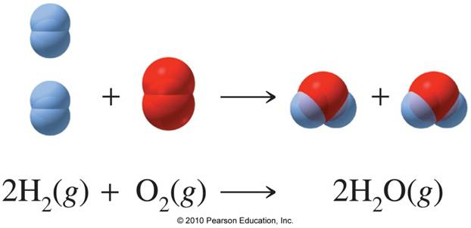
Gas Stoichiometry
Reactions of gases—treat the same way as reactions of liquids and solids.
Coefficients also represent the volumetric relationships in the rxn.

