Slide 1
Empire State Building
CREATED BY BRADY , ZACHARY ,
AND RILEY

Slide 2
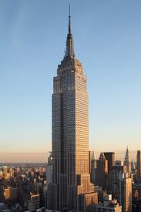
THE EIGHTH WONDER OF THE WORLD
Empire State Building.
It was designed by William Fredrick Lamb .
It was built in May 1,1931.
It was built at 5th Avenue.
It was used for looks.

Slide 3
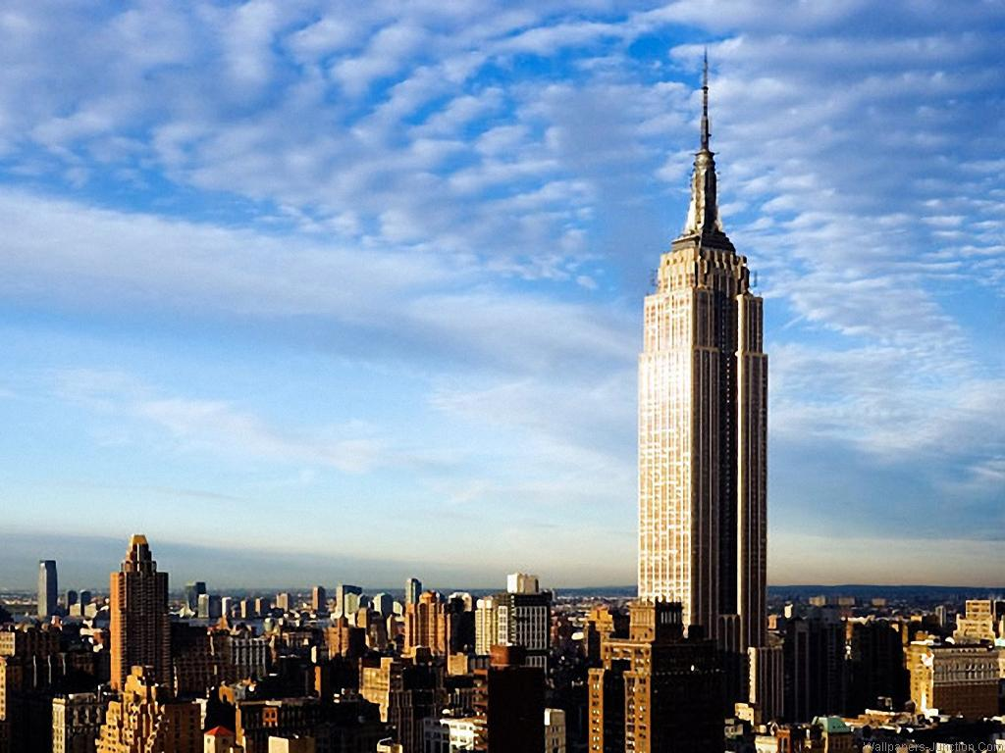
Materials And Facts
It was used in the movie “King Kong”
It was made of limestone on the front.
It was one of the last skyscrapers completed.
It features in many films today.
It was topped with an enormous spire.

Slide 4
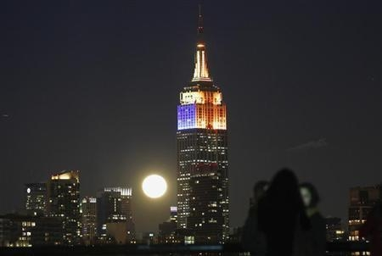
Pictures

Slide 5
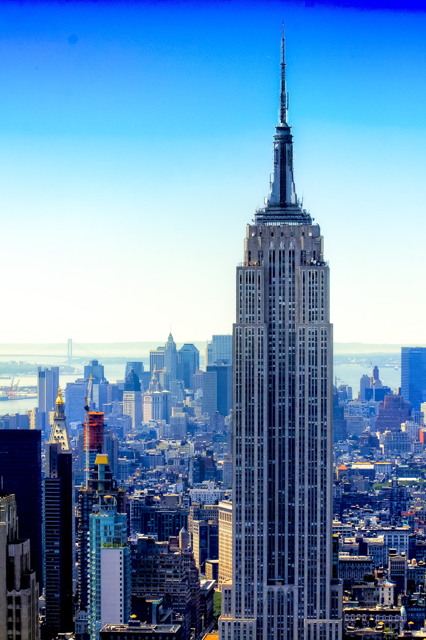
Resources
Website is: a view on cities
Pictures from: Google

