Slide 1
CLIMATE
CHAPTER 3

Slide 2
Earth’s tilt and revolutions=seasons(northern hemisphere)

Slide 3
Weather- condition of atmosphere at a particular location and specific time Climate- term for weather conditions for a particular location over a long period of time
Factors impacting weather
Amount of solar energy received by a location (think tilt)
Water vapor
Cloud cover
Landforms and bodies of water
Elevation-altitude
Air movement-wind

Slide 4
Types of precipitation
Convectional
Orographic
Frontal
Occurs after morning sunshine heats warm moist air.
Clouds form in the afternoon and rain falls in the afternoon
Think—equatorial rainforest regions
Associated with mountain ranges
Windward side and leeward side
Rain falls on the windward side of mountains because clouds cannot get over the mountains
Leeward side is rain shadow
Think Sierra Nevada
Andes
Associated with mid latitude
Interaction of Cold and warm fronts
Cold air is heavier and more dense so it pushes the warm air up into atmosphere causing precipitation to form

Slide 5
Convectional precipitation in the rain forest

Slide 6
Orographic precipitation

Slide 7
Image of South America—notice the orographic effect

Slide 8
Frontal Precipitation
warm front following a cold front
cold front pushing a warm front

Slide 9
Weather extremes

Slide 11
Weather extremes

Slide 13
Factors affecting climate of a region
Wind currents
Ocean currents
Zones of latitude
Altitude
Topography

Slide 14
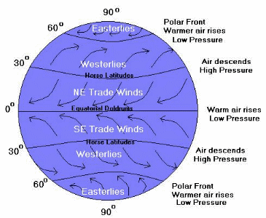
Wind currents
https://earth.nullschool.net/
Pg. 54

Slide 15
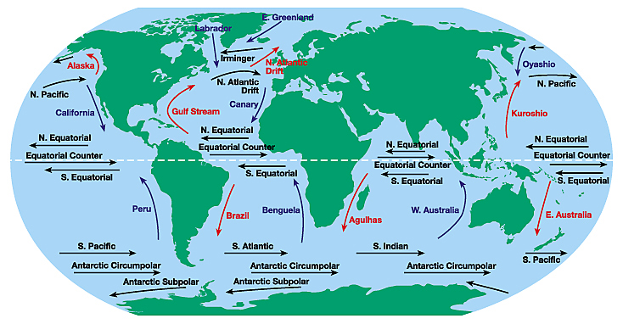
Ocean Currents
Pg.55

Slide 16
Zones of Latitude

Slide 18
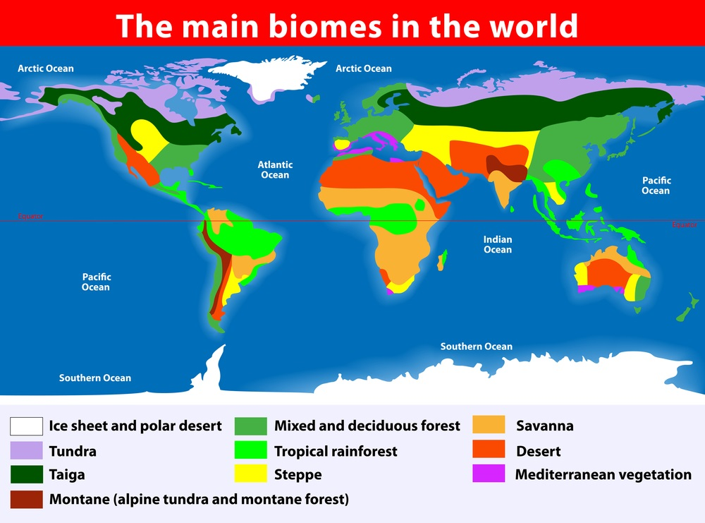

Slide 19
Ticket Out The Door
1. A TUNDRA climate would most likely be found in which zone of latitude?
2. Georgia is included in which global WIND CURRENT?
3. What is the relationship/difference between a CLIMATIC MAP and a BIOME MAP?

