Slide 1
Welcome to W.D. Robbins Library Media Center
Orientation 2016-17

Slide 2
Library Media Center Rules
Be Respectful
Use Quiet Voices
Be Responsible
Keep Your Hands and Feet to Yourself
Be Resourceful
Report All Problems to an Adult

Slide 3
Things we need to check out books!
Accelerated Reader Log
IRL and ZPD Zone
Library Card

Slide 4
Book Check Out Procedures
Return books to check out station.
Get a shelf marker to mark the place on the shelf where the book was taken from.
When finished selecting your books, go to the check out station. Make sure you come to the Library Media Center with your Library Card and your AR Reading Log.
Students in Grade 1 will check out 1 book at their reading level.
Students in Grade 2-5 will check out 2 books at their reading level. One book must be nonfiction and the Second book must be a Chapter Book.

Slide 5
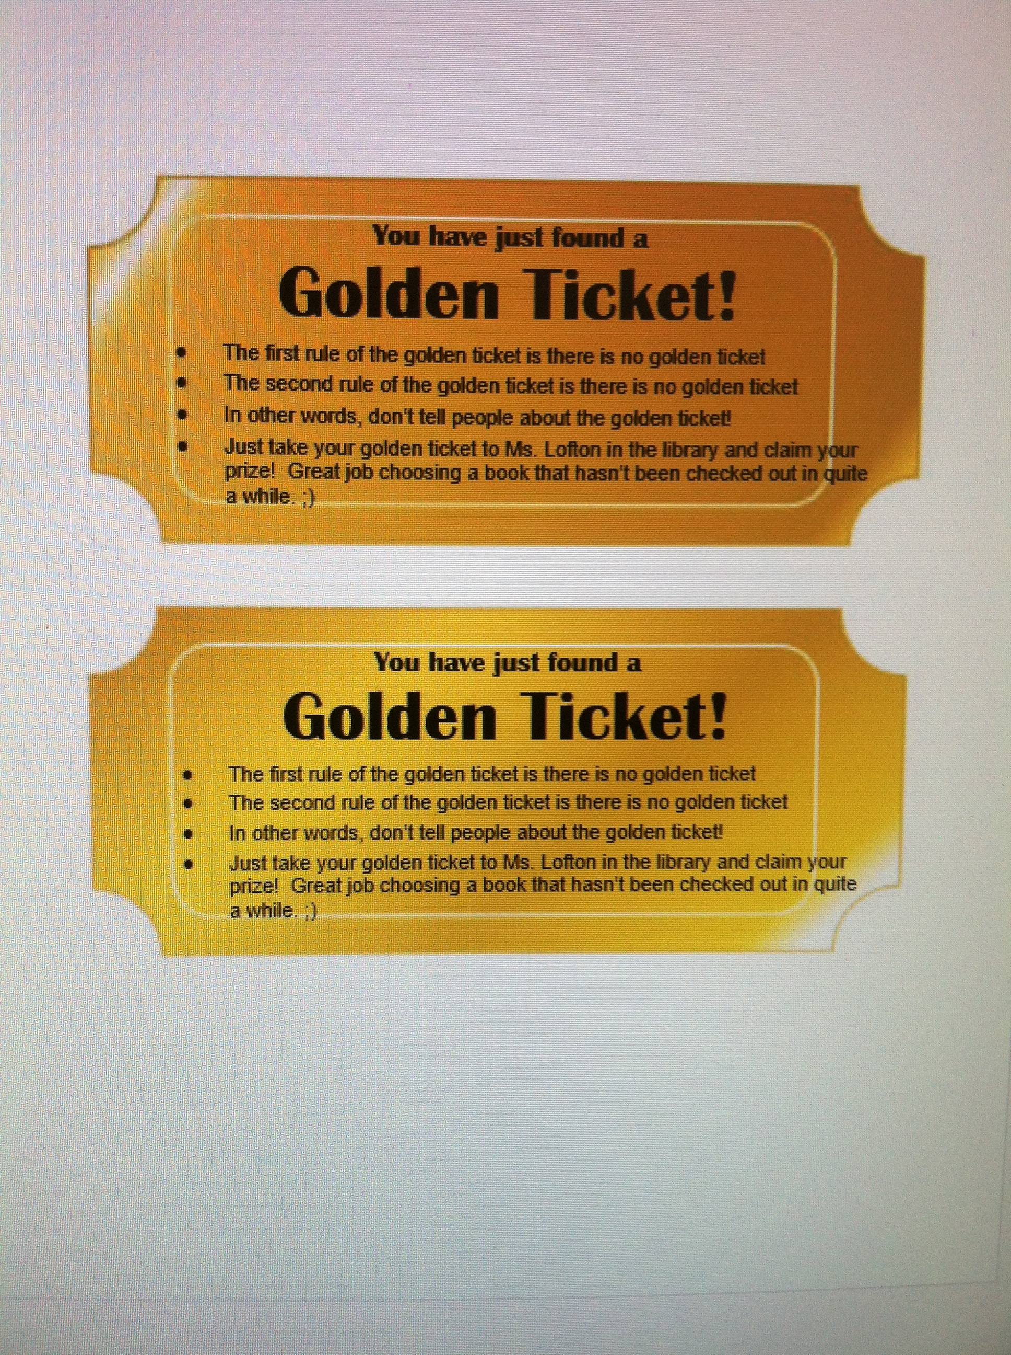
The Golden Ticket

