Slide 1
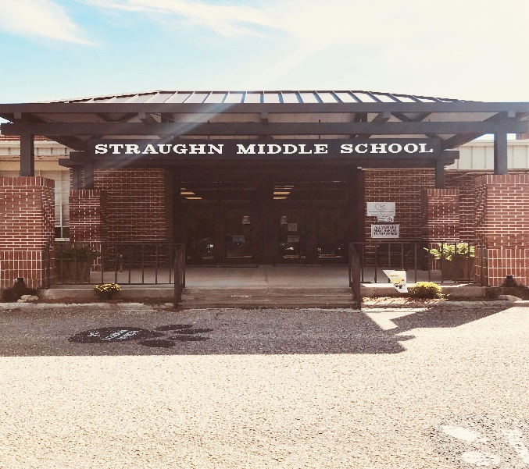
Where Can I Learn More?
What is Title I and How does it Impact our School?
Alabama State Department of Education
http://www.alsde.edu/sec/fp/Pages/home.aspx
For Additional
Questions
or to
Provide Feedback About our Programs…
Please contact:
Allocations for 2018-2019
Per Pupil Allocation $476.47
Total Allocation $76,235.20
Salaries and Benefits $44,832.38
Instructional Aid $16,600.00
Substitutes $323.04 School Level:
Library $5,000.00
Technology $8,479.78
Supplies $1,000.00
Parental Involvement $782.22
Total Budgeted $77,017.42
(with Parental Involvement)
Straughn
Middle School
2020-2021
Principal
Cassandra Anderson
Asst. Principal
Daniel Rodgers
29324 Straughn School Road
Andalusia, Al 36421
334-222-4090
Chris Thomasson,
Covington County Schools
Federal Programs Director
(334) 222-7571

Slide 2
What is Title I?
School-Parent Compact
Federal legislation requires that each district receiving Title I funds establish a School-Parent Compact to promote a collaborative effort to improve student academic achievement. Working together to educate the students, the staff and parents/guardians agree to implement the following:
The Schools:
Will provide research based instruction and intervention services
Will monitor student progress frequently to assess the success of interventions and adjust instruction as necessary
Will communicate with families on an ongoing basis regarding the students’ academic progress.
Will encourage parents/guardians to become involved in the governance of the school.
The Parents:
Will send their children to school prepared to learn, and on time.
Will attend at least one parent/teacher conference a year to discuss the academic progress of their children.
Will assist their children with their homework assignments on a regular basis to ensure completeness and accuracy.
How Can I Get Involved?
Title I is a program through which most school districts receive federal funding to provide supplemental instruction for students who qualify. The funds for each school district are based on a state formula that is calculated by the number of students from economically disadvantaged homes.
Students who qualify for academic support may be served in the areas of Language Arts and/or Mathematics. Title I funds are used to support mathematics instruction through the RTI process.
The goal of the Title I program is to provide the instructional services the students need in order to increase student performance and academic achievement.
Parental involvement is a critical component in student success. Please, make every effort to get involved in your child’s education and be a partner in their educational experience.
Keep in contact with your child’s teacher through telephone, conversations, or email
Participate in school-based events that are intended for attendance of all families (e.g., open houses, concerts, curriculum meetings…)
Serve as a role model, showing your child that you support his/her progress in school
Keep your child’s teacher informed about events in your child’s life that may affect his/her performance in school
Support your child’s extra-curricular activities
Discuss ideas for parent involvement with your child’s teacher and parent organization

