Slide 1
Veterinary Science CDE
Species Identification

Slide 2
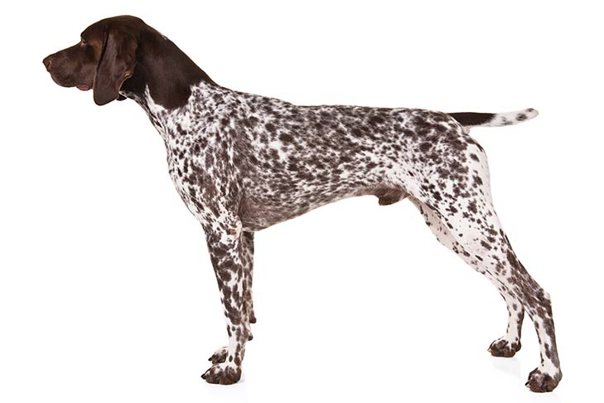

Slide 3
German Shorthair Pointer
Sporting Group

Slide 4
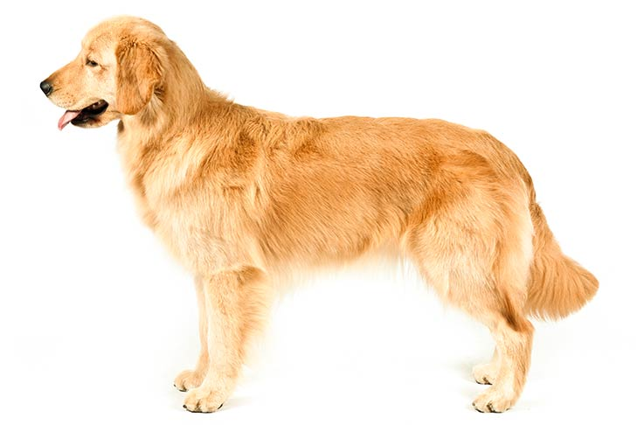

Slide 5
Golden Retriever
Sporting Group

Slide 6
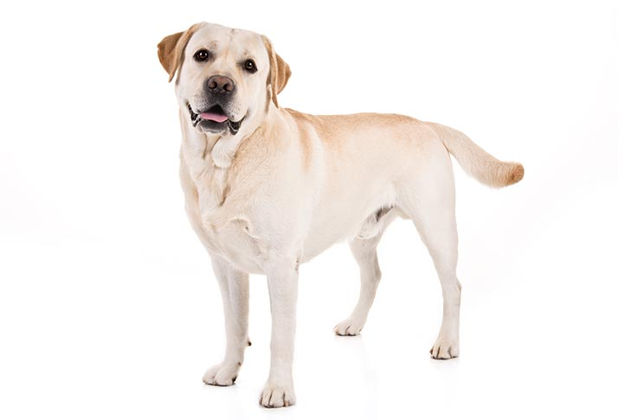

Slide 7
Labrador Retriever
Sporting Group

Slide 8
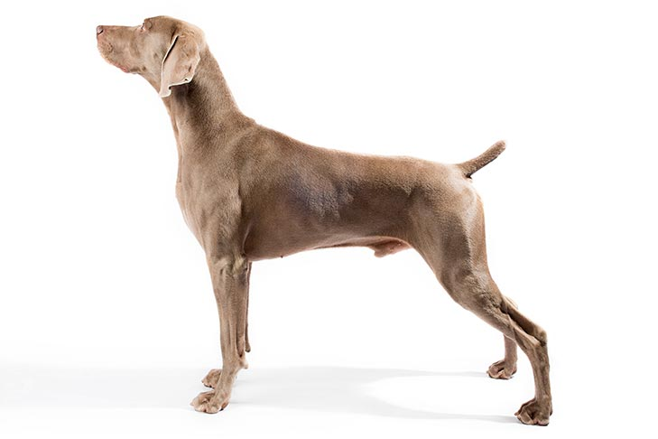

Slide 9
Weimaraner
Sporting Group

Slide 10
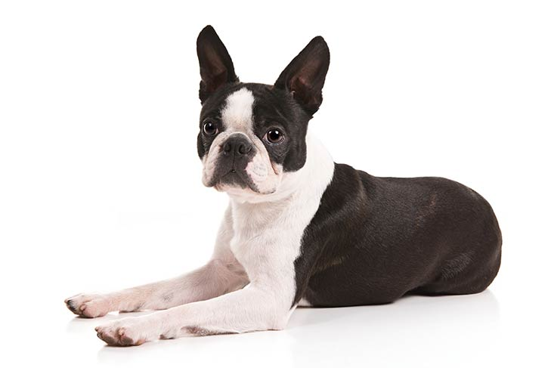

Slide 11
Boston Terrier
Non-Sporting Group

Slide 12
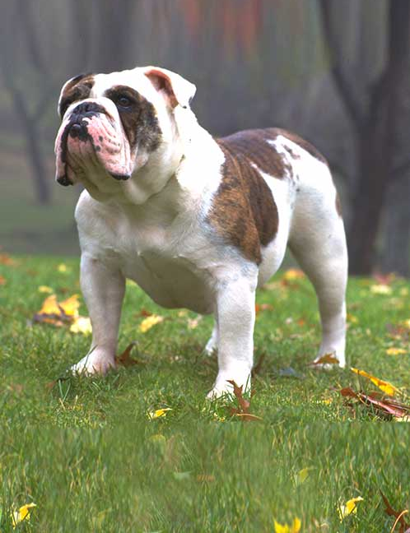

Slide 13
Bulldog
Non-Sporting Group

Slide 14
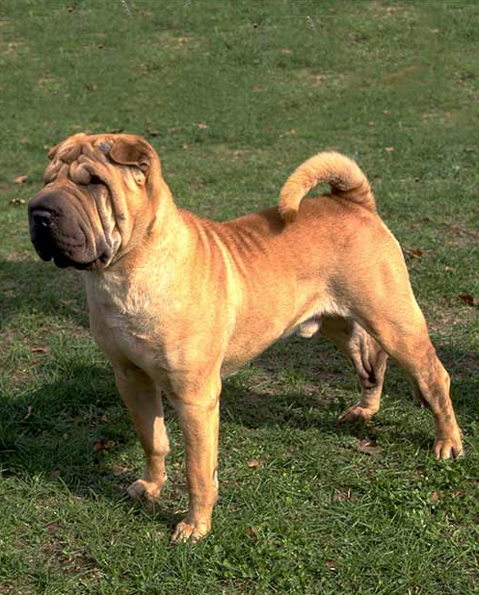

Slide 15
Chinese Shar-Pei
Non-Sporting Group

Slide 16
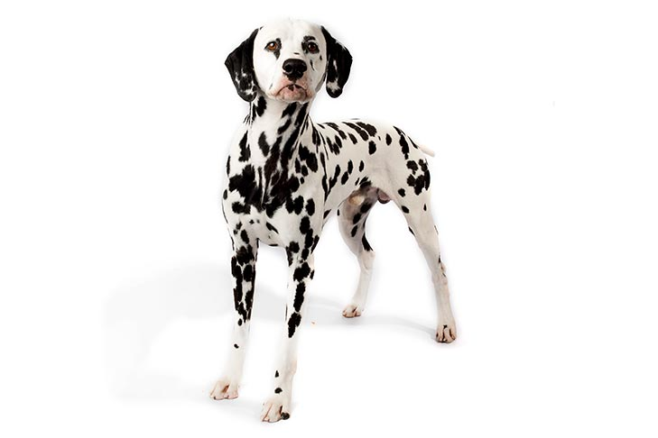

Slide 17
Dalmation
Non-Sporting Group

Slide 18
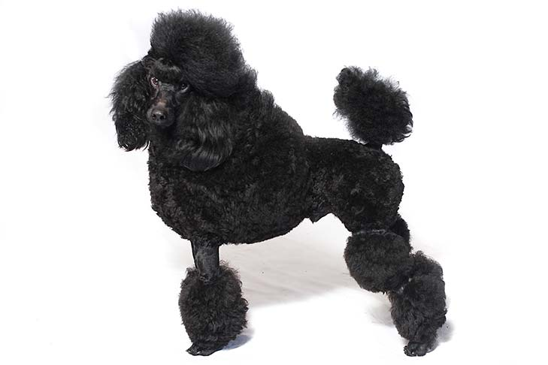

Slide 19
Poodle
Non-Sporting Group

Slide 20
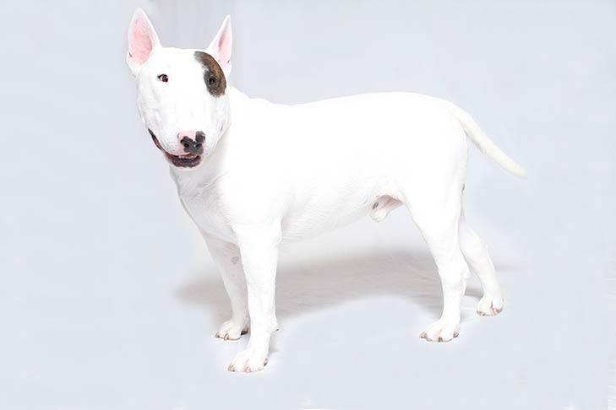

Slide 21
Bull Terrier
Terrier Group

Slide 22
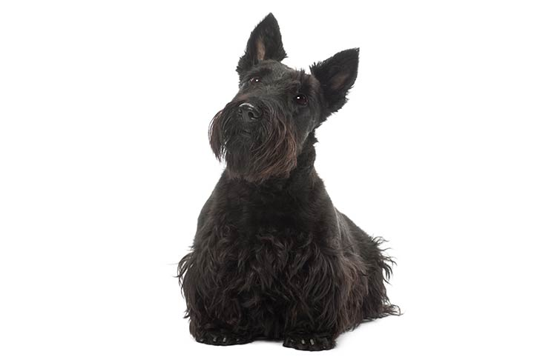

Slide 23
Scottish Terrier
Terrier Group

Slide 24
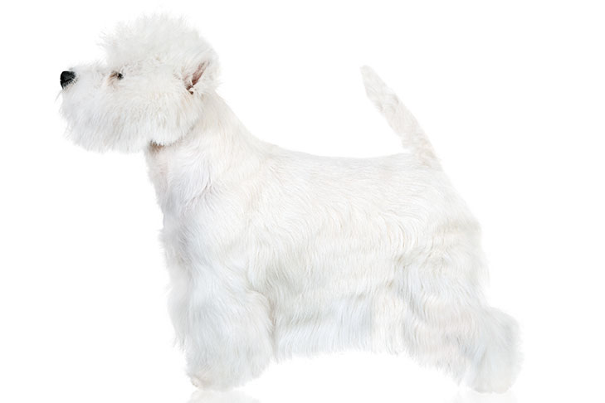

Slide 25
West Highland White Terrier
Terrier Group

Slide 26
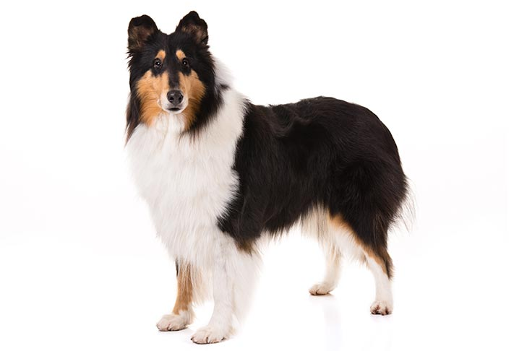

Slide 27
Collie
Herding Group

Slide 28
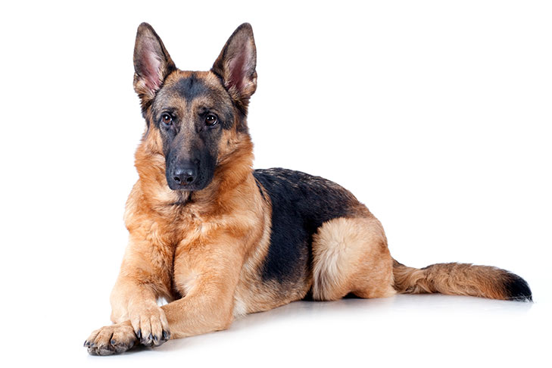

Slide 29
German Shepherd
Herding Group

Slide 30
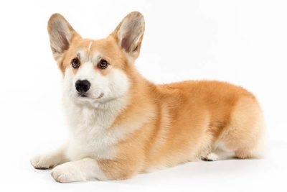

Slide 31
Pembroke Welsh Corgi
Herding Group

Slide 32
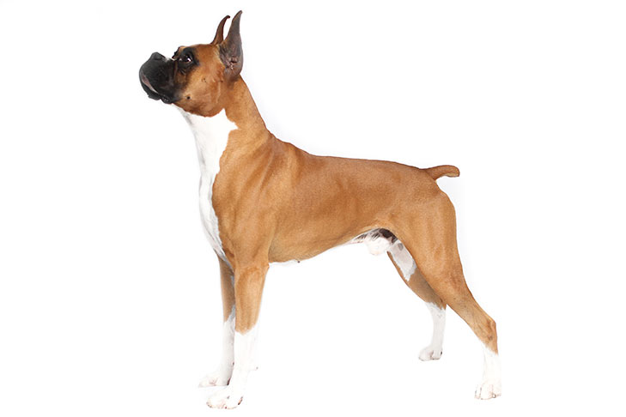

Slide 33
Boxer
Working Group

Slide 34
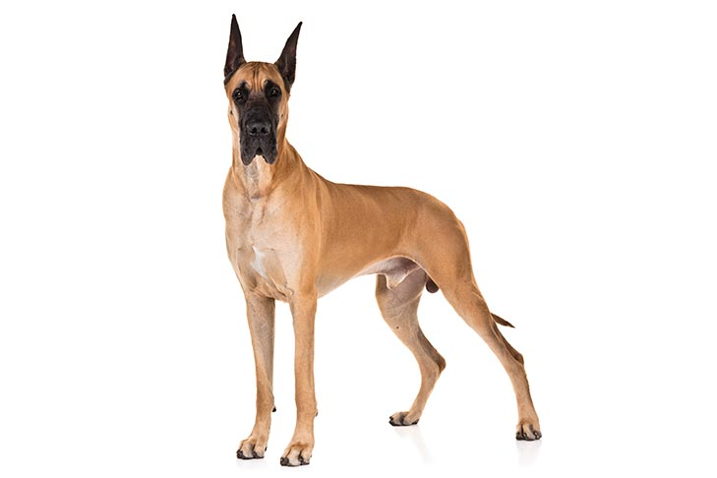

Slide 35
Great Dane
Working Group

Slide 36
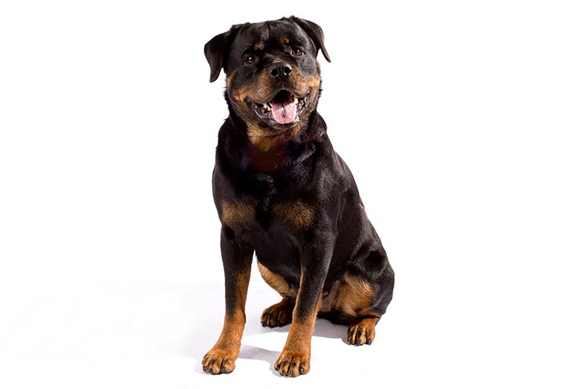

Slide 37
Rottweiler
Working Group

Slide 38
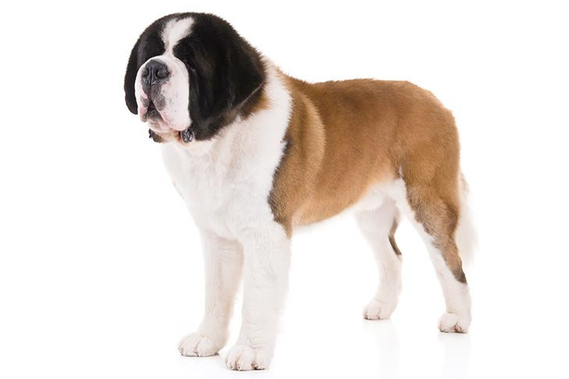

Slide 39
Saint Bernard
Working Group

Slide 40
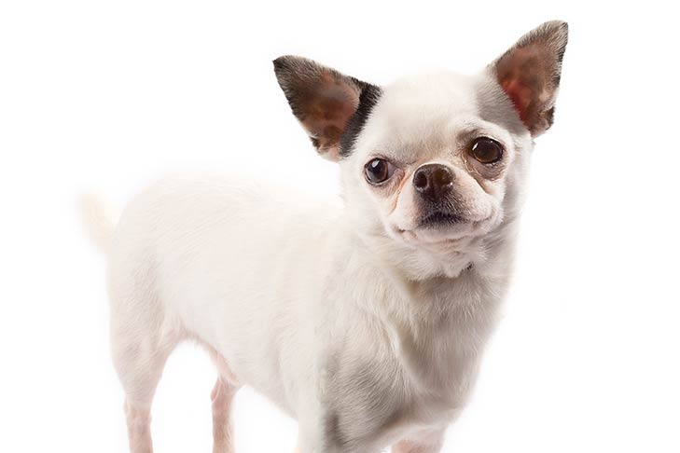

Slide 41
Chihuahua
Toy Group

Slide 42
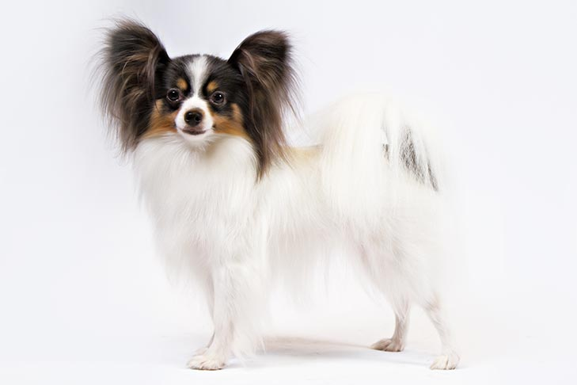

Slide 43
Papillion
Toy Group

Slide 44
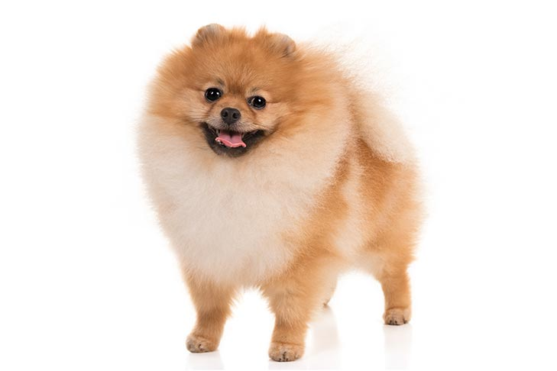

Slide 45
Pomerian
Toy Group

Slide 46
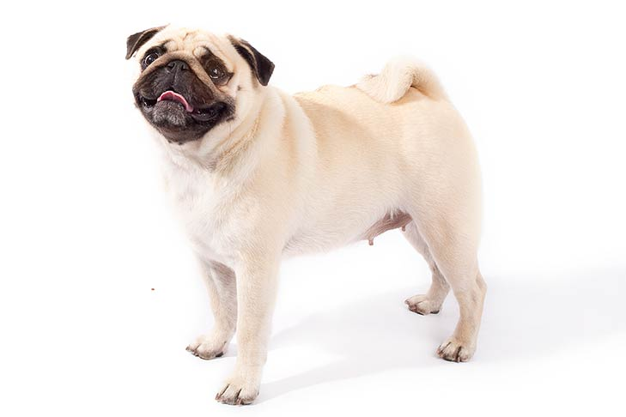

Slide 47
Pug
Toy Group

Slide 48
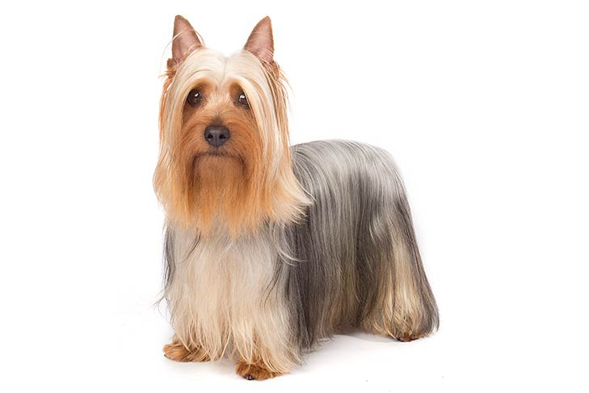

Slide 49
Yorkshire Terrier
Toy Group

Slide 50
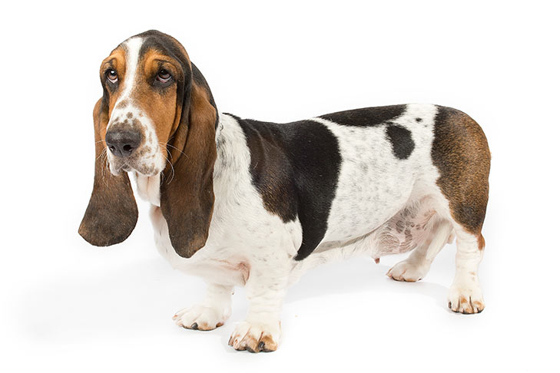

Slide 51
Basset Hound
Hound Group

Slide 52
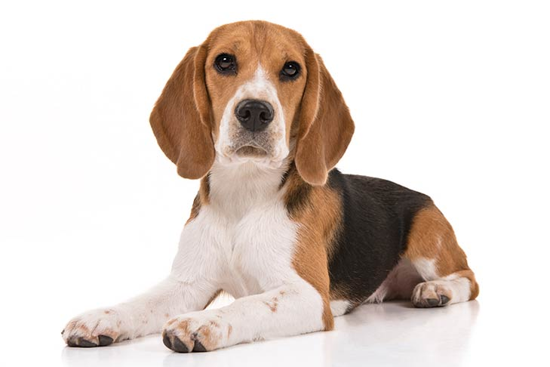

Slide 53
Beagle
Hound Group

Slide 54
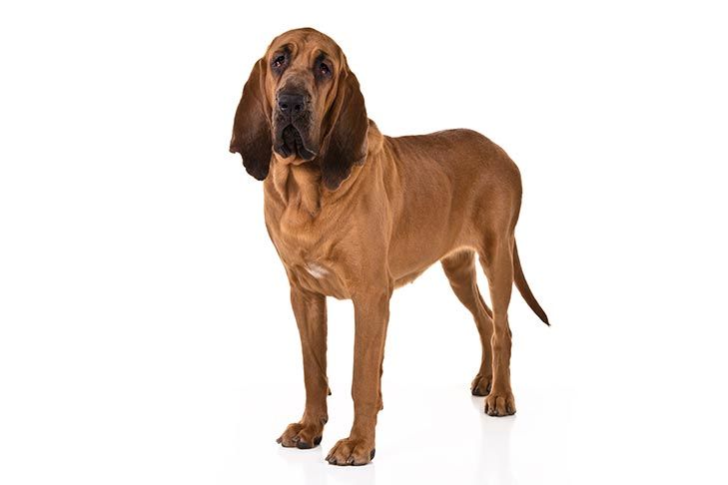

Slide 55
Bloodhound
Hound Group

Slide 56
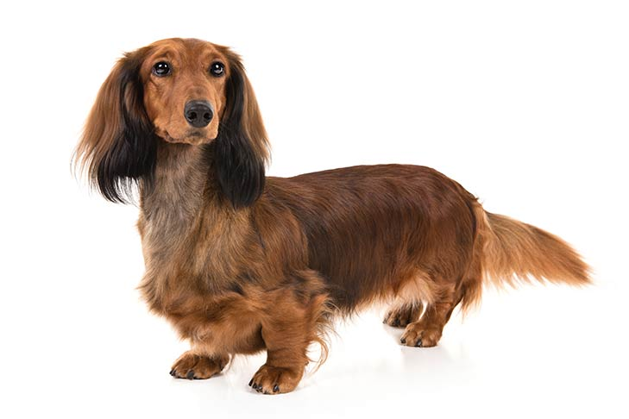

Slide 57
Dachshund
Hound Group

Slide 58
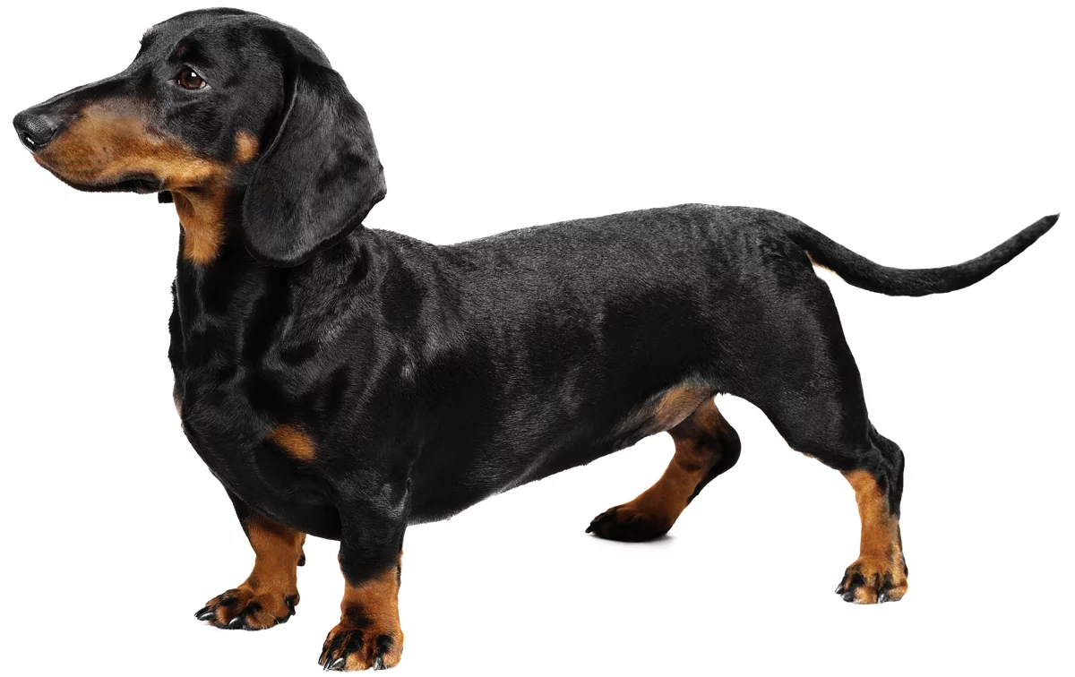

Slide 59
Dachsund
Hound Group

Slide 60
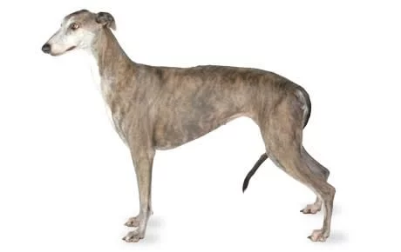

Slide 61
Greyhound
Hound Group

Slide 62
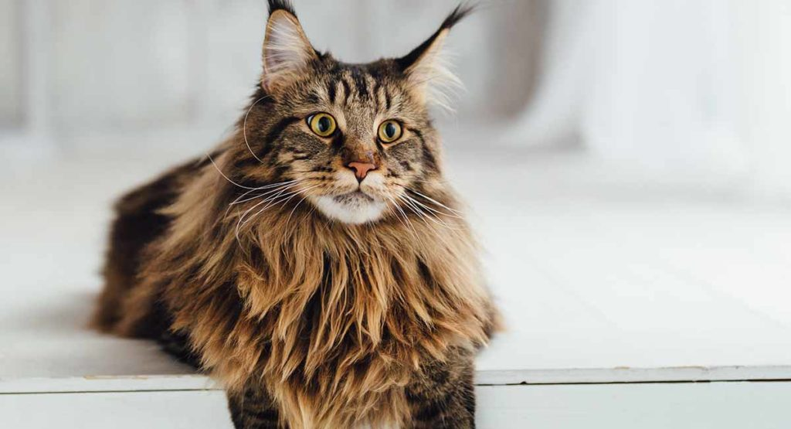

Slide 63
Maine Coon
Cats

Slide 64
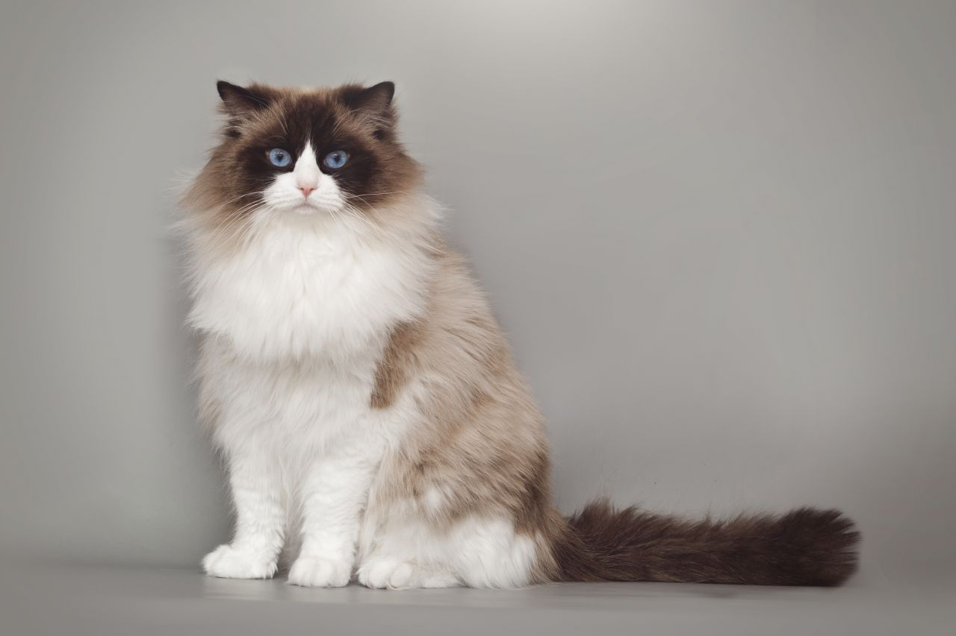

Slide 65
Ragdoll
Cats

Slide 66
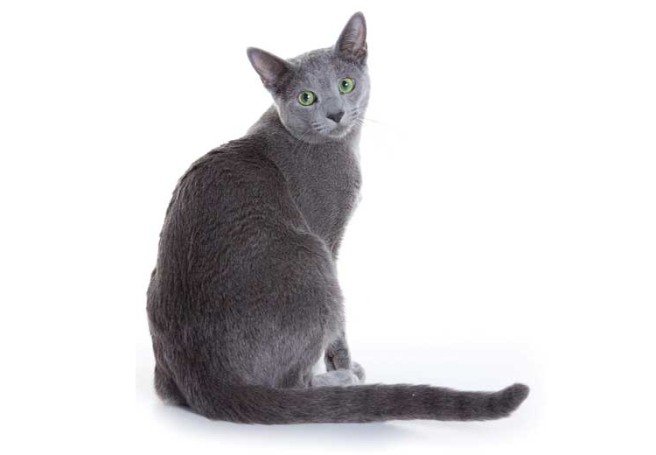

Slide 67
Russian Blue
Cats

Slide 68
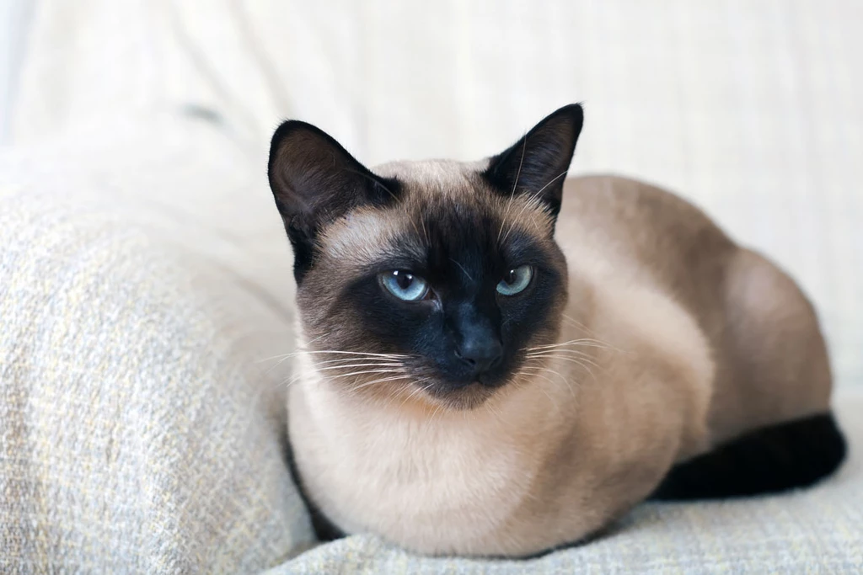

Slide 69
Siamese
Cats

Slide 70
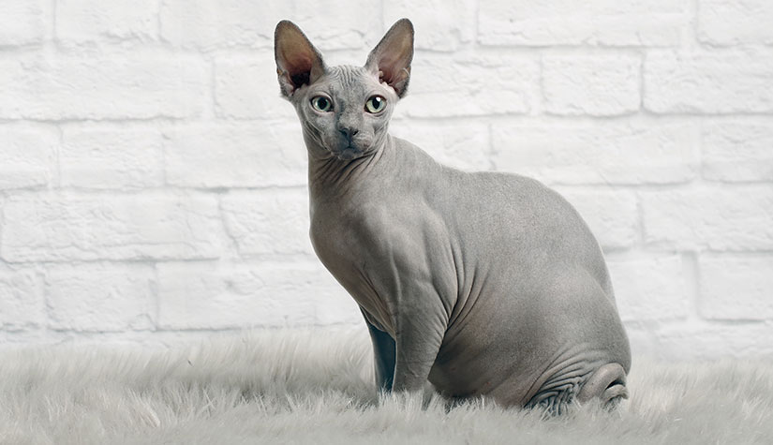

Slide 71
Sphynx
Cats

Slide 72
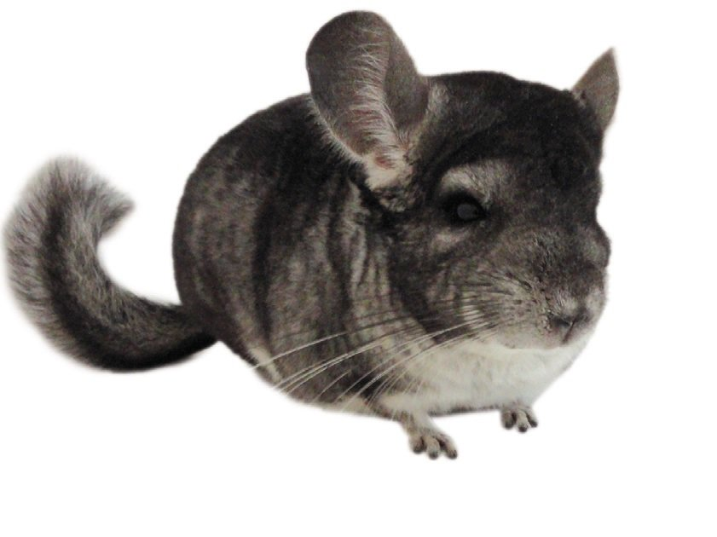

Slide 73
Chinchilla
Small Mammals

Slide 74
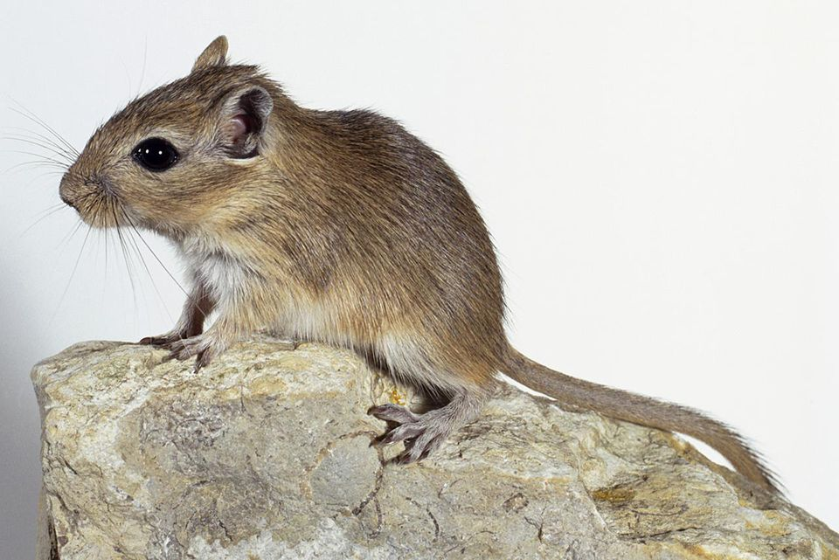

Slide 75
Gerbils
Small Mammals

Slide 76
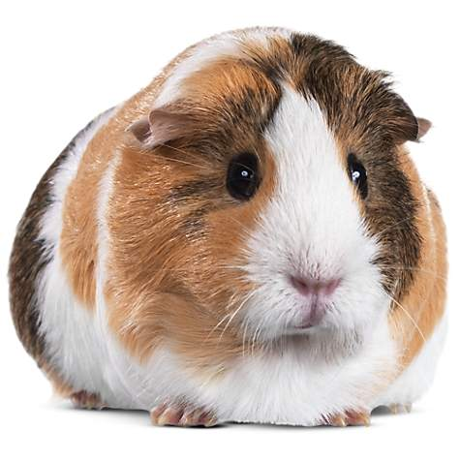

Slide 77
Guinea Pig
Small Mammals

Slide 78
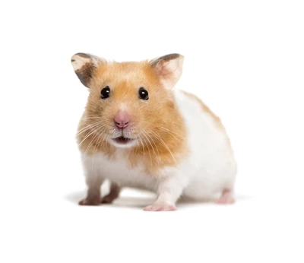

Slide 79
Hamster
Small Mammals

Slide 80
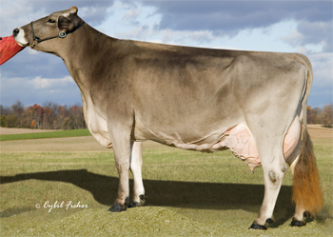

Slide 81
Brown Swiss
Dairy Cattle

Slide 82
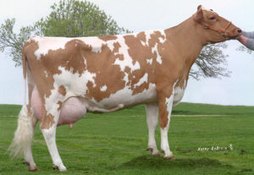

Slide 83
Guernsey
Dairy Cattle

Slide 84
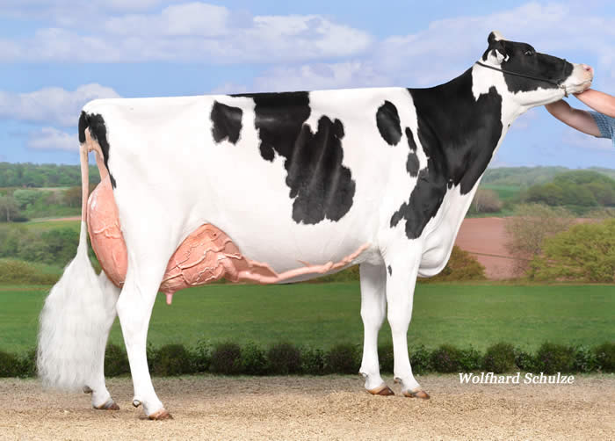

Slide 85
Holstein
Dairy Cattle

Slide 86
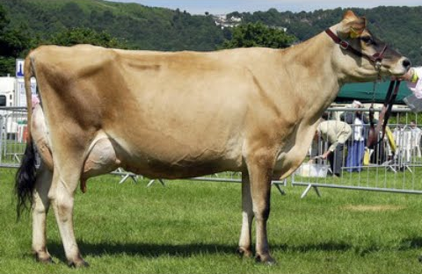

Slide 87
Jersey
Dairy Cattle

Slide 88
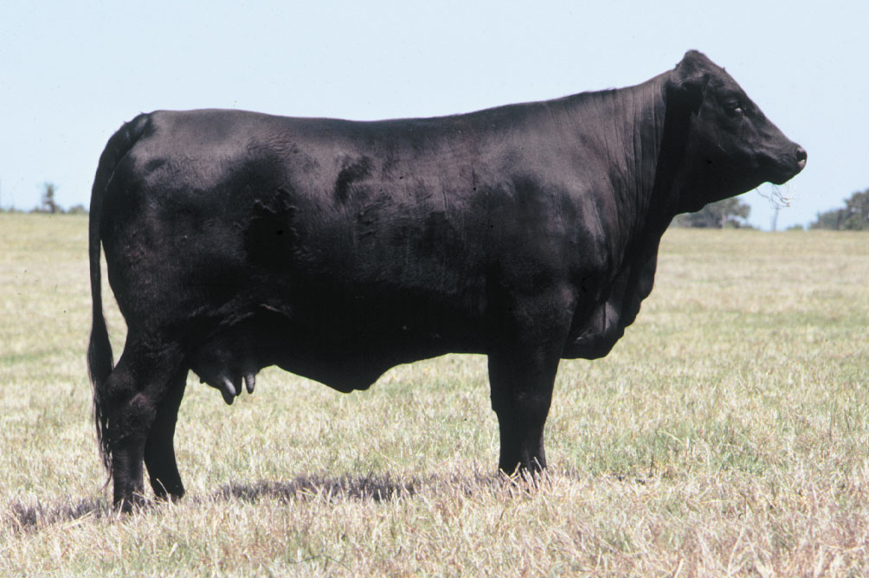

Slide 89
Angus
Beef Cattle

Slide 90
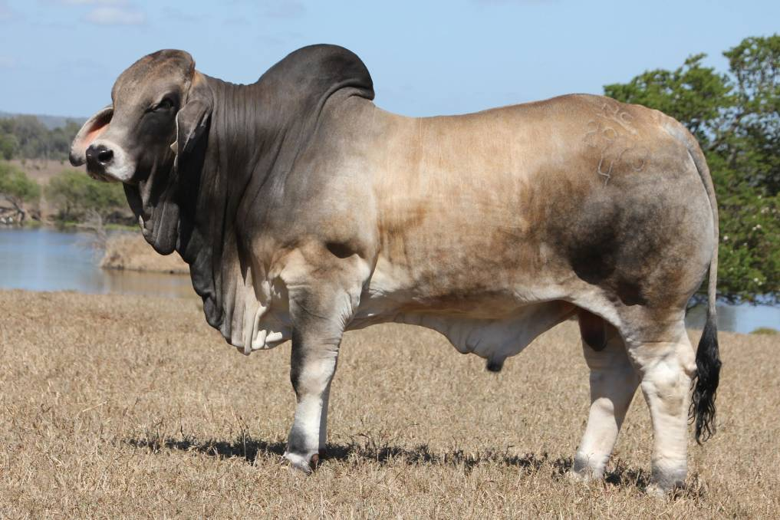

Slide 91
Brahman
Beef Cattle

Slide 92
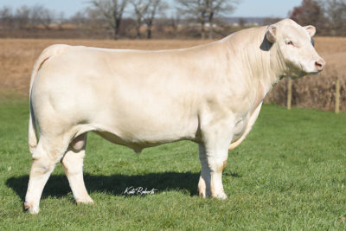

Slide 93
Charolais
Beef Cattle

Slide 94
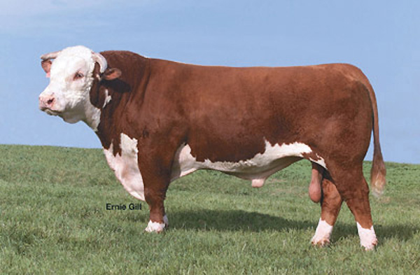

Slide 95
Hereford
Beef Cattle

Slide 96
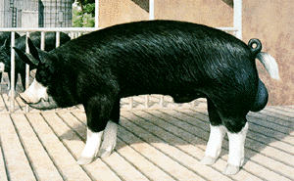

Slide 97
Berkshire
Swine

Slide 98
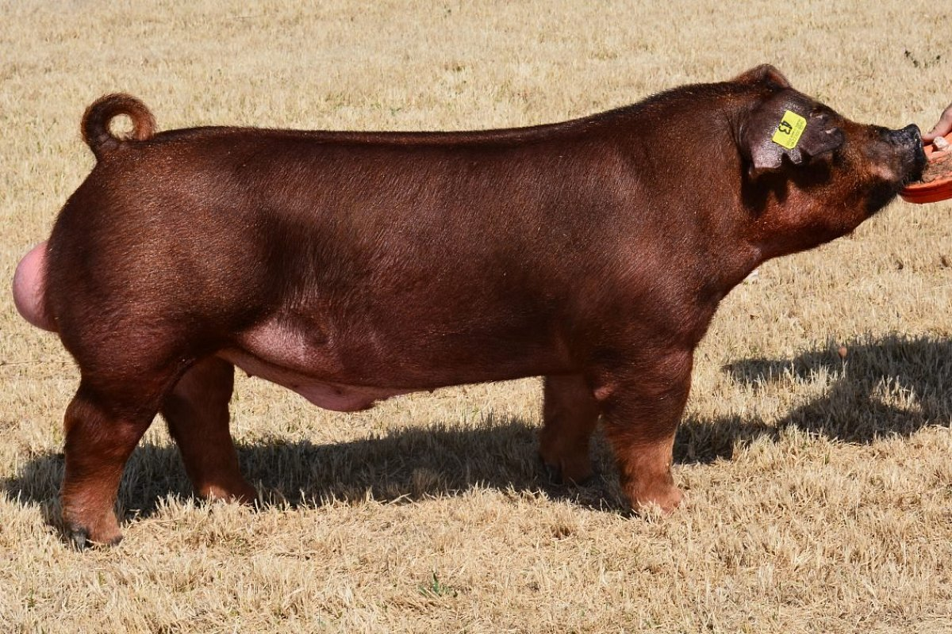

Slide 99
Duroc
Swine

Slide 100
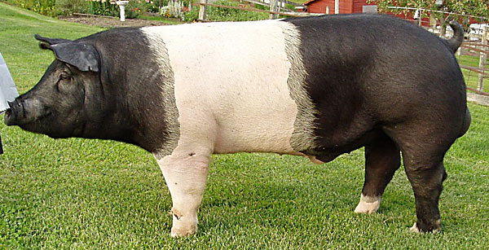

Slide 101
Hampshire
Swine

Slide 103
Yorkshire
Swine

Slide 104
Equipment ID

Slide 106
Autoclave

Slide 108
Centrifuge

Slide 110
Electric Dehorner

Slide 112
Fetal Extractor – Calf

Slide 114
Hoof Knife

Slide 116
Rumen Magnet

Slide 118
Scissors – Suture Wire Cutting

Slide 120
Squeeze Chute

