Slide 1
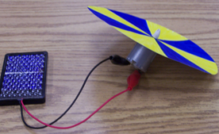
Color Spinners
This activity is a study of primary colors. Students design and build their very own color spinner to observe how colors change and how rapid movement can produce different colors.
Grades: 3-12

