Slide 1
FLORICULTURE PRACTICE SESSION
TWO

Slide 2
Instructions
You have 45 seconds to identify these plants and place the number of the plant in the correct place on you paper.
GOOD LUCK!

Slide 3
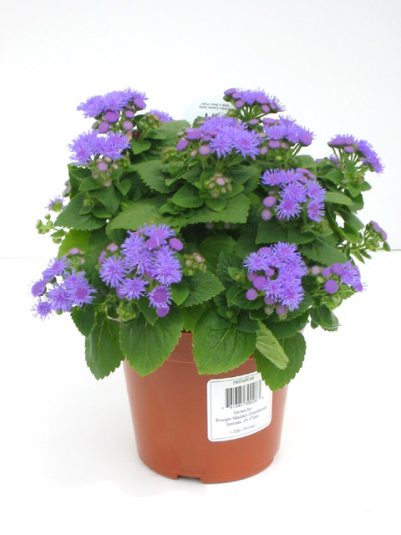
1

Slide 4
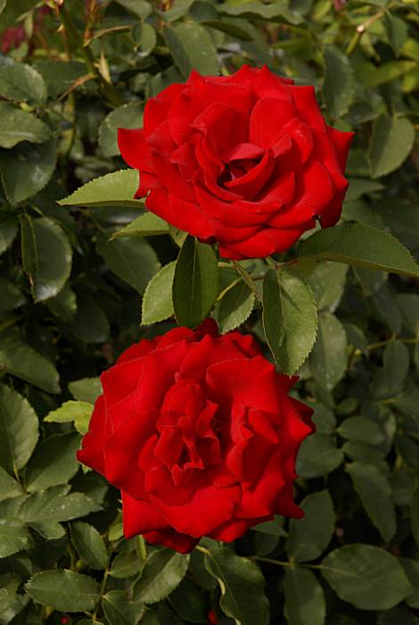
2

Slide 5
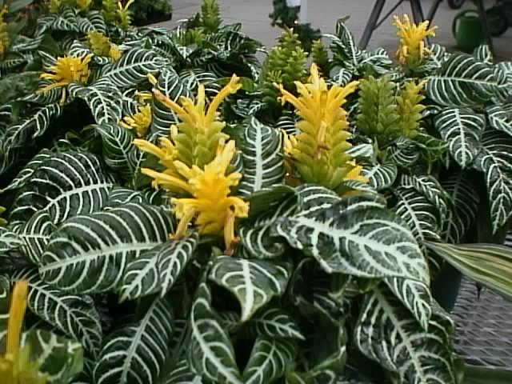
3

Slide 6
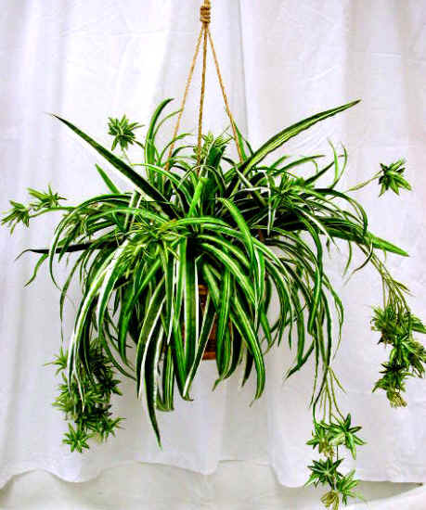
4

Slide 7
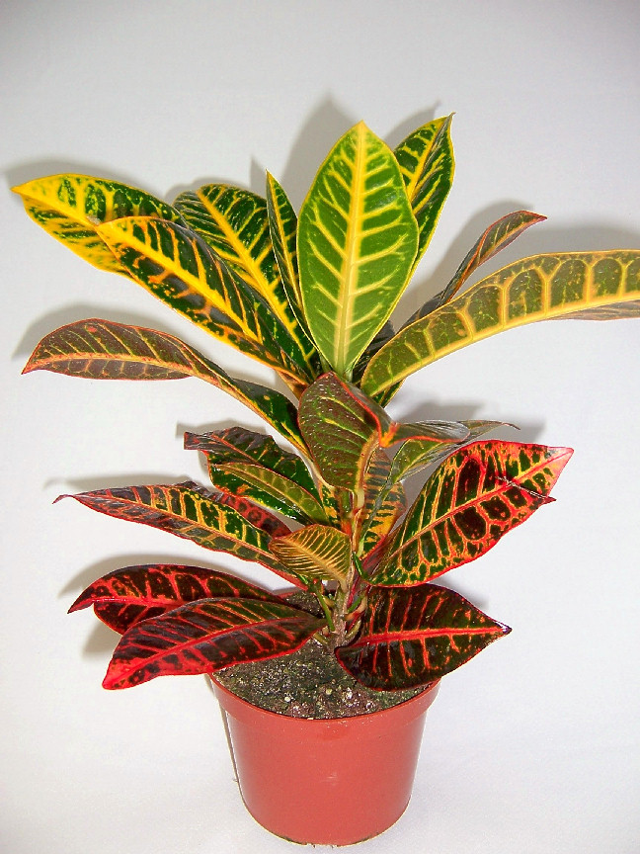
5

Slide 8
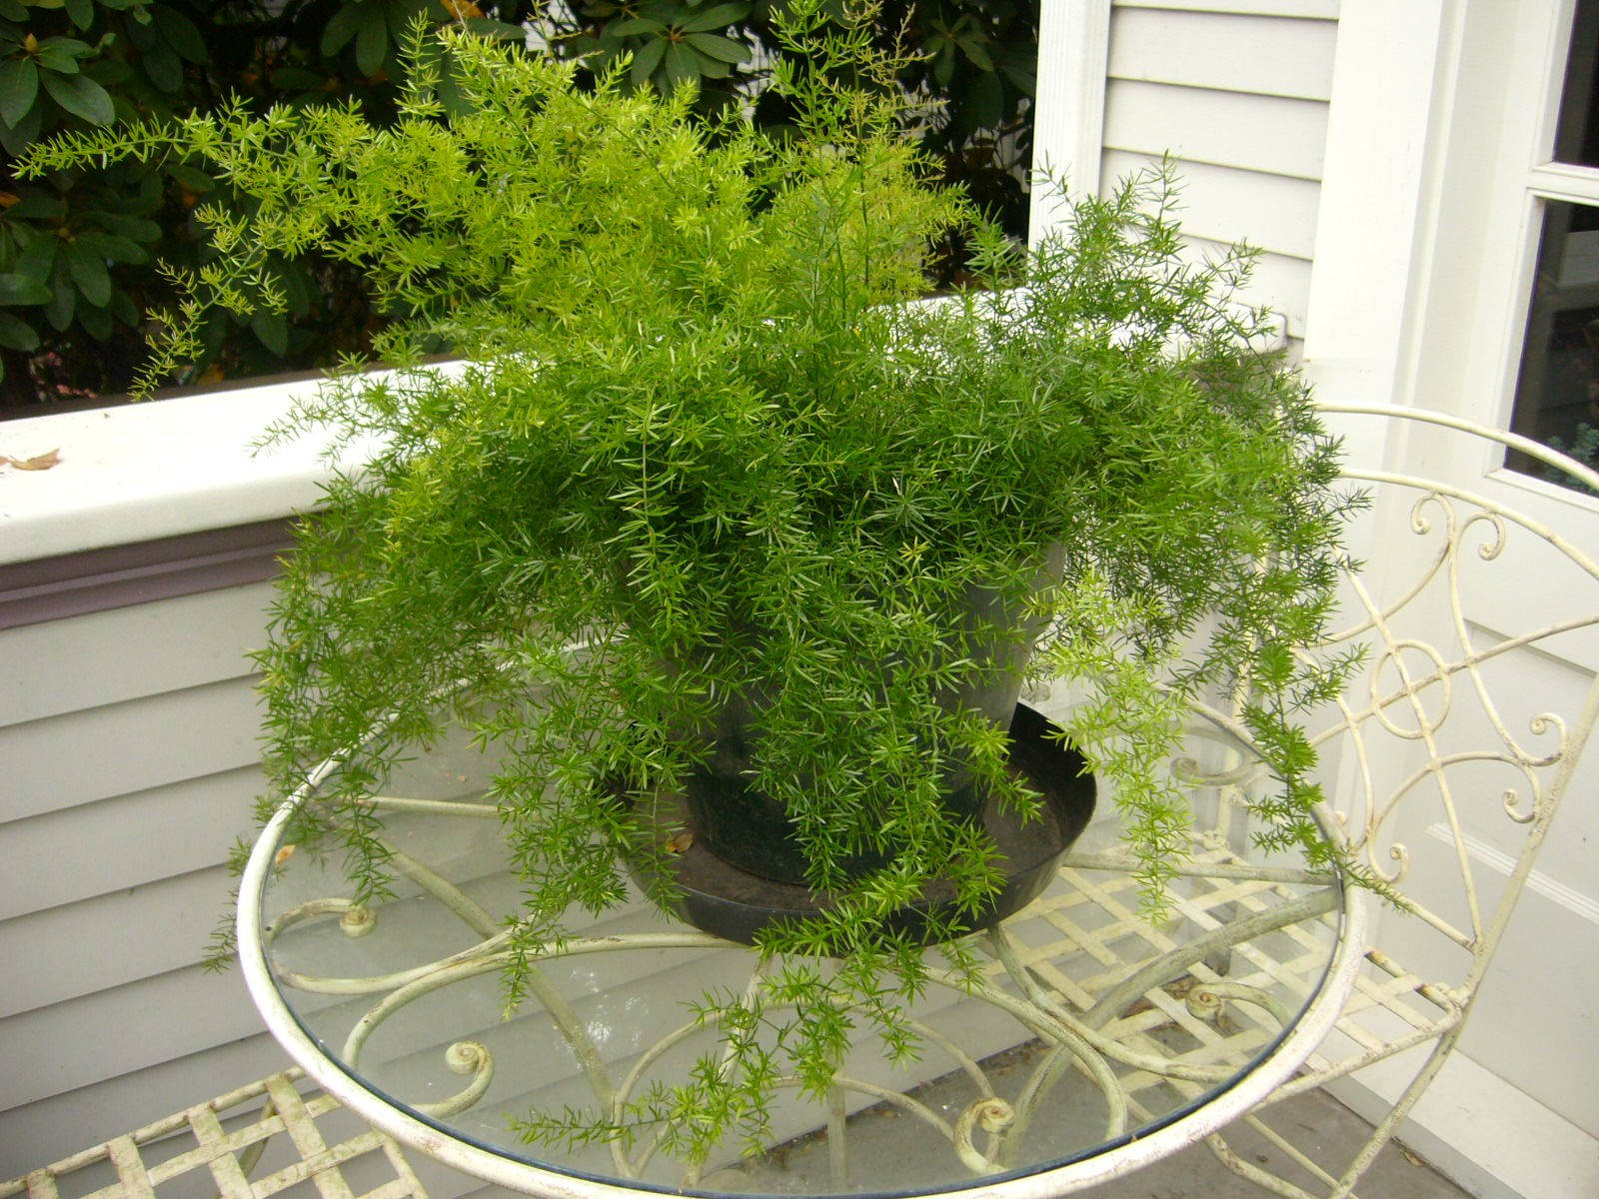
6

Slide 9
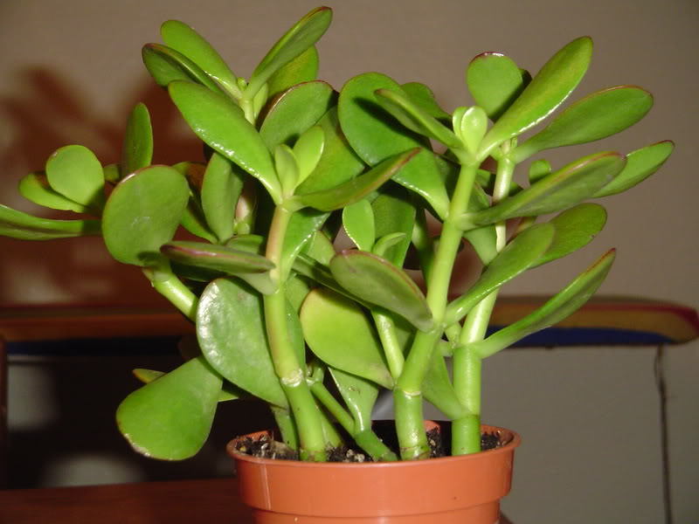
7

Slide 10
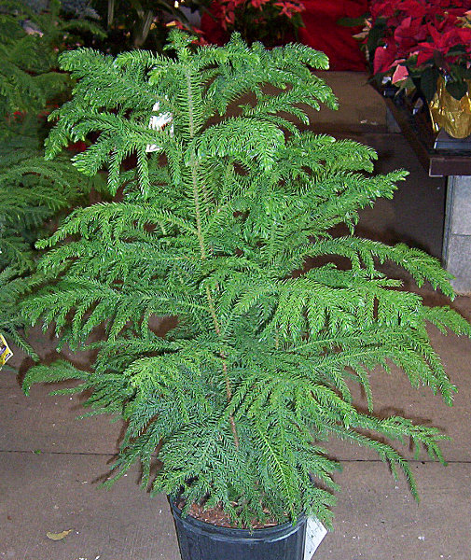
8

Slide 11
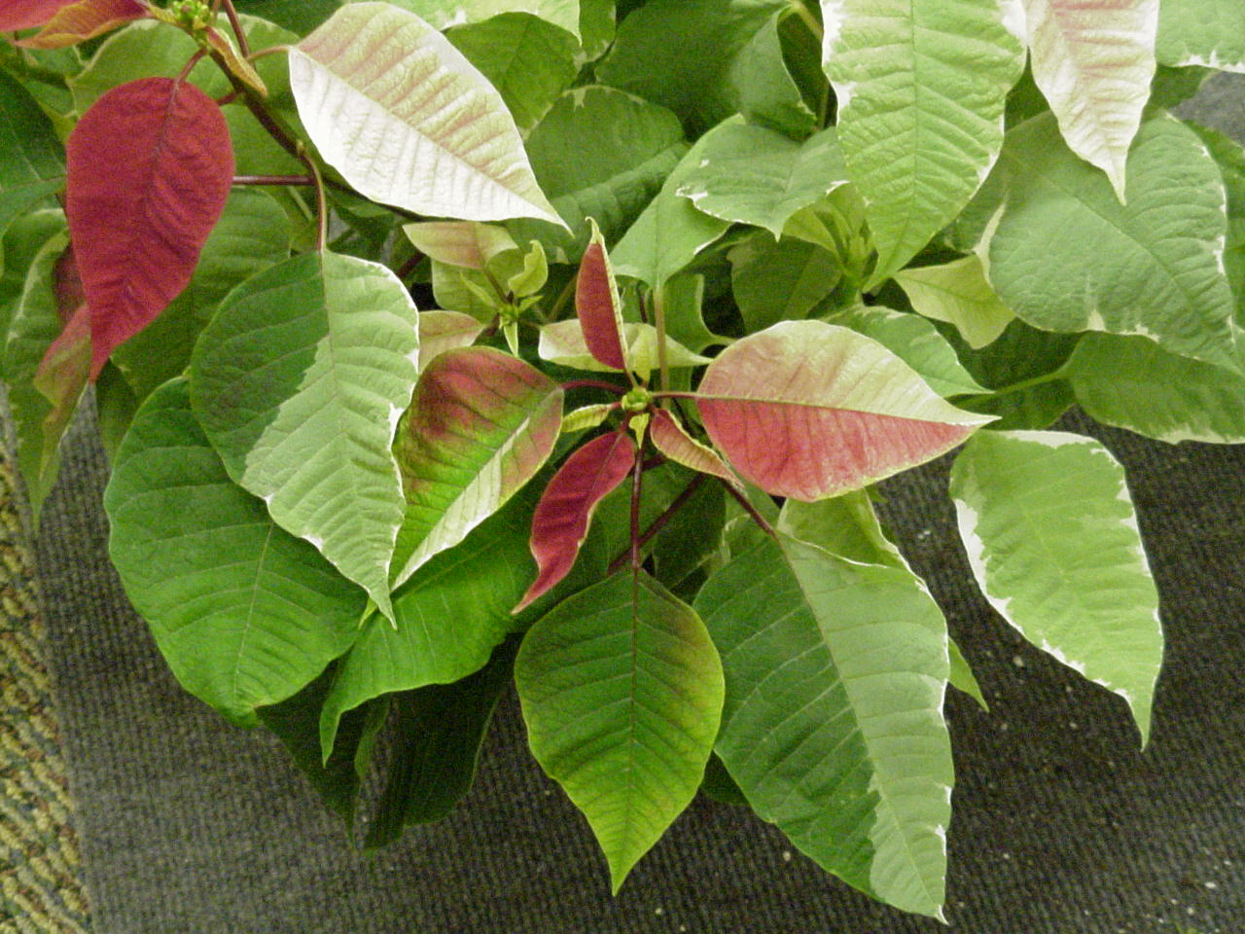
9

Slide 12
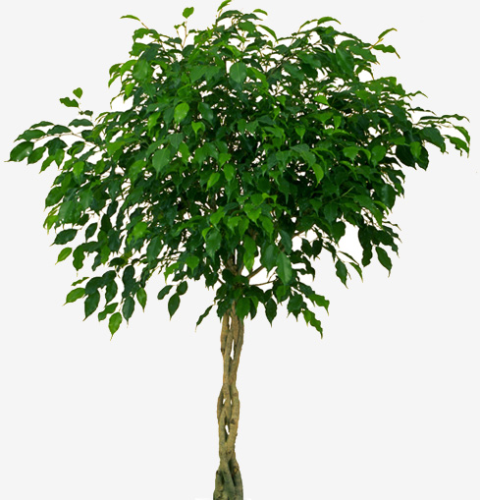
10

Slide 13
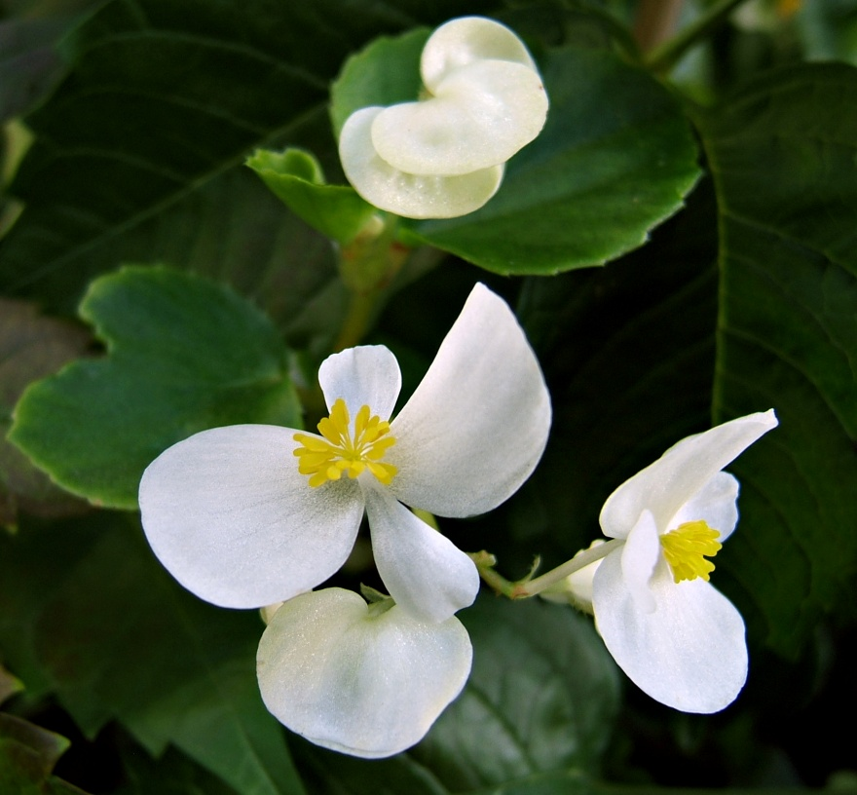
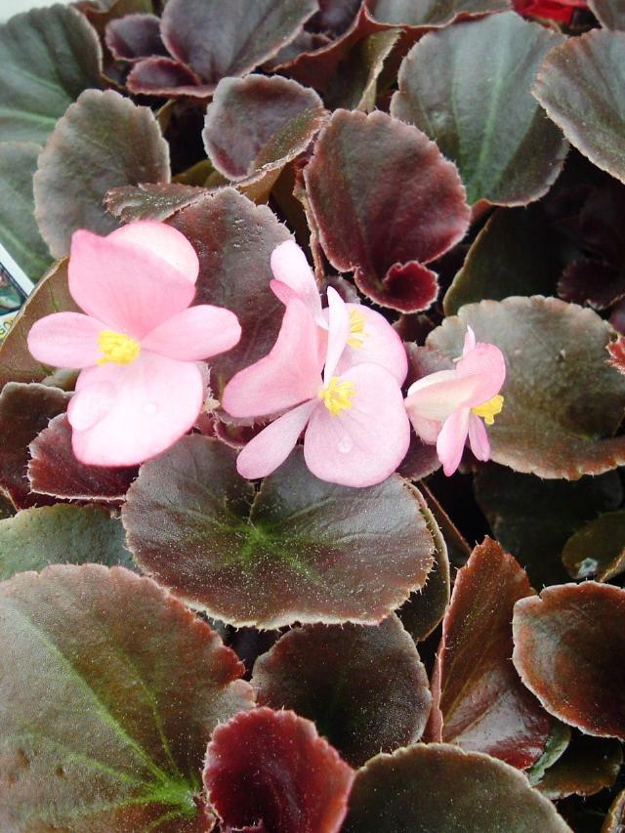
11

Slide 14
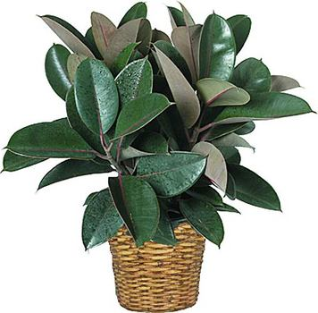
12

Slide 15
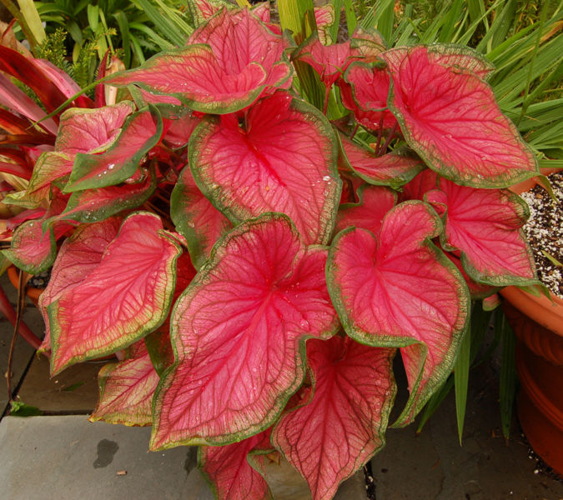
13

Slide 16
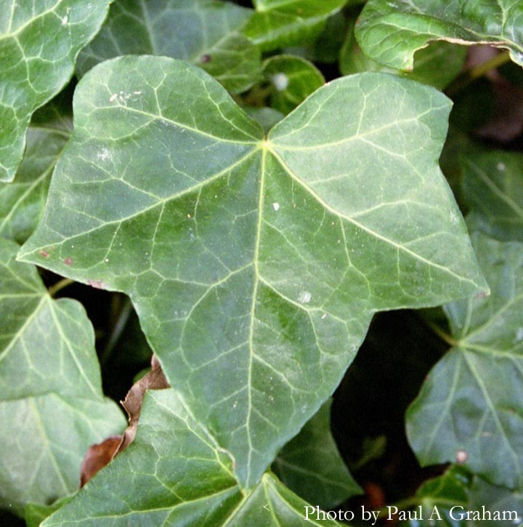
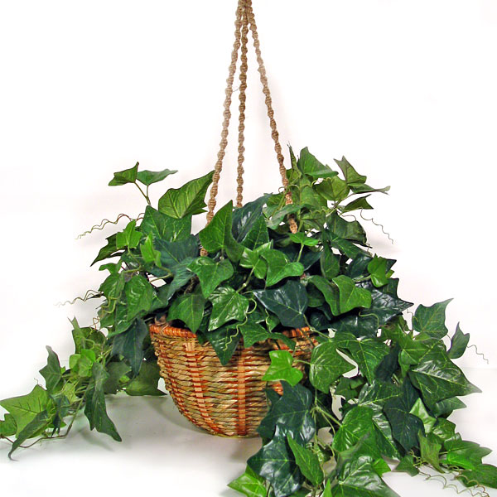
14

Slide 17
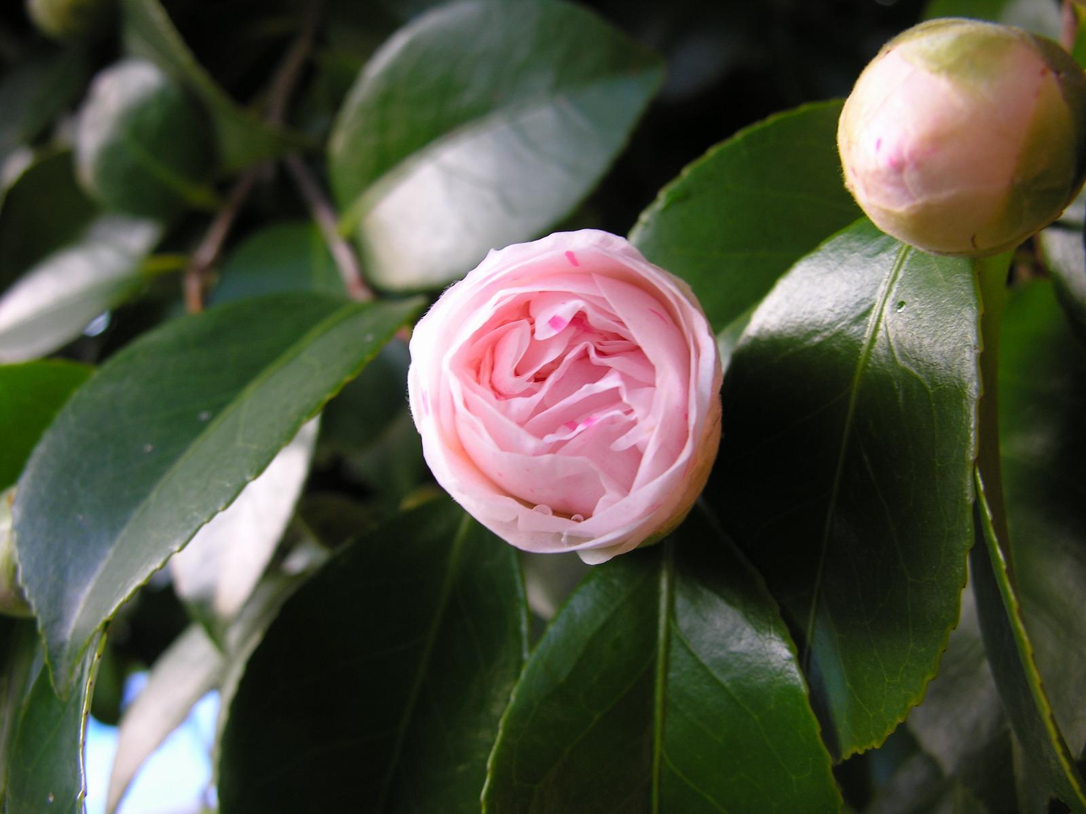
15

Slide 18
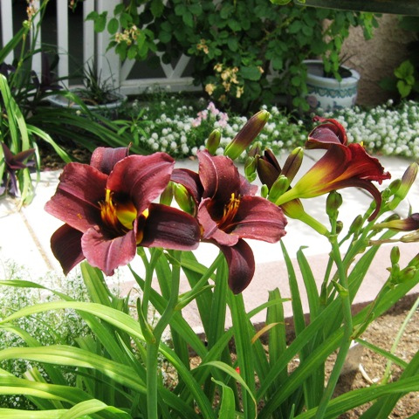
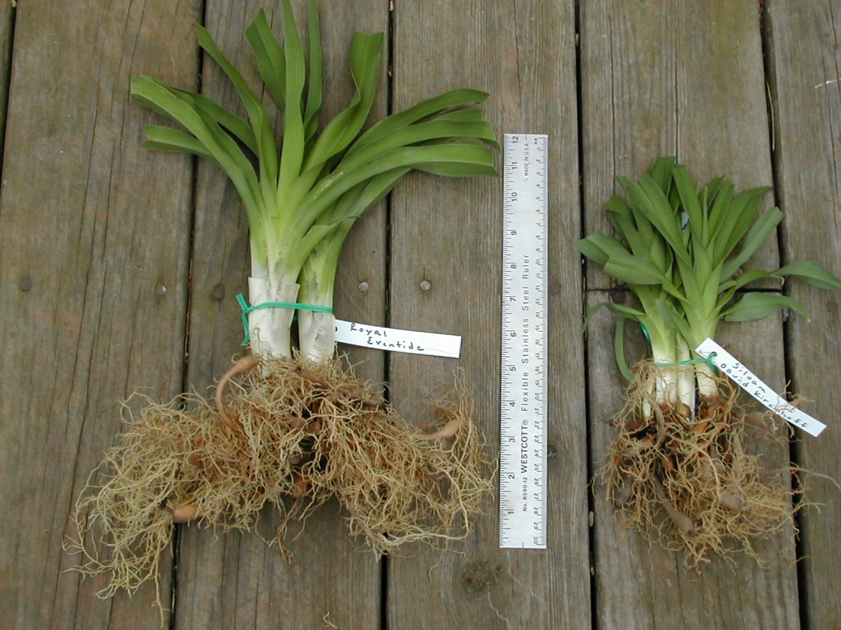
16

Slide 19
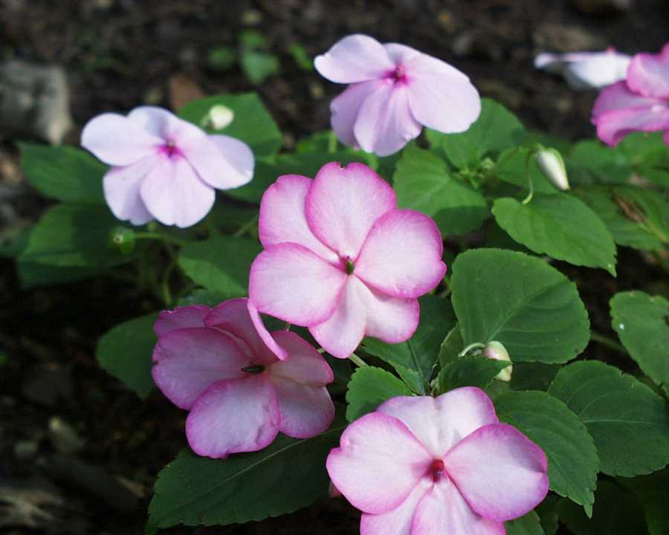
17

Slide 20
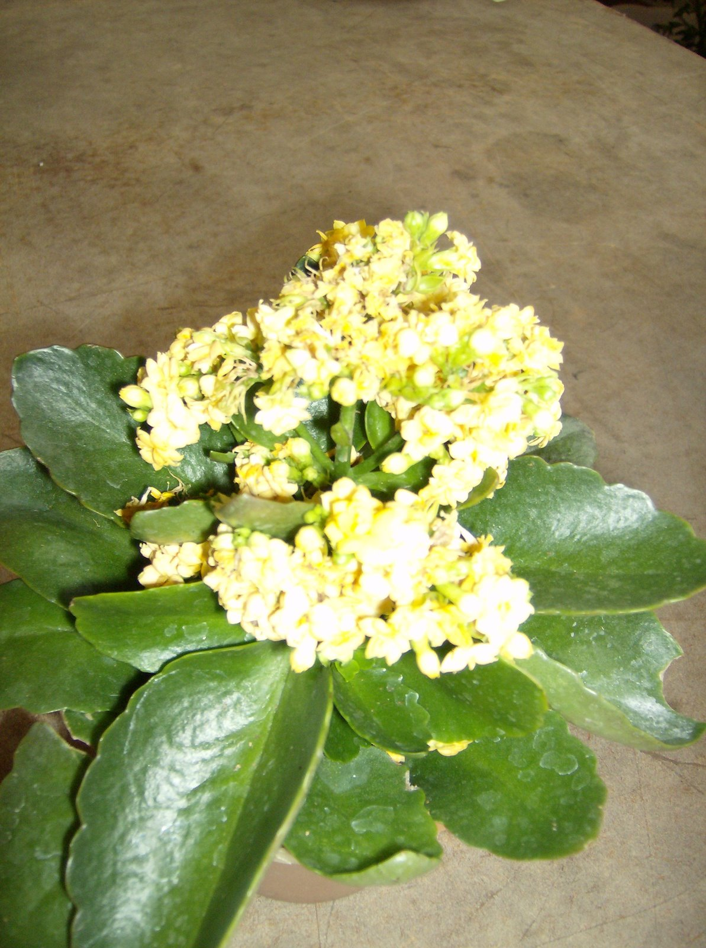
18

Slide 21
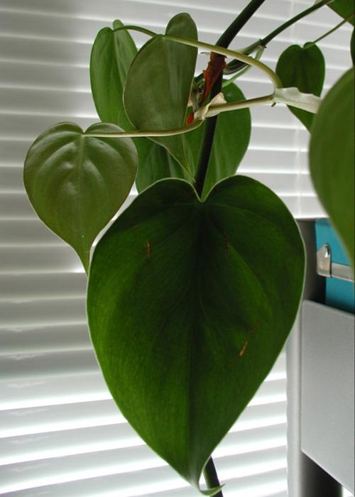
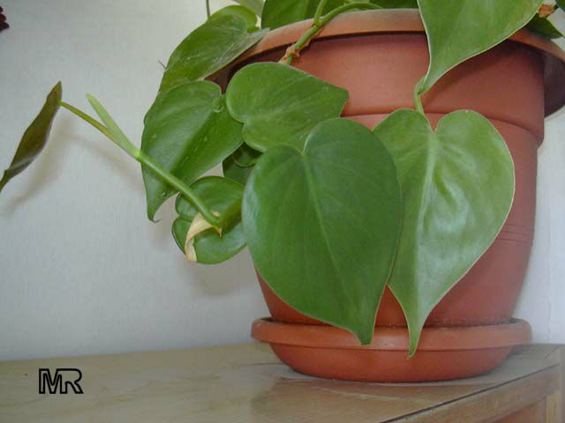
19

Slide 22
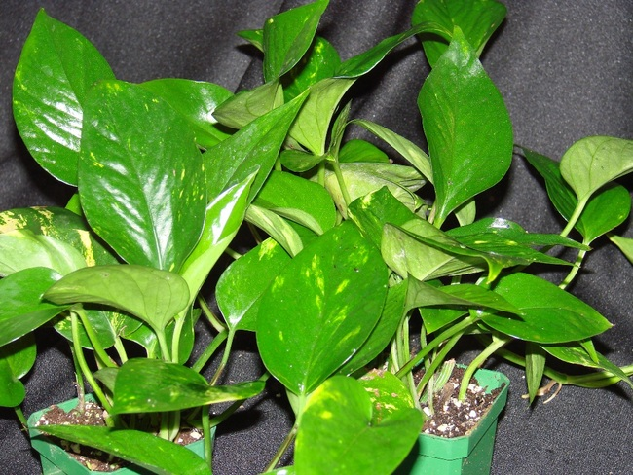
20

Slide 23
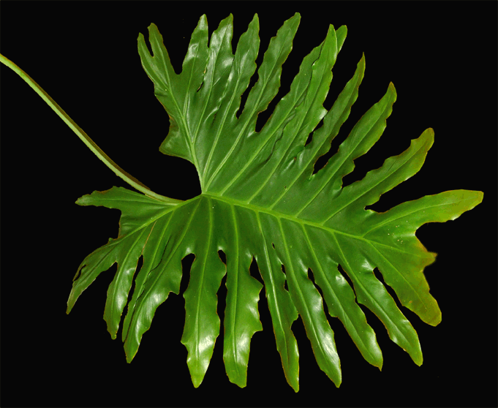
21

Slide 24
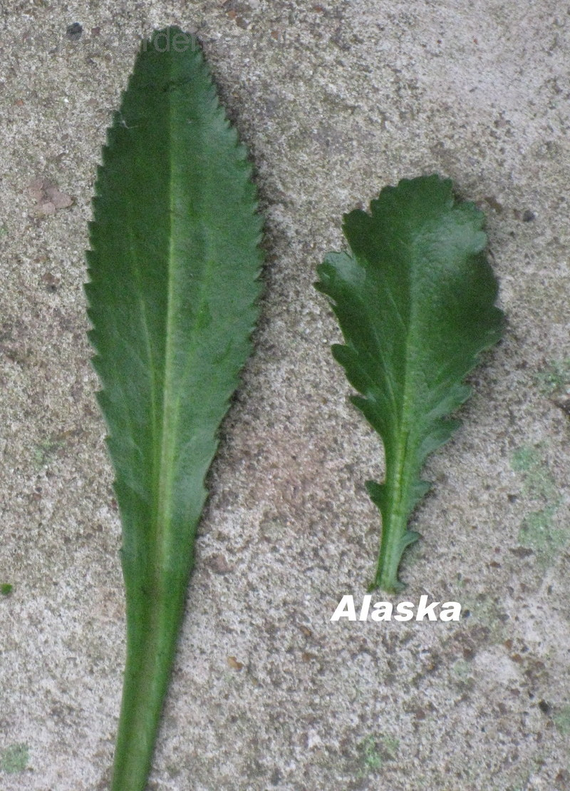
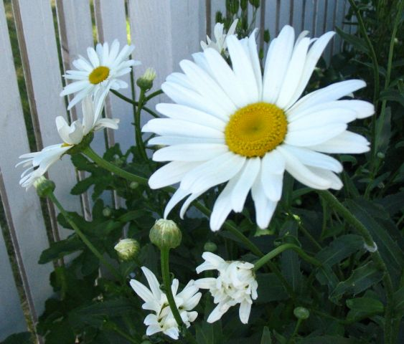
22

Slide 25
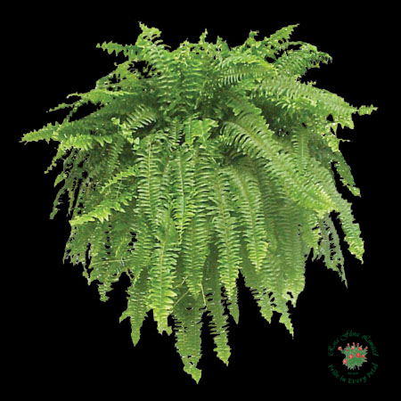
23

Slide 26
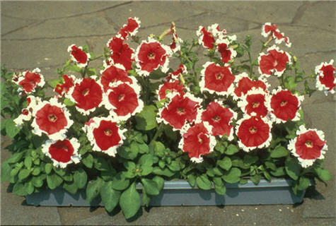
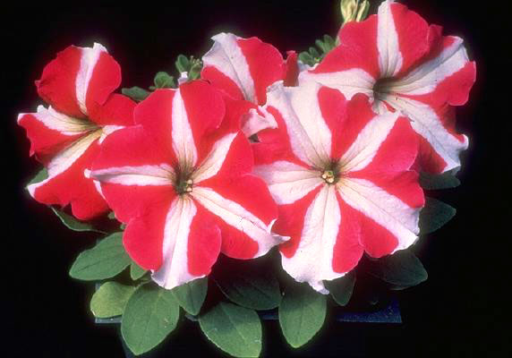
24

Slide 27
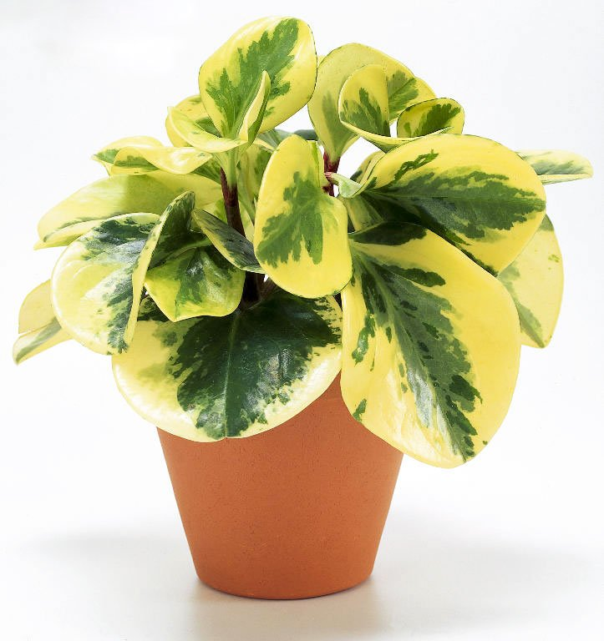
25

Slide 28
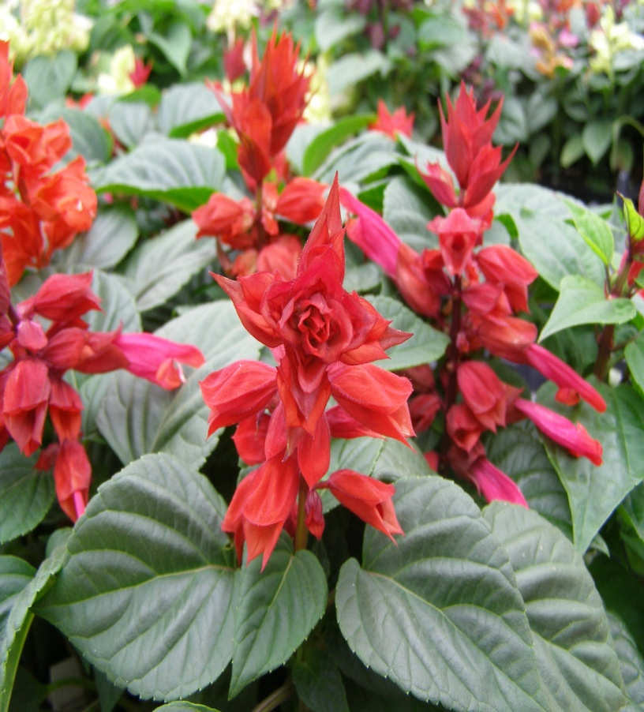
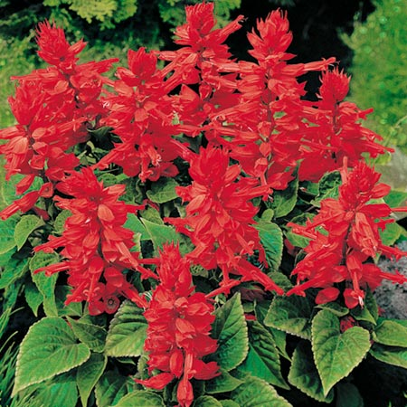
26

Slide 29
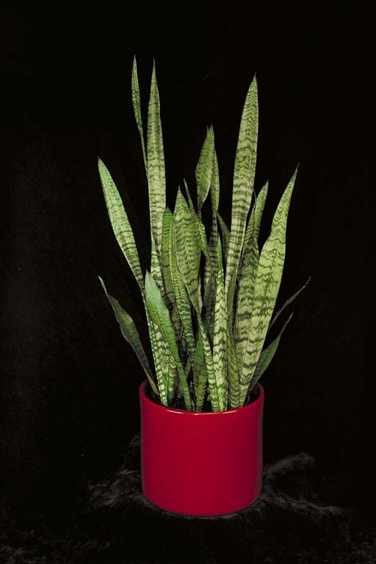
27

Slide 30
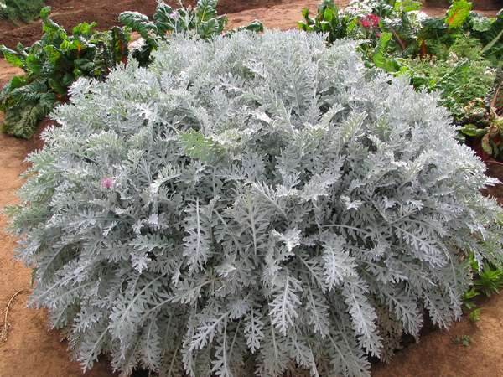
28

Slide 31
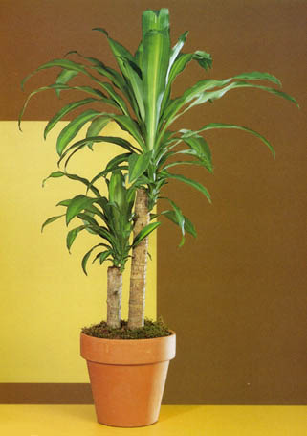
29

Slide 32
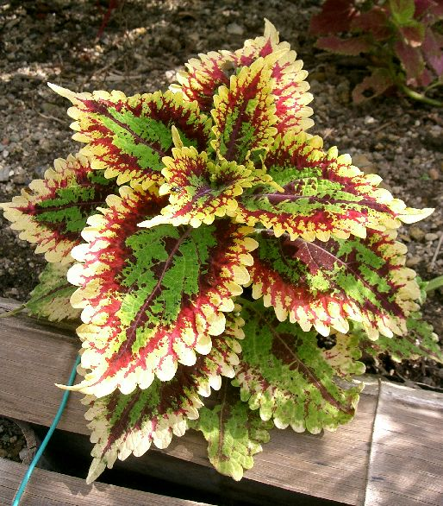
30

Slide 33
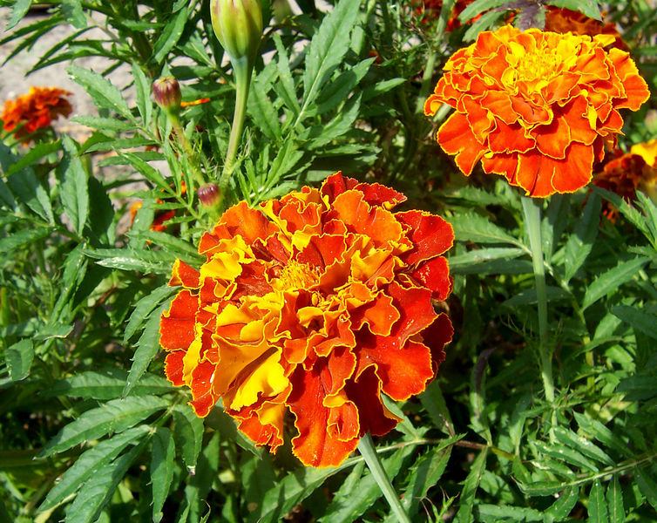
31

Slide 34
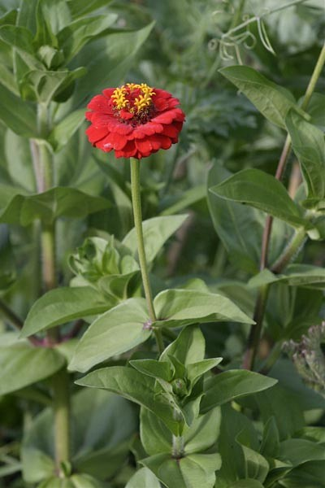
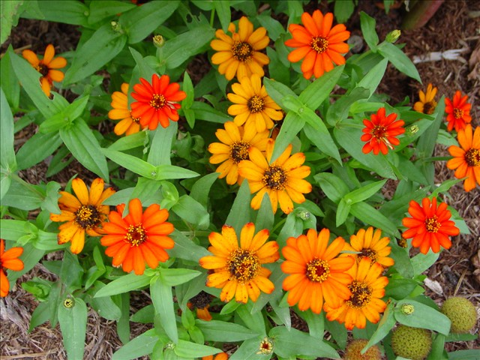
32

Slide 35
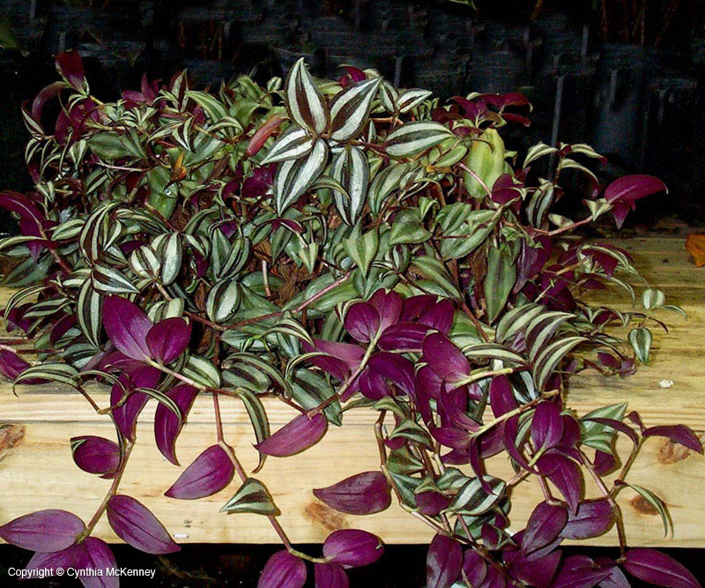
33

Slide 36
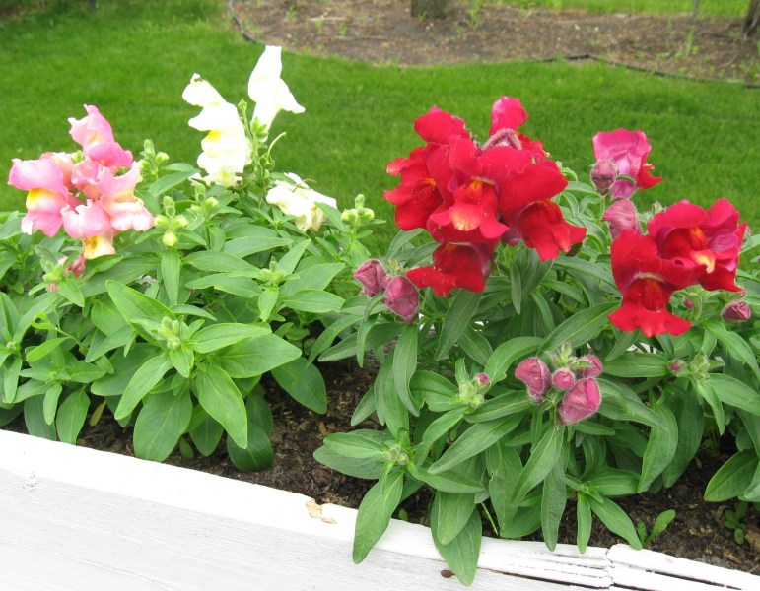
34

Slide 37
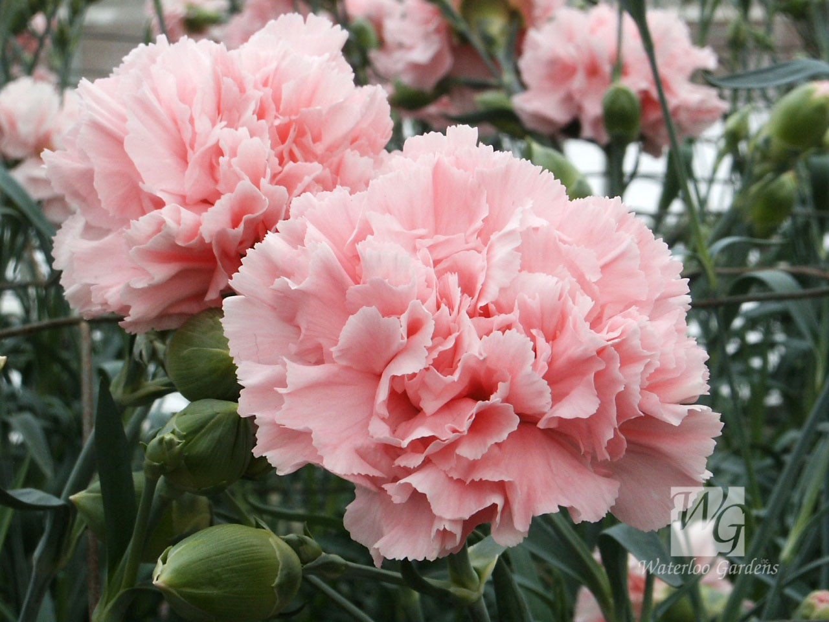
35

Slide 38
KEY
1 Ageratum
2 Tea Rose
3 Zebra Plant
4 Spider Plant
5 Croton
6 Sprengeri fern
7 Jade Plant
8 Norfolk Island Pine
9 Poinsettia
10 Benjamin Fig

Slide 39
KEY
11 Wax Begonia
12 Decora Rubber Tree
13 Fancy leaved Caladium
14 English Ivy
15 Common Camelia
16 Day Lily
17 Impatiens
18 Kalanchoe
19 Heart-leaf philodendron
20 Pothos/Devil’s Ivy

Slide 40
KEY
21 Cutleaf Philodendron
22 Shasta Daisy
23 Boston Fern
24 Common Petunia
25 Variegated peperomia
26 Salvia
27 Snake Plant
28 Diamond dusty miller
29 Corn Plant Draceana
30 Coleus

Slide 41
key
31 Marigold
32 Zinnia
33 Wandering Jew
34 Snapdragon
35 Carnation

Slide 42
THE END

