Slide 1
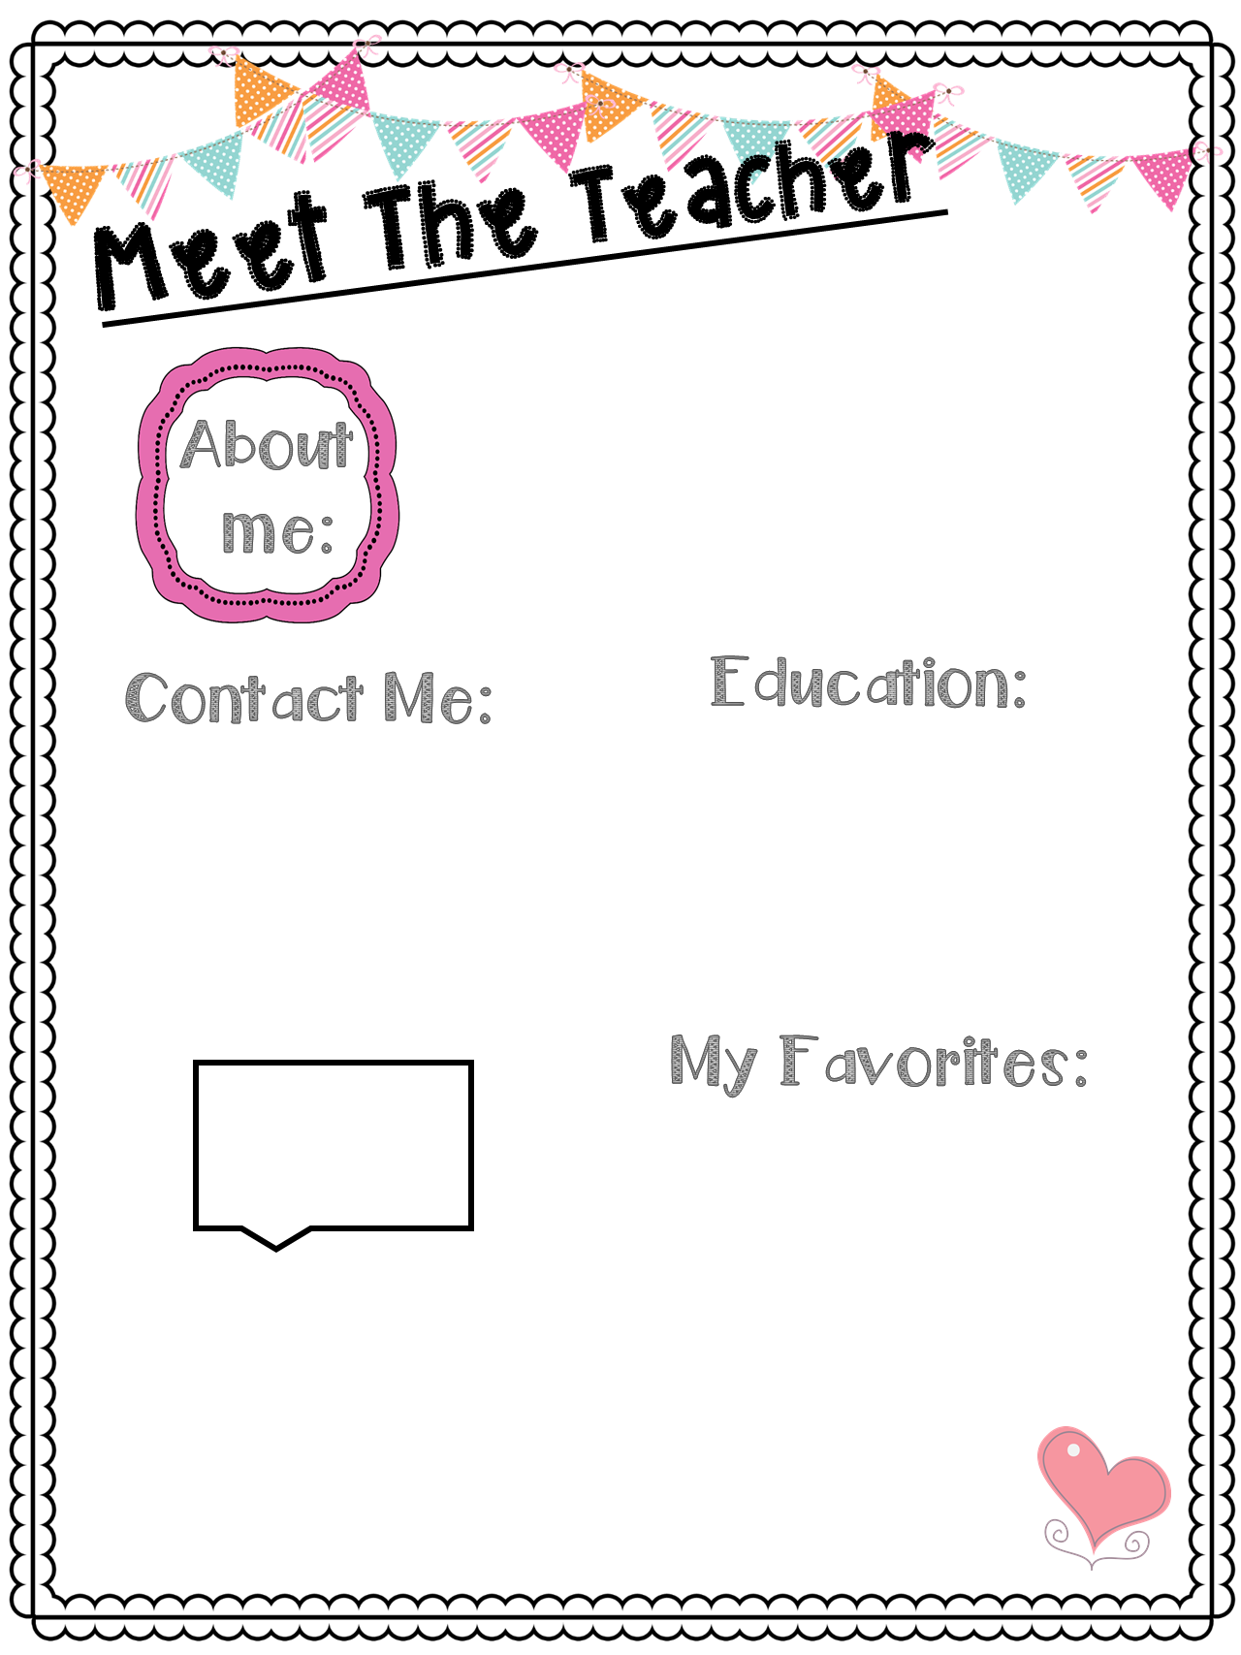
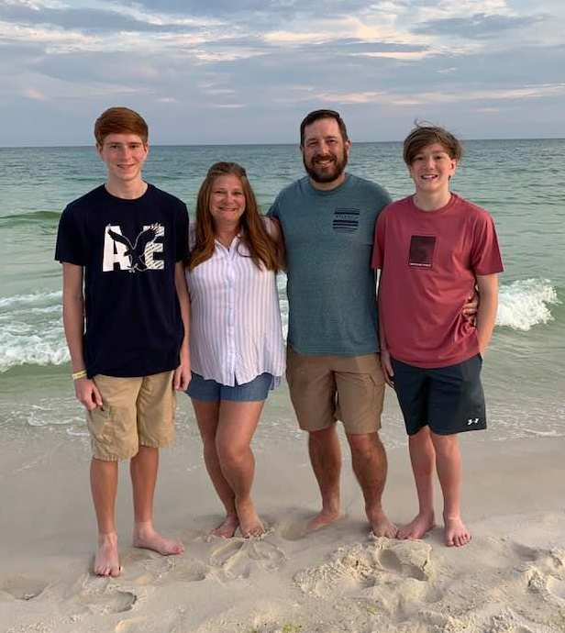
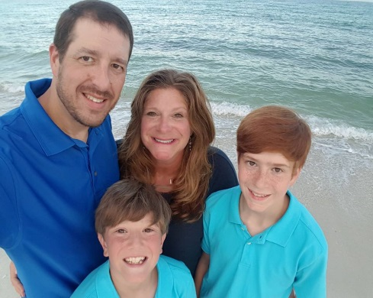
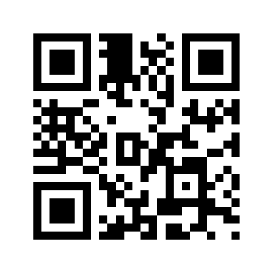
Mrs. Janes
Hi! My name is Sylenda Janes. I am excited to be your ^{2nd} grade teacher for the 2020-2021 school year. This will be my 23rd year of teaching at Chickasaw Elementary. My husband Whit and I have two sons, Wesley and Will. We have two dogs, Scout and Rusty, and two cats, Blue and Baby Kitty. We live in Olive Branch, MS. We enjoy sports, band, and camping with the Boy Scouts Troop#234. I am excited to meet you! I know you will make our class special!
I love to hear from parents throughout the year. Please always contact me with questions or concerns. I also love to hear from you if you are available to volunteer. ☺
We will be using School Status to communicate with you this year. You can text me through that text message/app. It may look like a strange number when you first see it, but it’s just me! It is the number I used when contacting you that I would be your child’s teacher.
Please scan the QR code to download my contact information into your cell phone. No cellphone? Write it down instead. sylenda.janes@dcsms.org (662) 895-6664
I graduated from Mississippi State University and Northeast Mississippi Community College with honors. I earned my Bachelors, Master’s, and Educational Specialist Degree in Elementary Education . I also carry endorsements in Reading, History, Science and Computers K-12.
Stores: Walmart & Target
Foods: Mexican
Hobbies: Gardening, Crafting, Hiking, Kayaking
Candy: Chocolate
Fast Food: Sonic
Restaurants: O’Charley’s, Mexican, McAlister’s
Flowers: Daffodils, Daisies, Roses
Drinks: Sweet Tea & Hot Chocolate
Season: Fall
Sports: OBHS & MSU Football, Basketball, Baseball, and Band
Subject: Reading

