Slide 1
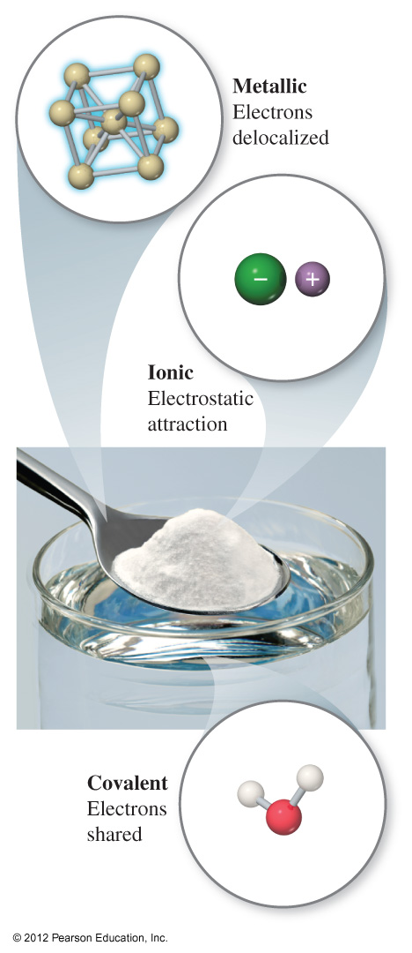
Chemical Bonds
Three basic types
Ionic
Electrostatic attraction between ions.
Covalent
Sharing of electrons.
Metallic
Metal atoms bonded to several other atoms. Electrons are delocalized.
System achieves lowest energy state by Bonding

Slide 2
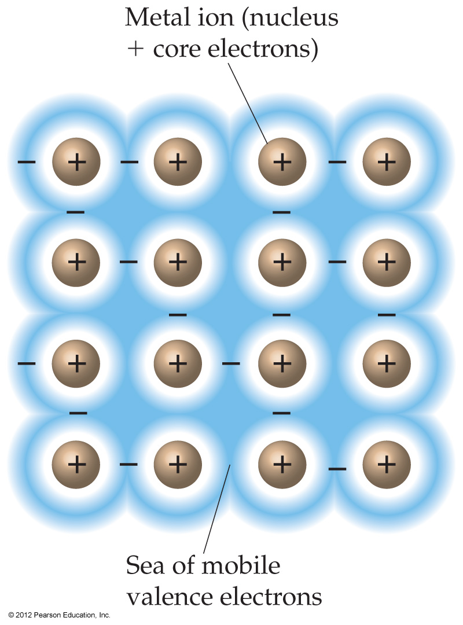
Metallic Bonding
Describes an array of positively charged metal cores surrounded by a sea of mobile (or delocalized) electrons.
The electrical and thermal conductivity, ductility, and malleability of metals is explained by this model.

Slide 3
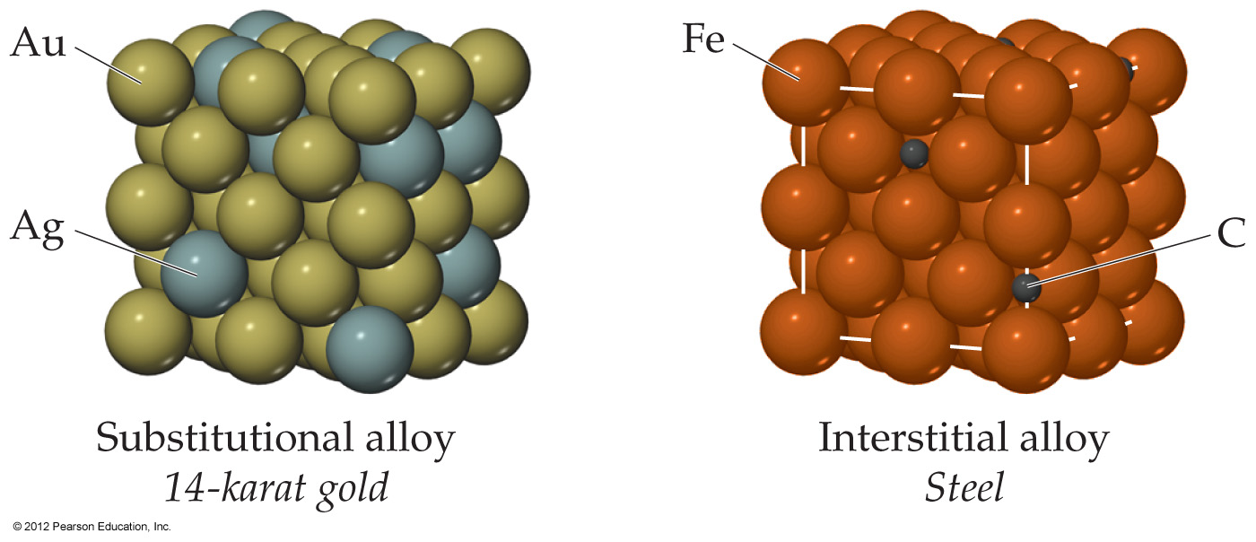
Alloys (metallic solids that are a mixture of metals)
In substitutional alloys, a second element of comparable radii substitutes for the other element in the lattice.
In interstitial alloys, smaller atoms fill the spaces between larger atoms in the lattice.

Slide 4
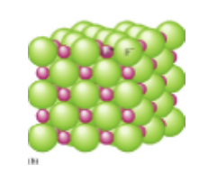
Ionic Bonding
Net attraction between oppositely charged ions, closely packed together as a regular array of cations and anions called a crystal lattice.
This arrangement maximizes the attractive forces while minimizing the repulsive forces.
Bonding is all about maximizing attraction and minimizing repulsion.

Slide 5
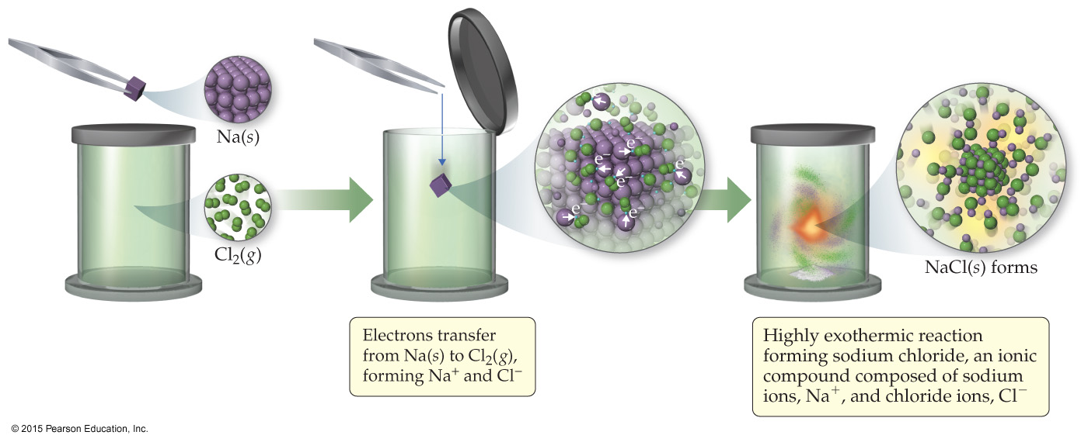
Ionic Bond Formation
Atoms tend to lose (metals) or gain (nonmetals) electrons to make them isoelectronic to the noble gases.

Slide 6
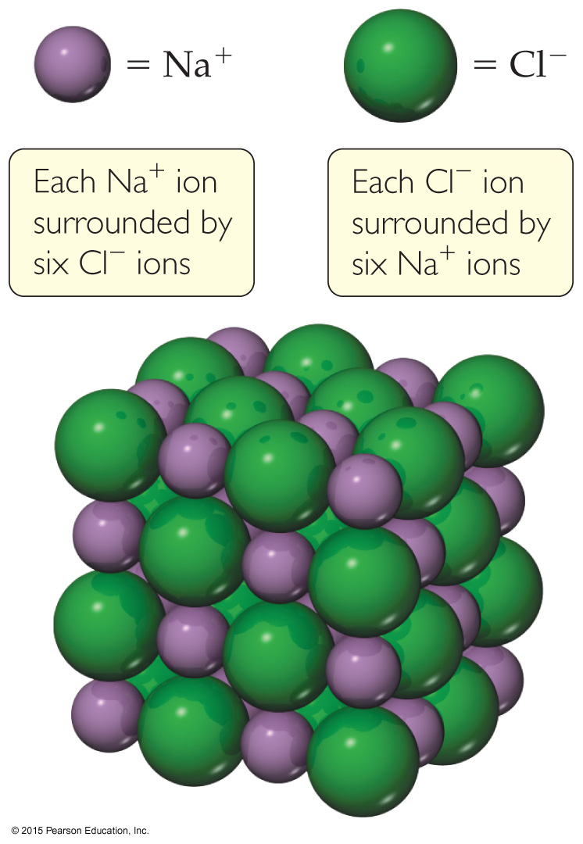
Energetics of Ionic Bonding: Born-Haber Cycle
Many factors affect the energy of ionic bonding.
1. Start with the metal and nonmetal elements: Na(s) and Cl₂(g).
2. Make gaseous atoms: Na(g) and Cl(g)
3. Make ions: Na⁺(g) and Cl–(g).
4. Combine the ions: NaCl(s)

Slide 7
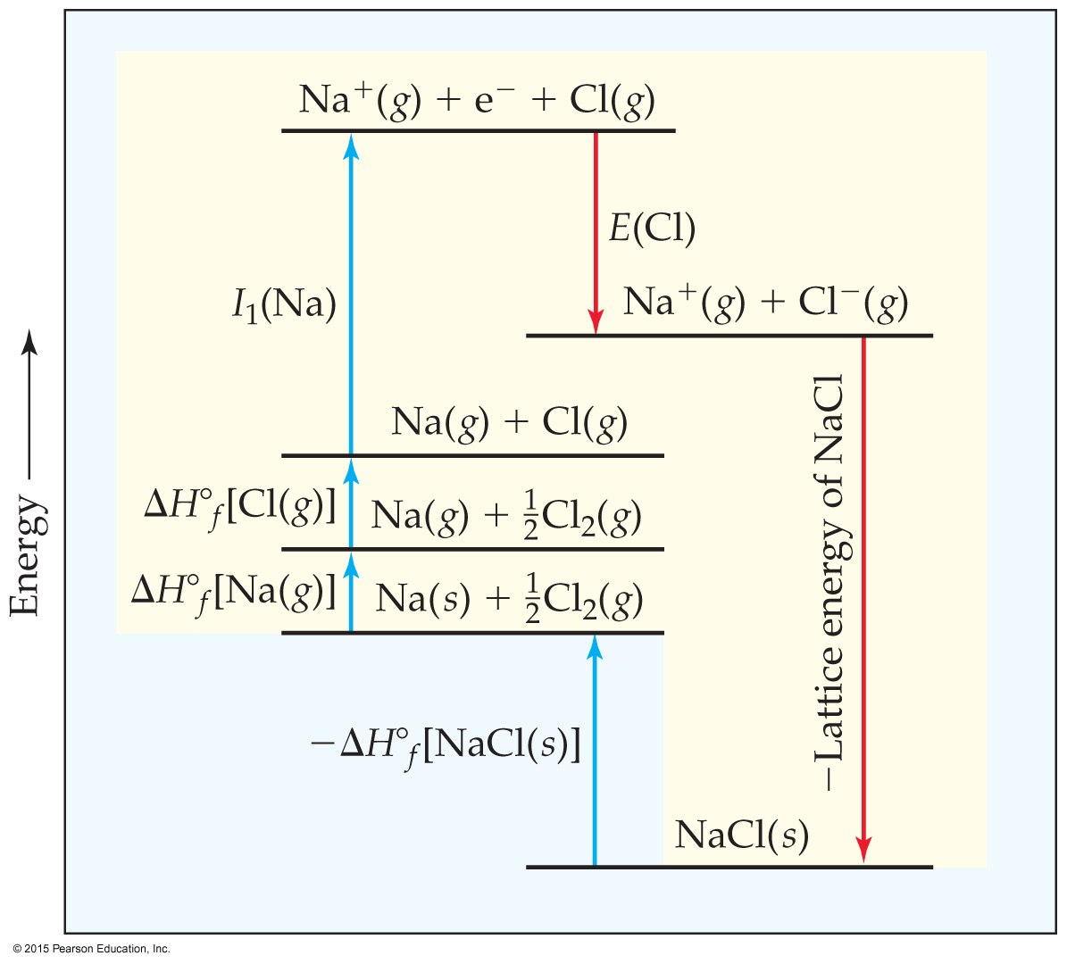
Lattice Energy
That huge, exothermic transition is the reverse of the lattice energy,
the energy required to completely separate a mole of a solid ionic compound into its gaseous ions.
How does lattice energy affect the melting points of ionic solids?

Slide 8
The energy associated with electrostatic interactions is governed by Coulomb’s Law
Coulomb’s Law indicates
the more highly charged the ions the stronger the attraction
smaller ions will form stronger attractions than larger ions because of the decreased in distance separating the two ions.

Slide 9
Justify why the lattice energy of CaO is higher than KF? And LiF higher than NaF?

Slide 10
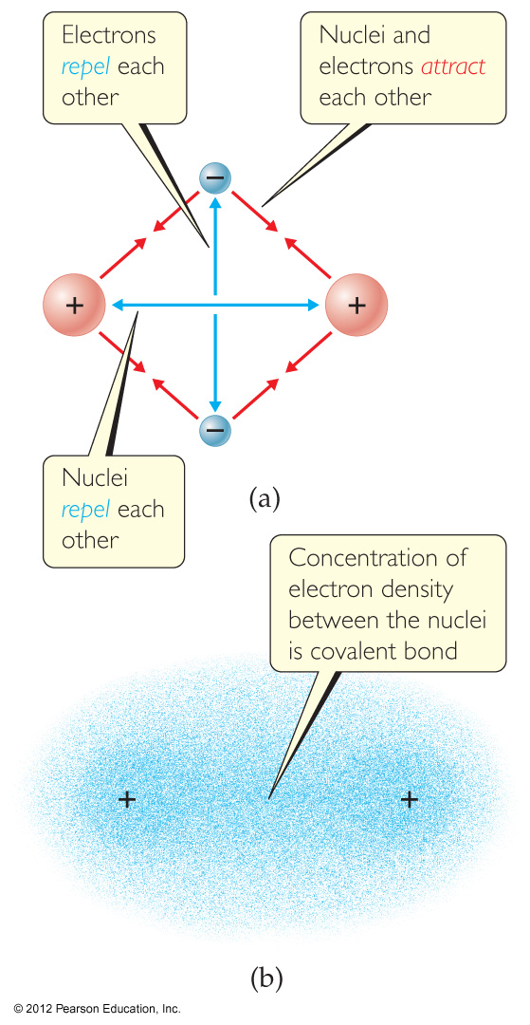
Covalent Bonding
In covalent bonds, atoms share one or more pairs of electrons.
There are several electrostatic interactions in these bonds:
Attractions between electrons and nuclei,
Repulsions between electrons,
Repulsions between nuclei.

Slide 11
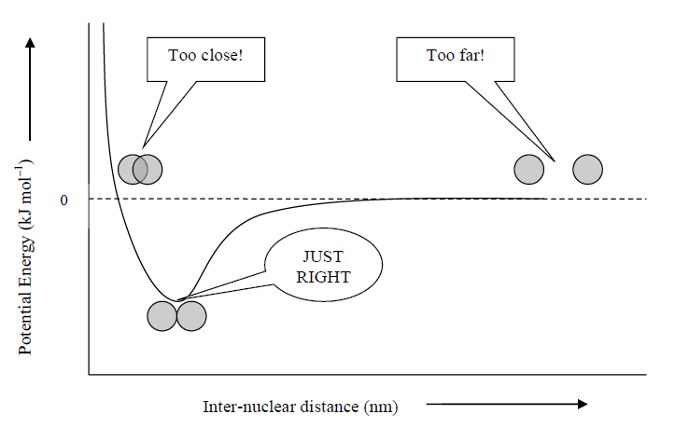
When the attractive forces offset the repulsive forces, the energy of the two atoms decreases and a bond forms.

Slide 12
Electronegativity and Polar Covalent Bonds
When two atoms share electrons unequally, a polar covalent bond results.
Electrons tend to spend more time around the more electronegative atom. The result is a partial negative charge (not a complete transfer of charge). It is represented by δ–.
The other atom is “more positive,” or δ+.

Slide 13
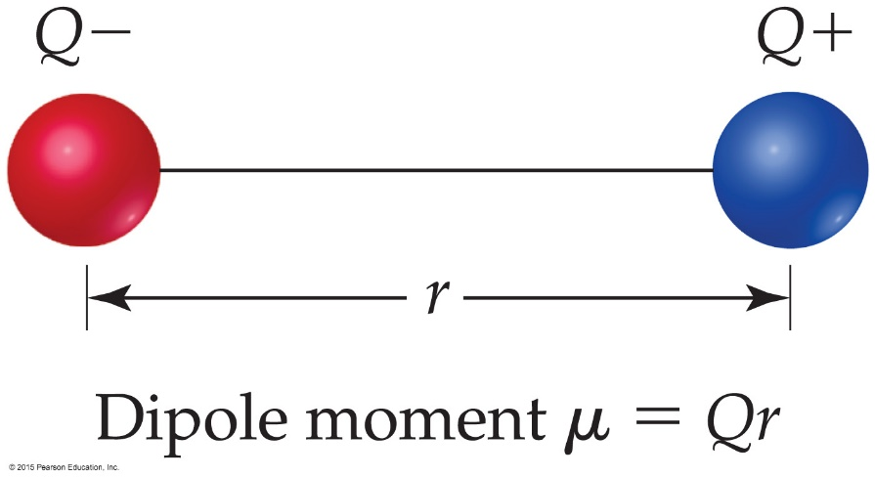
Dipoles
When two equal, but opposite, charges are separated by a distance, a dipole forms.
A dipole moment, μ, produced by two equal but opposite charges separated by a distance, r, is calculated:
μ = Qr
It is measured in debyes (D).

Slide 14
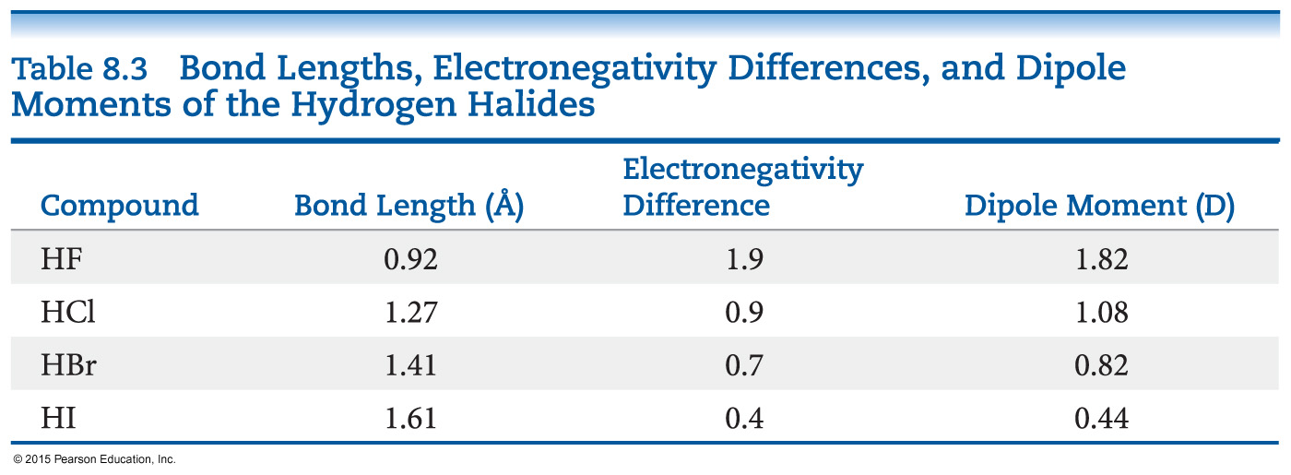
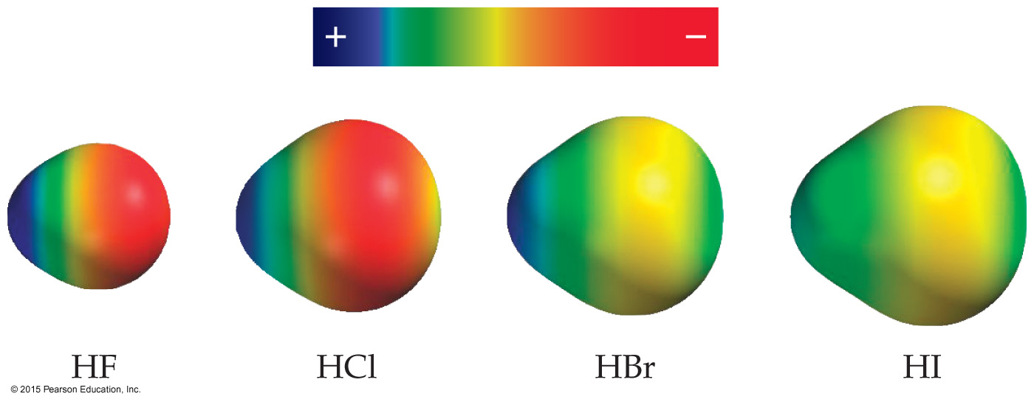
Polar Covalent Bonds
The greater the difference in electronegativity, the more polar is the bond.

Slide 15
Is a Compound Ionic or Covalent?
Simplest approach: Metal + nonmetal is ionic; nonmetal + nonmetal is covalent.
There are many exceptions: It doesn’t take into account oxidation number of a metal (higher oxidation numbers can give covalent bonding).
Electronegativity difference can be used; the table still doesn’t take into account oxidation number.
Properties of compounds are often best: Lower melting points mean covalent bonding, for example.

Slide 16
Notes:
Figure 8.8 Electron density distribution.

Slide 17
Writing Lewis Structures (Covalent Molecules)
Sum the valence electrons from all atoms, taking into account overall charge.
If it is an anion, add one electron for each negative charge.
If it is a cation, subtract one electron for each positive charge.
PCl₃
Keep track of the electrons:
5 + 3(7) = 26

Slide 18
Exceptions to the Octet Rule
There are three types of ions or molecules that do not follow the octet rule:
ions or molecules with an odd number of electrons,
ions or molecules with less than an octet,
ions or molecules with more than eight valence electrons (an expanded octet).

Slide 19
Fewer Than Eight Electrons
Elements in the second period before carbon can make stable compounds with fewer than eight electrons.
Consider BF₃:
Giving boron a filled octet places a negative charge on the boron and a positive charge on fluorine.
This would not be an accurate picture of the distribution of electrons in BF₃.

Slide 20
Writing Lewis Structures
Assign formal charges to decide which structure is best.
Formal charge is the charge an atom would have if all of the electrons in a covalent bond were shared equally.
Formal charge = valence electrons – ½ (bonding electrons) – all nonbonding electrons

Slide 21
Writing Lewis Structures
The dominant Lewis structure
is the one in which atoms have formal charges closest to zero.
puts a negative formal charge on the most electronegative atom.

Slide 22
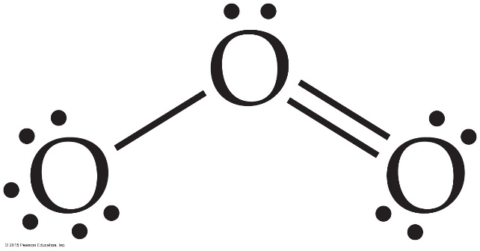
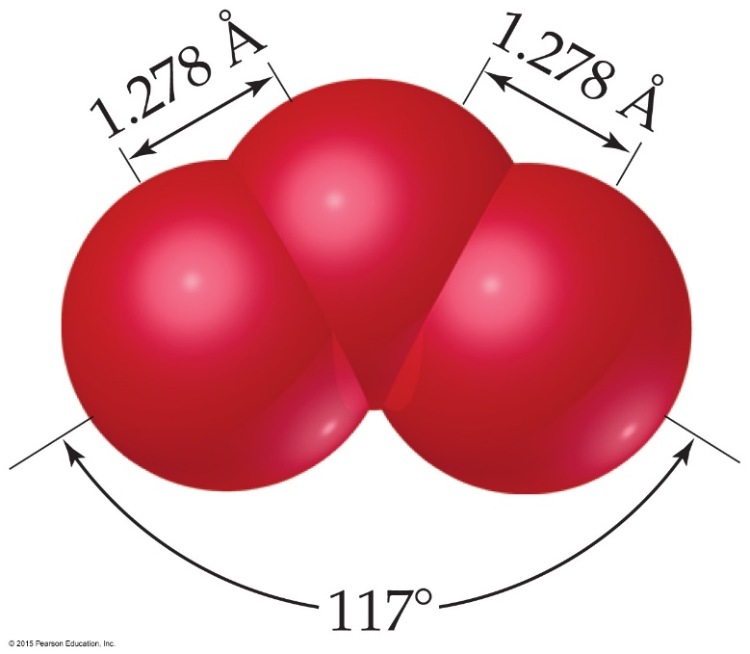
The Best Lewis Structure?
Following our rules, this is the Lewis structure we would draw for ozone, O₃.
However, it doesn’t agree with what is observed in nature: Both O to O connections are the same.
Notes:
Start here 6/11/10

Slide 23
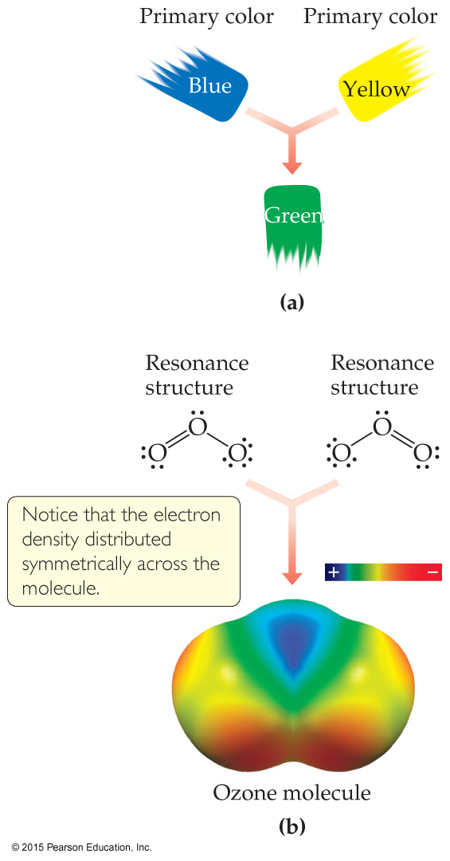
Resonance
One Lewis structure cannot accurately depict a molecule like ozone.
We use multiple structures, resonance structures, to describe the molecule.

Slide 24
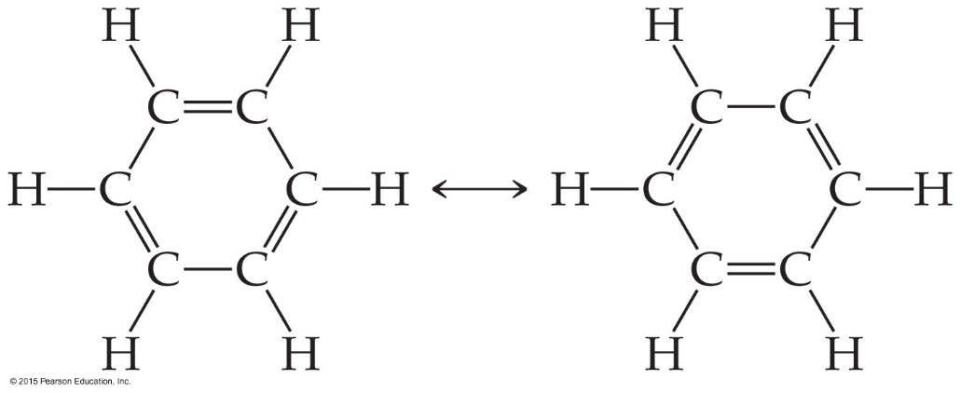
Resonance
The organic compound benzene, C₆H₆, has two resonance structures.
It is commonly depicted as a hexagon with a circle inside to signify the delocalized electrons in the ring.
Localized electrons are specifically on one atom or shared between two atoms; Delocalized electrons are shared by multiple atoms.

Slide 25
Draw the nitrate ion and all resonance structures.
Notes:
Chapter 9, Unnumbered Figure 3, Page 339

Slide 26
Resonance structures are “averaged” to give the best depiction of bonding (MUST draw all versions)
Use Bond order to describe bond length/strength
Notes:
Chapter 8, Unnumbered Figure 2, Page 310

Slide 27
Lewis diagrams with the VSEPR model
Can predict structural properties of many covalently bonded molecules and polyatomic ions, including:
Molecular geometry
Bond angles
Relative bond energies based on bond order
Relative bond lengths
Presence of a dipole moment

Slide 28
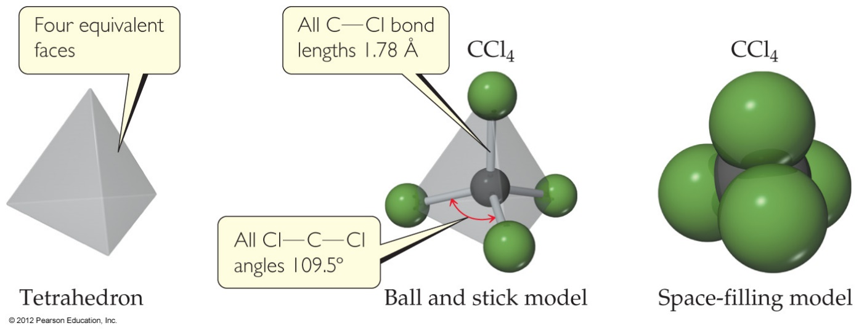
Valence-Shell Electron-Pair Repulsion Theory (VSEPR)
Predicting the arrangement of electron pairs around a central atom is based on the Coulombic repulsion between electrons

Slide 29
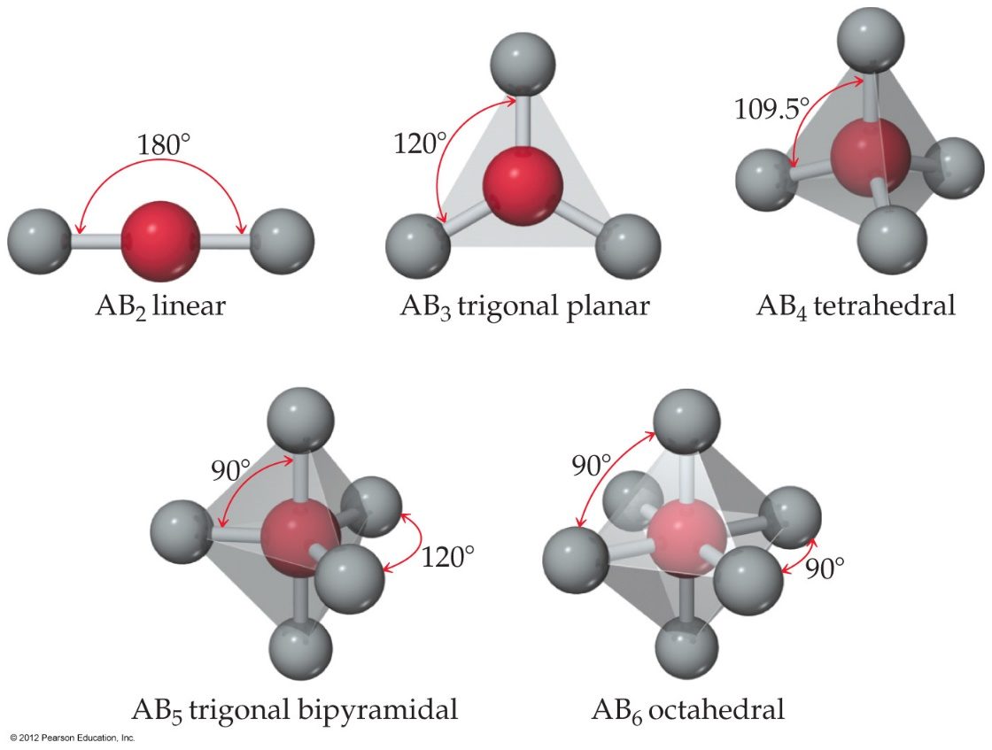
What Determines the Shape of a Molecule?
Electron pairs, whether they be bonding or nonbonding, repel each other.
By assuming the electron pairs are placed as far as possible from each other, we can predict the shape of the molecule.

Slide 30
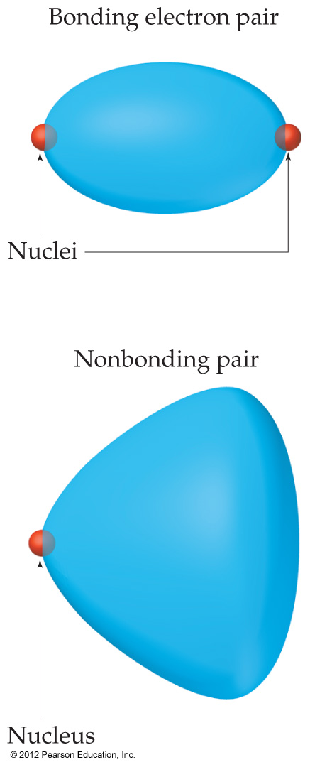
Nonbonding Pairs and Bond Angle
Nonbonding pairs are physically larger than bonding pairs.
Therefore, their repulsions are greater; this tends to decrease bond angles in a molecule.

Slide 31
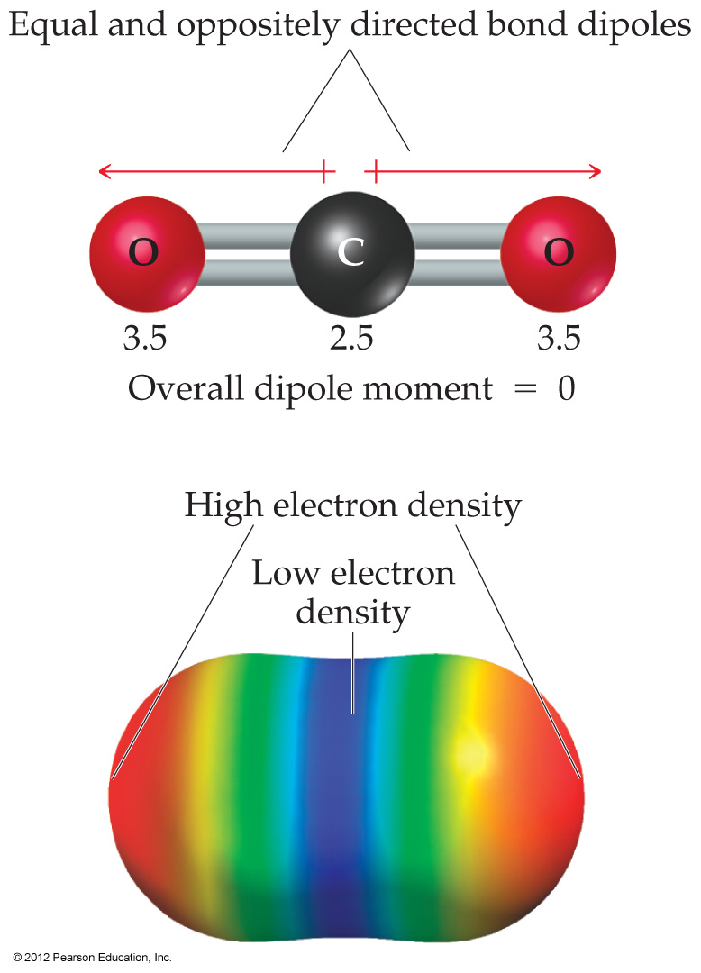
Notes:
Figure 9.10 CO₂, a nonpolar molecule.

Slide 32
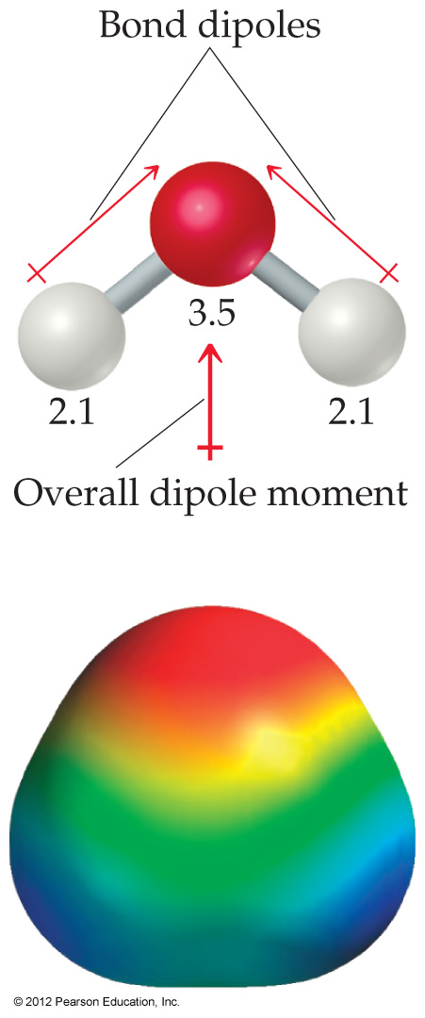
Notes:
Figure 9.11 H₂O, a polar molecule.

Slide 33
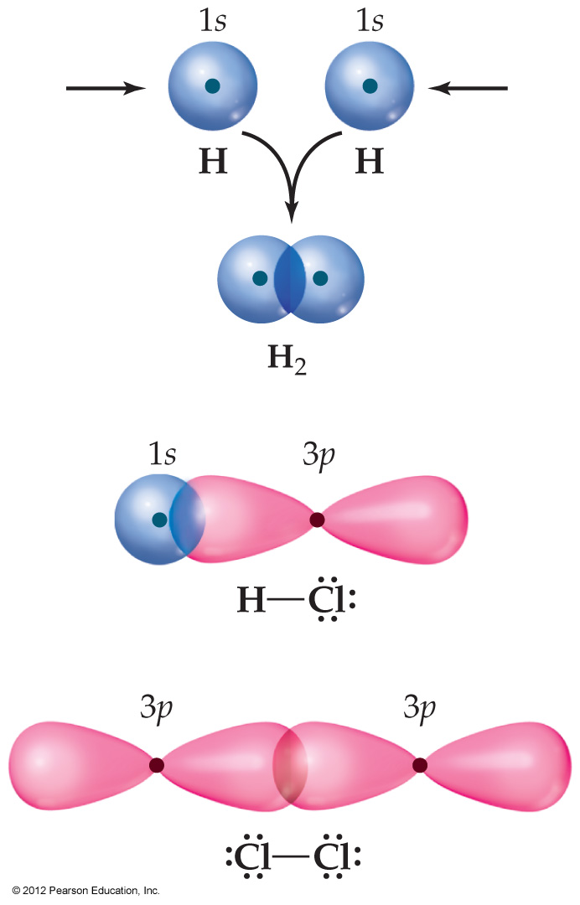
Overlap and Bonding
We think of covalent bonds forming through the sharing of electrons by adjacent atoms.
In such an approach this can only occur when orbitals on the two atoms overlap.
Notes:
Start here 6/14/10

Slide 34
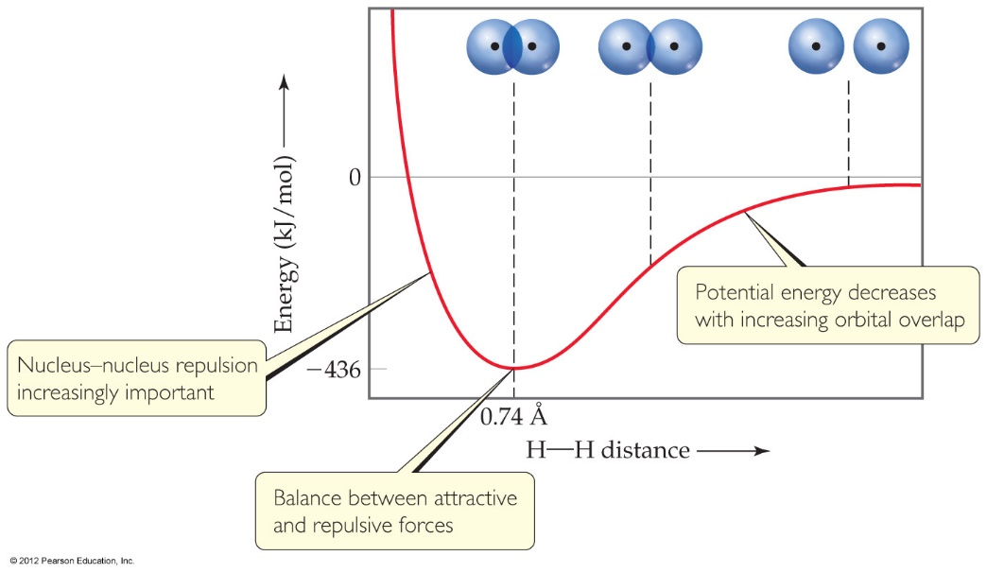
Overlap and Bonding
Increased overlap brings the electrons and nuclei closer together while simultaneously decreasing electron– electron repulsion.
However, if atoms get too close, the internuclear repulsion greatly raises the energy.

Slide 35
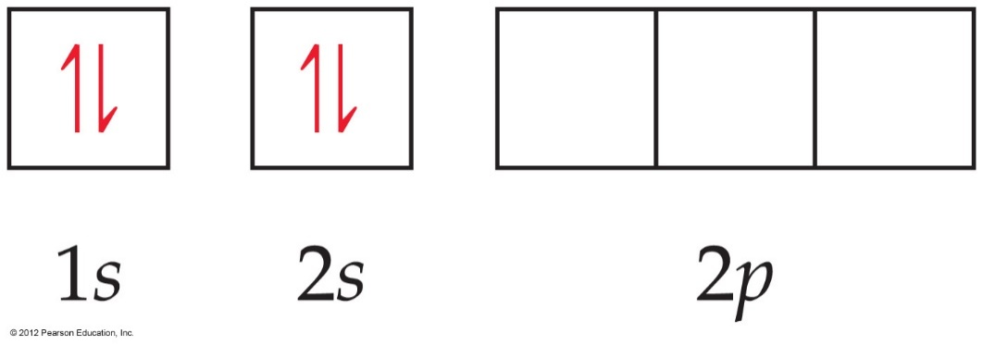
Hybrid Orbitals
Consider beryllium:
In its ground electronic state, beryllium would not be able to form bonds, because it has no singly occupied orbitals.

Slide 36
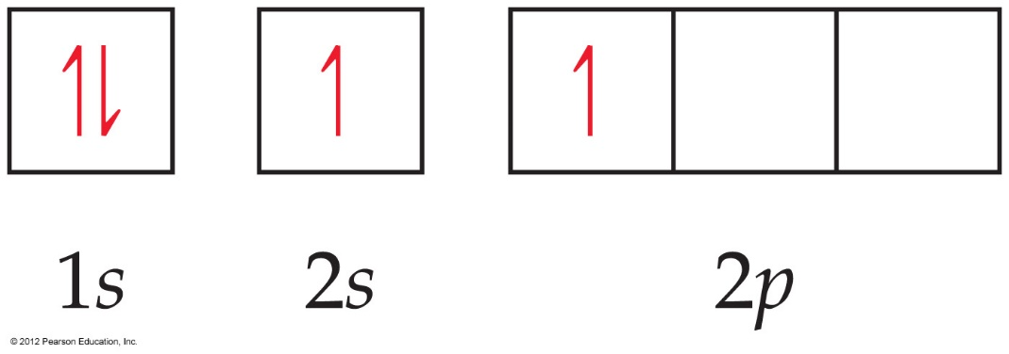
Hybrid Orbitals
But if it absorbs the small amount of energy needed to promote an electron from the 2s to the 2p orbital, it can form two bonds.

Slide 37
Hybrid Orbitals
Mixing the s and p orbitals yields two degenerate orbitals that are hybrids of the two orbitals.
These sp hybrid orbitals have two lobes like a p orbital.
One of the lobes is larger and more rounded, as is the s orbital.

Slide 38
Hybrid Orbitals
These two degenerate orbitals would align themselves 180° from each other.
This is consistent with the observed geometry of beryllium compounds: linear.

Slide 39
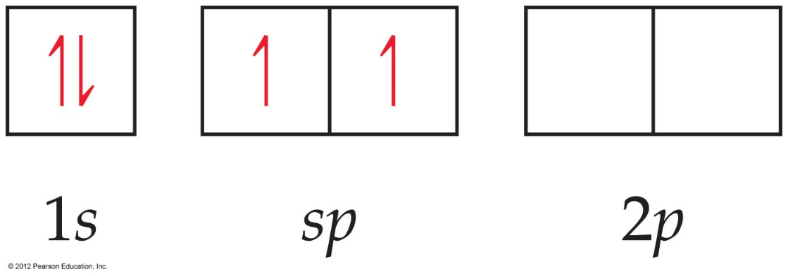
Hybrid Orbitals
With hybrid orbitals, the orbital diagram for beryllium would look like this (Fig. 9.15).
The sp orbitals are higher in energy than the 1s orbital, but lower than the 2p.

Slide 40
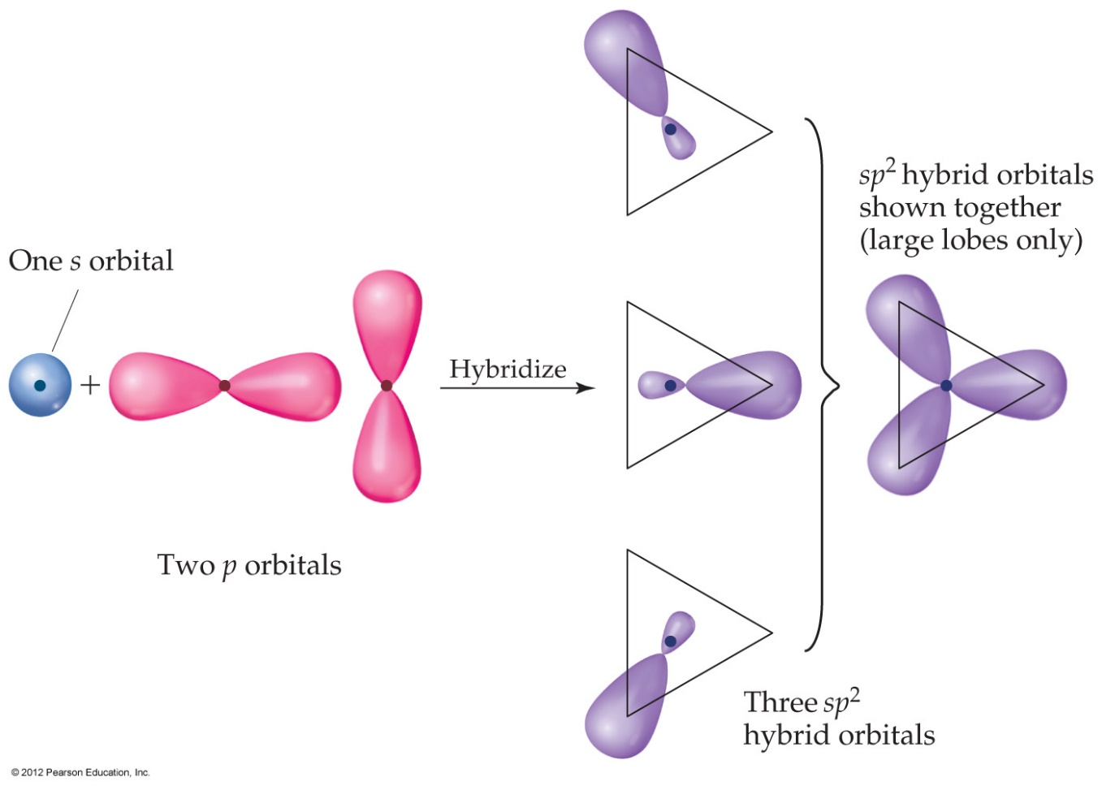
Hybrid Orbitals
Using a similar model for boron leads to three degenerate sp² orbitals.

Slide 41
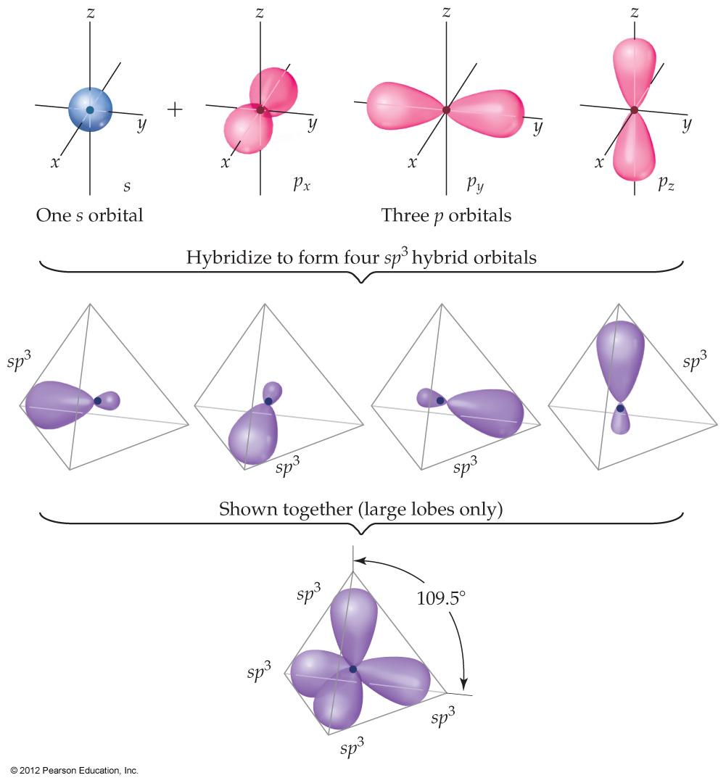
Hybrid Orbitals
With carbon, we get four degenerate sp³ orbitals.

Slide 42
Valence Bond Theory
Hybridization is a major player in this approach to bonding.
There are two ways orbitals can overlap to form bonds between atoms.

Slide 43
Sigma (σ) Bonds
Sigma bonds are characterized by
Head-to-head overlap.
Cylindrical symmetry of electron density about the internuclear axis.

Slide 44
Pi (π) Bonds
Pi bonds are characterized by
Side-to-side overlap.
Electron density above and below the internuclear axis.

Slide 45
Single Bonds
Single bonds are always σ bonds, because σ overlap is greater, resulting in a stronger bond and more energy lowering.

Slide 46
Multiple Bonds
In a multiple bond, one of the bonds is a σ bond and the rest are π bonds.

