Slide 1
Homecoming 2017
A Guide to Events, Tickets, and Proper Dress and behavior

Slide 2
Spirit Week Information:
“Beyond the Lights”
October 16-20
Spirit Week-all must be in uniform from the waist down (with the exception of career day ONLY)!
Monday: CELEBRITY DAY – Students appropriately dress as a celebrity of choice
  TV and movie stars
  musicians
  Politicians
  No tank tops, halter tops, crop tops, spandex dresses, or anything too far above the knee (Use common sense and remember we are in an educational setting: SCHOOL) Uniform pants ARE required
Tuesday: CAREER DAY – Dress out of uniform entirely to reveal dream occupation
  Appropriate Attire ONLY (Same rules as Monday apply – as far as the “Don’ts”)
  Your Career day choice should reflect a PROFESSIONAL and APPROPRIATE choice – meaning no creative illegal or inappropriate professions

Slide 3
Spirit Week Information:
Wednesday, Thursday, and Friday
Wednesday: GENERATION DAY – Represent your assigned generation (see below)
  Teachers – Teenagers
  Senior Class – Senior Citizens
  Juniors, Sophomores, and Freshmen – Babies
  Uniform pants ARE required
Thursday: BLUE AND GOLD DAY – Wear blue or gold shirts to represent Murphy!
  This is the day of the Homecoming Game
  Show your Panther Pride!!!!!
  Uniform pants ARE required
  Friday: TWIN DAY – Get with a friend/peer and dress alike!
  Have fun and dress to match your friend
  Uniform pants ARE required

Slide 4
Dance Information
Date: Friday, October 20th 2017
Place: The Grand Hall
                3556 Halls Mill Rd.
                Mobile, AL
                (Free Parking)
Time: 7:00 p.m. until 11:00 p.m.

Slide 5
Dance Tickets: Sale Dates and Procedures
The HC Ticket Pre-sale will be on Saturday, Oct. 14th from 8-11 a.m. (Math building on South St.)
The presale prices are$20 single or $40 for couples.
Regular ticket sales will be during the lunch waves Monday, October 16th through Wednesday, October 18th . Regular prices are $25 single or $50 for couples.
No tickets sold at school after the lunch wave on Wednesday.
Cost at the door is $40 per person.
We DO NOT provide Refunds - Tickets are non-refundable

Slide 6
Bringing a guest? Follow these rules!
  Couples' tickets are sold ONLY to those bringing a non-Murphy DATE; friends are not allowed, only DATES. If you have a friend who you want to attend, then you will need to find that friend a Murphy date.
  In addition, completed guest request forms with attached photocopied ID will be required in order to purchase a couples' ticket.
  Middle school students, adults over 20 years of age, and high school drop-outs will not be allowed to attend as guests.

Slide 7
Code of Conduct Policies
When purchasing a homecoming dance ticket, all students are agreeing to the following guidelines.
Not to drink alcoholic beverages before or during the school function.
Not to smoke at the school function.
To conduct oneself as a lady or gentleman at all times during the school function.
To uphold all Murphy High School and Mobile County Public Schools rules and regulations.
Students on the Do Not Admit list or students with disciple problems will not be allowed to attend the dance and should not purchase a ticket. Tickets are non-refundable and non-exchangeable, even if the student is disciplined after buying a ticket.

Slide 8
Dress Code for Ladies
The Homecoming dance is not a formal affair; it is semi-formal! This means that ladies can wear anything from a nice “Sunday” dress or skirt and blouse, to a sparkly party dress.
Usually dresses are not floor length—hems go from mid-shin to above the knee.
Cut-outs, deep open necklines, and low open backs are NOT allowed.
Remember—this is a school dance, not an adult Mardi Gras ball!
If in doubt – see Ms. Crandle, Ms. Gardner, or Dr. Jackson with a photo of your dress BEFORE you buy it!
Wear shoes that you can DANCE in!

Slide 9
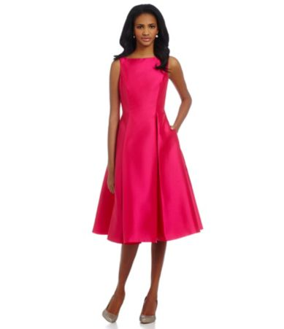
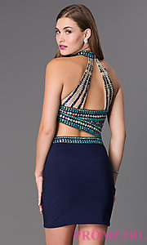
Dress Code for Ladies
What to wear
What not to wear

Slide 10
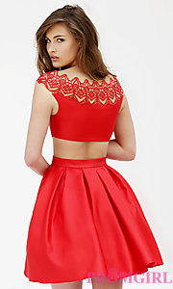
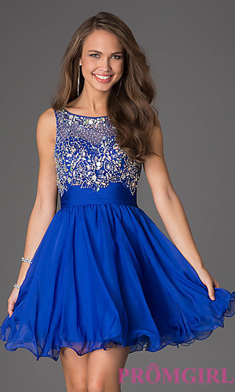
Dress Code for Ladies
What to wear
What not to wear

Slide 11
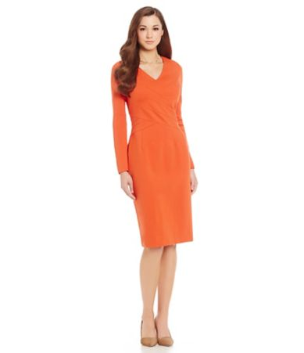
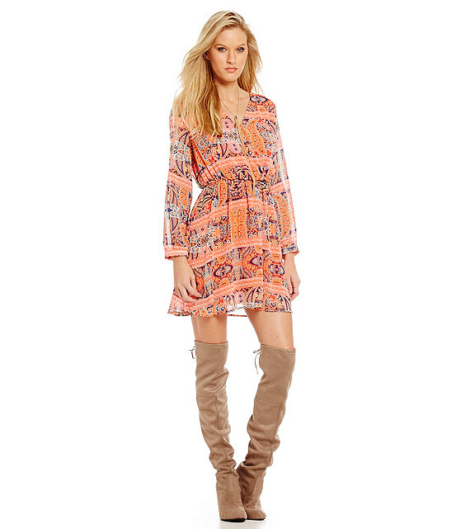
Dress Code for Ladies
What to wear
What not to wear

Slide 12
Dress Code for Gentlemen
Again, this is NOT a formal dance. This means that gentlemen can wear anything from a dress shirt and nice slacks with or without a coat and tie, to a suit and tie, to a tuxedo.
Check with your date, and dress to complement your date!
Leave your baseball caps and other hats at home.
Wear dress shoes, NOT tennis shoes or slides.
No blue jeans, jogger pants (elastic at ankle), or sagging pants.

Slide 13
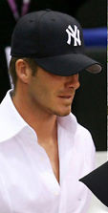
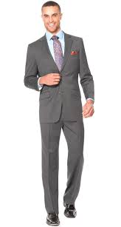
Dress Code for Gentlemen
What to wear
What not to wear

Slide 14
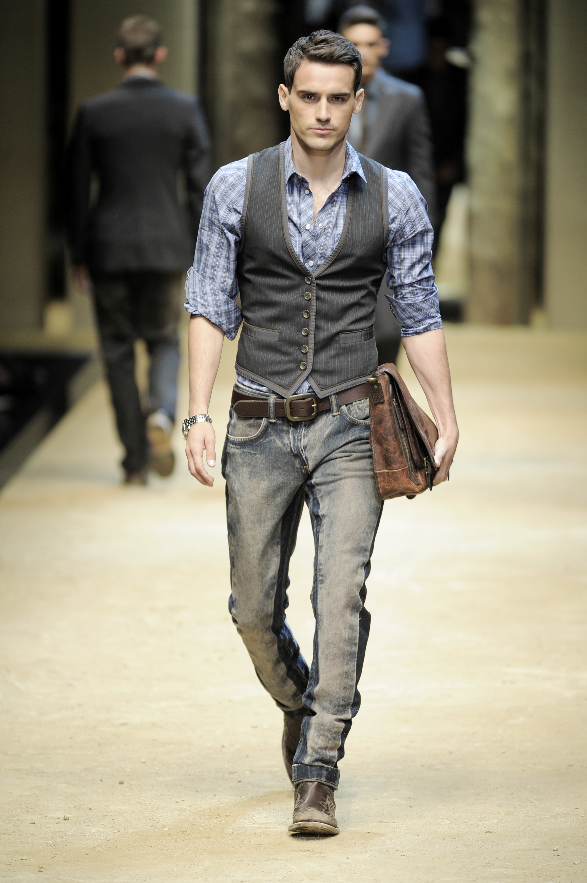
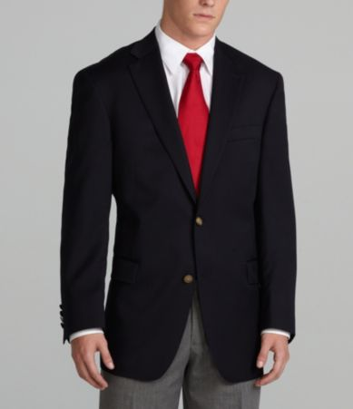
Dress Code for Gentlemen
What to wear
What not to wear

Slide 15
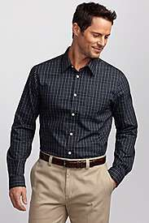
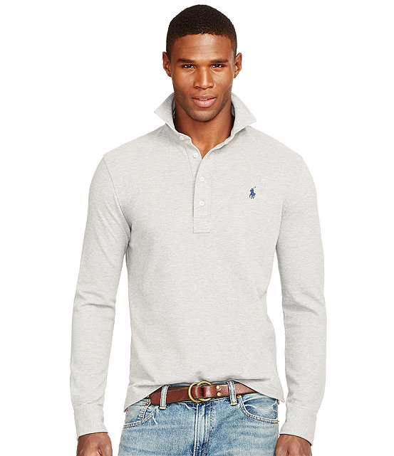
Dress Code for Gentlemen
What to wear
What not to wear

Slide 16
How to have fun at the dance
Remember that this is a school function—follow the rules!
Visit with friends and school staff.
Admire the decorations made by the Art Department.
Thank your SGA for organizing the dance.
Take pictures!
Dance!
Let your teachers see you at your best!

Slide 17
Sources for Photographs
www.Dillards.com
www.promgirl.com
Pinterest

