Slide 1


CHANGING THE WAY STUDENTS READ

Slide 2

BOCES shares 3,040+
Reading Plus seats
Plan your wish!

Slide 3
Learn.readingplus.com
https://learn.readingplus.com/wp-content/uploads/2013/07/Implementation-Planning-Worksheet-for-Administrators.pdf
Due November 8, 2013

Slide 4
Growing Reading Plus® Use in Colorado
What are they saying at Garfield Elementary?
-We are pleased to see more visuals and a variety of genres and choice available to students
-We like the embedded vocabulary work with the words that the students will encounter in their reading
-iBalance activities matches with research that we just learned about at a professional development session regarding the saccade (the forward scan with the eyes). It helps increase the student’s saccade.
One of our veteran RP students told a group of students that “Reading Plus has helped my fluency. I can read faster now.”- Lorenzo, third grader
Amy Jordan and Nicole Ball, Garfield Elementary

Slide 5
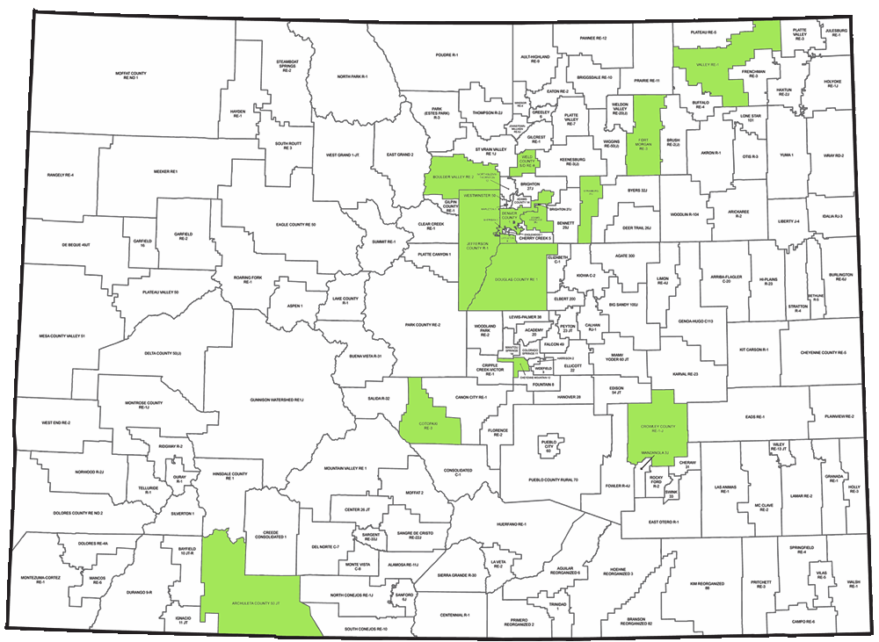
2009-2010

Slide 6
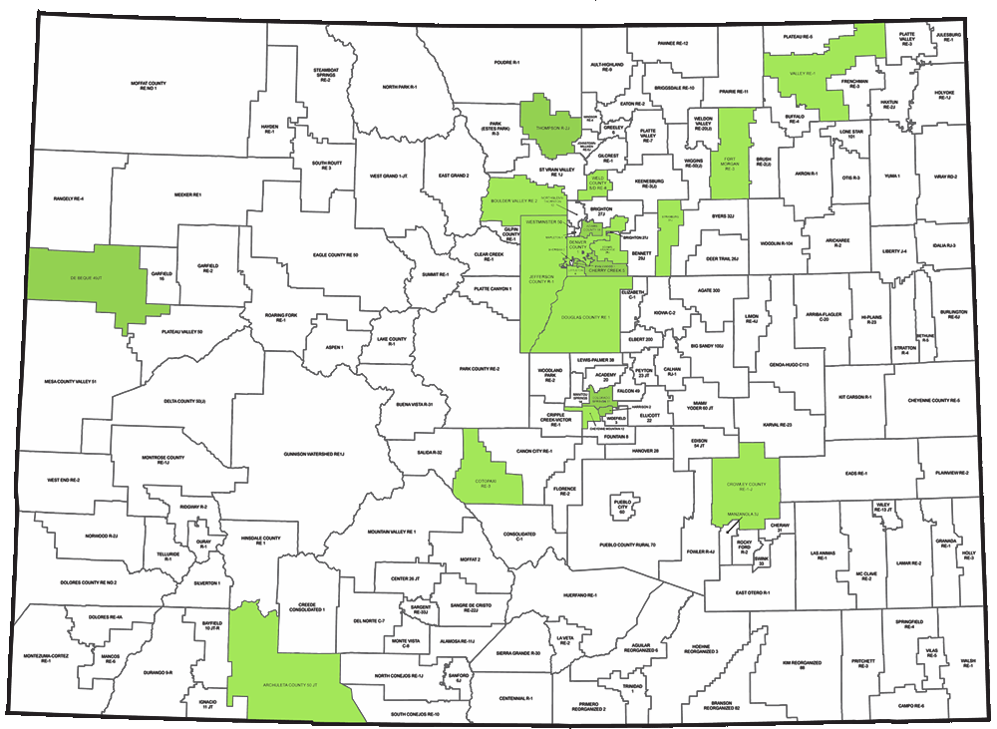
2010-2011

Slide 7
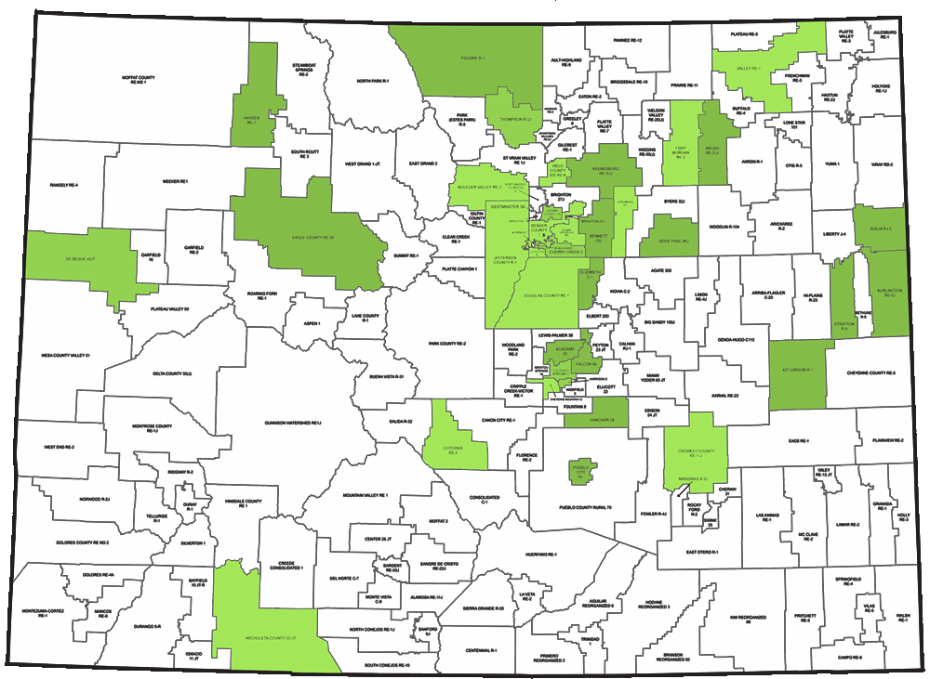
2011-2012

Slide 8
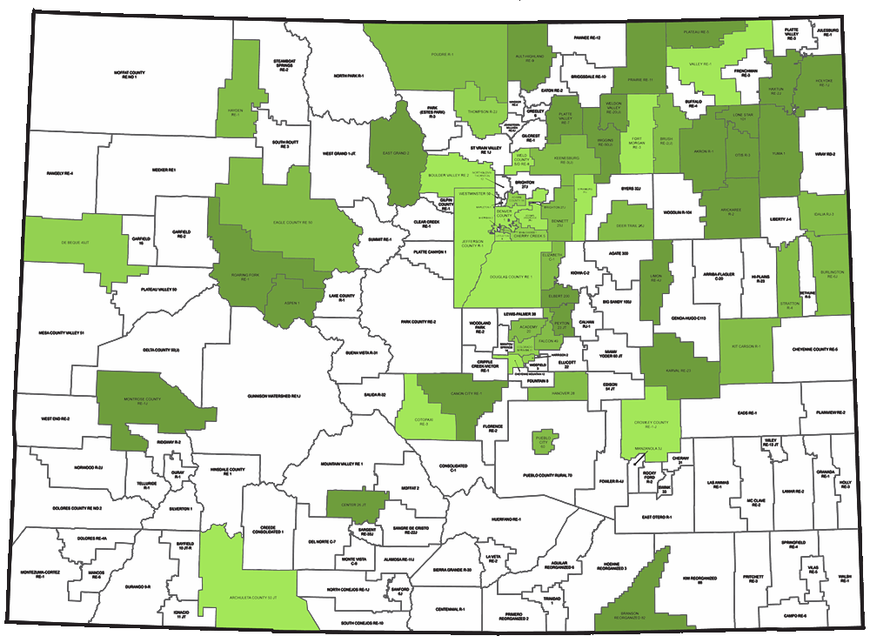
2012-2013

Slide 9
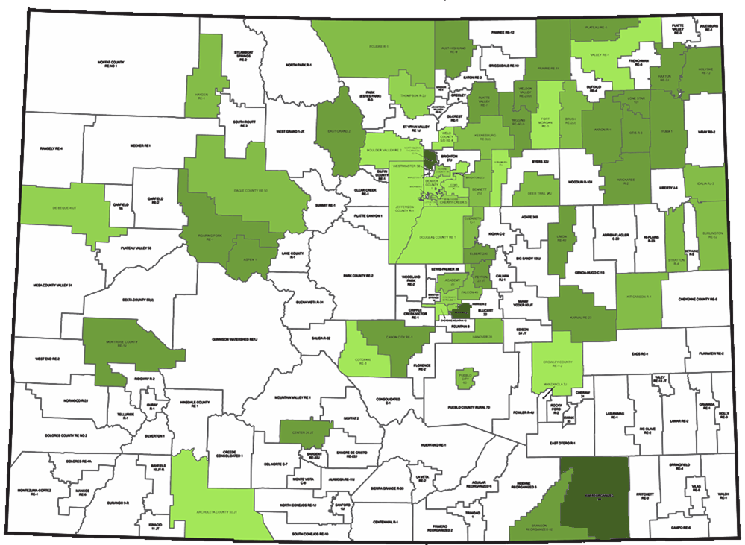
2013-2014

Slide 10
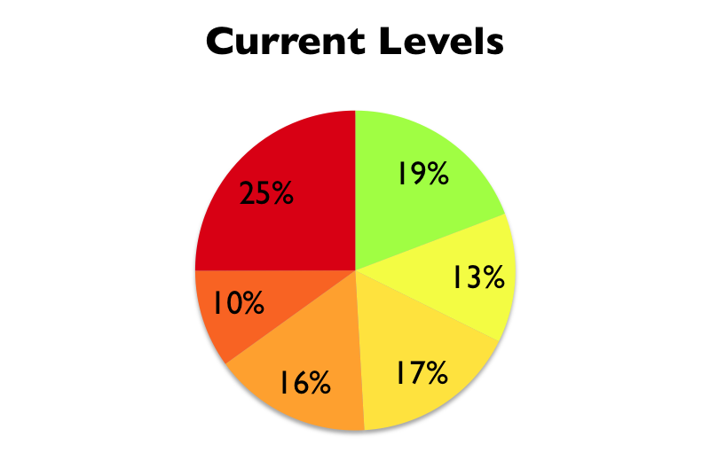
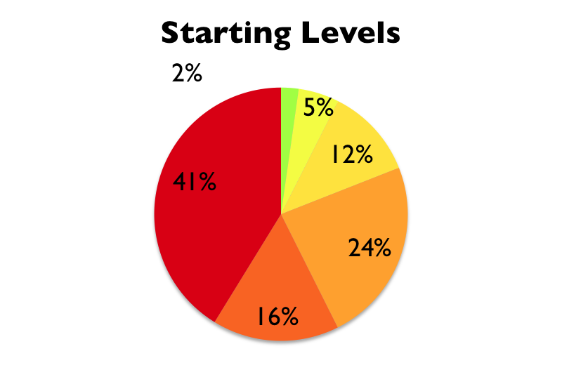
Colorado Literacy Dashboard
August 1, 2012 through April 9, 2013
# of Students using RP | Total Time on Task (hours) | Total Number of Words Read w/ 70%+ Comp | Total Number of GR Lessons w/ 70%+ Comp
35,488 | 316,211 | 588,649,080 | 542,517
Students improved their content reading level by 3.4 levels, on average.*
 | # of students (Starting) | Reading Level | # of students (Current) | Avg. Hours in GR
 | 496 | On Grade Level | 4,238 | 14
 | 1,144 | 1 Level Below | 2,886 | 10
 | 2,555 | 2 Levels Below | 3,700 | 8
 | 5,199 | 3 Levels Below | 3,520 | 7
 | 3,565 | 4 Levels Below | 2,186 | 7
 | 9,088 | 5+ Levels Below | 5,517 | 5
*This includes students who have completed at least 8 hours within Guided Reading.

Slide 11
Common Goal
COLLEGE
& CAREER
READY
Increase capacity to independently
read and comprehend complex text
Lexiles®
 | 450-600 | 600-750 | 750-900 | 900-1050 | 1050-1200 | 1200-1350
2-3
4-5
6-8
9-10
11-CCR
Old Text Difficulty Range
New Text Difficulty Range
Notes:
We’re all working towards a similar goal... namely, increasing students capacity to read progressively complex texts. Many of us are familiar with the shift in Lexile grade band difficulty that the Common Core has outlined. This means that standards for our struggling readers will be increased, and even those students formerly performing as proficient readers will need to increase their capacity to retain their proficient status. There is of course another challenge that we face as educators...

Slide 12

Common Problem
COLLEGE
& CAREER
READY
Increase capacity to independently
read and comprehend complex text
“I hate to read”
Notes:
Many of our students dislike reading altogether... if our student hate to read, how much do you think they’ll read? How often do any of us do things we hate doing?

Slide 13
How Big of a Problem?
Number of Words Read
Home Reading
School Reading
Home Reading - Guthrie, J.T.,Schafer, W.D., & Huang, C.W.
School Reading - Anderson, R.C., Wilson, P.T., & Fielding, L.G.
Notes:
Not surprisingly, struggling readers rarely read outside of school compared to their higher performing peers. They don’t enjoy reading, don’t see the value...and therefore rarely choose to read by choice. When we look at the number of words read by struggling readers we see that they read about half as many words in school, as compared to higher performing students. The reality is that these students spend about the same amount of time reading in school. So what accounts for this difference? Right... the rates at which they read.

Slide 14
Common Problem
Comprehension-Based Silent Reading Rates
Proficient
75th Percentile
180 wpm
Struggling
25th Percentile
Words Per Minute
Oral Reading Range
Silent Reading Rate Norms - Spichtig, A., Taylor S.
Notes:
Most of us speak between 120 and 180 wpm....these struggling readers barely reach an average oral rate of reading and never cross over from oral reading behaviors and rates into more efficient silent reading behaviors and rates. They have to put in close to twice the effort and time to extract the same about of knowledge as higher performing students. (click) Higher performing students cross this threshold by roughly 5th grade...while struggling readers continue to exhibit the behaviors of emergent readers all the way through high school....making reading laborious, unenjoyable, and unproductive. Let’s take a look at what a student reading in this way experiences.

Slide 15

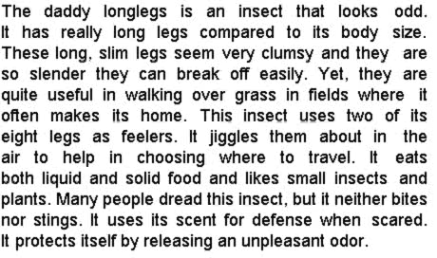
Why don’t they like reading?
Notes:
(video plays automatically)

Slide 16
Common Goal
Increase capacity to independently
read and comprehend complex text
COLLEGE
& CAREER
READY
Increase capacity to independently
read and comprehend complex text
Notes:
So, back to our common goal...we all want to increase student capacity to independently read and comprehend complex text... and much of what we do in education along with many programs are meant to make students who hate to read into better readers... I think this is flawed position to operate from. Instead, It seems to makes much more sense, to provide supports that can actually turn their negative reading experience into a positive one.

Slide 17
Common Goal
COLLEGE
& CAREER
READY
Increase capacity to independently
read and comprehend complex text
COLLEGE
& CAREER
READY
Increase capacity to independently
read and comprehend complex text
Develop silent reading fluency
to make reading productive
EFFICIENCY
Build purpose
and value for reading
MOTIVATION
Notes:
They need support to develop the efficient silent reading habits and stamina required to make reading more comfortable, enjoyable, and productive. (click) They also need support in developing motivation to read so that they begin to see reading as having purpose and value. So, if we could change (click)

Slide 18

Common Goal
COLLEGE
& CAREER
READY
Increase capacity to independently
read and comprehend complex text
WHAT
STUDENTS ARE CAPABLE OF READING
CAPACITY
HOW
Develop silent reading fluency
to make reading productive
STUDENTS READ
EFFICIENCY
EFFICIENCY
WHY
Build purpose
and value for reading
STUDENTS READ
MOTIVATION
MOTIVATION
Notes:
HOW students read, and (click) WHY students read...wouldn’t we be much better able to change (click) WHAT they are capable of reading?

Slide 19

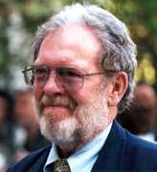




Pedagogical Advisors
WHAT
Elfrieda H. Hiebert, PhD
University of CA/ Berkeley
Vocabulary & Text Complexity
P. David Pearson, Phd
University of CA/ Berkeley
Assessment & Comprehension Development
CAPACITY
HOW
Ralph Radach, Phd
Florida State University/FCRR
Visual/Perceptual Skills
Stanford E. Taylor
Reading Plus®/Taylor Associates
Rate & Stamina
EFFICIENCY
WHY
John T. Guthrie, PhD
University of Maryland
Motivational Dimensions
MOTIVATION
Notes:
This is the question that Reading Plus® started asking 3 years ago when they brought together an advisory panel of leading reading researchers who have dedicated their careers to these various dimensions of reading improvement.
Freddy Hiebert and David Pearson helped guide the instructional design for text complexity, vocabulary acquisition, and comprehension development.
Ralph Radach and Stan Taylor focused on the design of text presentation and visual/perceptual activities to increase reading efficiency.
John Guthrie guided the design of motivational inventories and experiential methods for identifying and expanding student interest and intrinsic motivation.

Slide 20

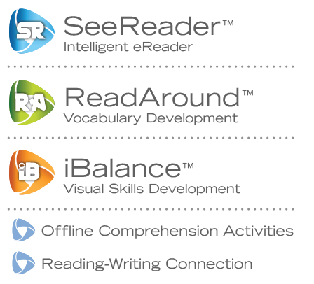
Assessment
of the Whole
Student
Instruction
for the Whole
Student
InSight™
Notes:
Students begin their work in Reading Plus with our assessment called InSight. InSight is an integrated assessment, created under the direction and guidance of leading reading researchers, that assesses the whole student in order to provide instruction that meets the needs of each leaner.
“Killer Detail” InSight and related reports

Slide 21

Assessment
of the Whole Student
CAPACITY
VOCABULARY LEVEL
WHAT
COMPREHENSION LEVEL
InSight™
Notes:
Of course, InSight assesses students’ capacity in terms of vocabulary and comprehension. However...

Slide 22

Assessment
of the Whole Student
EFFICIENCY
COMP-BASED READING RATE
HOW
VISUAL SCANNING
LETTER RECOGNITION SPAN
CAPACITY
VOCABULARY LEVEL
WHAT
COMPREHENSION LEVEL
InSight™
Notes:
InSight also provides a measure of the students’ reading efficiency, by assessing their comprehension based silent reading rates, the rate at which they can read with good comprehension. And those students who show rate deficiencies, will be further assessed to determine their visual scanning and letter recognition span, both of which are measures of visual efficiency.

Slide 23

Assessment
of the Whole Student
EFFICIENCY
COMP-BASED READING RATE
HOW
VISUAL SCANNING
LETTER RECOGNITION SPAN
CAPACITY
VOCABULARY LEVEL
WHAT
COMPREHENSION LEVEL
MOTIVATION
EXTRINSIC
InSight™
WHY
SELF-EFFICACY
VALUE
INTEREST
Notes:
In addition to capacity and efficiency, Insight also includes a motivation inventory that measures affective dimensions of the learner...starting with the most extrinsic and moving to the most intrinsic dimensions of motivation.

Slide 24
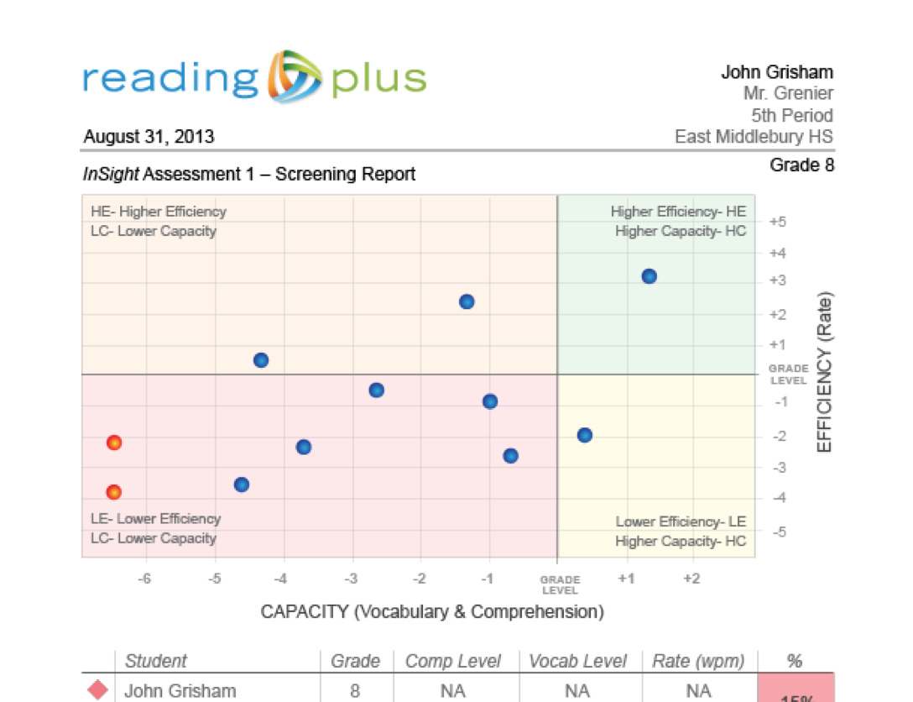
Universal Screening Report
Notes:
The initial administration of InSight serves as a universal screen to determine which students are not ready for Reading Plus instruction, which would benefit from silent reading intervention. and which are reading proficiently but can continue to build their capacity with increasingly complex texts.
Optional: This scatter plot graph uses measures of reading efficiency, or rate, and reading capacity, vocabulary knowledge and comprehension, to place students within one of 4 quadrants based on whether they are high or low in terms of efficiency or rate, and high or low in terms of capacity, (vocabulary knowledge and comprehension). Students will typically move up first, as efficiency develops, and will then move over, as they increase their ability to comprehend increasingly complex text.
Killer Detail

Slide 25
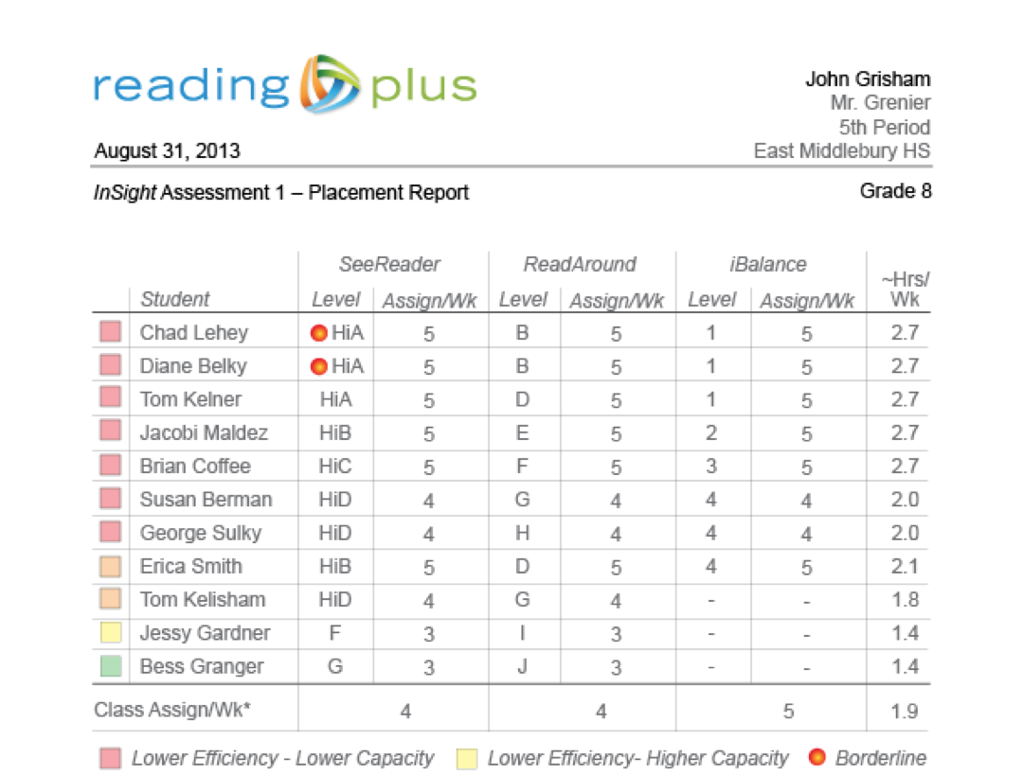
Placement Report
Notes:
Insight also serves as a placement test. Data gathered from InSight is used to determine each student’s initial placement and weekly assignment recommendations for each of the program’s various components.

Slide 26
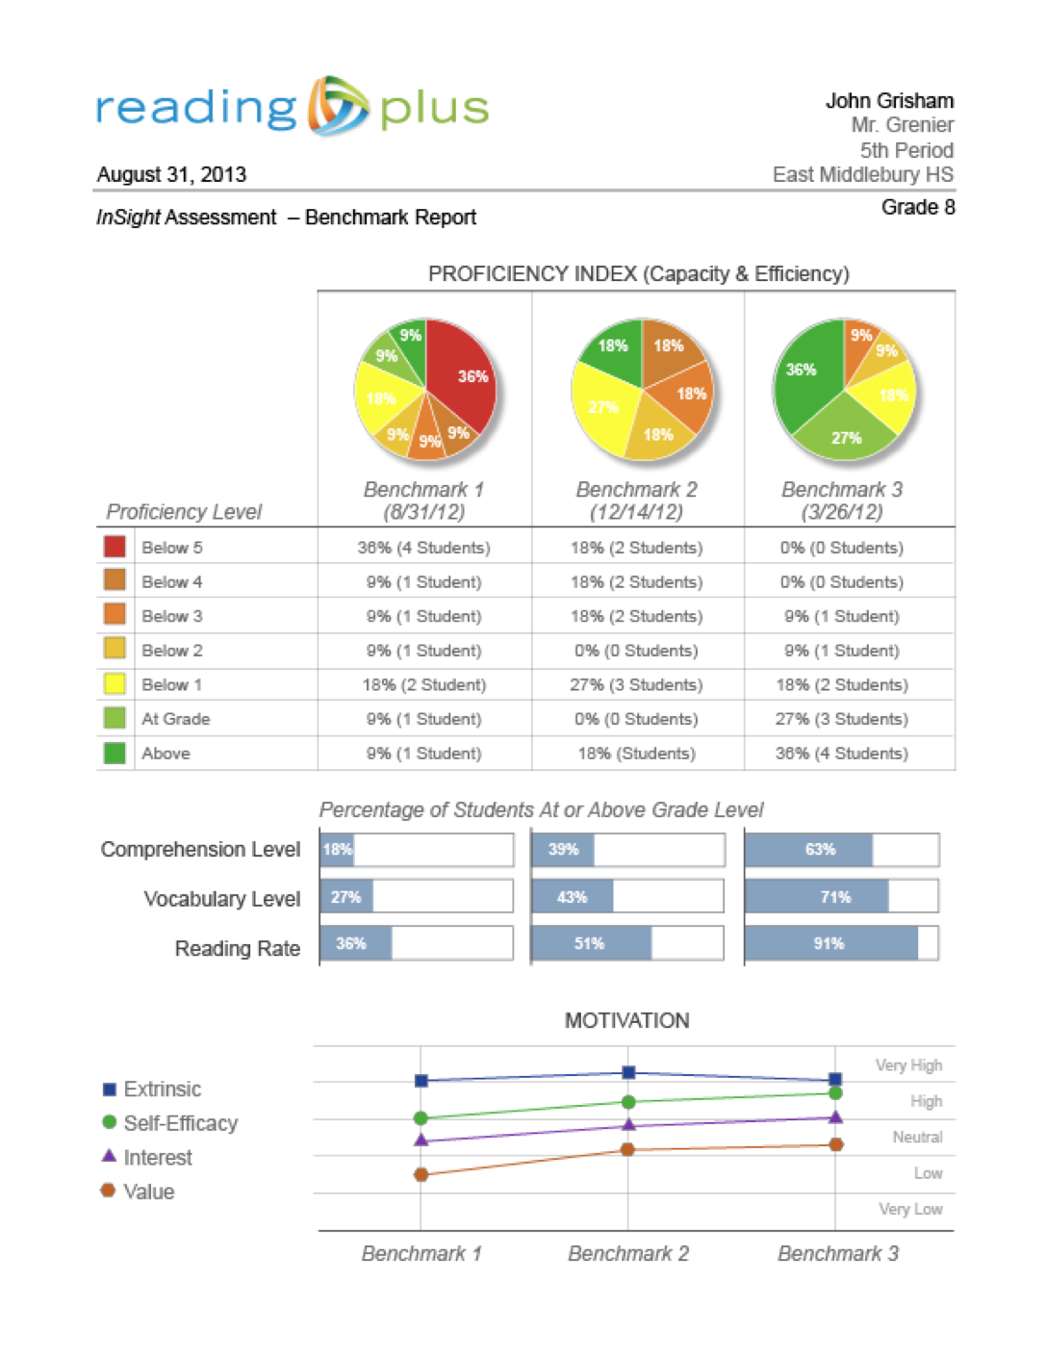
Benchmark Report
Notes:
Because there are multiple forms of InSight, it is also used as a benchmark assessment. Administration of these multiple forms over the course of a school year monitor students’ progress over time in the domains of reading efficiency, capacity and (c)

Slide 27
Benchmark Report
Notes:
…motivation.

Slide 28
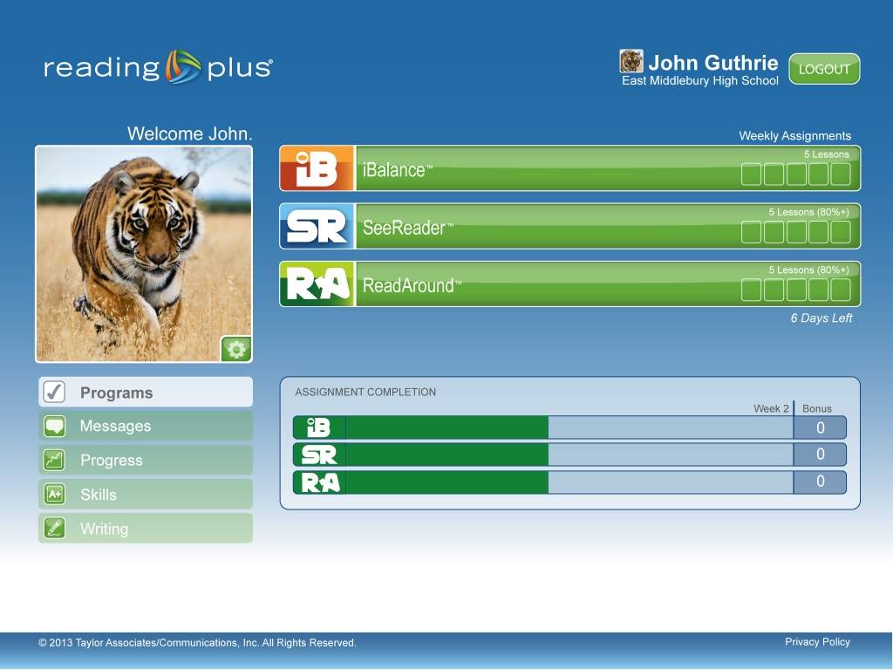

The Intelligent eReader
Notes:
Let’s take a look at the heart of the Reading Plus program... SeeReader. When students access See Reader from their student dashboard they are taken to a screen that allows them to choose the selection they’d like to read.

Slide 29
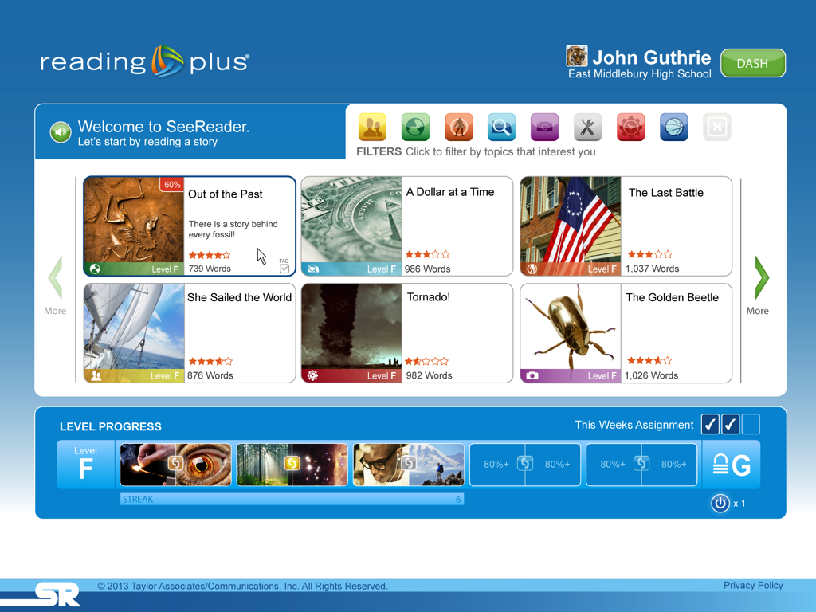
Engaging the Student
Notes:
Students can use the arrows to scroll through the available selections, all of which are within reading levels that are most appropriate for the individual student.

Slide 30
Engaging the Student
Notes:
(automatic animation to next slide)

Slide 31
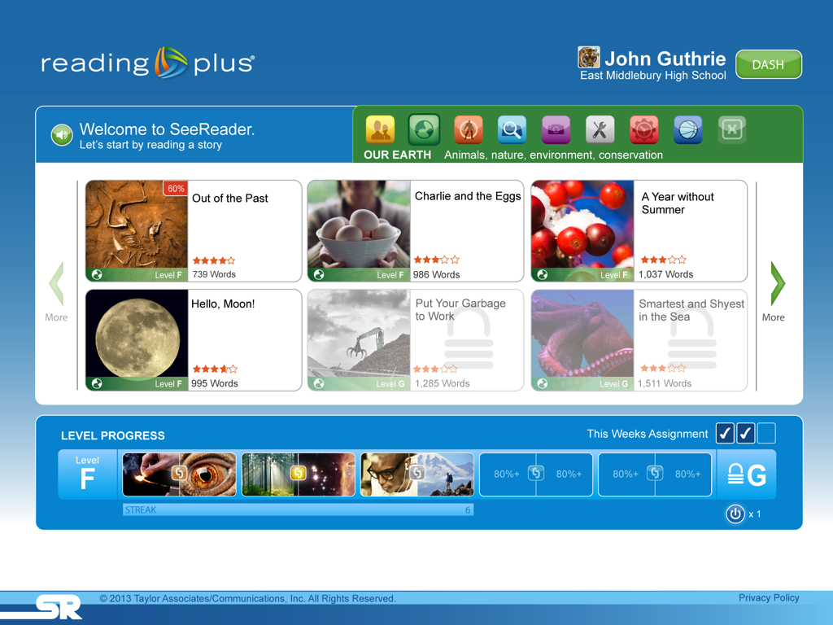
Deepen Interests
Notes:
You’ll notice the icons at the top....Instead of scrolling through all of the selections, students can deepen an existing interest by filtering selections by 8 different areas of interest. In this case, the student choose Our Earth and is presented with the selections at their current ability level that are within that interest group. You’ll see some selections are “greyed out” this provides a teaser to encourage students to work towards the next highest level in order to unlock those texts. This is one way in which we encourage intrinsic motivation for reading, “I want to do well so I can unlock a selection I want to read.”

Slide 32

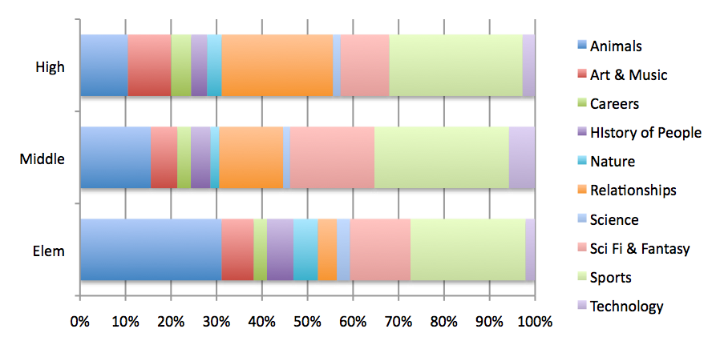







Student Interests
INTEREST FILTERS
Personal Journey
Friends, family, relationships, self-improvement
Our Earth
Animals, nature, environment, conservation
Heroes and Trailblazers
Champions, winners, innovators, leaders
Mystery and Adventure
Classics, real-life discoveries, supernatural events
Art and Culture
Art, music, fashion, food, movies, books
How Things Work
Science, technology, health, medicine
Time Machine
Cultures past and present, travel, civics
Get in the Game
Sports, athletes, sportsmanship
Animals
Arts & Music
Careers
History of My People
Nature
Relationships
Science
Sci-Fi & Fantasy
Sports
Technology
Notes:
To arrive at our interest filters, we polled students across grade levels, demographics, and ability levels and took their responses, converted them into these headings pushed out a survey to a large group of students.
“Killer Detail” results from our interest survey.

Slide 33
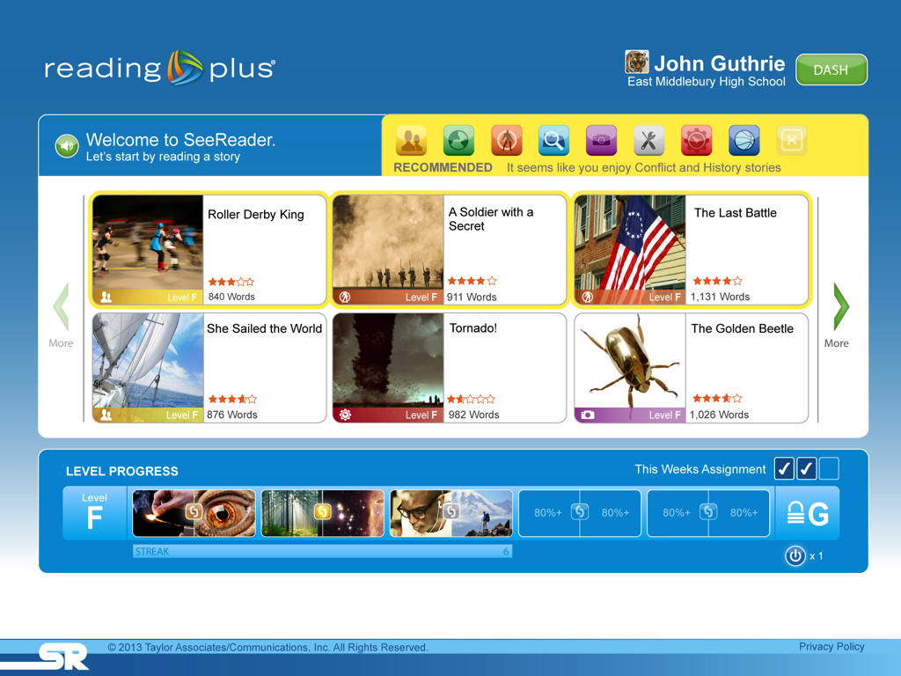
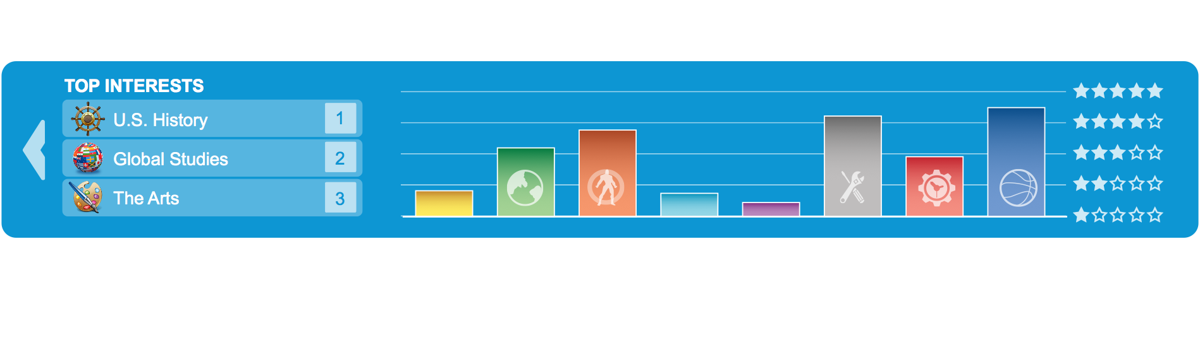
Expanding Interests
Notes:
We also use information about how students rate each selection to recommend selections to students. Choosing selections from areas they are interested in helps deepen interests, but by recommending selections we can help expand their interests. (Click) As students progress through the system, we can begin to mirror back to them not only what their interests are, but how those interests align with curriculum areas they are studying in school.
Optional: A student who never though they were interested in science starts to see the connection between all the “How Things Work” stories they choose and various disciplines within STEM.

Slide 34

Connecting Curiosity to Content
TOPIC FILTERS
CURRICULUM AREAS
TYPES OF TEXT
LITERATURE
GEOGRAPHY
HISTORY
STEM
GLOBAL STUDIES
ARTS
NARRATIVE
INFORMATIONAL
DRAMA
MYTHS & LEGENDS
BIOGRAPHIES
Notes:
In addition to each selection belonging to an interest areas, each selection is also tagged as belonging to a particular curriculum area. This ensures that as students deepen and broaden their interests, they are also building a broad range of knowledge while (c) reading various types of genre. For example, a story from “Time Machine” has connections to history and could be a piece of literature. while one story from “Heroes and trailblazers” is connected to STEM as a biography while another might be connected to geography as an informational text.
Optional: Although we show a few curriculum areas here, each of these is areas is broken down into very specific areas of study...For example a “Get in the Game” story about Jackie Robinson connects to history, more specifically, American History and even more specifically Civil Rights. Civil Rights.

Slide 35

Increasing
Capacity
Determining Complexity
Average Sentence Length
Rare Word Frequency
Text Complexity Staircase
LEXILE® RANGES
 | 450-600 | 600-750 | 750-900 | 900-1050 | 1050-1200 | 1200-1350
2-3
4-5
6-8
9-10
11-CCR
GRADE BANDS
Old Text Difficulty Range
New Text Difficulty Range
Notes:
When creating a reading experience that builds capacity we must also consider the complexity of the texts. As I mentioned before, The Common Core State Standards are calling for a dramatic shift in Lexile ranges. The range once appropriate for an 8th grader (c) is now expected of a 5th grader. (c) But what is a Lexile complexity score really comprised of? (c) actually, a Lexile is comprised of two measures… (c) average sentence length and (c) the frequency of rare words. (c)
“Killer Detail” text complexity

Slide 36
Increasing
Capacity
Determining Complexity
Rare Word Frequency
Progressive Increase in
Rare Word Frequency
Text Complexity
Staircase
1
2
3
4
5
6
7
8
9
10
11
12
PS
Notes:
However, the Lexile score is most heavily influenced by sentence length. This means that the Lexile score of a text can be dramatically altered simply by manipulating sentence length. But, research tells us that vocabulary complexity is a hugely significant factor when it comes to text complexity, one that deserves just as much attention as sentence length. Therefore, each Reading Plus selection contains a progressive and systematic increase in the number of rare words, creating a truly authentic staircase of text complexity. Our unique text complexity approach benefits readers of all abilities, but it is especially crucial for English Language Learners.

Slide 37
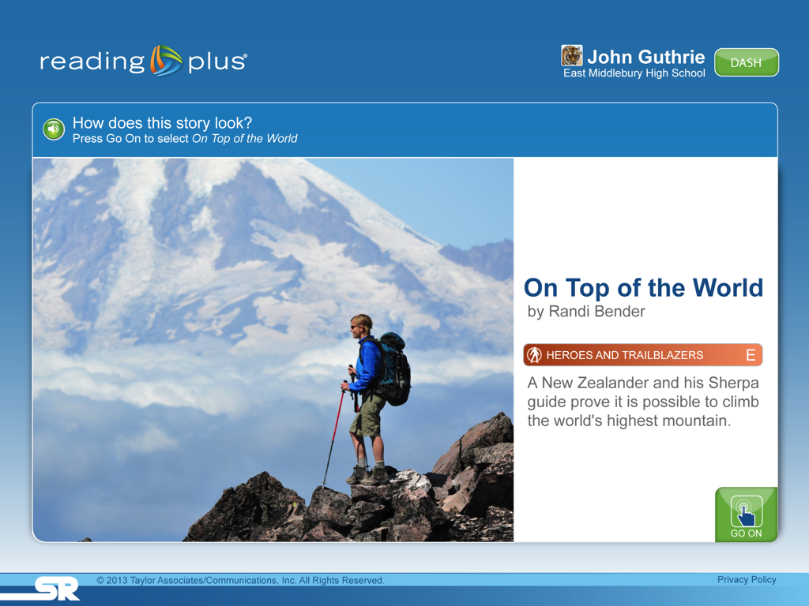
Title Screen
Notes:
Let’s take a look the student’s experience once they choose a selection to read. The student first sees a title screen

Slide 38
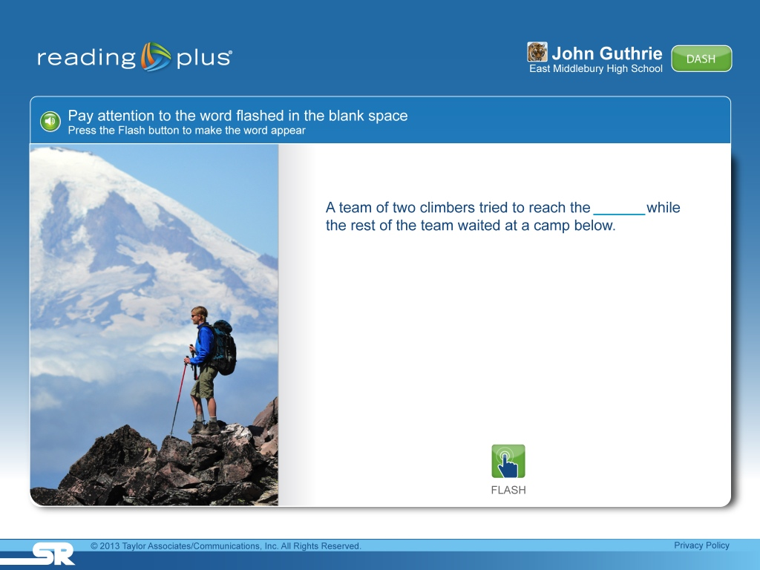
Key Words
Notes:
Then, before beginning to read, students complete a Key Word activity to ensure that they can instantly recognize and give meaning to words they will encounter while reading the selection. Students click flash and the target word is flashed for a brief moment in the blank and students are asked to type the word they saw. Students can flash the word multiple times if they have difficulty instantly recognizing the word.

Slide 39
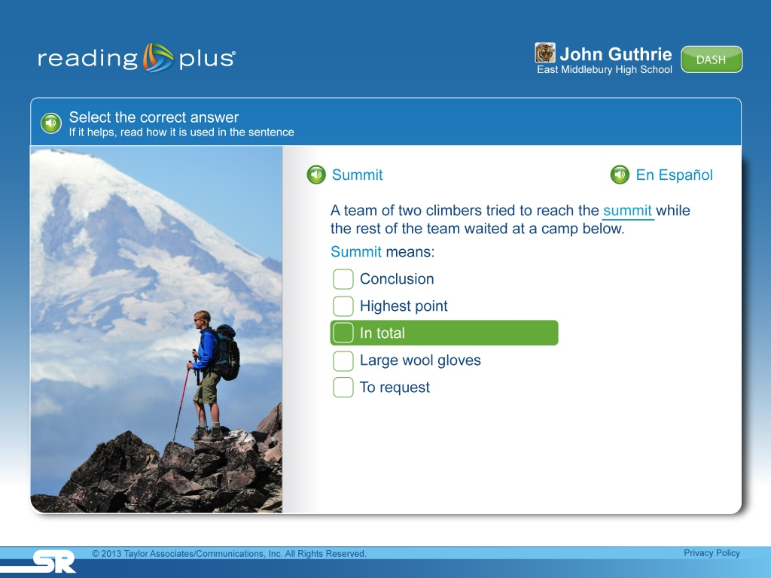
Key Words
Notes:
Of course, is addition to recognizing the word, students must know what the word means. To asses this, students are asked to find the word or phrase that means about the same as the target word. Once they choose an answer, students hear the word pronounced in English or Spanish.

Slide 40
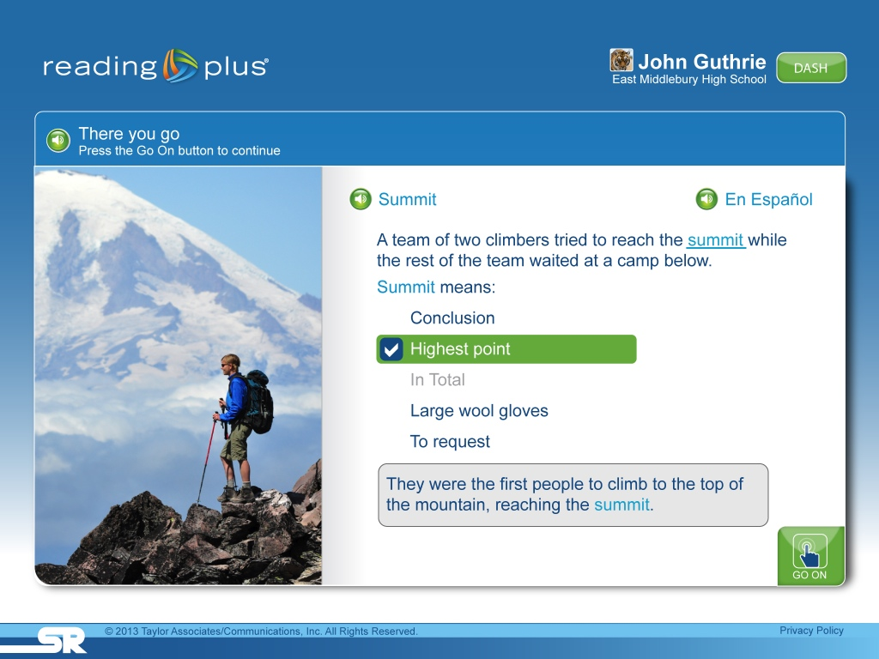
Key Words
Notes:
If students choose the wrong answer, as in this case where they chose ”In Total”, we show the correct answer and then use the target word in a contextual rich sentence which helps students learn the meaning of the word while developing contextual analysis skills. Being able to instantly recognize and giving meaning to words while reading creates a more fluent reading experience that ultimately improves comprehension.

Slide 41
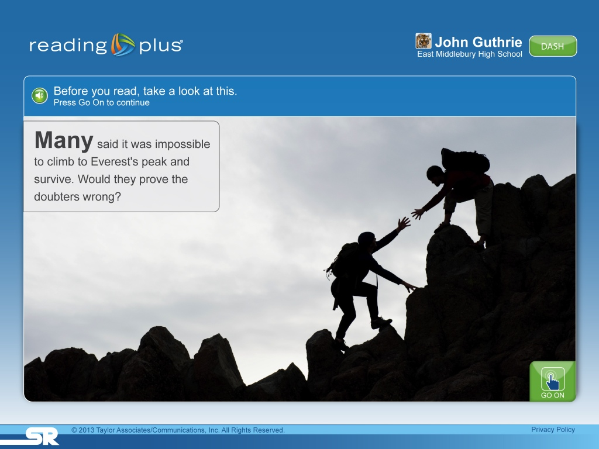
Getting Ready to Read
Notes:
To situate students in the selection, they are presented with a vivid image and intriguing intro to the story.

Slide 42
Building Stamina
Relationship Between Rate and Stamina
Time to read 2,000 words
Minutes
Words Per Minute
Notes:
However, we know many readers, especially those that are struggling, often lack the stamina to stay engaged and actively reading for longer text selections. We talked earlier about those students whose reading rates never make it past those of emergent readers. Take a look at what this does to the stamina demands of those students compared with a student reading at 250. A student reading at 250 wpm would take about 8 minutes to read a 2000 word text, while a student reading at 100 words per minutes must sustain attention for over twice as long to read the same amount of words. So, ironically, our most struggling readers also are faced with the greatest stamina demands.

Slide 43
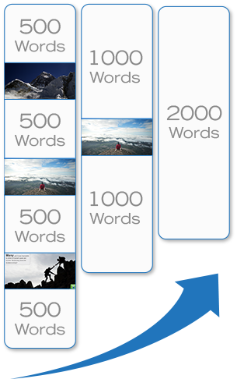
Building Stamina
Relationship Between Rate and Stamina
2,000 Word Text
Time to read 2,000 words
Minutes
Rate & Stamina
Words Per Minute
Notes:
Reading Plus provides dynamic text segmentation in accordance with the student’s reading rate. We can take a longer text, say a text of 2000 words, and break it up into more manageable chunks of a 1000 words or 500 words to scaffold their stamina and attention demands while they build the rate needed to tackle longer text. Text segment lengths are increased gradually as students build capacity with longer texts.

Slide 44

Engagement Builders
Notes:
Click

Slide 45
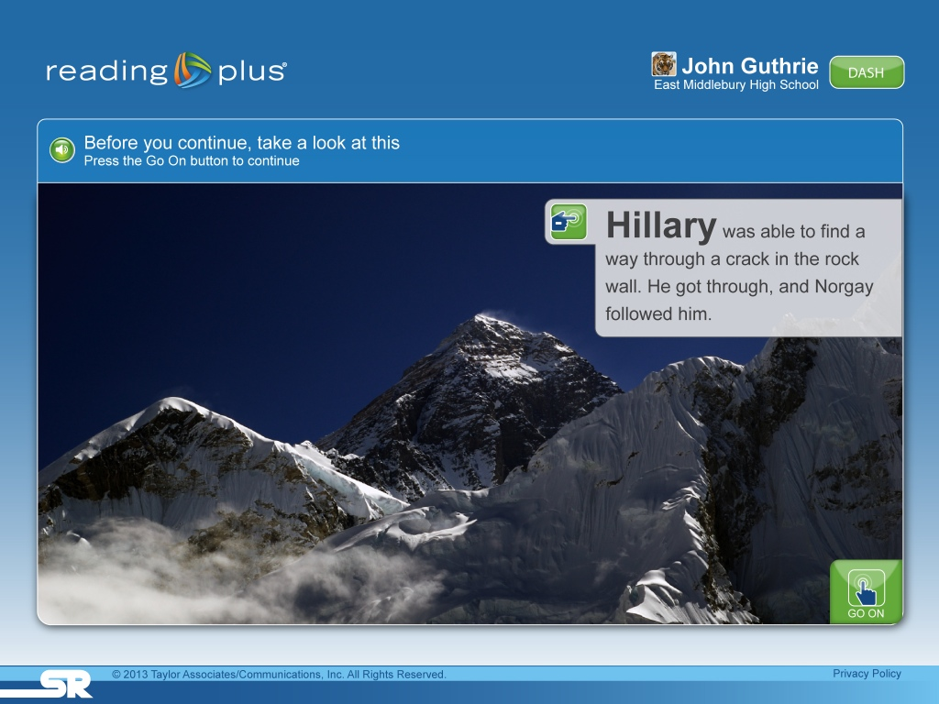
Engagement Builders
Notes:
“Engagement Builders” appear between text segments and provide enticing images with brief interesting text that help build prior knowledge, and encourage an active and engaged reading experience.

Slide 46

Changing How They Read
Notes:
For many students, though it isn’t only rate and stamina limitations that present barriers to comprehending complex texts. Inefficient silent reading behaviors can also impact fluency and make reading unenjoyable and unproductive. How do we change a student’s reading behaviors?
Well, when first teaching our students how to read, we modeled good reading, by reading out loud with prosody and intonation... But as students transition to silent reading we lost the ability to model effective, efficient reading? (click on video to play)
This Guided Window begins at the ideal practice pace and provides the opportunity for students to have a guided reading experience that models effective silent reading. It changes the way students take in text while reading and gradually increases comprehension-based silent reading rates. As students develop and automate reading efficiency and fluency, they are able to focus efforts on comprehension and gaining knowledge, rather than on the process of reading. This makes reading more productive, and more enjoyable.
The rate dynamically adjusts in accord with good comprehension. Does this feel really slow to you?? This is a student reading at 120 wmp... the rate at which many of our lowest quartile students are reading.

Slide 47

College & Career Ready Rate
Notes:
And here’s where our students need to be to be college and career ready... 280 WMP.

Slide 48

Encouraging Independence
Notes:
The system will gradually remove these text presentation scaffolds in response to students’ increasing ability to successfully comprehend text at more productive rates. This provides a more traditional reading experiences and encourages independence.

Slide 49
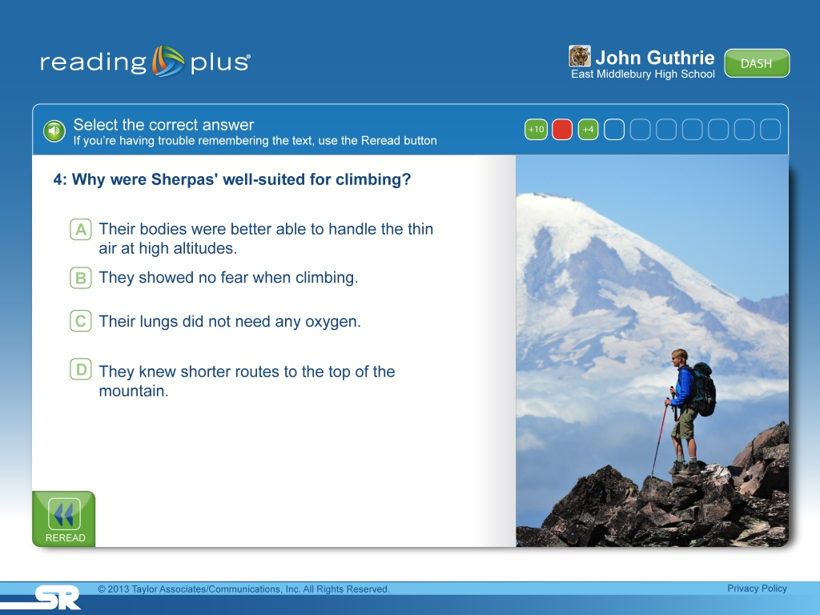
Text-Dependent Questions
Notes:
Each Reading Plus selection is followed by rigorously crafted text-dependent questions that monitor student comprehension performance. Our innovative question formats encourage the use of powerful comprehension strategies. Here the student is presented with a question... and you’ll notice a reread button in the bottom left corner this allows students to proactively reread portions of text, before selecting an answer option. Rereading before an answer is selected is a habit we want to encourage... go back in the text and find the answer...
“Killer Detail” on question, answer and foil creation.

Slide 50
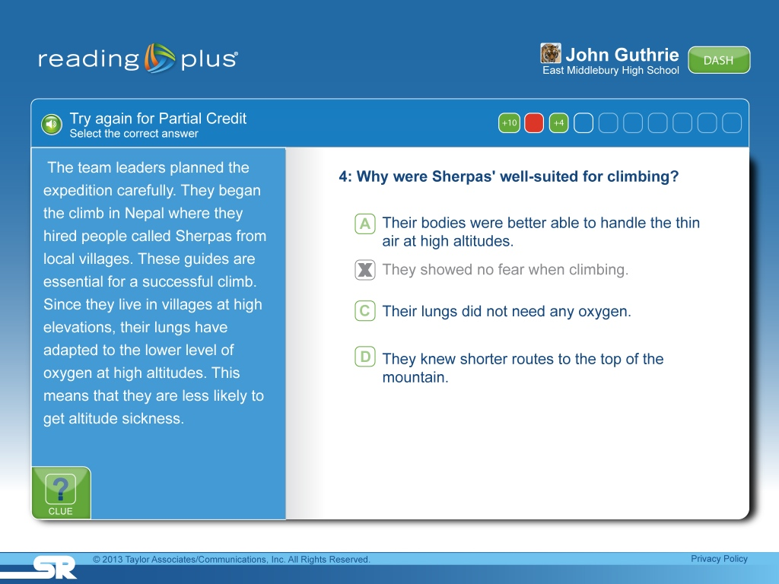
Reread Closely & Critically
Notes:
If a student selects an incorrect answer, he or she is automatically shown the portion of text where the correct answer can be found, allowing them to receive partial credit for the question.

Slide 51
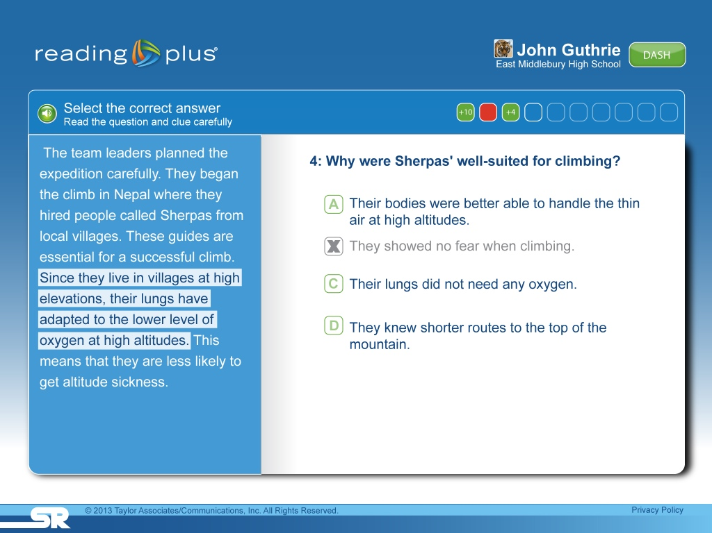
Clues for Struggling Readers
Notes:
For students who need additional support a clues button is available which highlights the specific location within the excerpt where the evidence needed to answer the question can be found.

Slide 52
CCSS
Anchor Standards Alignment
Key Ideas & Details
Craft & Structure
Integration of
Knowledge & Ideas
1
2
3
4
5
6
7
8
9
A
A
A
A
A
A
A
A
A
A
B
B
B
B
B
B
B
B
B
C
C
C
C
C
C
C
Notes:
Common Core has 9 anchor standards grouped under the headings of Key Ideas and details, Craft and Structure and Integration of knowledge and ideas. To assist teachers, (c) we worked with Dr. David Pearson to break each of these 9 standards into more specific sub-skills. Let’s take a look at an example of a question from anchor standard 5, Analyze structure of texts, including how portions of text relate to each other.

Slide 53
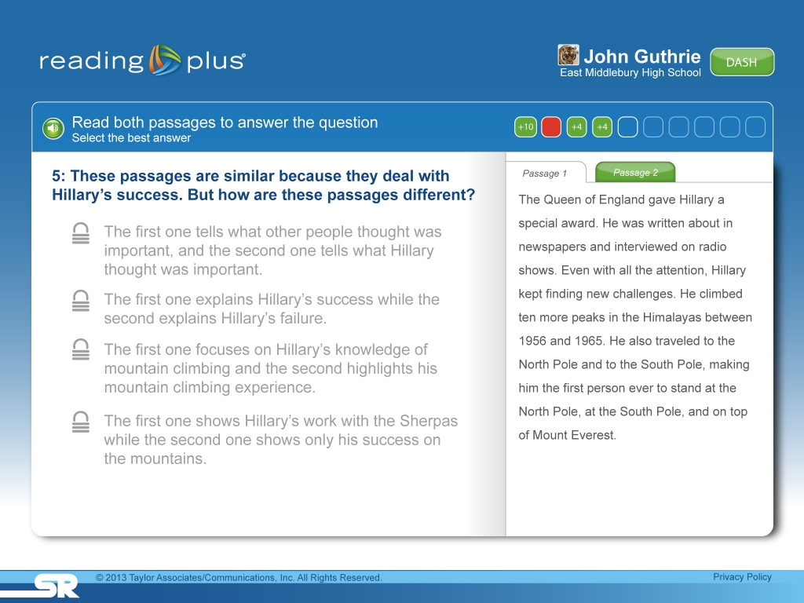
Read Two Excerpts
R
Notes:
In this example, students are asked to read an excerpt from the selection that was just read as well as (c) an excerpt from an outside source (c).

Slide 54
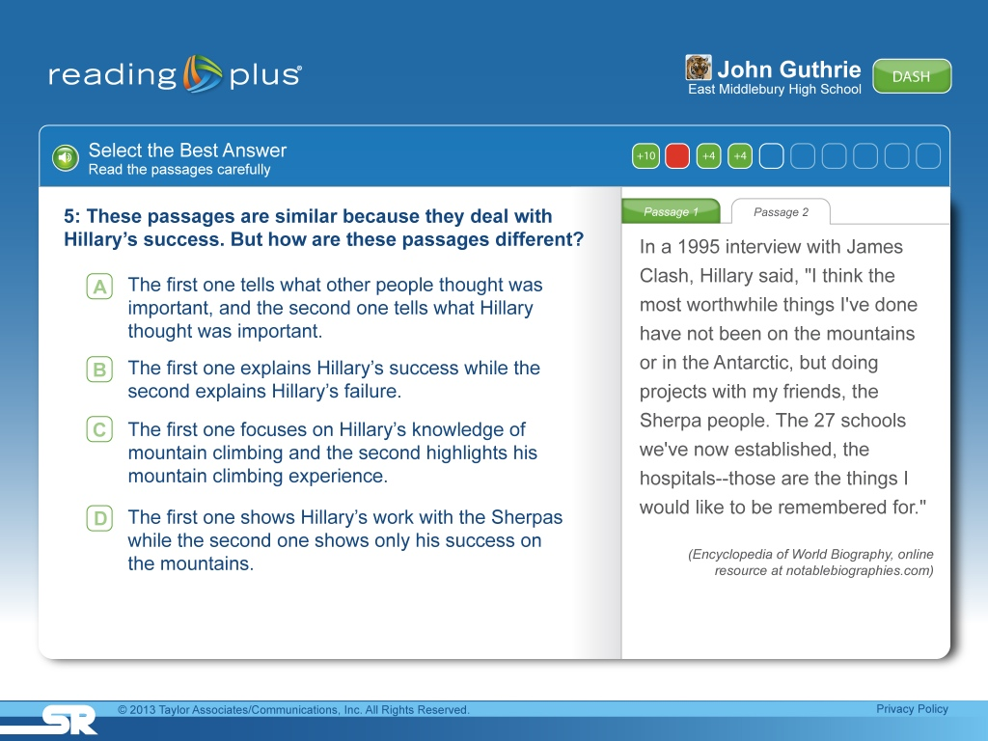
Analyze to Answer Question
R
Notes:
In this example, an excerpt from the Encyclopedia of world biography students need to analyze and synthesize information from both excerpts in order to effectively answer the question.

Slide 55
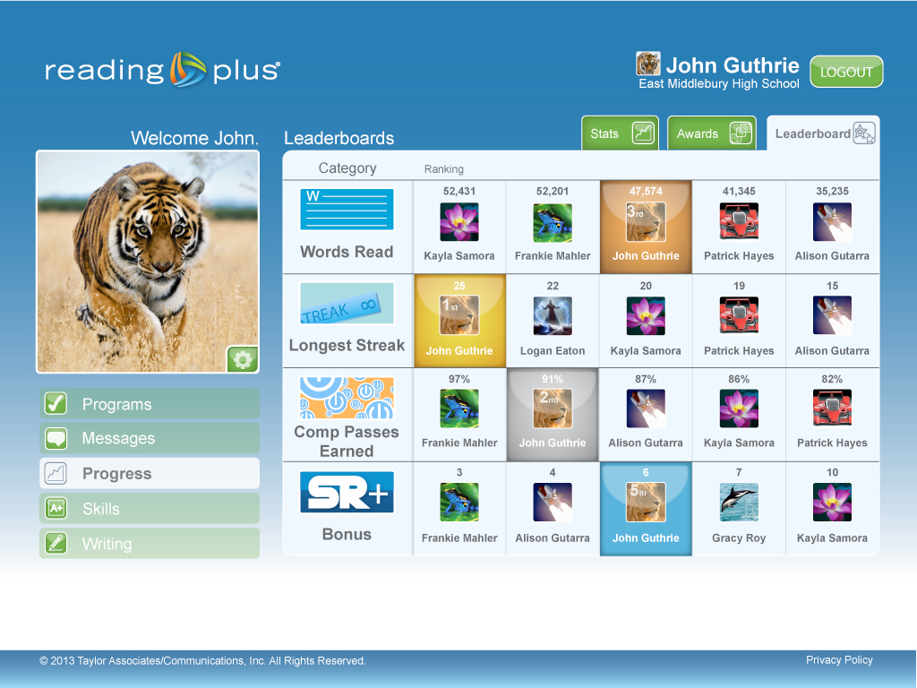
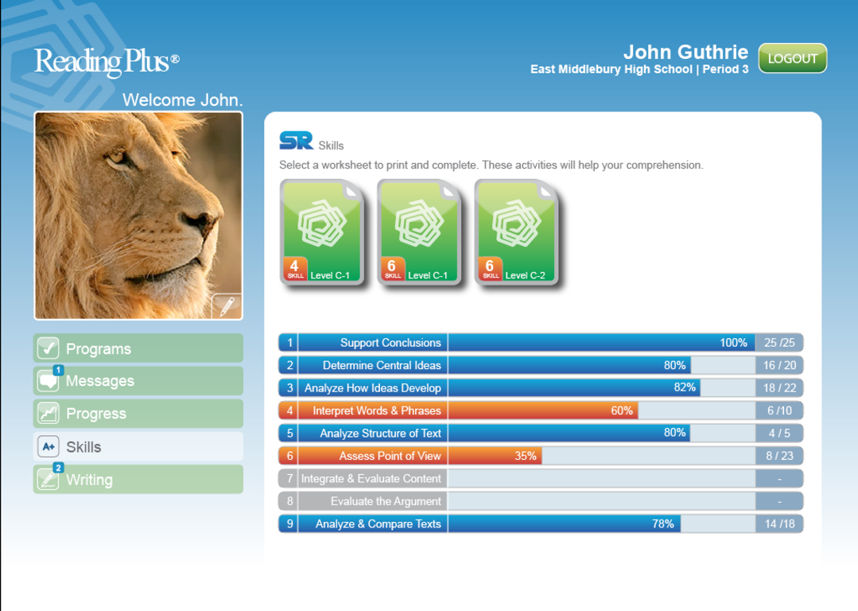
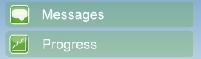
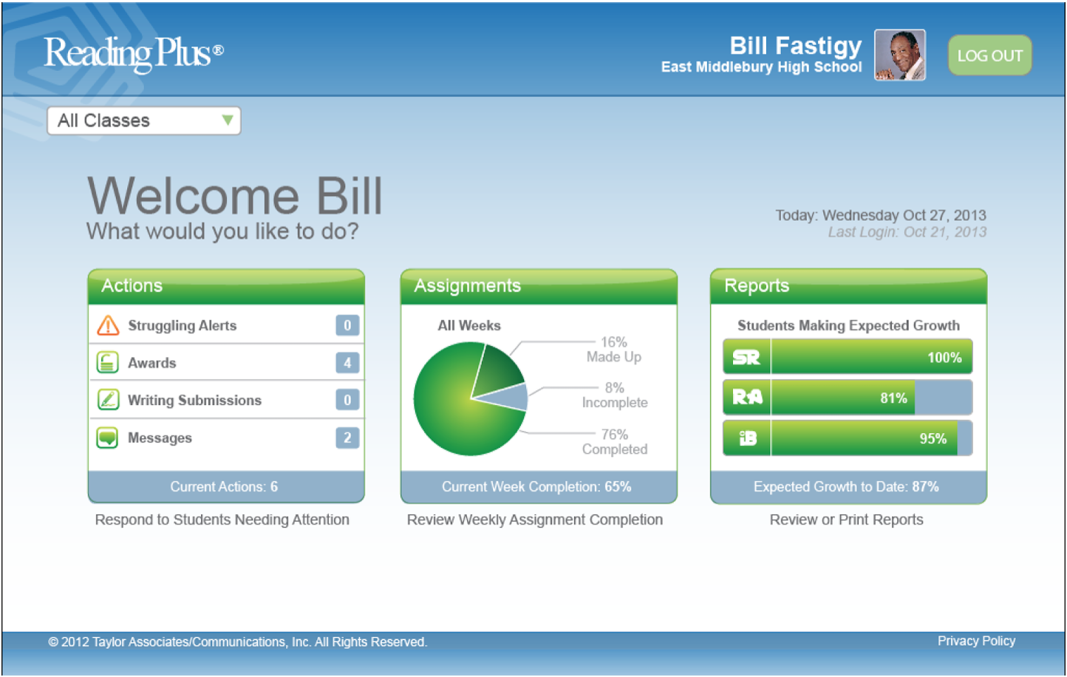
Skill Sheets Assigned
Skills
Notes:
Reading Plus tracks students’ performance on every question, and automatically assigns targeted instruction at each student’s independent level.

Slide 56
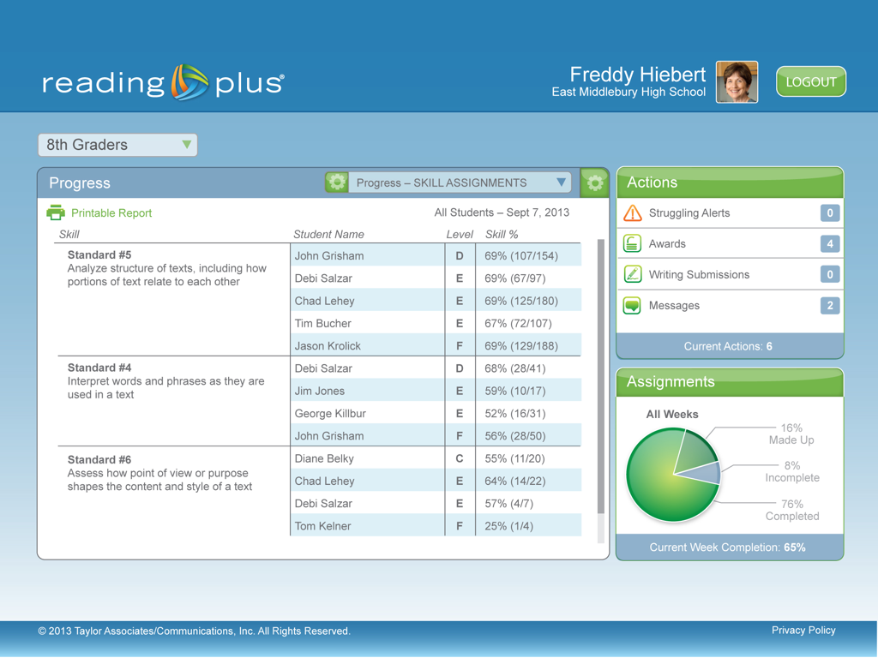
Grouped by Deficiencies
Notes:
The program also, automatically groups students by shared deficiencies and provides a report that teachers can use for differentiated, small group instruction.

Slide 57
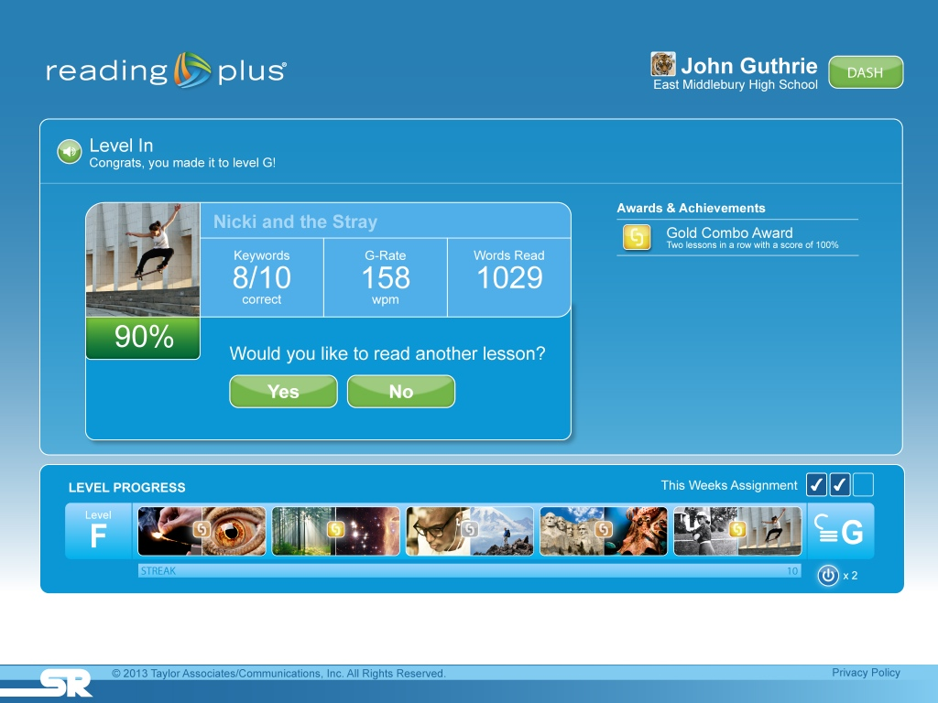
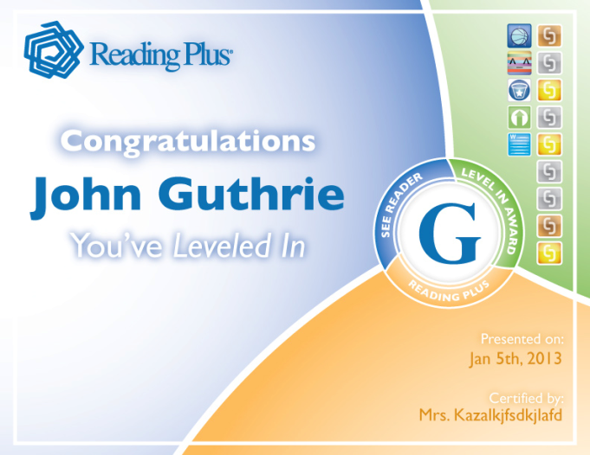
Celebrate Success
Notes:
We know that many of our reluctant readers are more extrinsically motivated when it comes to reading. We meet students where they are by providing frequent opportunities for success and by delivering rewards, that are always aligned with instructional goals. Following the completion of comprehension questions, students are given immediate feedback so that success is celebrated and so that they are aware of exactly what they need to do to continue making progress. So, in addition to choice over what they read, students feel a sense of control over their own learning experience. Dr. Guthrie’s research has been very clear, giving students choice and control is a powerful way to develop intrinsically motivated readers.

Slide 58
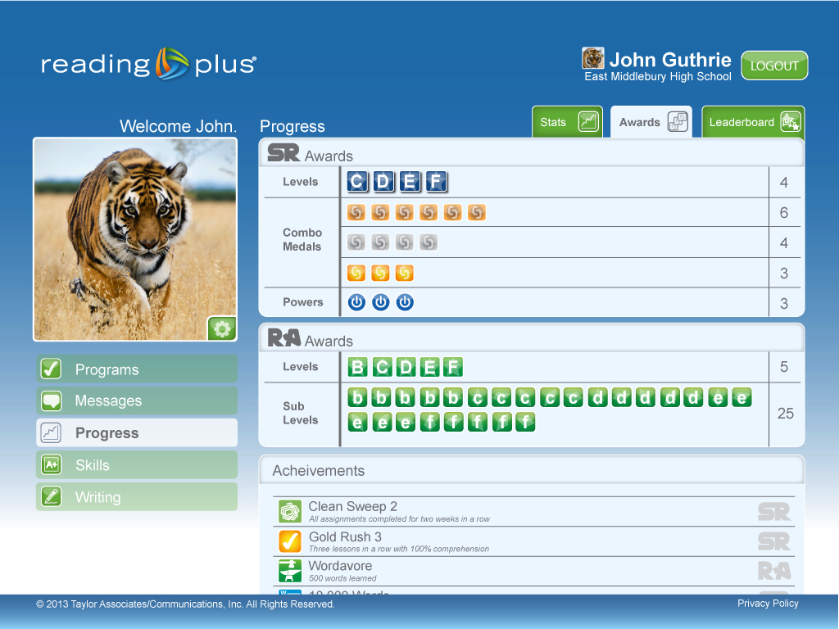
Progress & Achievements
Achievements
Notes:
As students experience success, and monitor their own progress their sense of self-efficacy increases.

Slide 59
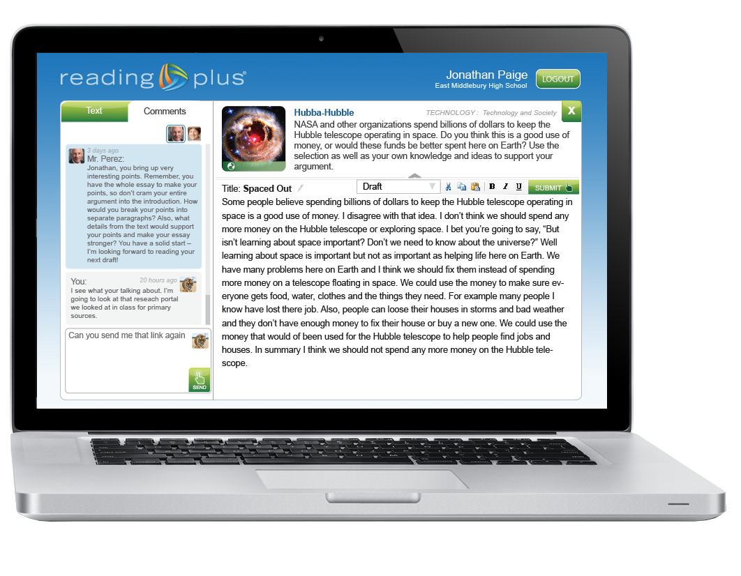
Reading-Writing Connection
Writing Assignments
  Evidence-Based Arguments
  Expository Writing Narratives
  Electronic Production and Distribution
  Ongoing Feedback
Notes:
In addition to demonstrating comprehension with questions, students in Reading Plus have frequent opportunities to demonstrate their understanding through writing.

Slide 60
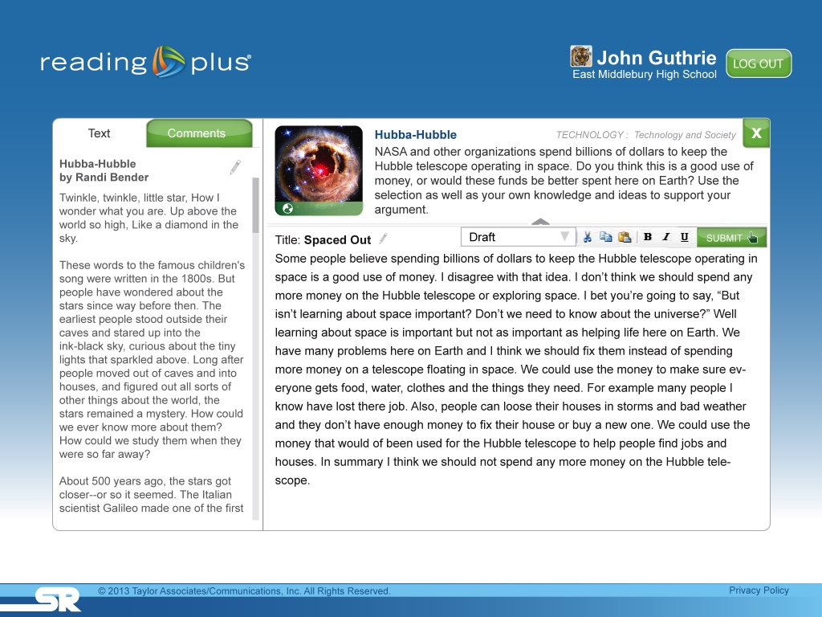
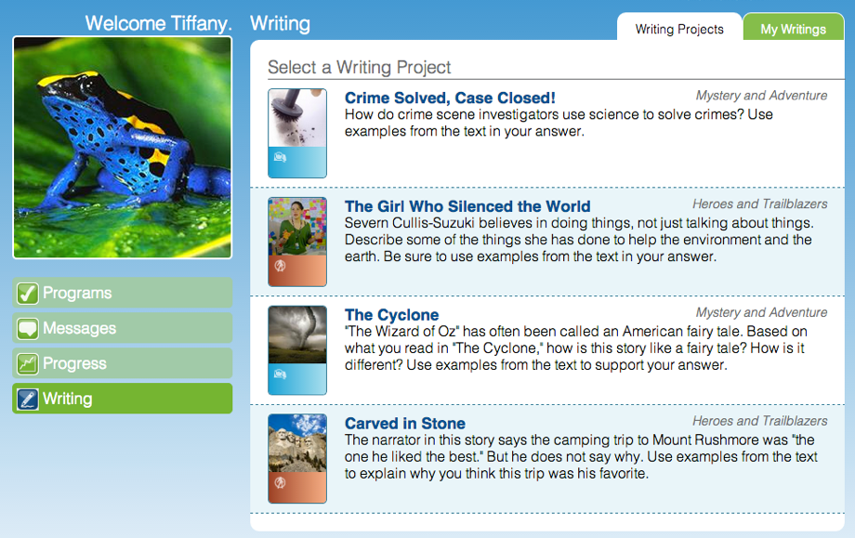
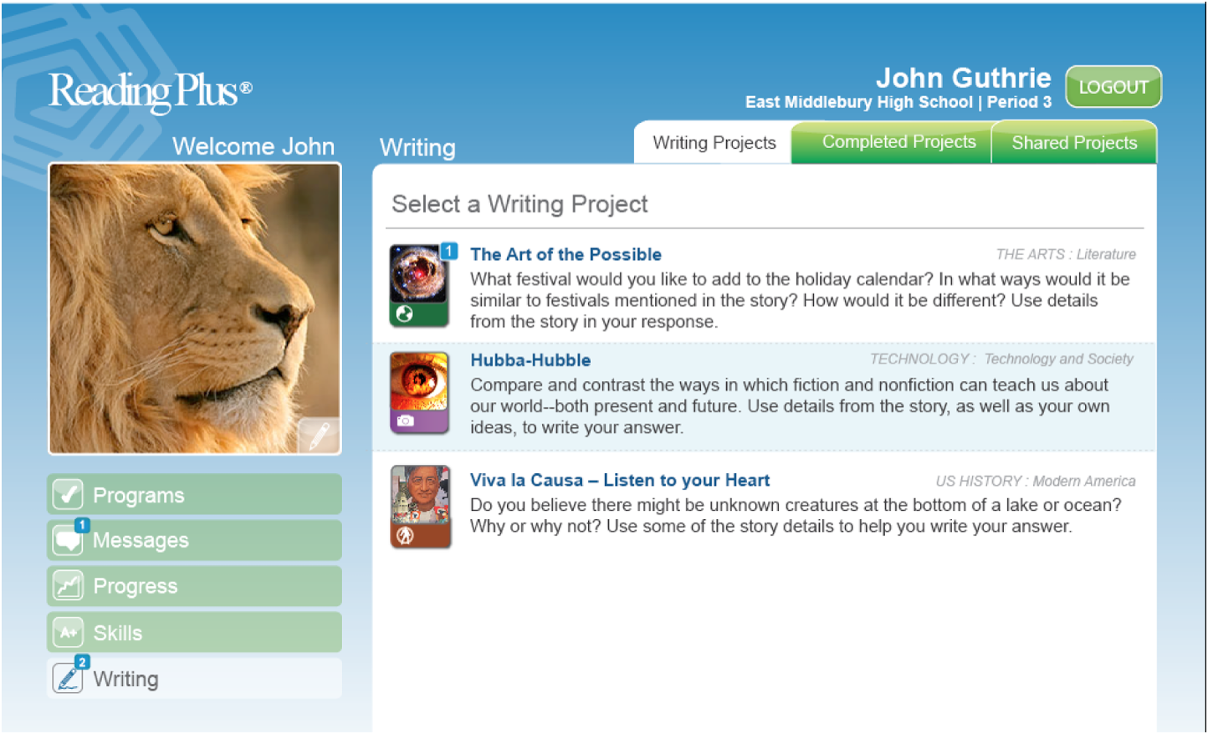
Writing Prompts
Notes:
After each reading selection, students are automatically presented with a writing prompt that is either expository, narrative or evidence based. When students are given the opportunity to share what they’ve learned, they begin to read with the purpose of gaining knowledge. They begin to see reading as a valuable means of getting information and writing as a productive way of sharing information. This student has chosen to respond to the prompt from the selection, Hubba Hubble.

Slide 61
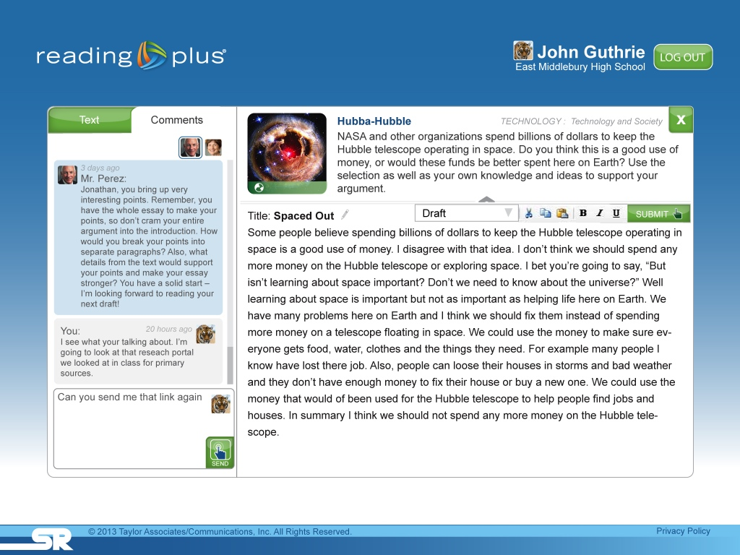
Crafting a Response
Notes:
The student uses the integrated writing portal to craft their response. (c) students can click on the text tab (c)

Slide 62
Reading Closely & Critically
Notes:
To bring up the reading selection. This let’s them read closely and critically to find the evidence, ideas, and details that will help them craft their response. Students can also designate where they are in the writing process: brainstorming, outline, draft, edit, revision, or final. when they are ready they can submit their work to their teacher or teachers and (c) click on the comments tab to see their teacher’s response. (c)

Slide 63
Comment Thread
research
Notes:
These electronic comment threads between teacher and student help students learn how to incorporate feedback into their writing. Teachers however, do not have to wait for students to submit their work. they can access students’ writing anytime from within their teacher dashboard.

Slide 64
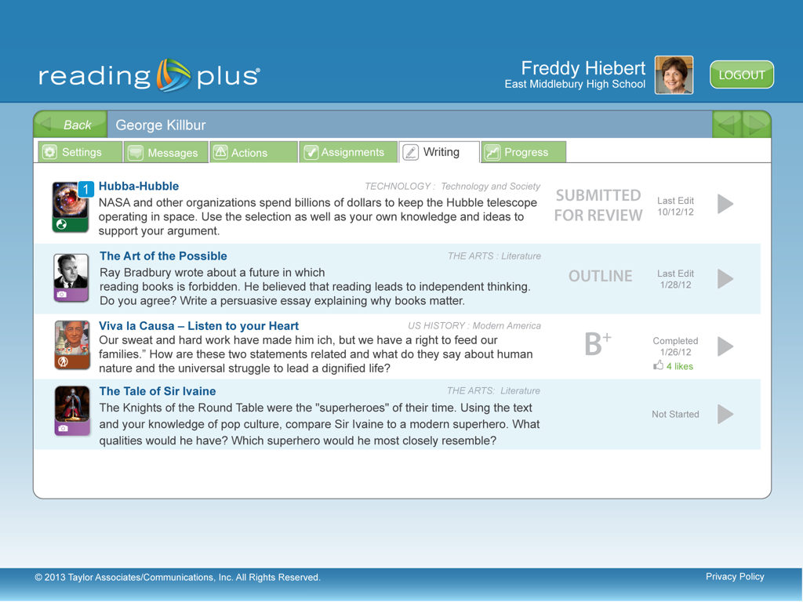
Teacher’s View
Notes:
Here, the teacher can see the last time the student made edits to their work, which have been graded and which have been submitted for review.

Slide 65
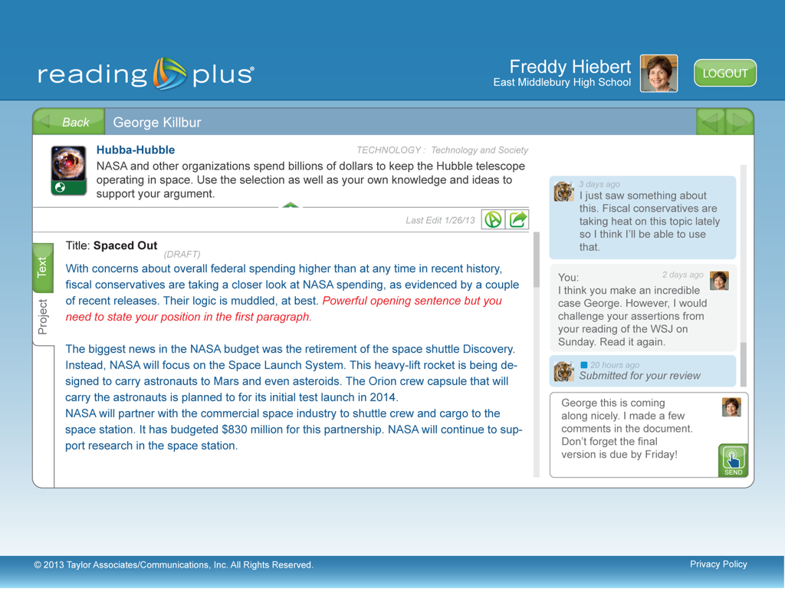
Comments & Edits
Notes:
When she clicks into a particular students’ writing, she can add comments as well as edit the text.

Slide 66
Vocabulary Development
Notes:
Because research shows such a strong correlation between vocabulary development and comprehension. Student progress in the SeeReader program is supported by work within our vocabulary program, Read Around.

Slide 67
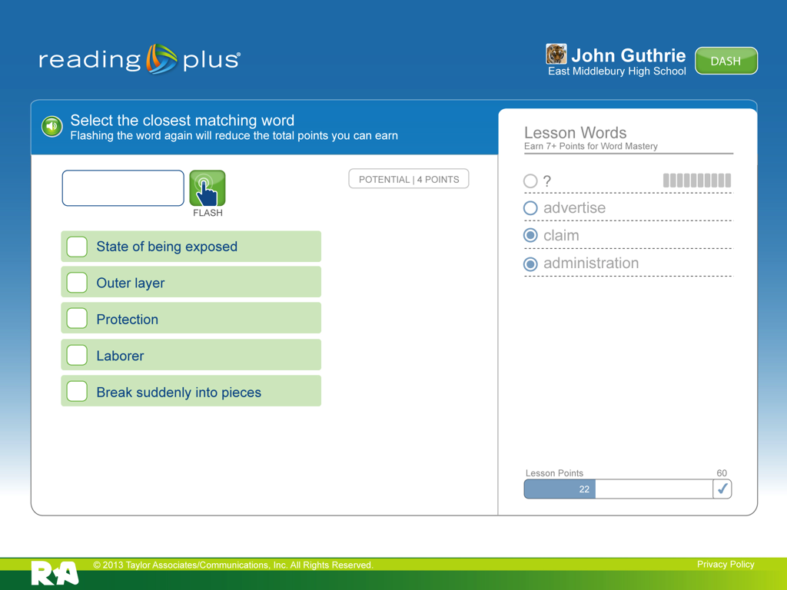
Instant Recognition
Notes:
The first activity in Read Around is used to determine if the student can instantly recognize and give meaning to a word. Skills essential for fluent reading with comprehension. The student clicks flash (CLICK)

Slide 68
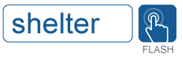
Instant Recognition

Slide 69
Apply Meaning
Notes:
and the target word is flashed quickly and then removed. The student, without the word visible, must choose the answer that most closely matches the target word.

Slide 70
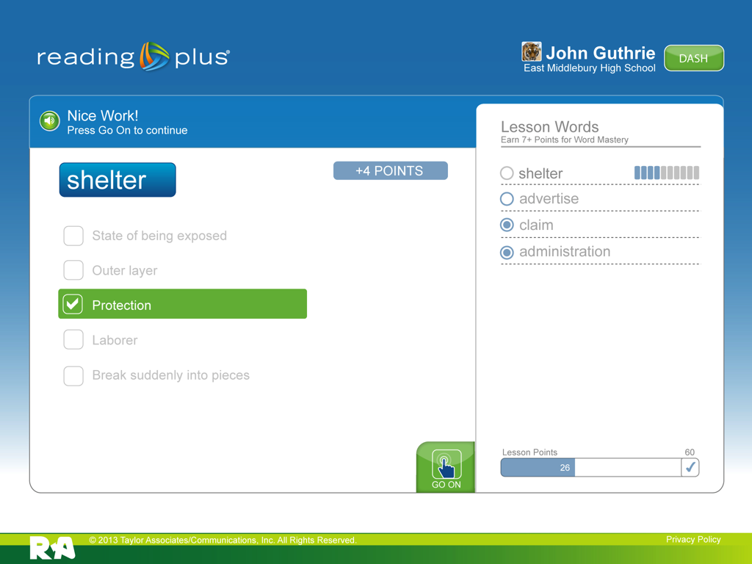
Instant Feedback
Notes:
Students get instant feedback and then move on to the next activity in ReadAround.

Slide 71
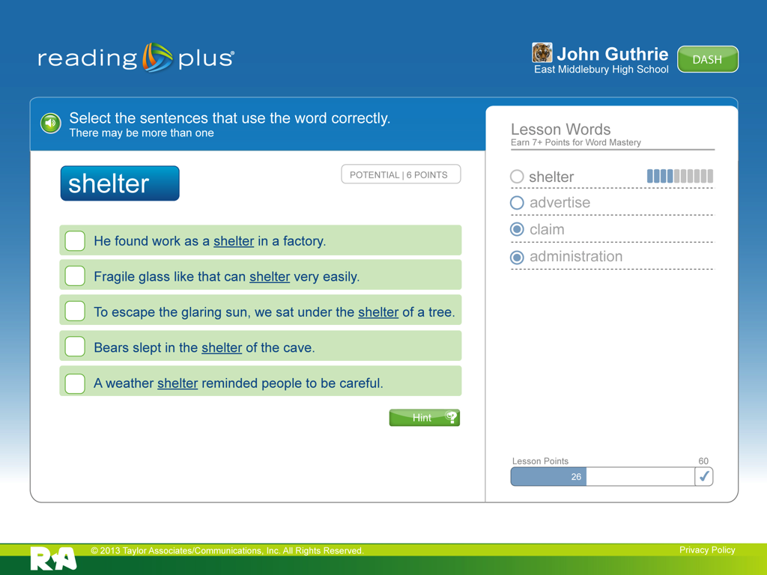
Word-in-Context
Notes:
In the second activity asses the students’ knowledge of the word in context. The student is asked to determine which 2 sentences use the Target word in correctly.

Slide 72

Contextually-Rich Hints
Notes:
If students are unsure they can get up to 2 hints, which use the word in contextually rich sentences.

Slide 73

Check Me
Notes:
One the student has chosen the 2 sentences they click “check me”.

Slide 74

Demonstrating Mastery
Notes:
Again, students receive instant feedback. If students demonstrate mastery of the word, they continue on to the next word, but if they don’t know the word, it gives us an opportunity to teach it.

Slide 75

Developing Vocabulary
Notes:
The teaching page develops vocabulary with explanations of word meaning and contextually rich sentences rather than traditional definitions, which are of limited value, (since students often don’t understand the definition any better than they understood the word). Students are also exposed to the target word’s word family which acts as a kind of knowledge multiplier. One word learned becomes several words known. Showing the word in a contextually rich sentence, helps students learn the meaning of this word while developing contextual analysis skills that help them unlock the meaning of other unfamiliar words. English and Spanish audio, and images for concrete words support the mastery of words that are difficult to learn using context clues only.

Slide 76

Word Family
Notes:
Progress made by students in all of the Reading Plus components can be easily monitored through the educator’s dashboard

Slide 77

Student Dashboard
Notes:
In addition to vocabulary support, [click] students who are identified as having visual skill deficiencies are directed to the iBalance program.

Slide 78
What Research Says About
Reading Efficiency
Vocabulary knowledge is essential
Reading is word based
There is an efficient way of taking in words
  Bigger perceptual span is better
  There are more and less effective fixation points to take in words as units
Serendipity

Slide 79


Notes:
iBalance has two activities that help students develop tracking efficiency and increase perceptual span, which is the quantity of characters the student can rapidly and accurately perceive.

Slide 80

Notes:
The flash activity develops a students perceptual span by increasing students’ ability to utilize the periphery of their visual span.

Slide 81

str
Notes:
Students focus on the cross in the middle of the screen and use their peripheral, or parafoveal, vision [click] to determine the letters flashed to the left or right of the cross.

Slide 82

Notes:
As students work within the activity, the distances that the letter clusters are flashed to the left or right of the cross are gradually increased. This occurs in accord with the student’s ability to accurately recognize and type the characters displayed.
These visual skill activities are foundational skills that pave the way for the rapid and accurate recognition skills required for fluent silent reading.

Slide 83

Notes:
The scan activity is what Dr. Ralph Radach describes as a “non-linguistic reading task”.
In just a moment, you’ll see the guided window move across lines of text as you did earlier. All of the letters within a text passage have been replaced with circles, however, and the student is asked to press the space bar each time he sees a circle with a break in it, or a “Landolt Ring”.

Slide 84


Notes:
[click to begin movie.]
As students engage in this activity, they are employing the same visual tracking skills used while reading text. However they aren’t required to engage in any of the cognitive processing involved in actual reading. The semantic dimension of the task has been stripped away, allowing students to develop visual discrimination and tracking efficiency, essential skills that determine the ease and comfort with which we read.
Of course every students works at a rate that is appropriate for his or her ability and the system gradually increases the difficulty of the task in accord with each student’s performance.

Slide 85

Educator
Dashboard
Notes:
Progress made by students in all of the Reading Plus components can be easily monitored through the educator’s dashboard.

Slide 86

Teacher Dashboard
Notes:
When teachers enter their dashboard they are presented with 3 options... review students who need attention, review assignments or view reports. We encourage teachers to first look at the actions that require their attention.

Slide 87

Clearing Actions
Notes:
Although most actions are automatically and dynamically adjusted in accord with the student’s progress, There are instances that call for the teacher to engage with her students. To make this as efficient as possible, the Actions panel groups students by the type of attention required by the teacher. (c) The orange triangles represent students who are struggling, (c)the “unlocked” icon shows students who have completed a level and have an award waiting, (c) the next group of students has submitted writing for the teacher to review and (c) the final group shows students who have sent the teacher a message. It is most important that teachers respond to students who are struggling. Teachers can click on the students name to (c)…
“Killer detail” on actions.

Slide 88

Struggling Students
Notes:
review the actions that have been taken automatically by the system to assist the student, review the system’s analysis of the data and send a pre-populated message to the student with suggestions to help them get back on track.
“Killer detail” on suspensions.

Slide 89

Printing an Award
Notes:
And they can take action for the other groups directly from this panel. Choosing to send a message and print the award for one or all of the students in this group or…

Slide 90

Messaging Students
Notes:
they can respond to individual student messages. (c) When the teacher is ready, she can click on the assignments widget to see how her students are doing with their weekly assignments.

Slide 91

Monitoring Assignments
Notes:
This is the beginning of a week showing 5 assignments due for each component.
“Killer detail” on monitoring and grading.

Slide 92

Mid-Week Monitoring
Notes:
With 3 days left in the week, the teachers can clearly see who has completed assignments with 80% comprehension shown as green, who has struggled with some assignments, shown as orange and who still has blue bars indicating that assignments haven’t been completed. The reports widget allows teachers to access disaggregated reports… we’ve already looked at reports from the assessment and skills, and other reports are available to monitor student progress such as (c)…
“Killer detail” on settings, sub-populations, scheduling and assignments.

Slide 93

Monitoring Expected Growth
Notes:
monitoring student progress against expected growth.

Slide 94


HOW
Students Read
The intelligent eReader...
...that changes the way students read
WHAT
Students are Capable of Reading
WHY
Students Read
Notes:
So that is a high-level look at Reading Plus, the intelligent e-reader that changes the way our students read by changing (C) How they read (C) and why they read so we can more effectively change (c) what our students are capable of reading.
We do this by impacting student motivation, efficiency, which ultimately builds student capacity to independently read and comprehend complex text. We’ll take a look at each of these in turn, but let’s focus first on motivation... as creating truly engaged readers is one of the most important and often overlooked domains of reading success.

Slide 95

Effectiveness
L2L: Links to Learning

Slide 96

Effectiveness
L2L: Links to Learning

Slide 97

Effectiveness
L2L: Links to Learning

Slide 98
Single Seat License
Single-Seat Subscriptions, K-12. Includes Professional Development, Implementation, and Technical Support
# Single Seats | 50 | 150 | 300
1 year TOTAL | $3,933 | $8,089 | $12,290
3 year TOTAL | $8,168 | $16,799 | $25,526
Annualized 3 year $ | $2,723 | $5,600 | $8,509
Cost/Student 3 year | $54 | $37 | $28

Slide 99

Single Seat Subscription (SS)

Slide 100

Unlimited Access (UA)

Slide 101
Unlimited Access
Unlimited Access Subscriptions, K-12. Includes Professional Development, Implementation, and Technical Support. (Based on total school enrollment)
Unlimited Access (UA) | 200 | 500 | 1000
1 year TOTAL | $6,293 | $10,998 | $17,020
3 year TOTAL | $13,071 | $22,842 | $35,348
Annualized 3 year $ | $4,357 | $7,614 | $11,783
Cost/Student 3 year | $22 | $15 | $12

Slide 102

Pilot Opportunities
Fully supported Pilots (Professional Development, Implementation Support, Technology Support)
10 to12 Weeks
At no cost to you!
Notes:
.Read slide

Slide 103
BOCES shares 3,040+
Reading Plus seats
Plan your wish!

Slide 104
Learn.readingplus.com
https://learn.readingplus.com/wp-content/uploads/2013/07/Implementation-Planning-Worksheet-for-Administrators.pdf
Due November 8, 2013

Slide 105
Rachel@readingplus.com
(802) 777-7111 learn.readingplus.com

Slide 106
CHANGING THE WAY STUDENTS READ

