Slide 1
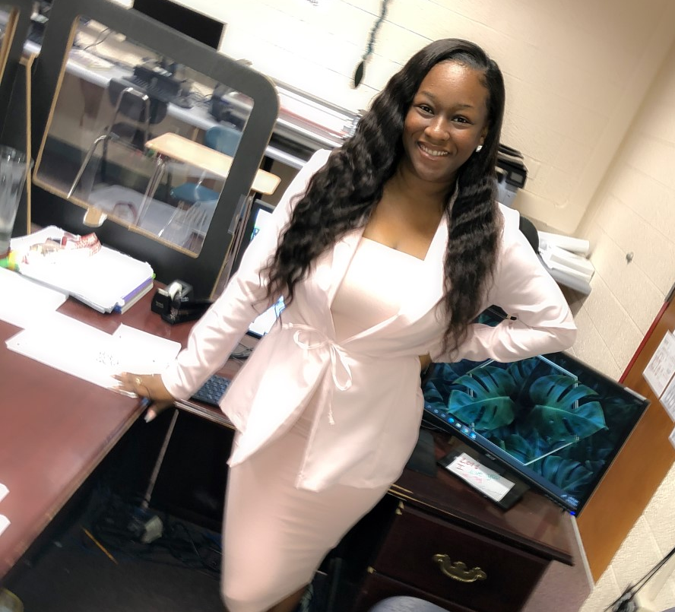
I completed my Bachelor’s Degree at Fort Valley State University in Accounting. I have also completed my Masters of Business Administration (MBA) at Clayton State University.
My name is Amber Hardee and I am so happy to be a part of WRHS family. More importantly, I am EXCITED to be your teacher. This is my 3rd year teaching Business Financial Management and I absolutely love it.. Our year will be filled with gaining development skills for the finance world with opportunities that expand beyond basic business skills into technology, financial literacy, and accounting. I’m excited to make this my best year yet!
Email: amber.hardee@hcbe.net
School phone #: (478) 929 - 7877
Color : Pink
Food: Grilled food
Season: Fall
Subject: Math
Sport: Dance
Animal: Cheetah
Hobby: Hairstylist
Fav Person: My son

