Slide 1
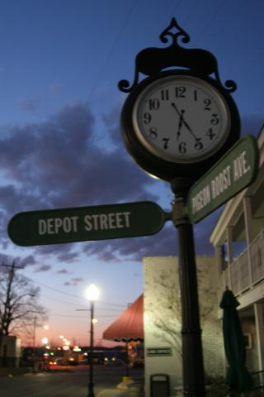
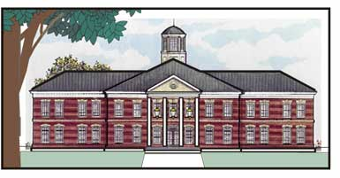

Slide 2
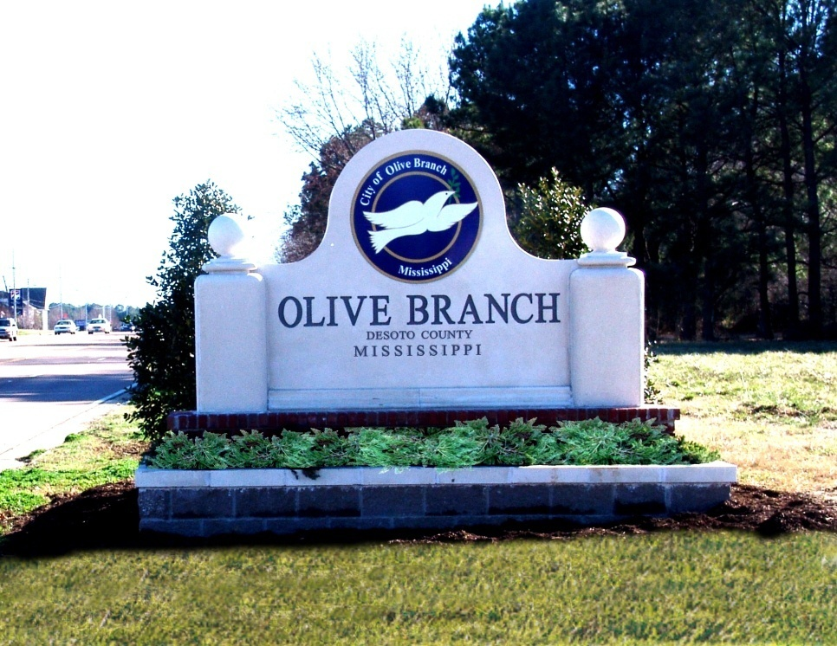
Page 374
Municipal Government

Slide 3
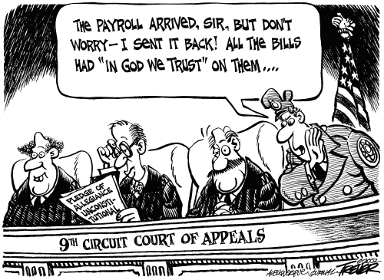
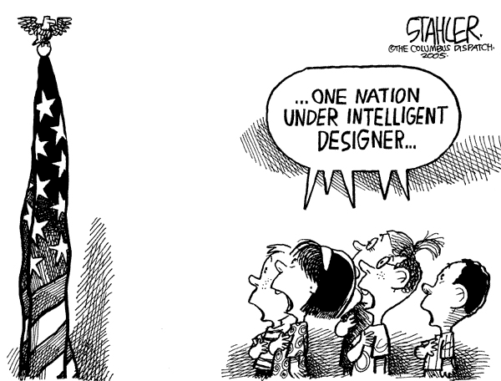
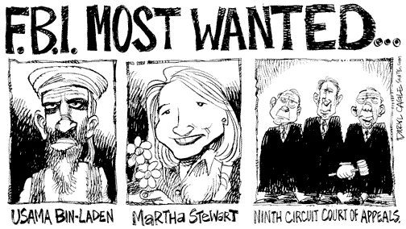
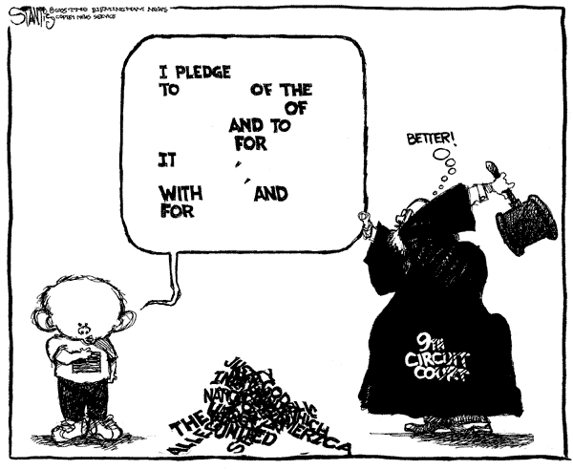

Slide 4
Objectives
MS4 Demonstrate the ability to use social studies tools (e.g., timelines, maps, globes, resources, graphs, a compass, technology, etc.). (G, E)
MS5 Explain how civic responsibilities are important to Mississippians as citizens of the United States and residents of a global setting. (C, H)

Slide 5
Objectives
MS5a Explain the necessity of politics and government.
MS5b Describe the roles of citizens in the state and nation.
MS5d Identify the major responsibilities of state and local government.

Slide 6
Review
Counties
Board of Supervisors
Types of County Government
Law Enforcement
County Superintendent and the Board of Education

Slide 7
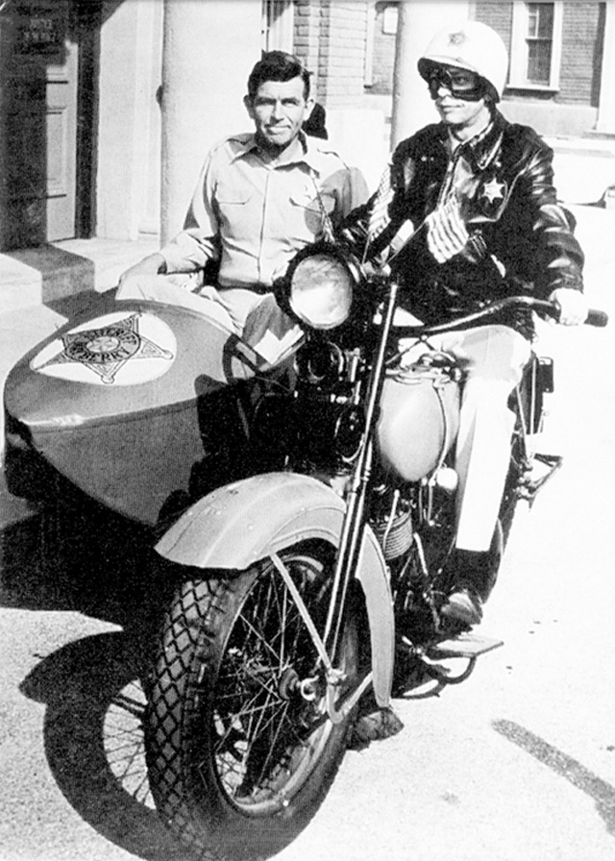
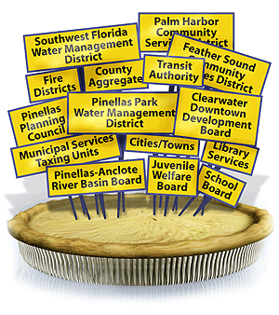
City Government
Olive Branch
Olive Branch
Police
Olive Branch
Olive Branch
Olive Branch
OB
Olive Branch
City Park

Slide 8
Overview
Municipalities (Cities, towns, and villages)
Functions of City Government
Types of City Government
Annexation
Other Local Governments
Taxes

Slide 9
Municipal Government
Is Mississippi a rural state?
Yes
Why is Mississippi considered a rural place?
51.2% live in a rural setting.

Slide 10
How does the book define rural?
A place or municipal with a population of less than 2,500 persons.

Slide 11
What are municipalities?
Political units that provide local government to specific areas, can be classified according to population size.

Slide 12
How are municipalities classified according to size?
50 to
300
More than 2,000
Cities
301 to 2,000
Towns
Villages

Slide 13
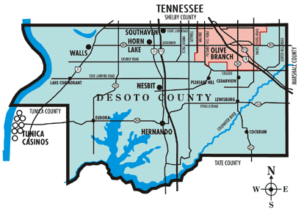
Any villages in DeSoto County?

Slide 14
Memphis
Memphis is a village in DeSoto County, Mississippi. The population was 87 at the 2000 census. The village of Memphis has officially become part of Walls, Mississippi.
The Village of Memphis

Slide 15
The Village of Memphis
As of the census of 2000, there were 87 people, 27 households, and 25 families residing in the village.
According to the United States Census Bureau, the village has a total area of 4.4 square miles.

Slide 16
Population in July 2007: 119.
Males: 54 (46.0%)
Females: 65 (54.0%)
Village resident age: 31.5 years
Mississippi median age: 33.8 years
Estimated median household income in 2007: $90,175
(it was $74,375 in 2000)
Memphis: $90,175
Mississippi: $36,338
F
M

Slide 17
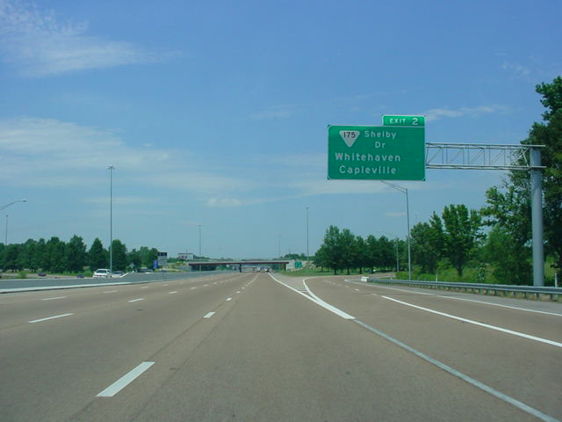
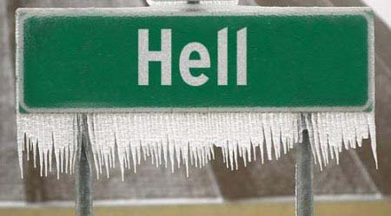
City Limit Signs
According to a UPI news report, it also snowed in Hell at least once, causing many to remark that "it was a cold day in Hell".
Hell
Capleville
Unincorporated
POP: 16
ELEV: 745
According to the United States Geological Survey, Hell is a located in Riverside County, California

Slide 18
What is Unincorporated mean?
To answer this question we to know what mean to be incorporated.
Incorporated municipality is one with a charter received from the state.
Unincorporated community, which exists only by tradition and does not have elected officials at the town level.

Slide 19
How does municipality get a charter?
Must present a petition, signed by two thirds of the qualified voters who reside in the proposed city, to chancery court (the court that deals with land issues).
Once the chancery court approves the incorporation, the secretary of state issues a charter for the new city.

Slide 20
What needs to be on the petition?
Describe the boundaries of the city.
Designate a name.
Identify the number of inhabitants.
Calculate the assessed value of real property.
State the reasons for incorporation.
Identify the services to be offered.
Identify a list of interim (temporary) city officials.

Slide 21
Incorporated Municipality
Legal person
Can sue or be sued
Make contracts
Buy and sell property

Slide 22
Municipal Government Services
Maintaining roads and bridges
Providing police
Fire protection
Libraries
Recreation facilities
Street lighting
Furnishing health
Sanitation services

Slide 23
3 Forms of Municipal Government
Mayor-council
Strong-mayor
Weak mayor (Mayor-alderman)
Commission
Council-manager

Slide 24
Mayor-Council Form
Has a mayor and a board of alderman.
Number of alderman can vary from 5 to 7.
Alderman represent districts called wards.

Slide 25
2 types of Mayor-Council
Mayor-council governments are described as either a weak mayor type or a strong mayor type, depending on the powers granted the mayor.
Strong-mayor
Weak mayor
(Mayor-alderman)

Slide 26
Weak mayor (Mayor-alderman)
Mayor and the aldermen together decide whether other officials, such as the clerk or tax collector, are elected or appointed.
The mayor shares many administrative powers with the aldermen and other officials.
Budget preparation would be a joint effort.

Slide 27
Strong mayor (Mayor-Council)
The mayor has the power to hire and fire city employees.
The mayor has a stronger role in preparing the budget.
The mayor presides over the council meetings and has veto power, which the council may override.

Slide 28
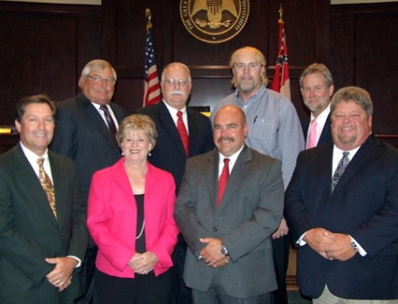
What type is Olive Branch?
Mayor Scott Phillips
The Board consists of seven members, one each being elected from the city's six wards along with one at-large member.
Mayor and Board of Aldermen

Slide 29
Commission Form
A mayor and at least two commissioners.
The mayor presides over commission meetings but has no veto power.
The mayor is the official representative of the city.
The mayor generally administers the police and fire departments.
The commissioners head specific departments of city government.

Slide 30
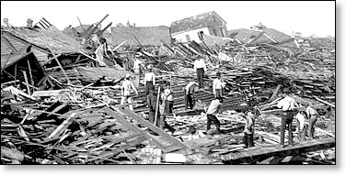
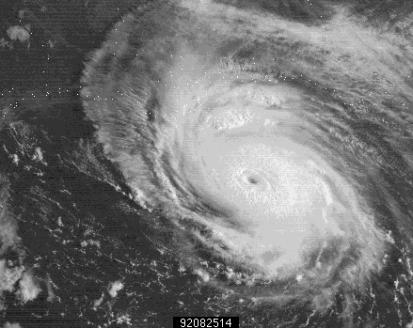
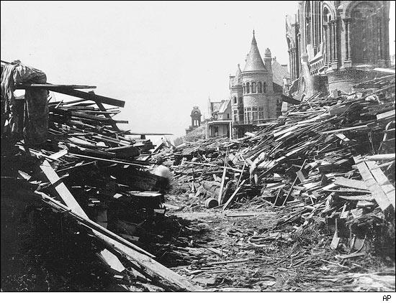
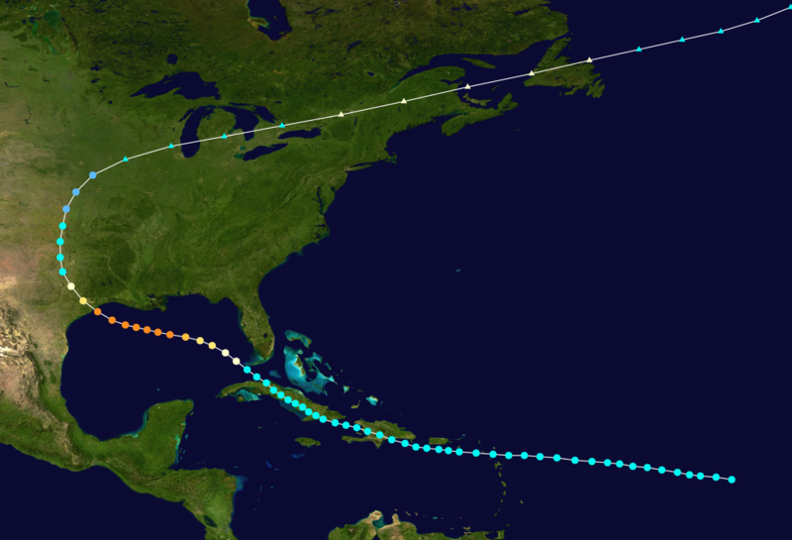
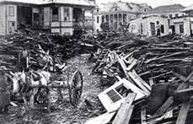
Commission Form starts in Texas.
On September 8, 1900, the island city of Galveston, Texas, a hurricane devastated the city killing more than 6,000 people.

Slide 31
Commission Form in Mississippi
There were close to five hundred cities using a commission form of government by 1920.
Jackson, Mississippi, adopted the commission form of government in 1912 followed by nine other Mississippi cities.
Today, only Vicksburg and Clarksdale use the commission form of government.

Slide 32
Jackson, Mississippi
Jackson, Mississippi, adopted the commission form of government in 1912.
Jackson, the state capital, changed to a strong mayor-council form of government in 1985.

Slide 33
Council-Manager Form
Mayor and council, which in turn, hire a city manager.
The mayor presides over council meetings.
The mayor represents the city at most functions.
The council is the policy-making body for the city.
The manager handles the day-to-day operations, hires and fires city employees, prepares the budget, and attends council meetings but cannot vote.

Slide 34
Which form of Municipal Government is used the most in Mississippi?
The weak mayor-council (sometimes called mayor-alderman) form of government is the most widely used form in Mississippi.

Slide 35
Annexation
What is annexation?
Expanding municipalities boundaries by adding adjoining land.
Have we done any annexing in DeSoto County?
Yes, a lot.

Slide 36
DeSoto County Annexation

Slide 37
Mississippi School Districts
Mississippi has 152 school districts.
What is our school district?
DeSoto County Schools (All of the county)
Not all districts are county wide.
Tupelo is in Lee County.
Tupelo schools are in Tupelo Public Schools.
Outside of Tupelo is Lee County Schools.
Issaquena County does not have it own school district.

Slide 38
Other Forms of Local Government
Mississippi Planning and Development Districts (PDDs).
Soil and Water Conservation Districts.
Levee districts.
Drainage districts.
Port commissions.
And so on.

Slide 39
Financing Local Government
Financing Local Government
What is ad valorem tax?
Ad valorem tax is levied on the assessed value of real and personal property.
Car registration list the amount of ad valorem tax that you paid.

Slide 40
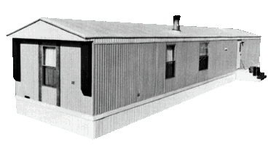
Real and Personal Property
Real property consists of land and permanent structures on the land.
Personal property refers to movable items such as automobiles.
What about ?
Personal

Slide 41
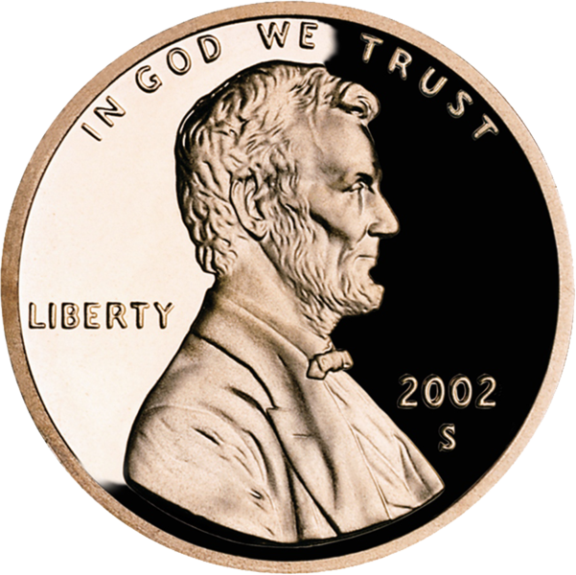
Amount of Tax?
The financial needs of the local government, determines the tax rate.
What is a mill?
In the United States, it is equivalent to 1/1000 of a United States dollar (a tenth of a cent).

Slide 42
DeSoto Millage
Estimated median house or condo value in 2007:
DeSoto County
$159,300
Mississippi
$96,000

Slide 43
$127,500
Estimated median house or condo value in Desoto County 2011:

Slide 44
Millage
$127,500 @ 1 mill
X .001
$127.50

Slide 45
Millage
If the tax rate is set @ 2.6 mill, how much would you pay in taxes that year on your house?
$127.50
X 2.6
$331.50

Slide 46
Other City Taxes
Cities receive 18.5 percent of the sales tax revenues collected within their boundaries.
Cities can levy a tax on certain types of businesses and items.
Example: Starkville, Hattiesburg, and Oxford tax hotel and motel room rentals.

Slide 47
Homestead Exemption
State law gives homeowners on their primary residence a tax break. (If you file for Homestead Exemption.)
You may apply for Homestead Exemptions during the months of January, February and March of each Year.
If you are over 65 by January 1st, you qualify for additional tax exemption.
100% disabled individuals qualify for additional tax exemption.

Slide 48
Review
Municipalities (Cities, towns, and villages)
Functions of City Government
Types of City Government
Annexation
Other Local Governments
Taxes

Slide 49
Homework
Study for Chapter 15 Test.

