Slide 1
Quitman County school district
Technology Department
Presenter: Twanda Banks

Slide 2
Acceptable Use Policy
Every Faculty/Staff member will receive and sign the District’s Acceptable Use Policy.
Be aware that consequences may arise from Social Media abuse. Faculty/Staff think twice about being friends with students on all social media sites. Personal photos or comments can ruin your career. Being available by email to students and parents is normally acceptable and even encouraged but keep it professional.

Slide 3
Faculty/Staff devices
All Faculty/Staff member will sign an Agreement Form for their school owned devices. It is the responsibility of each faculty/staff to secure and protect their devices. The devices are apart of your school day, please ensure that you have them at school EVERY day. Please do not allow students to use your device. Further detailed will be explained in the Agreement Form.

Slide 4
Social Media Guidelines
All Faculty/Staff member will be issued a copy of the District’s Social Media Guidelines. Please read the document thoroughly. The document will be signed and turned into the Technology Coordinator, Mrs. Banks.

Slide 5
Email
All Teachers/Paraprofessionals/Department Heads/Administrators will be issued a MacBook/Laptop and an iPad. Your email credentials are the same as your authentication credentials.
Email can be accessed via the App on your MacBook/iPad or via WebMail. Staff members can access webmail via the District Page
https://login.microsoftonline.com
If you receive a message to change your password..authentication issues, please contact Mrs. T. Banks.

Slide 6
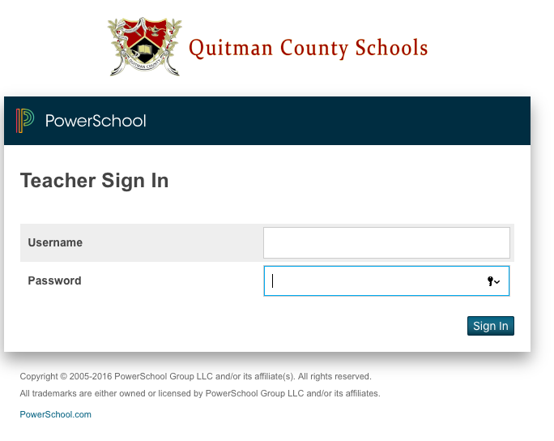
Sis – powerschool
Teachers will use PowerSchool for Attendance, Demographic Information and Communication with Parents.
Gradebook Pro inside of PowerSchool will be used to enter grading information. Teachers please be mindful of the due dates for Progress Reports and Report Cards.
Powerschool.quitman.k12.ga.us/teachers

Slide 7
Sis – Attendance
To be in compliance with the 90% attendance teacher rule…....Teacher will have to take attendance every period in grades PreK-12. Attendance must be taken daily...No Exception
Attendance is used for Safety and Funding

Slide 8
TKES/LKES
TKES is the District’s Evaluation System. All teachers, paraprofessionals and administrators will have login credentials for TKES.
This application will be available via PowerSchool…SLDS

Slide 9
Educator Handbook
All faculty/staff members will receive login credentials for discipline referrals. When entering referral information in Educator Handbook, only include the name of the student that you are referring. Further guidelines will be given on the use of Discipline Referrals
Website: https://incidents.educatorshandbook.com

Slide 10
Devices
Faculty/Staff members please read carefully the Employee Use Policy regarding devices
Any Device that you receive is your responsibility. If a device is lost/stolen or damaged you are responsible for the device.
Devices must not be in plain sight or left in vehicles.
Personal own devices (phones, ipads, laptops, and etc.......are not allowed on the school network.
Staff members will back up their devices weekly via Code42 back-up software and all documents must be backed up using OneDrive via Microsoft. The district will not be responsible for lost data.

Slide 11
webpages
All faculty/staff members will be responsible for maintaining his/her webpage. Websites will be checked weekly.
Staff in Grades Pre-K- 8 pages will be stored on the Elementary Page.
Grades 9 – 12 will be stored on the High School Page
The District page will have information that pertains to both schools and District Operations.
District Page: www.quitman.k12.ga.us
Elementary/Middle: http://quitman.ga.qce.schoolinsites.com
High School: http://quitman.ga.qch.schoolinsites.com
Login credential via email will be sent out this week.

Slide 12
iPad Carts
All Homeroom teachers will receive an Ipad Cart with devices
Carts will not be Switched out with another Teacher
Teachers MUST check carts and iPads in the morning and prior to dismissal for damages and to ensure none are missing. Teachers will keep a sign-in/out checklist for iPads EVERYDAY! No exceptions. When Calling Roll every period…and iPad Check must be conducted.
Teachers must ensure Carts are charging before leaving work.
Teachers will allow students to push updates through when permission is given by Mrs. Banks
Students will be assigned and will keep the same iPad for the entire school year.
Students MUST not share passwords with other students. If this is observed taking place, please contact Mrs. T. Banks.
Please refrain from storing anything other than your assigned printer on top of the iPad Cart. When a device is discovered missing the teacher is to notify Mrs. Banks Immediately.

Slide 13
APPS
All request for iPad Apps must be submitted to Mr. Jones. After Mr. Jones has approved the request the App will be pushed to the iPads.

Slide 14
New apple software
This school term we will be utilizing Apple Classroom and Apple School Work.
Please click on the link below to learn more about these two wonderful Apple Applications
Apple Schoolwork - https://www.apple.com/education/teaching-tools/
Apple Classroom - https://images.apple.com/education/docs/Classroom_Guide_Education_9.3.pdf

Slide 15
School software
Quitman County School District will be utilizing the resources from Microsoft Office 365 and Apple. Please review the resources that you have at your disposal from these two Vendors.

Slide 16
Georgia slds Statewide longitudinal data system
The Statewide Longitudinal Data System (SLDS) is designed to help districts, schools, and teachers make informed, data-driven decisions to improve student learning. SLDS is a free application that is accessed via a link in the district’s Student Information System (SIS). It provides districts, schools, and teachers with access to historical data, including Assessments, Attendance, Enrollment, Courses, and Grades beginning with the 2006-2007 school year.
Resources for SLDS can be found on the GaDOE Website.

Slide 17
TECHNOLOGY PURCHASES
All Technology purchases will be ordered by the Technology Coordinator, Twanda Banks.
Purchases includes items such as, Computers Devices, Printers, Document Cameras, Software, Ink cartridges and etc.

Slide 18
Technology support
All request for support will be submitted via the Technology Trouble ticket. The link can be found at: https://qcsd.freshdesk.com/
Please provide as much detail as possible.
After submitting a trouble ticket please check your email periodically

Slide 19
Questions/Answers
If there are any questions please contact me via email at bankst@quitman.k12.ga.us

