Slide 1
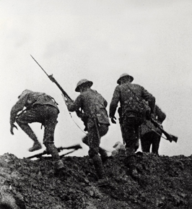
The Great War, 1914–1918
Several factors lead to World War I, a conflict that devastates Europe and has a major impact on the world.
Allied soldiers climbing over trenches on first day of the costly Battle of the Somme (July 1, 1916).
NEXT

Slide 2
Section 2
Europe Plunges into War
One European nation after another is drawn into a large and industrialized war that results in many casualties.
NEXT

Slide 3
SECTION
2
Europe Plunges into War
The Great War Begins
Armies on the March
• Russia moves troops to its borders with Austria and
Germany
• Germany declares war on Russia, quickly attacks
France
• Great Britain declares war on Germany
Nations Take Sides
• By mid-August 1914, two sides at war throughout
Europe:
- Central Powers—Germany, Austria-Hungary (and
other nations)
- Allies—Britain, France, Russia (and other nations)
NEXT

Slide 4
SECTION
2
A Bloody Stalemate
The Conflict Grinds Along
• Western Front—heavy battle zone in northern
France
• Schlieffen Plan—German plan to defeat France,
then fight Russia
• German army quickly advances to outskirts of
Paris
• Forced to retreat at First Battle of the Marne
• Schlieffen Plan fails; Germany has to fight two-
front war
Interactive
Continued . . .
NEXT

Slide 5
SECTION
2
continued A Bloody Stalemate
War in the Trenches
• Conflict descends into trench warfare—armies
fighting from trenches
• Battles result in many deaths, small land gains
• Life in trenches is miserable, difficult, unsanitary
• New weapons only lead to more deaths
• Massive losses for both sides at 1916 battles of
Verdun and Somme
Image
NEXT

Slide 6
SECTION
2
The Battle on the Eastern Front
Early Fighting
• Eastern Front—site of main fighting along the
German-Russian border
• Russians push into Austria and Germany, but soon
forced to retreat
Russia Struggles
• Russia’s war effort suffering by 1916; many
casualties, few supplies
• Huge size of Russian army keeps it a formidable
force
- prevents Germany from sending more troops to
the Western Front
NEXT

