Slide 1
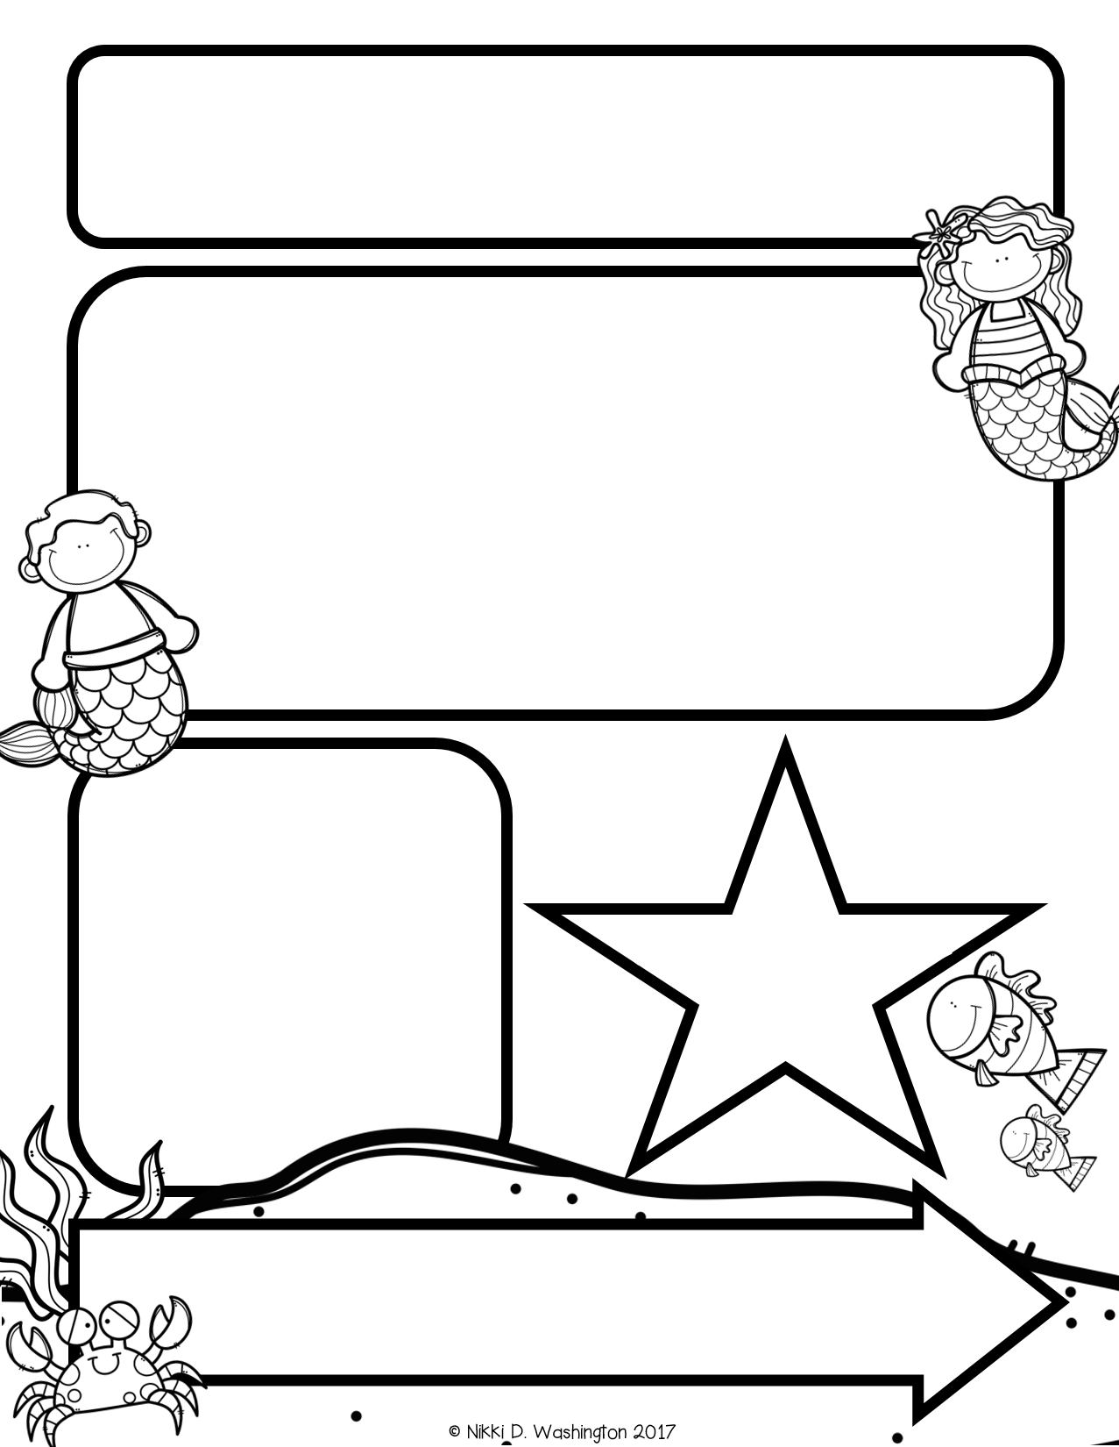
Mrs. Davis’s
Newsletter
This Week:
ABC BootCamp- Letters L,O,G,H,T
Sight Words- I, a, the
Making Meaning( reading) Author and Illistrator and
reading My Friends
Being a Writer- Rhyming
Math- Counting and working with numbers 0-5
Review:
Announcements:
WELCOME TO KINDERGARTEN!!!
Please make sure to have students here by 7:45, we start ABC Bootcamp at this time!
Shout Outs:
Thanks to all that brought supplies!!
Coming Up:
School Pictures scheduled for September 14th
More info to come!

