Slide 1

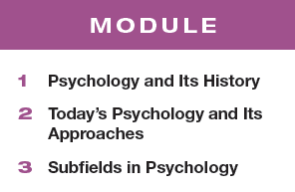

Unit 1: Psychology’s History and Approaches
10-14%

Slide 2


Module 1: Psychology’s History
Module 1
Psychology’s History
Learning Targets
  1-1 Explain why psychology is a science and why the “rat is always right.”
  1-2 Describe the three key elements of the scientific attitude and how they support scientific inquiry.
  1-3 Explain how critical thinking feeds a scientific attitude and smarter thinking for everyday life.
  1-4 Describe how psychology developed from early understandings of mind and body to the beginnings of modern science.
  1-5 Explain how critical thinking feeds a scientific attitude and smarter thinking for everyday life.
  1-6 Explain how behaviorism, Freudian psychology and humanistic psychology furthered the development of psychological science.

Slide 3
How is psychology a science?
Psychology uses the tools of science to
describe
explain
predict
control
behavior and mental processes.

Slide 4
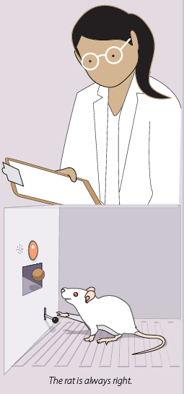
Why is the “rat always right”?
Why is the “rat is always right”?
Facts speak for themselves
Researchers have to accept the results of the study even if the hypothesis has been proven wrong.

Slide 5

TRY IT
Can these questions be answered using science?
  Are the body and the soul separate entities?
  Does having a positive attitude improve outcomes for individuals with serious illness?
  What was the evolutionary benefit of depression?

Slide 6
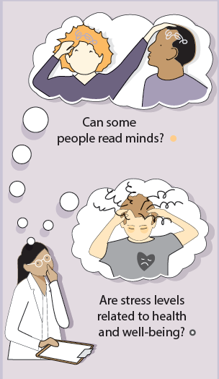
What is one key element of the scientific attitude?
Curiosity:
asking questions

Slide 7
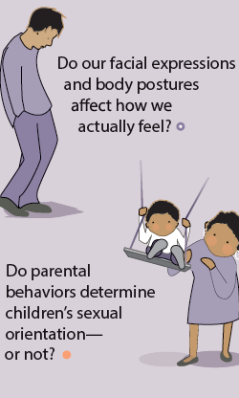
What is another key element of the scientific attitude?
Skepticism:
sifting reality from fantasy and demanding evidence

Slide 8
What is a third key element of the scientific attitude?
Humility:
accepting incorrect predictions

Slide 9
What is critical thinking?
Examining assumptions
Appraising the source
Discerning hidden biases
Evaluating evidence
Assessing conclusions

Slide 10
How would you think critically about the following statement?
TRY IT
Climate change is a real and pressing danger.
What is the assumption?
What is the source of this statement? Are they reliable?
Might the source have a reason to believe this? A bias?
What evidence exists to support this statement? What evidence exists to refute it?
What conclusions can I make about the information I gathered?

Slide 11
What did philosophers wonder about the mind?
How does our mind work?
How does our body relate to our mind?
How much of what we know is innate? How much comes from our experiences?

Slide 12
The Greeks
mind and body are separate
mind continues after death
knowledge is innate
Socrates
Plato
need data
knowledge comes from observation
knowledge is NOT innate
Aristotle

Slide 13
The French
The French
René Descartes
agreed with Socrates and Plato
dissected animals
fluid in brain flows through nerves to muscles causing movement

Slide 14
The British
The British
founder of modern science
empiricism
Francis Bacon
tabula rasa
the mind at birth is a blank slate on which experience writes
John Locke

Slide 15
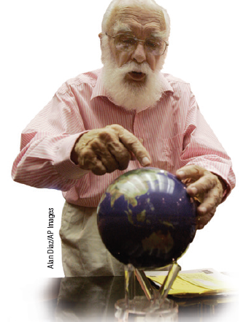
What is empiricism?
What is empiricism?
The idea that knowledge is the result of experience and that scientific knowledge is developed through observation and experimentation.

Slide 16
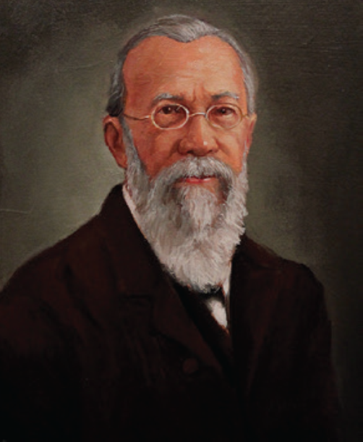
What were important milestones in psychology’s early development?
established the first psychology lab
wanted to measure the “atoms of the mind”… the fastest mental processes
Wilhelm Wundt
(1832-1920)

Slide 17
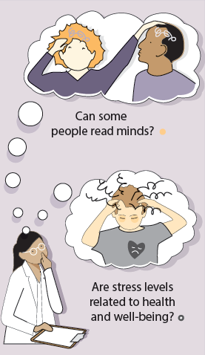
Wundt’s experimental design question
What did he test?
What was he curious about?
In two separate trials, subjects were asked to press a
telegraph key as soon as…
they heard the sound of a ball hitting a platform
they were consciously aware of perceiving the sound

Slide 18
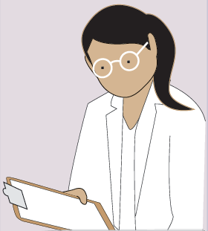
Wundt’s experimental design results
What did he find?
What were the results?
In the first trial the subjects pressed the button in 1/10th of a second when they heard the sound of a ball hitting a platform
But it took 2/10th of a second to wait until they were consciously aware of perceiving the sound

Slide 19
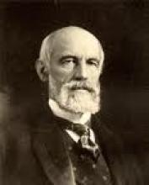
What were important milestones in psychology’s early development? Cont.
Wundt’s American student
Went on to establish the first formal US psychology laboratory at Johns Hopkins University
G. Stanley Hall

Slide 20
What were important milestones in psychology’s early development? Cont.
introduced structuralism to study the elements of the mind
used introspection
Edward Bradford Titchener (1867-1927)

Slide 21
What is structuralism? What is introspection?
What is structuralism?
What is introspection?
Early school focused on identifying the elements of thought and mind (structures) the way early chemists developed the periodic table to classify elements.
The process of looking inward to directly observe one’s own psychological processes.

Slide 22
Describe what you sense when you…
TRY IT
Chew a piece of spearmint gum.
Smell the fries cooking in the cafeteria.
Sit in the chair at your desk.

Slide 23
1. What Would You Answer?
1. What Would You Answer?
Self-reflective introspection about the elements of experience best describes a technique used by which school of thought in psychology?
functionalists
empiricists
structuralists
behaviorists
humanists

Slide 24
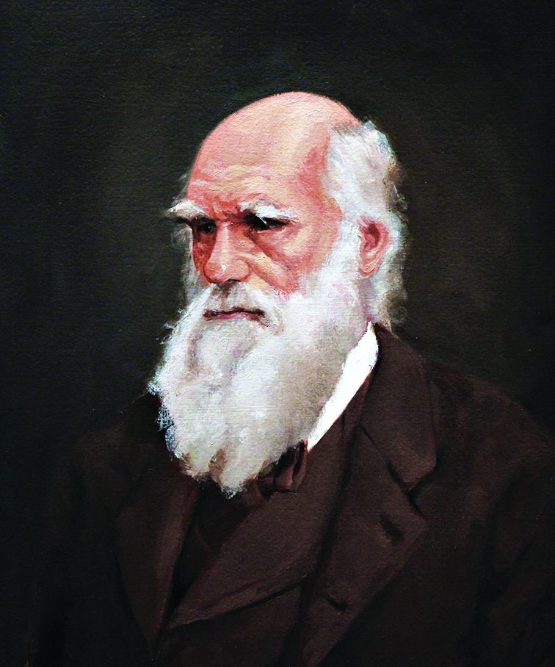
What were other important milestones in psychology’s early development?
natural selection of mental and physical traits
adaptive evolution
influenced William James
Charles Darwin
(1809-1882)

Slide 25
What were some important milestones in psychology’s early development?
introduced functionalism
Principles of Psychology
William James
(1842-1910)

Slide 26
What is functionalism?
Functionalism assumes a purpose…
smelling and thinking must have helped us evolve….
structures of consciousness must serve a function.
smelling is what the nose does
thinking is what the brain does
but…WHY?

Slide 27
structuralism or functionalism?
TRY IT
Why do some people have strong willpower and others do not?
Describe the characteristics of the pencil you are holding.
How does eye color limit our ability to see in the dark?

Slide 28
What were additional important milestones in psychology’s early development?
student of William James
denied her Ph.D. due to gender
memory researcher
first female president of the APA
Mary Whiton Calkins
(1863-1930)

Slide 29
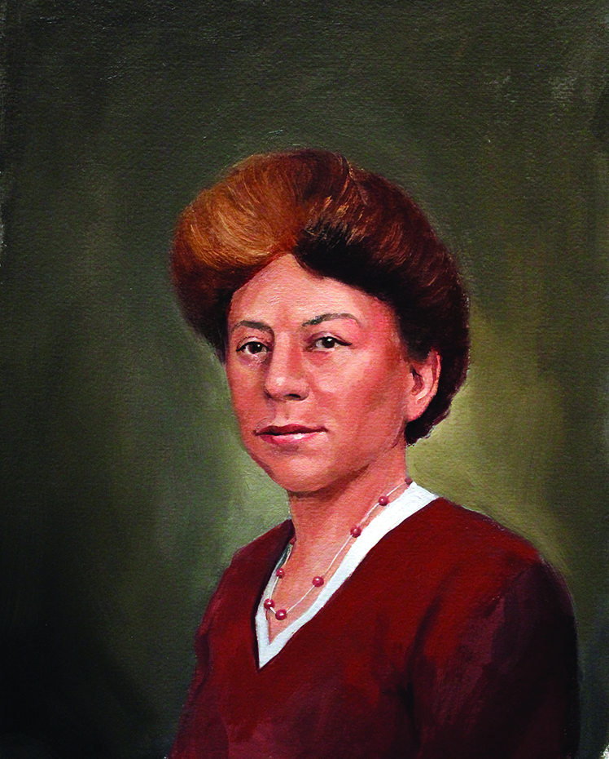
What were important contributions to psychology’s early development?
student of Edward Titchener
first female to earn Ph.D.in psychology
The Animal Mind
Margaret Floy Washburn (1871-1939)

Slide 30
2. What Would You Answer?
2. What Would You Answer?
By seeking to measure “atoms of the mind”, who established the first psychology laboratory?
Edward Bradford Titchener
Margaret Floy Washburn
Wilhelm Wundt
G. Stanley Hall
William James

Slide 31
How did behaviorism further the development of psychological science?
B.F. Skinner
(1904-1990)
John B. Watson
(1878-1958)

Slide 32
What is behaviorism?
psychology should be an objective science
observable behavior is important to study… not the unseen mental processes

Slide 33
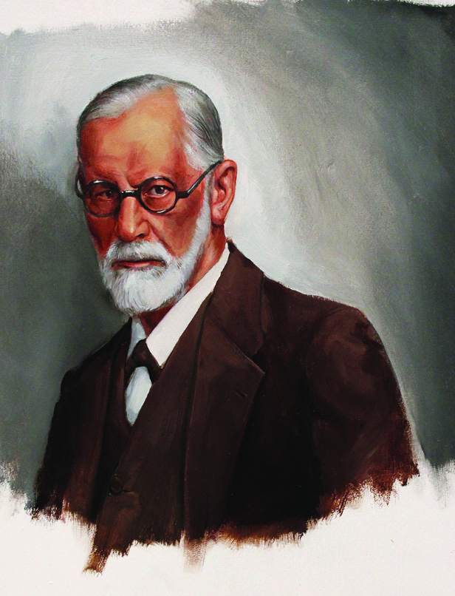
How did Freud further the development of psychological science?
developed an influential treatment process called psychoanalysis
personality theory
Sigmund Freud
(1856-1939)

Slide 34
What is Freudian
(or psychoanalytic) psychology?
Unconscious forces and
childhood experiences
affect our behavior and
mental processes.

Slide 35
How did humanism further the development of psychological science?
Humans strive to reach their full potential
Unconditional love
Personal growth
Abraham Maslow
Carl Rogers

Slide 36
What is humanism?
“third force” in psychology
rejected both behaviorism and
psychoanalytic psychology
the study of potential and personal growth

Slide 37
What is gestalt?
An organized whole.
Gestalt psychologists emphasized our tendency to integrate pieces of information into meaningful wholes
Examples: figure-ground, Necker cube, closure

Slide 38
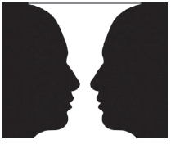
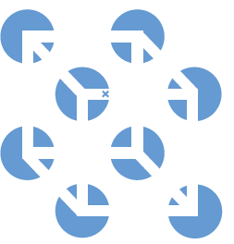
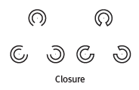

Slide 39
3. What Would You Answer?
3. What Would You Answer?
With which of the following statements would John B. Watson most likely agree?
Psychology should study the growth potential in all people.
Psychology should study the unconscious mind.
Psychology should focus on observable behavior.
Psychology should study mental thought processes.
Psychology should study how culture and beliefs impact an individual.

Slide 40
Learning Target 1-1 Review
How is psychology a science,
and why is it
the “rat is always right”?
Psychologists:
think critically
use the scientific method
accept the results

Slide 41
Learning Target 1-2 Review
What are the three key elements
of the scientific attitude, and how
do they support
scientific inquiry?
The scientific attitude encourages us to be:
curious
skeptical
humble
in testing ideas that don’t agree with ours.

Slide 42
Learning Target 1-3 Review
How does critical thinking feed a
scientific attitude
and smarter thinking for everyday life?
Critical thinking puts ideas to the test by:
examining assumptions
appraising the source
discerning hidden biases
evaluating evidence
assessing conclusions

Slide 43
Learning Target 1-4 Review
How did psychology develop from
early understandings of mind and body
to the beginnings of modern science?
The Greeks wondered if ideas were innate or came from experience
Locke thought we were tabula rasa
Bacon gave us empiricism

Slide 44
Learning Target 1-5 Review
What were some important
milestones in
psychology’s early development?
Wundt established the first psych lab
Wundt and Titchener: structuralism and introspection
James: functionalism

Slide 45
Learning Target 1-6 Review
How did behaviorism, Freudian
psychology, and humanistic
psychology further the development
of psychological science?
Watson: behaviorism focuses on studying behavior
Freud: psychoanalysis focuses on unconscious influences
Rogers and Maslow: humanism focuses on striving for growth

Slide 46
Module 2
Today’s Psychology and Its Approaches
Module
2
Today’s Psychology and Its Approaches
Learning Targets
  2-1 Describe how contemporary psychology focuses on cognition, biology and experience, culture and gender, and human flourishing.
  2-2 Describe the biopsychosocial approach and psychology’s main perspectives
  2-3 Explain how psychological principles can help you learn, remember, thrive, and do better on the AP® exam.

Slide 47
How does contemporary psychology focus on cognition?
How does contemporary psychology
focus on cognition?
What is cognitive psychology?
What is cognitive neuroscience?
The study of mental processes:
thinking, perceiving, learning, remembering, communicating and solving problems.
The interdisciplinary study of the brain activity linked with cognition (including perception, thinking, memory, and language).

Slide 48
1. What Would You Answer?
1. What Would You Answer?
Which specialty in psychology is most interested in studying the link between mental activity and brain activity?
A. Humanistic psychology
B. Behavior genetics
C. Cognitive neuroscience
D. Psychodynamic psychology
E. Social-cultural psychology

Slide 49
What is psychology?
What is psychology?
Psychology is the scientific study of the
behavior and mental processes
of humans and other animals.

Slide 50
Why is psychology scientific?
Why is psychology scientific?
Psychology is scientific because it
uses empiricism and
the scientific method
to critically evaluate evidence.

Slide 51
What is behavior?
What is behavior?
Psychology examines behavior which consists of any observable and measurable action taken by a person or other animal…
….so, anything a person or animal DOES.

Slide 52
What are mental processes?
What are mental processes?
Psychology examines mental processes which consist of the internal, subjective experiences inferred from behavior…
…so sensations, perceptions, dreams, thoughts, beliefs, and feelings.

Slide 53

Psychology is Growing and Globalizing
Contemporary psychology is influenced by biology and experience, culture and gender, and human flourishing

Slide 54
How does contemporary psychology focus on cognition?
Other Contributors to Psychology
Ivan Pavlov
Jean Piaget
Russian physiologist who pioneered the study of learning: classical conditioning
Swiss biologist who was an influential observer of children

Slide 55
How does contemporary psychology focus on cognition, biology and experience?
How does contemporary psychology
focus on cognition, biology and experience?
Nature-Nurture Issue
Is it genes or is it experience?
Contemporary psychology recognizes the
importance of both nature and nurture
as well as how they interact

Slide 56

AP® Exam Tip
What is nature?
What is nurture?
Behaviors and mental process occur because they are inborn or innate
Socrates and Plato
Rene Descartes
Charles Darwin
Behaviors and mental processes occur as a result of experience or the environment
Aristotle
John Locke’s “blank slate”

Slide 57
TRY IT.
Nature or Nurture?
  Think about YOU. Make a list of your:
  physical traits (height, hair color, etc.)
  personality traits (sense of humor, stubbornness, etc.)
  Which of the traits you listed were genetic or biologically derived? (nature)
  Which of the traits are influenced by your environment? (nurture)

Slide 58
Charles Darwin and Nature v. Nurture
Argued for nature in his book On the Origin of the Species
Traits and behaviors that provide a survival or reproductive advantage are naturally selected
Charles Darwin
(1809-1882)

Slide 59
How does contemporary psychology focus on biology and experience?
How does contemporary psychology
focus on biology and experience?
Evolutionary Psychology
Behavior Genetics
The study of how behaviors and mental processes present in the species today exist because they were naturally selected
The study of the relative influence and limits of genetic (nature) and environmental (nurture) influences on behaviors and mental processes

Slide 60

Twin Studies
Twin Studies
https://mctfr.psych.umn.edu/research/UM%20research.html
Identical (monozygotic) twins share 100% of the same genes
Fraternal (dizygotic) twins share 50% of the same genes
Twin studies provide evidence for the relative influence of nature and nurture and are used in behavior genetics

Slide 61
What are WEIRD cultures?
What are WEIRD cultures?
Western
Industrialized
Democratic
W
I
D
Educated
Rich
E
R

Slide 62
TRY IT
Why WEIRD cultures?
Talk with your partner:
What can be learned from psychological studies done only in one place at one time?
What if the participants of a study on fashion came only from WEIRD cultures?

Slide 63
How does contemporary psychology focus on culture?
How does contemporary psychology
focus on culture?
Culture: The shared ideas, values, behaviors, and traditions, shared by a group of people and passed from one generation to the next.
Culture Impacts:
Perception of time and promptness
Ideal personal space
Beliefs about marriage and sex
Emotional display

Slide 64

How does the culture we are from impact…kissing?
In cultures with languages that read from left to right
about 2/3 of couples lean their heads
to the right
when kissing

Slide 65
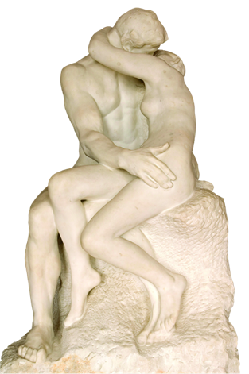
How does the culture we are from impact…more kissing?
77% of Hebrew and Arabic language speakers who read from right to left
kiss by tilting their heads to the left.

Slide 66
How does contemporary psychology focus on gender?
How does contemporary psychology
focus on gender?
Gender: socially constructed roles and characteristics by which a culture defines male and female.
Reported gender differences
how emotions are expressed or detected
what we dream
risk for certain psychological disorders
Biological similarities
age of first steps
how we remember and forget
overall intelligence and well-being

Slide 67
How does contemporary psychology focus on biology and experience? Cont.
How does contemporary psychology
focus on biology and experience? Cont.
Shared Biological Processes Guide Behavior Across Cultures
Individuals with specific learning disorder (formerly dyslexia) show the same brain malfunction across diverse cultures.
All human languages share the same deep principles of grammar.
Nonverbal communication of basic emotions is universal (e.g. the message of a smile).

Slide 68
How does contemporary psychology focus on human flourishing?
How does contemporary psychology
focus on human flourishing?
Positive Psychology
the scientific study of human flourishing
goal of discovering and promoting human strengths and virtues
strengthening individuals and communities

Slide 69

“The main purpose of positive psychology is to measure, understand, and then build the human strengths and virtues.” ~Martin Seligman

Slide 70
2. What Would You Answer?
2. What Would You Answer?
Positive psychology, which studies the ideas behind human flourishing, is connected to which psychologist?
John Locke
Martin Seligman
Charles Darwin
Sigmund Freud
John Watson

Slide 71
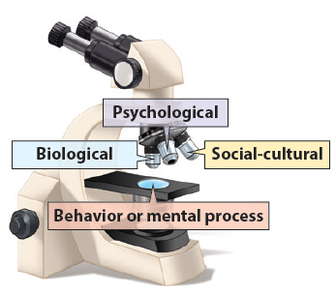
What is the biopsychosocial approach?
What is the biopsychosocial approach?
Understanding behavior or mental processes from three key viewpoints.

Slide 72
How can you explain the recent horrific school shootings across our country?
TRY IT
What are the psychological explanations?
What are the biological explanations?
What are the social-cultural explanations?

Slide 73
What are psychology’s behavioral and biological perspectives?
What are psychology’s behavioral and biological perspectives?
Behavioral Perspective
How learned and observable behaviors impact behavior and mental processes.
Biological Perspective
How biological (genetics, neural, hormonal) and physiological processes impact behavior and mental processes.

Slide 74
What is psychology’s cognitive perspectives?
What is psychology’s cognitive perspectives?
Cognitive Perspective
How interpretations of situations and mental processes (thoughts, memories, problem-solving) impact behavior and mental processes.

Slide 75
What are psychology’s evolutionary and humanistic perspectives?
What are psychology’s evolutionary and humanistic perspectives?
Evolutionary Perspective
How the natural selection of traits has promoted the survival of genes
Humanistic Perspective
How the drive for personal growth and self-actualization impact behavior and mental processes.

Slide 76
What are psychology’s psychodynamic and social-cultural perspectives?
What are psychology’s psychodynamic and social-cultural perspectives?
Psychodynamic Perspective
How unconscious drives and conflicts
impact behavior and mental processes.
Social-Cultural Perspective
How behavior and thinking vary across situations
and cultures

Slide 77
Explain the behavior in this photo from the
____________ perspective
TRY IT
Behavioral
Biological
Cognitive
Evolutionary
Humanistic
Psychodynamic
Social-cultural

Slide 78
3. What Would You Answer?
3. What Would You Answer?
Which of the following perspectives would be most likely to examine the unconscious motives of a person who is overly aggressive on the basketball court?
psychodynamic
socio-cultural
behavioral
evolutionary
humanistic

Slide 79
4. What Would You Answer?
4. What Would You Answer?
Which of the following perspectives is most likely to address how the encoding, storing, and retrieval of information might alter one’s thoughts or behaviors?
evolutionary
psychodynamic
humanistic
cognitive
biological

Slide 80
How can psychological principles help on the AP® Exam?
Adequate Sleep
Exercise
Long-Term Goals with Daily Aims
Growth Mindset
Prioritize Relationships

Slide 81
Are you using the strategies that help ensure a happy, successful life?
TRY IT
How many hours a night do you sleep?
How often do you exercise?
How often do you hang out with friends?

Slide 82
How can the testing effect and active processing help on the AP® Exam?
Testing Effect
Active Processing
Enhanced memory occurs as a result of retrieving, rather than rereading material.
Test yourself
Ask someone to quiz you
Enhanced memory occurs with intentional engagement with material.
Put material in your
own words
Use a mnemonic device

Slide 83
How do I use the SQ3R method?
Survey
Scan the headings and
note the module organization.
Question
Attempt to answer the questions posed
by learning targets and headings.
Find out what you do and do not know
before you read.

Slide 84
What are the next steps in the
SQ3R method?
Read
Actively read searching for answers to questions
ask more questions
take notes
Retrieve
Test yourself – use the testing effect to your advantage.
Utilize the Check Your Understanding sections.

Slide 85
What are the final steps of the
SQ3R method?
Review
Reread your notes paying attention to the organization of the module.
Write or say what something is before rereading.
Use the Module Review to summarize the answers to the learning targets.
Complete the AP® Exam Practice Questions.
Use the Unit Review sections for Key Terms, Key Contributors, AP® Exam Practice Questions, and Free-Response Questions.

Slide 86

How can psychology help on the AP® Exam?
Use spaced practice and distribute your studying over several different study sessions.
This leads to better long-lasting retention than cramming or massed practice.
Study Schedule
Monday 1 hour
Tuesday 1 hour
Wednesday 1 hour
Thursday 1 hour
Friday: The TEST

Slide 87
How else can psychology help on the AP® Exam?
Use interleaving and break up your time studying psychology with the study of other subjects.
This leads to greater
long-term retention and protection against overconfidence.
Study Schedule
Monday psych
Tuesday bio
Wednesday psych
Thursday gov
Friday: The TEST

Slide 88
What psychological techniques will help on the AP® Exam?
Think critically as you study and question assumptions and potential biases.
Process information actively as you take part in class. Listen for and write down main ideas
Relate new information to existing knowledge
Explain what you learned in class to someone else
Overlearn as you study and continue to practice and review even after you are able to remember it easily.

Slide 89
How can David Myers help on the AP® Exam?
To learn more
about the testing effect and the SQ3R
method, view the 5-minute animation,
“Make Things Memorable”,
by clicking on the link below.
Make Learning Memorable!

Slide 90
Discuss the psychological principles you use to learn and remember.
TRY IT
Distributing your study time.
Processing class information actively
Thinking critically.

Slide 91
5. What Would You Answer?
5. What Would You Answer?
Six months ago, Carlos emigrated from Mexico to the United States. Although fluent in English and an honor student in Mexico, Carlos has had difficulty completing his assignments since moving to the United States. His parents do not understand why he is not succeeding like he did in his last school. Carlos has quit participating in family traditions.
Explain how each of the following psychological perspectives might explain Carlos’ behavior:
Psychodynamic
Cognitive
Social-cultural

Slide 92
Learning Target 2-1 Review
  Describe how contemporary
  psychology focuses on cognition,
  biology and experience, culture and gender, and human flourishing.
The nature-nurture issue helps explain behavior
Darwin’s natural selection led to evolutionary and biological perspectives on behavior
Attitudes and behaviors may vary by gender or culture, but we are more similar than different
Positive psychology promotes human flourishing

Slide 93
Learning Target 2-2 Review
  Describe the biopsychosocial approach and psychology’s main perspectives
The biopsychosocial approach integrates the biological, psychological and social-cultural viewpoints
Psychology’s main perspectives are: behavioral, biological, cognitive, evolutionary, humanistic, psychodynamic, and social-cultural.

Slide 94
Learning Target 2-3 Review
  Explain how psychological principles
  can help you learn, remember,
  thrive, and do better on the AP® exam.
The testing effect shows we remember more when practicing retrieval
The SQ3R method can help you learn and remember
Four study tips: distribute your study time, learn to think critically, process class information actively, and overlearn.
Flourish: sleep, exercise, grow, form relationships

Slide 95
Module 3: Subfields in Psychology
Module 3
Subfields in Psychology
Learning Targets
  3-1 Explain the difference between basic and applied psychology.
  3-2 Describe what psychologists working in various subfields do and where they work.

Slide 96
What is Psychometrics?
Psychometrics
The scientific study of the measurement of human abilities, attitudes, and traits

Slide 97
What is the difference between basic and applied psychology?
What is the difference between
basic and applied psychology?
What is basic research?
What is applied research?
Scientific inquiry that aims to increase psychology’s knowledge base
Pure science
Scientific inquiry that aims to use psychology to solve practical problems
Real-world application of science

Slide 98
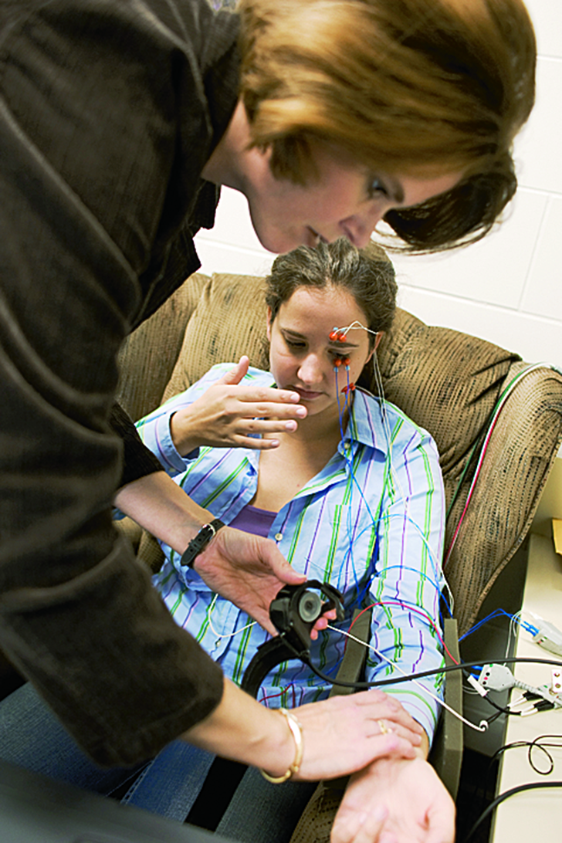
Which types of psychologists conduct basic research?
Which types of psychologists
conduct basic research?
Psychologists Conducting Basic Research
biological psychologists (neuroscientists)
developmental psychologists
cognitive psychologists
educational psychologists
personality psychologists
social psychologists

Slide 99
The British
Basic Research Domains
Explores the links between body and mind
Biological Psychology
Studies physical, cognitive, and social change throughout the life span
Developmental Psychology

Slide 100
The British
Basic Research Domains
Experimenting with how we perceive, think, and solve problems
Cognitive Psychology
Studies influences on teaching and learning
Educational Psychology

Slide 101
The British
Basic Research Domains
Investigates our persistent traits
Personality Psychology
Explores how we view and affect one another
Social Psychology

Slide 102
Which type of psychologists conduct applied research?
Which type of psychologists
conduct applied research?
Psychologists Conducting Applied Research
biological psychologists (neuroscientists)
developmental psychologists
cognitive psychologists
educational psychologists
personality psychologists
social psychologists
industrial-organizational psychologists
human factors psychologists

Slide 103
The British
Applied Research Domains
The application of psychological concepts and methods to optimizing human behavior in workplaces
Industrial-organizational Psychology
Explores how people and machines interact and how machines and physical environments can be made safe and easy to use
Subfield of I/O
Human Factors Psychology

Slide 104
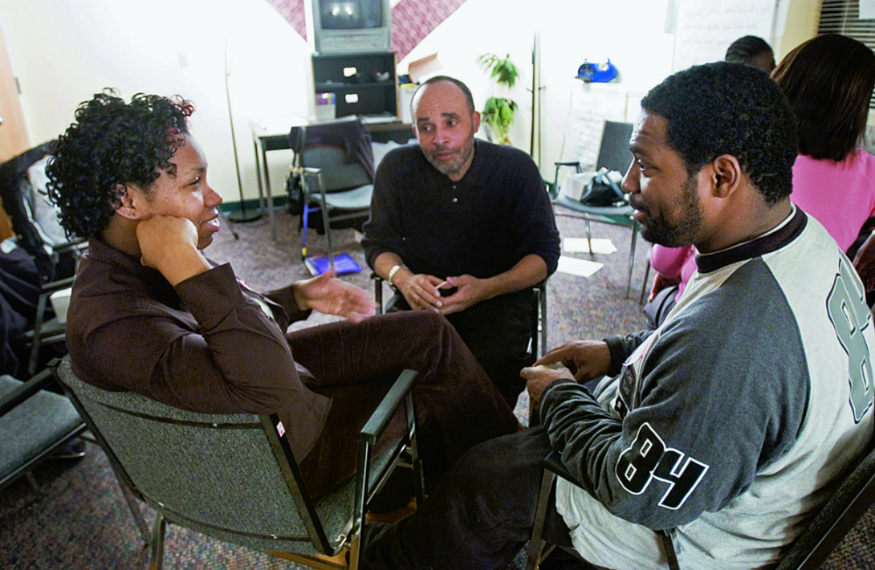
Psychology as a helping profession
Psychology as a helping profession
guide people toward healthier relationships
help people overcome anxiety and depression
help people cope with difficulties

Slide 105
How do counseling and clinical psychologists differ?
How do counseling and clinical psychologists differ?
Counseling Psychologists
help people cope with adjustments and crises
challenges related to work, school, family, and relationships
administer and interpret psychological tests
therapy and counseling
may conduct research
Clinical Psychologists
asses and treat mental, emotional, and behavioral disorders
administer and interpret psychological tests
therapy and counseling
may conduct research

Slide 106
How is a clinical psychologist different from a psychiatrist?
How is a
clinical psychologist different
from a psychiatrist?
What is a clinical psychologist?
What is a psychiatrist?
holds a PhD or PsyD
provides psychotherapy to individuals with psychological disorders
holds a MD
may prescribe drugs to treat the physiological causes of psychological disorders
may also provide psychotherapy

Slide 107
1. What Would You Answer?
1. What Would You Answer?
Psychiatrists differ from clinical psychologists in that they
help people cope with challenges and crises.
conduct research.
explore how we view and affect one another.
experiment with how people perceive, think and solve problems.
are medical doctors licensed to prescribe medication.

Slide 108
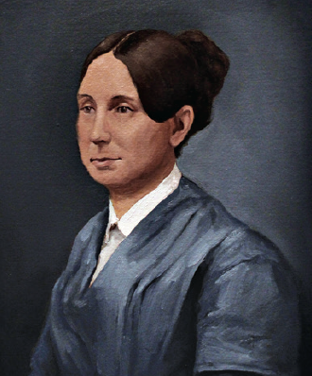
Psychology as a reforming profession
reformer who advocated for the humane treatment of the mentally ill
“I … call your attention to the state of Insane Persons confined within this Commonwealth, in cages.”
  ~Dorothea Dix
Dorothea Dix
(1802-1887)

Slide 109

What do cognitive psychologists do, and where do they work?
What do cognitive psychologists do,
and where do they work?
They study human thinking and might work as a professor or a corporate consultant.

Slide 110
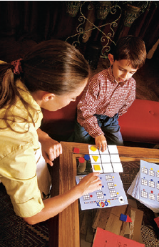
What do developmental psychologists do, and where do they work?
What do developmental psychologists
do, and where do they work?
They study how our behavior changes as we age.
They might work in a school, or day care center. They may specialize in elder behavior and work in a senior center.

Slide 111

What do educational psychologists do, and where do they work?
What do educational psychologists
do, and where do they work?
They study how we learn in different environments and in different ways.
They might work in schools or universities designing tests or teacher training.

Slide 112
What do experimental psychologists do, and where do they work?
What do experimental psychologists
do, and where do they work?
They conduct experiments to understand our behaviors and mental processes.
They might work as professors at a university or be employed at a research institution, zoo, business, or government agency.

Slide 113
What do psychometric psychologists do, and where do they work?
What do psychometric psychologists
do, and where do they work?
They use math and statistics to create, administer, score and interpret tests… intelligence or personality tests for example.
They might work in a university, a private research firm or a government agency.

Slide 114
What do social psychologists do, and where do they work?
What do social psychologists
do, and where do they work?
They study how we interact with others and how groups impact us individually.
They might work as university professors or in consulting positions, market research, or other applied fields such as social neuroscience.

Slide 115
2. What Would You Answer?
2. What Would You Answer?
Which of the following psychologists would be most likely to investigate biological, psychological, cognitive, and social changes over a lifetime?
educational
experimental
social
cognitive
developmental

Slide 116
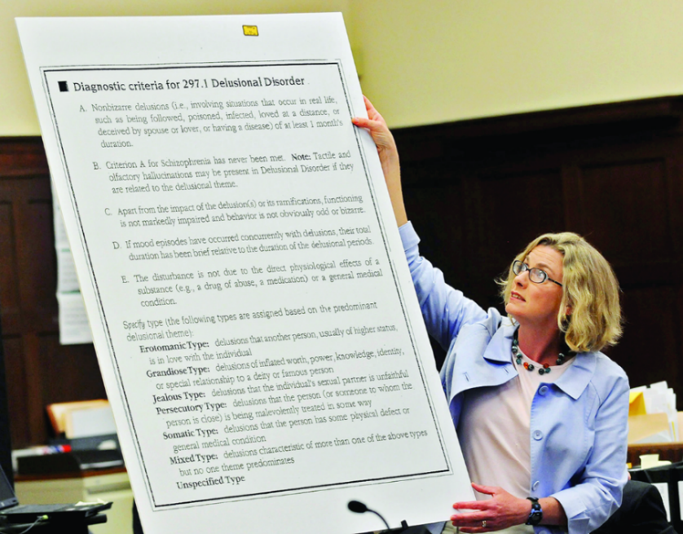
What do forensic psychologists do, and where do they work?
What do forensic psychologists
do, and where do they work?
They bring law and psychology together. They might
develop public policy for the mentally ill, consult on
jury selection or help law enforcement in criminal cases.
They might work in a law school, a court, a mental health
agency or a prison.

Slide 117
What do environmental psychologists do, and where do they work?
What do environmental psychologists
do, and where do they work?
They study how we are influenced and affected by our natural or built (urban) surroundings.
They might work as university professors or as part of an interdisciplinary team, for a consulting firm, a nonprofit, or a government agency.

Slide 118
What do health psychologists do, and where do they work?
What do health psychologists do,
and where do they work?
They work to promote health and prevent disease. They might design programs to stop smoking, lose weight, improve sleep, manage pain, and prevent psychosocial problems related to disease.
They work as university professors or in a rehabilitation center, hospital, medical school, public health agency, or private practice.

Slide 119
What do I/O psychologists do, and where do they work?
What do I/O psychologists do,
and where do they work?
They study the relationship between people and our work environments. They investigate worker productivity and personnel selection, as well as organizational structuring, consumer behavior, and training.
They work as university or in business, industry, consulting, or a government agency.

Slide 120
What do neuropsychologists do, and where do they work?
What do neuropsychologists do,
and where do they work?
They study how our brain impacts our
behavior and thoughts.
They might treat Alzheimer’s or stroke, work
with athletes and concussions or
with people with autism or ADHD.
They work as university professors and some clinical neuropsychologists may work in a hospital neurology, neurosurgery, or psychiatric unit.

Slide 121
What do rehabilitation psychologists do, and where do they work?
What do rehabilitation psychologists
do, and where do they work?
They help individuals who have lost functioning after an accident or illness.
They might work as university professors conducting basic or at a medical school, rehabilitation center, federal vocational rehabilitation agency, or in private practice working with individuals who have disabilities.

Slide 122

What do school psychologists do, and where do they work?
What do school psychologists do,
and where do they work?
They work with kids in school dealing with problems that may negatively impact learning in the classroom.
Most work in elementary and secondary schools.
Some might work as university professors or for a government agency or private research company.

Slide 123
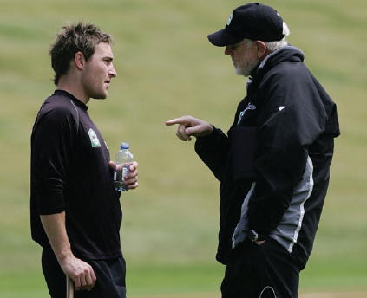
What do sports psychologists do, and where do they work?
What do sports psychologists do,
and where do they work?
They work with athletes to help them improve their performance.
They might work as university professors or as a consultant for a team, or private company. They may work with athletes that have psychological problems such as anxiety or substance abuse.

Slide 124
What do clinical psychologists do, and where do they work?
What do clinical psychologists do,
and where do they work?
They promote psychological health in individuals, groups, or organizations. May specialize in specific psychiatric disorders.
They provide therapy in private practice, mental health organizations, schools, industries, legal systems, counseling centers, correctional facilities, or the military.

Slide 125
What do community psychologists do, and where do they work?
What do community psychologists
do, and where do they work?
They work with larger groups and communities and focusing on crisis management…such as recovering from a hurricane.
They work as university professors or in federal, state, or local mental health departments or as consultants for private or government agencies.

Slide 126
What do counseling psychologists do, and where do they work?
What do counseling psychologists
do, and where do they work?
They help individuals cope with or make difficult life changes.
They work as university professors or in a counseling center, community mental health center, school, business, or in private practice.

Slide 127
3. What Would You Answer?
3. What Would You Answer?
Who among the following would most likely study the interaction of people, machines, and physical environments?
human factors psychologist
personality psychologist
industrial-organizational psychologist
counseling psychologist
educational psychologist

Slide 128
4. What Would You Answer?
4. What Would You Answer?
Anisha, a high school junior, has been struggling recently in many areas of her life. She is overweight and spends several hours per day watching Netflix and YouTube. She is having trouble keeping up in her classes and says she cannot seem to maintain her focus. She also is having trouble making friends and “fitting in” at school.
Explain how the following applied psychologists might attempt to help Anisha’s current situation.
health psychologists
school psychologists
counseling psychologists

Slide 129
Learning Target 3-1 Review
  Explain the difference between basic and applied psychology.
Scientists conduct basic research to increase the field’s knowledge base
Scientists conduct applied research to solve practical problems

Slide 130
Learning Target 3-2 Review
  Describe what psychologists working
  in various subfields do and where they work.
Psychology’s subfields include: cognitive, developmental, educational, experimental, psychometric and quantitative, social psychology,
forensic, health, industrial-organizational,
neuropsychology, rehabilitation, school, and
sport psychology and the helping professions clinical, community, and counseling

Slide 131
Learning Target 3-2 Review cont.
  Describe what psychologists working in
  various subfields do and where they work.
Work settings for psychologists include:
government agencies,
industrial and business settings,
clinics and counseling centers,
health care institutions,
schools, universities, and
research organizations.

