Slide 1
Robotics Education & Competition Foundation
Trouble Shooting & Resources

Slide 2
Troubleshooting
There are Professional Grade Trouble shooting Flow Charts located:
http://content.vexrobotics.com/docs/VEX-Robot-Troubleshooting-Flowchart-20140430.pdf
They include:
General Systems, Competition Robots, VEXNet, Motors
VEX Equipment and VEXNet user Guide
http://content.vexrobotics.com/docs/VEXnet-UserGuide-20150210.pdf
This includes many examples of:
Set-up, Default Code, Joystick Jumpers, Blinking light Codes, Joy Stick calibration

Slide 3
VEX Forums
The VEX Forums are a resource to gather information, see examples of other robots and to ask questions. Often the experienced VEX Community will have an answer or suggestion to assist you in your problem.
Forums are a searchable database that has a wealth of information.
www.vexforums.com
Like all wiki sites the VEX wiki is filled with great resources including video
www.vexrobotics.com/wiki/

Slide 4
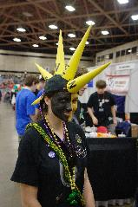
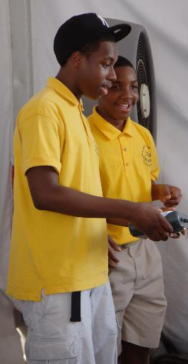
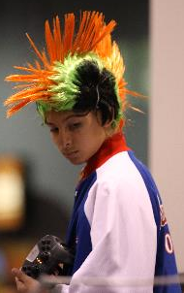
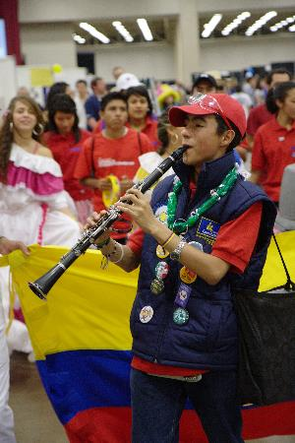
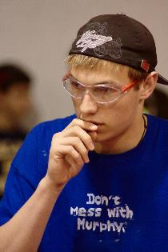
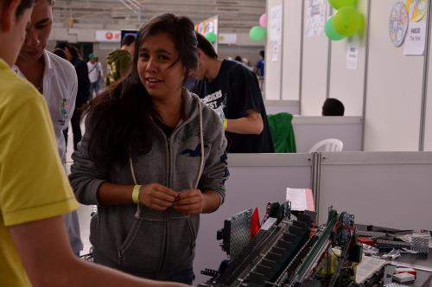
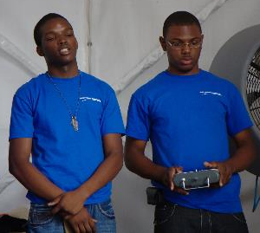
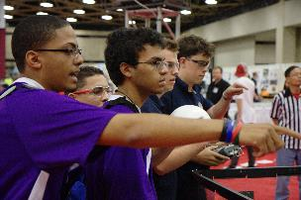
Thank you!

