Slide 1
joints
Joints (articulations) are the functional junctions between bones.
Joints enable a wide variety of body movements.

Slide 2
joints
Joints can also be classified according to the type of tissue that binds them together (structural)
Joints can be classified according to the degree of movement possible and can be immovable, slightly movable, or freely moveable.

Slide 3
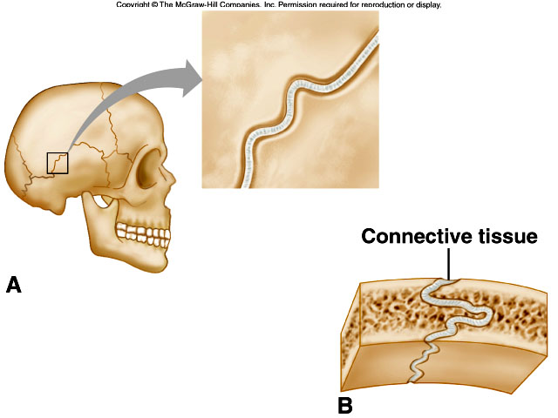
joints
Fibrous joints
Fibrous joints are held close together by dense connective tissue and are immovable (sutures of skull) or only slightly movable (joint between the distal tibia and fibula).

Slide 4
joints
Cartilaginous Joints
Hyaline cartilage or disks of fibrocartilage unite the bones in cartilaginous joints.
Intervertebral disks between vertebrae help absorb shock and are slightly movable.
Other examples of cartilaginous joints include symphysis pubis and the first rib with the sternum

Slide 5
joints
synovial joints
Most joints of the skeleton are synovial joints, which are more complex than fibrous or cartilaginous joints.
The articular ends of bone in a synovial joint are covered with hyaline cartilage.

Slide 6
joints
A joint capsule consists of an outer layer of dense connective tissue that joins the periosteum, and an inner layer made up of synovial membrane.
Synovial fluid lubricates articulating surfaces within the joint.
Some synovial joints contain shock-absorbing pads or fibrocartilage called menisci.
Some synovial joints have fluid-filled sacs called bursae.

Slide 7
