Slide 1
PREPING FOR ENVIROTHON
WILDLIFE MANAGEMENT TOOLS

Slide 2
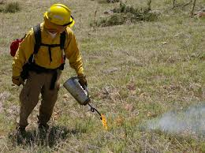
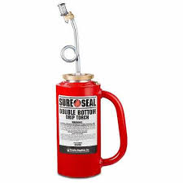
Wildlife Management tools
Drip Torch- the drip torch is perhaps the most commonly used ignition device for burning out. When you’re carrying the torch, it allows the burning fuel to drip onto the vegetation where you want to burn.
Helps control fires

Slide 3
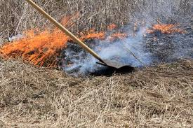
Wildlife Management tools
Fire swatter/Flapper
Along small fire lines, a trusty tool is needed to quickly snuff out small fires that ignite. The Fire Swatter is composed of a flexible yet thick rubber flapper that stops supply of oxygen when it hits the ground.

Slide 4
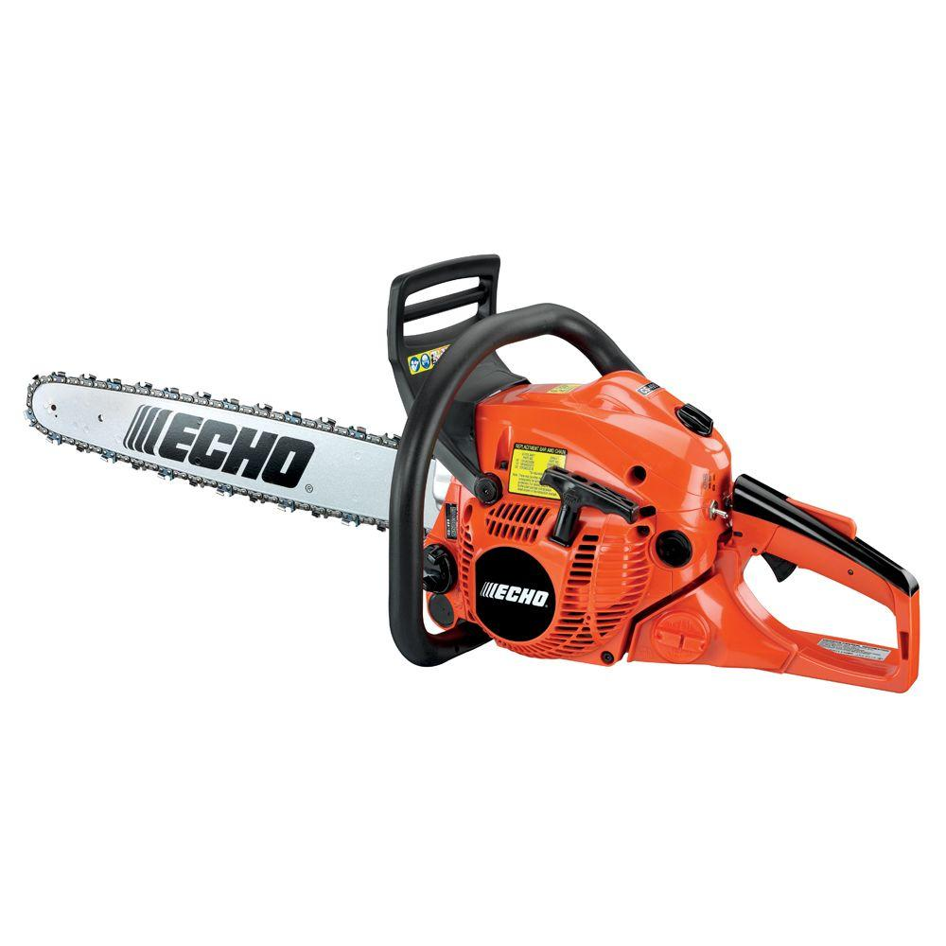
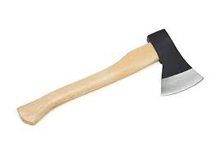
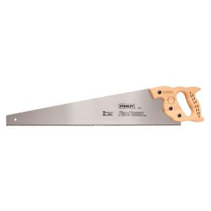
Wildlife Management tools
Chain saw
Ax
Hand saw
All are used for cutting
wood.

Slide 5
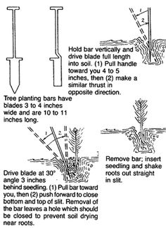
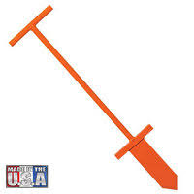
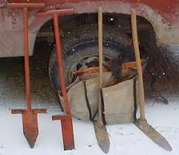
Wildlife Management tools
Dibbler bar – Used for planting.

Slide 6
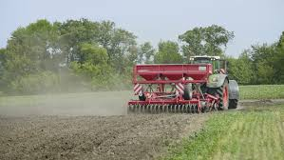
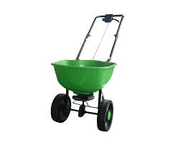
Wildlife Management tools
Seed spreader

Slide 7
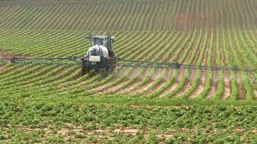
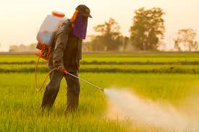
Wildlife Management tools
Herbicide and/or sprayer – Kills specific weeds/plants.

Slide 8
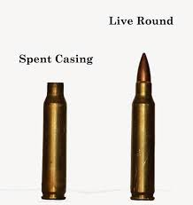
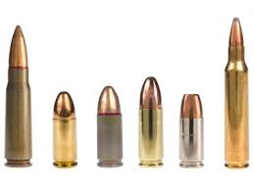
Wildlife Management tools
Bullets and/or shells – used to kill

Slide 9
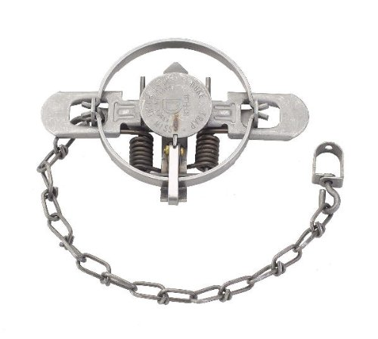
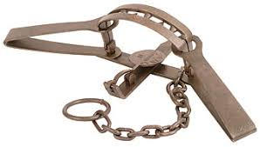
Wildlife Management tools
Foothold/leg traps-are designed to catch an animal by the foot and restrain it.

Slide 10
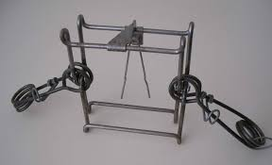
Wildlife Management tools
Conibear trap- Used in water trapping. Can also be used on land.

Slide 11
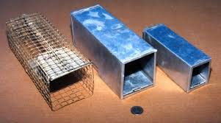
Wildlife Management tools
Sherman Live Trap – Used by biologists to capture animals for research/observation. Used by others to relocate animals.

Slide 12
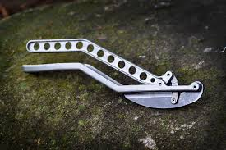
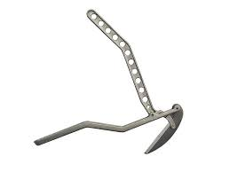
Wildlife Management tools
Deer jaw bone extractor – removes a the jaw of a deer.

Slide 13
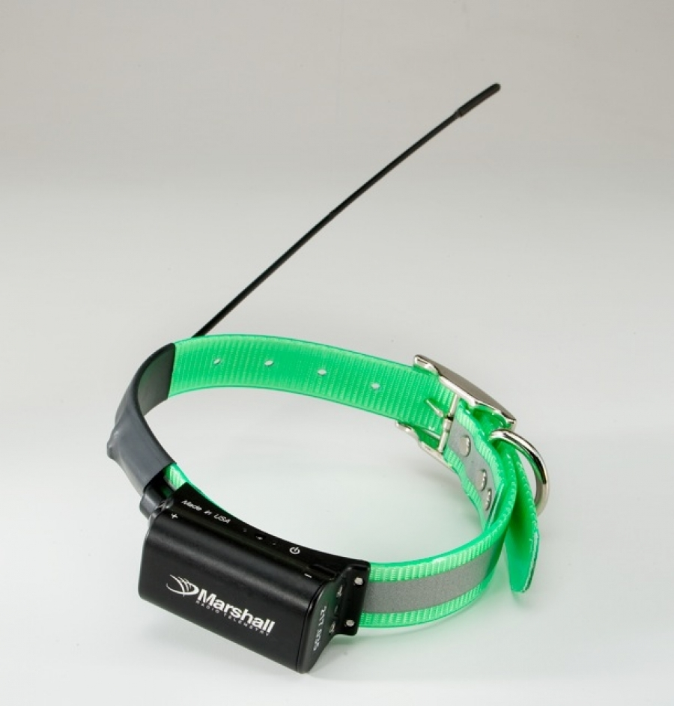
Wildlife Management tools
Radio collar-
Used to track
Animals in a
specific area
for a specific
time period.

Slide 14
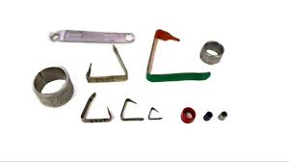
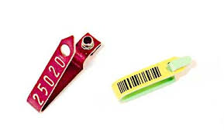
Wildlife Management tools
Wildlife bands or tags – allows the tracking of animals for population studies. Can track animals that migrate

