Slide 1
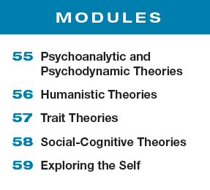
Unit 10 Personality

Slide 2
Learning Targets
Module 55
55-1 Explain what psychologists mean by personality, and identity the theories that inform our understanding of personality.
55-2 Explain how Sigmund Freud’s treatment of psychological disorders led to his view of the unconscious mind, and describe his view of personality.
Psychoanalytic and Psychodynamic Theories
55-3 Identify the developmental stages Freud proposed, and discuss how he thought people defended themselves against anxiety.

Slide 3
Learning Targets cont.
Module
55
55-4 Identify which of Freud’s ideas his followers accepted and rejected.
55-5 Describe projective tests and how they are used, and discuss some criticisms of them.
Psychoanalytic and Psychodynamic Theories
55-6 Discuss how contemporary psychologists view Freud’s psychoanalysis, and describe how modern research has developed our understanding of the unconscious.

Slide 4
What is personality?
an individual’s
characteristic pattern of thinking,
feeling, and acting
Our personality drives what we laugh at, whom we hang with, how we occupy our time, why we cry and where we choose to live.
Our personality underlies all that makes us…. us.

Slide 5
What theories inform our understanding of personality?
Psychoanalytic or psychodynamic theories proposed that childhood sexuality and unconscious motivations influence personality.
Humanistic theories focused on our inner capacities for growth
and self-fulfillment.
Trait theories examine characteristic patterns of
behavior (traits).
Social-cognitive theories explore the interaction
between people’s traits (including their thinking) and their social
context.

Slide 6
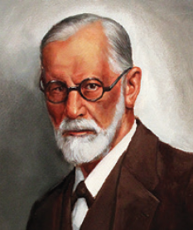
What are the psychodynamic theories?
Psychodynamic theories of personality view human personality as a dynamic interaction
between the conscious mind and unconscious mind, including associated motives and
conflicts.
Sigmund Freud
(1856-1939)

Slide 7
How are psychodynamic theories related to psychoanalysis?
Psychodynamic theories are descended from Sigmund Freud’s psychoanalysis and his theory that proposed childhood sexuality and unconscious motivations influence personality.
Sigmund Freud
(1856-1939)

Slide 8
How did Sigmund Freud’s treatment of psychological disorders lead to his view of the unconscious mind?
In treating patients whose disorders had no clear physical explanation, Freud concluded that these problems reflected unacceptable thoughts and feelings, hidden away in the unconscious mind
For instance, Freud speculated that lost feeling in one’s hand might be caused by a fear of touching one’s genitals; that unexplained blindness or deafness might be caused by not wanting to see or hear something that aroused intense anxiety.

Slide 9
What is the unconscious?
According to Sigmund Freud, the unconscious is a reservoir of mostly unacceptable thoughts, wishes, feelings, and memories.

Slide 10
How did Sigmund Freud explore the unconscious?
To explore the unconscious, the hidden part of a patient’s mind, Freud used free association and dream analysis.
In psychoanalysis, free association is a method of exploring the unconscious in which the person
relaxes and says whatever comes to mind, no matter
how trivial or embarrassing.

Slide 11
1. What Would You Answer?
Carly’s therapist asks her to simply say what is on her mind rather than responding to specific questions or topics. Her therapist is making use of a technique known as
A. the ego.
B. self-efficacy.
C. sublimation.
D. free association.
E. identification.

Slide 12
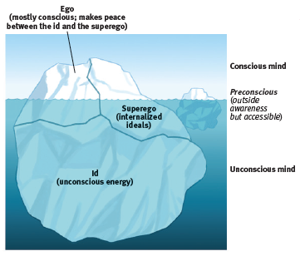
How is Freud’s view of the mind depicted?
Psychologists have used an iceberg image to illustrate Freud’s idea that the mind is mostly hidden beneath the
conscious surface.

Slide 13
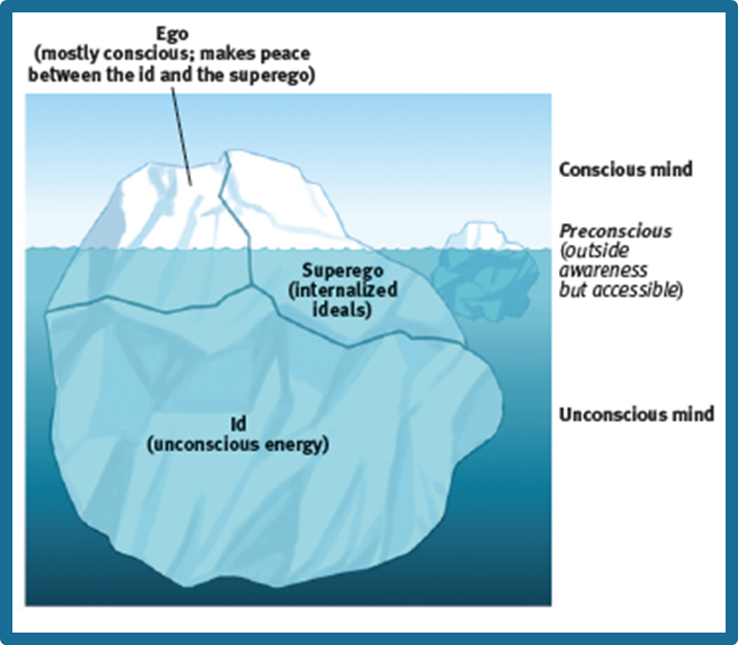
How did Freud view the mind?
Basic to Freud’s theory was his belief that the mind is mostly hidden Our conscious awareness is like the part of an iceberg that floats above the surface. Beneath this
awareness is the larger unconscious mind, with its thoughts, wishes, feelings, and memories.

Slide 14
What did Freud believe about the unconscious?
Of greater interest to Freud was the mass of
unacceptable passions and thoughts that he believed we repress, or forcibly block from our consciousness because they would be too unsettling to acknowledge.
Freud believed that without our awareness, these unconscious, troublesome feelings and ideas powerfully influence us, sometimes gaining expression in disguised forms—the work we choose, the beliefs we hold, our daily habits, our upsetting symptoms.

Slide 15
What was Freud’s belief about human personality?
Freud believed that human personality, including its emotions and desires, arises from a conflict between impulse and restraint—between our aggressive, pleasure-seeking biological urges and our internalized social controls over these urges.
Freud believed personality arises from our efforts to resolve this basic conflict—to express these impulses in ways that bring satisfaction without also bringing guilt or punishment.

Slide 16
Freud’s proposition
To understand the mind’s dynamics during this conflict, Freud proposed three interacting systems:
the id, ego, and
superego.

Slide 17
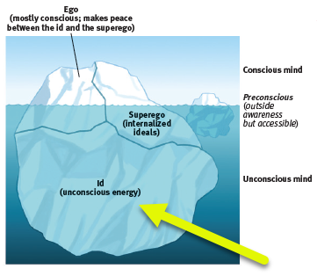
the id
a reservoir of unconscious
psychic energy that, according to Freud, strives to satisfy basic sexual and aggressive drives
The id operates on the pleasure principle, demanding immediate
gratification.

Slide 18
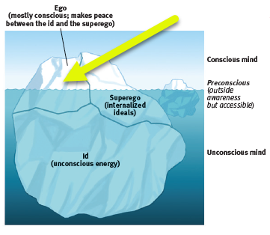
the ego
the largely conscious,
“executive” part of personality that, according to Freud, mediates among the demands of the id, superego, and reality
The ego operates on the reality principle, satisfying the id’s desires and the superego’s restraints in ways that will realistically bring pleasure rather than pain.

Slide 19
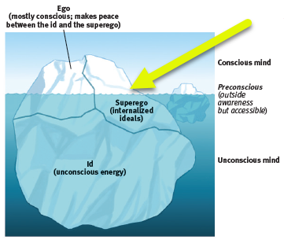
the superego
the part of personality
that, according to Freud,
represents internalized ideals and provides standards for judgment (the conscience) and for future aspirations

Slide 20
Can you name the three parts of the mind?
Give a brief explanation of the function of each part of the mind, according to Sigmund Freud.

Slide 21
2. What Would You Answer?
The Freudian concept of the ego is
best described as
A. operating on the reality principle.
B. operating on the pleasure principle.
C. focusing solely on the morality of an issue.
D. the repression of disturbing thoughts.
E. the strive for perfection.

Slide 22
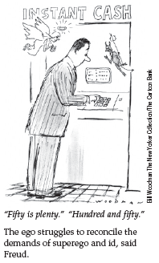
What is the role of the ego?
Because the superego’s demands often oppose the id’s, the ego struggles to reconcile the two.
The ego is the personality “executive,” mediating among the impulsive demands of the id, the restraining demands of the superego, and the real-life demands of the external world.

Slide 23
What developmental stages did Freud propose?
Freud believed that children pass through a series of psychosexual stages, during which the id’s pleasure-seeking energies focus on distinct pleasure-sensitive areas of the body called erogenous zones.

Slide 24
What is the Oedipus complex?
Freud believed that during the phallic stage, for example, boys develop both unconscious sexual desires for their mother and jealousy and hatred for their father, whom they consider a rival.
These feelings, he thought, lead boys to feel guilty and to fear punishment, perhaps by castration, from their father.
He called this collection of feelings the Oedipus complex after the Greek legend of Oedipus, who unknowingly killed his father and married his mother.

Slide 25
How did Freud believe the child reduced the threat of the Oedipus complex?
Freud believed children eventually cope with the threatening feelings of the Oedipus complex by repressing them and by identifying with (trying to become like) the rival parent.
Through this identification process, children’s superegos gain strength as they incorporate many of
their parents’ values.

Slide 26
What is the Electra complex?
Some psychoanalysts in Freud’s era believed that girls experience a parallel Electra complex (named
after a mythological plotting daughter).
As with the Oedipus complex, young girls in the phallic stage would seek to identify with their mother or step-mother in hopes of diffusing the unconscious tension.

Slide 27
forming identity
Freud believed that identification with the same-sex parent provided what psychologists now call our gender identity—our sense of being male, female, or some combination of the two.

Slide 28
What is fixation?
in psychoanalytic theory, according to Freud, a lingering focus of pleasure-seeking energies
at an earlier psychosexual stage, in
which conflicts were unresolved
In Freud’s view, conflicts unresolved during earlier psychosexual stages could surface as maladaptive behavior in the adult years.
At any point in the oral, anal, or phallic stages,
strong conflict could lock, or fixate, the person’s
pleasure-seeking energies in that stage.

Slide 29
What is an example of a fixation?
A person who had been either orally overindulged or deprived (perhaps by abrupt, early weaning) might fixate at the oral stage.
This orally fixated adult could exhibit either passive
dependence (like that of a nursing infant) or an exaggerated denial of this dependence (by
acting tough or uttering biting sarcasm).
Or the person might continue to seek oral
gratification by smoking or excessive eating.

Slide 30
How did Freud believe people defended themselves against anxiety?
Freud proposed that the ego protects itself with defense mechanisms —tactics that reduce
or redirect anxiety by distorting reality.

Slide 31
AP® Exam Tip
The differences between these defense mechanisms aren’t always clear.
For example, repression can be found in most examples.
Focus on each example’s key feature.
If the key feature is seeing your own impulse in someone else, it’s projection.
If the key feature is shifting your aggression from one
target to another, it’s displacement.

Slide 32
What are defense mechanisms and how did Freud believe they function?
In psychoanalytic theory, defense mechanisms are the ego’s protective methods of reducing anxiety by unconsciously distorting reality.
For Freud, all defense mechanisms function
indirectly and unconsciously. Just as the body unconsciously defends itself against disease, so also
does the ego unconsciously defend itself against anxiety.

Slide 33
What is repression?
in psychoanalytic theory, the basic defense
mechanism that banishes from consciousness anxiety-arousing thoughts, feelings, and memories
For example, repression banishes anxiety-arousing wishes and feelings from consciousness.
According to Freud, repression underlies all the other defense mechanisms.
However, because repression is often incomplete, repressed urges may appear as symbols in dreams or as slips of the tongue in casual conversation.

Slide 34
What are “Freudian slips?”
Freud believed he could glimpse the unconscious seeping through what we today call “Freudian slips.”
Freud also viewed jokes
as expressions of repressed sexual and aggressive tendencies.

Slide 35
Can you explain?
Explain to your classmate how the image above relates to Freudian slips and what makes it funny.

Slide 36
What did Freud believe about dreams?
Freud viewed dreams as the
“royal road to the unconscious.”
The remembered content of dreams
(the manifest content) he believed to be a censored expression of the dreamer’s unconscious wishes
(the dream’s latent content).
In his dream analyses, Freud searched for
patients’ inner conflicts.

Slide 37
Who were the neo-Freudians?
These pioneering psychoanalysts, referred to as the neo-Freudians, adopted Freud’s interviewing techniques and accepted his basic ideas: the personality structures of id, ego, and superego; the importance of the unconscious; the childhood roots of personality; and the dynamics of anxiety and the defense mechanisms.

Slide 38
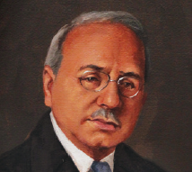
Who was Alfred Adler?
Adler (who gave us the still popular inferiority complex idea) had struggled to overcome childhood illnesses and accidents.
He believed that much of our behavior is driven by efforts to conquer childhood inferiority feelings that
trigger our strivings for superiority and power.
Alfred Adler
(1870-1937)

Slide 39
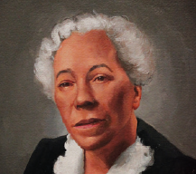
Who was Karen Horney?
Horney said childhood anxiety triggers our desire for love and security.
She also opposed Freud’s assumptions that women have weak superegos and suffer “penis envy,” and she attempted to balance his masculine bias.
Karen Horney
(1885-1952)

Slide 40
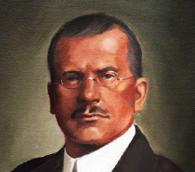
Who was Carl Jung?
Jung believed the unconscious contains more than our repressed thoughts and feelings.
He believed we also have a
collective unconscious, a common reservoir of images, or archetypes, derived from our species’
universal experiences.
Carl Jung
(1875-1961)

Slide 41
What are examples of archetypes?
The Hero and the Rebel, the Caregiver and the Innocent are among the twelve archetypes Jung believed reside within the collective unconscious of humans.
Jung thought these twelve archetypes generate deep emotions, and dominate the personality.
Carl Jung
(1875-1961)

Slide 42
What is the collective unconscious?
Jung said that the collective unconscious explains why, for many people, spiritual concerns are deeply rooted and why people in different cultures share certain myths (such as the flood myth) and images.
Most of today’s psychologists discount the idea of inherited experiences.
But they do believe that our shared evolutionary history shaped some universal dispositions, and that
experience can leave epigenetic marks affecting gene expression.

Slide 43
3. What Would You Answer?
What did Carl Jung call the shared, inherited reservoir of memory traces from our species’ history?
A. Neurosis
B. Archetypes
C. Collective unconscious
D. Inferiority complex
E. Terror management

Slide 44
What is a projective test?
a personality test that provides ambiguous images
designed to trigger projection of one’s inner dynamics
A psychologist working in the Freudian tradition would require a personality test that could provide some sort of road into the unconscious—to unearth the residue of early childhood experiences, move beneath surface thoughts, and reveal hidden conflicts and impulses.
Objective assessment tools, such as agree-disagree or true-false questionnaires, would be inadequate because they would merely tap the conscious surface.

Slide 45
What is the Thematic Apperception Test (TAT)?
a projective test in which people express their inner feelings
and interests through the stories they make up about ambiguous
scenes

Slide 46
How does the Thematic Apperception Test (TAT) work?
Shown a daydreaming boy, those who imagine he is fantasizing about an achievement are presumed to be projecting their own goals.
“As a rule,” said Henry Murray, developer of the TAT, “the subject leaves the test happily unaware that he has presented the psychologist with what amounts to an X-ray of his inner self.” (quoted by Talbot, 1999)
Numerous studies suggest that Murray was right: The TAT provides a valid and reliable map of people’s implicit motives.

Slide 47
What is the Rorschach inkblot test?
the most widely used projective test; a set of 10 inkblots, designed by
Hermann Rorschach; seeks to identify people’s inner feelings by analyzing their interpretations of the blots

Slide 48
How does the Rorschach inkblot test work?
In the Rorschach inkblot test, people tell what they see in a series of symmetrical inkblots.
Some who use this test are confident that the
interpretation of ambiguous images will reveal unconscious aspects of the test-taker’s personality.
Some clinicians cherish the Rorschach test, even offering Rorschach-based assessments of criminals’ violence potential. Others view the test as a source of suggestive leads, an icebreaker, or a revealing interview technique

Slide 49
How is the Rorschach inkblot test criticized?
Critics argue that only a few of the many Rorschach-derived scores, such as those for cognitive impairment and thought disorder, have demonstrated reliability and validity. (Mihura et al., 2013, 2015; Wood et al., 2015)
Inkblot assessments have inaccurately diagnosed many
healthy adults as pathological.
(Wood, 2003; Wood et al., 2006)
“Even seasoned professionals can be fooled by their intuitions and their faith in tools that lack strong evidence of effectiveness,” (Scott Lilienfeld, James Wood, and Howard Garb (2001, p. 47).

Slide 50
How do contemporary psychologists view Freud’s psychoanalysis?
Both Freud’s devotees and his detractors agree that recent research contradicts many of his specific ideas.
Today’s developmental psychologists see our development as lifelong, not fixed in childhood. They doubt that infants’ neural networks are mature enough
to sustain as much emotional trauma as Freud assumed.
Some think Freud overestimated parental influence and underestimated peer influence.

Slide 51
How do Freud’s theories fall short?
Psychologists further criticize Freud’s theory for its scientific shortcomings.
Recall from Module 5 that good scientific theories explain observations and offer testable hypotheses.
Freud’s theory rests on few objective observations, and parts of it offer few testable hypotheses.
For Freud, his own recollections and interpretations of patients’ free associations, dreams, and slips—sometimes selected to support his theory—were evidence enough.

Slide 52
What is the most serious problem with Freud’s theory?
It offers after-the-fact explanations of any characteristic (of one person’s smoking, another’s fear of horses, another’s sexual orientation), yet fails to predict such behaviors and traits.
A good theory makes testable predictions.
For example, If you feel angry at your mother’s death, you illustrate Freud’s theory because “your unresolved childhood dependency needs are threatened.”
If you do not feel angry, you again illustrate his theory because “you are repressing your anger.”

Slide 53
How do Freud’s supporters respond?
Freud’s supporters object to the criticism.
To criticize Freudian theory for not making testable predictions is, they say, like criticizing baseball for not being an aerobic exercise—something it was never intended to be.
Freud never claimed that psychoanalysis
was predictive science.
He merely claimed that, looking back, psychoanalysts could find meaning in our state of mind.
(Rieff, 1979)

Slide 54
How has Freud’s idea of reaction formation been supported in the research?
One study demonstrated the defense mechanism reaction formation (trading unacceptable impulses for their opposite) in men who reported strong antigay attitudes.
Compared with those who did not report such attitudes, these antigay men experienced greater arousal when watching videos of homosexual men having sex. (Adams et al., 1996)
Likewise, some evidence suggests that people who unconsciously identify as homosexual—but who consciously identify as straight—report more negative
attitudes toward gays. (Weinstein et al., 2012)

Slide 55
How might Freud’s theories have been correct?
Research has supported Freud’s idea that we unconsciously defend ourselves against anxiety. Researchers have proposed that one source of anxiety is “the terror resulting from our awareness of vulnerability and death” (Greenberg et al., 1997).
Nearly 300 experiments testing terror-management theory show that thinking about one’s
mortality— for example, by writing a short essay on dying and its associated emotions—provokes
various terror-management defenses.
(Burke et al., 2010)

Slide 56
What are terror-management defenses?
Death anxiety increases terror-management defenses such as aggression toward rivals and esteem for oneself.
(Cohen & Solomon, 2011; Koole et al., 2006)
Faced with a threatening world, people act not only to enhance their self-esteem but also to adhere more strongly to worldviews that answer questions about life’s meaning.
(Norenzayan & Hansen, 2006)

Slide 57
What is terror-management theory?
a theory of death-related anxiety;
explores people’s emotional and
behavioral responses to reminders of their impending death

Slide 58
Was Freud right about the unconscious?
Freud was right about a big idea that underlies today’s psychodynamic thinking: We have
limited access to all that goes on in our mind.
(Erdelyi, 1985, 1988, 2006; Norman, 2010)
Our two-track mind has a vast out-of-sight realm.
Some researchers even argue that “most of a person’s everyday life is determined by
unconscious thought processes.”
(Bargh & Chartrand, 1999)

Slide 59
Learning Target 55-1 Review
Explain what psychologists mean by
personality, and identity the theories
that inform our understanding of personality.
Personality is an individual’s characteristic pattern of thinking, feeling, and acting.
Psychoanalytic (and later psychodynamic) theory and humanistic theory have become part of Western culture. They laid the foundation for later theories, such as trait and social-cognitive theories of personality.

Slide 60
Learning Target 55-2 Review
Explain how Sigmund Freud’s treatment
of psychological disorders led to his view
of the unconscious mind, and describe his
view of personality.
Psychodynamic theories view personality from the perspective that behavior is a lively (dynamic) interaction between the conscious and unconscious mind. The theories trace their origin to Sigmund Freud’s theory of psychoanalysis.

Slide 61
Learning Target 55-2 Review cont.
Explain how Sigmund Freud’s treatment
of psychological disorders led to his view
of the unconscious mind, and describe his
view of personality.
In treating patients whose disorders had no clear physical explanation, Freud concluded that these problems reflected unacceptable thoughts and feelings, hidden away in the unconscious mind. To explore this hidden part of a patient’s mind, Freud used free association and dream analysis.
Freud believed that personality results from conflict arising from the interaction among the mind’s three systems: the id ego, and superego.

Slide 62
Learning Target 55-3 Review
Identify the developmental stages Freud
proposed, and discuss how he thought
people defended themselves against anxiety.
Freud believed children pass through five psychosexual stages (oral, anal, phallic, latency, and genital).
According to this view, unresolved conflicts at any stage can leave a person’s pleasure-seeking impulses fixated (stalled) at that stage.

Slide 63
Learning Target 55-3 Review cont.
Identify the developmental stages Freud
proposed, and discuss how he thought
people defended themselves against anxiety.
For Freud, anxiety was the product of tensions between the demands of the id and superego. The ego copes by using unconscious defense mechanisms, such as repression, which he viewed as the basic mechanism underlying and enabling all the others.

Slide 64
Learning Target 55-4 Review
Identify which of Freud’s ideas his
followers accepted and rejected.
Freud’s early followers, the neo-Freudians, accepted many of his ideas. They differed in placing more emphasis on the conscious mind and in stressing social motives more than sexual or aggression motives.
Neo-Freudian Carl Jung proposed the collective unconscious.

Slide 65
Learning Target 55-4 Review cont.
Identify which of Freud’s ideas his
followers accepted and rejected.
Contemporary psychodynamic theorists and therapists reject Freud’s emphasis on sexual motivation. They stress, with support from modern research findings, the view that much of our mental life is unconscious, and they believe that our childhood experiences influence our adult personality and attachment patterns.
Many also believe that our species’ shared evolutionary history shaped some universal predispositions.

Slide 66
Learning Target 55-5 Review
Describe projective tests and how
they are used, and discuss some
criticisms of them.
Projective tests attempt to assess personality by showing people ambiguous stimuli with many possible interpretations; answers reveal unconscious motives.
The Thematic Apperception Test (TAT) and the Rorschach inkblot test are two such tests. The TAT provides a valid and reliable roadmap of people’s implicit motives, and responses have been shown to be consistent over time. The Rorschach has low reliability and validity, but some clinicians value it as a source of suggestive leads, an icebreaker, or a revealing interview technique.

Slide 67
Learning Target 55-6 Review
Discuss how contemporary psychologists
view Freud’s psychoanalysis, and
describe how modern research has developed our understanding of the unconscious.
Today’s psychologists give Freud credit for drawing attention to the vast unconscious, to the struggle to cope with anxiety and sexuality, and to the conflict between biological impulses and social restraints, and for some forms of defense mechanisms.

Slide 68
Learning Target 55-6 Review cont.
Discuss how contemporary psychologists
view Freud’s psychoanalysis, and
describe how modern research has developed our understanding of the unconscious.
But Freud’s concept of repression, and his view of the unconscious as a collection of repressed and unacceptable thoughts, wishes, feelings, and memories, have not survived scientific scrutiny.
Freud offered after-the-fact explanations, which are hard to test scientifically. Research does not support many of Freud’s specific ideas, such as the view that development is fixed in childhood.

Slide 69
Learning Target 55-6 Review part III
Discuss how contemporary psychologists
view Freud’s psychoanalysis, and
describe how modern research has developed our understanding of the unconscious.
Research confirms that we do not have full access to all that goes on in our mind.
Today’s science views the unconscious as a separate and parallel track of information processing that occurs outside our awareness.
Schemas, perceptions, priming, implicit memories of learned skills, instantly activated emotions, and stereotypes filter our information processing of others’ traits and characteristics.

