Slide 1
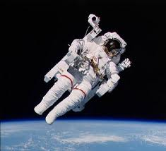
Living and Working in Space
From liftoff to landing, this demonstration explains how astronauts sleep, eat, and work in space. Students explore a replica space suit, sleep restraint, feeding tray, and glove box. Intriguing demonstrations help students understand the vacuum of space.
Grades K-12

