Slide 1
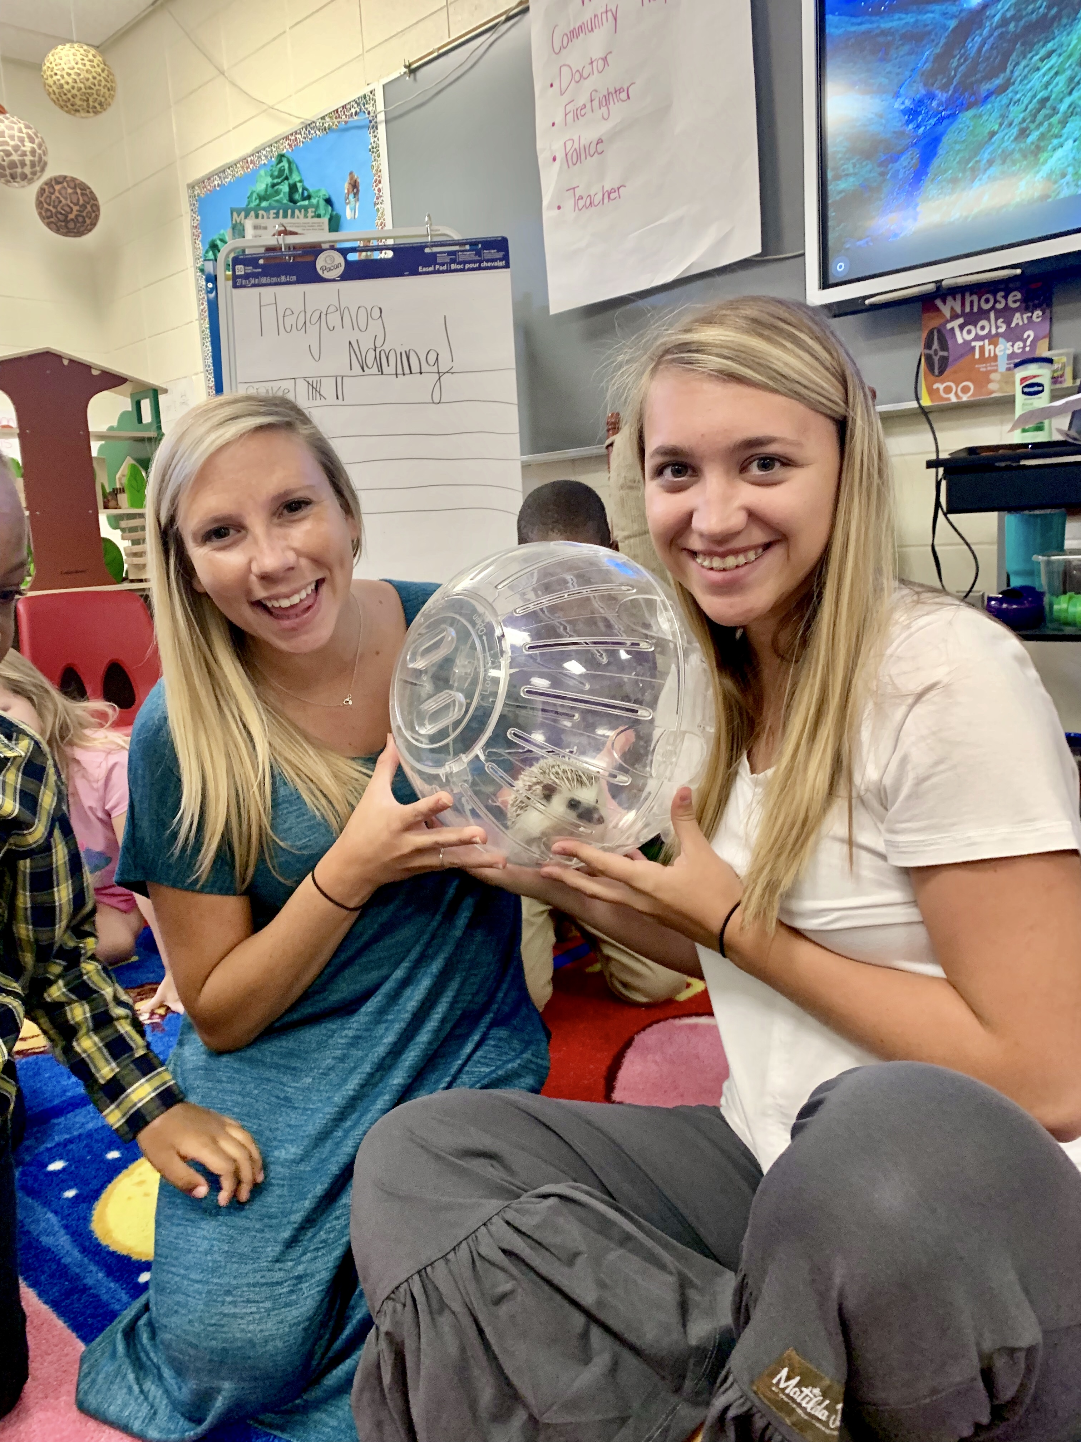

Slide 2
A quick Hello from
Your teacher!
All About
Your teacher
A Peek inside of our classroom
Your teacher’s favorite things
Books that
Your teacher
loves
Contact
Info

Slide 3
Hello Students and Family,
Mrs. Wilson and Miss. Caroline are so excited about this upcoming School year in PreK. We have been busy preparing our rooms for all of you to arrive. We can’t wait to start this new adventure with all of you! We are looking forward to lots of learning, fun, and memories being made.

Slide 4
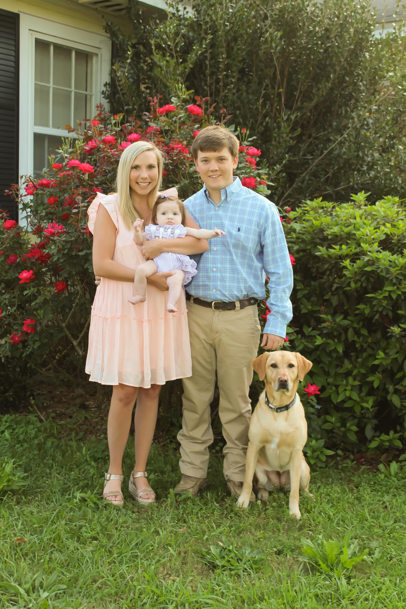
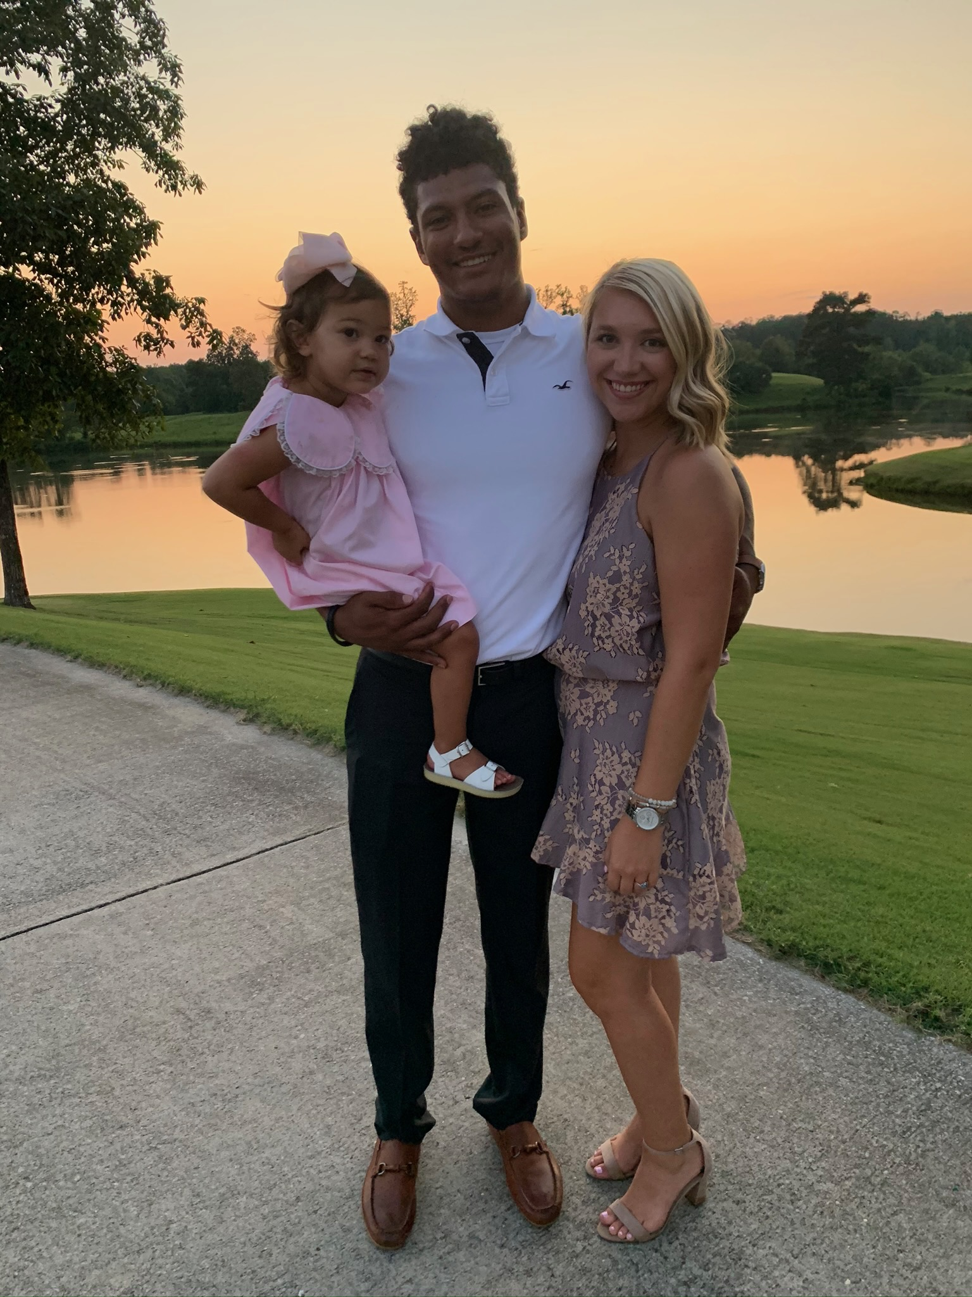
Mrs. Wilson, lives in Grove hill, Alabama. She is married and has a daughter. She enjoys spending time with her family and going to the beach. This is her 3rd year in education. She is excited about meeting her new students this fall.
Miss. Caroline, is from Sweetwater, Alabama. She has one daughter. She enjoys spending time with her family and friends. This is her second year as an auxiliary teacher at Sweetwater.
Mrs. Wilson
Miss. Caroline

Slide 5
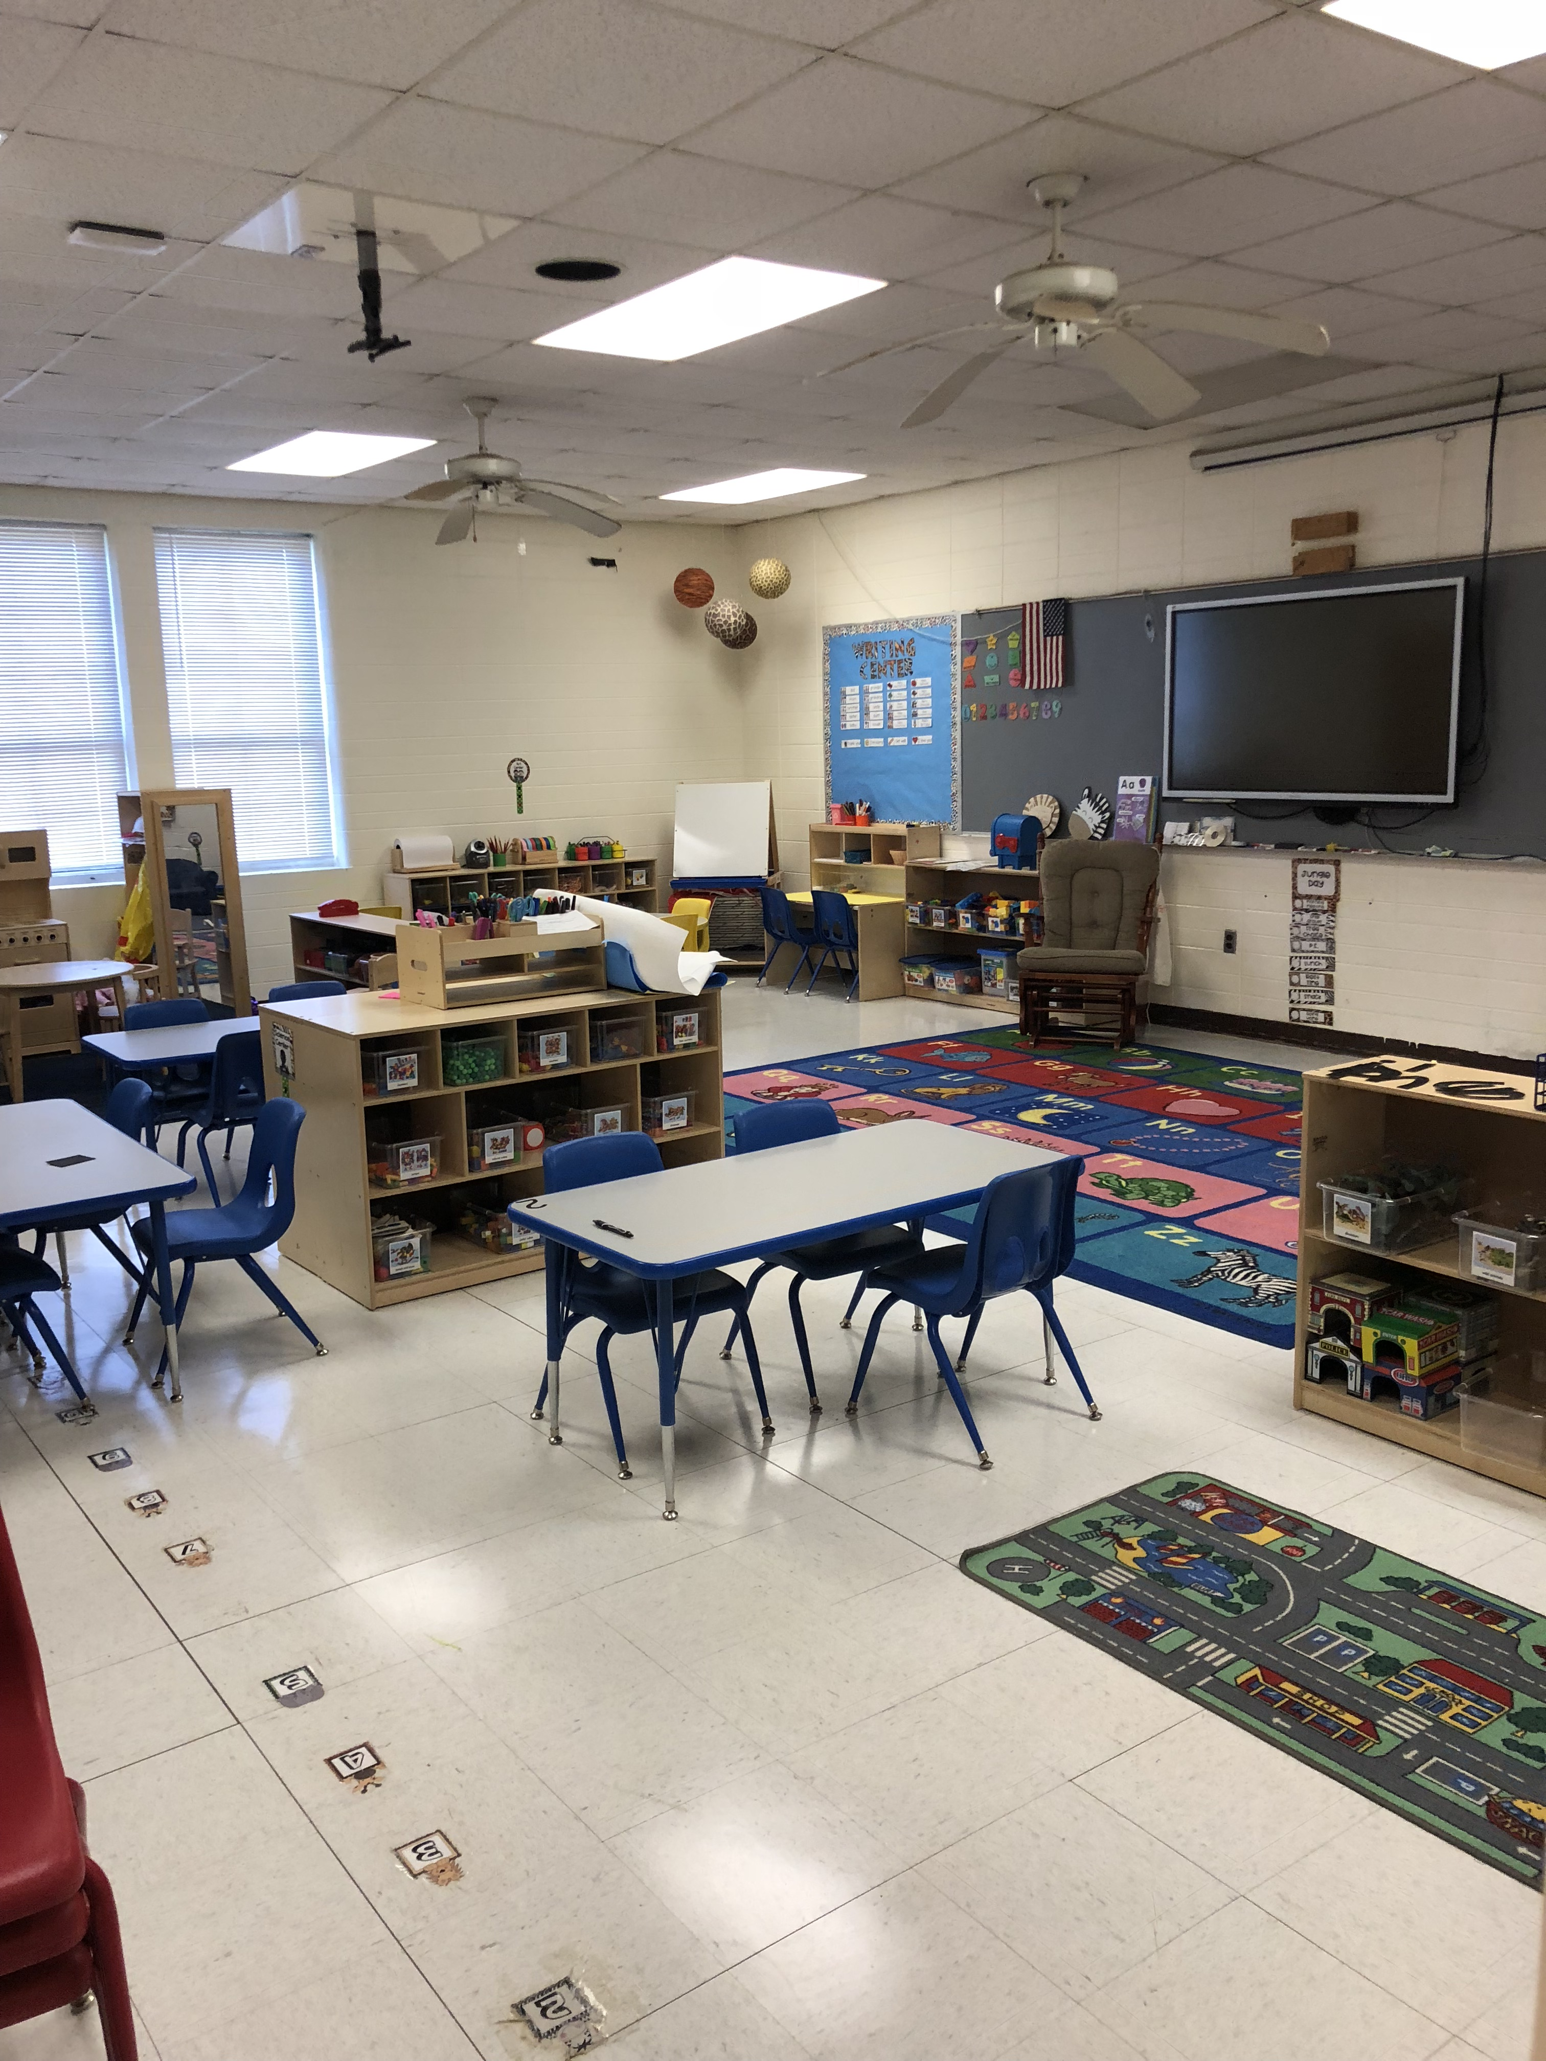

Slide 6
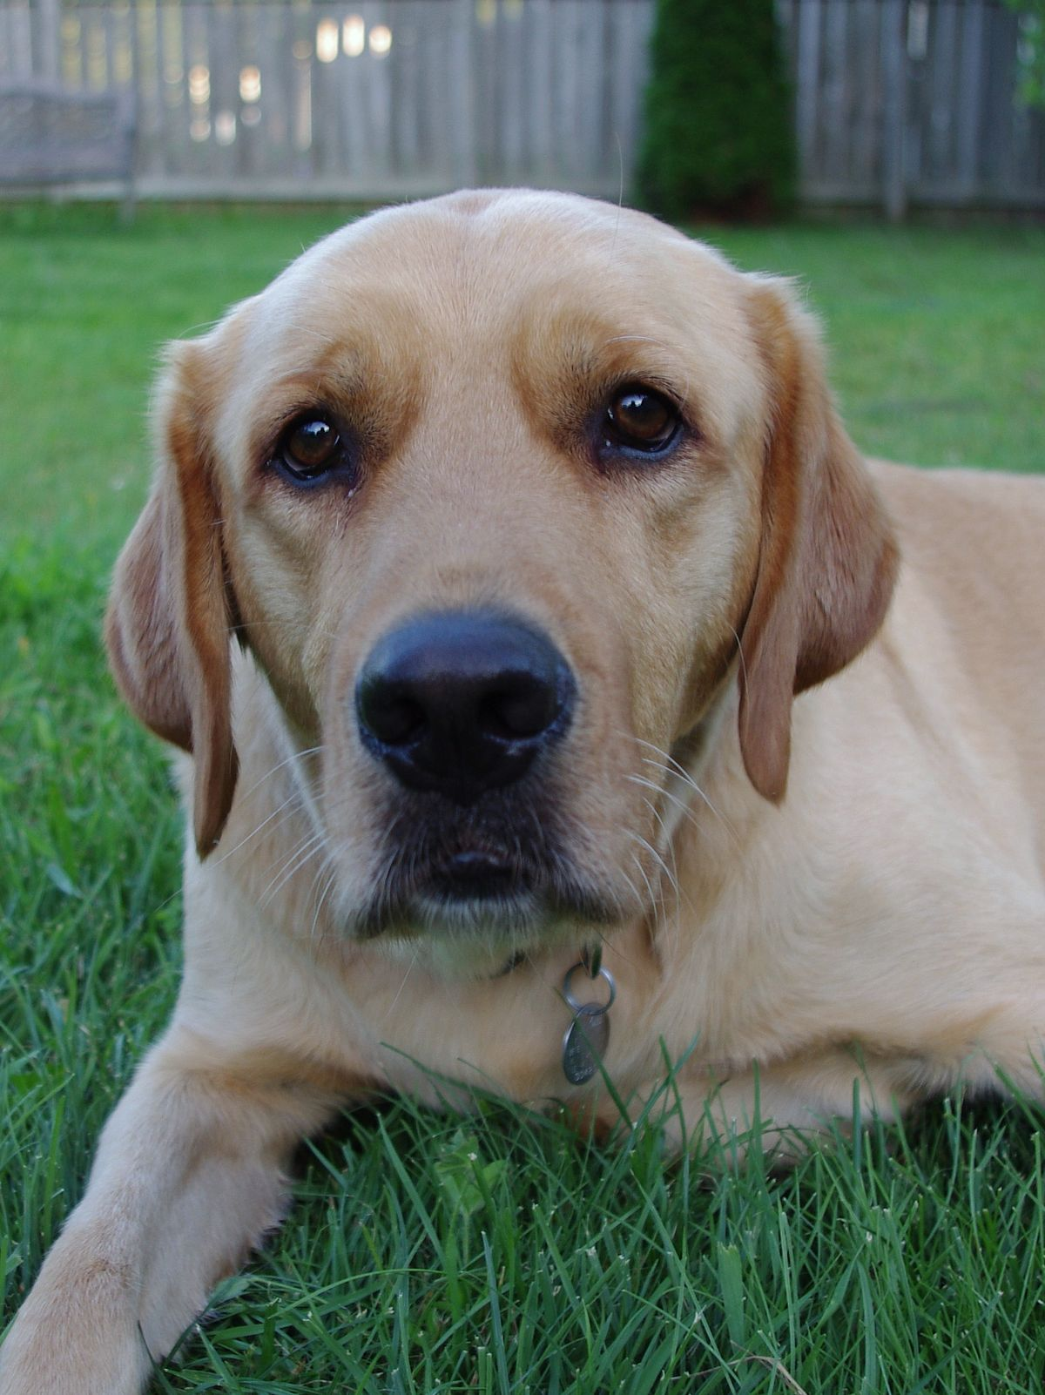
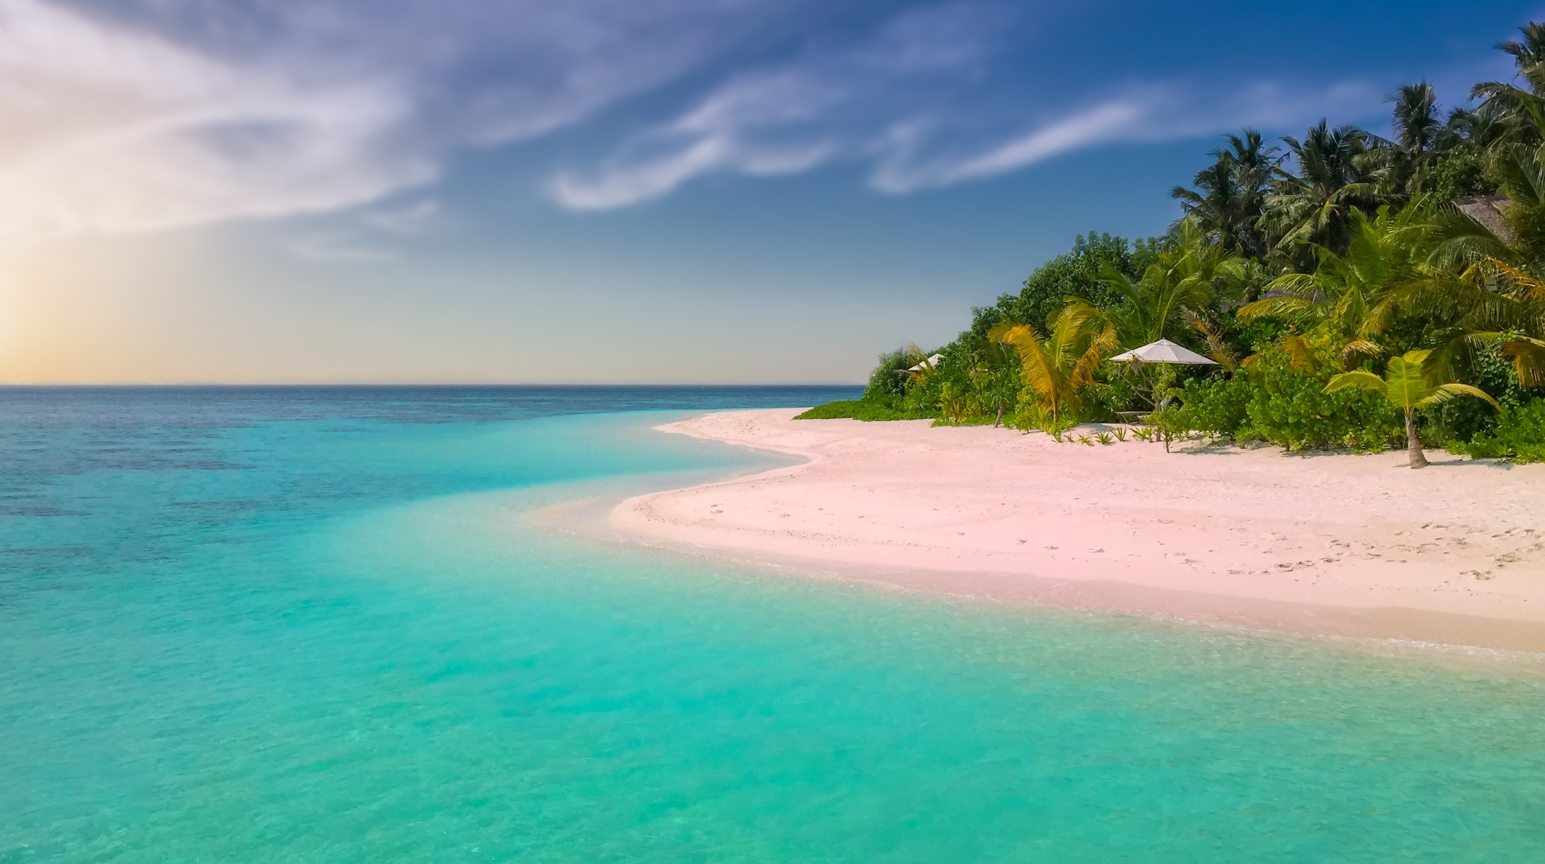
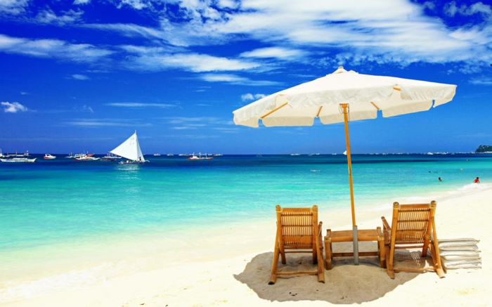
Miss Wilson’s Favorites
Miss Caroline’s
Favorites

Slide 8
ambermcdaniel@marengo.k12.al.us
If you would like to virtually meet with your teacher before school , you can get in touch by contacting ambermcdaniel@marengo.k12.al.us
334-994-4263

