Slide 1
Unit 3
Lesson 2
Grammar on the Go! PowerEd Express
Make the sentence
corrections in red.
Write the vocabulary words
in your personal dictionary.
PowerEd Plans 2014

Slide 2
Grammar on the Go! PowerEd Express
Unit 3-2
Sentence
would you like a snack now sweetie she queried while pouring a boiling pot of spaghetti over a makeshift strainer she set up over the kitchen sink
Type of Sentence(s) – Declarative, Imperative, Interrogative, Exclamatory
PowerEd Plans 2014

Slide 3
Unit 3-2
Corrections
Grammar on the Go! PowerEd Express
New Paragraph
Punctuation in Dialogue
¶ “ Would you like a snack now, Sweetie?” she queried while pouring a boiling pot of spaghetti over a makeshift strainer she set up over the kitchen sink.
Interrogative
Capitalization
End Punctuation
Direct Address
PowerEd Plans 2014

Slide 4
Unit 3-2
Paragraph
Grammar on the Go! PowerEd Express
Paragraph ¶
Begin a new paragraph when starting new dialogue.. Indent the first line of the new paragraph.
¶“Would you like a snack now, Sweetie?” she queried while pouring a boiling pot of spaghetti over a makeshift strainer she set up over the kitchen sink.
PowerEd Plans 2014

Slide 5
Unit 3-2
Punctuation
Quote/Dialogue
Grammar on the Go! PowerEd Express
Punctuation – Quote/Dialogue
Use of Quotation Marks – “ ” – at the beginning and end of a direct quotation or dialogue. Remember, the punctuation goes to the LEFT of the quotation marks.
“Would you like a snack now, Sweetie?” she queried while pouring a boiling pot of spaghetti over a makeshift strainer she set up over the kitchen sink.
PowerEd Plans 2014

Slide 6
Unit 3-2
Comma
Grammar on the Go! PowerEd Express
Comma in Direct Address
Always use a comma when directly addressing someone/something, regardless of whether the direct address is at the beginning or end of the sentence.
Ladies and gentlemen, may I have your attention?
It was a pleasure to meet you, Sir.
If the direct address is in the middle of a sentence, use a pair of commas to set off the direct address.
Thank you, students, for remembering to use correct English.
“Would you like a snack now, Sweetie?” she queried while pouring a boiling pot of spaghetti over a makeshift strainer she set up over the kitchen sink.
PowerEd Plans 2014

Slide 7
Unit 3-2
Capitalization
Grammar on the Go! PowerEd Express
Capitalization
Writing a word with its first letter as a capital letter (upper-case letter) and the remaining letters in lower case.
The first word of every sentence.
Capitalize nick names when they are used in place of a name.
“Would you like a snack now, Sweetie?” she queried while pouring a boiling pot of spaghetti over a makeshift strainer she set up over the kitchen sink.
PowerEd Plans 2014

Slide 8
Unit 3-2
End Punctuation
Grammar on the Go! PowerEd Express
End Punctuation
. A period is a full stop. It marks the end of a sentence. It marks the end of an idea or a thought. It marks the end of an action.
? A question mark is, naturally, a mark which shows the sentence is a question. A question mark is required at the end of an interrogative sentence.
! Exclamation marks are used in exclamatory sentences, and sometimes in imperative sentences.
“Would you like a snack now, Sweetie?” she queried while pouring a boiling pot of spaghetti over a makeshift strainer she set up over the kitchen sink.
PowerEd Plans 2014

Slide 9
Unit 3-2
Interrogative Sentence
Grammar on the Go! PowerEd Express
Interrogative Sentence
An interrogative sentence is a type of sentence which usually asks a question and use a question mark (?).
“Would you like a snack now, Sweetie?” she queried while pouring a boiling pot of spaghetti over a makeshift strainer she set up over the kitchen sink.
PowerEd Plans 2014

Slide 10
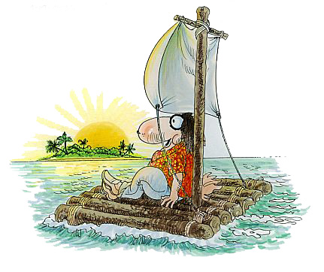
Unit 3-2
Vocabulary
Grammar on the Go! PowerEd Express
makeshift
Adjective
serving as a temporary
substitute; sufficient
for the time being
PowerEd Plans 2014

