Slide 1
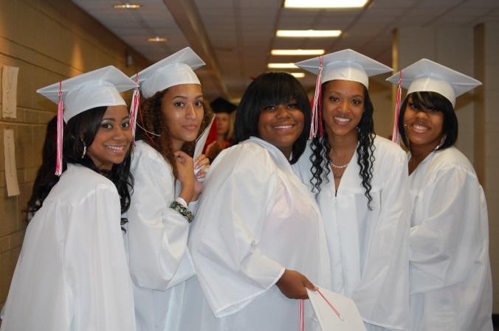
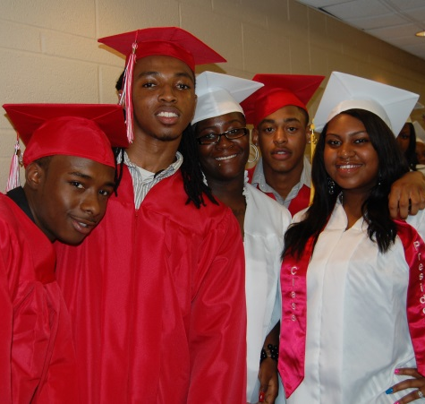
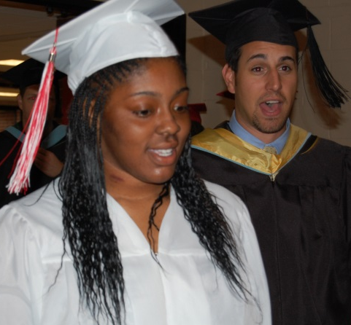
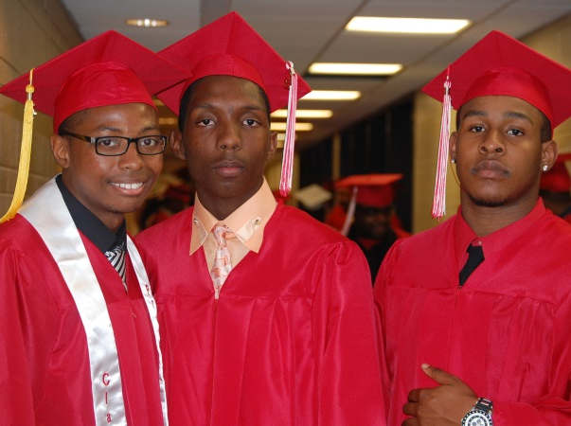
Senior Meeting
September 3, 2014

Slide 2
STAFF
Herman Harris, Alternative Education Coordinator
Vanessa Meads, Lead Counselor 9th Grade & JETS
Bobbie Barnett-College Advisor
Tim Williams-Educational Talent Search
Dr. Tiffany Anderson, Superintendent
Dr. Anthony Robinson, Director of Secondary Education
Dr. Miranda Avant-Elliott, Dir. College and Career Readiness

Slide 3
Introductions and Expectations

Slide 4
Scheduled Activities
Senior Portraits
Spirit Week
Prom
Six Flags
Senior Recognition
Graduation

Slide 5
Senior
Warrior Memories Package | Senior Memories Package | Senior Farewell Package
Package Includes: Cap and gown ACT Exam Yearbook Senior Class Picture | Package Includes: Cap and gown ACT Exam Yearbook Senior Class Picture Senior Recognition | Package Includes: Cap and gown ACT Exam Yearbook Senior Class Picture Six Flags Senior T-Shirt
$75 | $100 | $125

Slide 6
Graduation Information
Commencement – Friday, May 22nd @ 7:00 PM at Saint Louis University Chaifetz Arena with unlimited seating

Slide 7
In Order to Participate in College Tours
Exemplary behavior
Eligible to attend the college based on GPA and ACT
Interested in attending the college
98% attendance
Good academic standing in current courses

Slide 8
Student Expectations
Senior are expected to have: 98% Attendance Exemplary Behavior as Role Models Maintain above a 2.0 G.P.A.

Slide 9
Clip from Graduation
http://www.jenningsk12.tv/Default.aspx

Slide 10
Graduation Requirements & Mo Options

Slide 11
Graduation Requirements
Subject Requirements and Jennings Required Courses | Credits Required
 | Jennings Requirements | College Prep Certificate
Communication Arts English 9, English 10, Amer. Lit., World Lit. (4th credit must be above English III) | 4 | 4
Mathematics | 3 | 4
Science Physical Science, Biology I, one science elective | 3 | 3
Social Studies Am. History, World History, Am. Government | 3 | 3
Fine Arts | 1 | 1
Practical Arts | 1 | 1
Physical Education | 1 | 1
Health | .5 | .5
Personal Finance | .5 | .5
Electives (Some colleges require 2 years of the same foreign language.) | 7 | 7
Total | 24 | 25

Slide 12
Additional Requirements
End of Course Graduation Requirements
American Government
Algebra I
Biology
English II

Slide 13
MO Options
The Missouri Options program is offered at JETS and specifically targets students who are 17 years of age or older and are at least one year behind their graduating class or for other significant reasons not able to be successful in a traditional high school setting. Students will remain in school and are not counted as dropouts when it is time to take the HiSET Test. Once the school district issues a diploma, participants are then counted as High School Graduates.

Slide 14
CCR Assessments & A Plus
Dr. Miranda Avant-Elliott

Slide 15
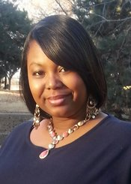
Dr. Miranda Avant-Elliott, Director of College and Career Readiness
Highest Degree Earned: Educational Doctorate

Slide 16
A+ Program
Requirements:
2.5 Cumulative GPA
90% Attendance Rate
50 Hours of Tutoring/Mentor Hours
12.5 hours can be job shadowing (job shadow parent, family, teacher, etc.)
Ways to get volunteer hours:
Work as a classroom tutor
Tutor with Stars and Heroes or at JSD Elementary or Middle setting
Served as a peer leader last year
Must score proficient on Math EOC (added requirement this year) or make qualifying score on AC Math or ACT COMPASS Pre-Algebra

Slide 17
CCR Initiatives
College and Career Center-Missouri Advisor Office
College Corner-Every Class
College Connection Newsletter
Expanded College Tours with one HBCU tour
College Link on the District’s Main Web Page
www.jenningsk12.org/ccr
Senior of the Month
College Planning Guide

Slide 18
College and Career Readiness Goals
Students and teachers play an important role in helping the district become fully accredited. In order for the district to achieve College and Career Readiness points students must earn the following scores on national assessments:
Test Name | Target Score
*ACT | 22 or higher
*SAT | 990 - 1180
*ASVAB | 63 – 87
*COMPASS | Reading Compass score of 82, a writing score of 70, and/or a Math Compass score of 66
PLTW End of Course | 6 or higher
TSA/IRC | Score Proficient (Passing Score Varies by Test)
* Required Assessments for Graduation

Slide 19
ACT & Dual Enrollment/Credit

Slide 20
ACT test dates for 2014-2015 school year
Test Date | Registration Deadline | (Late Fee Required)
September 13, 2014 | August 8, 2014 | August 9–22, 2014
October 25, 2014 | September 19, 2014 | September 20–October 3, 2014
December 13, 2014 | November 7, 2014 | November 8–21, 2014
February 7, 2015* | January 9, 2015 | January 10–16, 2015
April 18, 2015 | March 13, 2015 | March 14–27, 2015
June 13, 2015 | May 8, 2015 | May 9–22, 2015

Slide 21
The BIG Day – Test Day!
Get plenty of rest
Eat a good breakfast
Arrive to the test center early 7:30 to 7:45
Don’t forget to bring
Your photo ID
Your admissions ticket
Two number 2 pencils
An ACT approved calculator
A snack to have during breaks
A great attitude

Slide 22
ACT Prep
Edgenuity Online at Home
ACT Boot Camp and/ or ACT Prep Class
Go to: http://www.actstudent.org/sampletest/
ACT test is 38.00 and the late fee is 24.00

Slide 23
College Readiness Rolling Admissions & Naviance

Slide 24
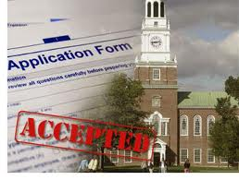
College Goals
College Acceptances
Schools with rolling admissions.
The goals is to have 100% in a post-secondary institution. You can get support with applying.

Slide 25
Explanation of Rolling Admissions
Used by many colleges and universities in the United States
Applicants are notified of acceptance within a few weeks of applying.
Process starts in early fall and may continue through the summer.

Slide 26
Advantages of Rolling Admissions
Applicants may receive a decision long before the March or April notification period of regular admission colleges
Applying early can improve an applicant's chance of being accepted
Applying early may improve an applicant's chance of receiving a scholarship
A student who applies early and is rejected may still have time to apply to other colleges with winter deadlines

Slide 27
Some Colleges/Universities in the Area with Rolling Admissions
University of Missouri-Columbia
Webster University
Stephens College
University of Central Missouri

Slide 28
Common Application
What is the Common Application?
Used for undergraduate admissions by over 500 universities
A holistic admissions approach
Not just grades and standardized test scores:
Community Service
Extracurricular Activities
Personal Essay

Slide 29
Some Common Application Colleges/Universities in the Area
Washington University
Saint Louis University
Webster University
Williams Jewell College
Fontbonne University

Slide 30
Naviance
Why Naviance?
Post High School Search - Trade Schools - 2 year colleges - 4 year colleges & universities 2. Scholarship Search & Apply
How Do I Get To Naviance?
www.jenningsk12.org/CCR Click Departments Click College & Career Readiness Click Naviance Login Jennings Senior High

Slide 31
Senior Year Planning

Slide 32
Scholarships & College Acceptance
Scholarship information will be available through the counselors and the in the College and Career Center
Students are expected to provide their counselors scholarship award and college acceptance letters

Slide 33
Senior Year Planning
August-December
Attend college fairs/tours
Start applying for colleges.
More than one school!
Note specific deadlines!
Scholarship deadlines
Send out transcripts/Fee waivers
Get letters of recommendations
Write any personal statements or application essays
Take the ACT to improve score.
Fee Waivers
Improving a score 1 or 2 points could be thousands of dollars.

Slide 34
Senior Year Planning Cont.
January-May
FAFSA (Free Application for Federal Student Aid)
Can be completed ASAP after January 1st
Priority Deadline – March 1st
Missouri State Deadline – April 1st
Send in 7th semester grades if colleges ask for them.
Scholarship applications
Tie up loose ends
Housing
Accept Financial Aid Awards
Enroll in classes (Summer activity)

Slide 35
Upcoming Events
ACT Test - September 13st & October 25th
ACT Deadline – August 8th & September 19th
College Colors Day August 29th
Infinite Scholars Fair – September 6th
Look out for announcements about ACT prep, college tours, and campus reps visits
ACT prep for students taking September ACT will be September 3rd and September 8th
First College Tour September 19th to Southeast Missouri Sate University (SEMO)… Only taking 25 students

Slide 36
Upcoming Events
Infinite Scholars College Fair
Saturday, September 6, 2014
9:00am – 1:00pm
SLU (The Center for Global Leadership)
Multiple copies of
Unofficial transcript
2 letters of recommendations & Resume
Printed ACT Score
DRESS FOR SUCCESS
Pre-register at www.infinitescholars.org

Slide 37
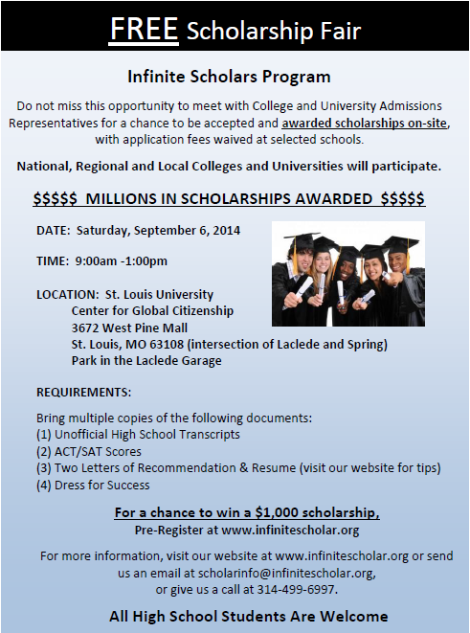

Slide 38
Questions?

