Slide 1
Logic and Flow of Programming
For VEX EDR and VEX IQ

Slide 2
Common Logic used in Programming
VEX and VEX IQ robots are programmed using logical statements such as if, else, while, repeat, repeat until, repeat forever as well as some non-logical commands such as wait.

Slide 3
Common Logic used in Programming
while
The term while is what is known as a conditional statement. When we tell the robot to do something when a certain condition is present.
“While the car is moving less than 70 mph, press on the accelerator.”

Slide 4
The ‘while’ statement
In the code snippet below, the motor on port 1 will be moving forward at a power of 50 until the potentiometer returns a value of 1000 at which point the motor on port 1 will turn off.

Slide 5
Common Logic used in Programming
If
The If command tells the robot what to do if a certain condition is met like a button push, but if that condition is not met the robot will not do anything. In the example below if the chocolate milk was not available in 1 gallon containers you would not get anything.
“If the grocery store has chocolate milk in 1 gallon containers get me a gallon.”

Slide 6
The ‘If’ statement
In the code snippet below the robot will move backwards 1 rotation of the wheels if the front touch switch is bumped, otherwise it will sit still.

Slide 7
Common Logic used in Programming
If / Else
The If / Else command tells the robot what to do if a certain condition is met like a button push, but also tells it what to do otherwise.
“If the grocery store has chocolate milk get me a gallon, Else get me 2 half gallons.”

Slide 8
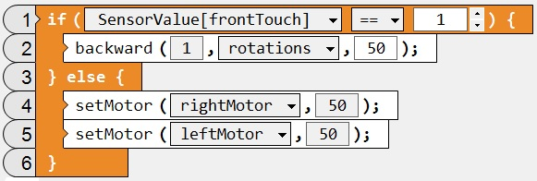
The If / Else statement
In the code snippet below the robot will move backwards 1 rotation of the wheels if the front touch switch is bumped, otherwise it moves forwards.

Slide 9
Common Logic used in Programming
Repeat
The Repeat command comes in 3 flavors, Repeat, Repeat Until, and Repeat Forever.

Slide 10
The ‘Repeat’ statement
When we use the Repeat statement we tell the robot how many times to repeat a task. Repeat statements are actually “Loops” since we return to the beginning upon completion. This is the simplest command for getting a robot to complete the same task a certain number of times in a row.

Slide 11
The ‘Repeat’ statement
In the code snippet below the robot will move forward 1 rotation of the wheels and then backwards 1 rotation of the wheels 5 times. After the 5th time it moves forward and backwards it will stop.

Slide 12
The ‘Repeat-Until’ statement
In the code snippet below the robot will move forward 1 rotation of the wheels and then backwards 1 rotation of the wheels repeatedly until button 5D is pressed on the remote control. After button 5D is pressed it will stop.

Slide 13
The ‘Repeat (forever)’ statement
In the code snippet below the robot will move forward 1 rotation of the wheels and then backwards 1 rotation repeatedly as long as the robot is powered on and the program is running. The repeat (forever) command or loop is where we would place our remote control commands.

Slide 14
Common Logic used in Programming
Wait
The wait command is commonly used in programming to allow timed commands as well as creating pauses between tasks.

Slide 15
The Wait command
In the code snippet below we are telling the robot to move forwards for 1 second and then stop.
This is an effective method of programming autonomous routines for new teams who do not have a lot of programming experience.

Slide 16
Questions?

