Slide 1
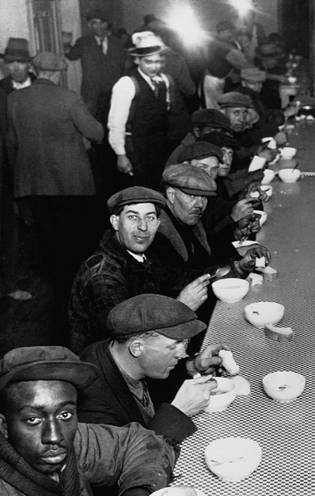
Years of Crisis, 1919–1939
Societies undergo political, economic, and social changes that lead to renewed aggression.
Unemployed men in a Chicago soup kitchen during the Great Depression (1930).
NEXT

Slide 2
Years of Crisis, 1919–1939
SECTION 1
Postwar Uncertainty
SECTION 2
A Worldwide Depression
SECTION 3
Fascism Rises in Europe
SECTION 4
Aggressors Invade Nations
Map
Chart
Chart
NEXT
Notes:
These are my notes for slide 2

Slide 3
Section 4
Aggressors Invade Nations
As Germany, Italy, and Japan conquer other countries, the rest of the world does nothing to stop them.
NEXT

Slide 4
SECTION
Aggressors Invade Nations
4
Japan Seeks an Empire
Militarists Take Control of Japan
• Military leaders take control of country
• Want to solve economic problems through foreign
expansion
Japan Invades Manchuria
• Japan has investments in Manchuria, Chinese
province
• In 1931, Japanese army seizes Manchuria
• League of Nations protests action; Japan
withdraws from League
Japan Invades China
• In 1937, Japan launches war on China
Map
NEXT

Slide 5
SECTION
4
European Aggressors on the March
Mussolini Attacks Ethiopia
• In 1935, Mussolini attacks Ethiopia
• League of Nations does not stop aggression
Hitler Defies Versailles Treaty
• In 1935, Hitler begins rebuilding German army
• In 1936, Germany occupies Rhineland
• Britain urges appeasement, a policy of giving in
to aggression
• Germany, Italy, and Japan—the Axis Powers—
form an alliance
Continued . . .
NEXT

Slide 6
SECTION
4
continued European Aggressors on the March
Civil War Erupts in Spain
• In 1931, a republic is declared in Spain
• In 1936, General Francisco Franco leads
rebellion
• Hitler and Mussolini help Franco and his Fascists
• In 1939, Franco wins Spanish Civil War
• Franco becomes Spain’s Fascist dictator
NEXT

Slide 7
SECTION
4
Democratic Nations Try to Preserve Peace
United States Follows an Isolationist Policy
• Isolationism—avoidance of political ties with
other countries
• In 1935, Congress passes Neutrality Acts
The German Reich Expands
• Hitler plans to expand Third Reich—German
Empire
• In 1938, Hitler annexes Austria
• Hitler demands the Sudetenland from
Czechoslovakia
• Czechs refuse, ask France for help
Image
Continued . . .
NEXT

Slide 8
SECTION
4
continued Democratic Nations Try to Preserve Peace
Britain and France Again Choose Appeasement
• Leaders meet at Munich Conference to settle
Czech crisis
• Britain and France agree to let Hitler take
Sudetenland
• But in 1939, Hitler still takes rest of
Czechoslovakia
• Mussolini takes Albania; Hitler demands part of
Poland
Image
Nazis and Soviets Sign Nonaggression Pact
• In 1939, Stalin and Hitler pledge never to attack
one another
NEXT

