Slide 1

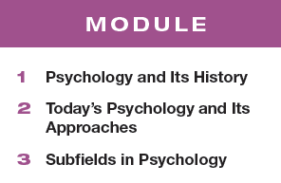

Unit 1: Psychology’s History and Approaches

Slide 2


Module 1: Psychology’s History
Module 1
Psychology’s History
Learning Targets
  1-1 Explain why psychology is a science and why the “rat is always right.”
  1-2 Describe the three key elements of the scientific attitude and how they support scientific inquiry.
  1-3 Explain how critical thinking feeds a scientific attitude and smarter thinking for everyday life.
  1-4 Describe how psychology developed from early understandings of mind and body to the beginnings of modern science.
  1-5 Explain how critical thinking feeds a scientific attitude and smarter thinking for everyday life.
  1-6 Explain how behaviorism, Freudian psychology and humanistic psychology furthered the development of psychological science.

Slide 3
How is psychology a science?
Psychology uses the tools of science to
describe
explain
predict
control
behavior and mental processes.

Slide 4
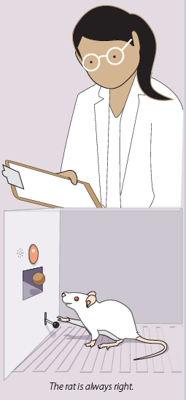
Why is the “rat always right”?
Why is the “rat is always right”?
Facts speak for themselves
Researchers have to accept the results of the study even if the hypothesis has been proven wrong.

Slide 5

TRY IT
Can these questions be answered using science?
  Are the body and the soul separate entities?
  Does having a positive attitude improve outcomes for individuals with serious illness?
  What was the evolutionary benefit of depression?

Slide 6
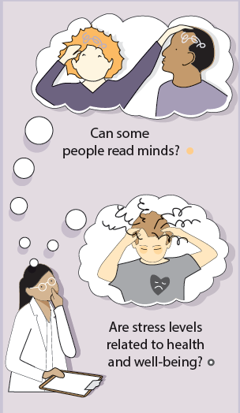
What is one key element of the scientific attitude?
Curiosity:
asking questions

Slide 7
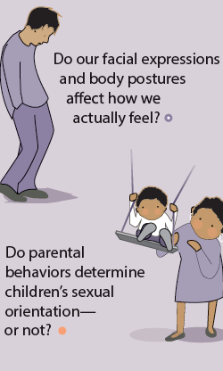
What is another key element of the scientific attitude?
Skepticism:
sifting reality from fantasy and demanding evidence

Slide 8
What is a third key element of the scientific attitude?
Humility:
accepting incorrect predictions

Slide 9
What is critical thinking?
Examining assumptions
Appraising the source
Discerning hidden biases
Evaluating evidence
Assessing conclusions

Slide 10
How would you think critically about the following statement?
TRY IT
Climate change is a real and pressing danger.
What is the assumption?
What is the source of this statement? Are they reliable?
Might the source have a reason to believe this? A bias?
What evidence exists to support this statement? What evidence exists to refute it?
What conclusions can I make about the information I gathered?

Slide 11
What did philosophers wonder about the mind?
How does our mind work?
How does our body relate to our mind?
How much of what we know is innate? How much comes from our experiences?

Slide 12
The Greeks
mind and body are separate
mind continues after death
knowledge is innate
Socrates
Plato
need data
knowledge comes from observation
knowledge is NOT innate
Aristotle

Slide 13
The French
The French
René Descartes
agreed with Socrates and Plato
dissected animals
fluid in brain flows through nerves to muscles causing movement

Slide 14
The British
The British
founder of modern science
empiricism
Francis Bacon
tabula rasa
the mind at birth is a blank slate on which experience writes
John Locke

Slide 15
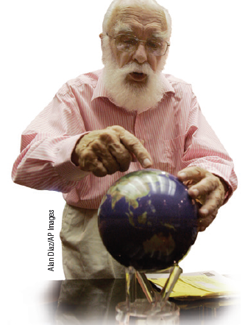
What is empiricism?
What is empiricism?
The idea that knowledge is the result of experience and that scientific knowledge is developed through observation and experimentation.

Slide 16
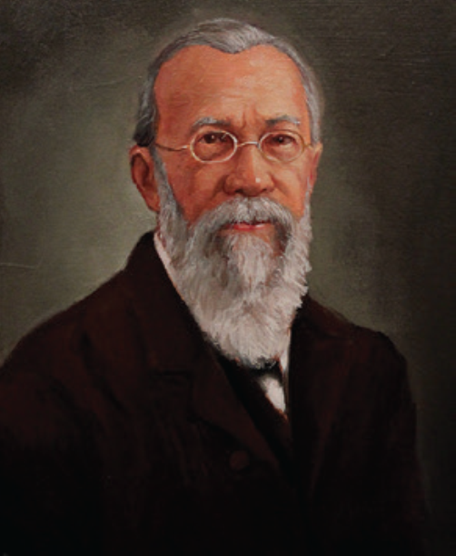
What were important milestones in psychology’s early development?
established the first psychology lab
wanted to measure the “atoms of the mind”… the fastest mental processes
Wilhelm Wundt
(1832-1920)

Slide 17
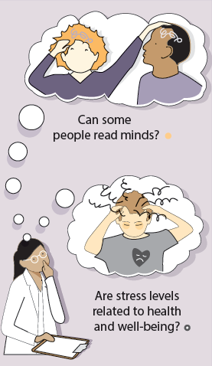
Wundt’s experimental design question
What did he test?
What was he curious about?
In two separate trials, subjects were asked to press a
telegraph key as soon as…
they heard the sound of a ball hitting a platform
they were consciously aware of perceiving the sound

Slide 18
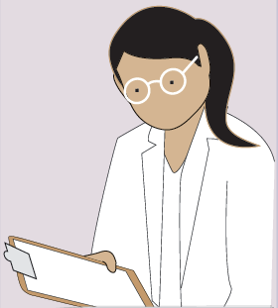
Wundt’s experimental design results
What did he find?
What were the results?
In the first trial the subjects pressed the button in 1/10th of a second when they heard the sound of a ball hitting a platform
But it took 2/10th of a second to wait until they were consciously aware of perceiving the sound

Slide 19
What were important milestones in psychology’s early development? Cont.
introduced structuralism to study the elements of the mind
used introspection
Edward Bradford Titchener (1867-1927)

Slide 20
What is structuralism? What is introspection?
What is structuralism?
What is introspection?
Early school focused on identifying the elements of thought and mind (structures) the way early chemists developed the periodic table to classify elements.
The process of looking inward to directly observe one’s own psychological processes.

Slide 21
Describe what you sense when you…
TRY IT
Chew a piece of spearmint gum.
Smell the fries cooking in the cafeteria.
Sit in the chair at your desk.

Slide 22
1. What Would You Answer?
1. What Would You Answer?
Self-reflective introspection about the elements of experience best describes a technique used by which school of thought in psychology?
functionalists
empiricists
structuralists
behaviorists
humanists

Slide 23
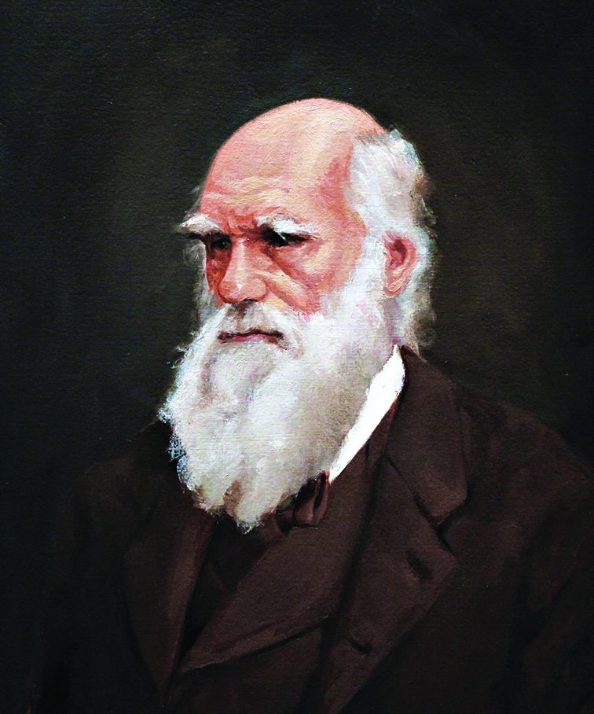
What were other important milestones in psychology’s early development?
natural selection of mental and physical traits
adaptive evolution
influenced William James
Charles Darwin
(1809-1882)

Slide 24
What were some important milestones in psychology’s early development?
introduced functionalism
Principles of Psychology
William James
(1842-1910)

Slide 25
What is functionalism?
Functionalism assumes a purpose…
smelling and thinking must have helped us evolve….
structures of consciousness must serve a function.
smelling is what the nose does
thinking is what the brain does
but…WHY?

Slide 26
structuralism or functionalism?
TRY IT
Why do some people have strong willpower and others do not?
Describe the characteristics of the pencil you are holding.
How does eye color limit our ability to see in the dark?

Slide 27
What were additional important milestones in psychology’s early development?
student of William James
denied her Ph.D. due to gender
memory researcher
first female president of the APA
Mary Whiton Calkins
(1863-1930)

Slide 28
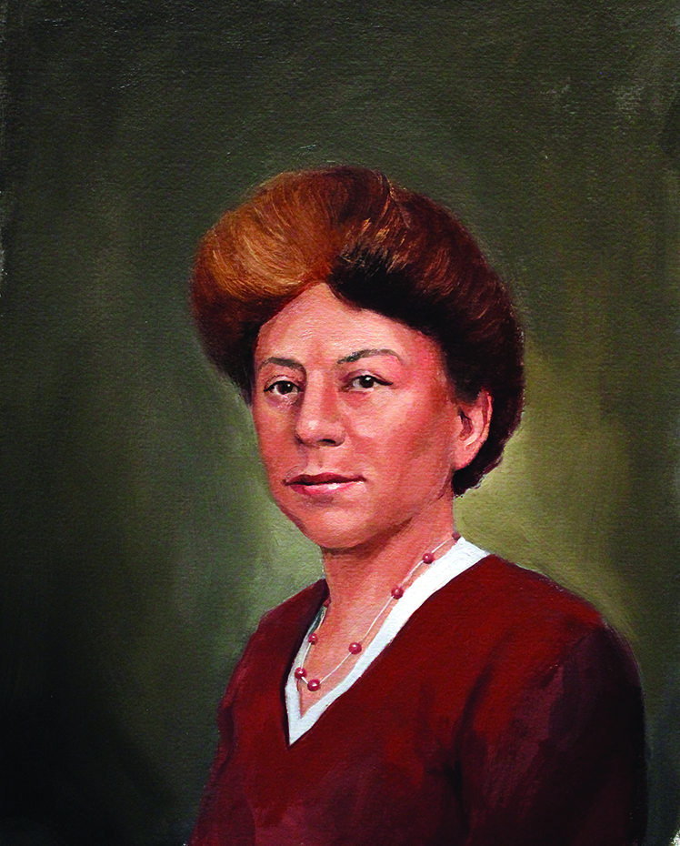
What were important contributions to psychology’s early development?
student of Edward Titchener
first female to earn Ph.D.in psychology
The Animal Mind
Margaret Floy Washburn (1871-1939)

Slide 29
2. What Would You Answer?
2. What Would You Answer?
By seeking to measure “atoms of the mind”, who established the first psychology laboratory?
Edward Bradford Titchener
Margaret Floy Washburn
Wilhelm Wundt
G. Stanley Hall
William James

Slide 30
How did behaviorism further the development of psychological science?
B.F. Skinner
(1904-1990)
John B. Watson
(1878-1958)

Slide 31
What is behaviorism?
psychology should be an objective science
observable behavior is important to study… not the unseen mental processes

Slide 32
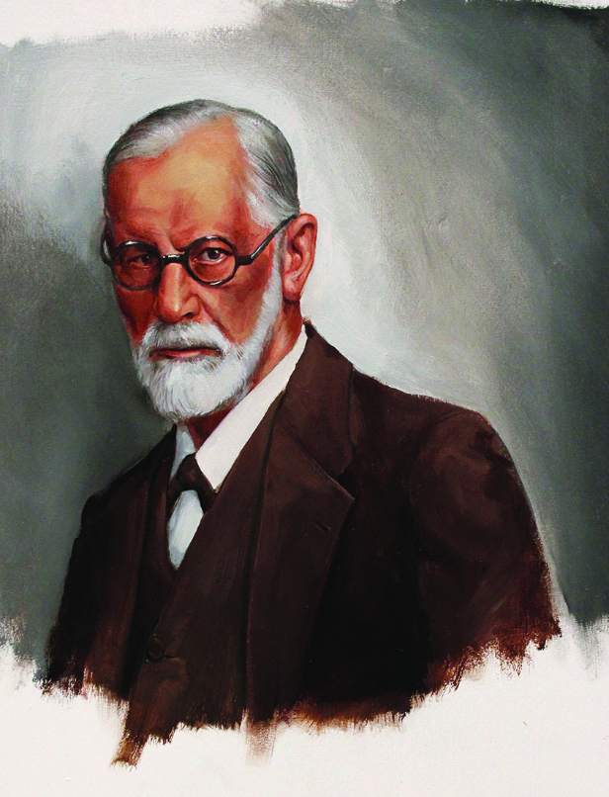
How did Freud further the development of psychological science?
developed an influential treatment process called psychoanalysis
personality theory
Sigmund Freud
(1856-1939)

Slide 33
What is Freudian
(or psychoanalytic) psychology?
Unconscious forces and
childhood experiences
affect our behavior and
mental processes.

Slide 34
How did humanism further the development of psychological science?
Humans strive to reach their full potential
Unconditional love
Personal growth
Abraham Maslow
Carl Rogers

Slide 35
What is humanism?
“third force” in psychology
rejected both behaviorism and
psychoanalytic psychology
the study of potential and personal growth

Slide 36
3. What Would You Answer?
3. What Would You Answer?
With which of the following statements would John B. Watson most likely agree?
Psychology should study the growth potential in all people.
Psychology should study the unconscious mind.
Psychology should focus on observable behavior.
Psychology should study mental thought processes.
Psychology should study how culture and beliefs impact an individual.

Slide 37
Learning Target 1-1 Review
How is psychology a science,
and why is it
the “rat is always right”?
Psychologists:
think critically
use the scientific method
accept the results

Slide 38
Learning Target 1-2 Review
What are the three key elements
of the scientific attitude, and how
do they support
scientific inquiry?
The scientific attitude encourages us to be:
curious
skeptical
humble
in testing ideas that don’t agree with ours.

Slide 39
Learning Target 1-3 Review
How does critical thinking feed a
scientific attitude
and smarter thinking for everyday life?
Critical thinking puts ideas to the test by:
examining assumptions
appraising the source
discerning hidden biases
evaluating evidence
assessing conclusions

Slide 40
Learning Target 1-4 Review
How did psychology develop from
early understandings of mind and body
to the beginnings of modern science?
The Greeks wondered if ideas were innate or came from experience
Locke thought we were tabula rasa
Bacon gave us empiricism

Slide 41
Learning Target 1-5 Review
What were some important
milestones in
psychology’s early development?
Wundt established the first psych lab
Wundt and Titchener: structuralism and introspection
James: functionalism

Slide 42
Learning Target 1-6 Review
How did behaviorism, Freudian
psychology, and humanistic
psychology further the development
of psychological science?
Watson: behaviorism focuses on studying behavior
Freud: psychoanalysis focuses on unconscious influences
Rogers and Maslow: humanism focuses on striving for growth

