Slide 1
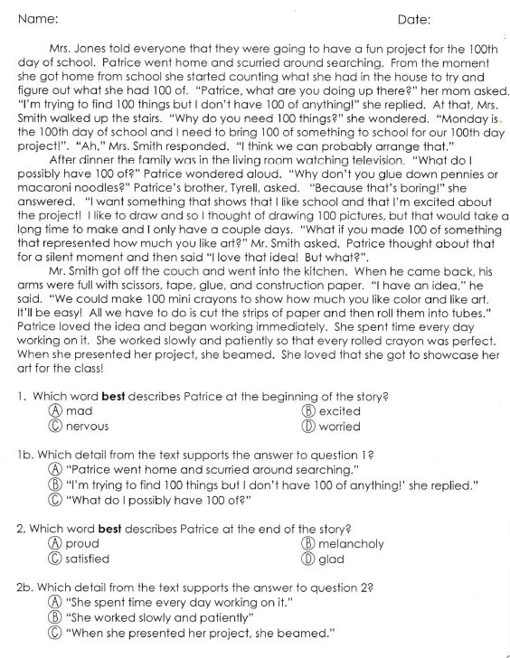
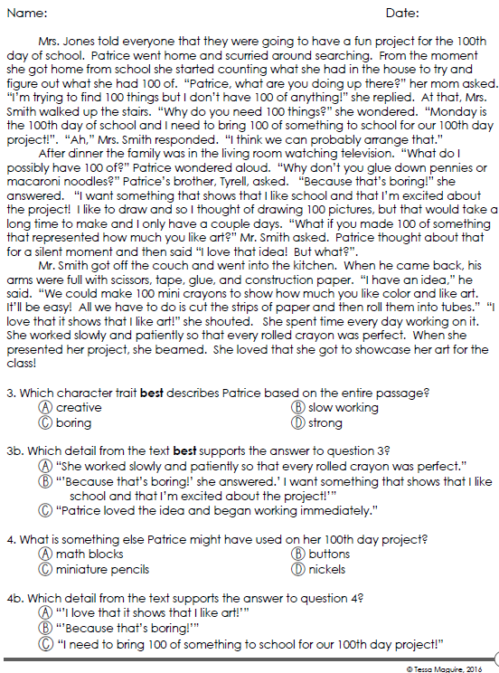
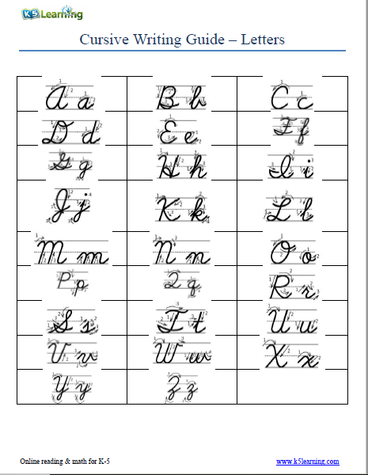
Support your Answer
Monday, August 12, 2019
Practice writing “a” in cursive when finished.
7:55 – 8:30

Slide 3
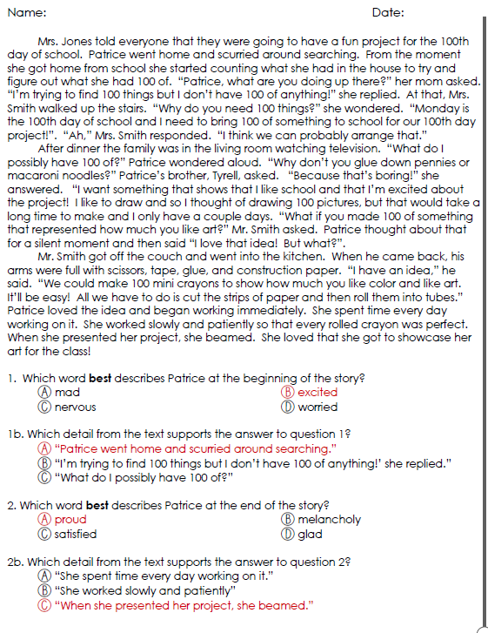
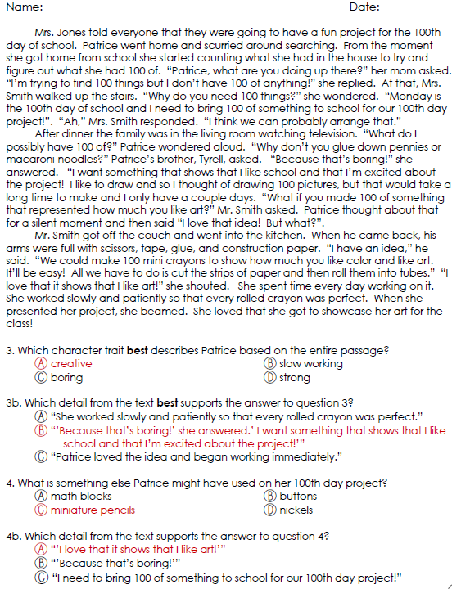

Slide 4
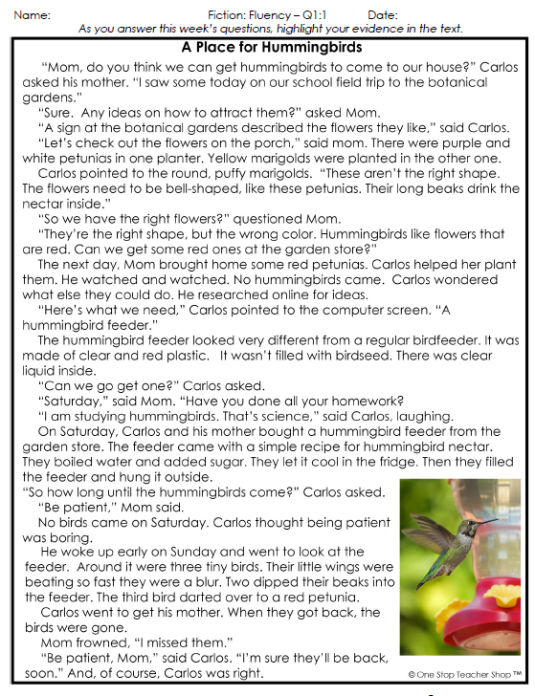
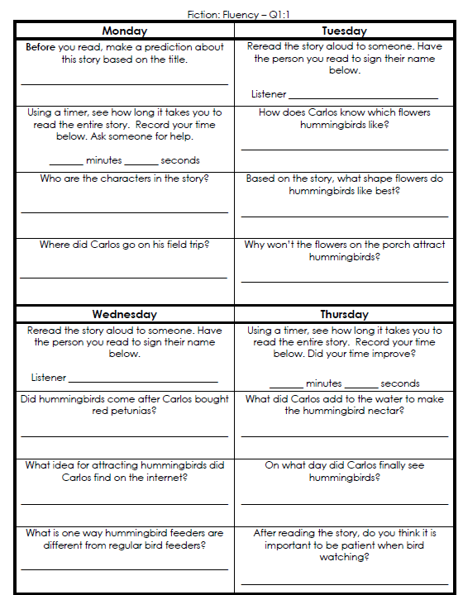
Reading Homework

Slide 5
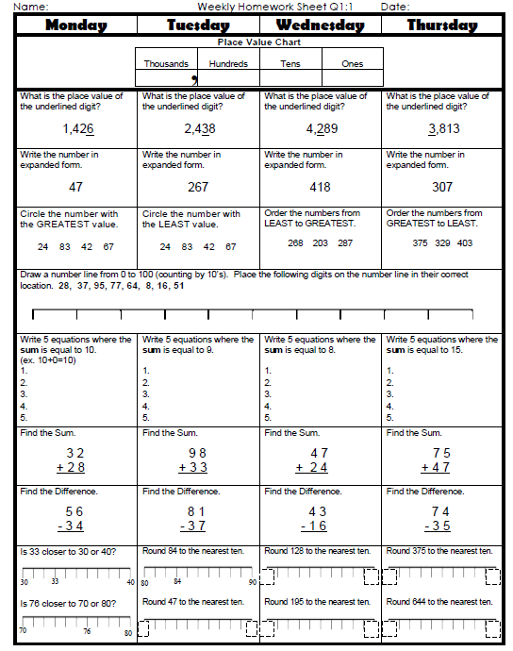
Math Homework

Slide 6

CHOMP TIME
F.A.S.T. Groups
Focused Academic Support Time

Slide 7
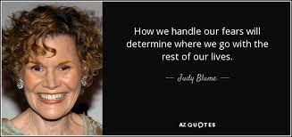
F.A.S.T. Designations
Computers – Epic: Adalyn Jaylie Jearon Amiyah Cohen Emma Caydance Kaylee Jordyn | Mrs. Roby: LLI Jaiden Macon Kaylah Katelynn | Mrs. Thompson: LLI Landon Paisleigh | IDR – 40 book challenge Aiden Alexis Cayli Brena Khamani Carleen McKenzie Erin Noah Elin
8:40 – 9:10

Slide 8

Restroom Break
9:10 – 9:20

Slide 9

Reading Time
9:20 – 9:55
Objective: RL.3.2
I can recount stories; determine the central message, lesson, or moral and explain how it is conveyed through key details in the text.
Objective: RL.3.9
I can compare and contrast the themes, settings, and plots of stories written by the same author about the same or similar characters.
Objective: SL.3.1c
I can ask questions to check understanding of information presented, stay on topic, and link my comments to the remarks of others.

Slide 10


Contrast Miss Nelson Stories
In what ways are these stories different? Turn to your Partner

Slide 11
Comprehension Check -
Compare Miss Nelson Stories
Written Response:
In what ways are these stories similar, or alike? Cite evidence from both books.

Slide 12
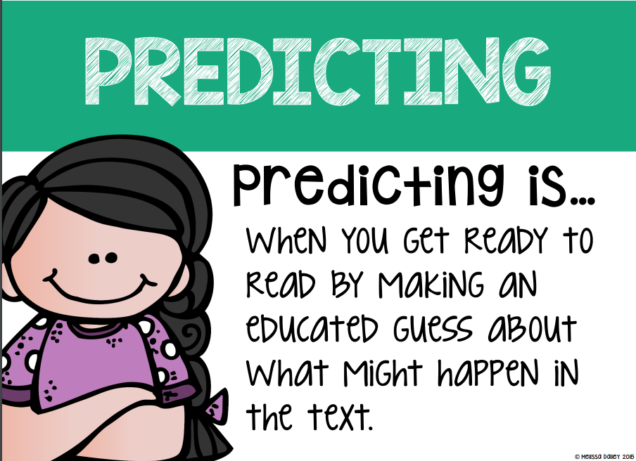
Become a better reader by using READING STRATEGIES:
Reading Strategy of the Week: Predicting
I predict that …because…
I think that … will happen next…because…
This makes me think that …will happen next because…
When I read ________, it makes me think _______ will happen because…
I predict the main character will…because…
I predict the problem will be solved by …because…

Slide 13

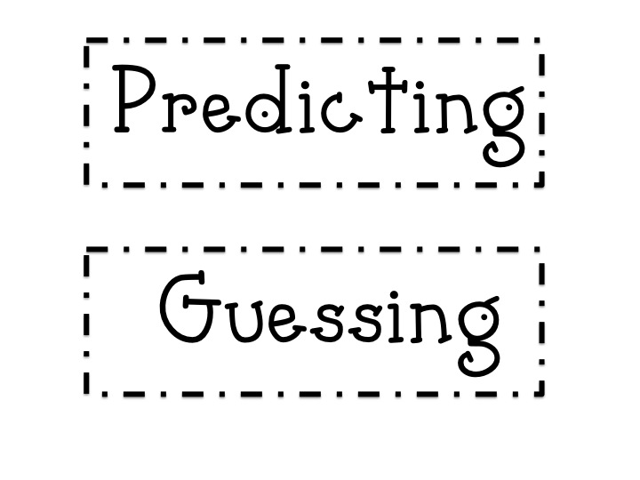

Predicting vs. Guessing
What is the difference between these two?
Predicting uses
clues in the text!

Slide 14

Make a prediction:
Based on the previous two books we read by Harry Allard, what do you predict this book will be about?
What evidence from the previous books makes you think so.

Slide 15

Computers - Epic:
  Jaiden
  Macon
  Kaylah
  Katelynn
  McKenzie
  Erin
  Noah
  Elin
  Landon
  Paisleigh
  Mrs. Roby:
  LLI
  Emma
  Caydance
  Kaylee
  Jordyn
Independent Daily Reading & Teacher Conferences
  Mrs. Thompson:
  LLI
  Jaylie
  Jearon
  Amiyah
  Cohen
All others Independent Novel for Book Challenge! ☺
9:55 – 10:25

Slide 16

Snack Time & 7 Habits
10:25 – 10:40

Slide 17
Review of
7 Habits of Highly Effective People
Habit #1: Be Proactive
Habit #2: Begin with the End in Mind
Habit #3: Put First Things First
Habit #4: Think Win-Win
Habit #5: Seek First to Understand, Then to Be Understood
Habit #6: Synergize
Habit #7: Sharpen the Saw
  I take care of my body by eating right, exercising, and getting sleep.
  I spend time with family and friends.
  I learn in lots of ways and lots of places, not just at school.
  I take time to find meaningful ways to help others.

Slide 18
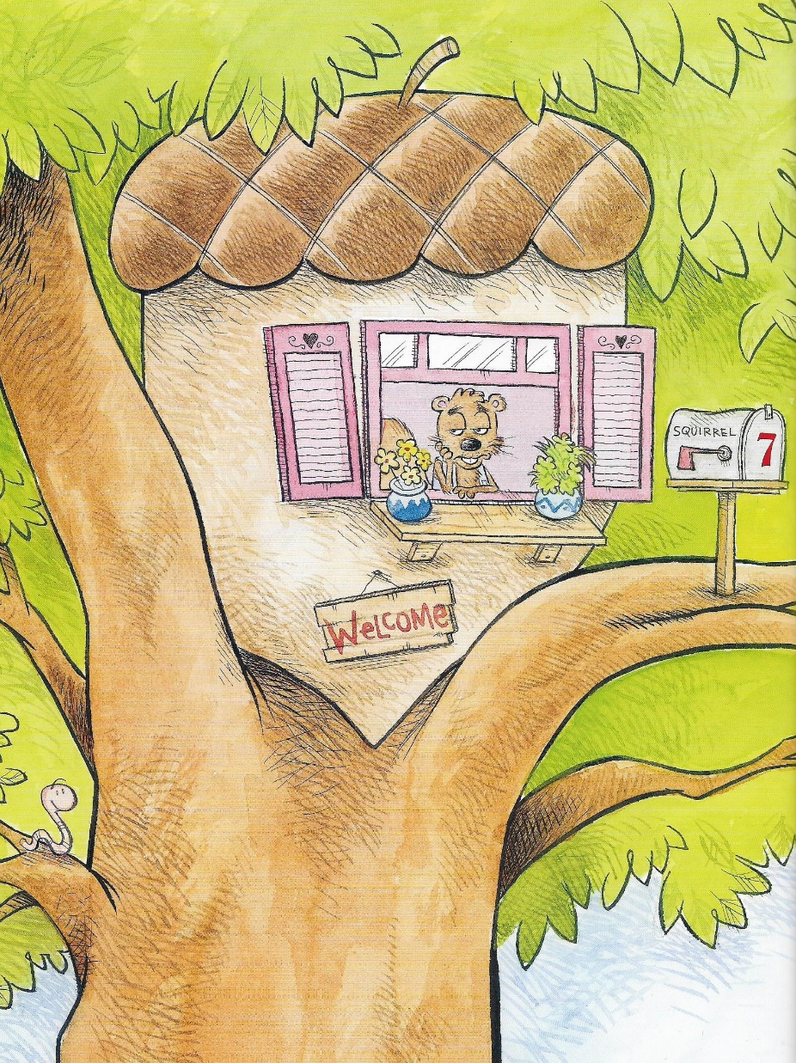
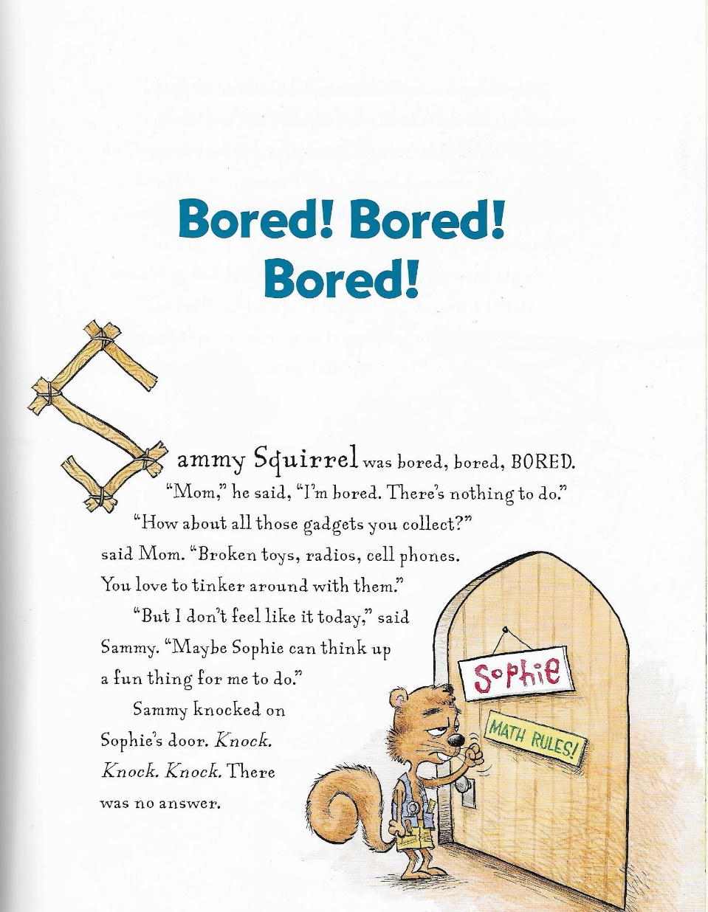

Slide 19
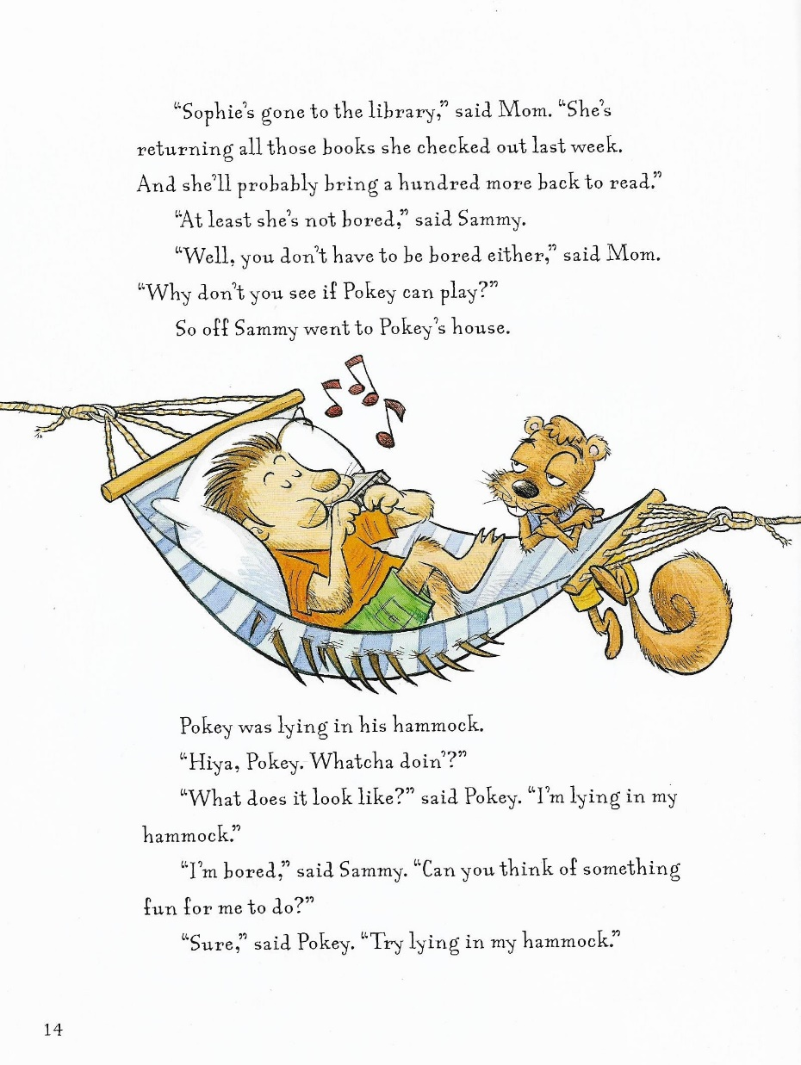
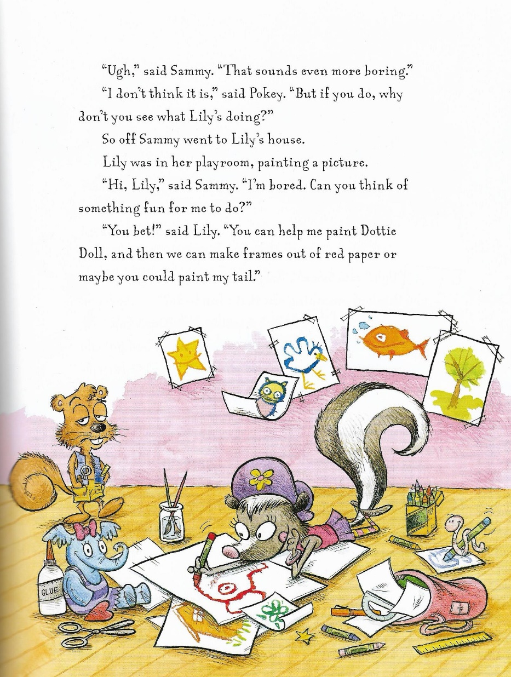

Slide 20
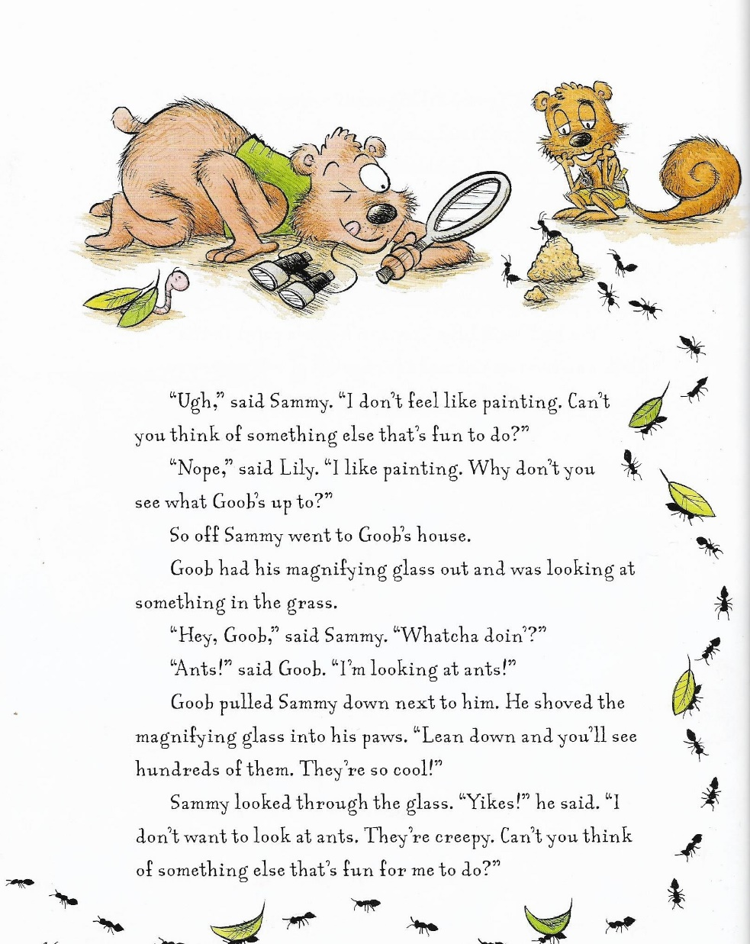
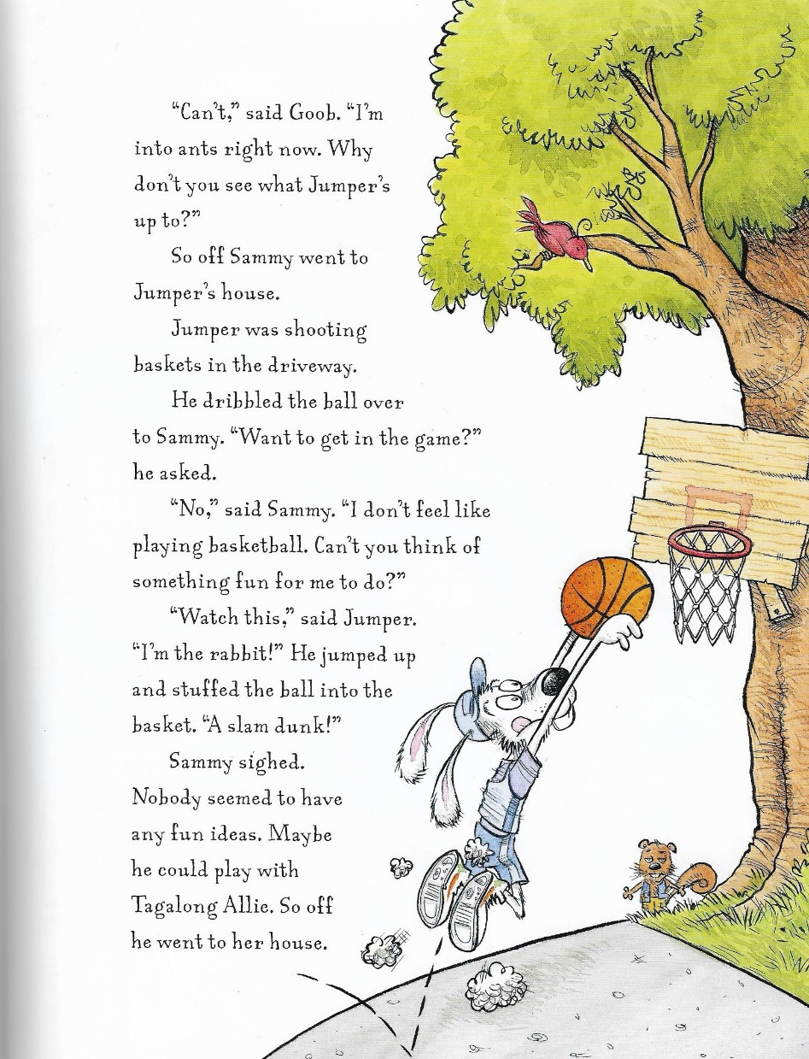

Slide 21
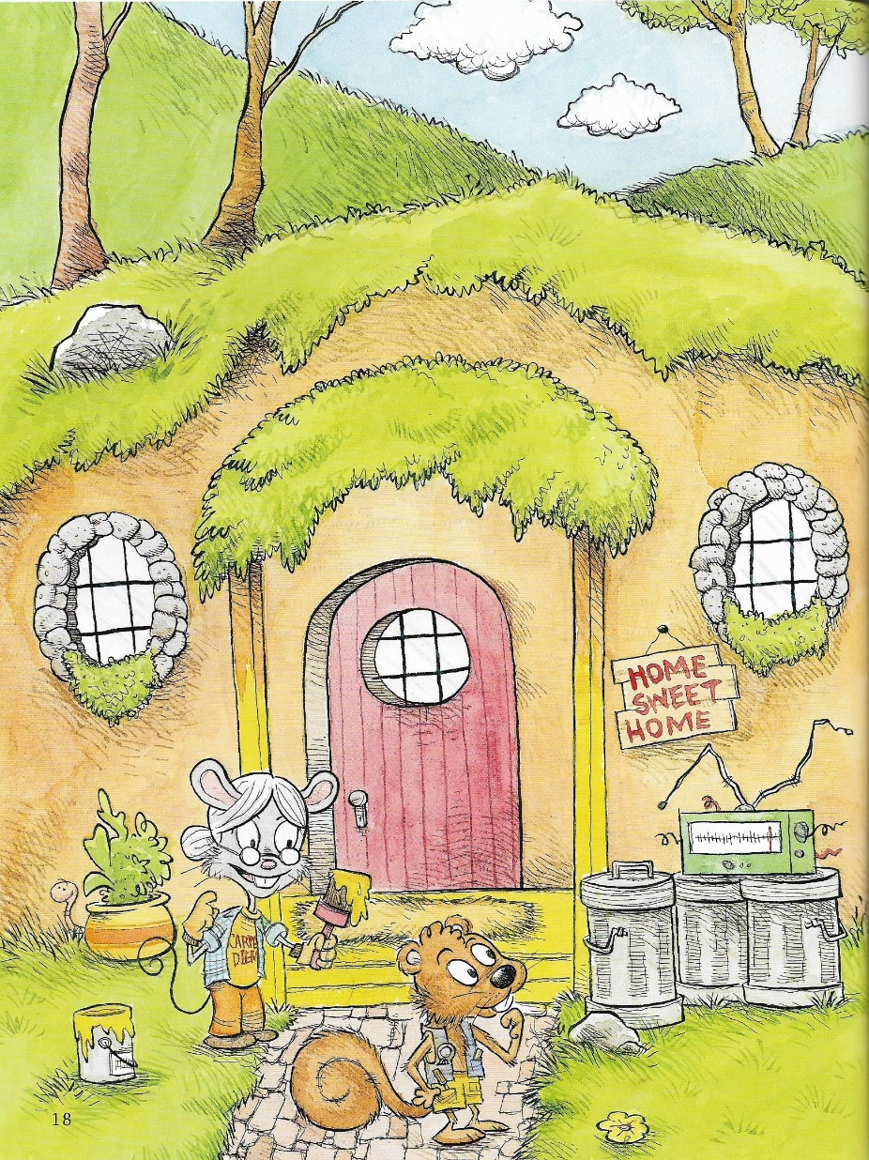
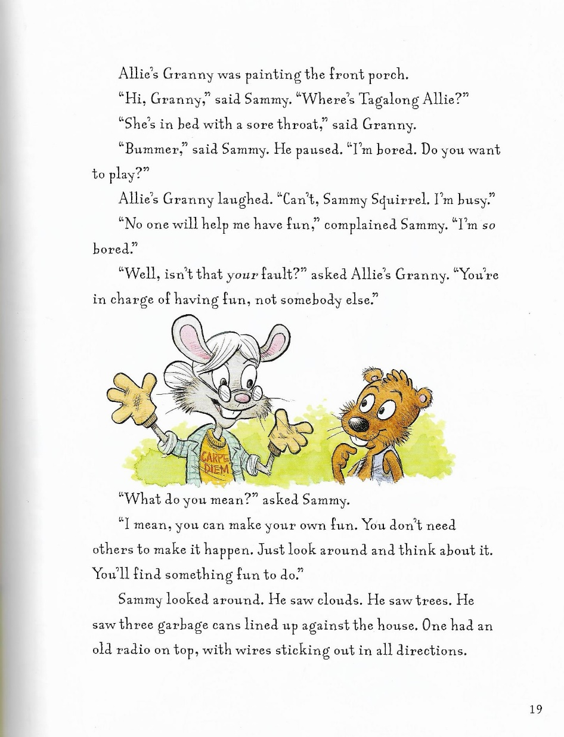

Slide 22
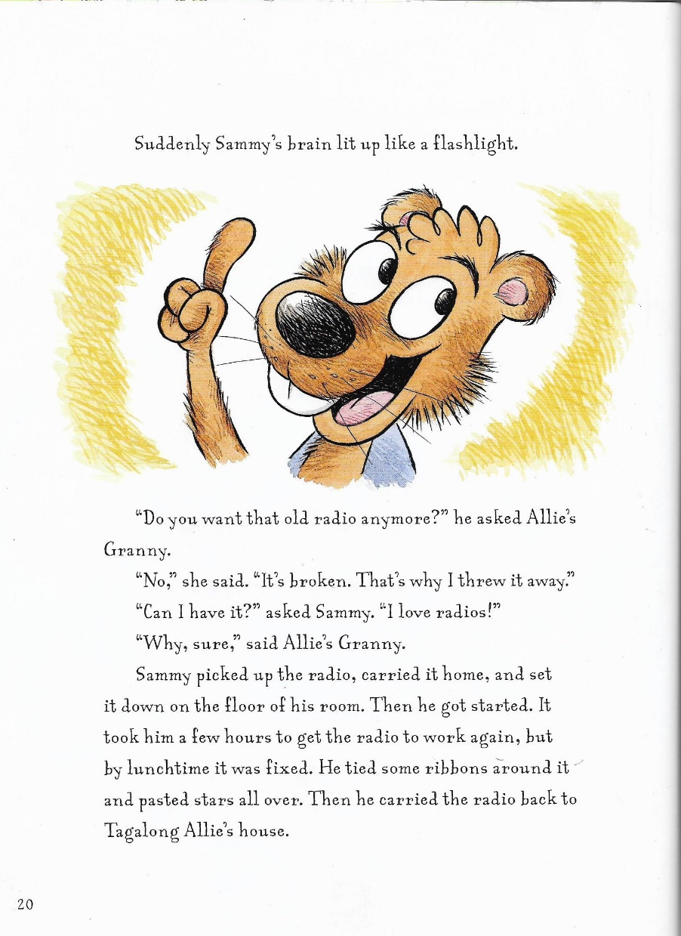
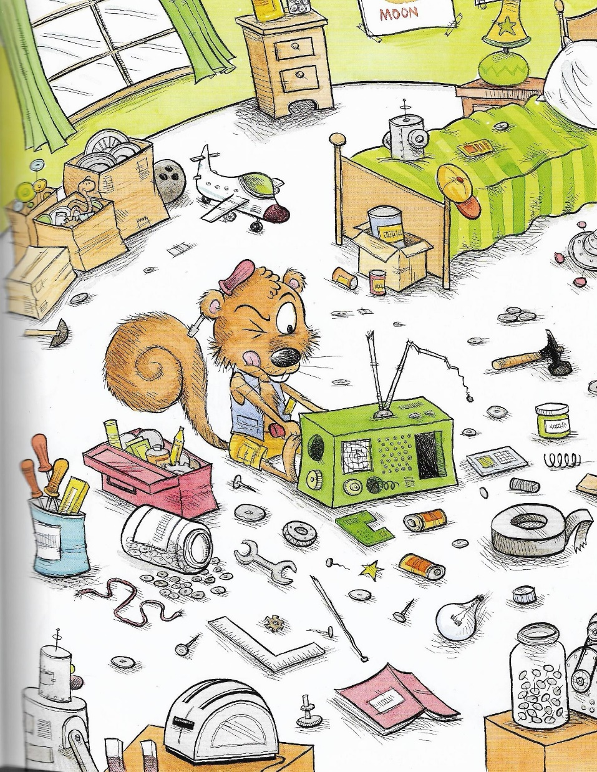

Slide 23
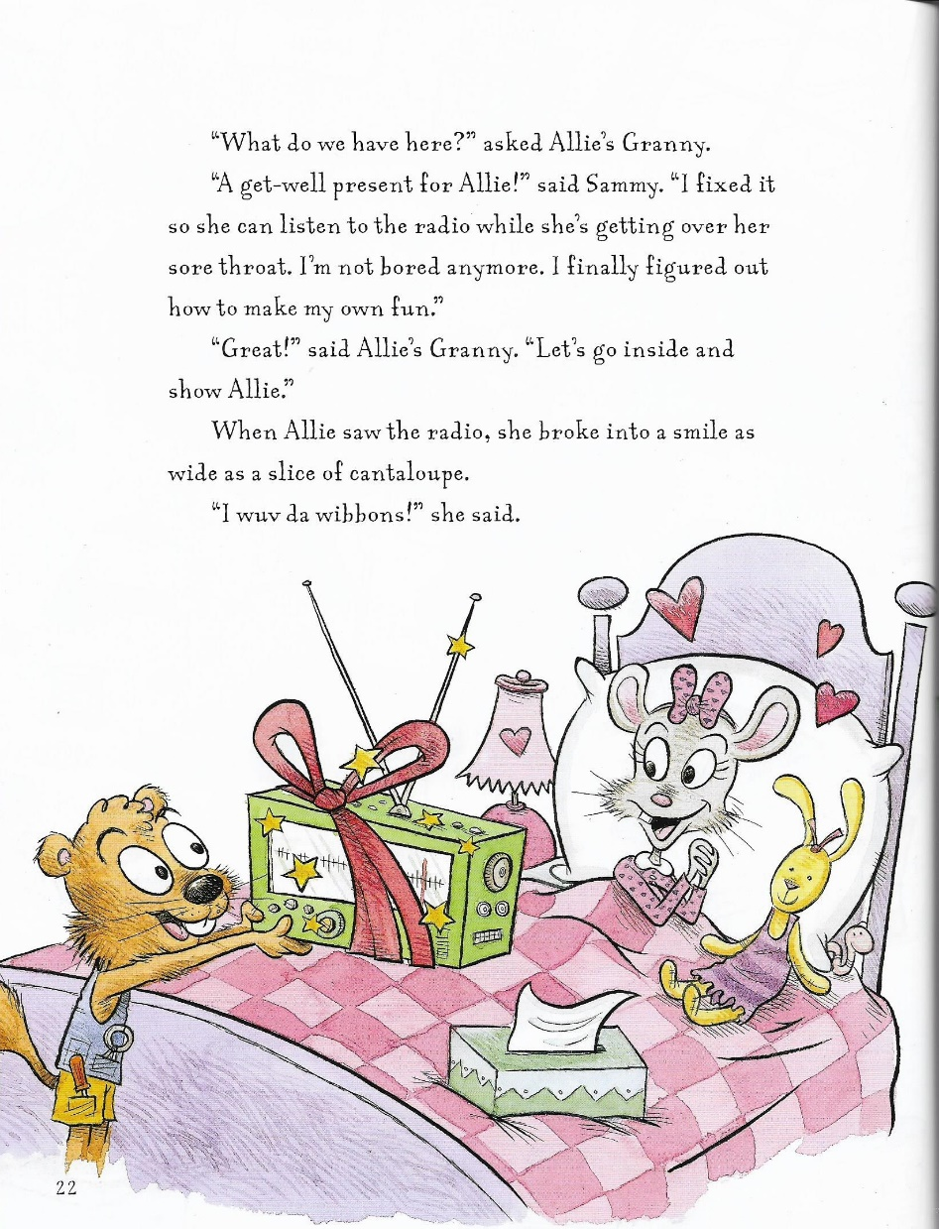
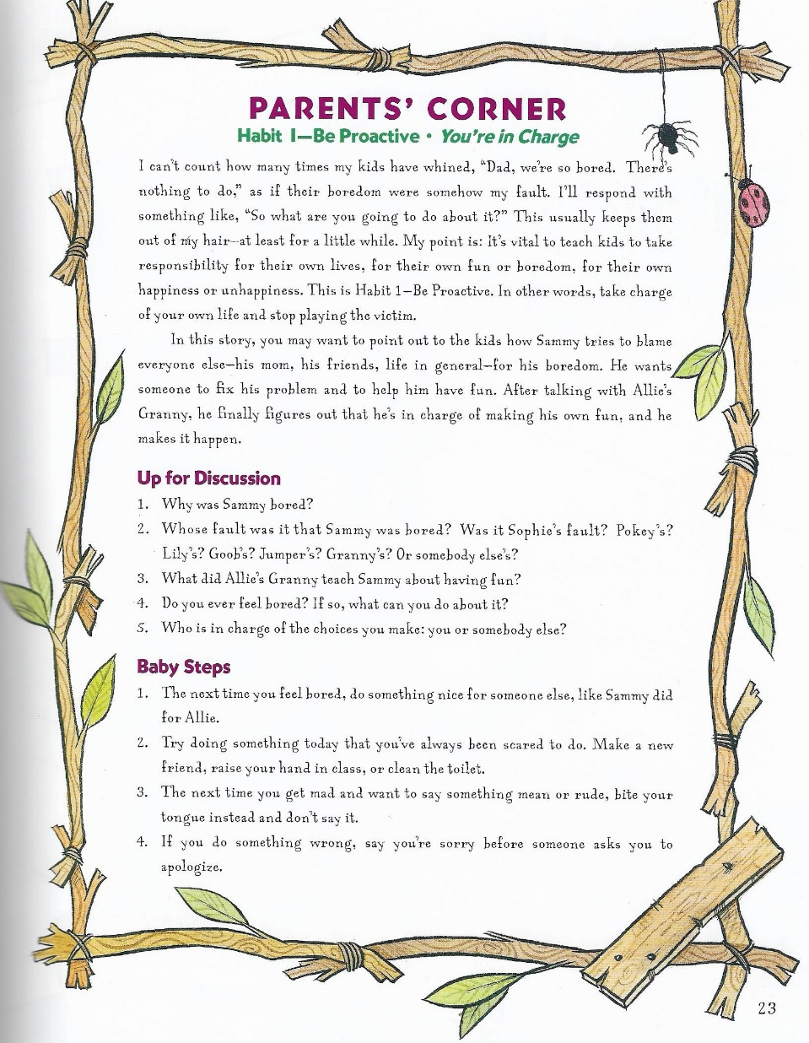

Slide 24
Out of Classroom!
Recess 10:40 – 11:05

Slide 25
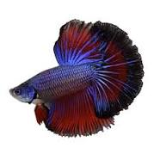
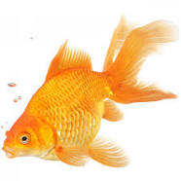
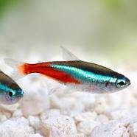
Finalize Fish Vote! ☺
Betta fish
Goldfish
Neon tetra

Slide 26

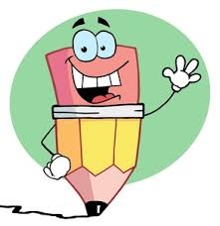

Writing Time
Objective: W3.3
I can write narratives to develop real or imagined experiences or events using effective technique, descriptive details, and clear event sequences.
11:05 – 11:35

Slide 27

Gather at the Carpet…
Was it a perfect transition?

Slide 28


Our Writing Community Goals
Write about things that interest us
Share and talk about our writing
Learn about what professional authors do
Become stronger writers

Slide 29


Share Time!!
What are some things you’ve written?
(Don’t forget to restate the question ☺)
What are some reasons that your write, in and out of school?
Objective: SL.3.1b Follow agreed-upon rules for discussions (e.g., gaining the floor in respectful ways, listening to others with care, speaking one at a time about the topics and texts under discussion).

Slide 30
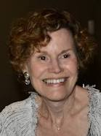

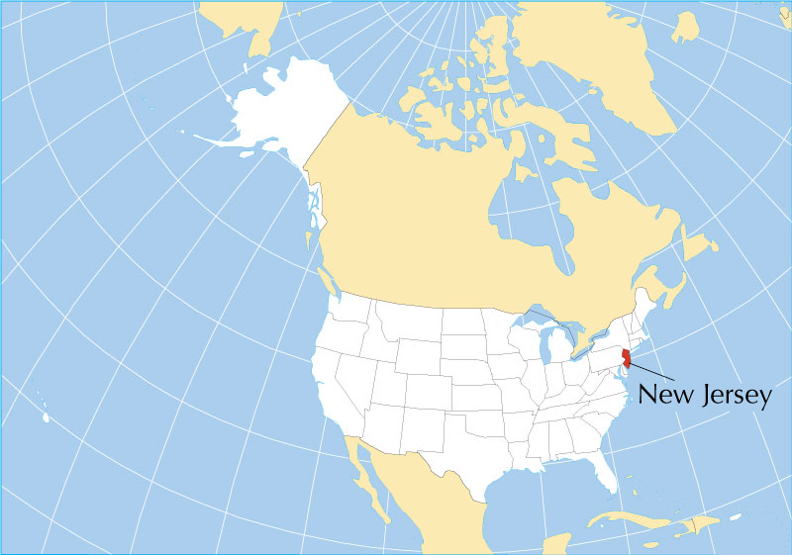
Today I’ll read the first part of this book.
Author: Judy Blume
Born in New Jersey

Slide 31
Who is telling this story?
Who is “the Pain”?
What do you find out about the little brother in this story?
If you were going to write a funny story about someone you know, whom might you write about? What might you write about that person?

Slide 32
Classroom Anchor Chart
People We Can Write About
Let’s add some ideas you have to our chart!

Slide 33

Introduce Writing Journal
Writing Ideas! – 1st section
All your drafting (first-time writing) – 2nd section
  Each entry needs to be dated ☺
Everything double spaced to leave room for revisions and editing.

Slide 34
Writing Journal
Turn to the first page in the first section and let’s create an entry for our Writing Ideas section
  People We Can Write About

Slide 35

Sharing and Reflecting
What did you like about writing in your Writing Journal today?
What did you do to be responsible as you moved back to your seat?

Slide 36
Math Fluency & Focus Lesson!
11:35 – 11:55

Slide 37

Workbook Introduction!!

Slide 38
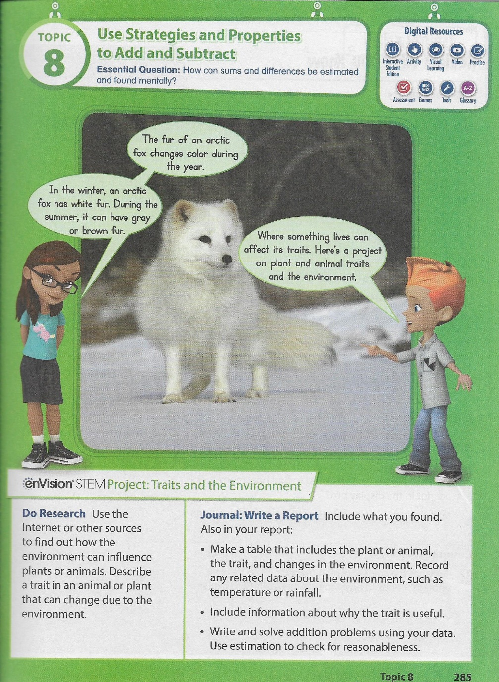
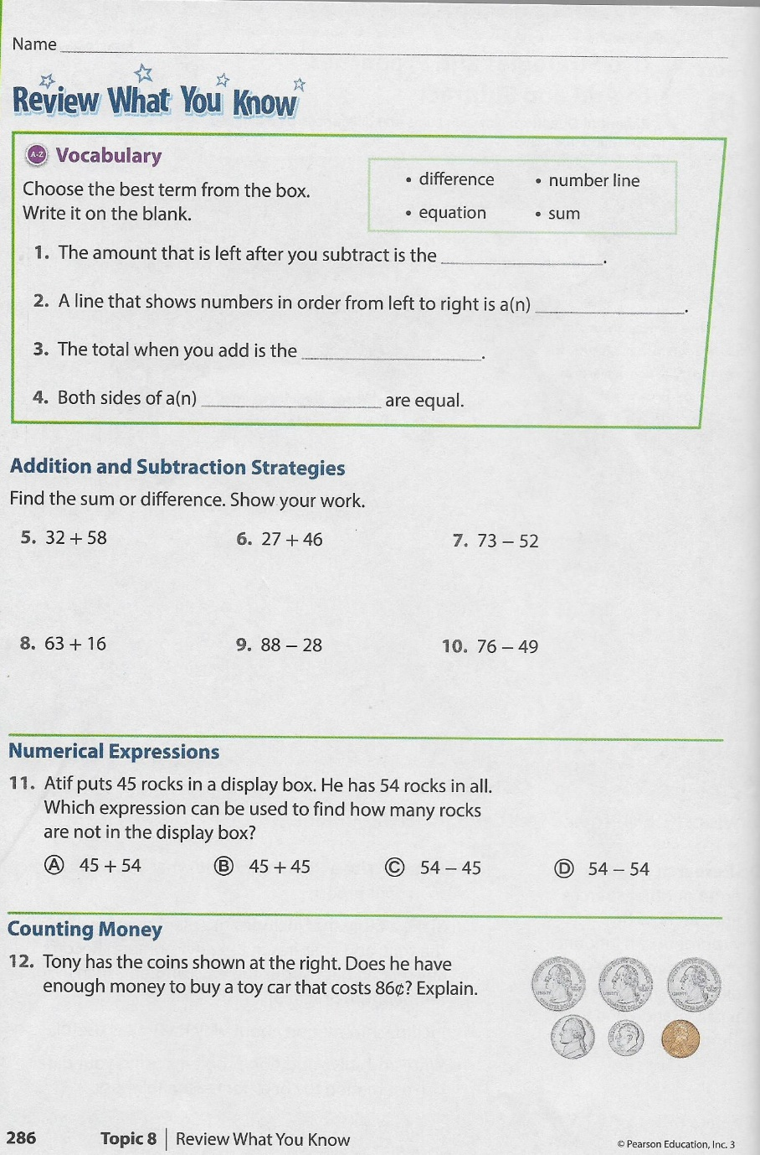
Introduction

Slide 39
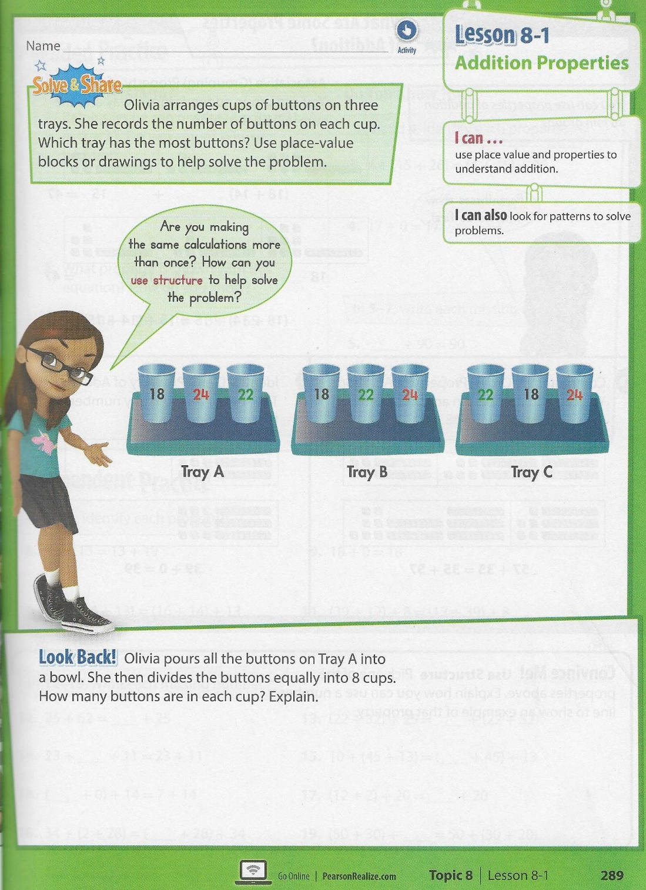
Let’s read Solve & Share!
What do the different numbers on the cups on each tray represent?
How will you use the numbers to solve the problem?
Let’s Solve!!
How does changing the order of the numbers on each tray change the sum?
What is the total number of buttons in all of the cups on each of the trays?
T.E. page 289

Slide 40
Commutative Property of Addition
Classroom Discussion
How does the Commutative Property of Addition work with the Solve & Share problem you just completed?
What if you added three buttons to a cup on each of the trays? Would the sums of the buttons on each tray be different? Explain.

Slide 41
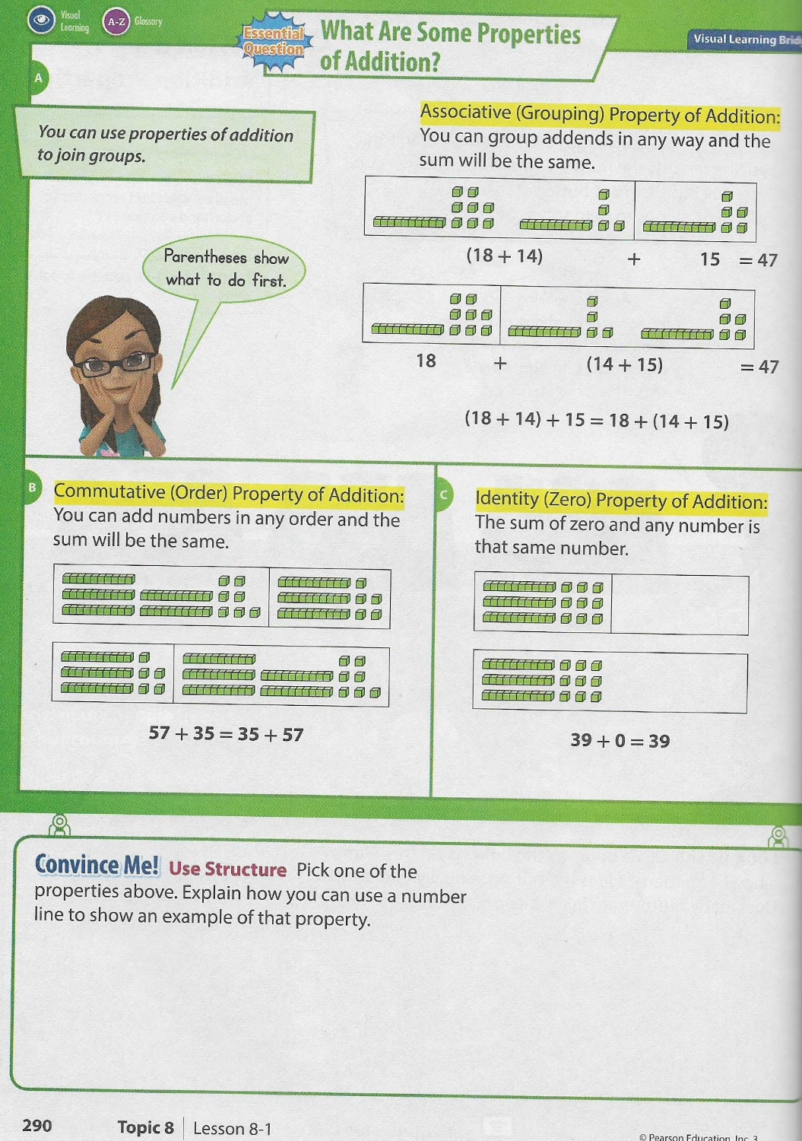
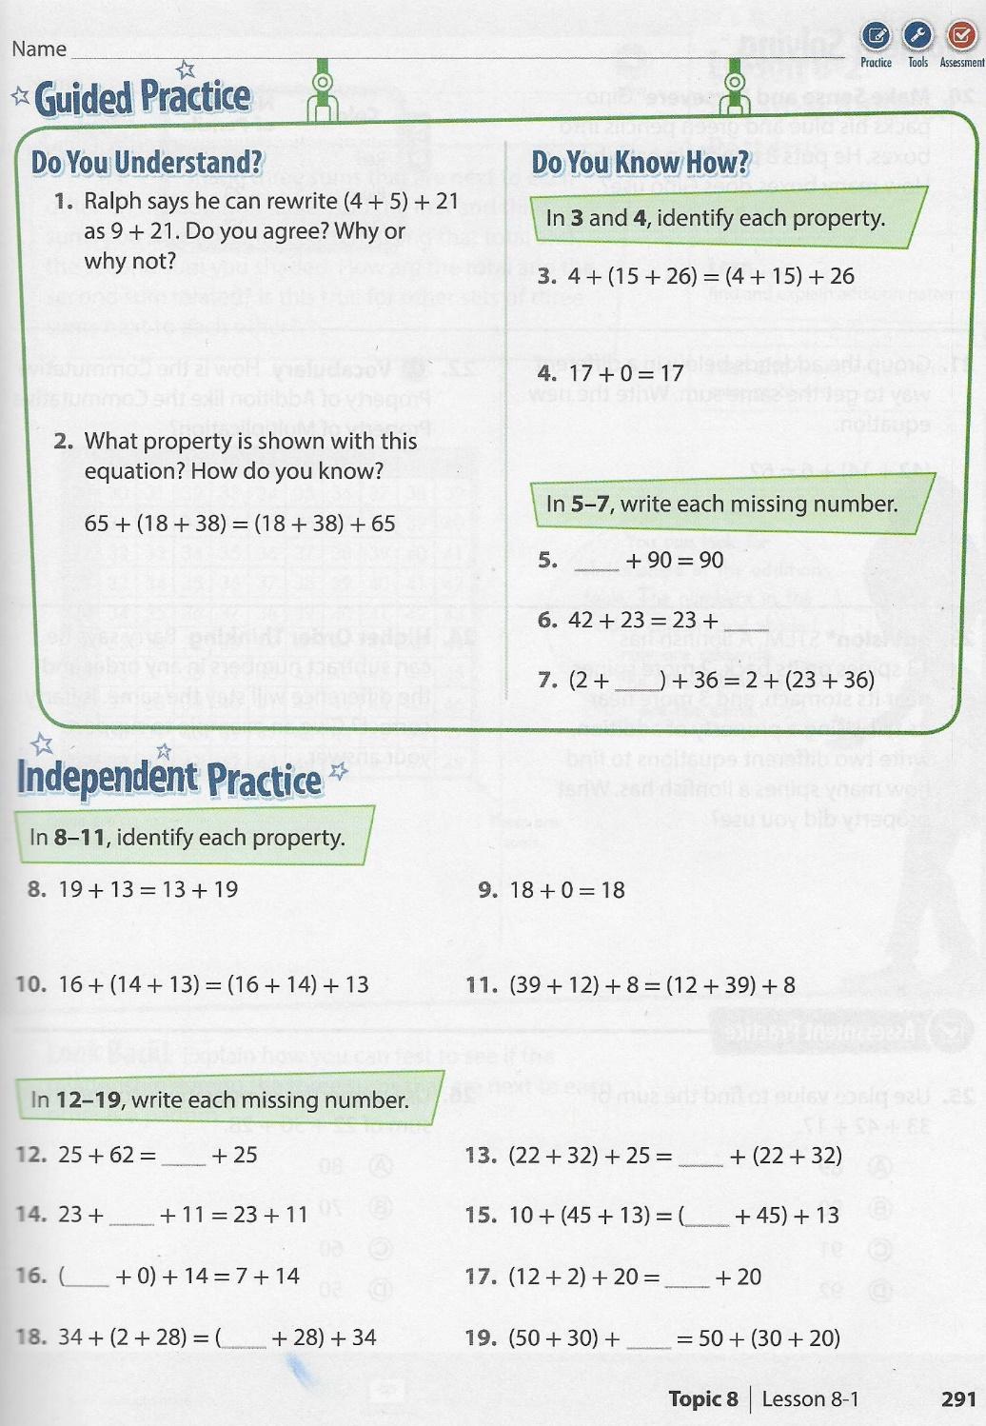
Let’s work some together. We’ll begin with
Guided Practice

Slide 42
Small Group Rotations 1 & 2
  11:55 – 12:15
Group 1 – Computers (TC, A, B, C, D): Epic
Group 2 – Mrs. Roby: Math IP p291, 292 even numbers
Group 3 – Computers (E, F, G, H, I): Imagine Learning/Epic
Group 4 – Mrs. Thompson: Reading Passage
Group 5 – Independent Practice Math p 291, 292 odd numbers
  12:15 – 12:35
Group 5 – Computers (TC, A, B, C, D): Epic
Group 1 – Mrs. Roby: Math IP p291, 292 even numbers
Group 2 – Computers (E, F, G, H, I): Imagine Learning/Epic
Group 3 – Mrs. Thompson: Reading Passage
Group 4 – Independent Practice Math p 291, 292 odd numbers

Slide 43

Out of Classroom!
Lunch 12:35 – 1:05

Slide 44
Restroom Break
1:05 – 1:10

Slide 45

Out of Classroom!
Activity 1:10 – 1:55

Slide 46
Small Group Rotations 3 & 4
  1:55 – 2:15
Group 4 – Computers (TC, A, B, C, D): Epic
Group 5 – Mrs. Roby: Math IP p291, 292 even numbers
Group 1 – Computers (E, F, G, H, I): Imagine Learning/Epic
Group 2 – Mrs. Thompson: Reading Passage
Group 3 – Independent Practice Math p 291, 292 odd numbers
  2:15 – 2:35
Group 3 – Computers (TC, A, B, C, D): Epic
Group 4 – Mrs. Roby: Math IP p291, 292 even numbers
Group 5 – Computers (E, F, G, H, I): Imagine Learning/Epic
Group 1 – Mrs. Thompson: Reading Passage
Group 2 – Independent Practice Math p 291, 292 odd numbers

Slide 47
Small Group Rotation 5
  2:35 – 2:55
Group 2 – Computers (TC, A, B, C, D): Epic
Group 3 – Mrs. Roby: Math IP p291, 292 even numbers
Group 4 – Computers (E, F, G, H, I): Imagine Learning/Epic
Group 5 – Mrs. Thompson: Reading Passage
Group 1 – Independent Practice Math p 291, 292 odd numbers

Slide 48
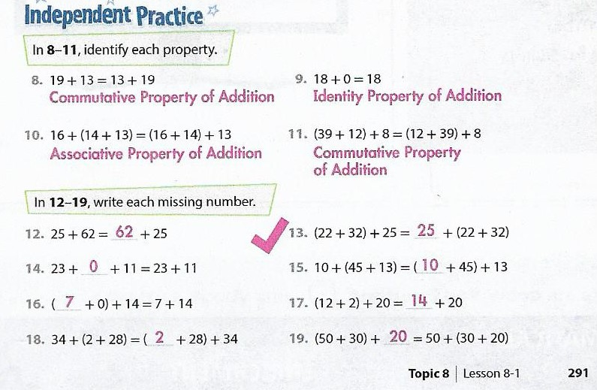
Independent Practice Check

Slide 49
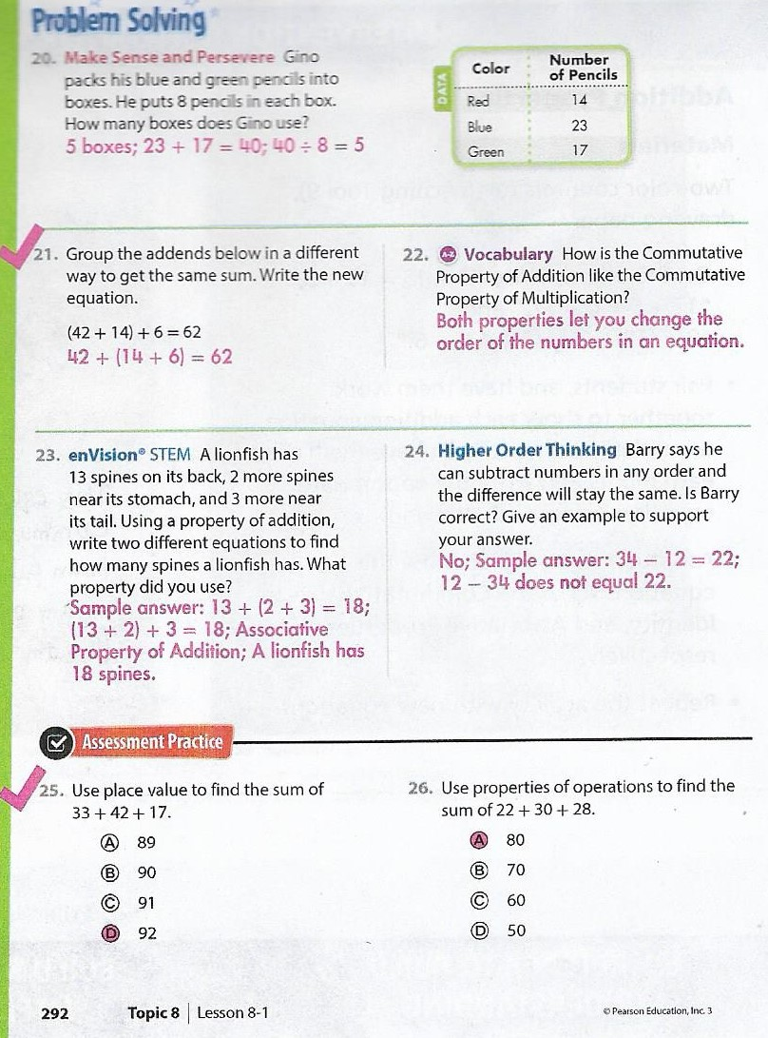

Slide 50

SCIENCE TIME
Objective: P.3.5.1
I can plan and conduct scientific investigations to determine how changes in heat (i.e., an increase or decrease) change matter from one state to another (e.g., melting, freezing, condensing, boiling, or evaporating).
2:55 – 3:15

Slide 51
Gather at the Carpet…
We should be professionals at this by now! ☺

Slide 52

Your Turn! You and your partner take turns playing the same way!

Slide 53




3:10 – 3:15 Wrap Up!
Pair-Up back to back and share one thing you learned in class today with your partner
Pack-Up
Office will announce:
Car Riders – Leave around 3:20
Bus Riders – (listen to intercom for dismissal)
2:30 – 3:20
How much time has elapsed?

