Slide 1
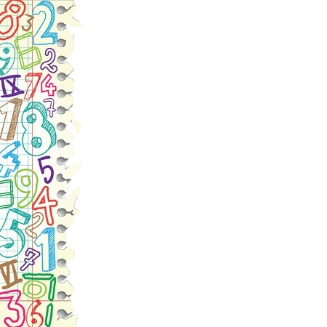
Parent literacy
& Math event
K-2
February 23, 2021

Slide 2
Grade | Required Fluency
Kindergarten | Add/Subtract within 10 Fact Fluency within 5
1st | Add/Subtract within 20 Fact Fluency within 10
2nd | Add/Subtract within 100 Fact Fluency within 20
3rd | Add/Subtract within 1,000 Multiply/Divide within 100 Multiplication Fact Fluency- all products of two 1-digit numbers
4th | Add/Subtract within 1,000,000 (standard algorithm) Multiply up to a 4-digit number by a 1-digit number and two 2-digit numbers Divide up to a 4-digit dividend by a 1-digit divisor
5th | Multiply multi-digit numbers (standard algorithm) Divide by a 2-digit divisor

Slide 3
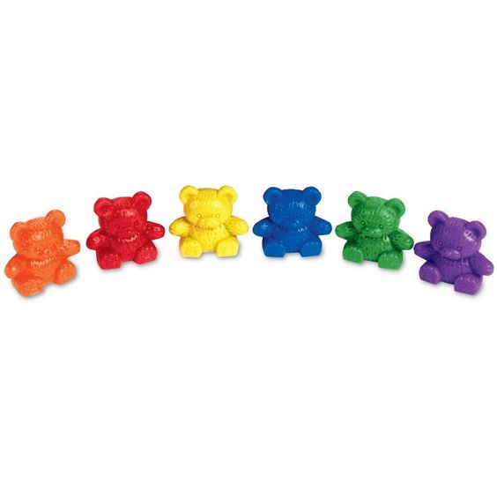
Kindergarten
Count to 100 by ones and tens
Write numbers 0-20
Represent a number of objects with a written numeral
Count with one-to-one correspondence and cardinality

Slide 4
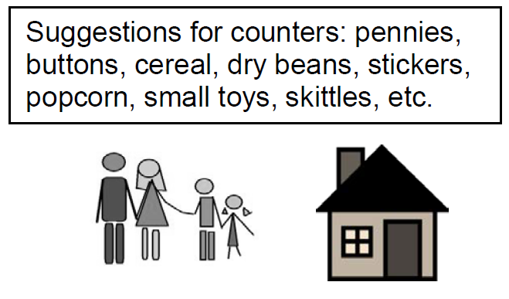
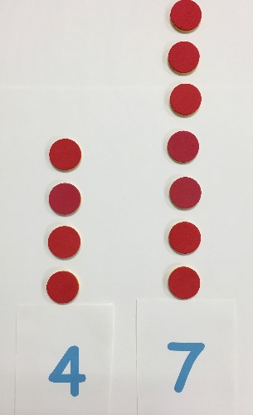
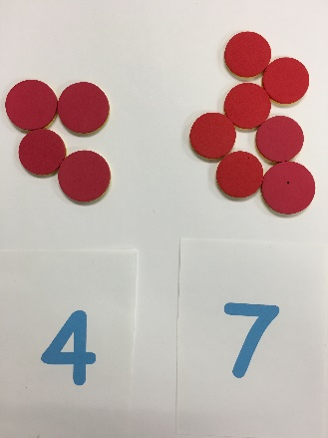
Kindergarten
Count to answer “how many” for groups of up to 20 objects
Count out a given number of objects (1-20)
Tell whether one group of objects is greater than, less than, or equal to another group
Compare two numbers (1-10) presented as written numerals

Slide 5
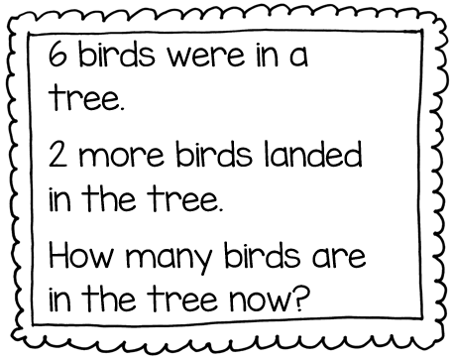
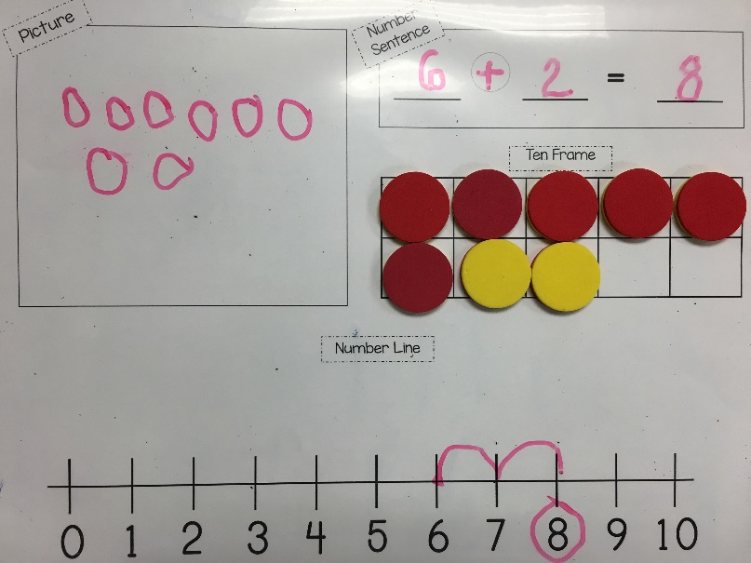
Kindergarten
Represent addition and subtraction with objects, fingers, drawings, acting out, etc.
Add and subtract within 10 using objects or drawings
Solve addition and subtraction word problems

Slide 6
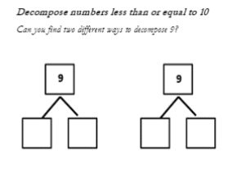
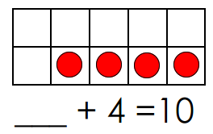

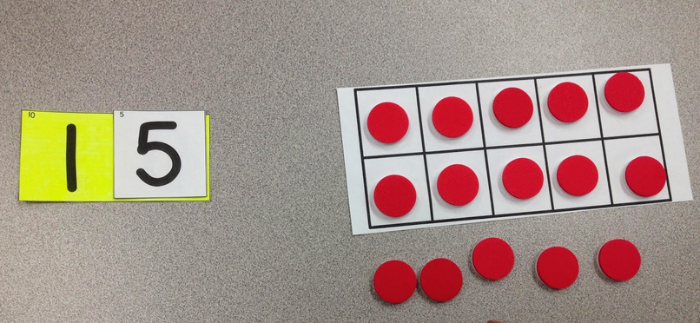
Kindergarten
Decompose numbers less than or equal to 10 in more than one way
For any number 1-9 find how many more to make ten
Break apart teen numbers as a group of ten and ____ more
Fluently add and subtract within 5
6
15 is one group of ten and 5 more

Slide 7
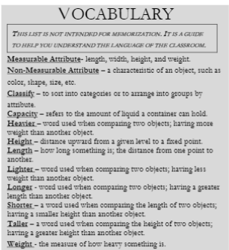
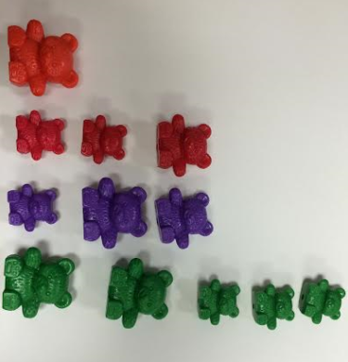
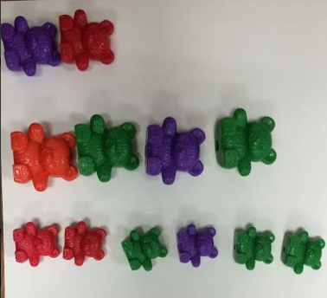
Kindergarten
(Measurement & Data Focus)
Describe attributes of objects such as length and/or weight
Compare attributes of two objects
Sort and order by count
Sorted by color
Sorted by size

Slide 8
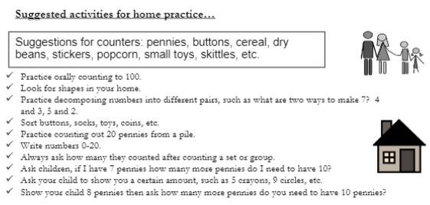

Slide 9
First Grade Goals
Order three objects by length.
Measure the length of an object using multiples of the same object
(paperclips, toothpicks, beans, cubes, etc).
Tell and write time an hours and half-hours.
Compose a new shape using two-dimensional and three-dimensional shapes.
Distinguish defining attributes of shapes
Partition circles and rectangle into 2 and 4 equal parts (halves, fourths, and quarters).
Fluently add and subtract numbers within 10.

Slide 10
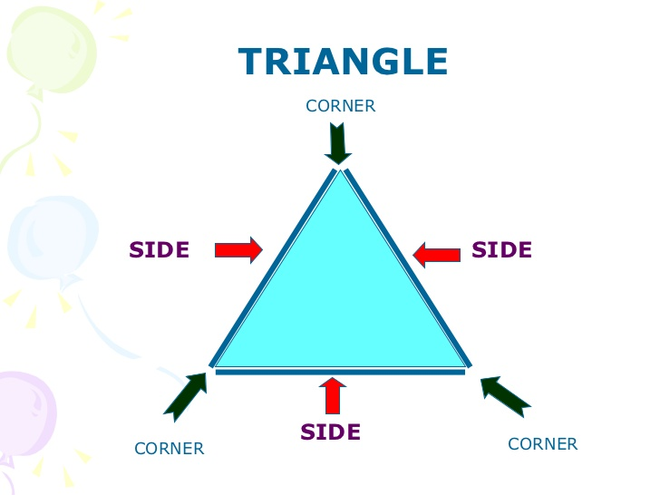
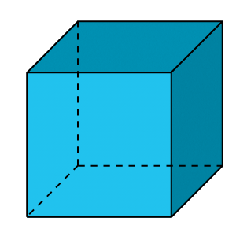
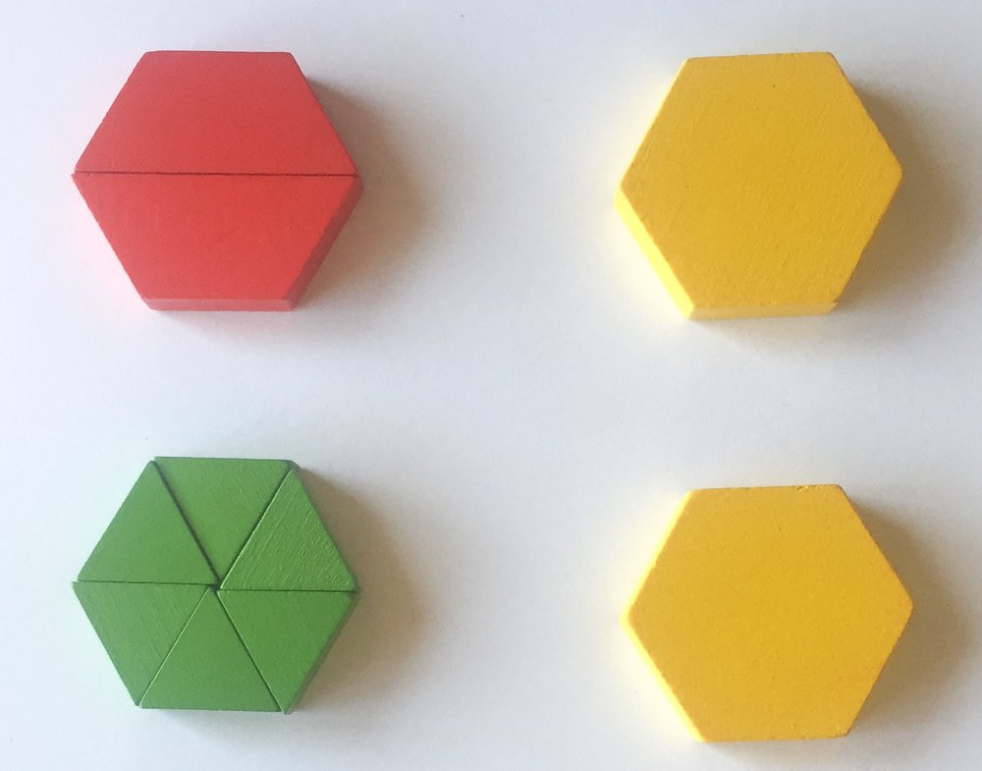
First Grade
Identify attributes of shapes
Use more than one shape to create another shape
face

Slide 11
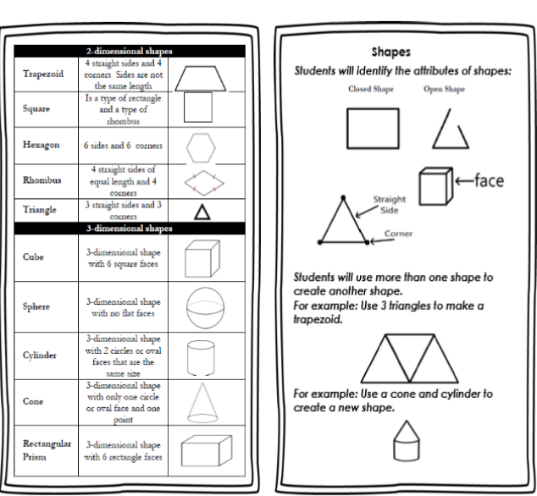
2-Dimensional/3-Dimensional Shapes

Slide 12

First Grade
Identify if a shape is divided into equal parts
Partition circles and rectangles into equal parts (halves or fourths/quarters)
not equal
equal

Slide 13
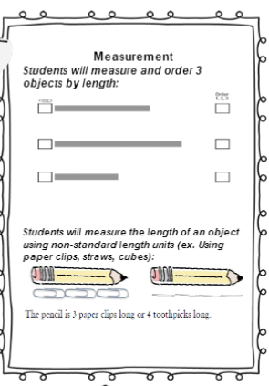
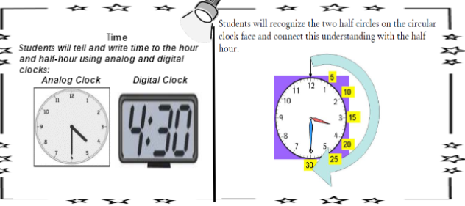
First Grade
Order 3 objects by lengths
Measure objects using smaller objects
Tell and write time in hours and half hours

Slide 14
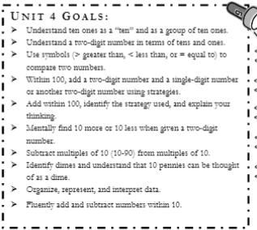
First Grade Goals

Slide 15
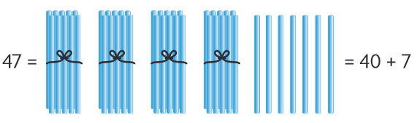
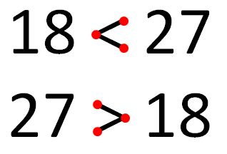
First Grade
Add and subtract within 20
Fluently add and subtract within ten (addition/subtraction facts)
Understand that the two digits of a two-digit number represents the amount of tens and ones
Compare two two-digit numbers using the symbols >, <, =

Slide 16
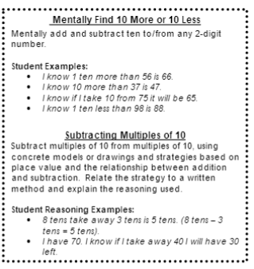
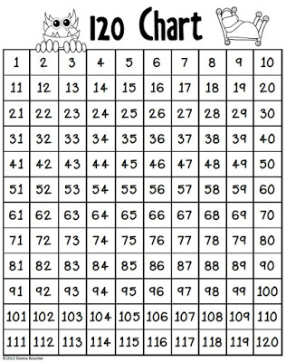
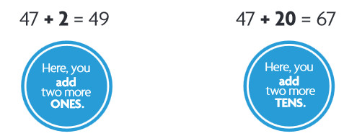
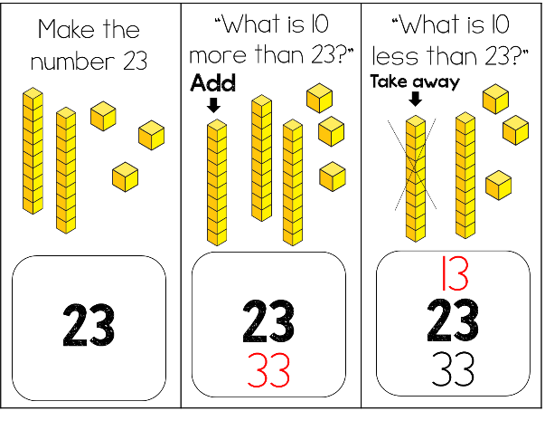
First Grade
Add a two-digit number and a one digit number
Add a two-digit number and a multiple of ten
Mentally find 10 more or 10 less than a two-digit number

Slide 17
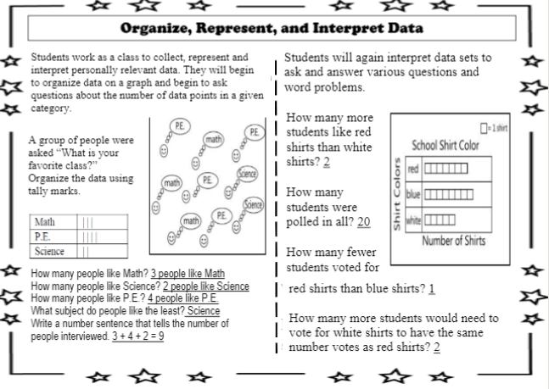
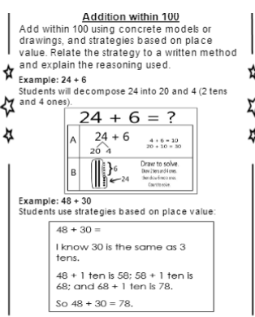
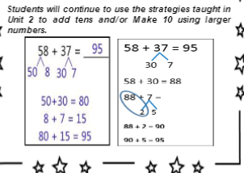
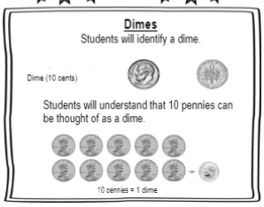
MORE

Slide 18
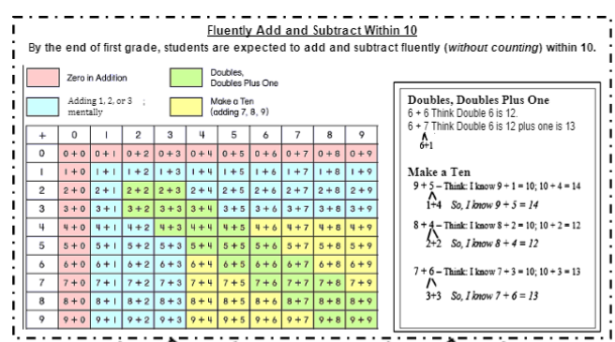
First Grade
Fluently add and subtract within 10

Slide 19
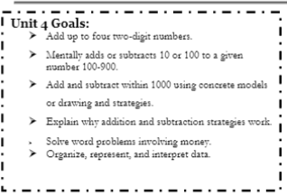
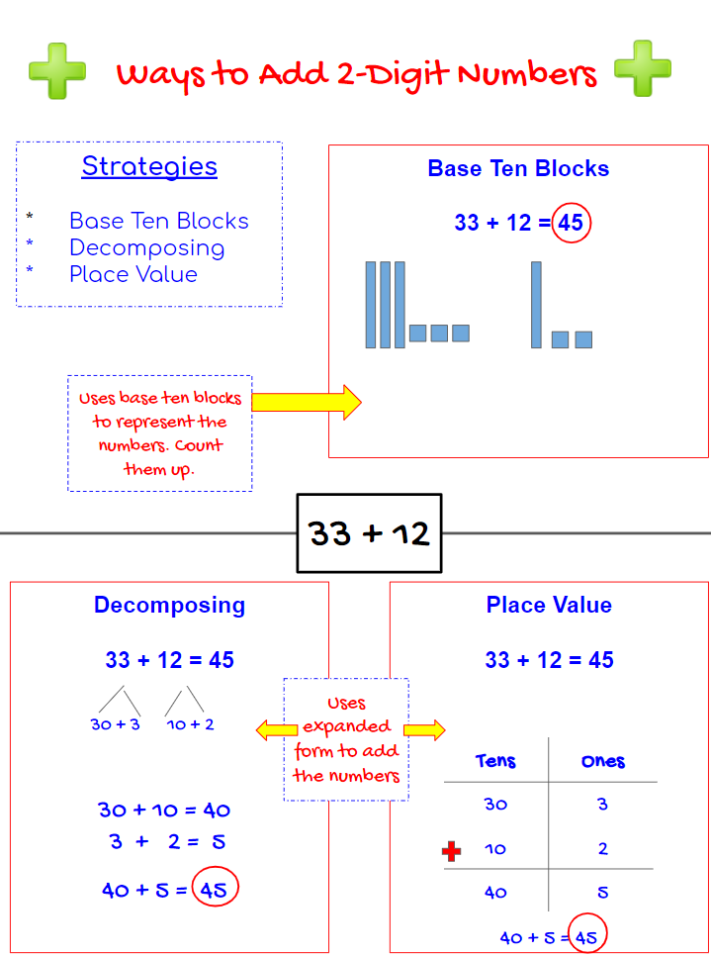
Second Grade Goals
Addition Strategies

Slide 20
second Grade
Add up to four 2-digit numbers
90
5
23+15+26+31=
95

Slide 21
second Grade
Add up to four 2-digit numbers
23+15+26+31=
95
20+3
1 0+5
20+6
30+ 1
+
80+15= 95

Slide 22
second Grade
Add and subtract within 1,000 using place value strategies
455+327=
782
700
+
80
+
2

Slide 23
second Grade
Add and subtract within 1,000 using place value strategies
455+327=
400 + 50 + 5
+
300 + 20 + 7
700 + 70 + 12
= 782

Slide 24
second Grade
Add and subtract within 1,000 using place value strategies
325-176=
149
100
+
40
+
9

Slide 25
second Grade
Add and subtract within 1,000 using place value strategies
325-176=
200
1
10
15
300 20 5
-
100 70 6
100
+ +
40
9
= 149

Slide 26
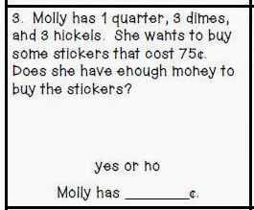
second Grade
Mentally add and subtract 10 or 100 from a given number
Solve word problems involving dollar bills, quarters, dimes, nickels, and pennies
Draw a picture graph and a bar graph to represent data; answer questions about graph

Slide 27
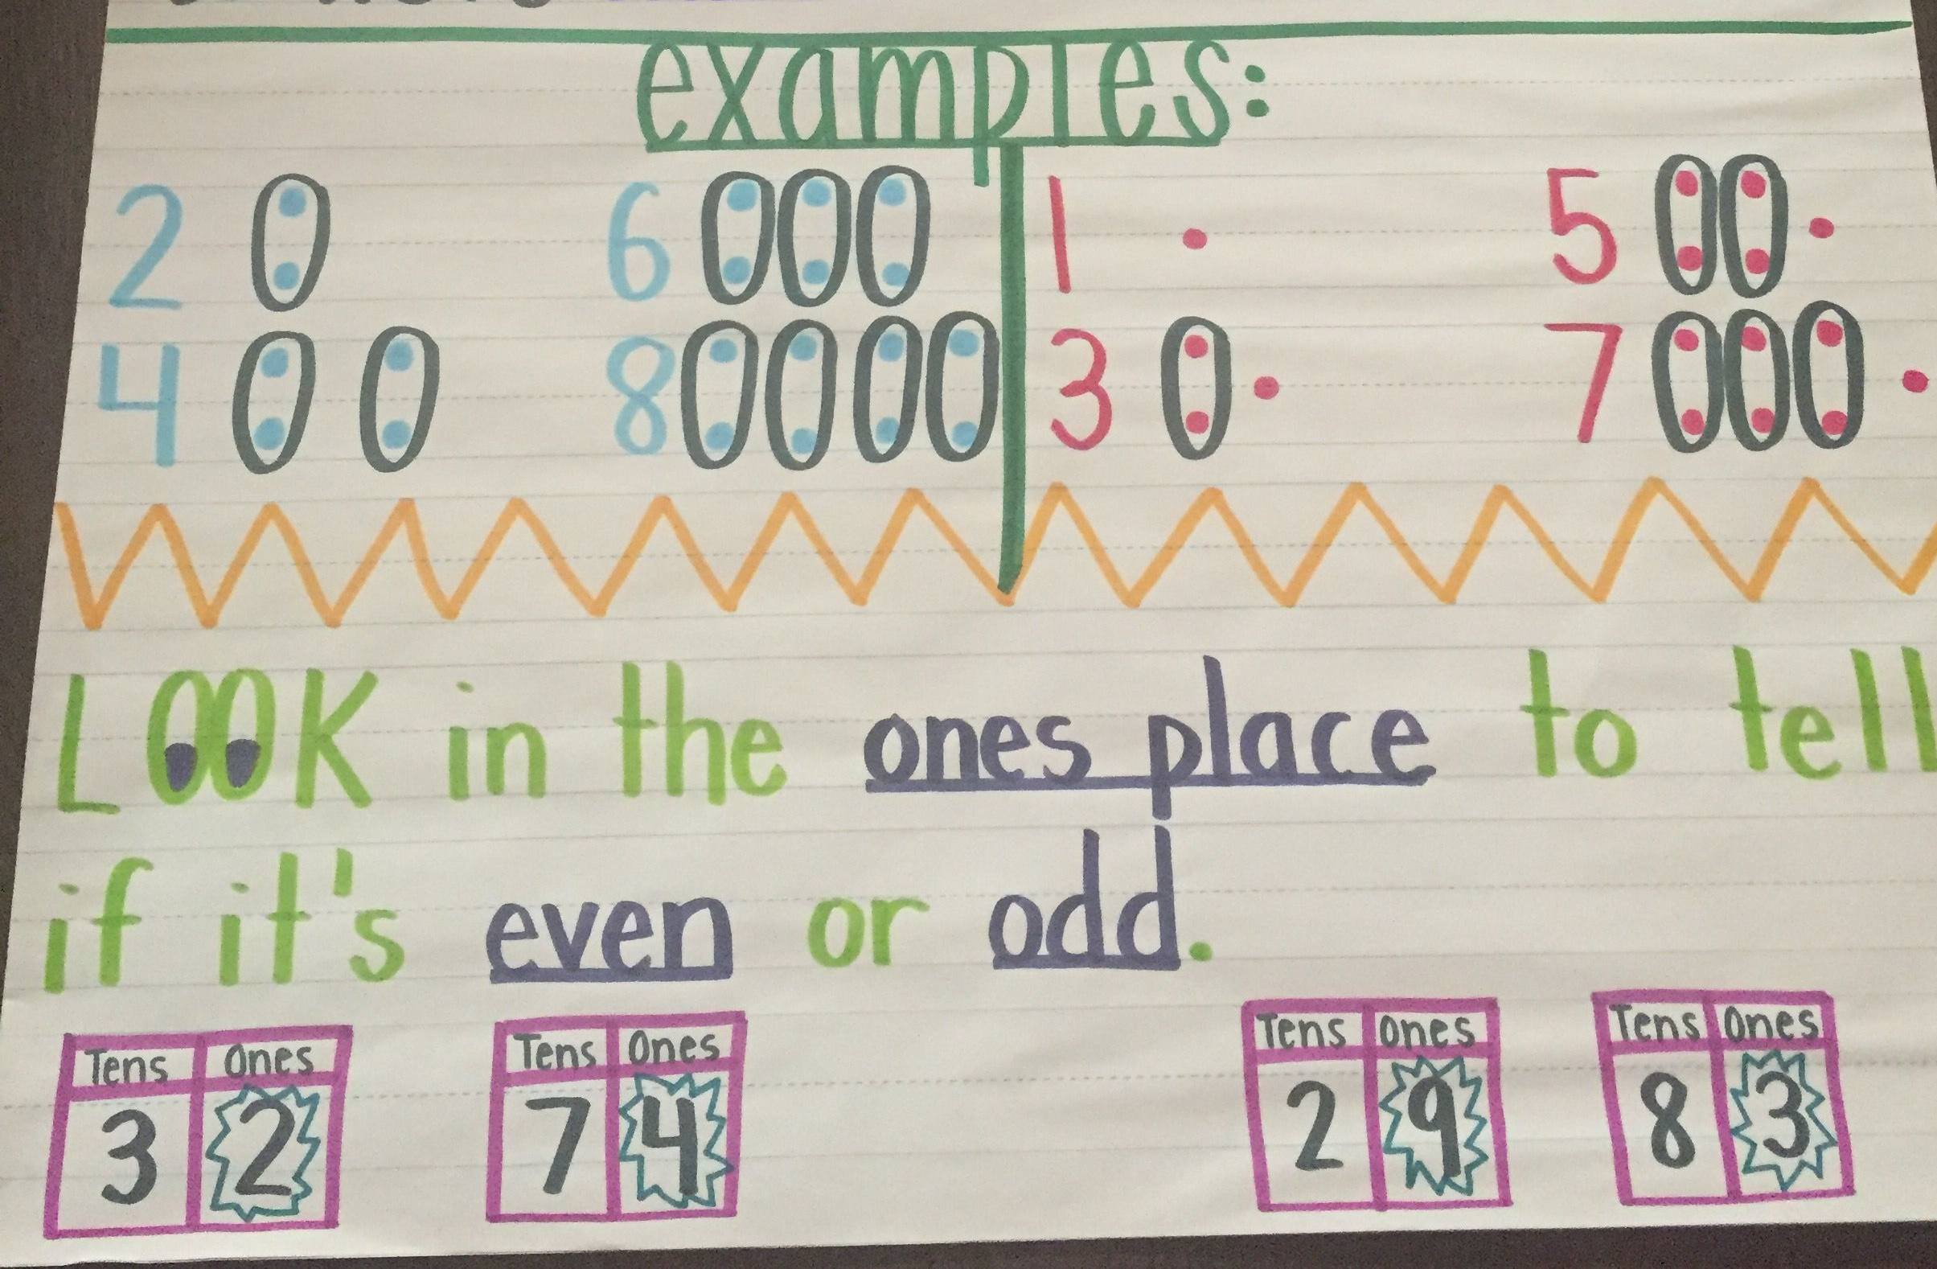
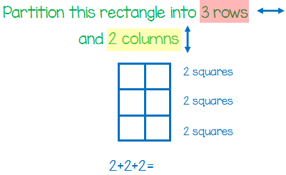
second Grade
Determine whether a group of objects (up to 20) is odd or even
Recognize and draw shapes with given attributes
Partition circles and rectangles into two, three, or four equal shares; describe the shares using the words halves, thirds, fourths, etc.
Partition a rectangle into equal sized rows and columns; count to find total

Slide 28
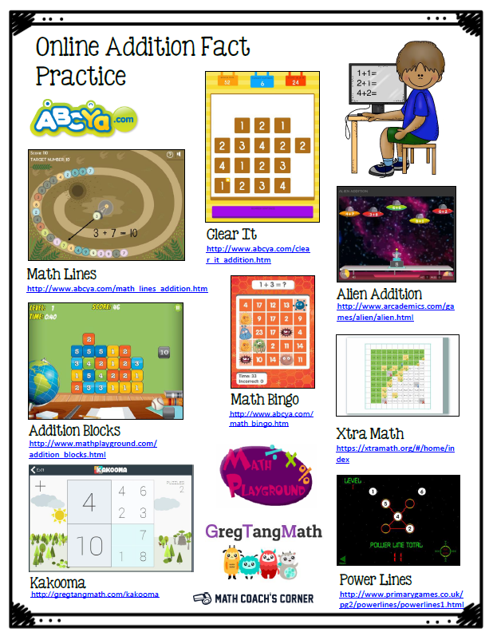

Slide 29

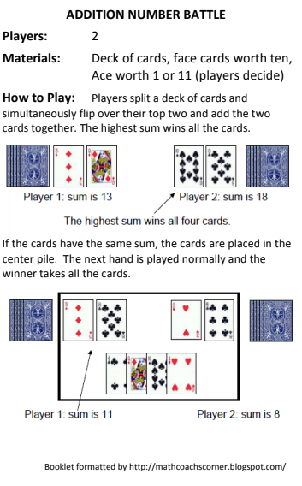
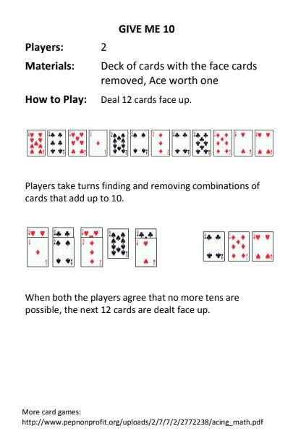

Slide 30

Parents and Students
eLearning Resource
https://wke.lt/w/s/CcQxLu

Slide 31

Contacts
EIP Math: angela.t.ezell@hcbe.net
Kindergarten: stephanie.harthorne@hcbe.net
First Grade: april.walmer@hcbe.net
Second Grade: yolanda.mcdonald@hcbe.net

